Slide 1

Chi-Square
Dr. Hamza Alduraidi

Slide 2
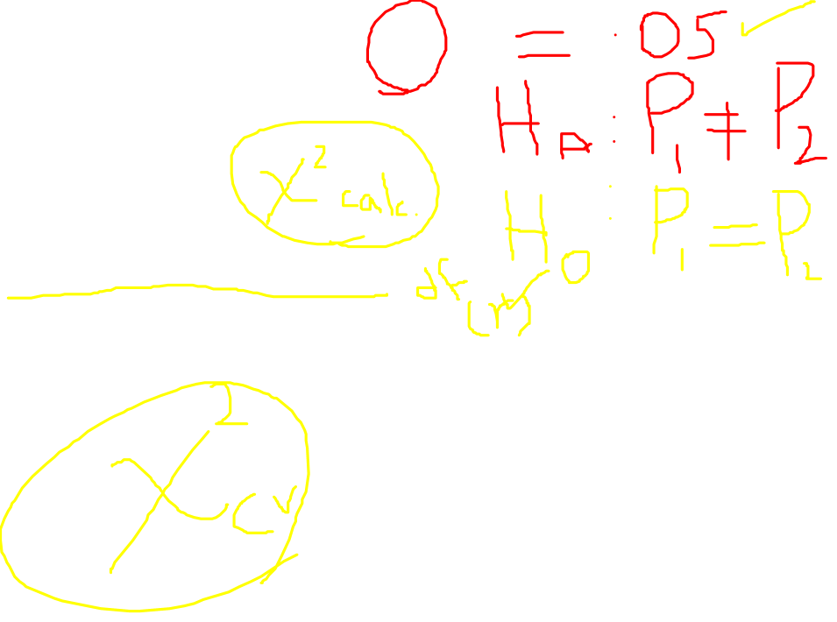
Steps in Test of Hypothesis
Determine the appropriate test
Establish the level of significance:α
Formulate the statistical hypothesis
Calculate the test statistic
Determine the degree of freedom
Compare computed test statistic against a tabled/critical value

Slide 3
1. Determine Appropriate Test
Chi Square is used when both variables are measured on a nominal scale.
It can be applied to interval or ratio data that have been categorized into a small number of groups.
It assumes that the observations are randomly sampled from the population.
All observations are independent (an individual can appear only once in a table and there are no overlapping categories).
It does not make any assumptions about the shape of the distribution nor about the homogeneity of variances.

Slide 4

2. Establish Level of Significance
α is a predetermined value
The convention
    α = .05
    α = .01
    α = .001

Slide 5
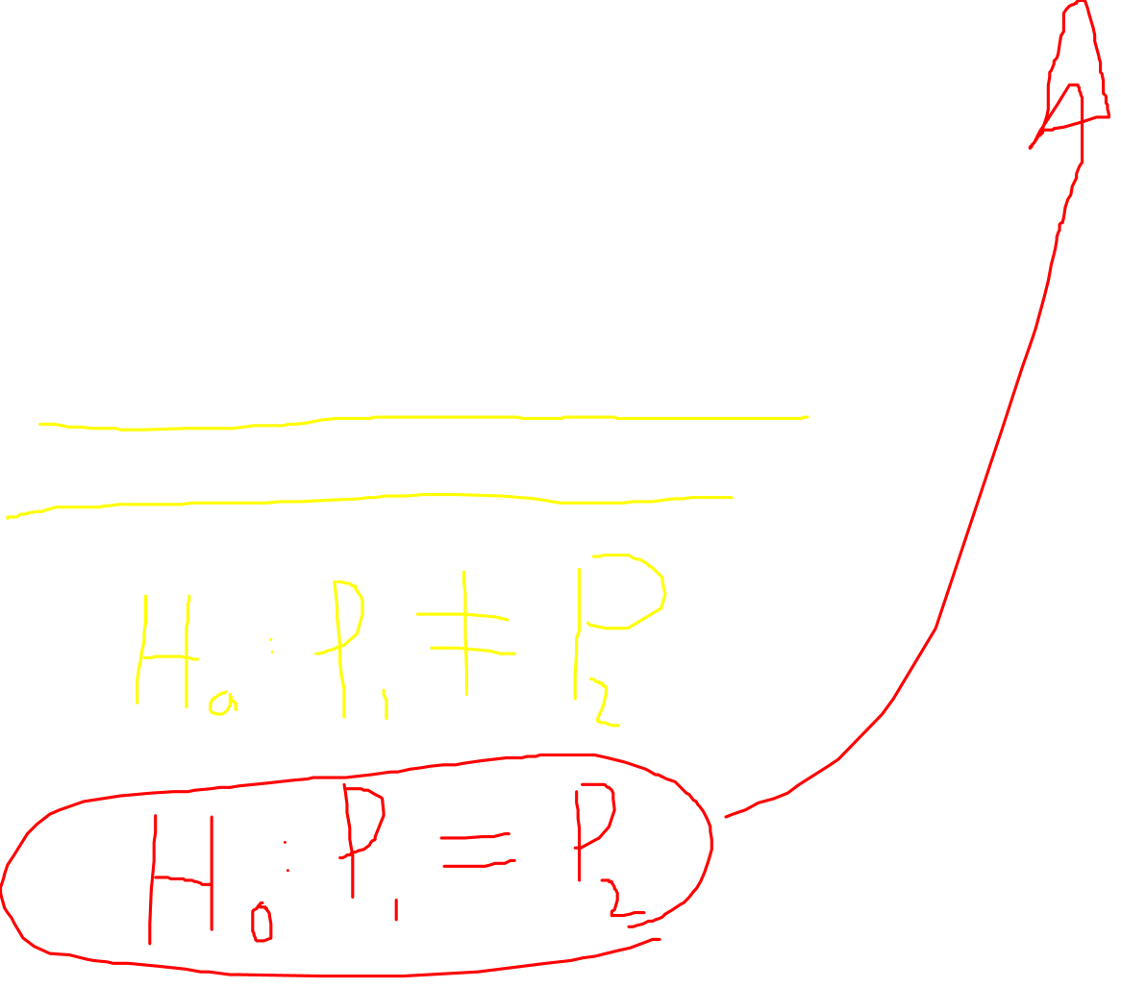
3. Determine The Hypothesis:
Whether There is an Association or Not
H_{o} : The two variables are independent
H_{a} : The two variables are associated

Slide 6

4. Calculating Test Statistics
Contrasts observed frequencies in each cell of a contingency table with expected frequencies.
The expected frequencies represent the number of cases that would be found in each cell if the null hypothesis were true ( i.e. the nominal variables are unrelated).
Expected frequency of two unrelated events is product of the row and column frequency divided by number of cases.
  F_{e}= F_{r} F_{c} / N
Expected frequency = row total x column total
Grand total
Notes:
Mean difference between pairs of values

Slide 7
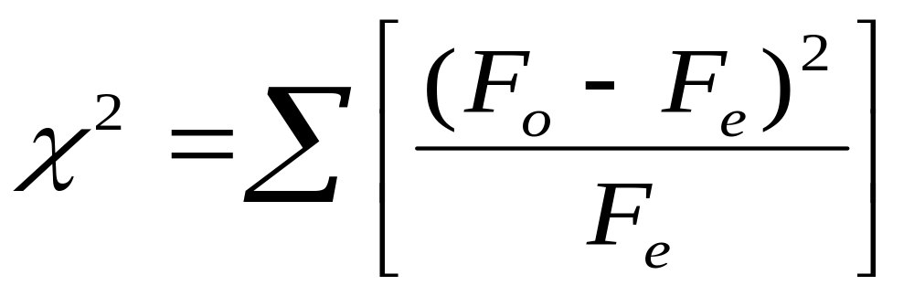

4. Calculating Test Statistics
Continued
Notes:
Mean difference between pairs of values

Slide 8
4. Calculating Test Statistics
Continued
Observed
frequencies
Expected
frequency
Expected
frequency
Notes:
Mean difference between pairs of values

Slide 9

5. Determine Degrees of Freedom
Number of levels in column variable
df = (R-1)(C-1)
Number of levels in row variable

Slide 10

6. Compare computed test statistic against a tabled/critical value
The computed value of the Pearson chi- square statistic is compared with the critical value to determine if the computed value is improbable
The critical tabled values are based on sampling distributions of the Pearson chi-square statistic
If calculated χ² is greater than χ² table value, reject H_{o}

Slide 11
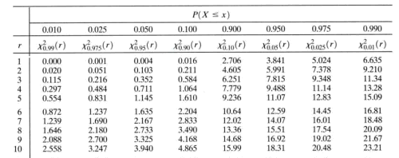
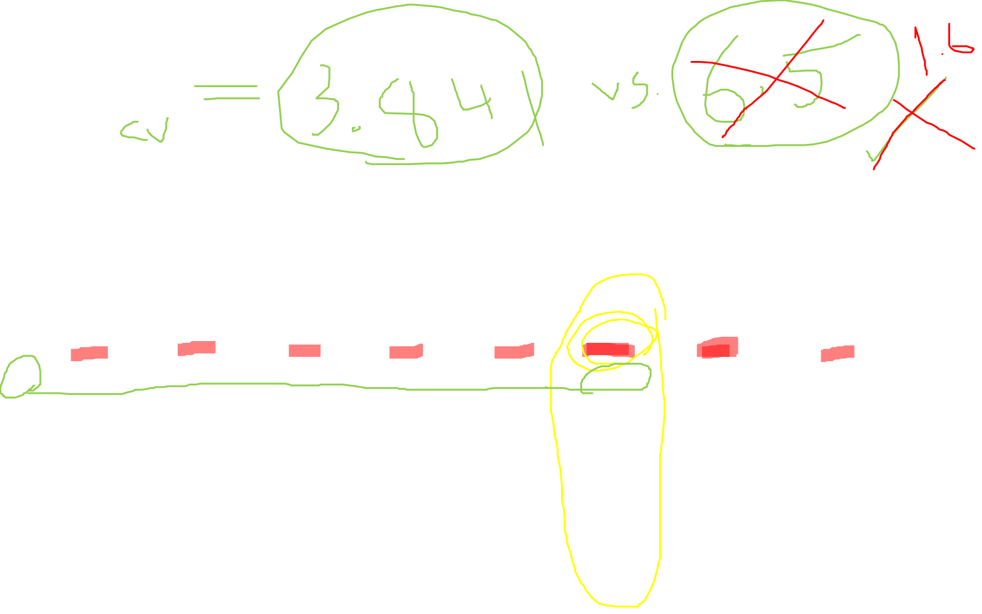
χ²

Slide 12

Decision and Interpretation
If the probability of the test statistic is less than or equal to the probability of the alpha error rate, we reject the null hypothesis and conclude that our data supports the research hypothesis. We conclude that there is a relationship between the variables.
If the probability of the test statistic is greater than the probability of the alpha error rate, we fail to reject the null hypothesis. We conclude that there is no relationship between the variables, i.e. they are independent.

