Slide 1

Dependent (paired) Sample t-tests
Dr. Hamza Alduraidi

Slide 2
Dependent Samples t-test
Used when we have dependent samples – matched, paired or tied somehow
  Repeated measures
  Brother & sister, husband & wife
  Left hand, right hand, etc.
Useful to control individual differences. Can result in more powerful test than independent samples t-test.
Notes:
We use this when we have measures on the same people in both conditions (or other dependency in the data). Usually there are individual differences among people that are relatively enduring. For example, suppose we tested the same people on the psychomotor test twice. Some people would be very good at it. Others would be relatively poor at it. The dependent t allows us to take these individual differences into account. The scores on the variable in one treatment will be correlated with the scores on the other treatment.
If the observations are positively correlated (most people score either high on both or low on both) and if there is a difference in means, we are more likely to show it with the dependent t-test than with the independent samples t-test. [Emphasize this point, they need to know it for their homework.]

Slide 3
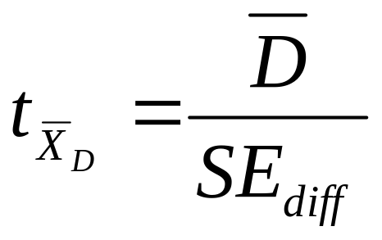
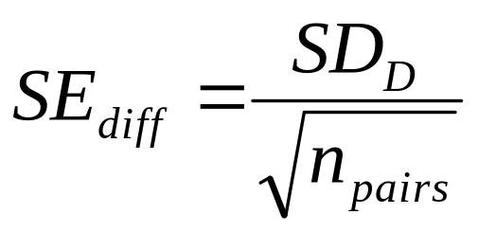
Dependent Samples t
Formulas:
t is the difference in means over a standard error.
The standard error is found by finding the difference between each pair of observations. The standard deviation of these difference is SD_{D}. Divide SD_{D} by sqrt (number of pairs) to get SE_{diff}.
Notes:
We are still dealing with the Sampling Distribution of the Difference between the means. Our subscript is different here, but says basically the same thing. We are looking at the MEAN DIFFERENCE SCORE. The subscript for the independent samples t said we were looking at the DIFFERENCE BETWEEN THE MEANS.

Slide 4
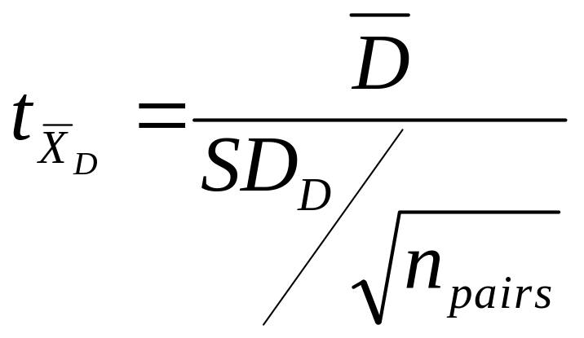
Another way to write the formula
Notes:
In this formula, we just put the formula for Se_{diff} in the denominator instead of having you calculate it separately. [this is the formula that appears on the “Guide to Statistics” sheet they can download.

Slide 5
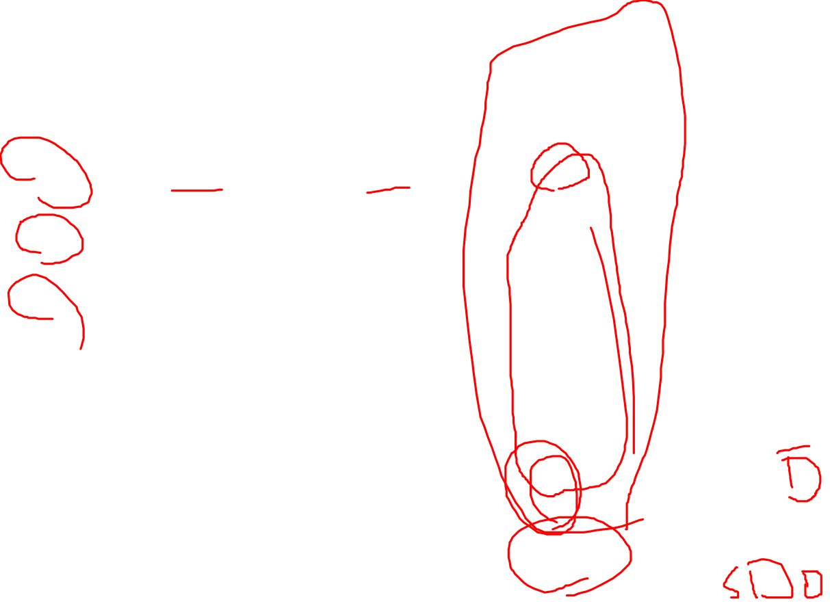
Dependent Samples t example
Person | Painfree (time in sec) | Placebo | Difference
1 | 60 | 55 | 5
2 | 35 | 20 | 15
3 | 70 | 60 | 10
4 | 50 | 45 | 5
5 | 60 | 60 | 0
M | 55 | 48 | 7
SD | 13.23 | 16.81 | 5.70
Notes:
Suppose that we are testing Painfree, a drug to replace aspirin. Five people are selected to test the drug. On day one, ½ get painfree, and the other get a placebo. Then all put their hands into icewater until it hurts so bad they have to pull their hands from the water. We record how long it takes. The next day, they come back and take the other treatment. (Counterbalancing & double blind.)

Slide 6
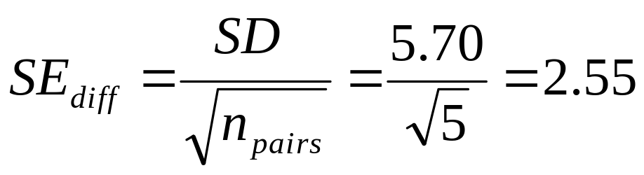
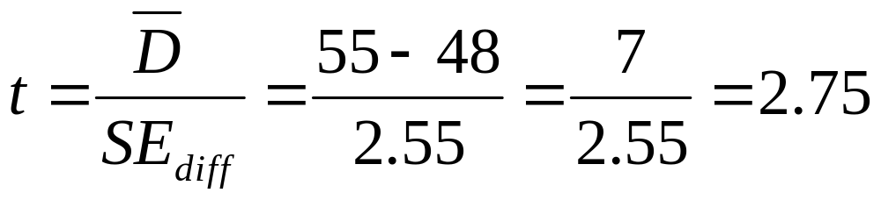
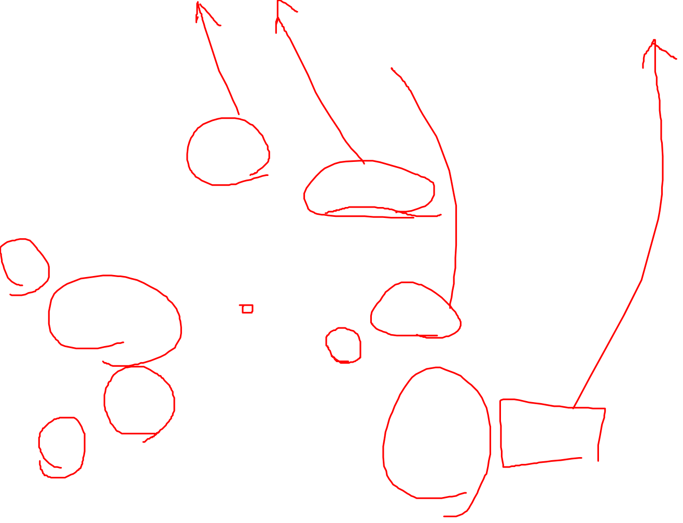
Dependent Samples t Example (2)
Set alpha = .05
Null hypothesis: H₀: μ₁ = μ₂. Alternative is H₁: μ₁ ≠ μ_{2.}
Calculate the test statistic:
Notes:
1. Set alpha = .05, two tailed (just a difference, not a prediction of greater or less than).
2. Null Hypothesis: . This is the same as . This says that there is no difference between the pain killer and the placebo in the population. The alternative hypothesis is that the pain killer does have an effect, or
3. Calculate the test statistic (see slide).

Slide 7
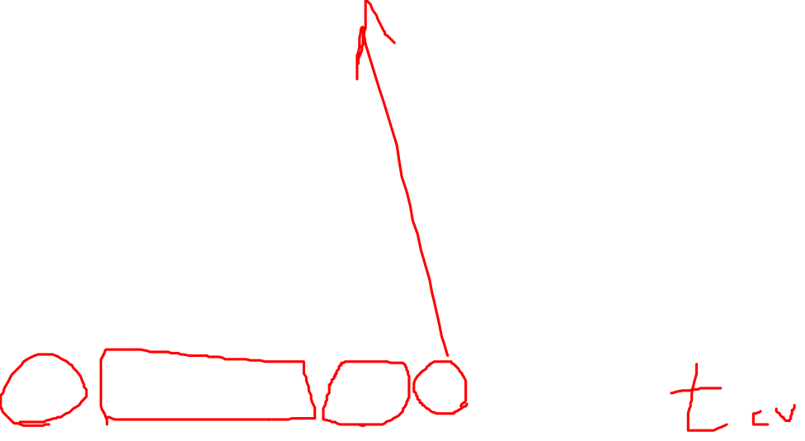
Dependent Samples t Example (3)
Determine the critical value of t.
Alpha =.05, tails=2
df = N(pairs)-1 =5-1=4.
Critical value is 2.776
Decision rule: is absolute value of sample value larger than critical value?
Conclusion. Not (quite) significant. Painfree does not have an effect.
Notes:
4. Determine the critical value of the statistic. We look this up in a table. Alpha is .05, t is 2-tailed and our df are N-1, where N is the number of pairs. In this case df = 5-1 = 4. The critical value is 2.776.
5. State the decision rule. If the absolute value of the test statistic is larger than the critical value, reject the null hypothesis. If |2.75| > 2.776, reject the null.
6. Conclusion. he population means are not (quite) different. The result is not significant at p < .05.

Slide 8
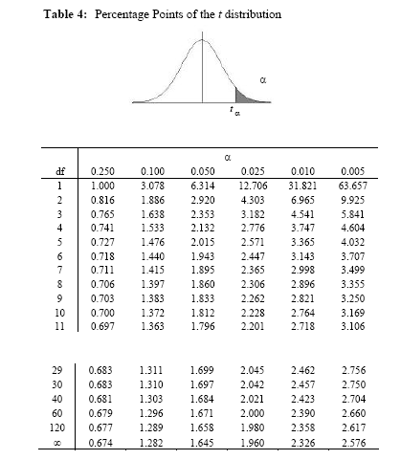
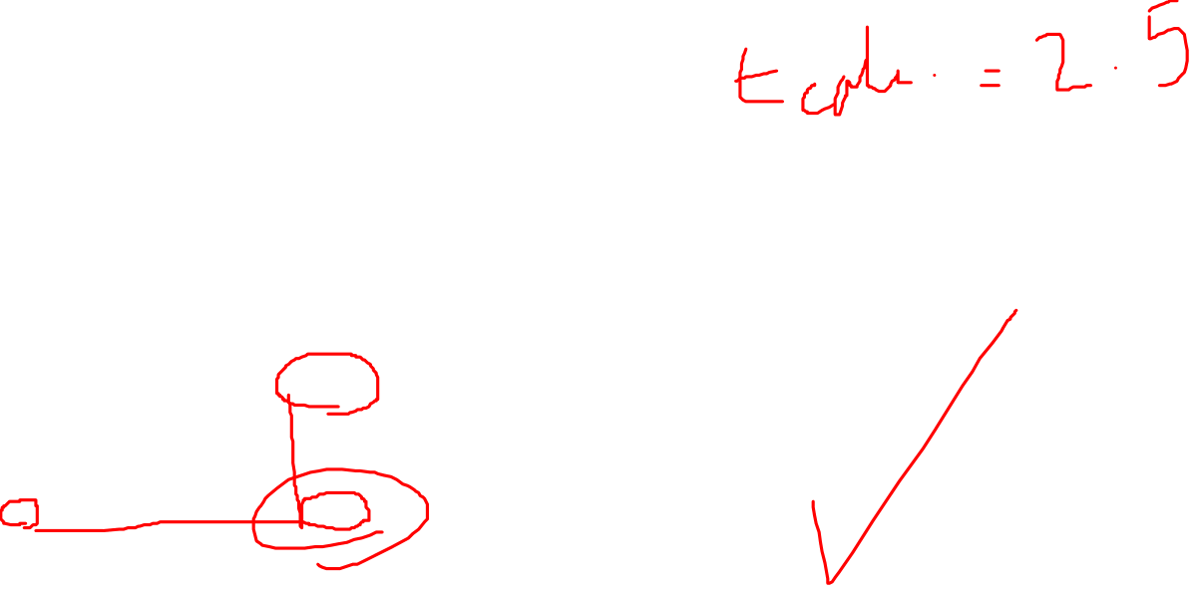

Slide 9
Using SPSS for dependent t-test
Open SPSS
Open file “SPSS Examples” (same as before)
Go to:
  “Analyze” then “Compare Means”
  Choose “Paired samples t-test”
  Choose the two IV conditions you are comparing. Put in “paired variables box.”
Notes:
Point out that the data for an independent t-test and dependent t-test must be entered differently in SPSS.
[They should choose “painfree” and “placebo” to put in the paired variables box.]

Slide 10
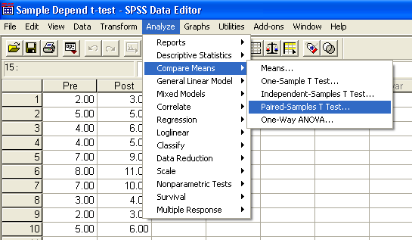
Dependent or Paired t-Test: Select Paired-Samples

Slide 11
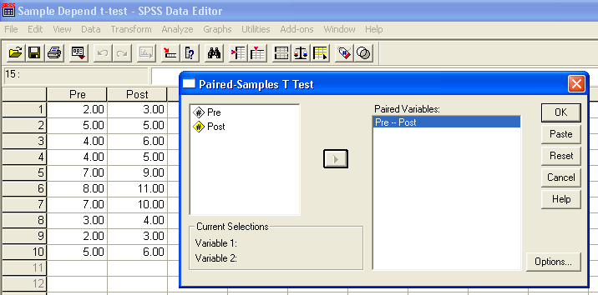

Dependent or Paired t-Test: Select Variables

Slide 12
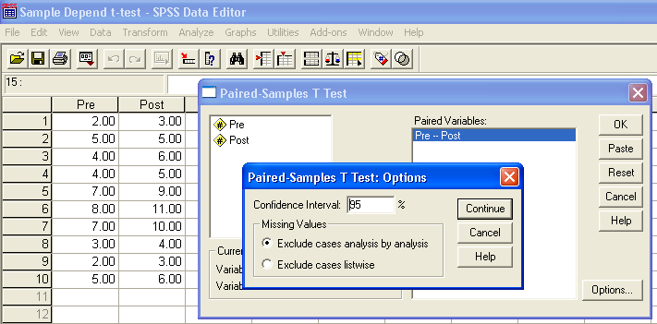
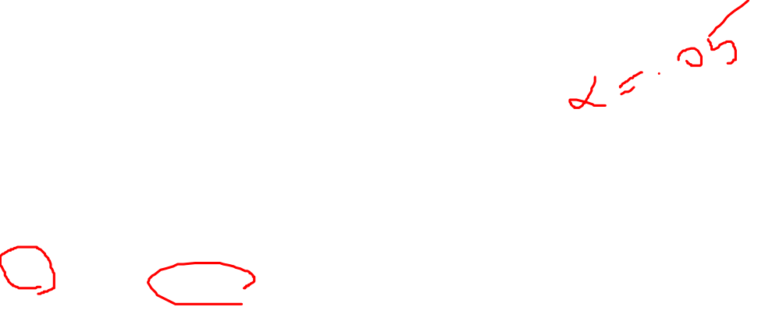
Dependent or Paired t-Test: Options

Slide 13
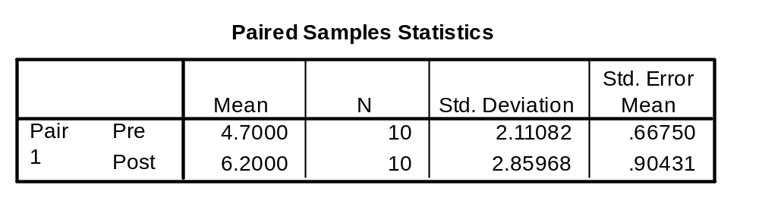
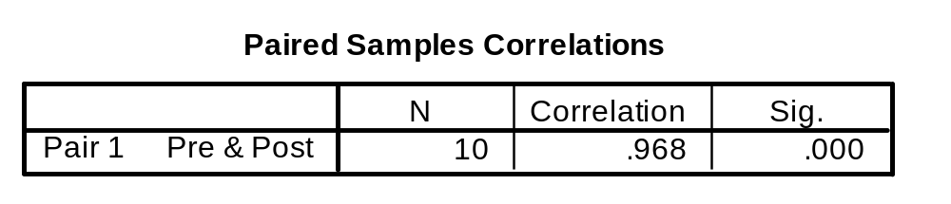
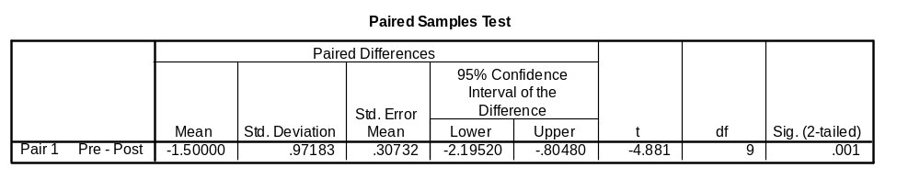
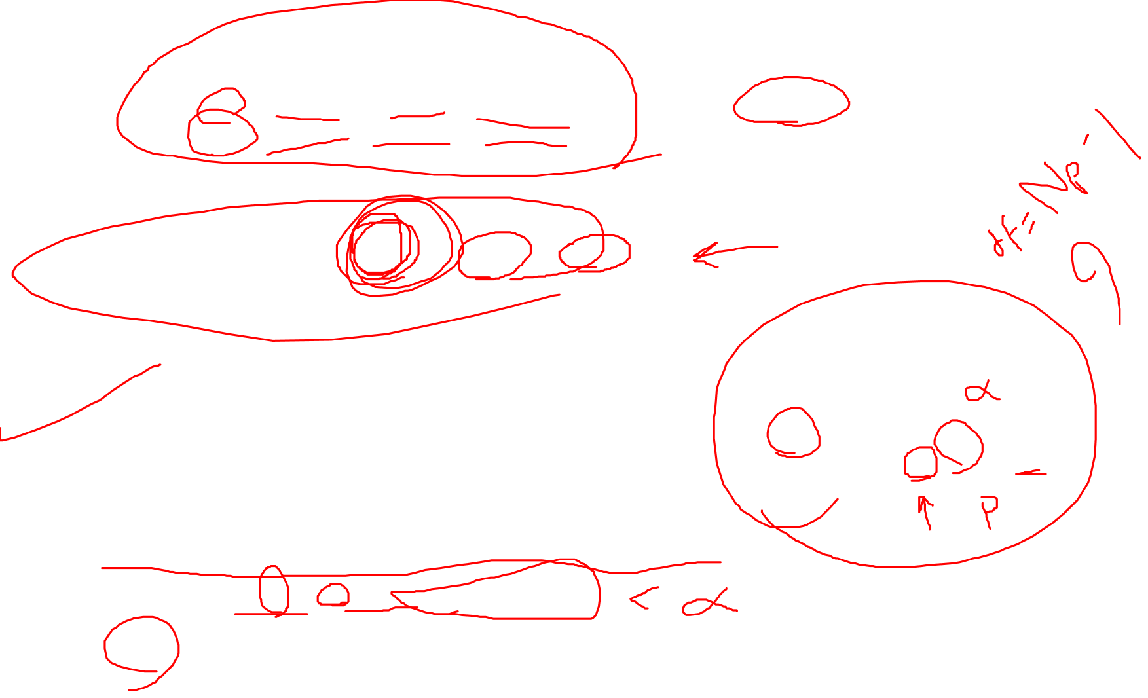
Dependent or Paired t-Test: Output
Is there a difference between pre & post?
t(9) = -4.881, p = .001
Yes, 4.7 is significantly different from 6.2

