Slide 1
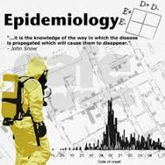

Introduction to and History of Epidemiology
Dr. Sireen Alkhaldi, BDS, MPH, DrPH
Community Medicine, first semester 2023/ 2024
School of Medicine, The University of Jordan

Slide 2
Lecture Contents….
1. Epidemiology defined.
2. The components of epidemiology
3. Major examples of epidemiologic investigations.
4. History of epidemiology

Slide 3
Definitions…
Epidemiology is a core science of public health.
Public health
The science & art of
Preventing disease,
prolonging life, and
promoting health & efficiency
through organized community effort
(Winslow, 1920)

Slide 4
Definitions
Health: A state of complete physical, mental and social well-being and not merely the absence of disease or infirmity (WHO,1948)
Disease: A physiological or psychological dysfunction. (Literally, dis-ease, the opposite of ease, when something is wrong with a bodily function).
Illness: A subjective state of not being well (subjective state of a person who feels aware of not being well)
Sickness: A state of social dysfunction (i.e., a role that the individual assumes when ill).

Slide 5
Definitions
Epidemiology
The science of the mass phenomena of infectious diseases or the natural history of infectious diseases. (Frost 1927)
The science of infective diseases, their prime causes, propagation and prevention. (Stallbrass 1931.)

Slide 6
Definitions…
Epidemiology
“The study of the distribution and determinants of health-related states or events in specified populations, and the application of the study to the control of health problems”.
(J.M. Last 1988)

Slide 7
Epidemiology as a Science and a Method
Epi- demio- logy: The word itself comes from the Greek epi, demos, and Logos……
literally translated it means the study (logos) of what is upon (epi) the people (demos).
It is the scientific method of disease investigation − Typically, it involves the disciplines of biostatistics and medicine.

Slide 8
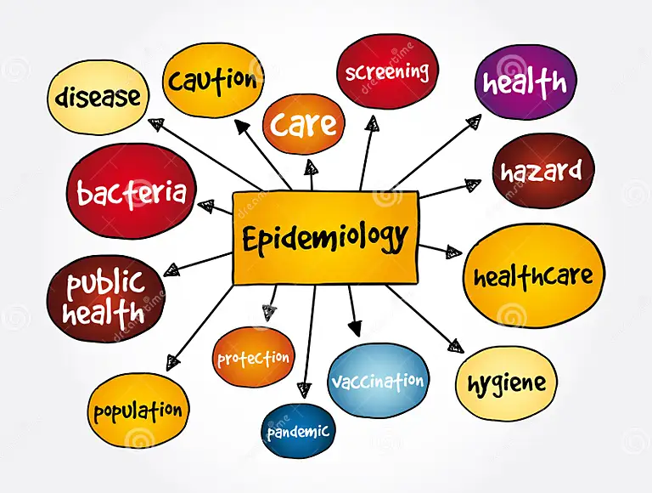
Components of the definition
Study: Systematic collection, analysis and interpretation of data
Epidemiology involves collection, analysis and interpretation of health related data
Epidemiology is a science.

Slide 9
Components of epidemiology
Distribution: Epidemiology is concerned with the frequency and pattern of health events in a population:
Frequency: A core characteristic of epidemiology is to measure the frequency (number of cases) of diseases, disability or death in a specified population.
It also refers to the relationship of that number to the size of the population.
This falls in the domain of biostatistics, which is a basic tool of epidemiology.

Slide 10
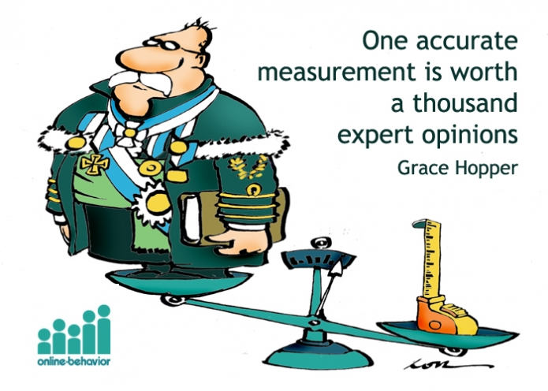
Components of epidemiology
Disease frequency:
E.g. Prevalence, Incidence rates, Death rate etc.
These rates are essential for comparing the disease frequency in different populations or sub groups of the same population

Slide 11
Components of epidemiology
Distribution….. The study of the pattern of an event by person, place and time.
Epidemiology studies distribution of diseases among subgroups of the population, in different geographic areas, and also any increase or decrease over time.
It answers the question who, where and when? This is descriptive epidemiology.
An important outcome of this step is formulation of etiological hypothesis

Slide 12
PERSON DISTRIBUTION
In descriptive studies disease is further characterized by defining the persons who develop the disease by age, gender, ethnicity, occupation, marital status, habits, social class & other host factors.
These host factors help us to understand the natural history of disease.

Slide 13
PLACE DISTRIBUTION
Study of the geography of the disease (geographical pathology) is one of the important dimensions of epidemiology.
With the geographical pathology we learn the differences in disease patterns between two geographical areas (e.g. international, national, or urban/rural differences).
These variations may be due to variations in population density, social class, deficiencies in health services, levels of sanitation, education & environmental factors.

Slide 14
TIME DISTRIBUTION
The pattern of a disease may be described by the time of occurrence
The occurrence of disease changes over time.
Some of these changes occur regularly, while others are unpredictable.
Two diseases that occur during the same season each year include influenza (winter) and West Nile virus infection (August– September).
In contrast, diseases such as hepatitis B and salmonellosis can occur at any time.
Day of the week or time of the day may be important.

Slide 15
TIME DISTRIBUTION
Epidemiologists have identified three kinds of time trends or fluctuations in disease occurrence:
Short term fluctuation: Single (one incubation period and one peak)(e.g. food poisoning)
or multiple or continuous exposure (well of contaminated water-cholera)
Minamata disease in Japan??
2. Periodic fluctuation:
Seasonal: GI infection in Summer
Cyclic: Human coronavirus every 7-10 years..antigenic variations. (e.g. SARS-CoV in 2003, MERS-CoV in 2012, SARS-CoV-2 (COVID-19) in 2019).
3. Long–term or Secular trend (e.g. CVD, lung cancer)

Slide 16
Components of the Definition of Epidemiology
Determinants:
Factors the presence/absence of which affect the occurrence and level of a health event (Risk Factor).
Epidemiology studies what determines or influences health events:
It answers the question: how and why?
Epidemiology analyzes health events “analytical epidemiology”. Here we test a hypothesis to prove right or wrong.
Analytical strategies help in developing scientifically sound health programes, interventions & policies.

Slide 17
Components…
Health-related states and events
Epidemiology is not only the study of diseases.
The focus of Epidemiology is not only patients’ health as individuals, but anything in the environment that may affect their health and well-being in any way.
It studies all health related conditions
Epidemiology is a broad science

Slide 18
Components…
Specified population
Epidemiology diagnoses and prevents disease in communities/ populations
The unit of study is a population (groups of people)
Clinical medicine diagnoses and treats patients after they get sick and go seek physician’s help.
Epidemiology is a basic science of public health.

Slide 19
Components…
Application
Epidemiological studies have direct and practical applications for prevention of diseases & promotion of health
Epidemiology is a science and practice
Epidemiology is an applied science
Epidemiology provides data essential to the planning, implementation & evaluation of services for the prevention, control & treatment of disease.

Slide 20
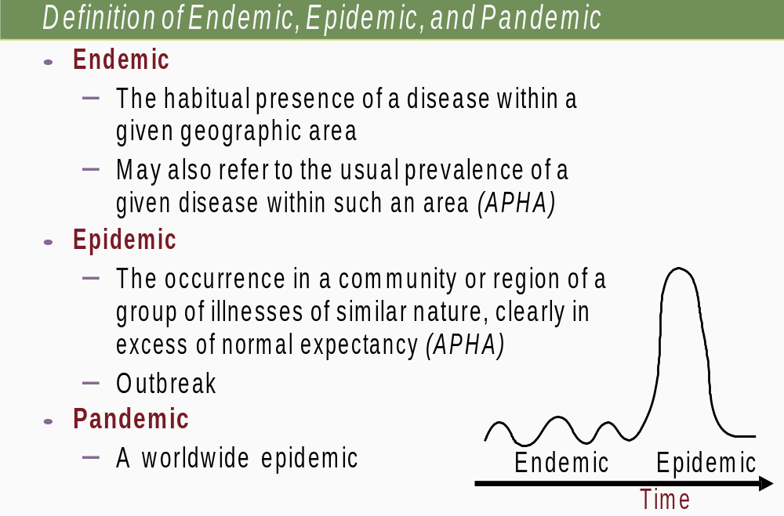

Slide 21
Epidemiology
In Epidemiology, we ask the following questions related to the health event:
What is the event? ( The Health problem).
What is the magnitude?
Where did it happen ?
When did it happen?
Who is affected?
Why did it happen?

Slide 22
Epidemiology
In Epidemiology, we ask the following questions related to the health action:
What can be done to reduce this problem and its consequences?
How can it be prevented in future?
What action should be taken by the community? By whom should these activities be carried out?

Slide 23
What Do Epidemiologists Do?
  Count cases of disease or injury
  Define the affected population
  Compute rates of disease or injury in that population
  Compare rates with those found in other populations
  Make inferences regarding patterns of disease
  Determine whether a problem exists

Slide 24
Fundamental assumptions in epidemiology
Human disease does not occur at random
Disease has causal and preventive factors that can be identified using systematic investigations
Notes:
24

Slide 25
Epidemiologic Reasoning
There is a natural progression in epidemiologic reasoning:
Begins with suspicion (clinical practice, descriptive epidemiology, laboratory research or theoretical speculation)
Formulation of specific hypothesis
Hypothesis is tested in epidemiologic studies using:
Notes:
judgment: causal-effect association (causal inference) magniude of the association, the consistency of findings, and biologic credibility
25

Slide 26
Sources of information (data) in Epidemiology
Registration of births, deaths and diseases
Population censuses
Routine health information systems
Surveillance
Investigation of epidemics
Sample surveys
Notes:
26

Slide 27
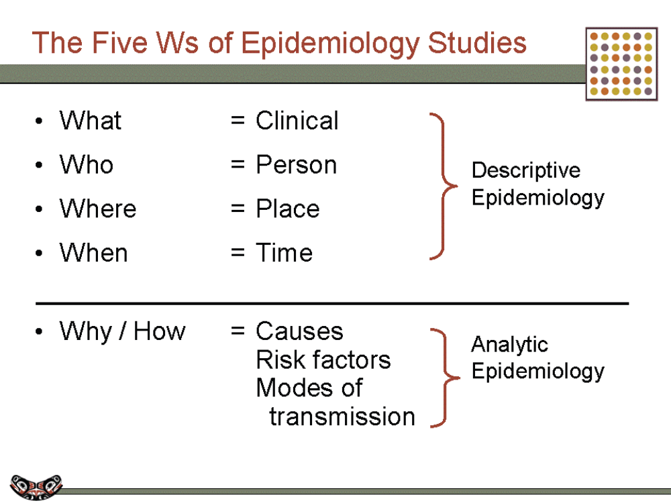
The Five Ws of Epidemiologic Studies

Slide 28
EPIDEMIC CURVE
EXPOSURE
NUMBER OF CASES
TIME

Slide 29

Fatalities Associated with Farm Tractors
In 1982, an epidemiologist studied the number of farm tractor-associated deaths in Georgia and described them in terms of time, place, and person by using death certificates and records from an existing surveillance system (All tractor related incidents between 1971-1981, N=166 cases).
He then generated a hypothesis for further study. Let’s look at the descriptive epidemiology (Who, When and Where….)
29
Notes:
SAY:
Let’s look at an example.
In 1982, an epidemiologist in the Georgia Department of Public Health became interested in the number of deaths associated with farm tractors. He determined he could examine this problem by using readily available data — death certificate records that were included in an existing surveillance system. He obtained the death certificate records for all deaths that had occurred in Georgia during 1971 through 1981 that were associated with farm tractor incidents.
After collecting the data, he used the information to describe the problem in terms of time, place, and person and then generated a hypothesis for further study. We’ll talk about his hypothesis in a moment, but first let’s look at the descriptive epidemiology.
GO to next slide.

Slide 30
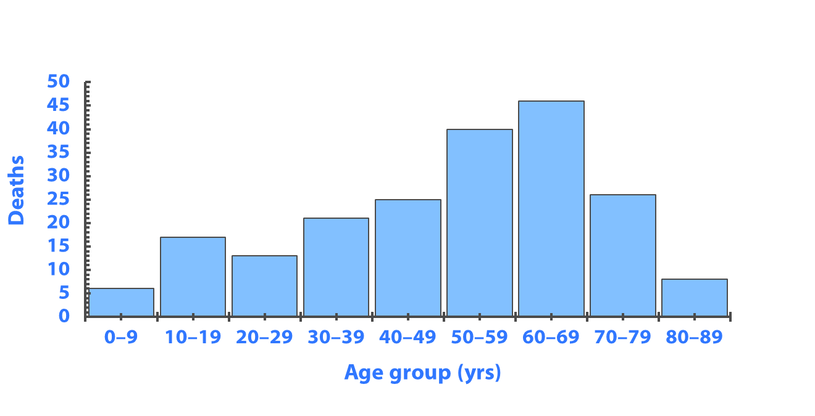
Fatalities Associated with Farm Tractors (person)
Goodman RA, Smith JD, Sikes RK, et al. Fatalities associated with farm tractor injuries: an epidemiologic study. Public Health Rep 1985;100: 329–33.
30
Notes:
SAY:
This graph describes the who. It indicates the number of deaths by age group.
What else can you infer from this graph?
<SAY:
An increase in the number of deaths occurred among older persons, which again, is part of the descriptive analysis.
<ASK: By analyzing these data, which age group is at greatest risk for death from tractor-related incidents among this population?>
<ELICIT answers from the participants.>
SAY:
Unfortunately, you cannot tell. These are absolute counts of events, not rates. Without the population size for each age group, we cannot compare the relative risks.
Do the higher death numbers among persons aged 60 to 69 years reflect the fact that users of tractors are predominantly older? That older tractor users might be more likely to have an unintentional injury or less likely to survive an incident? We need to understand who is driving the tractor. Why do you think tractor-related deaths occur among the 0- to 9-year age group? Are children playing on tractors and fatally injuring themselves?
This example illustrates how descriptive epidemiology can be used to characterize a specific problem in terms of when, where, and who, and it can help generate a hypothesis for further study to answer how and why the problem occurs.
GO to next slide.

Slide 31
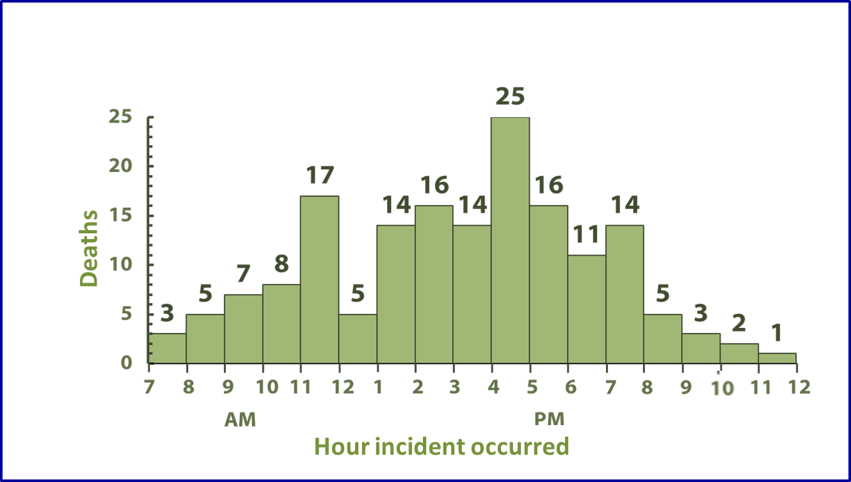
Fatalities Associated with Farm Tractors (time)
Goodman RA, Smith JD, Sikes RK, et al. Fatalities associated with farm tractor injuries: an epidemiologic study. Public Health Rep 1985;100:329–33.
31
Notes:
SAY:
This graph describes the when for 166 of the farm tractor-associated deaths. We can examine the data by looking at the time of day when the deaths occurred.
What inferences can we make from this graph?
<CLICK for the first two arrows to appear.>
SAY:
Peaks in deaths occurred just before lunch and during late afternoon.
<CLICK for the third arrow to appear.>
SAY:
A decrease in deaths occurred from noon to 1:00 p.m.
We can infer that deaths occur when farmers are probably most fatigued right before lunch, which might lead to the increase in deaths in late morning. More deaths occur in late afternoon when children are home from school. Conversely, fewer deaths occur while the farmers are probably eating their lunch.
GO to next slide.

Slide 32
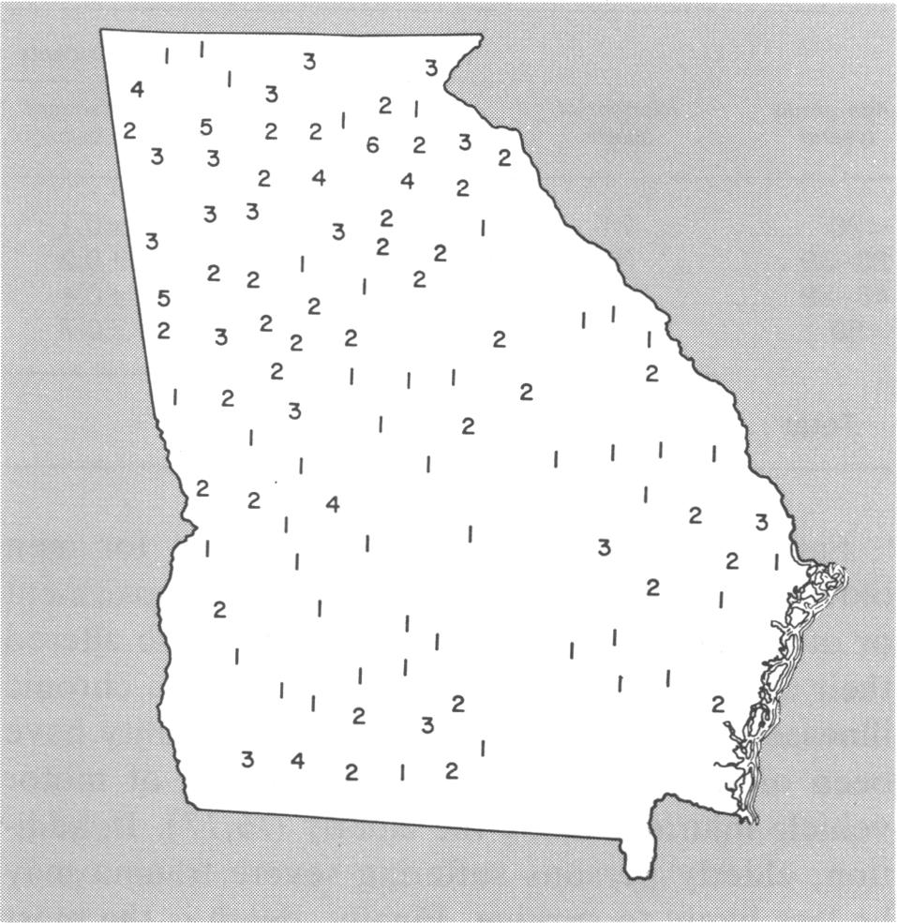
Fatalities Associated with Farm Tractors (place)
Goodman RA, Smith JD, Sikes RK, et al. Fatalities associated with farm tractor injuries: an epidemiologic study. Public Health Rep 1985;100:329–33.
32
Notes:
SAY:
This map describes where. It indicates the number of deaths by county (place) in Georgia.
<CLICK for animation to appear.>
Most of the deaths occurred in the northern areas of Georgia, which has a more mountainous terrain. Fewer deaths occurred in south-central Georgia, which is characterized by much flatter farmlands.
<ASK: What are some possible explanations for this geographic distribution?>
<ELICIT answers from the participants.>
<ASK: Can you infer that the distribution indicates that the rugged terrain is responsible for more tractor-related incidents?>
SAY:
Remember that the map indicates the number of deaths, not the rates. The numbers possibly reflect differences in population or the number of tractors being used. More farming occurs in south-central Georgia. Therefore, the number of tractors probably does not explain the difference. Perhaps geographic differences exist in the experience or skill level of those using the tractors.
GO to next slide.

Slide 33
Epidemiological contributions to medical science and humanity
Doll & Bradford-Hill smoking and carcinoma of the lung:
preliminary report, BMJ 1950;II:739-48
Patients with lung cancer more likely to have smoked
85-90% of cases are due to tobacco”

Slide 34
Breast cancer screening (Swedish two country trial)
Screening with mammography was started in 1977 in the counties of Kopparberg and Ostergotland.
The results at 29-year follow-up: A substantial and significant reduction in breast cancer mortality was associated with an invitation to screening (31% lower mortality rate in women diagnosed via mammography).
At 29 years of follow-up, the number of women needed to undergo screening for 7 years to prevent one breast cancer death was 414
Notes:
The Swedish two county trial of mammographic screening for breast cancer: recent results and calculation of benefit.
L Tabar, G Fagerberg, S W Duffy, and N E Day
J Epidemiol Community Health. 1989 June; 43(2): 107–114.

Slide 35
Legionnaire’s disease outbreak
Members of the American Legion gathered for the annual American Legion Convention held July 21 through 24, 1976, in Philadelphia.
Soon after the convention began, a substantial number of attendees were admitted to hospital emergency departments or were examined in doctors’ offices with acute onset of fever, chills, headache, malaise, dry cough, and muscle pain.
More troublesome is that during July 26 to August 1, a total of 18 conventioneers died, reportedly from pneumonia.
On the morning of August 2, a nurse at a veterans’ hospital in Philadelphia called CDC to report cases of severe respiratory illness among convention attendees.
Subsequent conversations that day with public health officials uncovered an additional 71 cases among persons who had attended the convention.
The goal was to find out why these conventioneers were becoming ill and, in some cases, dying!!!

Slide 36
Legionnaire’s disease outbreak
American Legion Convention,
Philadelphia, Pennsylvania
Health care provider at a veterans’ hospital in Philadelphia calls CDC to report cases
of severe respiratory illness among attendees of the American Legion Convention
July 21–24
August 2
(Morning)
August 2
(Evening)
July 26–Aug 1
18 deaths reported among conventioneers
71 additional cases reported
Fraser DW, Tsai, T, Orenstein W, et al. Legionnaires’ disease: description of an epidemic of pneumonia. New Engl J Med 1977;297:1189–97.
36
Notes:
SAY:
Let’s look at an example of how the rates were calculated in an actual case of unexplained pneumonia.
<CLICK for timeline animation to begin.>
SAY:
Members of the American Legion gathered for the annual American Legion Convention held July 21 through 24, 1976, in Philadelphia.
Soon after the convention began, a substantial number of attendees were admitted to hospital emergency departments or were examined in doctors’ offices with acute onset of fever, chills, headache, malaise, dry cough, and muscle pain.
<CLICK for timeline animation to continue.>
SAY:
More troublesome is that during July 26 to August 1, a total of 18 conventioneers died, reportedly from pneumonia.
<CLICK for timeline animation to continue.>
SAY:
On the morning of August 2, a nurse at a veterans’ hospital in Philadelphia called CDC to report cases of severe respiratory illness among convention attendees.
<CLICK for timeline animation to continue.>
SAY:
Subsequent conversations that day with public health officials uncovered an additional 71 cases among persons who had attended the convention.
The goal was to find out why these conventioneers were becoming ill and, in some cases, dying.
GO to next slide.

Slide 37
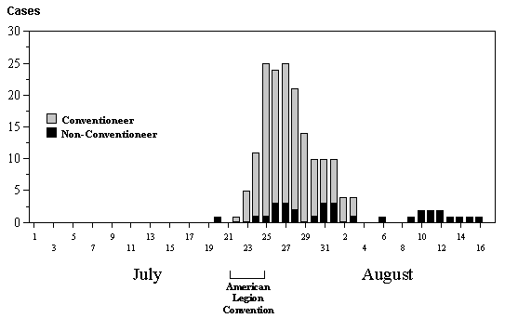
Legionnaires’ Disease Cases, by Day
37
Fraser DW, Tsai, T, Orenstein W, et al. Legionnaires’ disease: description of an epidemic of pneumonia. New Engl J Med 1977;297:1189–97.
Notes:
SAY:
This graph indicates the number of Legionnaires’ disease cases by day in July and August 1976. Remember these are the number of cases, not the disease rate.
<CLICK for arrow to appear.>
The arrow indicates that the number of cases peaks from July 25 to July 27, and the number declines thereafter.
We can infer that the number of cases started soon after the convention began. By the end of the convention, the number of cases had reached its peak.
However, this descriptive analysis only tells us what can be read directly from the graph and data. Analytic processes take us one step further to a hypothesis and assessment of the causes for the trend identified by the descriptive analysis.
GO to next slide.

Slide 38
Legionnaires’ Disease Attack Rates by Place
Hotel A
Hotel B
Hotel C
Age (yrs) |  | Ill | Total | Percent ill |  | Ill | Total | Percent ill |  | Ill | Total | Percent ill
≤39 |  | 3 | 44 | 6.8 |  | 3 | 116 | 2.6 |  | 6 | 160 | 3.7
40–49 |  | 9 | 160 | 5.6 |  | 11 | 232 | 4.7 |  | 20 | 392 | 5.1
50–59 |  | 27 | 320 | 8.4 |  | 25 | 523 | 4.8 |  | 52 | 843 | 6.2
60–69 |  | 12 | 108 | 11.1 |  | 19 | 207 | 9.1 |  | 31 | 315 | 9.8
≥70 |  | 11 | 54 | 20.4 |  | 5 | 76 | 6.5 |  | 16 | 130 | 12.3
Unknown |  | 0 | 2 | 0 |  | 0 | 7 | 0 |  | 0 | 9 | 0
Total |  | 62 | 688 | 9.0 |  | 63 | 1,161 | 5.4 |  | 125 | 1,849 | 6.8
Those who stayed in Hotel A have the highest percentage of illness — 9.0% versus 5.4% and 6.8 at other hotels (% Ill in Hotel A= 62 / 688 = 9.0%).
The age group that has the highest percentage of ill persons is those aged 70 years or older (% Ill in >70y in Hotel A = 11 / 54 = 20.4%)
38
Notes:
SAY:
This table lists the rates of illness among American Legion delegates by age and where they were staying — Hotel A or another hotel.
Let’s see what the data tell us.
<WALK participants through the rows and columns of the table.>
<CLICK to advance animation.>
SAY:
The age group that has the highest percentage of ill persons is those aged 70 years or older, regardless of where they were staying.
<CLICK to advance animation.>
SAY:
Combining all age groups, those who stayed in Hotel A have the highest percentage of illness — 9.0% versus 5.4% at other hotels.
We can infer, therefore, that a connection exists between staying in Hotel A and becoming ill; we can also infer that older persons are somehow more susceptible to the disease.
GO to next slide.

Slide 39
Legionnaires’ Disease Rate by Age Group
Hotel A Residents
Time: July 21–24, 1976
Frequency
Unit
Rate
Age (yrs) | Sick | Total | Percentage
≥39 | 3 | 44 | 6.8
40–49 | 9 | 160 | 5.6
50–59 | 27 | 320 | 8.4
60–69 | 12 | 108 | 11.1
≥70 | 11 | 54 | 20.4
Unknown | 0 | 2 | 0
Those who stayed in Hotel A have the highest percentage of illness — 9.0% versus 5.4% and 6.8 at other hotels (% Ill in Hotel A= 62 / 688 = 9.0%)..
The age group that has the highest percentage of ill persons is those aged 70 years or older
(% Ill in >70y in Hotel A = 11 / 54 = 20.4%)
39
Notes:
SAY:
We can calculate the rate at which each age group became ill after staying at or attending a meeting at Hotel A during the convention by using a basic formula.
<ASK: Among which age group did the largest number become ill?>
<CLICK for highlighted answer to appear.>
SAY:
Those aged 50 to 59 years.
<ASK: Which age group had the highest rate of persons becoming ill?>
<CLICK for highlighted answer to appear.>
SAY:
Those aged 70 years or older.
At times, raw numbers can tell you valuable information. However, as you can see displayed in this table, without examining the rates associated with those raw numbers, those data can be misleading.
GO to the next slide.

Slide 40
Legionnaires’ Disease
The age group that has the highest percentage of ill persons is those aged 70 years or older, regardless of where they were staying.
Combining all age groups, those who stayed in Hotel A have the highest percentage of illness — 9.0% versus 5.4% at other hotels.
We can infer, therefore, that a connection exists between staying in Hotel A and becoming ill; we can also infer that older persons are somehow more susceptible to the disease.

Slide 41
Legionnaires’ Disease
Five months after the first cases of Legionnaires’ disease occurred, results of the case-control study indicated that spending time in the lobby of Hotel A was a risk factor for illness
In January 1977, the Legionella bacterium was finally identified and isolated and was found to be breeding in the cooling tower of the hotel’s air-conditioning system; the bacteria then spread through the building whenever the system was used.
Similar bacteria grew in warm waters in nature, such as hot springs, and also had been identified in air-conditioning cooling towers.
The finding from this outbreak investigation lead to development of new regulations worldwide for air conditioning systems.

Slide 42
London Smog Disaster, 1952
Air pollution causes respiratory illnesses and death.
When fog and soot from coal burning created a dense smog in Winter, 1952, in London, the smog was around for five days from December 5–10.
There was a substantial increase in mortality
The death rate in London in the previous week was around 2,062
In the week of the smog, 4,703 died

Slide 43
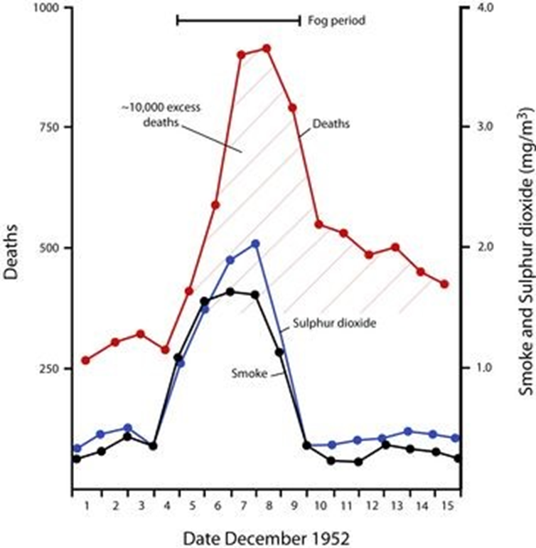

Slide 44
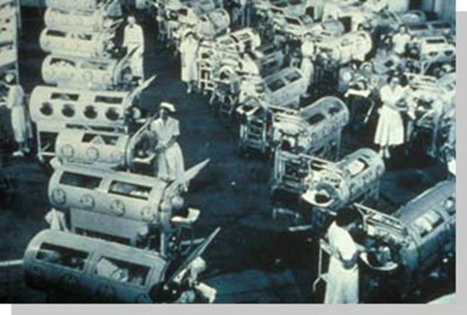
Epidemiology and Polio Vaccine
In April, 1955, Dr. Thomas Francis,
director of Poliomyelitis Vaccine
Evaluation Center at the University
of Michigan, announced that the
two-year field trial of the Salk vaccine
against polio was up to 90% effective
“The results announced by Francis effectively marked the beginning of the end of polio as the most life-threatening and debilitating public health threat to the children of the United States“.

Slide 45
Scope of Epidemiology
Originally, Epidemiology was concerned with investigation & management of epidemics of communicable diseases
Lately, Epidemiology was extended to endemic communicable diseases and non-communicable diseases
Recently, Epidemiology can be applied to all diseases and other health related events

Slide 46
History of Epidemiology
Seven land marks in the history of Epidemiology:
1) Hippocrates (460BC): Environment & human behaviors affect health: “healthy mind in health body”.
2) John Graunt (1662): Quantified births, deaths and diseases (Statistician, founder of demography in London).
James Lind (1747): Scottish Doctor, treated scurvy among sailors with fresh fruit (lemons)…first Clinical trial in history
William Farr (1839): Established application of vital statistics to evaluate health problems…Founder of medical statistics.

Slide 47
History…
5) John Snow (1854): tested a hypothesis on the origin of an epidemic of cholera in London.
Alexander Louis (1872): French physician, Systematized application of numerical thinking (quantitative reasoning and clinical trials).
Bradford Hill (1937): Suggested criteria for establishing causation.
Epidemiology flourished as a scientific discipline in 1940s

Slide 48
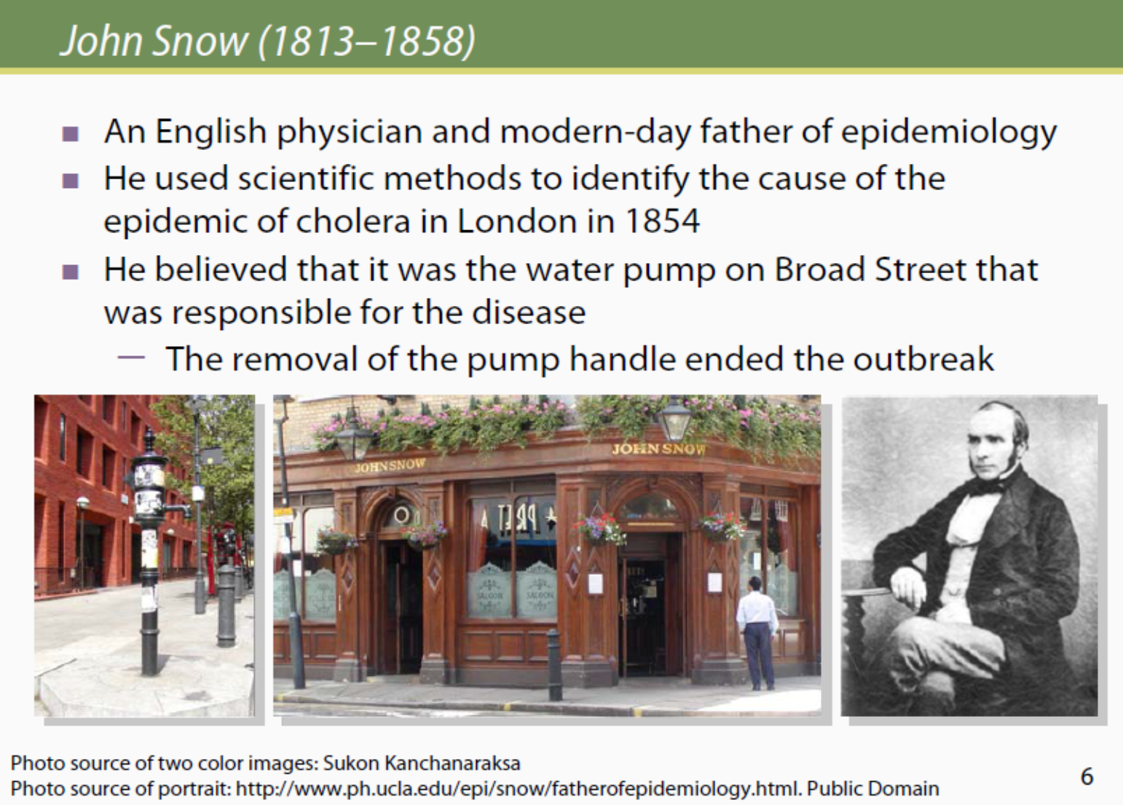

Slide 49
History of epidemiology
John Snow conducted a series of investigations in London. Snow conducted his classical study in 1854 when an epidemic of cholera developed in the golden square of London.
During the time of microscope development, snow conducted studies of cholera outbreak both to discover the cause of cholera and how to prevent its recurrences.
During that time Farr and Snow had major disagreement about the cause of cholera. Farr adhered to what was called the miasmatic theory of diseases, according to this theory, which was commonly held at that time, diseases were transmitted by a miasma or a cloud with bad smell that clung low on the earth surface.

Slide 50
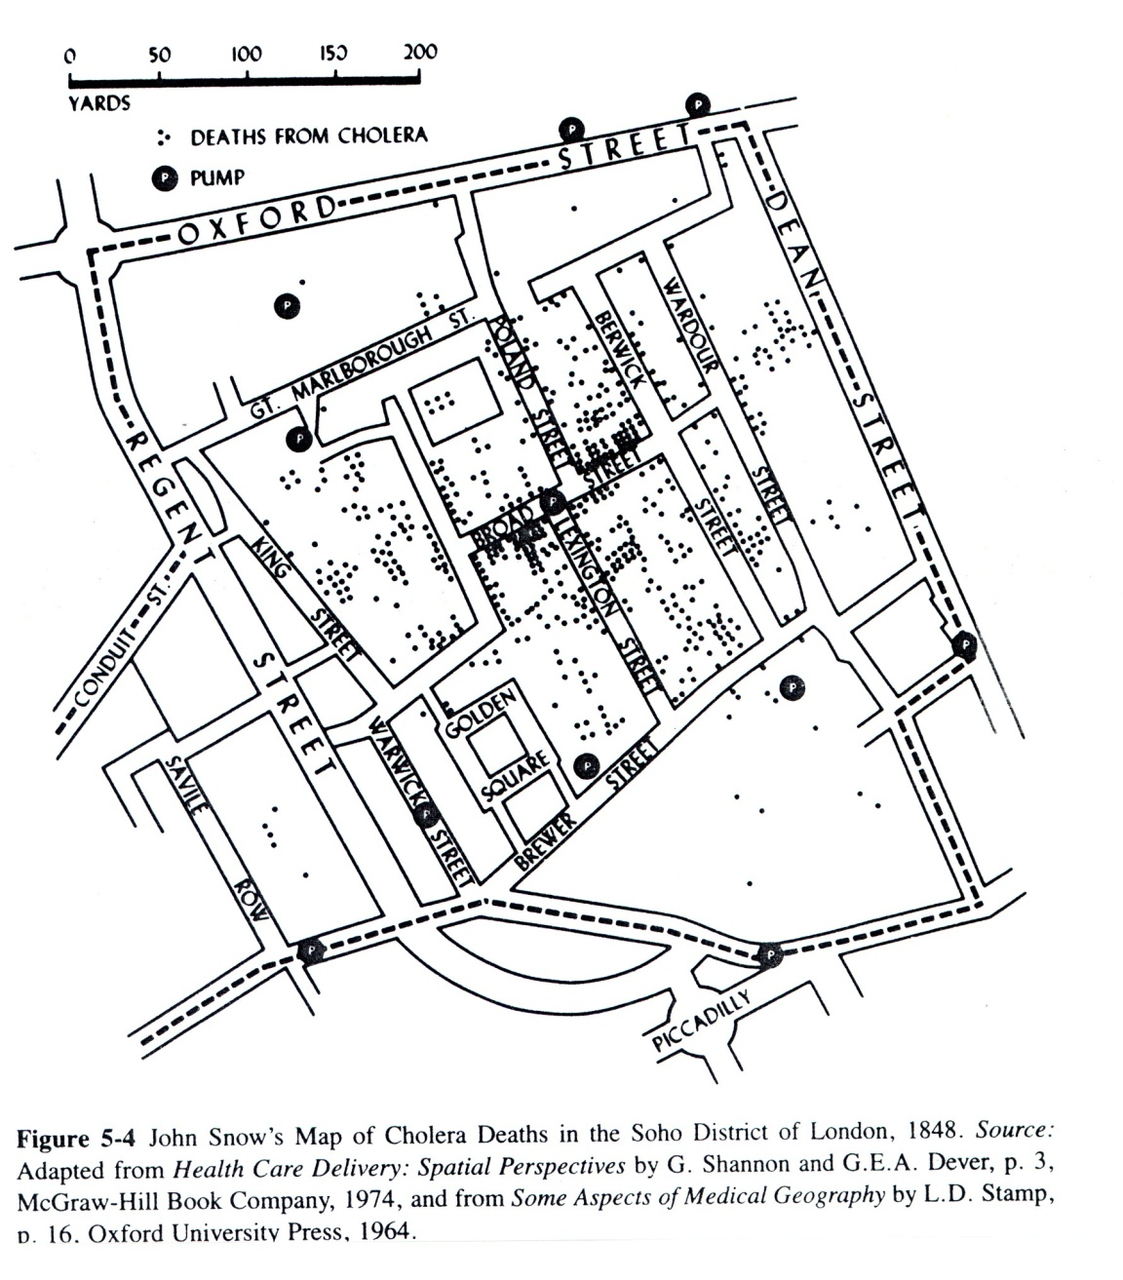

Slide 51
History of epidemiology
However, Snow did not agree, he believed that cholera is transmitted through contaminated water. He began his investigation by determining where in this area in London persons with cholera lived and worked. He then used this information to map for distribution of diseases.
Snow believed that water was the source of infection for cholera. He marked the location and searched the relationship between cases and water sources (water pumps).
He found most cases clustered around the Broad Street pump.
So, he decided to break the pump handle, which stopped the outbreak.
He found that cholera was transmitted through contaminated water. This was a major achievement in epidemiology.

Slide 52
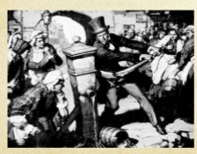
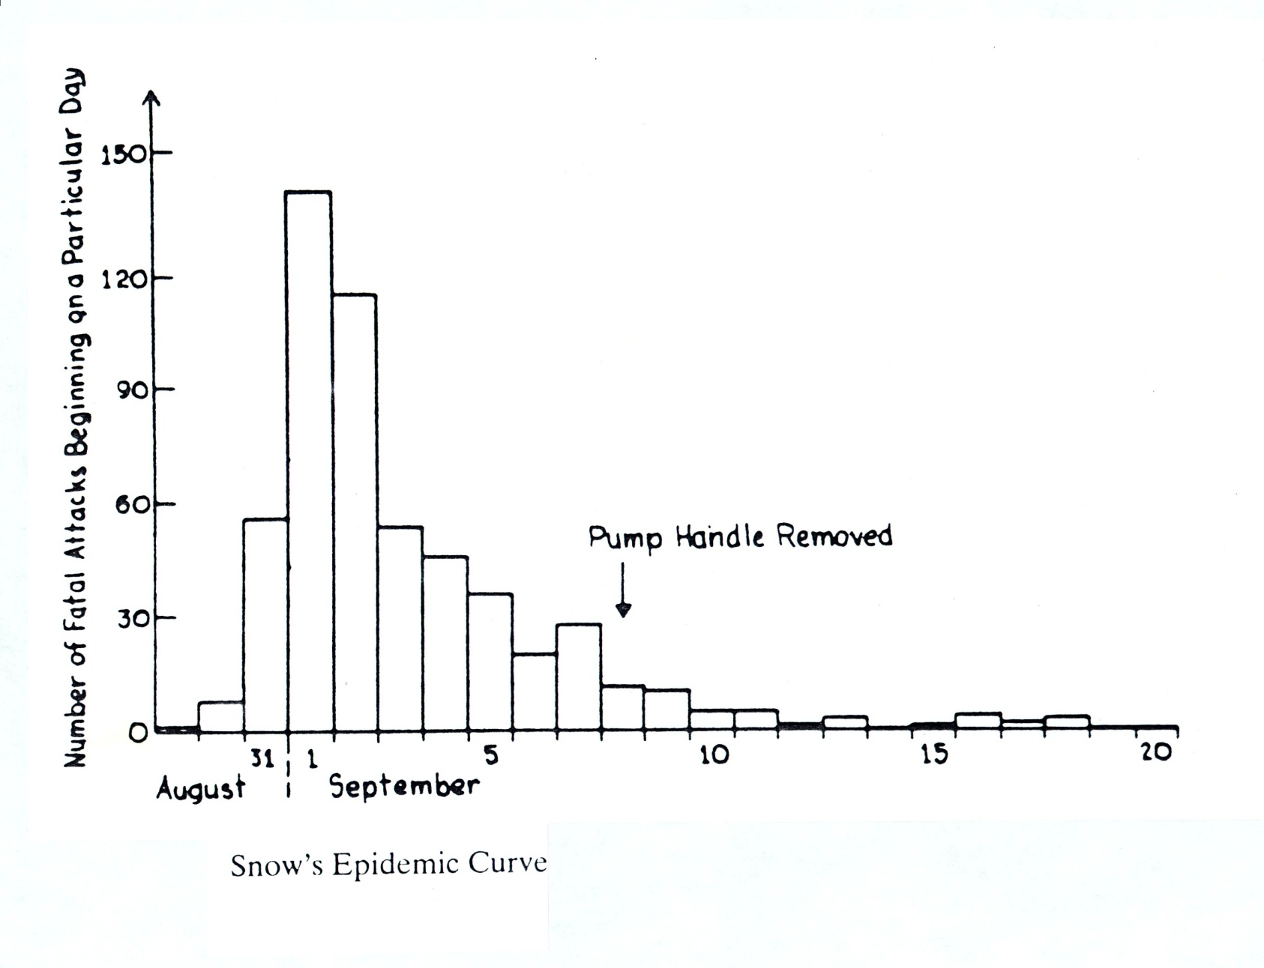

Slide 53
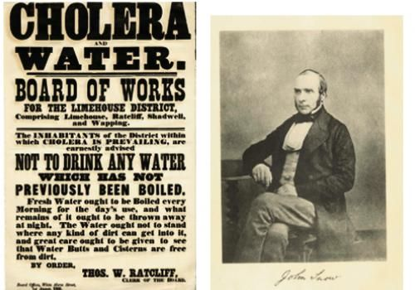
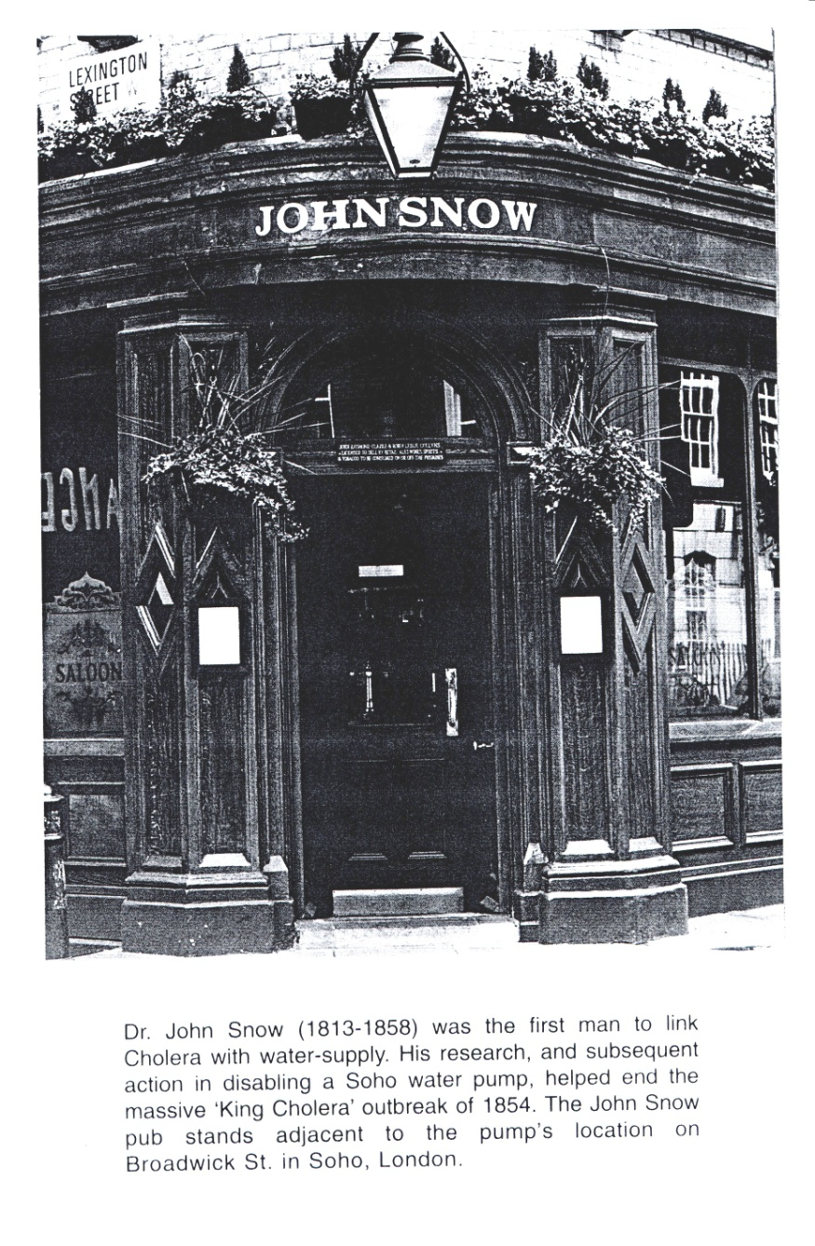

Slide 54
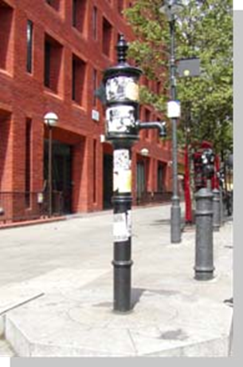


Slide 55
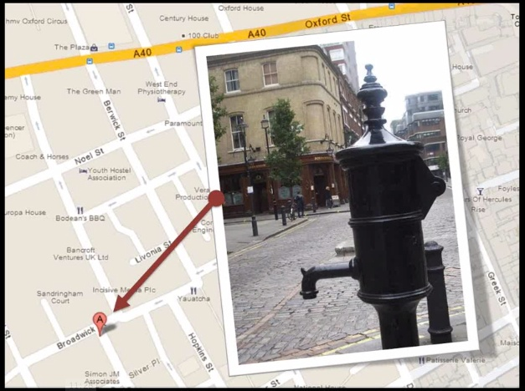

Slide 56
