Slide 1

Disease Causation and Natural History of disease
Dr. Sireen Alkhaldi, DrPH
Community Medicine 2023/ 2024
School of Medicine/ The University of Jordan

Slide 2
Natural History and Spectrum of Disease
Natural history of disease refers to the progression of a disease process in an individual over time, in the absence of treatment.
For example, untreated infection with HIV causes a spectrum of clinical problems beginning at the time of seroconversion (primary HIV) and terminating with AIDS and usually death. It is now recognized that it may take 10 years or more for AIDS to develop after seroconversion.

Slide 3
Natural History and Spectrum of Disease
Because the spectrum of disease can include asymptomatic and mild cases, the cases of illness diagnosed by clinicians in the community often represent only the tip of the iceberg.
Many additional cases may be too early to diagnose or may never progress to the clinical stage. Unfortunately, persons with inapparent or undiagnosed infections may nonetheless be able to transmit infection to others.

Slide 4
Natural History and Spectrum of Disease
Such persons who are infectious but have subclinical disease are called carriers. Frequently, carriers are persons with incubating disease or inapparent infection.
Persons with measles, hepatitis A, influenza and several other diseases become infectious a few days before the onset of symptoms.

Slide 5
Natural History and Spectrum of Disease
However carriers may also be persons who appear to have recovered from their clinical illness but remain infectious, such as chronic carriers of hepatitis B virus, or persons who never exhibited symptoms.
The challenge to public health workers is that these carriers, unaware that they are infected and infectious to others, are sometimes more likely to unintentionally spread infection than are people with obvious disease. These are the dangerous group in the population…..
During the current Covid-19 epidemic, you should perceive anybody as infectious …..literally, any body.

Slide 6
Inapparent Infection
Preclinical disease: in the early stage of disease progression, disease is not clinically detected but is destined to become clinical disease.
Subclinical disease: disease is not detected but the host carries the organism or has antibody response.
Chronic carriers are those who continue to harbor a pathogen such as hepatitis B virus or Salmonella Typhi, the causative agent of typhoid fever, for months or even years after their initial infection.

Slide 7
Unapparent Infection
One notorious carrier is Mary Mallon, or Typhoid Mary, who was an asymptomatic chronic carrier of Salmonella Typhi. As a cook in New York City and New Jersey in the early 1900s, she unintentionally infected dozens of people until she was placed in isolation on an island in the East River, where she died 23 years later.

Slide 8
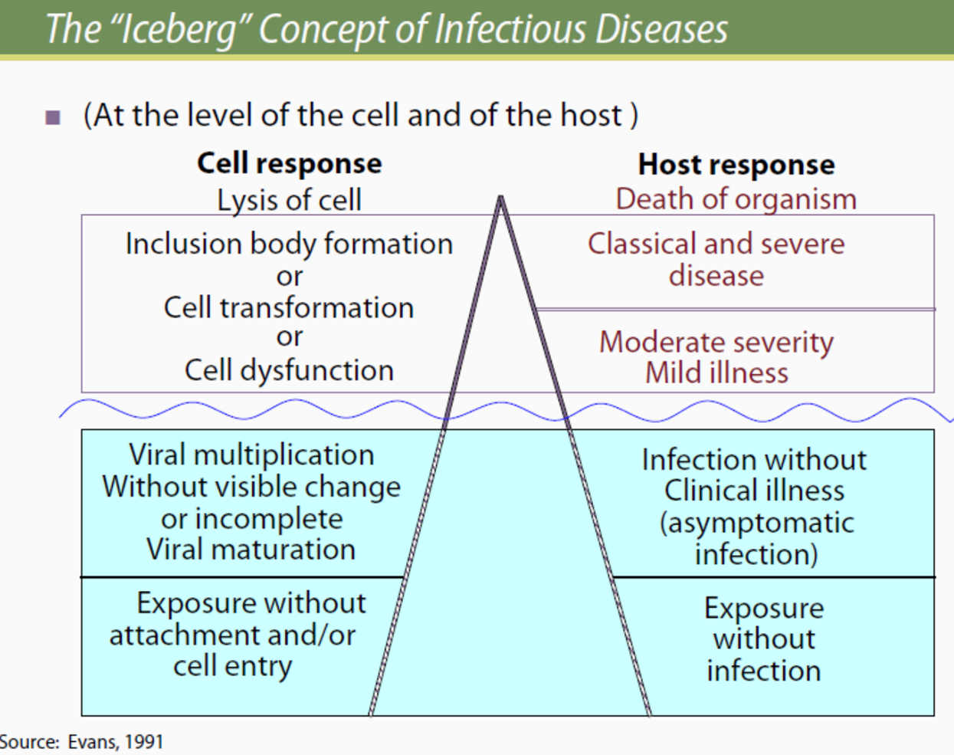
Natural History and Spectrum of Disease

Slide 9
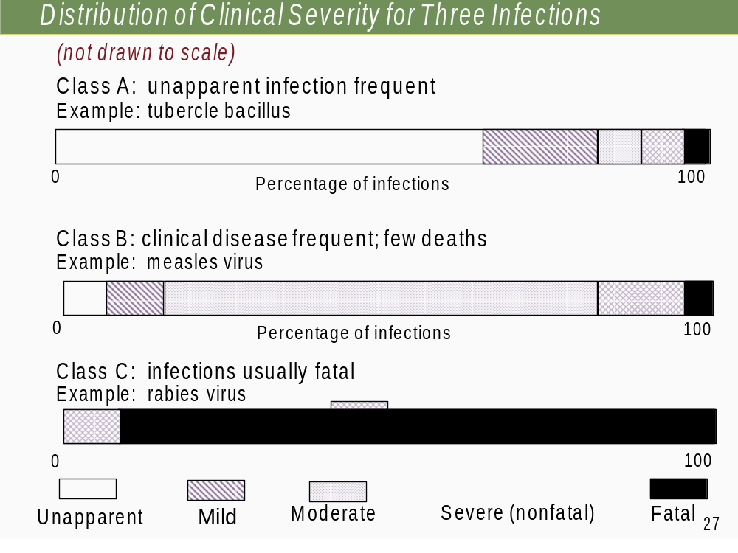

Slide 10
Chain of Infection
As described above, the traditional epidemiologic triad model holds that infectious diseases result from the interaction of agent, host, and environment.
More specifically, transmission occurs when the agent leaves its reservoir or host through a portal of exit, is conveyed by some mode of transmission, and enters through an appropriate portal of entry to infect a susceptible host. This sequence is sometimes called the chain of infection.

Slide 11
Reservoir
The reservoir of an infectious agent is the habitat in which the agent normally lives, grows, and multiplies. Reservoirs include humans, animals, and the environment.
The reservoir may or may not be the source from which an agent is transferred to a host.
For example, the reservoir of Clostridium botulinum is soil, but the source of most botulism infections is improperly canned food containing C. botulinum spores.

Slide 12
Human Reservoir
Many common infectious diseases have human reservoirs. Diseases that are transmitted from person to person without intermediaries include the sexually transmitted diseases, measles, mumps, streptococcal infection, and many respiratory pathogens.
Because humans were the only reservoir for the smallpox virus, naturally occurring smallpox was eradicated after the last human case was identified and isolated in Somalia in 1977.

Slide 13
Animal Reservoir
Humans are also subject to diseases that have animal reservoirs. Many of these diseases are transmitted from animal to animal, with humans as incidental hosts.
The term zoonosis refers to an infectious disease that is transmissible under natural conditions from vertebrate animals to humans. Long recognized zoonotic diseases include brucellosis (cows and pigs), anthrax (sheep), plague (rodents), trichinellosis/trichinosis (swine: pigs), and rabies (bats, raccoons, dogs, and other mammals).
Many newly recognized infectious diseases in humans, including HIV/AIDS, Ebola infection and SARS, are thought to have emerged from animal hosts, although those hosts have not yet been identified.

Slide 14
Environmental Reservoir
Plants, soil, and water in the environment are also reservoirs for some infectious agents.
Many fungal agents, such as those that cause histoplasmosis, live and multiply in the soil.
Outbreaks of Legionnaires disease are often traced to water supplies in cooling towers and evaporative condensers, which are the reservoirs for the causative organism Legionella pneumophila.

Slide 15
Portal of Exit
Portal of exit is the path by which a pathogen leaves its host. The portal of exit usually corresponds to the site where the pathogen is localized.
For example, influenza viruses and Mycobacterium tuberculosis exit the respiratory tract, schistosomes through urine, cholera vibrios in feces, Sarcoptes scabiei in scabies skin lesions.
Some bloodborne agents can exit by crossing the placenta from mother to fetus (rubella, syphilis, toxoplasmosis), while others exit through cuts or needles in the skin (hepatitis B) or blood-sucking insects (malaria).

Slide 16
Modes of Transmission
An infectious agent may be transmitted from its natural reservoir to a susceptible host in different ways:
Direct transmission OR Indirect transmission
Direct transmission (person-to-person):
Direct contact: skin-to-skin contact, kissing (saliva), sexual contact, and soil. Droplet spread: spray with relatively large, short-range droplets produced by sneezing, coughing, or even talking (hepatitis B, influenza).

Slide 17
Modes of Transmission
Indirect transmission:
Airborne: infectious agents are carried by dust or droplet nuclei suspended in air (<5micons)(measles in a doctor’s office).
Vehicleborne (inanimate objects ): food (Clostreniam Botulinum, E.coli), water (Hepatitis A virus, E.coli), biologic products (blood), and fomites (such as handkerchiefs, bedding, surgical scalpels, tooth brush, toys, cutting board).
Vectorborne (mechanical or biologic):mosquitoes, fleas, lice, and ticks may carry an infectious agent through purely mechanical means or may support growth or changes in the agent (malaria)

Slide 18
Transmission of Agents from Mother to Child
Vertical transmission (inter-generation) is the transmission of disease-causing agents from mother directly to baby
  Just before or just after birth
  Via placenta or breast milk
Horizontal transmission: all other transmissions are horizontal.
Diseases that can be transmitted from mother to baby include:
  HIV
  Hepatitis C

Slide 19
Portal of Entry
The portal of entry refers to the manner in which a pathogen enters a susceptible host.
The portal of entry must provide access to tissues in which the pathogen can multiply or a toxin can act.
Often, infectious agents use the same portal to enter a new host that they used to exit the source host.
For example, influenza virus exits the respiratory tract of the source host and enters the respiratory tract of the new susceptible host.

Slide 20
Portal of Entry
In contrast, many pathogens that cause gastroenteritis follow a so-called “fecal-oral” route because they exit the source host in feces, are carried on inadequately washed hands to a vehicle such as food, water, or utensil, and enter a new host through the mouth.
Other portals of entry include the skin (hookworm), mucous membranes (syphilis), and blood (hepatitis B, HIV).

Slide 21
Susceptible Host
Susceptibility of a host depends on genetic factors, specific immunity, and nonspecific factors (skin, mucous membranes, gastric acidity, cilia in the respiratory tract, the cough reflex) that affect an individual’s ability to resist infection or to limit pathogenicity.
For example, persons with sickle cell trait are partially protected from a particular type of malaria.
Specific immunity refers to protective antibodies that are directed against a specific agent. Such antibodies may develop in response to infection, vaccine, or toxoid.
Factors that may increase susceptibility to infection by disrupting host defenses include malnutrition, alcoholism, and disease or therapy (chemotherapy), that impairs immune response.

Slide 22
Implications for public health
Knowledge of the portals of exit and entry and modes of transmission provides a basis for determining appropriate control measures. In general, control measures are usually directed against the segment in the infection chain that is most susceptible to intervention:
Some interventions are directed at the mode of transmission (isolation of someone with infection, or counseling persons to avoid the specific type of contact associated with transmission) e.g. personal hygiene and social distancing to prevent Covid-19.

Slide 23
Implications for public health
Some strategies that protect portals of entry are simple and effective (bed nets for mosquitoes, mask, gloves, and face shield).
Some interventions aim to increase a host’s defenses (Vaccinations).
Some interventions attempt to prevent a pathogen from encountering a susceptible host (The concept of herd immunity in childhood vaccines).

Slide 24
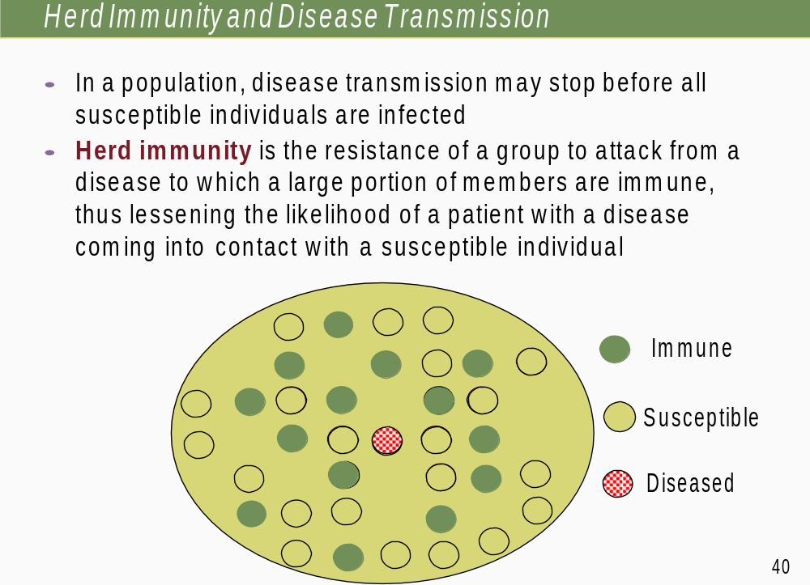

Slide 25
Herd Immunity and Disease Control
The success of herd immunity in controlling the disease depends on the proportion of subjects with immunity in a population (Immunity can be from immunization or infection)
So, when the population is immunized (e.g. ,vaccinated) at or above the herd immunity level (critical immunization threshold level), the infectious disease will be more rare, will spread less and will be eliminated.
Herd immunity level differs for various diseases
  For example, it is estimated that 94% of the population must be immune before measles can be controlled
  For mumps, it is around 90%, and for polio is 80%
  The more infectious the disease is, the higher the herd immunity level.

Slide 26
Requirements for Herd Immunity
The disease agent is restricted to a single-host species within which transmission occurs (For example, smallpox in human; no reservoir in the environment).
There is relatively direct transmission from one member of the host species to another (direct contact only).
Infections must induce solid immunity (natural or from immunization).

