Slide 1

Measures of Association in Epidemiology
Dr. Sireen Alkhaldi
Community Medicine 2023/ 2024
Faculty of Medicine, The University of Jordan

Slide 2
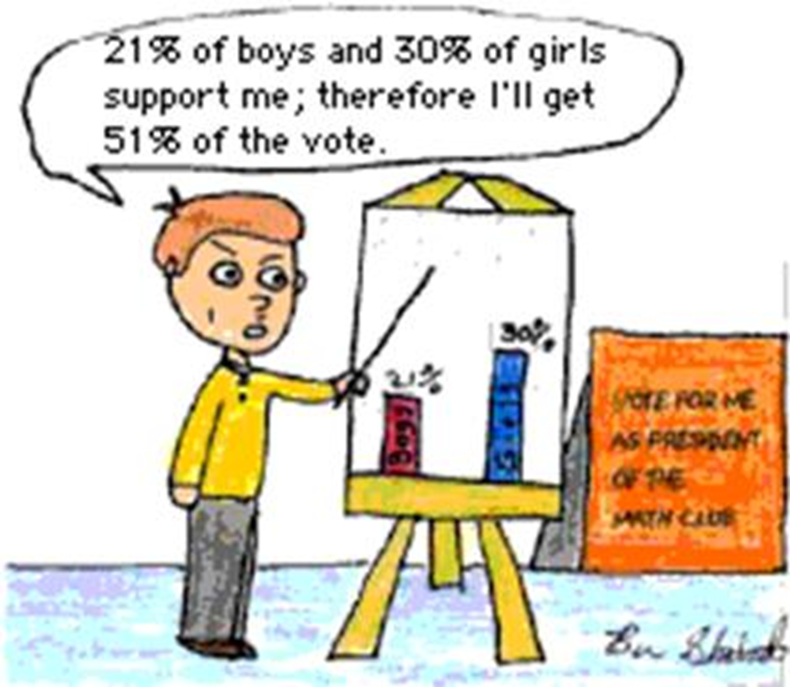

Slide 3
Measures of Association in Epidemiology
Chi square
Odds Ratio (OR)
Relative Risk or Risk Ratio (RR)
Attributable Risk (AR)

Slide 4
2X2 Table (contingency table)
 |  | Disease
 |  | Yes (+) | No (-) | Total
Exposure | Yes (+) | a | b | a+ b
 | No (-) | c | d | c+ d
 | Total | a+ c | b+ d | a+b+c+d

Slide 5
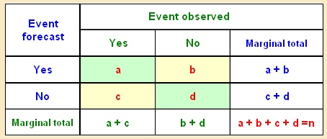
Cells
A= Exposed, and diseased
B= Exposed, Not diseased
C= Not exposed, diseased
D= Not exposed, Not diseased
A+B+C+D=Total

Slide 6
Totals
Marginal totals
a+b= Exposed
c+d= Non-exposed
a+c= Diseased
b+d= Non-diseased
Grand total
n = a+b+c+d

Slide 7
1. Chi-square in Cross-sectional studies
Chi-square tests whether there is an association between two categorical variables.
For a 2X2, table: Χ ² = n (ad - bc) – n /2)²
(a+b)(a+c)(c+d)(b+d)
If the calculated chi-square value is greater than the critical value or P<0.05, we say that there is a significant association between the risk factor and the disease (usually calculated using software like SPSS or excel).
Chi-square statistic tells only whether there is association. It doesn’t tell us how strong an association is.

Slide 8
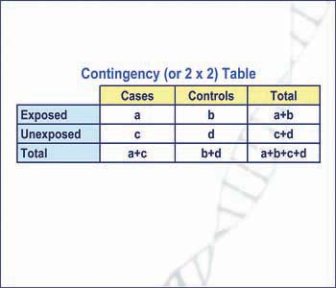
2. Relative risk (RR) or Risk Ratio (RR)
In a cohort study
RR: The estimation of disease risk associated with exposure (strength of association)
RR Expresses risk of developing a disease in exposed group (a + b) as compared to non-exposed group (c + d)
RR= Incidence (risk) among exposed
Incidence (risk) among non-exposed
RR= a/(a+b)
c/(c+d)

Slide 9
Analysis in Cohort studies
In a Cohort Study, we can calculate Incidence.
So, Relative Risk can be obtained from a cohort study.
Cigarette smoking
(Exposure)
Disease
(with Ca lung )
No Disease
(without Ca lung )
Total
Yes
7000 (a+b)
70 (a)
6930 (b)
No
3(c)
3000
(c+d)
2997(d)

Slide 10
RR in a Cohort Study
Incidence rates :
Risk among exposed (smokers) = 70/7000 = 10 / 1000.
Risk among non-exposed(non smokers) = 3/3000 = 1 / 1000.
RR = Risk (Incidence) among exposed
Risk (Incidence) among non exposed.
RR = 10/1=10
The exposed have 10 times the risk of developing the disease when compared to non-exposed

Slide 11
Interpretation of relative risk
What does a RR of 2 mean?
Risk in exposed=2X Risk in non-exposed
Thus a relative risk of 2 means the exposed group is two times at a higher risk of developing the disease when compared to non-exposed

Slide 12
Strength of association
In general strength of association can be considered as:
High association if RR>3
Moderate if RR is between 1.5 & 2.9
Weak association if RR is between 1.2 & 1.4
No association exists if RR is 1
Negative association (protective effect) if RR <1

Slide 13
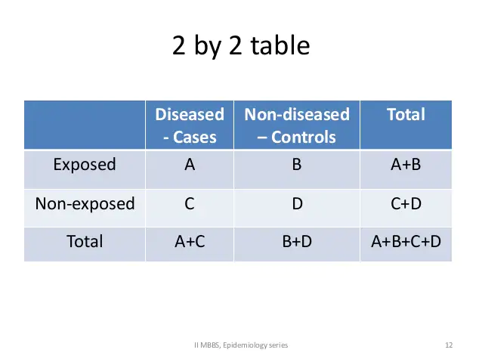
3. ODDS RATIO (OR)
Odds Ratio (OR) is a measure of the strength of the association between risk factor & outcome.
The odds ratio is the cross product of the entries in table.
OR can be calculated in case-control studies instead of RR

Slide 14
Odds ratio (OR)
Odds Ratio can be a good estimate of RR.
Odds ratio is the ratio of odds of exposure among diseased to odds of exposure among non-diseased
OR = Odds of exposure among diseased
Odds of exposure among non-diseased
= (a/c)/(b/d) = ad/bc
Interpretation of OR is the same as that of RR

Slide 15
Odds ratio…
RR can be best estimated by OR if the following conditions are fulfilled:
Controls are representative of general population
Selected cases are representative of all cases
The disease is rare

Slide 16
ANALYSIS in case-control studies
Estimation of the odds of exposure among the exposed ( odds ratio )

Slide 17
OR in a case-control study
Cases (with Ca lung )
Controls (without Ca lung )
Smokers
33 (a)
55 (b)
Non smokers
2 (c)
27 (d)
Total
35 (a+c)
82 (b+d)

Slide 18
OR in Case-control studies
Odds ratio is a key parameter in the analysis of
Case-control studies
Disease
Cases (Lung Ca)
Controls
(No Lung Ca)
Smokers
Not smokers
a (33)
c (2)
b (55)
d (27)
Odds Ratio = ad/bc = 33 x 27
55 x 2
= 8.1

Slide 19
Attributable Risk (AR)
AR indicates how much of the risk is due to (attributable to) the exposure.
Quantifies the excess risk in the exposed that can be attributable to the exposure, by removing the risk of the disease that occurred due to other causes.
AR= Risk (incidence) in exposed- Risk (incidence) in non-exposed
AR= [a/(a+b)] - [c/(c+d)]
Attributable risk is also called risk difference.

Slide 20
Attributable risk percent (AR%)
Estimates the proportion of disease among the exposed that is attributable to the exposure (example of smoking and lung C).
AR%= (Risk in exposed – Risk in non-exposed)X100%
Risk in exposed
AR%= 10 - 1 X 100% = 90% (as in the previous Cohort study example)
10
90% of the lung cancer among smokers was due to their smoking.
This suggests the amount of disease that might be eliminated if smoking could be controlled or eliminated.

Slide 21
Possible outcomes in studying the relationship between exposure & disease
No association
RR=1
AR=0
2. Positive association
RR>1
AR>0
3. Negative association
RR<1 (fraction)
AR<0 (Negative)

Slide 22
Risk Vs Preventive factors
A risk factor is any factor positively associated with a disease (RR>1). It is associated with an increased occurrence of a disease
A preventive factor is any factor negatively associated with a disease (RR<1). It is associated with a decreased occurrence of a disease.
Risk and preventive factors may (not) be amenable to change (e.g. Smoking, age)

