Slide 1

Unit Two
Descriptive Biostatistics
Dr. Hamza Aduraidi

Slide 2
Biostatistics
What is the biostatistics? A branch of applied math. that deals with collecting, organizing and interpreting data using well-defined procedures.
Types of Biostatistics:
  Descriptive Statistics. It involves organizing, summarizing & displaying data to make them more understandable.
  Inferential Statistics. It reports the degree of confidence of the sample statistic that predicts the value of the population parameter.

Slide 3
Descriptive Biostatistics
The best way to work with data is to summarize and organize them.
Numbers that have not been summarized and organized are called raw data.

Slide 4
Definition
6 April 2020
4
Data is any type of information
Raw data is a data collected as they receive.
Organize data is data organized either in ascending, descending or in a grouped data.

Slide 5
Descriptive Measures
  Measures of Location
    Measures of central tendency: Mean; Median; Mode
    Measures of non-central tendency - Quantiles
      Quartiles; Quintiles; Percentiles
  Measures of Dispersion
    Range
    Interquartile range
    Variance
    Standard Deviation
    Coefficient of Variation
  Measures of Shape
    Mean > Median-positive or right Skewness
    Mean = Median- symmetric or zero Skewness
    Mean < Median-Negative of left Skewness

Slide 6
Measures of Location
It is a property of the data that they tend to be clustered about a center point.
Measures of central tendency (i.e., central location) help find the approximate center of the dataset.
Researchers usually do not use the term average, because there are three alternative types of average.
These include the mean, the median, and the mode. In a perfect world, the mean, median & mode would be the same.
    mean (generally not part of the data set)
    median (may be part of the data set)
    mode (always part of the data set)

Slide 7
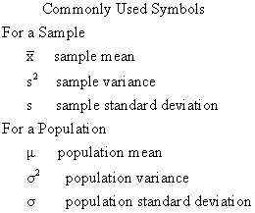

Slide 8
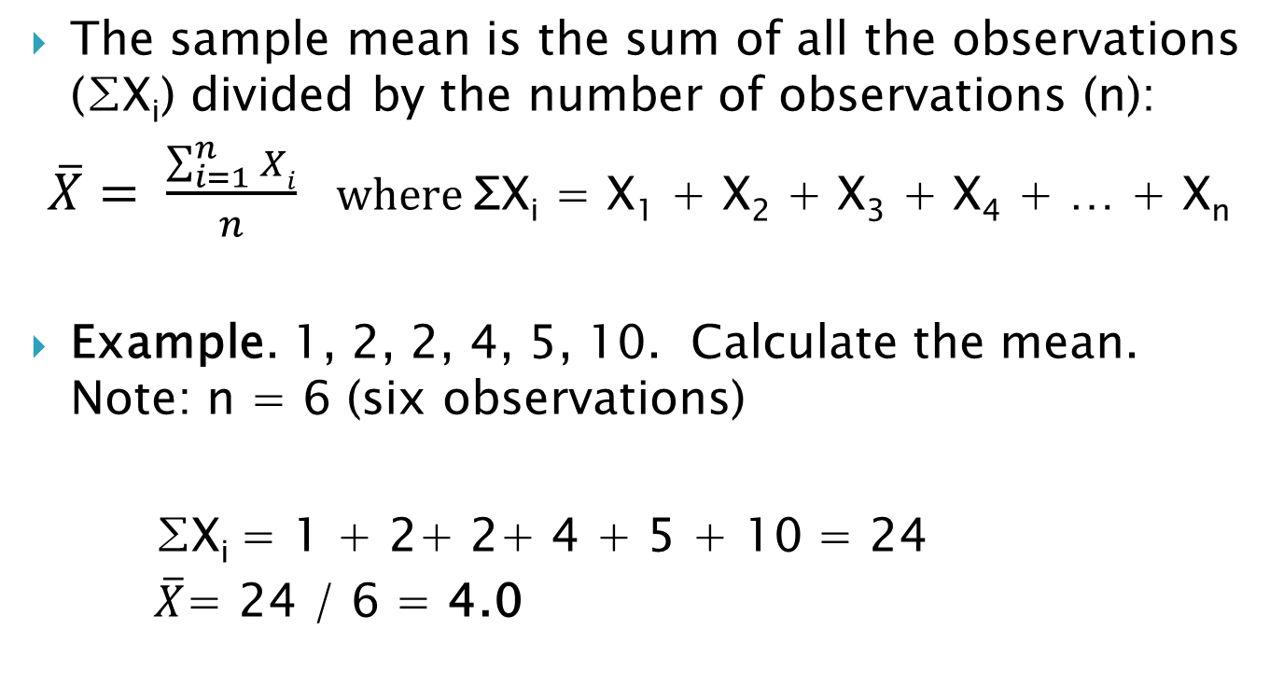
The Mean
8
Notes:
8

Slide 9
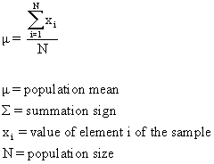
General Formula--Population Mean

Slide 10
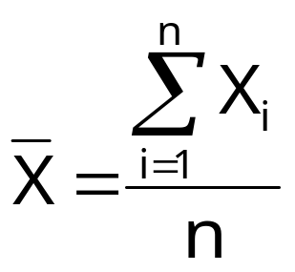
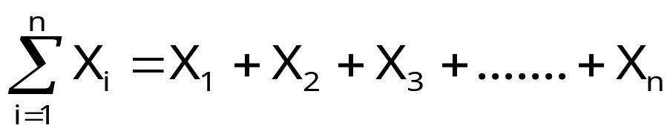
Notes on Sample Mean X
Formula
Summation Sign
  In the formula to find the mean, we use the “summation sign” — ∑
  This is just mathematical shorthand for “add up all of the observations”
6 April 2020
10

Slide 11
Notes on Sample Mean
Also called sample average or arithmetic mean
Mean for the sample = X or M, Mean for population = mew (μ)
Uniqueness: For a given set of data there is one and only one mean.
Simplicity: The mean is easy to calculate.
Sensitive to extreme values
6 April 2020
11

Slide 12
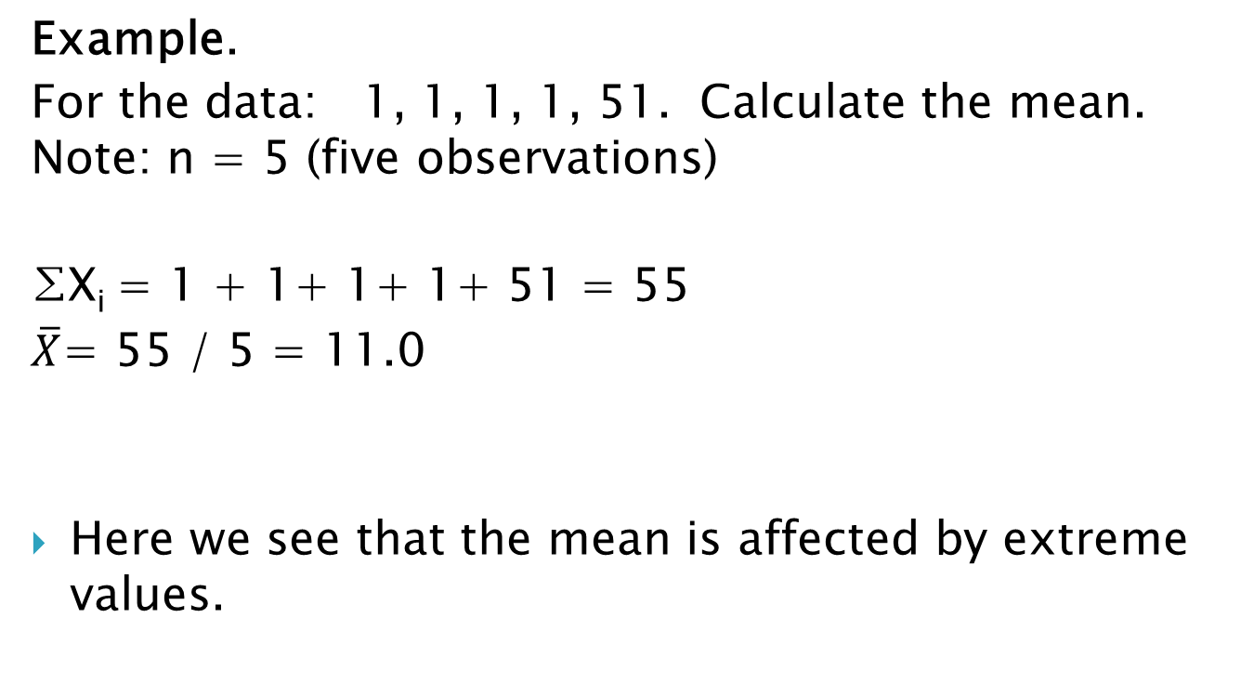
The Mean
12
Notes:
12

Slide 13
The Median
13
The median is the middle value of the ordered data
To get the median, we must first rearrange the data into an ordered array (in ascending or descending order). Generally, we order the data from the lowest value to the highest value.
Therefore, the median is the data value such that half of the observations are larger and half are smaller. It is also the 50th percentile.
If n is odd, the median is the middle observation of the ordered array. If n is even, it is midway between the two central observations.
Notes:
13

Slide 14
The Median
0 | 2 | 3 | 5 | 20 | 99 | 100
14
Example:
  Note: Data has been ordered from lowest to highest. Since n is odd (n=7), the median is the (n+1)/2 ordered observation, or the 4th observation.
Answer: The median is 5.
The mean and the median are unique for a given set of data. There will be exactly one mean and one median.
Unlike the mean, the median is not affected by extreme values.
  Q: What happens to the median if we change the 100 to 5,000? Not a thing, the median will still be 5. Five is still the middle value of the data set.
Notes:
14

Slide 15
The Median
10 | 20 | 30 | 40 | 50 | 60
Descriptive Statistics I
15
Example:
  Note: Data has been ordered from lowest to highest. Since n is even (n=6), the median is the (n+1)/2 ordered observation, or the 3.5th observation, i.e., the average of observation 3 and observation 4.
Answer: The median is 35.
Notes:
15

Slide 16
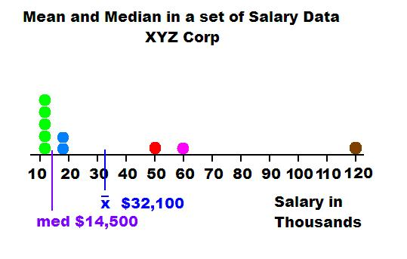

Slide 17
The Mode
17
The mode is the value of the data that occurs with the greatest frequency.
Unstable index: values of modes tend to fluctuate from one sample to another drawn from the same population
Example. 1, 1, 1, 2, 3, 4, 5
  Answer. The mode is 1 since it occurs three times. The other values each appear only once in the data set.
Example. 5, 5, 5, 6, 8, 10, 10, 10.
  Answer. The mode is: 5, 10.
  There are two modes. This is a bi-modal dataset.
Notes:
17

Slide 18
The Mode
18
The mode is different from the mean and the median in that those measures always exist and are always unique. For any numeric data set there will be one mean and one median.
The mode may not exist.
  Data: 1, 2, 3, 4, 5, 6, 7, 8, 9, 0
  Here you have 10 observations and they are all different.
The mode may not be unique.
  Data: 0, 1, 1, 2, 2, 3, 3, 4, 4, 5, 5, 6, 6, 7
  Mode = 1, 2, 3, 4, 5, and 6. There are six modes.
Notes:
18

Slide 19
Comparison of the Mode, the Median, and the Mean
In a normal distribution, the mode , the median, and the mean have the same value.
The mean is the widely reported index of central tendency for variables measured on an interval and ratio scale.
The mean takes each and every score into account.
It also the most stable index of central tendency and thus yields the most reliable estimate of the central tendency of the population.

Slide 20
Comparison of the Mode, the Median, and the Mean
The mean is always pulled in the direction of the long tail, that is, in the direction of the extreme scores.
For the variables that positively skewed (like income), the mean is higher than the mode or the median. For negatively skewed variables (like age at death) the mean is lower.
When there are extreme values in the distribution (even if it is approximately normal), researchers sometimes report means that have been adjusted for outliers.
To adjust means one must discard a fixed percentage (5%) of the extreme values from either end of the distribution.

Slide 21
Distribution Characteristics
6 April 2020
21
Mode: Peak(s)
Median: Equal areas point
Mean: Balancing point

Slide 22
Shapes of Distributions
Symmetric (Right and left sides are mirror images)
  Left tail looks like right tail
  Mean = Median = Mode
Mean
Mode
Median
6 April 2020
22

Slide 23
Shapes of Distributions
Mode
Mean
Median
6 April 2020
23
Right skewed (positively skewed)
  Long right tail
  Mean > Median

Slide 24
Shapes of Distributions
Mean
Median
Mode
6 April 2020
24
Left skewed (negatively skewed)
  Long left tail
  Mean < Median

Slide 25
Quantiles
Descriptive Statistics I
25
Measures of non-central location used to summarize a set of data
Examples of commonly used quantiles:
  Quartiles
  Quintiles
  Deciles
  Percentiles
Notes:
25

Slide 26
Quartiles
Descriptive Statistics I
26
Quartiles split a set of ordered data into four parts.
  Imagine cutting a chocolate bar into four equal pieces… How many cuts would you make? (yes, 3!)
Q₁ is the First Quartile
  25% of the observations are smaller than Q₁ and 75% of the observations are larger
Q₂ is the Second Quartile
  50% of the observations are smaller than Q₂ and 50% of the observations are larger. Same as the Median. It is also the 50th percentile.
Q₃ is the Third Quartile
  75% of the observations are smaller than Q₃and 25% of the observations are larger
Notes:
26

Slide 27
Other Quantiles
Descriptive Statistics I
27
Similar to what we just learned about quartiles, where 3 quartiles split the data into 4 equal parts,
  There are 9 deciles dividing the distribution into 10 equal portions (tenths).
  There are four quintiles dividing the population into 5 equal portions.
  … and 99 percentiles (next slide)
In all these cases, the convention is the same. The point, be it a quartile, decile, or percentile, takes the value of one of the observations or it has a value halfway between two adjacent observations. It is never necessary to split the difference between two observations more finely.
Notes:
27

Slide 28
Measures of Dispersion
28
It refers to how spread out the scores are.
In other words, how similar or different participants are from one another on the variable. It is either homogeneous or heterogeneous sample.
Why do we need to look at measures of dispersion?
Notes:
28

Slide 29
Measures of Dispersion
29
We will study these five measures of dispersion
  Range
  Interquartile Range
  Standard Deviation
  Variance
  Coefficient of Variation
  Relative Standing.
Notes:
29

Slide 30
The Range
Is the simplest measure of variability, is the difference between the highest score and the lowest score in the distribution.
In research, the range is often shown as the minimum and maximum value, without the abstracted difference score.
It provides a quick summary of a distribution’s variability.
It also provides useful information about a distribution when there are extreme values.
The range has two values, it is highly unstable.

Slide 31
The Range
31
Range = Largest Value – Smallest Value
  Example: 1, 2, 3, 4, 5, 8, 9, 21, 25, 30
  Answer: Range = 30 – 1 = 29.
Pros:
  Easy to calculate
Cons:
  Value of range is only determined by two values
  The interpretation of the range is difficult.
  One problem with the range is that it is influenced by extreme values at either end.
Notes:
31

Slide 32
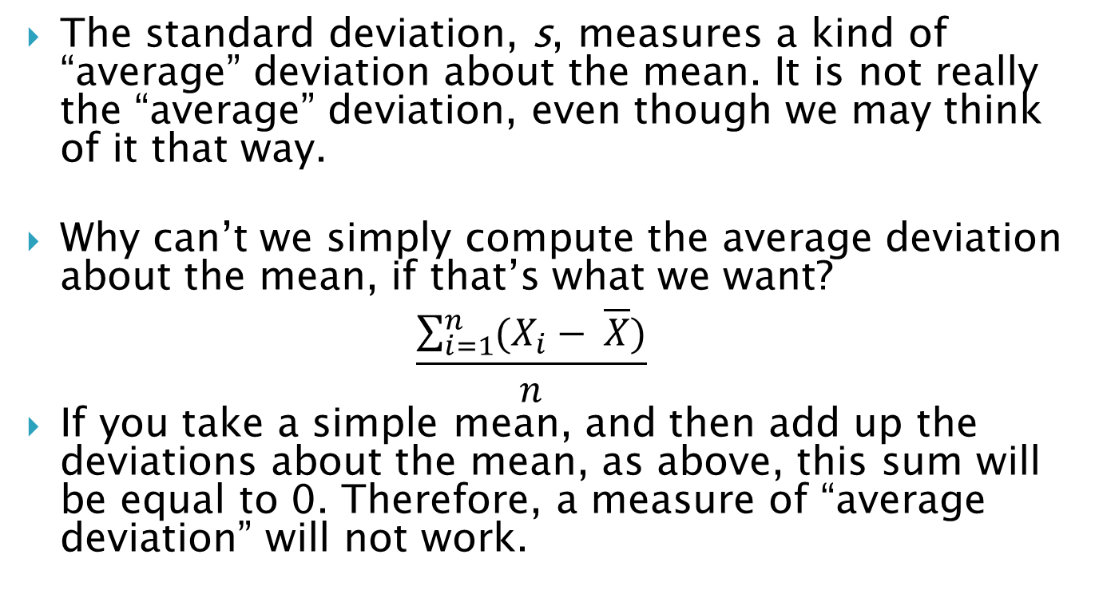
Standard Deviation
32
Notes:
32

Slide 33
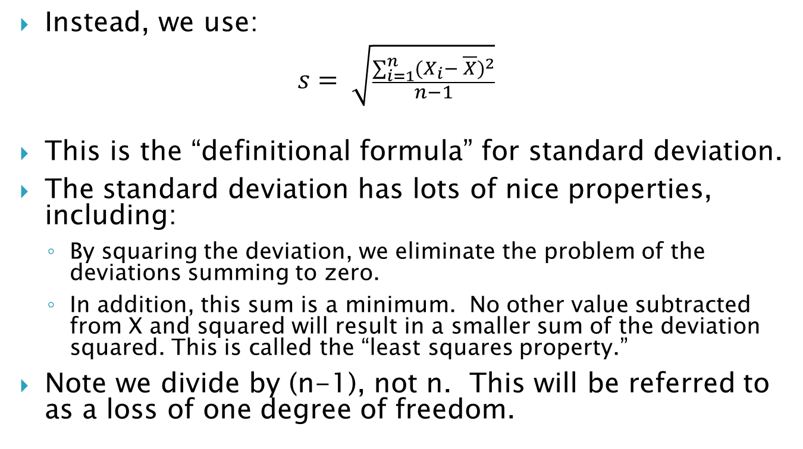
Standard Deviation
Descriptive Statistics I
33
Notes:
33

Slide 34
Standard Deviation
The smaller the standard deviation, the better is the mean as the summary of a typical score. E.g. 10 people weighted 150 pounds, the SD would be zero, and the mean of 150 would communicate perfectly accurate information about all the participants wt. Another example would be a heterogeneous sample 5 people 100 pounds and another five people 200 pounds. The mean still 150, but the SD would be 52.7.

Slide 35
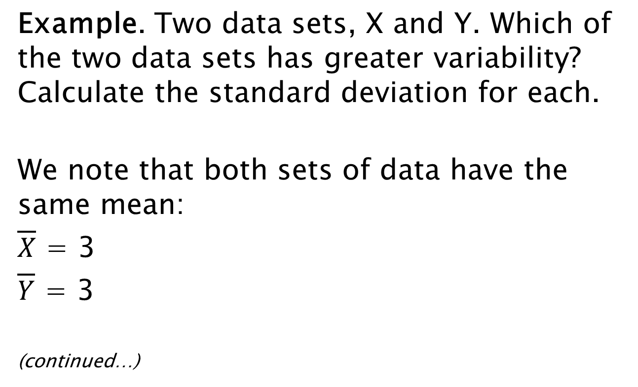
Standard Deviation
X_{i} | Y_{i}
1 | 0
2 | 0
3 | 0
4 | 5
5 | 10
35
Notes:
35

Slide 36
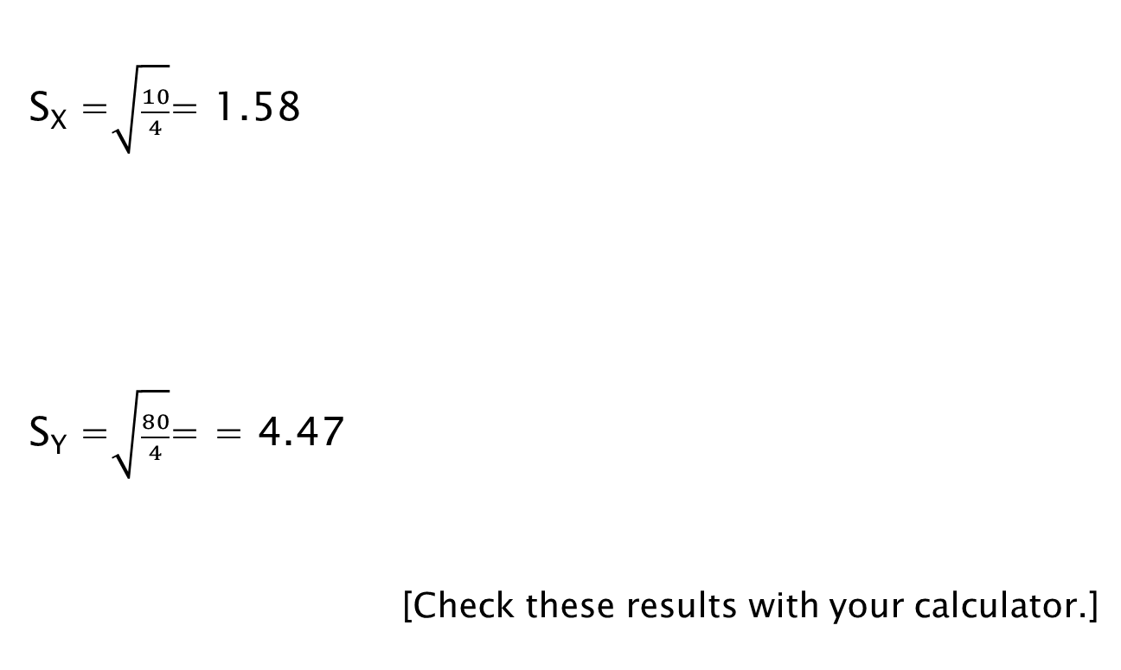
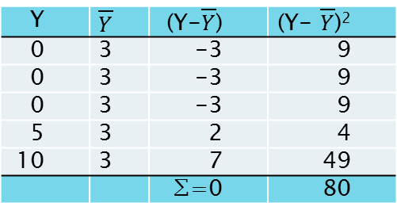
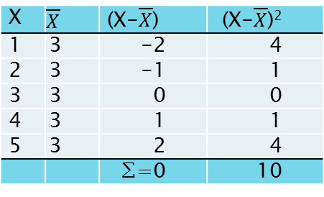
Standard Deviation
X
1 | 3 | -2 | 4
2 | 3 | -1 | 1
3 | 3 | 0 | 0
4 | 3 | 1 | 1
5 | 3 | 2 | 4
 |  | ∑=0 | 10
Y
0 | 3 | -3 | 9
0 | 3 | -3 | 9
0 | 3 | -3 | 9
5 | 3 | 2 | 4
10 | 3 | 7 | 49
 |  | ∑=0 | 80
36
Notes:
36

Slide 37
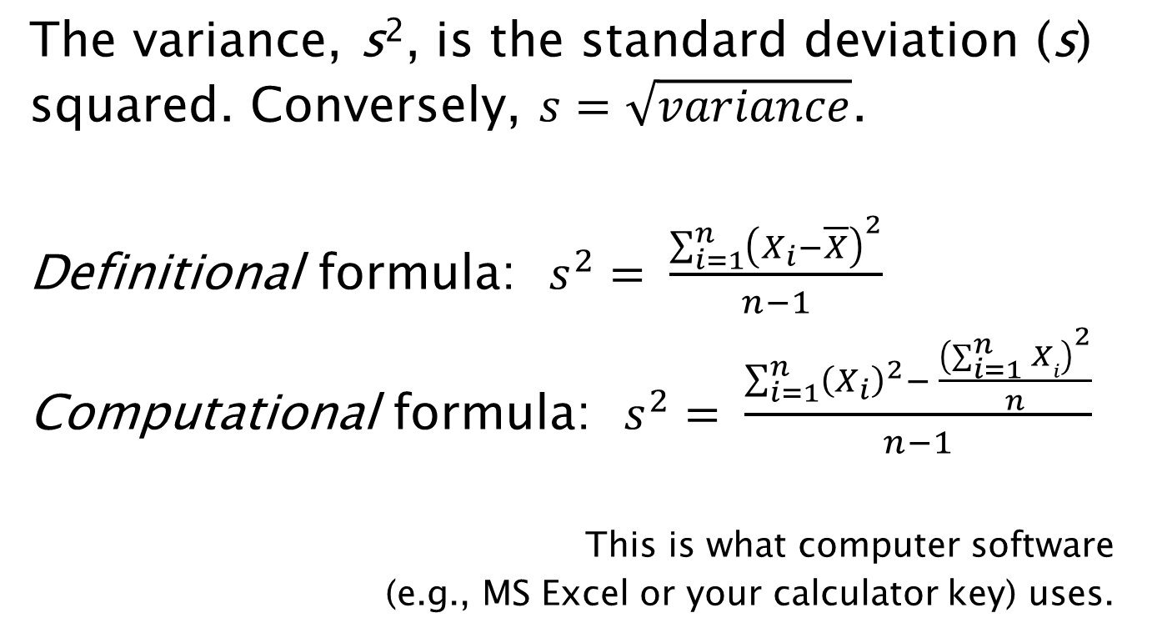
Variance
37
Notes:
37

Slide 38

Coefficient of Variation (CV)
38
The problem with s² and s is that they are both, like the mean, in the “original” units.
This makes it difficult to compare the variability of two data sets that are in different units or where the magnitude of the numbers is very different in the two sets. For example,
  Suppose you wish to compare two stocks and one is in dollars and the other is in yen; if you want to know which one is more volatile, you should use the coefficient of variation.
  It is also not appropriate to compare two stocks of vastly different prices even if both are in the same units.
  The standard deviation for a stock that sells for around $300 is going to be very different from one with a price of around $0.25.
The coefficient of variation will be a better measure of dispersion in these cases than the standard deviation (see example on the next slide).
Notes:
38

Slide 39
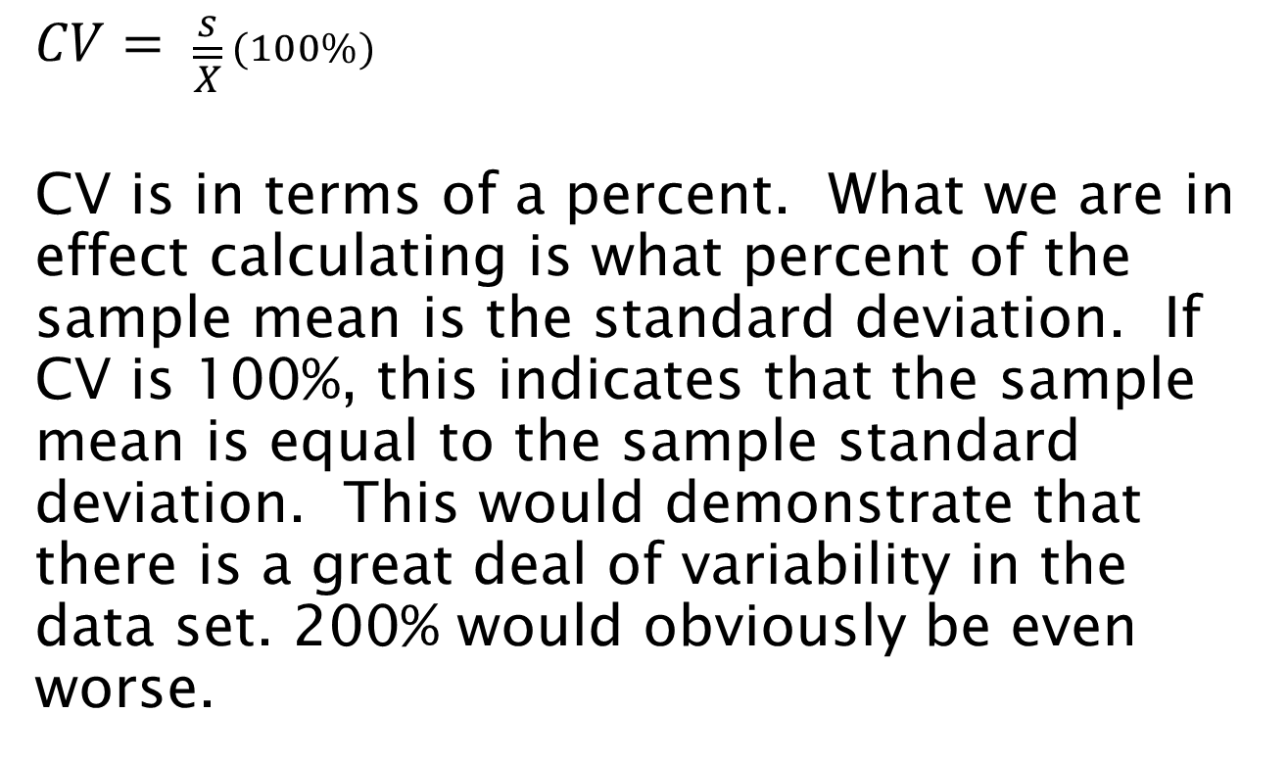
Coefficient of Variation (CV)
Descriptive Statistics I
39
Notes:
39

Slide 40
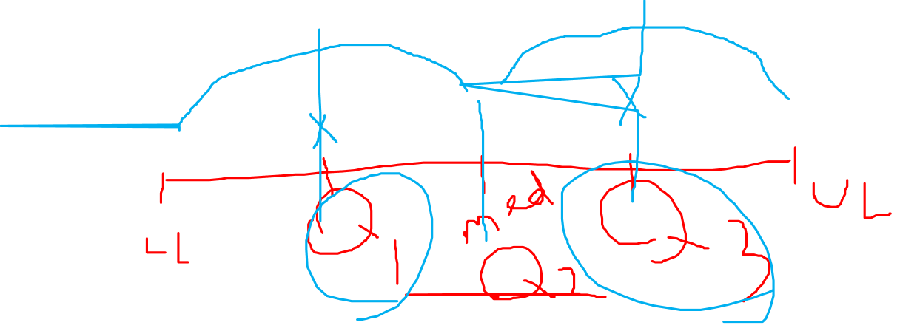
IQR
The Interquartile range (IQR) is the score at the 75th percentile or 3rd quartile (Q3) minus the score at the 25th percentile or first quartile (Q1). Are the most used to define outliers.
It is not sensitive to extreme values.

Slide 41
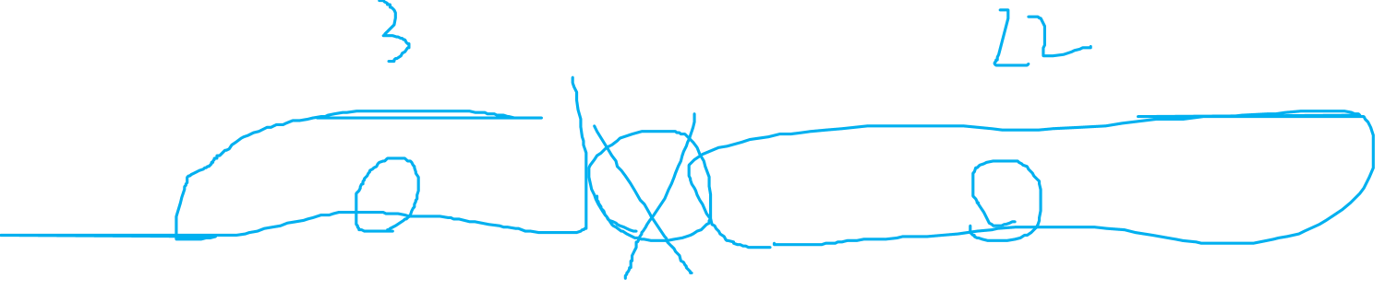
Inter-Quartile Range (IQR)
IQR = Q₃ – Q₁
Example (n = 15):
0, 0, 2, 3, 4, 7, 9, 12, 17, 18, 20, 22, 45, 56, 98
Q₁ = 3, Q₃ = 22
  IQR = 22 – 3 = 19 (Range = 98)
This is basically the range of the central 50% of the observations in the distribution.
Problem: The Interquartile range does not take into account the variability of the total data (only the central 50%). We are “throwing out” half of the data.
41
Notes:
41

Slide 42
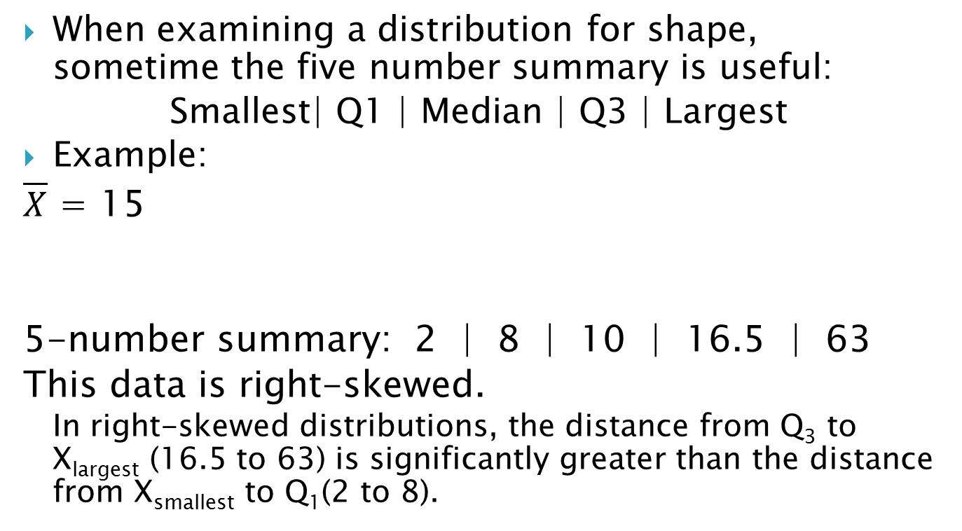
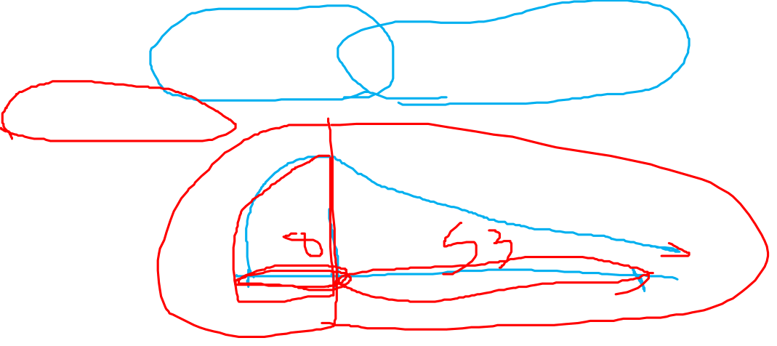
Five Number Summary
2 | 3 | 8 | 8 | 9 | 10 | 10 | 12 | 15 | 18 | 22 | 63
Q₁
Median
Smallest
Q₃
Largest
Descriptive Statistics II
42
Notes:
42

