Slide 1

Unit 3
Probability
Dr. Hamza Aduraidi

Slide 2
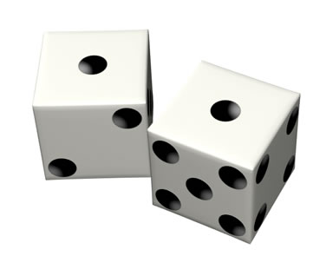
Probability
Probability theory developed from the study of games of chance like dice and cards. A process like flipping a coin, rolling a die or drawing a card from a deck is called a probability experiment. An outcome is a specific result of a single trial of a probability experiment.

Slide 3
Probability distributions
Probability theory is the foundation for statistical inference. A probability distribution is a device for indicating the values that a random variable may have.
There are two categories of random variables. These are:
  discrete random variables, and
  continuous random variables.

Slide 4
Discrete Probability Distributions
Binomial distribution – the random variable can only assume 1 of 2 possible outcomes. There are a fixed number of trials and the results of the trials are independent.
    i.e. flipping a coin and counting the number of heads in 10 trials.
Poisson Distribution – random variable can assume a value between 0 and infinity.
    Counts usually follow a Poisson distribution (i.e. number of ambulances needed in a city in a given night)
12 April 2020
4

Slide 5
Discrete Random Variable
A discrete random variable X has a finite number of possible values. The probability distribution of X lists the values and their probabilities.
Every probability p_{i} is a number between 0 and 1.
The sum of the probabilities must be 1.
Find the probabilities of any event by adding the probabilities of the particular values that make up the event.
Value of X | x₁ | x₂ | x₃ | … | x_{k}
Probability | p₁ | p₂ | p₃ | … | p_{k}
12 April 2020
5

Slide 6
Example
The instructor in a large class gives 15% each of A’s and D’s, 30% each of B’s and C’s and 10% F’s. The student’s grade on a 4-point scale is a random variable X (A=4).
What is the probability that a student selected at random will have a B or better?
ANSWER: P (grade of 3 or 4)=P(X=3) + P(X=4)
= 0.3 + 0.15 = 0.45
Grade | F=0 | D=1 | C=2 | B=3 | A=4
Probability | 0.10 | .15 | .30 | .30 | .15
12 April 2020
6

Slide 7
Continuous Variable
A continuous probability distribution is a probability density function.
The area under the smooth curve is equal to 1 and the frequency of occurrence of values between any two points equals the total area under the curve between the two points and the x-axis.

Slide 8
Normal Distribution
Also called bell shaped curve, normal curve, or Gaussian distribution.
A normal distribution is one that is unimodal, symmetric, and not too peaked or flat.
Given its name by the French mathematician Quetelet who, in the early 19th century noted that many human attributes, e.g. height, weight, intelligence appeared to be distributed normally.

Slide 9
Normal Distribution
12 April 2020
9
The normal curve is unimodal and symmetric about its mean (μ).
In this distribution the mean, median and mode are all identical.
The standard deviation (σ) specifies the amount of dispersion around the mean.
The two parameters μ and σ completely define a normal curve.

Slide 10
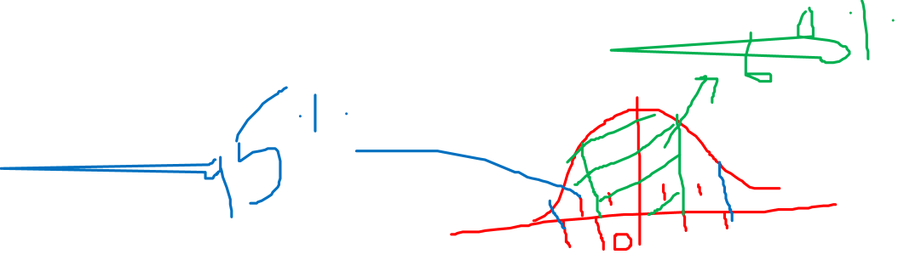
Normal Distribution
10
Also called a Probability density function. The probability is interpreted as "area under the curve."
The random variable takes on an infinite # of values within a given interval
The probability that X = any particular value is 0. Consequently, we talk about intervals. The probability is = to the area under the curve.
The area under the whole curve = 1.
Notes:
10

Slide 11
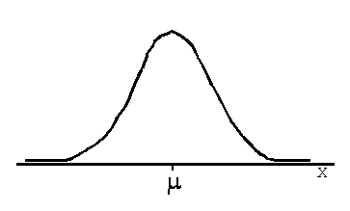
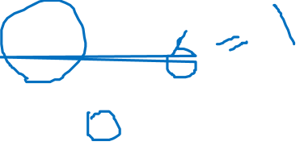

Slide 12
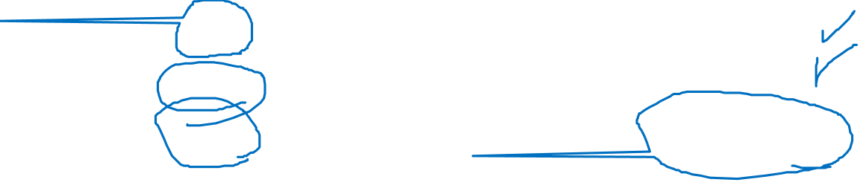
Properties of a Normal Distribution
1. It is symmetrical about μ .
2. The mean, median and mode are all equal.
3. The total area under the curve above the x-axis is 1 square unit. Therefore 50% is to the right of μ and 50% is to the left of μ.
4. Perpendiculars of:
±1 σ contain about 68%;
±2 σ contain about 95%;
±3 σ contain about 99.7%
of the area under the curve.

Slide 13
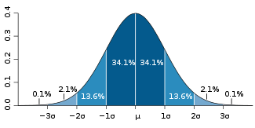
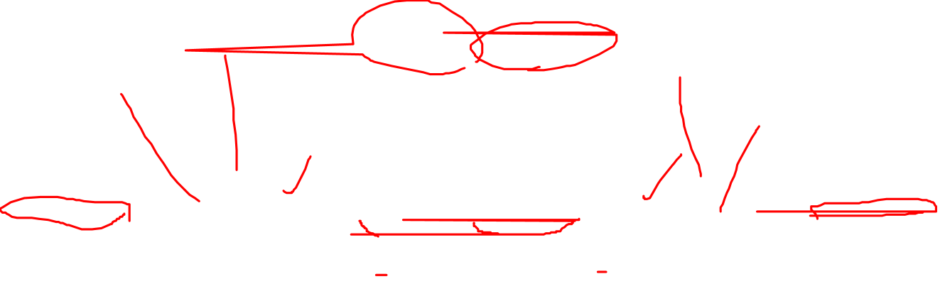
The normal distribution

Slide 14
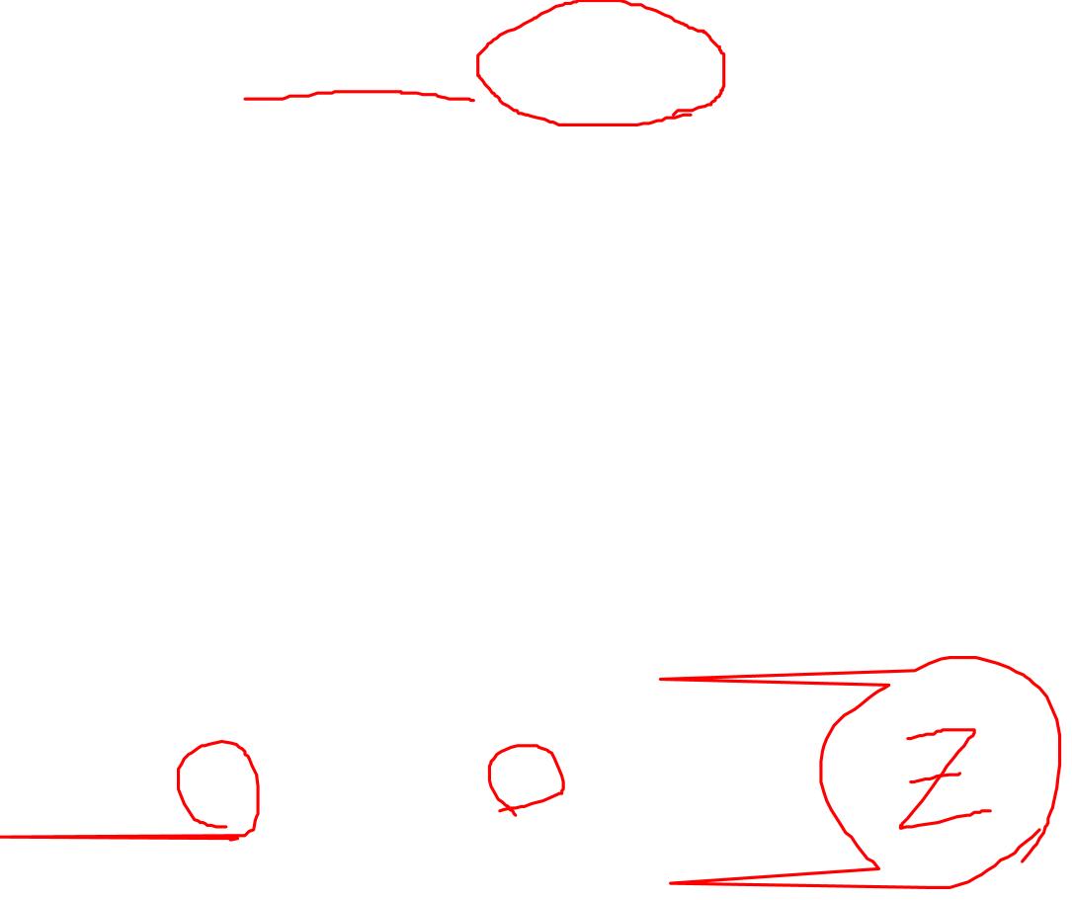
The Standard Normal Distribution
A normal distribution is determined by μ and σ. This creates a family of distributions depending on whatever the values of μ and σ are.
The standard normal distribution has
μ=0 and σ =1.

Slide 15

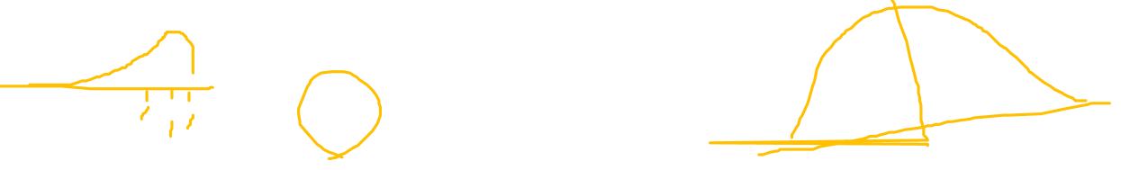
Standard Z Score
The standard z score is obtained by creating a variable z whose value is
Given the values of μ and σ we can convert a value of x to a value of z and find its probability using the table of normal curve areas.

Slide 16
Z Score
Is a standard score that indicates how many SDs from the mean a particular values lies.
Z = Score of value – mean of scores divided by standard deviation.

Slide 17
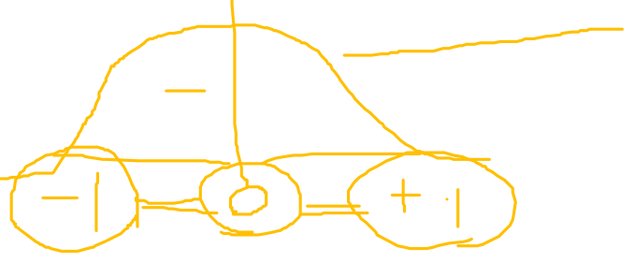
Standard Normal Scores
Observation – mean
Standard deviation
12 April 2020
17
How many standard deviations away from the mean are you?
Standard Score (Z) =
“Z” is normal with mean 0 and standard deviation of 1.

Slide 18

Standard Normal Scores
A standard score of:
Z = 1: The observation lies one SD above the mean
Z = 2: The observation is two SD above the mean
Z = -1: The observation lies 1 SD below the mean
Z = -2: The observation lies 2 SD below the mean
12 April 2020
18

Slide 19
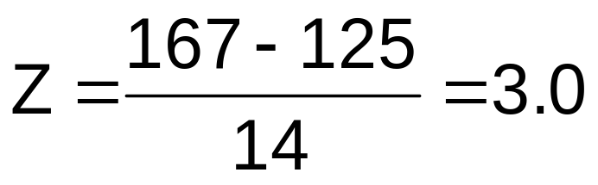
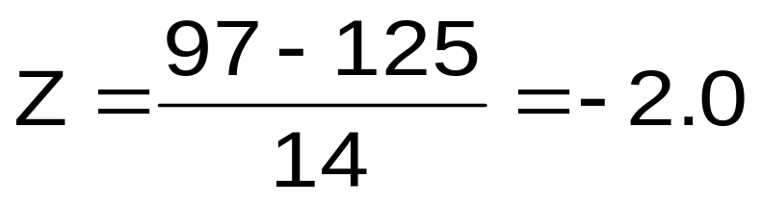
Standard Normal Scores
Example: Male Blood Pressure,
mean = 125, s = 14 mmHg
  BP = 167 mmHg
  BP = 97 mmHg
12 April 2020
19

Slide 20
What is the Usefulness of a Standard Normal Score?
12 April 2020
20
It tells you how many SDs (s) an observation is from the mean
Thus, it is a way of quickly assessing how “unusual” an observation is
Example: Suppose the mean BP is 125 mmHg, and standard deviation = 14 mmHg
  Is 167 mmHg an unusually high measure?
  If we know Z = 3.0, does that help us?

Slide 21
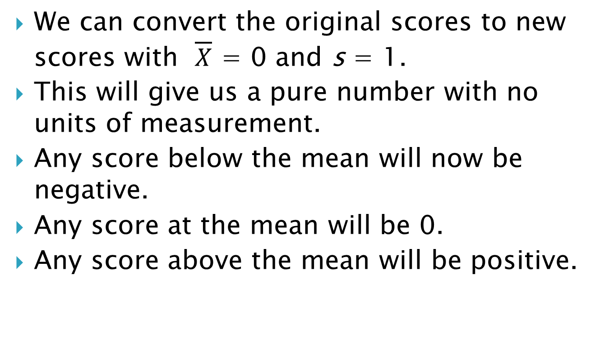
Standardizing Data: Z-Scores
Descriptive Statistics II
21
Notes:
21

Slide 22
Standardizing Data: Z-Scores
No matter what you are measuring, a Z-score of more than +5 or less than – 5 would indicate a very, very unusual score.
For standardized data, if it is normally distributed, 95% of the data will be between ±2 standard deviations about the mean.
If the data follows a normal distribution,
  95% of the data will be between -1.96 and +1.96.
  99.7% of the data will fall between -3 and +3.
  99.99% of the data will fall between -4 and +4.
22
Notes:
22

Slide 23
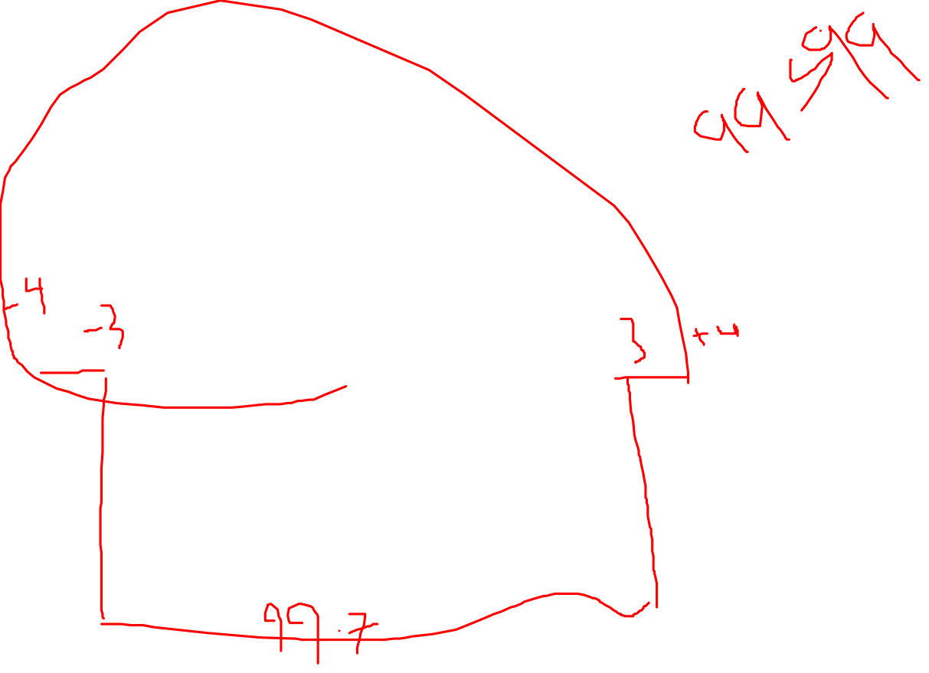
Relationship between SD and frequency distribution
SD -2.5 -2 -1 +1 +2 +2.5
mean
68%
95%
99%

Slide 24
Importance of Normal Distribution to Statistics
Although most distributions are not exactly normal, most variables tend to have approximately normal distribution.
Many inferential statistics assume that the populations are distributed normally.
The normal curve is a probability distribution and is used to answer questions about the likelihood of getting various particular outcomes when sampling from a population.

Slide 25

Why Do We Like The Normal Distribution So Much?
12 April 2020
25
There is nothing “special” about standard normal scores
  These can be computed for observations from any sample/population of continuous data values
  The score measures how far an observation is from its mean in standard units of statistical distance
But, if distribution is not normal, we may not be able to use Z-score approach.

Slide 26
Normal Distribution
12 April 2020
26
Is every variable normally distributed?
Absolutely not
Then why do we spend so much time studying the normal distribution?
Some variables are normally distributed; a bigger reason is the “Central Limit Theorem”!!!!!!!!!!!!!!!!!!!!!!!!!!!???????????

Slide 27
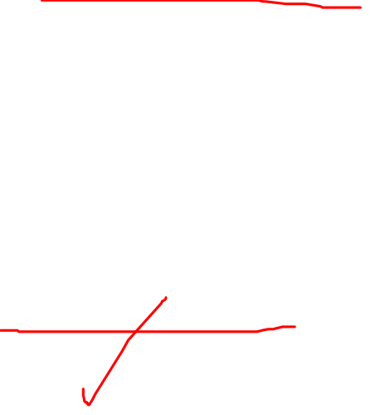
Central Limit Theorem
describes the characteristics of the "population of the means" which has been created from the means of an infinite number of random population samples of size (N), all of them drawn from a given "parent population".
It predicts that regardless of the distribution of the parent population:
  The mean of the population of means is always equal to the mean of the parent population from which the population samples were drawn.
  The standard deviation of the population of means is always equal to the standard deviation of the parent population divided by the square root of the sample size (N).
  The distribution of means will increasingly approximate a normal distribution as the size N of samples increases.

Slide 28
Central Limit Theorem
A consequence of Central Limit Theorem is that if we average measurements of a particular quantity, the distribution of our average tends toward a normal one.
In addition, if a measured variable is actually a combination of several other uncorrelated variables, all of them "contaminated" with a random error of any distribution, our measurements tend to be contaminated with a random error that is normally distributed as the number of these variables increases.
Thus, the Central Limit Theorem explains the ubiquity of the famous bell-shaped "Normal distribution" (or "Gaussian distribution") in the measurements domain.

Slide 29
Normal Distribution
29
Note that the normal distribution is defined by two parameters, μ and σ . You can draw a normal distribution for any μ and σ combination. There is one normal distribution, Z, that is special. It has a μ = 0 and a σ = 1. This is the Z distribution, also called the standard normal distribution. It is one of trillions of normal distributions we could have selected.
Notes:
29

Slide 30
Standard Normal Variable
12 April 2020
30
It is customary to call a standard normal random variable Z.
The outcomes of the random variable Z are denoted by z.
The table in the coming slide give the area under the curve (probabilities) between the mean and z.
The probabilities in the table refer to the likelihood that a randomly selected value Z is equal to or less than a given value of z and greater than 0 (the mean of the standard normal).

Slide 31
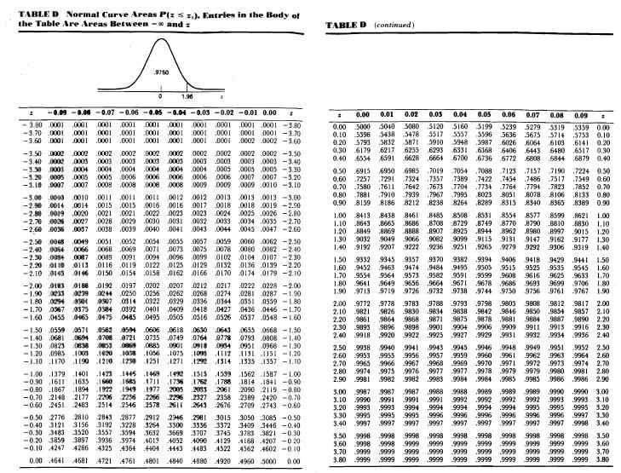
Table of Normal Curve Areas

Slide 32
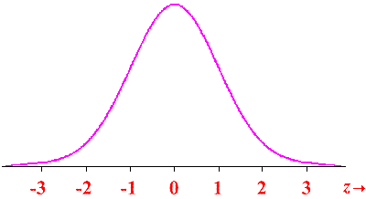
Standard Normal Curve
12 April 2020
32

Slide 33
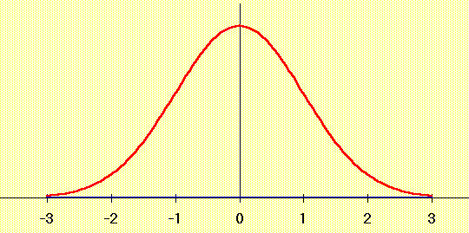
Standard Normal Distribution
50% of probability in here –probability=0.5
50% of probability in here–probability=0.5
12 April 2020
33

Slide 34
Standard Normal Distribution
95% of probability in here
2.5% of probability in here
2.5% of probability in here
Standard Normal Distribution with 95% area marked
12 April 2020
34

Slide 35
Calculating Probabilities
12 April 2020
35
Probability calculations are always concerned with finding the probability that the variable assumes any value in an interval between two specific points a and b.
The probability that a continuous variable assumes the a value between a and b is the area under the graph of the density between a and b.

Slide 36
Finding Probabilities
(a) What is the probability that z < -1.96?
(1) Sketch a normal curve
(2) Draw a line for z = -1.96
(3) Find the area in the table
(4) The answer is the area to the left of the line P(z < -1.96) = .0250

Slide 37
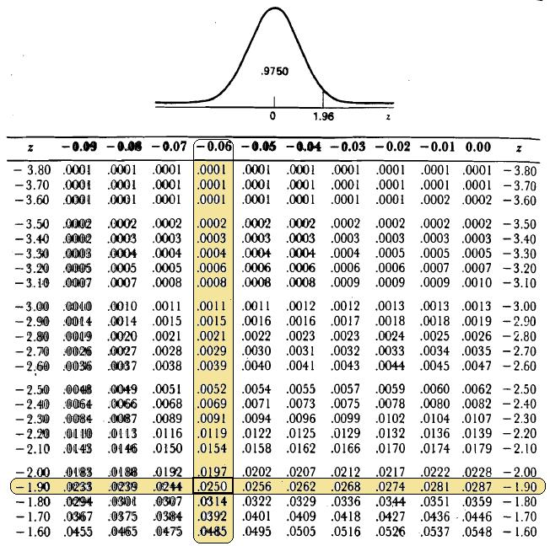

Slide 38
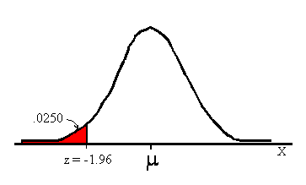
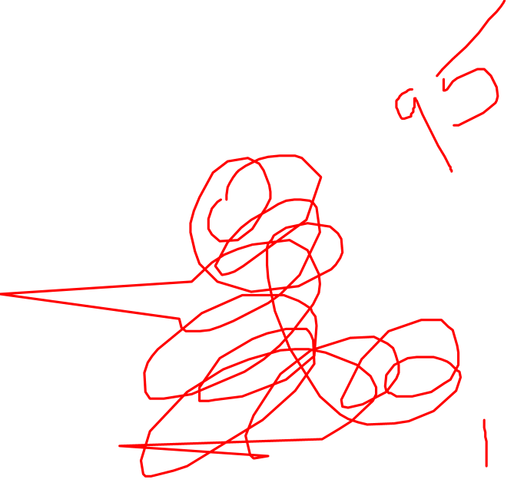
Finding Probabilities

