Slide 1

Unit One
Part 2

Slide 2
Variables
A variable is an object, characteristic, or property that can have different values.
A quantitative variable can be measured in some way.
A qualitative variable is characterized by its inability to be measured but it can be sorted into categories.

Slide 3
Types of Variables
Independent variable—the presumed cause (of a dependent variable)
Dependent variable—the presumed effect (of an independent variable)
Example: Smoking (IV) → Lung cancer (DV)

Slide 4
Levels of Measurement
  Nominal
  Ordinal
  Interval
  Ratio

Slide 5
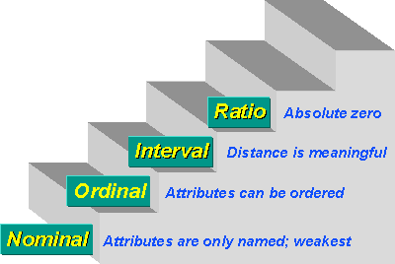
Levels of Measurement

Slide 6
Nominal Level of Measurement
Categories that are distinct from each other such as gender, religion, marital status.
They are symbols that have no quantitative value.
Lowest level of measurement.
Many characteristics can be measured on a nominal scale: race, marital status, and blood type.
Dichotomous.
Appropriate statistics: mode, frequency
We cannot use an average. It would be meaningless here.

Slide 7
Ordinal Level of Measurement
The exact differences between the ranks cannot be specified such as it indicates order rather than exact quantity.
Involves using numbers to designate ordering on an attribute.
Example: anxiety level: mild, moderate, severe. Statistics used involve frequency distributions and percentages.
Appropriate statistics: same as those for nominal data, plus the median; but not the mean.

Slide 8
Interval level of Measurement
They are real numbers and the difference between the ranks can be specified.
Equal intervals, but no “true” zero.
Involves assigning numbers that indicate both the ordering on an attribute, and the distance between score values on the attribute
They are actual numbers on a scale of measurement.
Example: body temperature on the Celsius thermometer as in 36.2, 37.2 etc. means there is a difference of 1.0 degree in body temperature.
Appropriate statistics
    same as for nominal
    same as for ordinal plus,
    the mean

Slide 9
Ratio level of Measurement
Is the highest level of data where data can categorized, ranked, difference between ranks can be specified and a true or natural zero point can be identified.
A zero point means that there is a total absence of the quantity being measured.
All scales, whether they measure weight in kilograms or pounds, start at 0. The 0 means something and is not arbitrary (SUBJECTIVE).
Example: total amount of money.

Slide 10
What Type of Dats To collect?
The goal of the researcher is to use the highest level of measurement possible.
  Example: Two ways of asking about Smoking behavior. Which is better, A or B?
    Do you smoke? Yes No
    How many cigarettes did you smoke in the last 3 days (72 hours)?
  (A) Is nominal, so the best we can get from this data are frequencies. (B) is ratio, so we can compute: mean, median, mode, frequencies.

Slide 11
Parameter and Statistic
Parameter is a descriptive measure computed from the data of the population.
  The population mean, μ, and the population standard deviation, σ, are two examples of population parameters.
  If you want to determine the population parameters, you have to take a census of the entire population.
  Taking a census is very costly.
  Parameters are numerical descriptive measures corresponding to populations.
  Since the population is not actually observed, the parameters are considered unknown constants.
Statistic is a descriptive measure computed from the data of the sample.
  For example, the sample mean, x̄ , and the standard deviation, s, are statistics.
  They are used to estimate the population parameters.

Slide 12
Statistics
It is a branch of applied mathematics that deals with collecting, organizing, & interpreting data using well-defined procedures in order to make decisions.
The term parameter is used when describing the characteristics of the population. The term statistics is used to describe the characteristics of the sample.
Types of Statistics:
  Descriptive Statistics. It involves organizing, summarizing & displaying data to make them more understandable.
  Inferential Statistics. It reports the degree of confidence of the sample statistic that predicts the value of the population parameter

Slide 13
Descriptive Statistics
Measures of Location
  Measures of Central Tendency:
    Mean
    Median
    Mode
  Measures of noncentral Tendency-Quantiles:
    Quartiles.
    Quintiles.
    Percentiles.
Measure of Dispersion (Variability):
  Range
  Interquartile range
  Variance
  Standard Deviation
  Coefficient of variation
Measures of Shape:
  Mean > Median-positive or right Skewness
  Mean = Median- symmetric or zero Skewness
  Mean < Median-Negative of left Skewness

Slide 14
Statistical Inference
Is the procedure used to reach a conclusion about a population based on the information derived from a sample that has been drawn from that population.

Slide 15
Inferential Statistics
Inferential statistics are used to test hypotheses (prediction) about relationship between variables in the population. A relationship is a bond or association between variables.
It consists of a set of statistical techniques that provide prediction about population characteristics based on information in a sample from population. An important aspect of statistical inference involves reporting the likely accuracy, or of confidence of the sample statistic that predicts the value of the population parameter.

Slide 16
Inferential Statistics
  Bivariate Parametric Tests:
    One Sample t test (t)
    Two Sample t test (t)
    Analysis of Variance/ANOVA (F).
    Pearson’s Product Moment Correlations (r).
  Nonparametric statistical tests: Nominal Data:
    Chi-Square Goodness-of-Fit Test
    Chi-Square Test of Independence
  Nonparametric statistical tests: Ordinal Data:
    Mann Whitney U Test (U
    Kruskal Wallis Test (H)

Slide 17
Research Hypothesis
A tentative prediction or explanation of the relationship between two or more variables
It’s a translation of research question into a precise prediction of the expected outcomes
In some way it’s a proposal for solution/s
In qualitative research, there is NO hypothesis

Slide 18

Research Hypothesis
States a prediction
Must always involve at least two variables
Must suggest a predicted relationship between the independent variable and the dependent variable
Must contain terms that indicate a relationship (e.g., more than, different from, associated with)

Slide 19
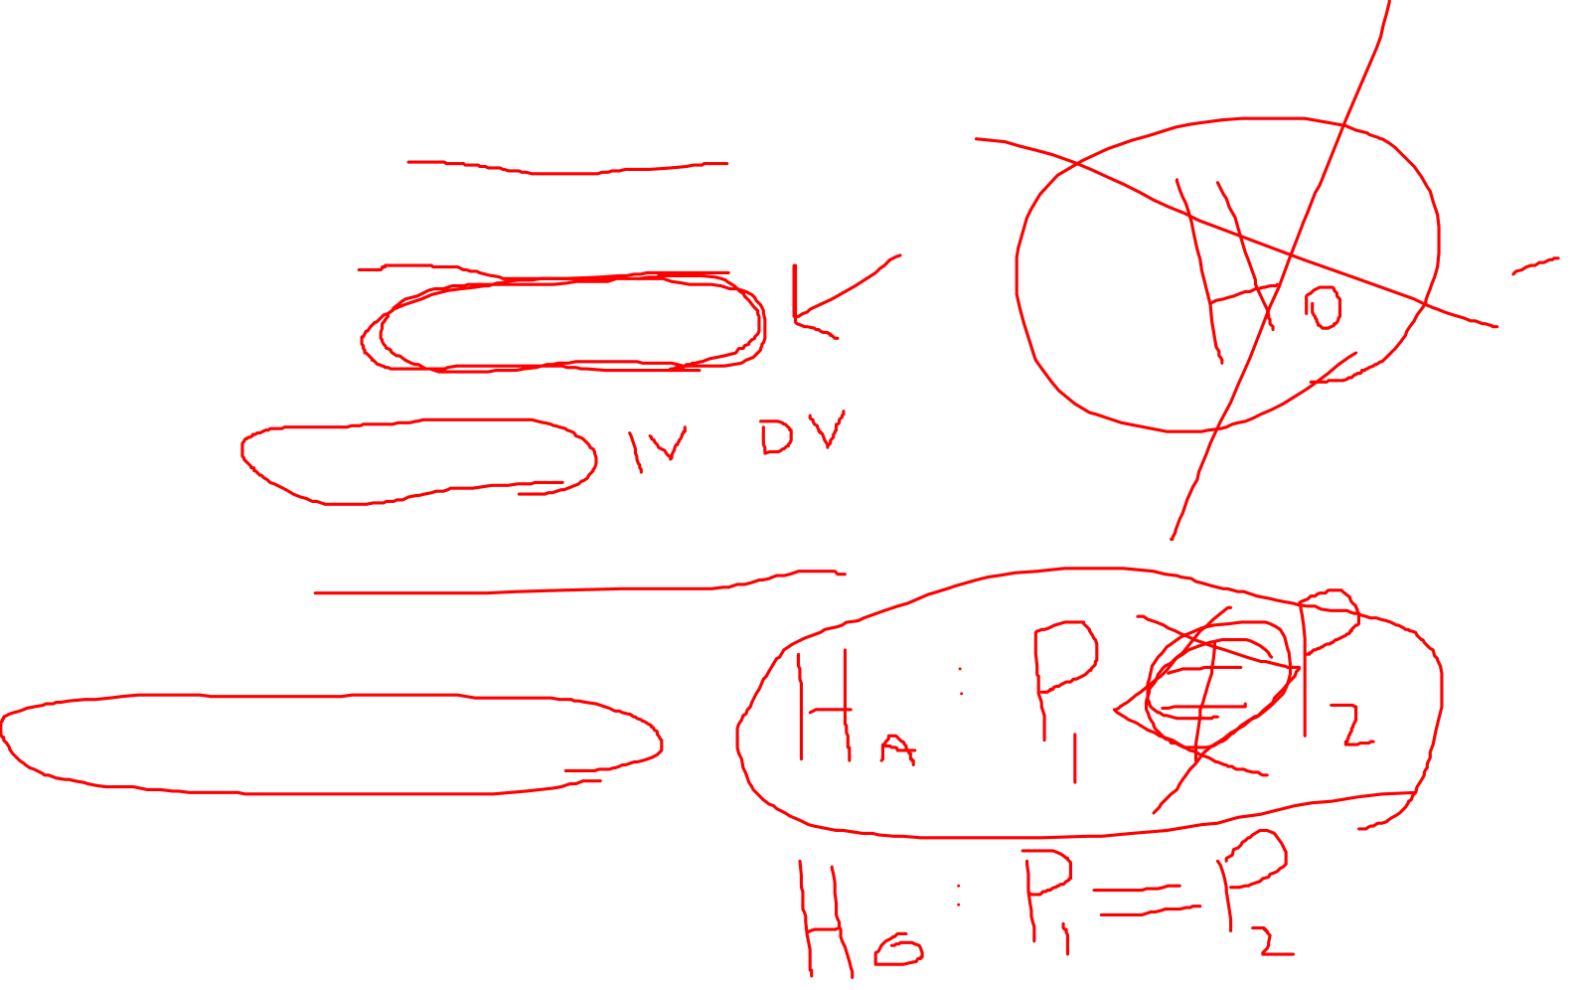
Hypotheses Criteria
Written in a declarative form.
Written in present tense.
Contain the population
Contain variables.
Reflects problem statement or purpose statement.
Empirically testable.

Slide 20

Hypothesis Testing
A hypothesis is made about the value of a parameter, but the only facts available to estimate the true parameter are those provided by the sample. If the statistic differs (and of course it will) from the hypothesis stated about the parameter, a decision must be made as to whether or not this difference is significant. If it is, the hypothesis is rejected. If not, it cannot be rejected.
H₀: The null hypothesis. This contains the hypothesized parameter value which will be compared with the sample value.
H₁: The alternative hypothesis. This will be “accepted” only if H₀ is rejected.
    Technically speaking, we never accept H₀ What we actually say is that we do not have the evidence to reject it.
20
Notes:
20

Slide 21
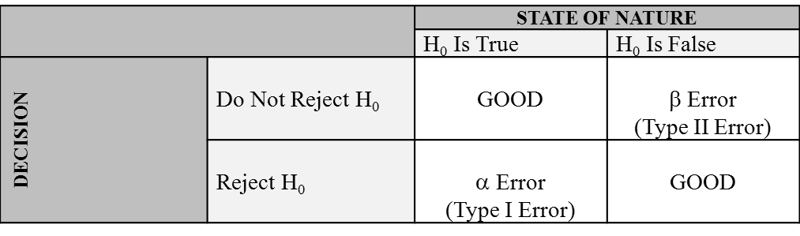
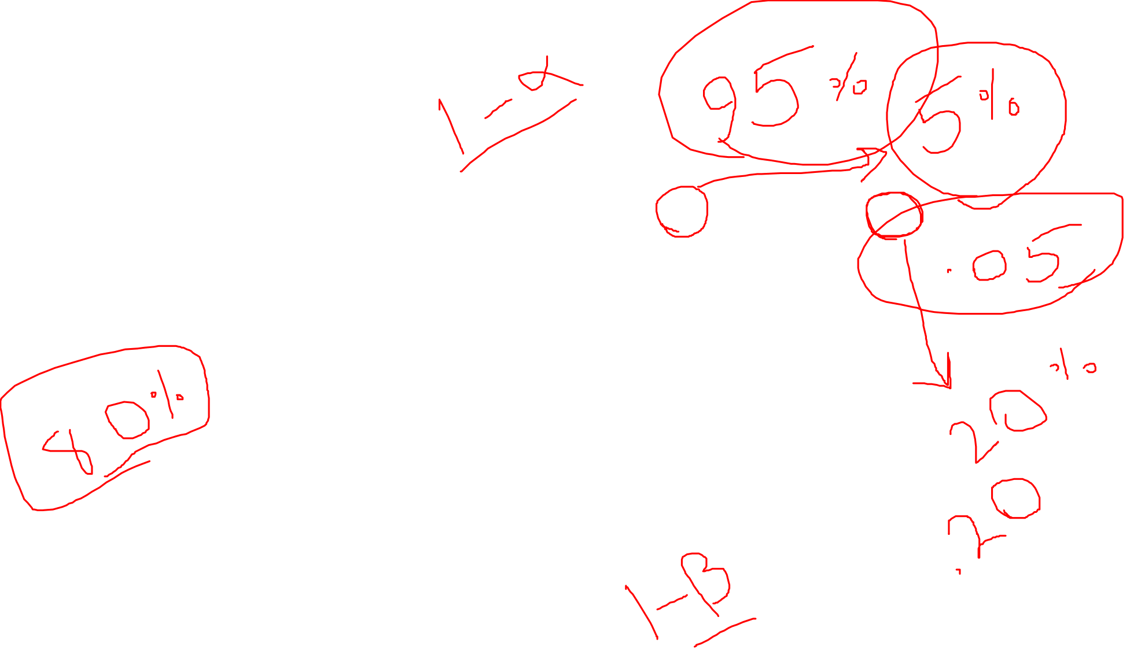
Two Types of Errors: Alpha and Beta
Two types of errors may occur: α (alpha) and β (beta). The α error is often referred to as a Type I error and β error as a Type II error.
  You are guilty of an alpha error if you reject H₀ when it really is true.
  You commit a beta error if you “accept” H₀ when it is false.
21
Notes:
21

Slide 22
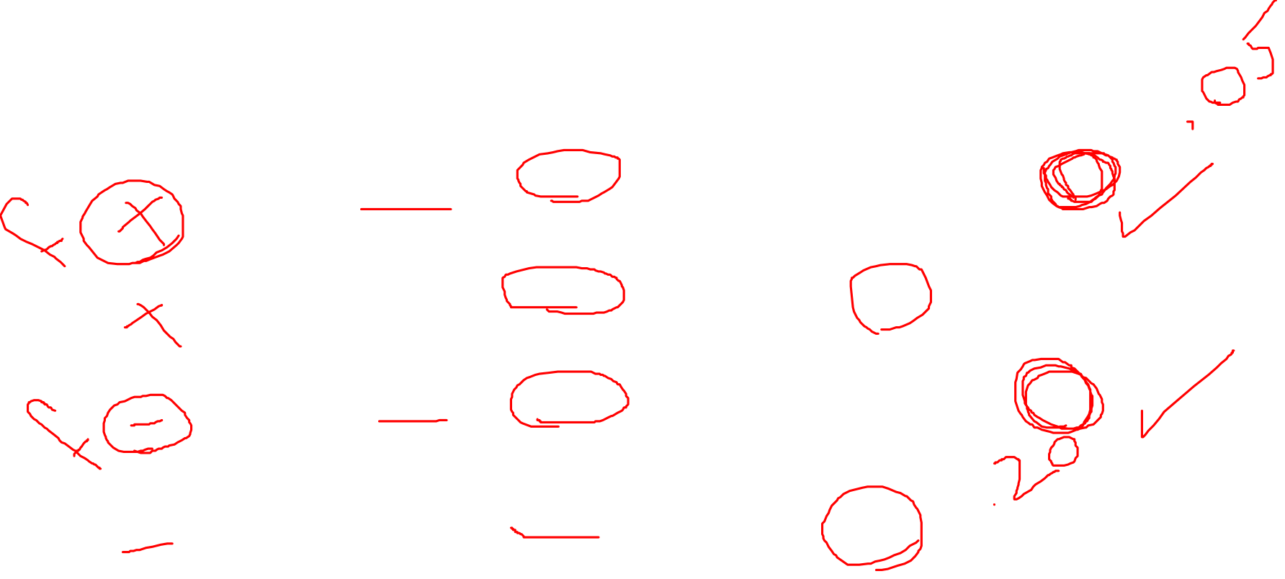
Types of Errors
If You…… | When the Null Hypothesis is… | Then You Have…….
Reject the null hypothesis | True (there really are no difference) | Made a Type I Error
Reject the null hypothesis | False (there really are difference) | ☻
Accept the null hypothesis | False (there really are difference) | Made Type II Error
Accept the null hypothesis | True (there really are no difference) | ☻

Slide 23
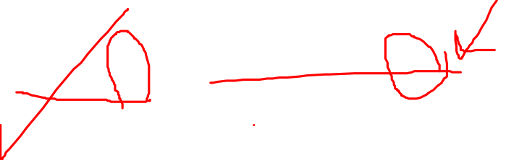
Steps in Hypothesis Testing
Formulate H₀ and H₁. H₀ is the null hypothesis, a hypothesis about the value of a parameter, and H₁ is an alternative hypothesis.
  e.g., H₀: µ=12.7 years; H₁: µ≠12.7 years
Specify the level of significance (α) to be used. This level of significance tells you the probability of rejecting H₀ when it is, in fact, true. (Normally, significance level of 0.05 or 0.01 are used)
Select the test statistic: e.g., Z, t, F, etc.
Establish the critical value or values of the test statistic needed to reject H₀. DRAW A PICTURE!
Determine the actual value (computed value) of the test statistic.
Make a decision: Reject H₀ or Do Not Reject H₀.
23
Notes:
23

Slide 24

Parametric Assumptions
The observations must be independent.
Dependent variable should be continuous (I/R)
The observations must be drawn from normally distributed populations
These populations must have the same variances. Equal variance (homogeneity of variance)
The groups should be randomly drawn from normally distributed and independent populations
  e.g. Male X Female
  Pharmacist X Physician
  Manager X Staff
  NO OVERLAP

Slide 25

Parametric Assumptions
The independent variable is categorical with two or more levels.
Distribution for the two or more independent variables is normal.

Slide 26

Advantages of Parametric Techniques
They are more powerful and more flexible than nonparametric techniques.
They not only allow the researcher to study the effect of many independent variables on the dependent variable, but they also make possible the study of their interaction.

Slide 27

Nonparametric Methods
Nonparametric methods are often the only way to analyze nominal or ordinal data and draw statistical conclusions.
Nonparametric methods require no assumptions about the population probability distributions.
Nonparametric methods are often called distribution-free methods.
Nonparametric methods can be used with small samples

Slide 28

Nonparametric Methods
In general, for a statistical method to be classified as nonparametric, it must satisfy at least one of the following conditions.
  The method can be used with nominal data.
  The method can be used with ordinal data.
  The method can be used with interval or ratio data when no assumption can be made about the population probability distribution (in small samples).

Slide 29
Non Parametric Tests
Do not make as many assumptions about the distribution of the data as the parametric (such as t test)
  Do not require data to be Normal
  Good for data with outliers
Non-parametric tests based on ranks of the data
  Work well for ordinal data (data that have a defined order, but for which averages may not make sense).

Slide 30

Nonparametric Methods
There is at least one nonparametric test equivalent to each parametric test
These tests fall into several categories
  Tests of differences between groups (independent samples)
  Tests of differences between variables (dependent samples)
  Tests of relationships between variables

Slide 31

Table of Statistical Tests
Level of Measurement
Sample Characteristics
Correlation
1 Sample
2 Sample
K Sample (i.e., >2)
Independent
Dependent
Independent
Dependent
Categorical or Nominal
Χ²
Χ²
Macnarmar’s Χ²
Χ²
Cochran’s Q
Rank or Ordinal
Mann Whitney U
Wilcoxin Matched Pairs
Kruskal Wallis H
Friendman’s ANOVA
Spearman’s rho
Parametric (Interval & Ratio)
z test or t test
t test between groups
t test within groups
1 way ANOVA between groups
1 way ANOVA (within or repeated measure)
Pearson’s r
Factorial (2 way) ANOVA

Slide 32
Summary: Parametric vs. Nonparametric Statistics
Parametric Statistics are statistical techniques based on assumptions about the population from which the sample data are collected.
  Assumption that data being analyzed are randomly selected from a normally distributed population.
  Requires quantitative measurement that yield interval or ratio level data.
Nonparametric Statistics are based on fewer assumptions about the population and the parameters.
  Sometimes called “distribution-free” statistics.
  A variety of nonparametric statistics are available for use with nominal or ordinal data.
Notes:
3

