Slide 1

t-test
Dr. Hamza Alduraidi

Slide 2

Review 6 Steps for Significance Testing
Set alpha (p level).
State hypotheses, Null and Alternative.
Calculate the test statistic (sample value).
Find the critical value of the statistic.
State the decision rule.
State the conclusion.
Notes:
1. Set Alpha level, probability of Type I error, that is probability that we
will conclude there is a difference when there really is not. Typically set
at .05, or 5 chances in 100 to be wrong in this way.
2. State hypotheses. Null hypothesis: represents a position that the
treatment has no effect. Alternative hypothesis is that the treatment has
an effect. In the light bulb example
Ho: mu = 1000 hours
H1: mu is not equal to 1000 hours
3. Calculate the test statistic. (see next slide for values)
4. Determine the critical value of the statistic.
5. State the decision rule: e.g., if the statistic computed is greater than the
critical value, then reject the null hypothesis.
Conclusion: the result is significant or it is not significant. Write up the
results.

Slide 3
t-test
t –test is about means: distribution and evaluation for group distribution
Withdrawn form the normal distribution
The shape of distribution depend on sample size and, the sum of all distributions is a normal distribution
t- distribution is based on sample size and vary according to the degrees of freedom

Slide 4
What is the t -test
t test is a useful technique for comparing mean values of two sets of numbers.
The comparison will provide you with a statistic for evaluating whether the difference between two means is statistically significant.
t test is named after its inventor, William Gosset, who published under the pseudonym of student.
t test can be used either :
  to compare two independent groups (independent-samples t test)
  to compare observations from two measurement occasions for the same group (paired-samples t test).

Slide 5
What is the t -test
The null hypothesis states that any difference between the two means is a result to difference in distribution.
Remember, both samples drawn randomly form the same population.
Comparing the chance of having difference is one group due to difference in distribution.
Assuming that both distributions came from the same population, both distribution has to be equal.

Slide 6
What is the t -test
Then, what we intend:
“To find the difference due to chance”
Logically, The larger the difference in means, the more likely to find a significant t test.
But, recall:
Variability
More variability = less overlap = larger difference
2. Sample size
Larger sample size = less variability (pop) = larger difference

Slide 7
Types
The independent-sample t test is used to compare two groups' scores on the same variable. For example, it could be used to compare the salaries of dentists and physicians to evaluate whether there is a difference in their salaries.
The paired-sample t test is used to compare the means of two variables within a single group. For example, it could be used to see if there is a statistically significant difference between starting salaries and current salaries among the general physicians in an organization.

Slide 8
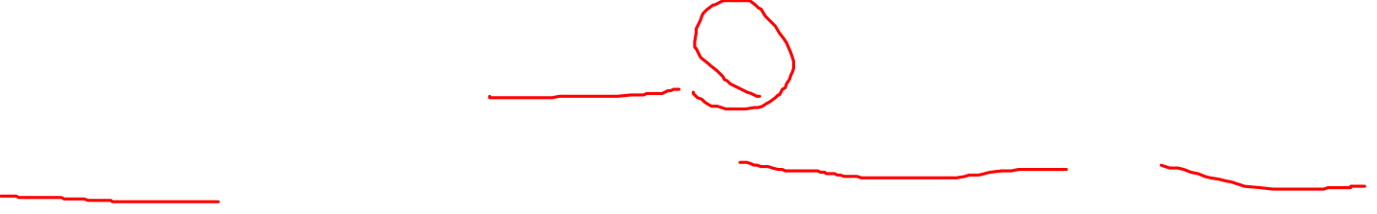
Assumption
Dependent variable should be continuous (I/R)
The groups should be randomly drawn from normally distributed and independent populations
  e.g. Male X Female
  Dentist X Physician
  Manager X Staff
  NO OVER LAP

Slide 9
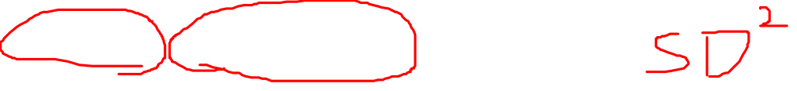
Assumption
the independent variable is categorical with two levels
Distribution for the two independent variables is normal
Equal variance (homogeneity of variance)
large variation = less likely to have sig t test = accepting null hypothesis (fail to reject) = Type II error = a threat to power
Sending an innocent to jail for no significant reason

Slide 10
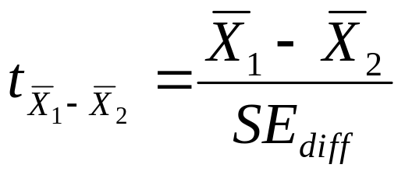

Independent Samples t-test
Used when we have two independent samples, e.g., treatment and control groups.
Formula is:
Terms in the numerator are the sample means.
Term in the denominator is the standard error of the difference between means.
Notes:
Here we have two different samples, and we want to know if they were drawn from populations with two different means. This is equivalent to saying whether a treatment has an effect given a treatment group and a control group. The formula for this t is on the slide.
Here t is the test statistic, and the terms in the numerator are the sample and population means. The term in the denominator is SE_{diff}, which is the standard error of the difference between means.
You can see from the subscripts for both t and SE, that we are now dealing with the Sampling Distribution of the DIFFERENCE between the means. This is very similar to the sampling distribution that we created last week. However, what we would do to create a sampling distribution of the differences between the means is rather than selecting 5 scores and computing a mean, we would select 5 pairs of scores, subtract one value from the other, then calculate the mean DIFFERENCE value.
If we are doing a study and have two groups, what do we EXPECT that the difference in their mean scores will be?
[They should say zero].
Thus, the mean of the sampling distribution of the differences between the means is zero.
The subscripts are here to tell you which Sampling Distribution we are dealing with (for the Sampling Distribution of Means last week, we had a subscript X-bar. For the sampling distribution of the differences between the means, we have a notation specifying a difference, specifically, the difference between X-bar1 and X-bar2.

Slide 11
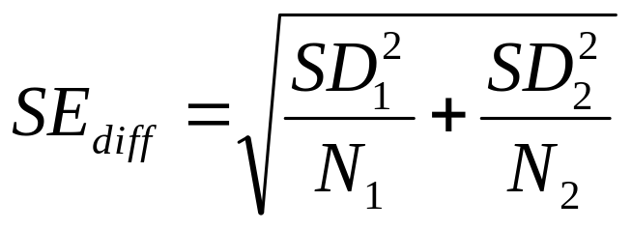

Independent samples t-test
The formula for the standard error of the difference in means:
Suppose we study the effect of caffeine on a motor test where the task is to keep a the mouse centered on a moving dot. Everyone gets a drink; half get caffeine, half get placebo; nobody knows who got what.
Notes:
Suppose we have two samples taken from the same population. Suppose we compute the mean for each sample and subtract the mean for sample 2 from sample 1. We will get a difference between sample means. If we do this a lot, on average, that difference will be zero. Most of the time it won’t be exactly zero, however. The amount that the difference wanders from zero on average is , the standard error of the difference.

Slide 12

Independent Sample Data (Data are time off task)
Experimental (Caff) | Control (No Caffeine)
12 | 21
14 | 18
10 | 14
8 | 20
16 | 11
5 | 19
3 | 8
9 | 12
11 | 13
 | 15
N₁=9, M₁=9.778, SD₁=4.1164 | N₂=10, M₂=15.1, SD₂=4.2805
Notes:
So let’s say we do the following study. We bring in our volunteers and give each of them a psychomotor test where they use a mouse to keep a dot centered on a computer screen target that keeps moving away (pursuit task). One hour before the test, both groups get an oral dose of a drug. For every other person (1/2 of the people), the drug is caffeine. For the other half, it’s a placebo. Nobody in the study knows who got what. All take the test. The results are in the slide.

Slide 13
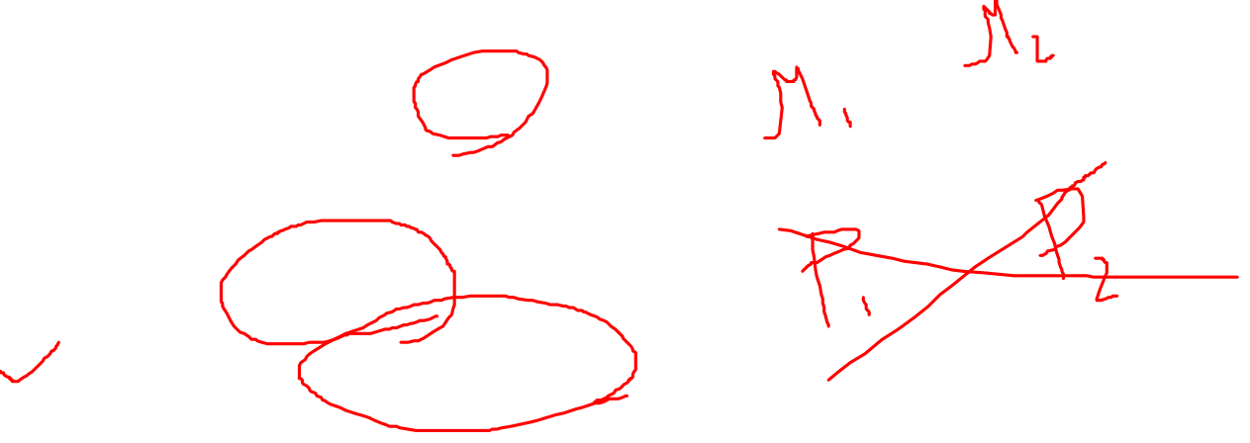
Independent Sample Steps(1)
Set alpha. Alpha = .05
State Hypotheses.
Null is H₀: μ₁ = μ₂.
Alternative is H₁: μ₁ ≠ μ_{2.}
Notes:
1. Set alpha = .05, two tailed (just a difference, not a prediction of greater n
or less than).
2. Null Hypothesis: . This is the same as . This says that there is no
difference between the drug group and the placebo group in psychomotor
performance in the population. The alternative hypothesis is that the
drug does have an effect, or

Slide 14
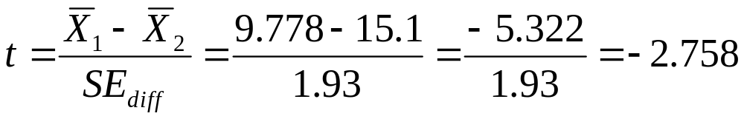
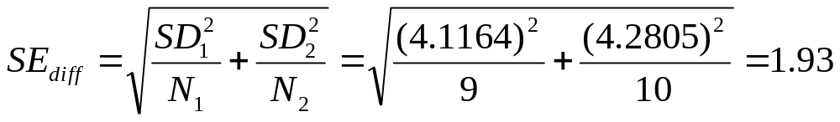

Independent Sample Steps(2)
3. Calculate test statistic:
Notes:
3. Calculate the test statistic (see the slide).

Slide 15

Independent Sample Steps (3)
Determine the critical value. Alpha is .05, 2 tails, and df = N1+N2-2 or 10+9-2 = 17. The value is 2.11.
State decision rule. If |-2.758| > 2.11, then reject the null.
Conclusion: Reject the null. the population means are different. Caffeine has an effect on the motor pursuit task.
Notes:
4. Determine the critical value of the statistic. We look this up in a table.
Alpha is .05, t is 2-tailed and the df are n₁+n₂-2, or in our case, 17. The
critical value is 2.110.
5. State the decision rule. If the absolute value of the test statistic is larger
than the critical value, reject the null hypothesis. If |-2.758| > 2.110, reject
the null.
6. Conclusion, the population means are different. The result is significant at
p < .05.

Slide 16
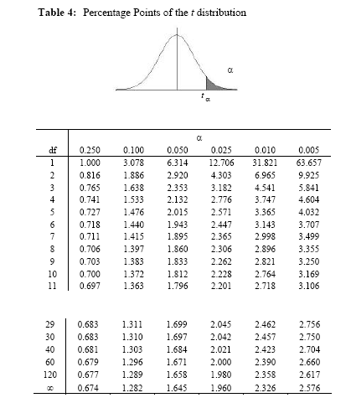
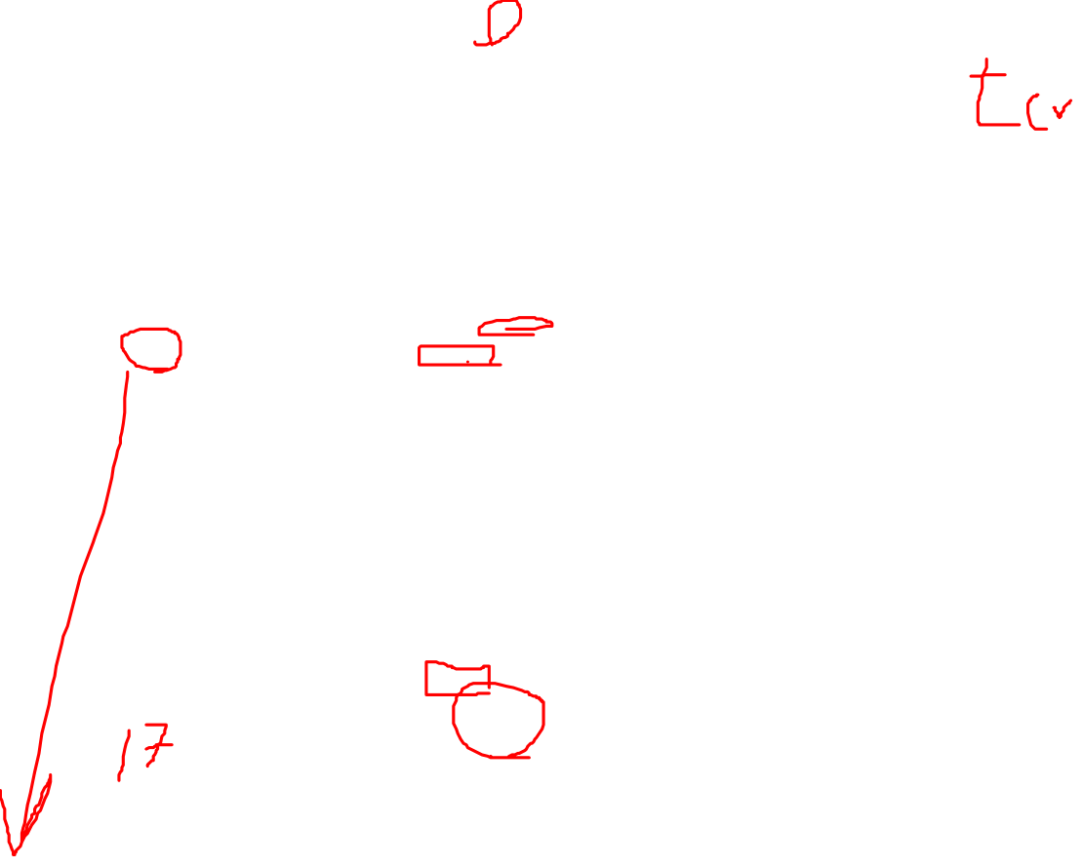
…

Slide 17

Using SPSS
Open SPSS
Open file “SPSS Examples” for Lab 5
Go to:
  “Analyze” then “Compare Means”
  Choose “Independent samples t-test”
  Put IV in “grouping variable” and DV in “test variable” box.
  Define grouping variable numbers.
    E.g., we labeled the experimental group as “1” in our data set and the control group as “2”
Notes:
Make sure that they look at the data in SPSS to see how the groups were defined and how that relates to the “define groups” task.

Slide 18
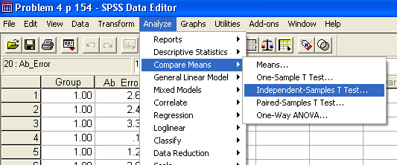

Independent t-Test

Slide 19
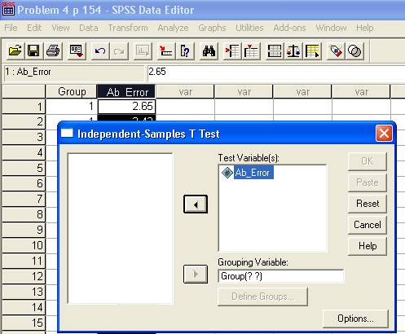

Independent t-Test: Independent & Dependent Variables

Slide 20
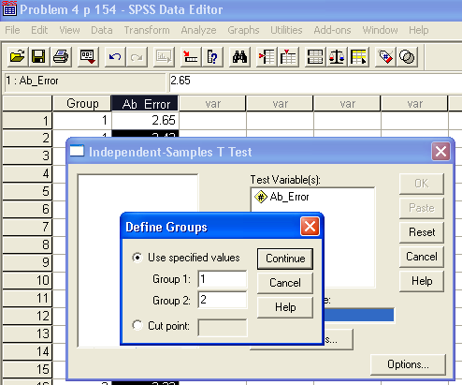
Independent t-Test: Define Groups

Slide 21
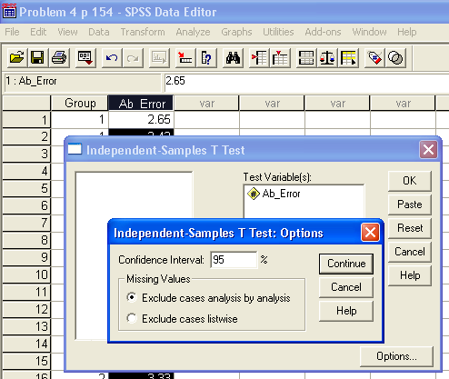
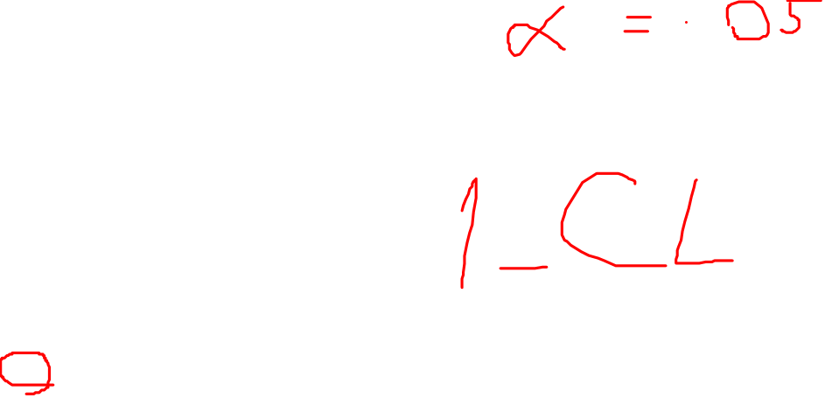
Independent t-Test: Options

Slide 22
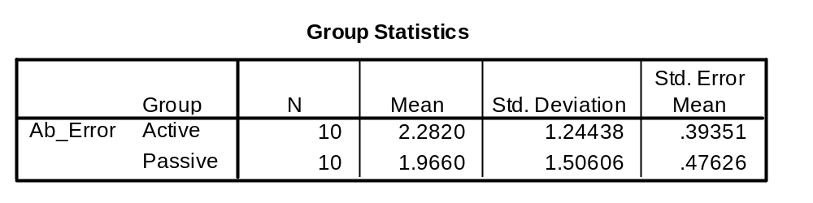
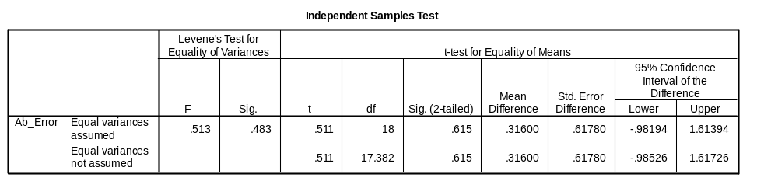
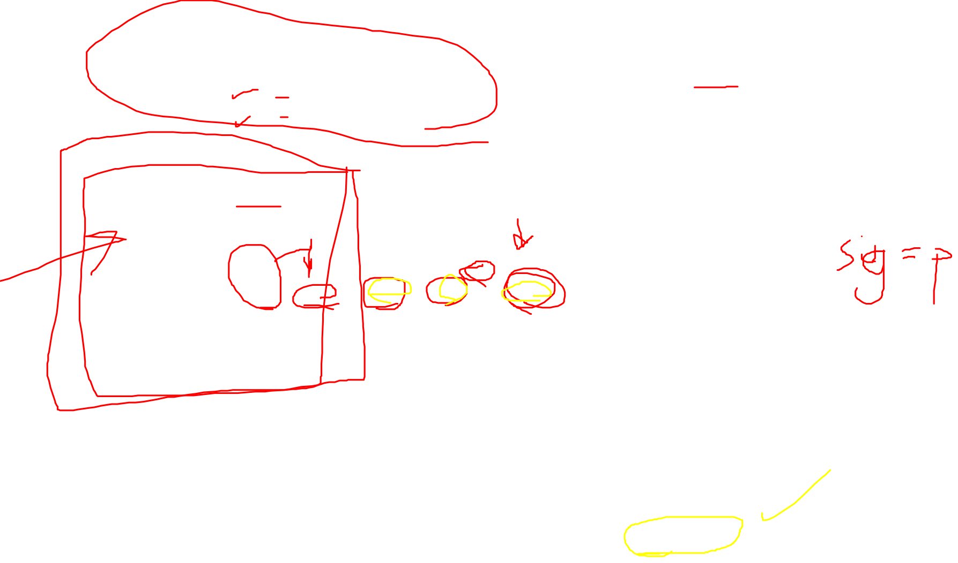
Independent t-Test: Output
Are the groups different?
t(18) = .511, p = .615
NO DIFFERENCE
2.28 is not different from 1.96

Slide 23
Independent Samples
Exercise
Experimental | Control
12 | 20
14 | 18
10 | 14
8 | 20
16
Work this problem by hand and with SPSS.
You will have to enter the data into SPSS.
Notes:
Have them work this one. Assume again that this is time off task for the DV.
Here are the answers for the independent samples exercise
M1 = 12, M2 = 18
SD1 = 3.162278, SD2 = 2.8284227
Std Error = 2
t = -6/2 = -3; df = 5 + 4 - 2 = 7
t(.05) = 2.3646; 3 > 2.3646
Reject null hypothesis
We conclude that caffeine has an effect.
Be sure to cover the relevant areas of the SPSS printout. You should show them where everything that they calculate by hand is on the printout. Also cover the Levene’s test. Explain that if the Levene’s test is significant, we need to use the row that says ‘equal variances NOT assumed”. We do NOT want the Levene’s test to be significant as it violates an assumption of the t-test.

Slide 24
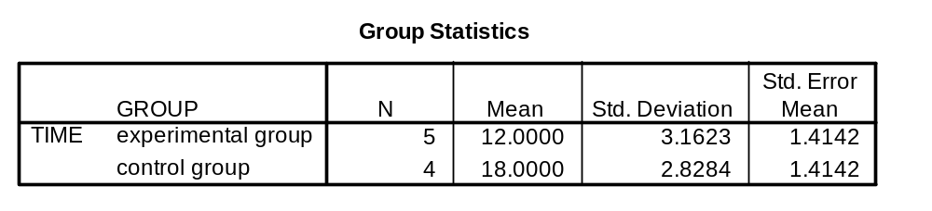
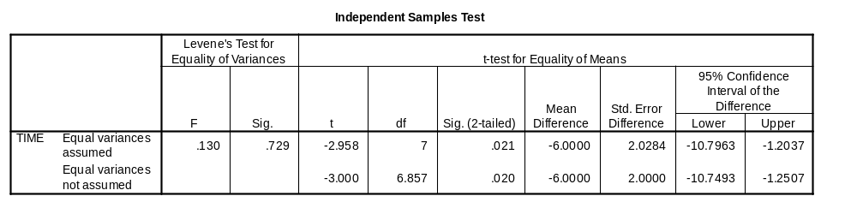

SPSS Results

