Slide 1
NMBA
Neuromuscular blocking agents
Prof: Subhi Al-Ghanem

Slide 2
Skeletal muscle relaxation can be produced by deep inhalational anesthesia, regional nerve block, or neuromuscular blocking agents
muscle relaxation does not ensure unconsciousness, amnesia, or analgesia
In 1942, Harold Griffith published the results of a study using an extract of curare (a South American arrow poison) during anesthesia. Following the introduction of succinylcholine as a “new approach to muscular relaxation,” these agents rapidly became a routine part of the anesthesiologist’s drug arsenal

Slide 3
Definition: NMBA are the drugs that act peripherally at NM-Junction and muscle fiber itself to block neuromuscular transmission.
Why do we need them ?
In order to facilitate muscle relaxation for surgery and
mechanical ventilation during surgery & in ICU.

Slide 4
Neuromuscular junction
Association between a motor neuron and a muscle cell.
Synaptic cleft.:The cell membranes of the neuron and muscle fiber are separated by a narrow (20-nm) gap.
The neurotransmitter responsible for neurotransmission at the neuromuscular junction is acetylcholine.
It is synthesized in the cytoplasm by combination of choline and coenzyme A with the help of choline acetyl transferase.
These synthesized acetylcholine stored in vesicles. A single vesicle contains about a quantum of Ach ( 10000 molecules of Ach)

Slide 5
As a nerve’s action potential depolarizes
its terminal, an influx of calcium ions through voltage-gated calcium channels into the nerve cytoplasm allows storage vesicles to fuse with the terminal plasma membrane and release their contents.
The ACh molecules diffuse across the synaptic cleft to bind with nicotinic cholinergic receptors on a specialized portion of the muscle membrane at the motor end-plate.
Each neuromuscular junction contains approximately 5 million of these receptors.
Among these minimum 500000 receptors required to be activated for normal muscle contraction.

Slide 6
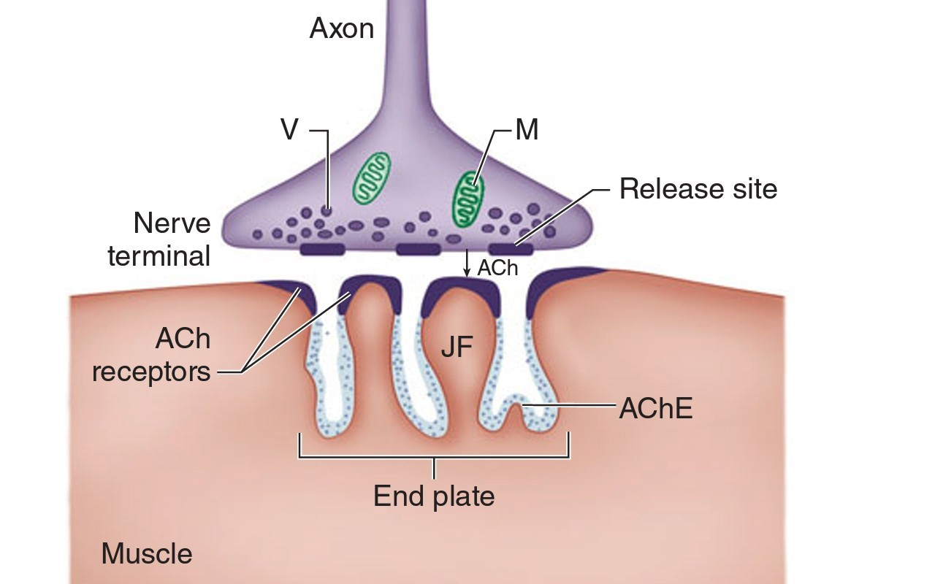

Slide 7
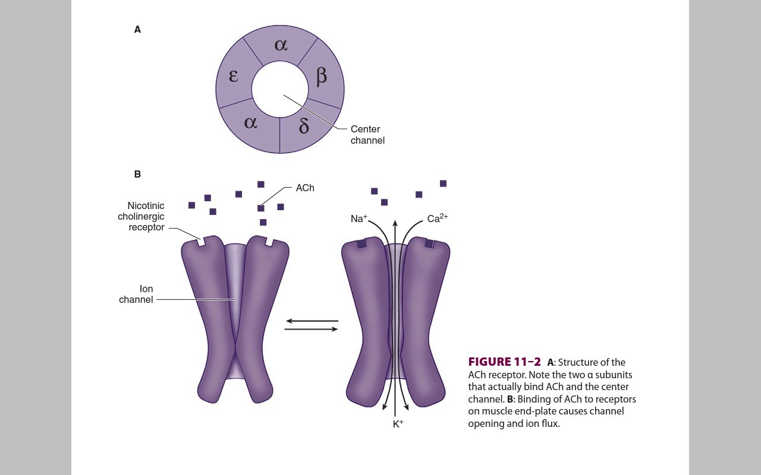
Another isoform of Ach contains a γ subunit instead of the ε subunit known as fetal or imature receptor , because this form initially expressed in fetal muscle.
It is also often referred to as extrajunctional receptors.
Cations flow through the open ACh receptor channel (sodium and calcium in; potassium out), generating an end-plate potential .
When enough receptors are occupied by ACh, the end-
plate potential will be sufficiently strong to depolarize the perijunctional membrane.

Slide 8
Structure of ACh receptors:
Each ACh receptor in the neuromuscular junction normally consists of five protein subunits; two α subunits; and single β, δ, and ε subunits.
Only the two identical α subunits are capable of binding Ach molecules.
If both binding sites are occupied by ACh, a conformational change in the subunits, briefly
(1 ms) opens an ion channel in the core of the receptor.
The channel will not open if Ach binds on only one site

Slide 9
Sodium channels are present in muscle membrane.
Perijunctional areas of muscle membrane have a higher density of these sodium channels than other parts of the membrane.
These sodium channels have two types of gate
  voltage dependent
  time dependent
Sodium ions pass only when both gates are open.

Slide 10
With the opening of sodium channels and entry of sodium,calcium ions release from sarcoplasmic reticulum.
This intracellular calcium allows the contractile proteins actin and myosin to interact, bringing about muscle contraction.

Slide 11
NMBA are divided into two major groups
1. Depolarizing muscle relaxants
2.Non-Depolarizing muscle relaxants.

Slide 12
Distinctions Between Depolarizing & Nondepolarizing Blockade :
Neuromuscular blocking agents are divided into two classes: depolarizing and nondepolarizing
all neuromuscular blocking agents are quaternary ammonium compounds whose positively charged nitrogen imparts an affinity to nicotinic ACh receptors
Whereas most agents have two quaternary ammonium atoms, a few have one quaternary ammonium cation and one tertiary amine that is protonated at physiological pH

Slide 13
depolarizing muscle relaxants act as ACh receptor agonists, whereas nondepolarizing muscle relaxants function as competitive antago- nists
depolarizing muscle relaxants very closely resemble ACh and readily bind to ACh receptors, generating a muscle action potential. Unlike ACh, however, these drugs are not metabolized by acetylcholinesterase, and their concentration in the synaptic cleft does not fall as rapidly, resulting in a prolonged depolarization of the muscle end-plate.

Slide 14
Continuous end-plate depolarization causes muscle relaxation because opening of perijunctional sodium channels is time limited
After the initial excitation and opening these sodium channels inactivate and cannot reopen until the end-plate repolarizes
The end-plate cannot repolarize as long as the depolarizing muscle relaxant continues to bind to ACh receptors; this is called a phase I block
After a period of time, prolonged end-plate depolarization can cause poorly understood changes in the ACh receptor that result in a phase II block

Slide 15
Non-classical Blockade
Some drugs interfere without agonist or antagonist properties
  Include inhaled anesthetic, local anesthetic or ketamine of unknown mechanisim of its action in blocking the receptor.
  Interfere with normal functioning of ach binding site and/or opening and closing of receptor channel
  Closed channel blockade :
  during closed channel blockade, drug physically plugs up the channel preventing passage of cations whether or not Ach has activated the receptor.
  Open channel blockade:
    Drug enters and obstructs ach receptor channel after opened
      Occurs with antibiotics, cocaine and quinidine
      Interferes with blockade reversal

Slide 16
Depolarizing and non-depolarizing Muscle Relaxants
Depolarizing | Non-depolarizing
Short-acting Succinylcholine | Short-acting Mivacurium
 | Intermediate-acting
 | Atracurium; Cisatracurium
 | Rocuronium; Vecuronium
 | Long-Acting
 | Doxacurium
 | Pancuronium; Pipecuronium

Slide 17
Succinylcholine
Only depolarizing in clinical use
Copycat Ach structure
Rapid onset (30-60s)
  Low lipid solubility as well as relative overdose given
Short duration of action (< 10 min)
As it enters the system, most is metabolized by pseudocholinesterase
  Only small fraction of injected dose reach NMJ

Slide 18
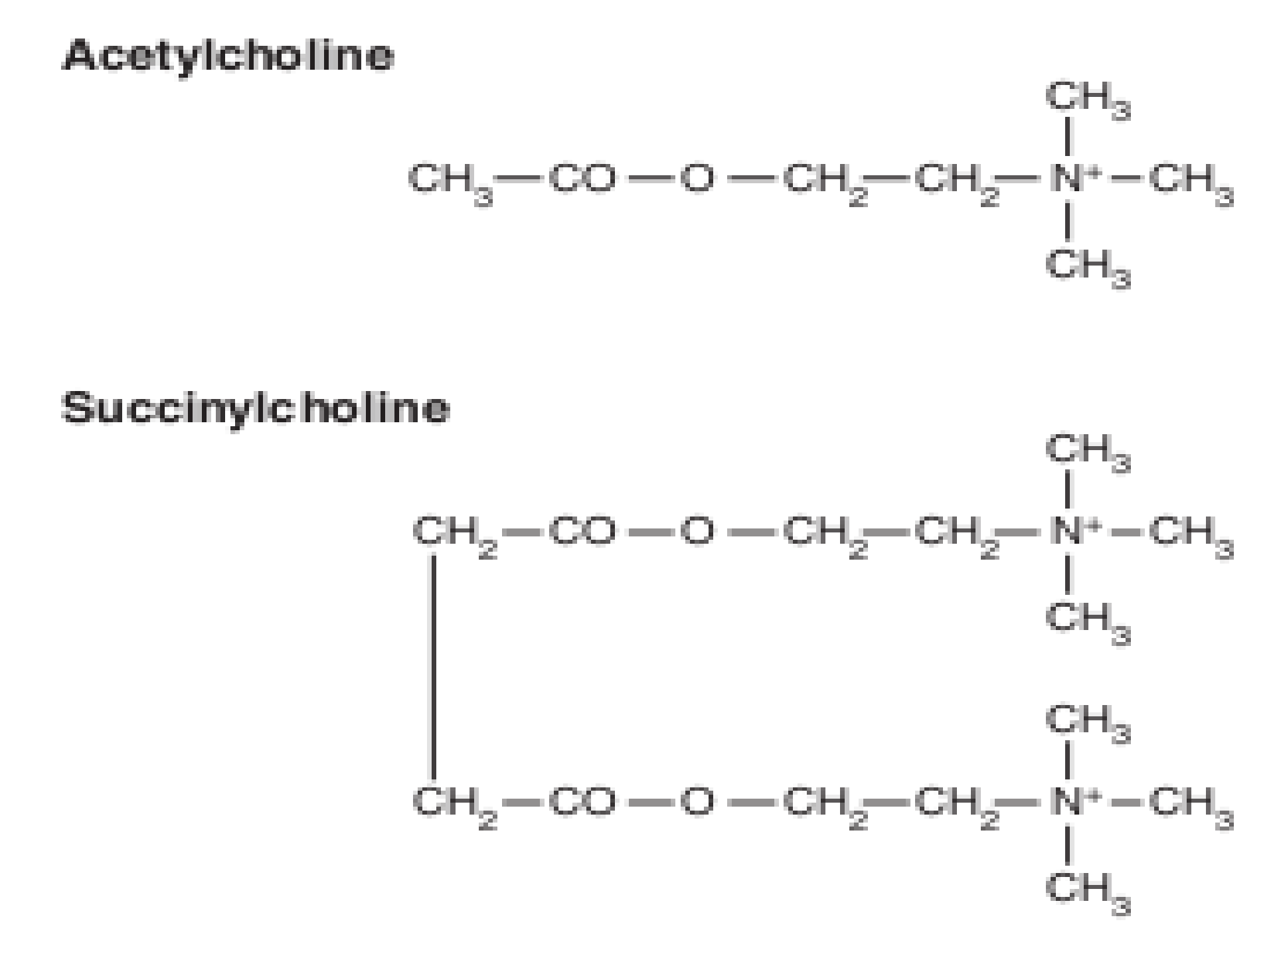

Slide 19
Duration of Action: Succinylcholine
Prolonged by high dose or abnormal metabolism
  Hypothermia
    Decreased rate of hydrolysis
  Low pseudo-cholinesterase levels
    Pregnancy, liver disease, renal failure and drugs
      Esmolol, metoclopramide, OCP among others
  Genetically variable enzyme
    1 in 50 = one normal and one abnormal gene
      Slightly prolonged block (20-30 min)
    1 in 3000
      2 abnormal genes, up to 4-8 hour blockade
      Dibucaine resistant –most common abnormal pseudocholinesterase

Slide 20
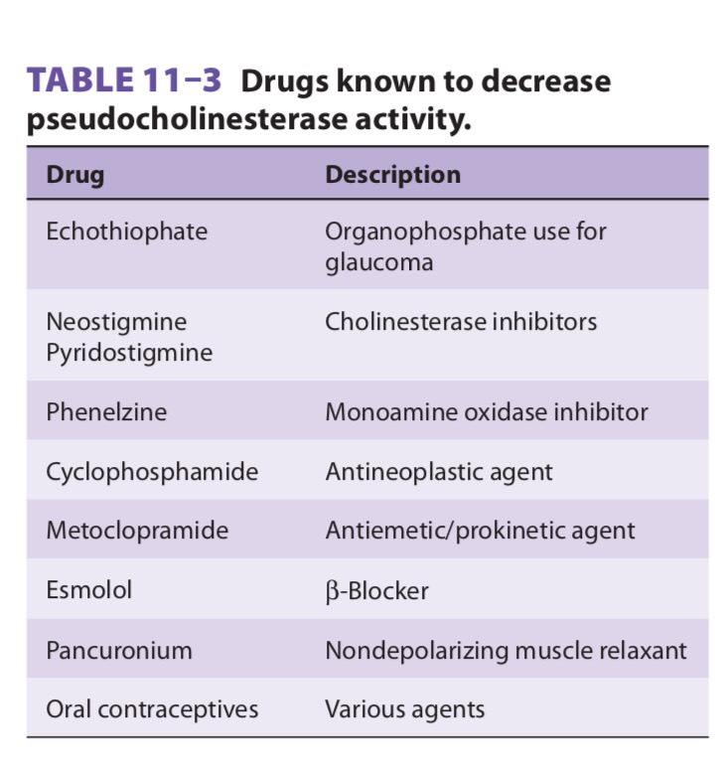

Slide 21
Drug Interactions: Succinylcholine
Cholinesterase inhibitors
  Prolong phase 1 block
    Inhibit acetylcholinesterase=higher ach concentration which increase depolarization
    Reduce hydrolysis of succinylcholine
      Inhibit pseudocholinestrase

Slide 22
Dosage: Succinylcholine
Adult
  Intubation
    1-1.5 mg/kg IV *(possibly excessive)
    .5 mg/kg acceptable if defasciculating dose of non-depolarizer is not used
  Maintenance
    Repeated small bolus (10mg) or drip (1g in 500-1000ml titrated to effect)
Children
  Intubation
    Infants/Small kids: 2mg/kg
    Older children and Adolescents 1mg/kg

Slide 23
Side Effects
Cardiovascular
  Variable
    Secondary to possible stimulation of nicotinic receptors in parasympathetic and sympathetic ganglia, as well as muscarinic receptors in SA node
  Low doses
    Can produce negative chronotropic/inotropic effects
  Higher doses
    Tend to increase heart rate and contractility as well as elevate circulating catecholamine
  Children
    Particularly susceptible to bradycardia
    Often treated prophylactically with atropine

Slide 24
Side effects cont.
Fasciculation
  Signals onset of paralysis
    Prevented by non-depolarizing relaxant
Muscle Pains
  Increased post-op myalgia
    Possibly from unsynchronized contraction of muscle groups
      Increased CK and myoglobinemia can be found after succinylcholine given
      Reduced by NSAID preoperatively

Slide 25
Side Effects
Hyperkalemia
  Intubating dose
    Normal muscle releases potassium to raise serum potassium level by .5 meq/l
  Excessive hyperkalemia( k level approaching 7meq/l ) in cases of
    Preexisting hyperkalemia (renal failure)
    Burn Injury
    Massive Trauma
    Neurological disorders
    Many more
  Cardiac arrest can prove to be quite refractory to routine cardiopulmonary resuscitation

Slide 26
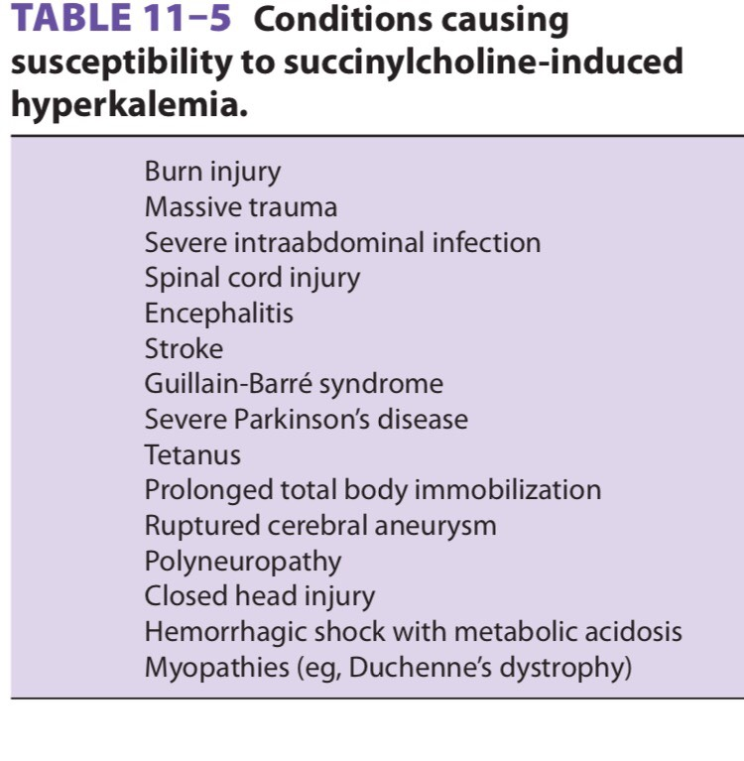

Slide 27
Side effects
Malignant Hyperthermia
  Potent triggering agent in patients susceptible to MH
Intracranial pressure
  May lead to increase in cerebral blood flow and ICP
    Attenuated with hyperventilation/good airway control
    Pre-treat with non-depolarizing muscle relaxant and IV lidocaine 2-3 minutes prior to intubation

Slide 28
Side effects
Intragastric pressure elevation
  Abdominal wall fasciculations increase pressure
    Offset by increase LES tone
    No increase reflux/aspiration
    Abolished by pretreatment
Intraocular pressure elevation
  Extra-ocular muscle
    multiple motor-end plates each cell
  Prolonged depolarization and contraction of muscle transiently raise IOP
    Worrisome in patient’s with injured eye

Slide 29
Non-Depolarizers
Drug | Structure | Metabolism | Primary Excretion | Onset | Duration | Hist. Release | Vagal Blockade
Atracurium | Benzylisoquinolone | +++ | x | ++ | ++ | + | 0
Cisatracurium | Benzylisoquinolone | +++ | x | ++ | ++ | 0 | 0
Mivacurium | Benzylisoquinolone | Cholinesterase enzymes | x | ++ | + | + | 0
Doxacurium | Benzylisoquinolone | Insignificant | Renal | +++ | +++ | 0 | 0
Pancuronium | Steroidal | + | Renal | +++ | +++ | 0 | ++
Pipercuronium | Steroidal | + | Renal | +++ | +++ | 0 | 0
Vecuronium | Steroidal | + | Biliary | ++ | ++ | 0 | 0
Rocuronium | Steroidal | insignificant | Biliary | + | ++ | 0 | +

Slide 30
Drug | Intubation dose (mg/kg) | Onset of action for Intubating dose (min) | Duration of action (min) | Maintenance dosing by boluses (mg/kg) | Maintenance dosing by infusion (ug/kg/min)
Succinylcholine | 1-1.5 | .5-1 | 5-10 | .15 | 2-15 mg/min
Rocuronium | .6 | 1.5-2.5 | 35-75 | .15 | 9-12
Mivacurium | .2 | 2.5-3.0 | 15-20 | .05 | 4-15
Atracurium | .5 | 2.5-3.0 | 30-45 | ,1 | 5-12
Cisatracurium | .2 | 3-4 | 40-75 | .02 | 1-2
Vecuronium | .12 | 2-3 | 45-90 | .01 | 1-2
Pancuronium | .12 | 2-3 | 60-120 | .01 | x
Pipercuronium | .1 | 2-3 | 80-120 | .01 | x
Doxacurium | .07 | 4-5 | 90-150 | .05 | x

Slide 31
Non-depolarizers
Three types
  Benzylisoquinolines
    Release histamine
  Steroids
    Vagolytic
  Related allergic history
  Other compounds ( like chlorofumarates )

Slide 32
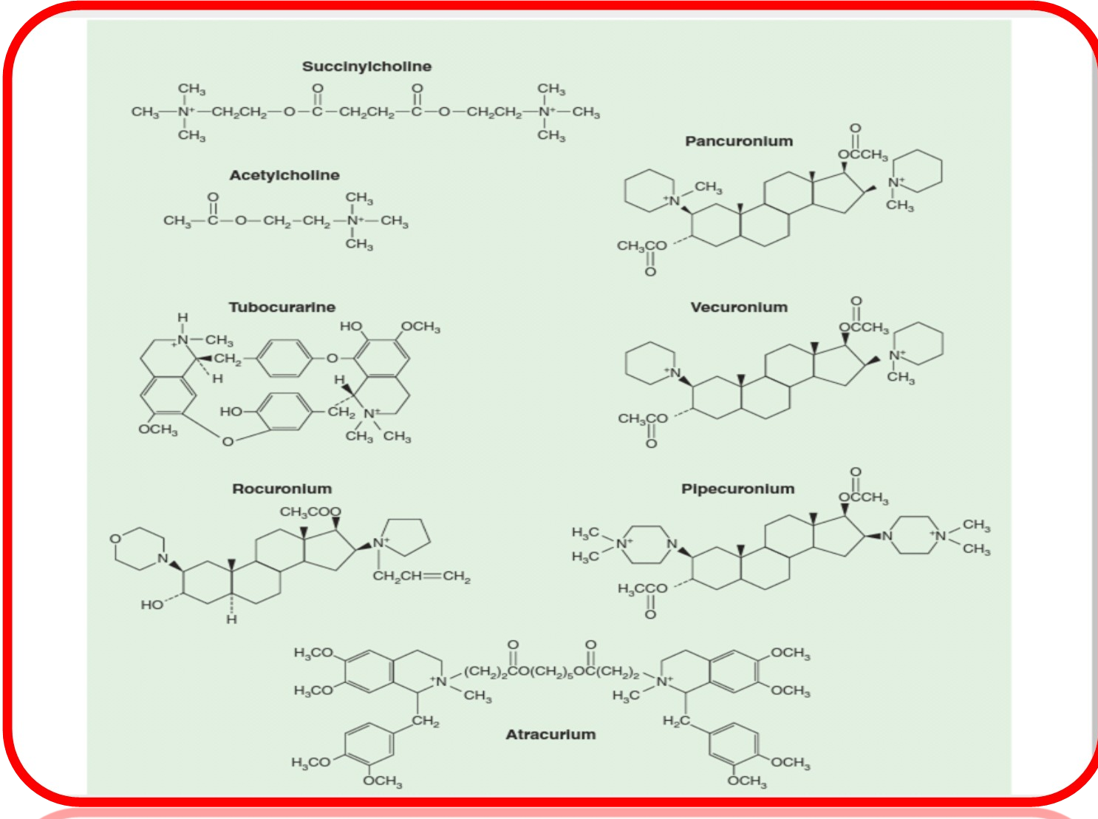
Chemical structure of muscle relaxents

Slide 33
Non-depolarizers
Intubation
  None as rapid onset as succinylcholine
  Quickened by larger dose or priming dose
    Prolongs duration of blockade and exacerbates SE
  Priming dose
    10-15 % of intubating dose 5 minutes before induction will occupy enough receptors so that paralysis quickly follows full dose
      Intubation conditions at 60s (Rocuronium)
        90s with other intermediate-acting depolarizers
    Does not usually lead to clinically significant paralysis
      (75-80% of receptors blocked)
    Can cause dyspnea, dysphagia and diplopia

Slide 34
Non-depolarizers
Maintenance relaxation
  LARGE VARIABLE IN DOSE RESPONSES
  Requires Close monitoring with Neuro-stimulator
  Bolus or infusion should be guided by stimulator as well as clinical signs
    Movement
    Spontaneous ventilation
  Some return of neuromuscular transmission should be evident prior to bolus dose
  Infusion should be titrated at or just above rate that allows return of neuromuscular transmission

Slide 35
Non-depolarizers
Potentiated by inhalational anesthetics
  Volatile agents decrease dosage requirements by at least 15 %
  Depends on agent
    Des> Sevo > Iso and Enflurane > Halothane > N202
  Muscle relaxant
    Pancuronium > vecuronium and atracurium
    Hypothetically due to volatile induced enhanced affinity for non-depolarizing muscle relaxants

Slide 36
Autonomic side Effects
Older agents (tubocurarine/metocurine)
  Blocked autonomic ganglia
    Decreased contractility/response to hypotension
Pancuronium
  Blocks vagal muscarinic receptors
    Tachycardia
Newer agents
  Devoid of significant autonomic effects

Slide 37
Excretion
Hepatic
  Pancuronium\Vecuronium metabolized mostly by liver
  Liver failure
    Prolongs pancuronium as well as rocuronium blockade
    Less effect on vecuronium
    No effect on Cisatracurium or atracurium
Renal
  Doxacurium/Pancuronium/Vecuronium and pipecuronium excreted by kidneys
    Prolonged action in patients with renal failure

Slide 38
Characteristics
Greater Potency=slower onset
Temperature
  Hypothermia prolongs blockade
    Decreased metabolism and excretion
Acid-Base
  Respiratory acidosis
    Potentiates blockade
Hypokalemia/Hypocalcemia
  Prolong blockade
Hypermagesemia
  Prolongs blockade by competing with Ca++ at motor-end plate
    Seen in preeclampsia

Slide 39
Age :
Neonates have an increased sensitivity to nondepolarizing relaxants because of their immature neuromuscular junctions. This sensitivity does not necessarily decrease dosage requirements, as the neonate’s greater extracellular space provides a larger volume of distribution.

Slide 40
Atracurium
Benzylisoquinoline
  Metabolized independent of renal and biliary routes
    Hoffman elimination
  Triggers dose –dependent histamine release above .5mg/kg (intubating dose)
    Hypotension/reflex tachycardia/cutaneous flush
  Laudanosine toxicity
    Product of breakdown of atracurium
    CNS excitation: possibly seizures
    Only relevant at extremely high doses or hepatic failure
  Precipitate as free acid if placed in IV line with alkaline solution (thiopental)

Slide 41
Cisatracurium
Stereoisomer of atracurium
4 times more potent
Hoffman elimination
*Does not produce a dose-dependent increase in histamine
  Also lower laudaonsine toxicity
PH/Temperature sensitive
  Secondary to unique metabolism
  Prolonged action by hypothermia/acidosis

Slide 42
Mivacurium
Metabolized by pseudocholinesterase
  Also prolonged by low pseudocholinesterase levels
Also causes histamine release
Brief duration of action
  About half of atracurium/vec/rocuronium
Markedly prolonged by prior administration of pancuronium

Slide 43
Doxacuronium
Benzylisoquinoline
Renal excretion
  Similar to other long acting non-depolarizers
Slow onset (4-6 minutes)
  .05mg/kg for tracheal intubation within 5 min
No cardiac or histamine-release side effects
Duration:60-90 minutes

Slide 44
Pancuronium
Steroid base
Primarily renal excretion
  Slowed by renal failure
Some excretion by bile
  Cirrhotic patients require higher initial dose
Side Effects:
  HTN and tachycardia
    Combination of vagal blockade and sympathetic stimulation
      Caution with CAD, aortic stenosis
  Arrhythmias
    Increases AV conduction and catecholamine release
    Worsened in patients using TCA and halothane
  Allergic reaction possible in patients hypersensitive to bromide

Slide 45
Pipecuronium
Steroid base (similar to Pancuronium)
Renal excretion
No cardiovascular side effects
  Advantage over pancuronium

Slide 46
Vecuronium
Biliary and renal excretion
    Satisfactory in renal failure however some prolongation occurs
Side effects
  No significant CV effects
    Can cause potentiation of opioid-induced bradycardia
  *Long term administration causes buildup of active 3-hydroxy metabolite: elongates drug clearance and can cause polyneuropathy

Slide 47
Rocuronium
Analogue of vecuronium designed for rapid onset
No active metabolite
  Better choice for long term infusion
Can cause prolonged duration of action in elderly
Primary hepatic and renal elimination
  Duration of action prolonged by hepatic disease and pregnancy
  Not Significantly affected by renal failure

Slide 48
Rocuronium
Useful for quick onset of action
  Closest non-depolarizer to succinylcholine
.1 mg/kg shown to be rapid and effective agent (decreased fasciculations and post-op myalgias for precurarization administration of succinylcholine
Slight vagolytic tendencies

Slide 49
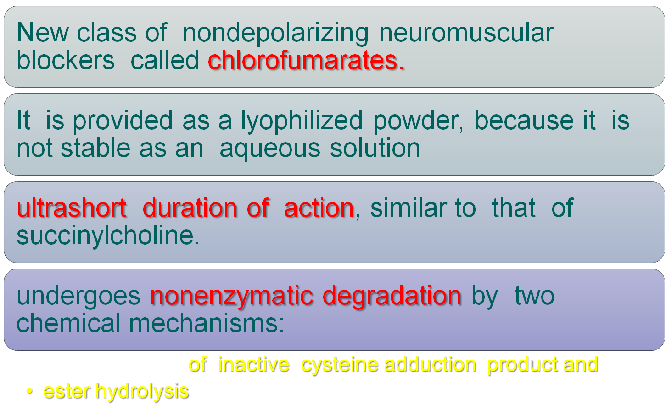
Gantacurium

Slide 50
gantacurium demonstrated an ultrashort duration of action, similar to that of succinylcholine. Its pharmacokinetic profile is explained by the fact that it undergoes nonenzymatic degradation by two chemical mechanisms: rapid formation of inactive cysteine adduction product and ester hydrolysis. At a dose of 0.2 mg/kg (ED95), the onset of action has been estimated to be 1-2 min, with a duration of blockade similar to that of succinyl- choline
Its clinical duration of action ranged from 5-10 min; recovery can be accelerated by edropho- nium, as well as by the administration of exogenous cysteine. Cardiovascular effects suggestive of histamine release were observed following the use of three times the ED95 dosage.

Slide 51
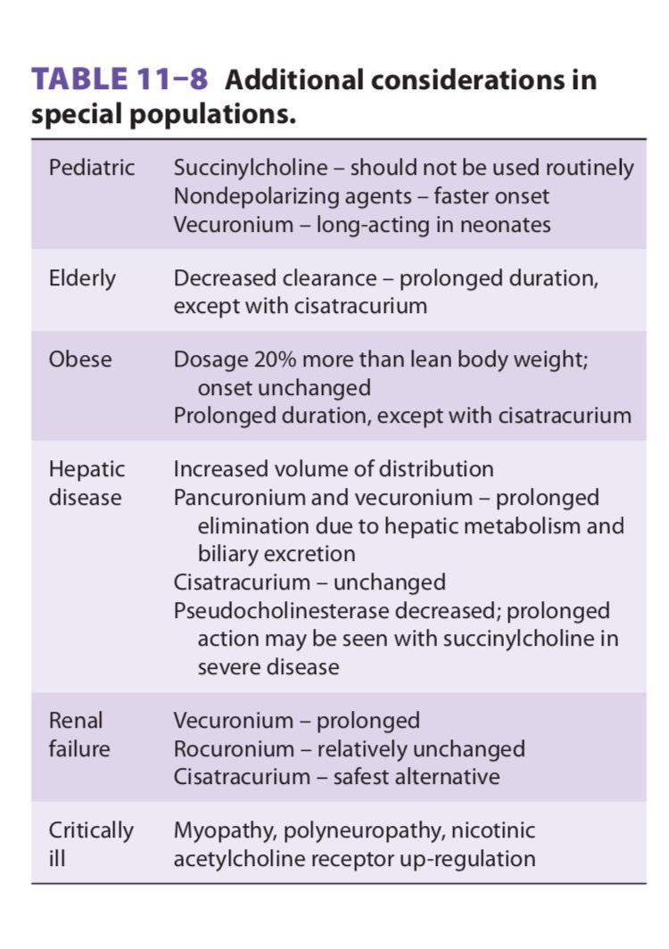

Slide 52
REVERSAL OF NEUROMUSCULAR blocking agents :
Cholinergic receptors have been subdivided into two major groups :
1.(Nicotinic receptors)Nicotine stimulates the autonomic ganglia and skeletal muscle receptors , 2.(Muscarinic receptors) : muscarine activates end-organ effector cells in bronchial smooth muscle, salivary glands, and the sinoatrial node .
Both receptors are activated by acetylcholine
Nicotinic receptors are blocked by muscle relaxants and muscarinic receptors are blocked by anticholinergic drugs, such as atropine.

Slide 53
REVERSAL OF NEUROMUSCULAR blocking agents :
When reversing neuromuscular blockade, the primary goal is to maximize nicotinic transmission with a minimum of muscarinic side effects.
Normal neuromuscular transmission critically depends on acetylcholine binding to nicotinic cholinergic receptors on the motor end-plate. Nondepolarizing muscle relaxants act by competing with acetylcholine for these binding sites, thereby blocking neuromuscular transmission. Reversal of blockade depends on gradual diffusion, redistribution, metabolism, and excretion from the body of the nondepolarizing relaxant (spontaneous reversal), often assisted by the administration of specific reversal agents (pharmacological reversal). Cholinesterase inhibitors ( as neostigmine ( indirectly increase the amount of acetylcholine available to compete with the nondepolarizing agent, thereby reestablishing normal neuromuscular transmission.

Slide 54
The increase in acetylcholine caused by cholinesterase inhibitors affects not only the nicotinic receptors of skeletal muscles ,but they can also act at cholinergic muscarinic receptors of several other organ systems, including the cardiovascular and gastrointestinal systems.

Slide 55
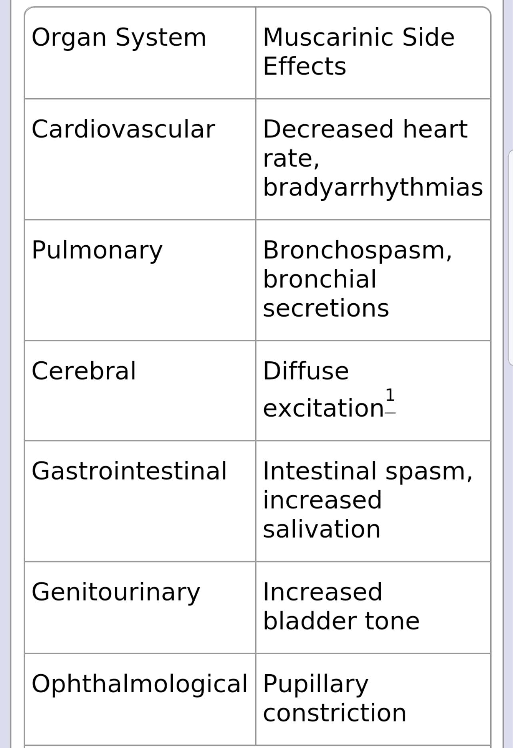
Muscarinic side effects of
Cholinesterase inhibitors:

Slide 56
Unwanted muscarinic side effects are minimized by prior or concomitant administration of anticholinergic medications, such as atropine sulfate or glycopyrolate.
Atropine has faster onset and shorter duration of action than glycopyrolate.

Slide 57
Succinylcholine is not metabolized by acetylcholinesterase, it unbinds the receptor and diffuses away from the neuromuscular junction to be hydrolyzed in the plasma and liver by another enzyme, pseudocholinesterase (nonspecific cholinesterase, plasma cholinesterase, or butyrylcholinesterase)
The ONLY time neostigmine reverses neuromuscular block after succinylcholine is when there is a phase II block AND sufficient time has passed for the circulating concentration of succinylcholine to be negligible

Slide 58
Sugammadex, a cyclodextrin, is the first selective relaxant-binding agent; it exerts its reversal effect by forming tight complexes in a 1:1 ratio with steroidal nondepolarizing agents (vecuronium, rocuronium,)
it does not act on Ach receptors . This drug has been in use in the European Union for the past few years. And FDA approved in the U.S.
In doses of 2 mg/kg , sugamadex will reverse both rocuronium and vecuronuim from a TOF of 2 to TOF of 0.9 in 2-4 min.
doses of 4 mg/kg , sugamadex will reverse deeper levels of neuromuscular block to TOF of 0.9 within 2.9 min.
Immediate reverse from profound block such as that encountered during failed RSI in which mask ventilation is not possible ( cannot intubate ,cannot ventilate) requires doses of 16mg/kg of sugamadex to reverse the relaxant effect of rocuronuim.
Sugamadex has no side effects related to coagulation profile, respiratory or cardiovascular system.
Sugamadex is reliable in reversing the action of rocuronuim in morbidely obese patients, in patients with neuromuscular disorders and after intense neuromuscular block, within very short period of time and far shorter than the reverse induced by neostigmine .
Sugamadex is not effective in reversing the effect of benzylisoquinoline type of muscle relaxants.

Slide 59
The newer neuromuscular blocking agents, such as gantacurium, which are still under investigation, show promise as ultrashort-acting nondepolar- izing agents; they undergo chemical degradation by rapid adduction with L-cysteine.

Slide 60
Thank you

