Slide 1
BURNS

Slide 2
Outline
Epidemiology
Etiology
Classification of Burns
  Burn Extent
  Burn Severity
Treatment
Surgical interventions
Complications

Slide 3
Epidemiology
In the US, ~ 500,000 people treated annually.
~ 4,000 people die as a consequence of injuries caused by fire and smoke inhalation
In 2011, there were 45,000 hospitalizations, of which 25,000 were in specialized burn centers

Slide 4
Definition & Etiology
Injuries to tissues (typically skin) caused by:
  Heat (majority of cases)
    Fires
    Scalding (from steam or hot liquids)
  Electricity
  Chemicals
    Strong acids or bases, oxidants
  Radiation
    Sunburn, medical radiation treatment

Slide 5
Classification

Slide 6
Classification- Burn Extent
Determined by total body surface area (TBSA)
  Rule of 9’s used to quickly estimate TBSA
  Lund and Browder chart- more specific
  ‘Palm’ method

Slide 7
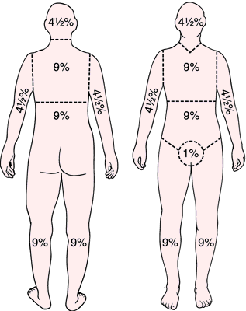
Wallace Rule of 9’s
Head & neck = 9%
Thorax (front) = 9%
Abdomen (front) = 9%
Each upper limb = 9%
Each lower limb (front) = 9%
Genitalia = 1%
Patient’s palm surface = 1%

Slide 8
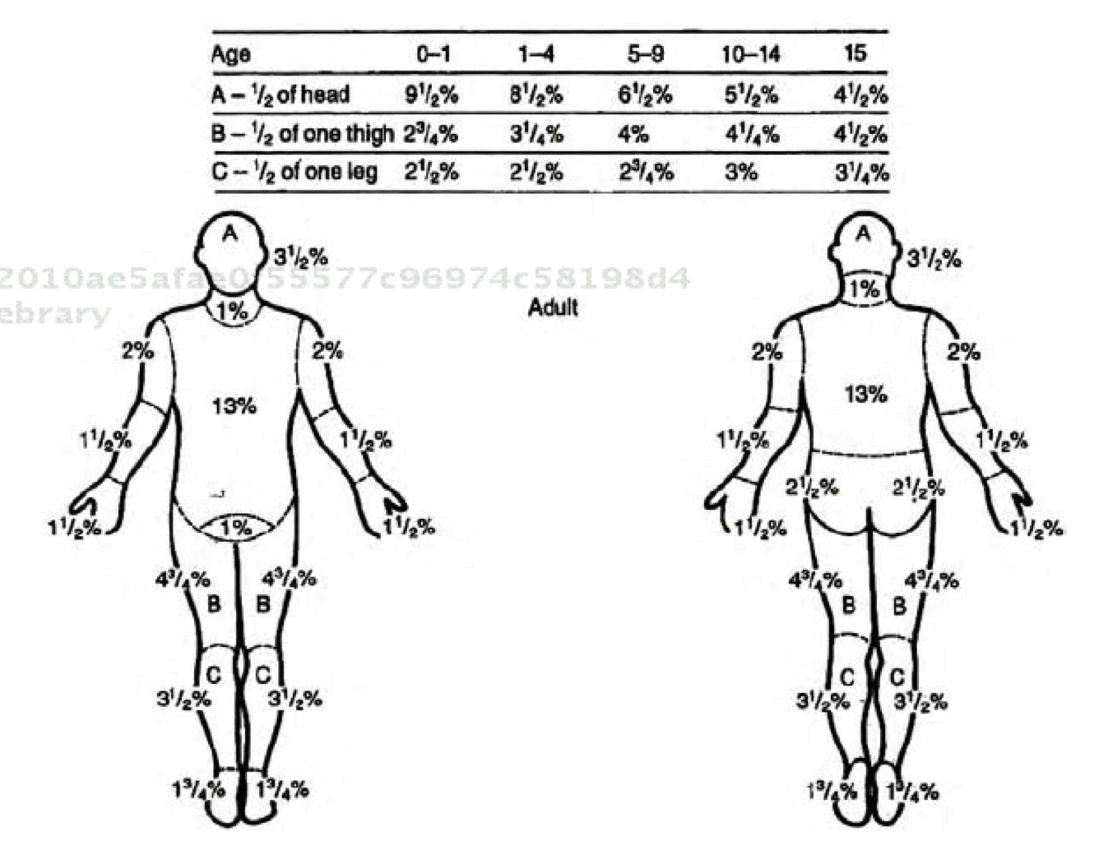
Lund and Browder Estimation of Burns
Notes:
FIGURE 5.
Modified Lund and Browder chart for estimating the area of burns. This approach is considered the most accurate for use in pediatric patients. The figures can be colored in with red for full-thickness burns and blue for partial-thickness burns. (2nd = second-degree burn; 3rd = third-degree burn; TBSA = total percentage of body surface area)

Slide 9
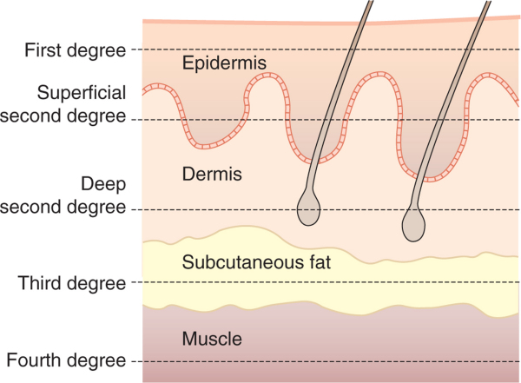
Classification- Burn Severity
1st degree (superficial)
2nd degree (partial thickness)
3rd degree (full thickness)
4th degree (full thickness)

Slide 10
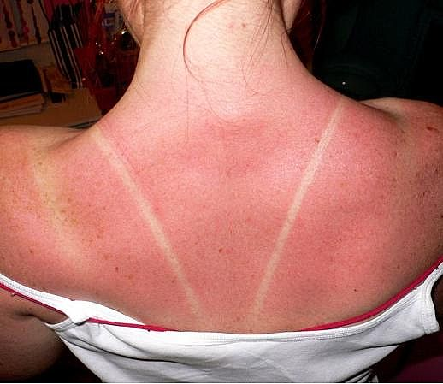
Burn Severity
First degree (superficial)
  Limited to epidermis
  Commonly due to scalding or sunburn
  Erythema, pain, edema, but no blistering
  Heals in <1wk
  No scarring

Slide 11
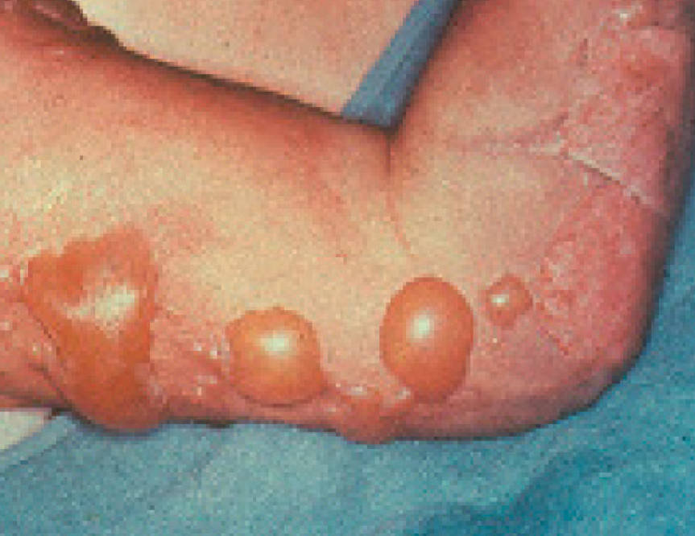
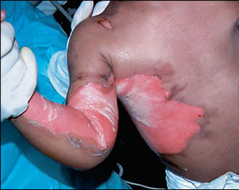
Burn Severity
Second degree (partial thickness)
  Involves epidermis with variable dermal involvement
  Very painful
  Erythema, blistering/raw skin
  Takes weeks to heal
  Complications include local infection/cellulitis
Difference between superficial and deep partial thickness:
  Superficial: blanches with pressure
  Deep: does not blanch with pressure
Superficial partial thickness
Deep partial thickness
Notes:
Risk of scarring w/ deep partial thickness burns

Slide 12
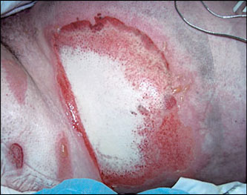
Burn Severity
Third degree (full thickness)
  Loss of epidermis and dermis
  Painless
  Usually has a stiff, white-brown appearance
  May have significant edema surrounding burn
  Loss of ability to re-epithelialize → scarring
  Needs debridement, excision and grafting

Slide 13
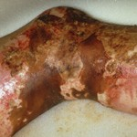
Burn Severity
Fourth degree (full thickness)
  Loss of epidermis, dermis and subcutaneous tissue
  Damage of muscles, fascia and/or bone
  Appears black and charred

Slide 14
Complications

Slide 15
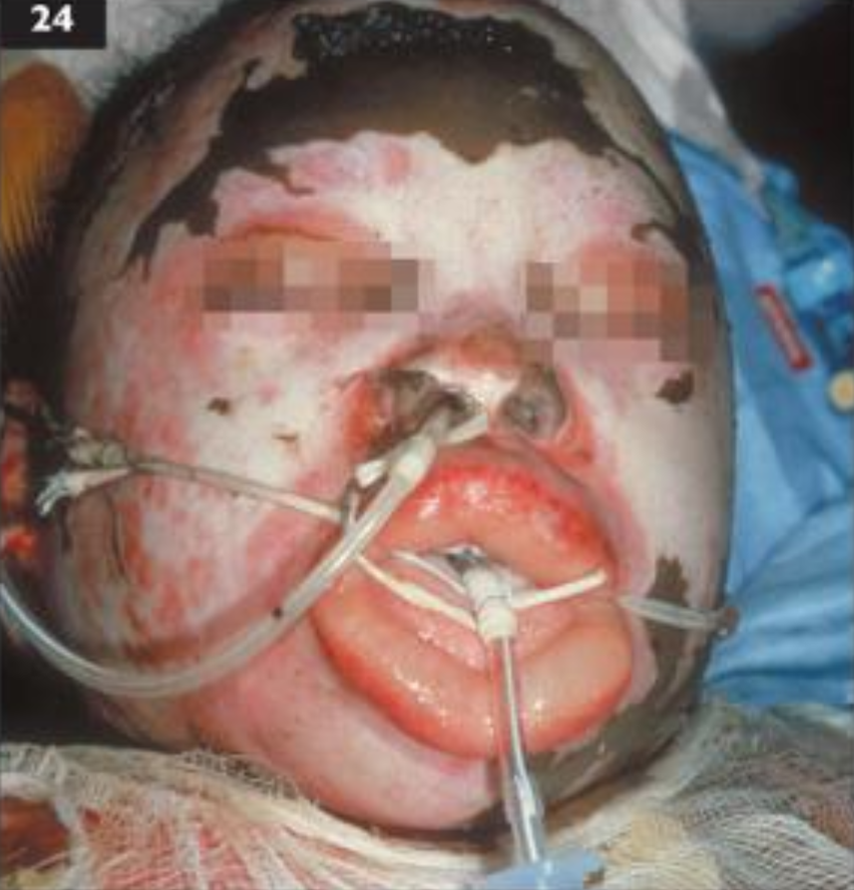
Complications
Infection
  Common organisms:
    Pseudomonas
    Streptococcus, S. aureus, E. coli
  Check tetanus immunization status
Hypermetabolic state
Acute tubular necrosis
Contractures
Hypertrophic scarring
Respiratory distress
Edema*
  Compartment syndrome
  Airway obstruction
Notes:
If it’s > 5 yrs since last immunization for tetanus → give a tetanus booster.
Burn patients have the highest metabolic rate of all critically ill or injured patients. The metabolic response to a severe burn injury is characterized by a hyperdynamic cardiovascular response, increased energy expenditure, accelerated glycogen and protein breakdown, lipolysis, loss of lean body mass and body weight, delayed wound healing, and immune depression [1, 2]. This response is mediated by increases in circulating levels of the catabolic hormones, catecholamines, cortisol, and glucagon [3]. Catecholamines increase up to 10 times normal. Catabolism after major burn injury begins on the 5th day after injury and continues up to 9 months later [4]. Increasing age, weight, and delay in definitive surgical treatment predict increased catabolism in children. In adults, the response increases up to age 50 where it plateaus [5]. The body surface area burned increases catabolism until a 40% body burn is reached. The magnitude of metabolic expenditure is 1.5 to twice normal in burns of greater than 40% total body surface area (TBSA). Catabolism is further increased by 50% with environmental cooling or the development of sepsis.
Hypermetabolism and muscle protein catabolism continue long after completion of wound closure [4]. Protein breakdown continues 6 and 9 months after severe burn. There is almost complete lack of bone growth for 2 years after injury resulting in long-term osteopenia which may adversely affect peak bone mass accumulation [6, 7].
Contracture develops when elastic connective tissues are replaced by inelastic fiber like tissue. This makes it hard to stretch the area and prevents normal movement

Slide 16
Treatment

Slide 17
Treatment
American Burn Association criteria for transfer to burn center:
  2nd degree burns > 10% TBSA
  3rd degree burns
  Burns to face, hands, feet, genitalia, perineum
  Electrical burns (including lightning injury)
  Chemical burns
  Inhalation injury
  Patients with pre-existing conditions

Slide 18
Treatment
1st degree burns
  None required
  Moisturizers
  Topical anesthetic

Slide 19
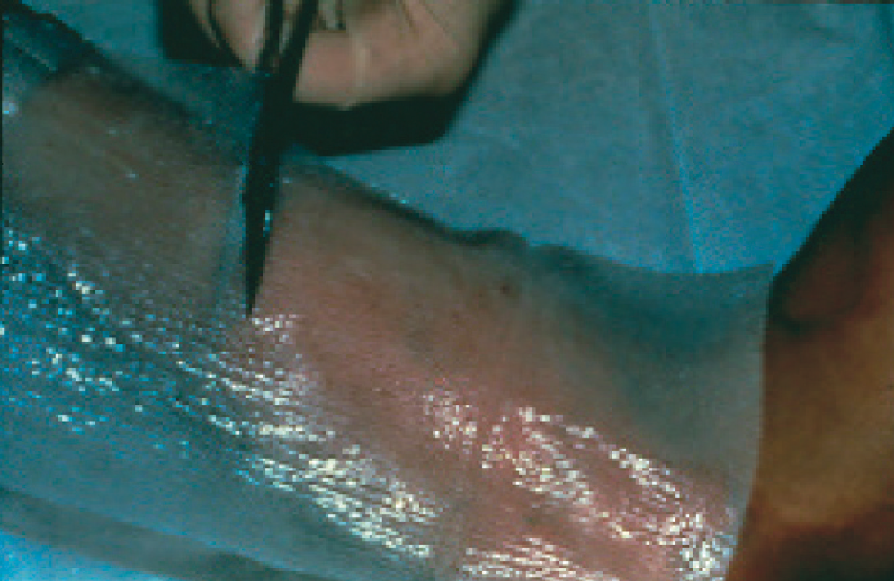
Treatment
2nd degree burns:
  Debridement
  Topical antibiotic
  Silver sulfadiazine (for dirty wounds)
  Petroleum jelly + gauze
  Temporary skin substitute
  Dressing changes as necessary
  Pain management
  HBOT

Slide 20
Treatment
3rd and 4th degree burns:
  Stop any continuing burn injury
  Airway management
    Intubate before respiratory problems
    FiO2 100%
    Check ABG, and CO level (carboxyhemoglobin >10% significant)
  Temperature regulation (keep patients warm)
  Fluid resuscitation (if > 20% TBSA)
  Topical antibiotics
  Surgical treatment
    Excision of burned area followed by skin grafting
  Enteral nutrition
  HBOT

Slide 21
Treatment
Fluid resuscitation for adults
  Parkland formula: calculates amount of resuscitation fluid required for the first 24 hrs **does not apply to larger burns
  First 24h - Lactated Ringer’s solution 4mL/kg/% burn
  Give first half resuscitation volume over first 8 hours
  Give second half resuscitation volume over next 16 hours
  Monitor urine output: 30-50 cc/hour
After 24h – Lactated Ringer’s solution 1 mL/kg/% burn daily
Notes:
Ringer’s lactate (1L) contains:
130 mEq of sodium ion = 130 mmol/L
109 mEq of chloride ion = 109 mmol/L
28 mEq of lactate = 28 mmol/L
4 mEq of potassium ion = 4 mmol/L
3 mEq of calcium ion = 1.5 mmol/L
Ringer’s lactate (lactate ringer’s solution) osmolarity = 273 mOsm/L (therefore isotonic to blood) -> this is a crystalloid type of solution
Colloid solutions: have larger molecules such as starch or gelatin

Slide 22
Surgical Interventions

Slide 23
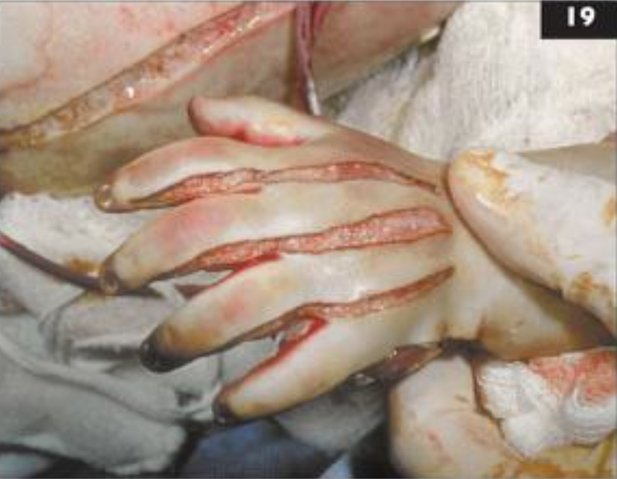
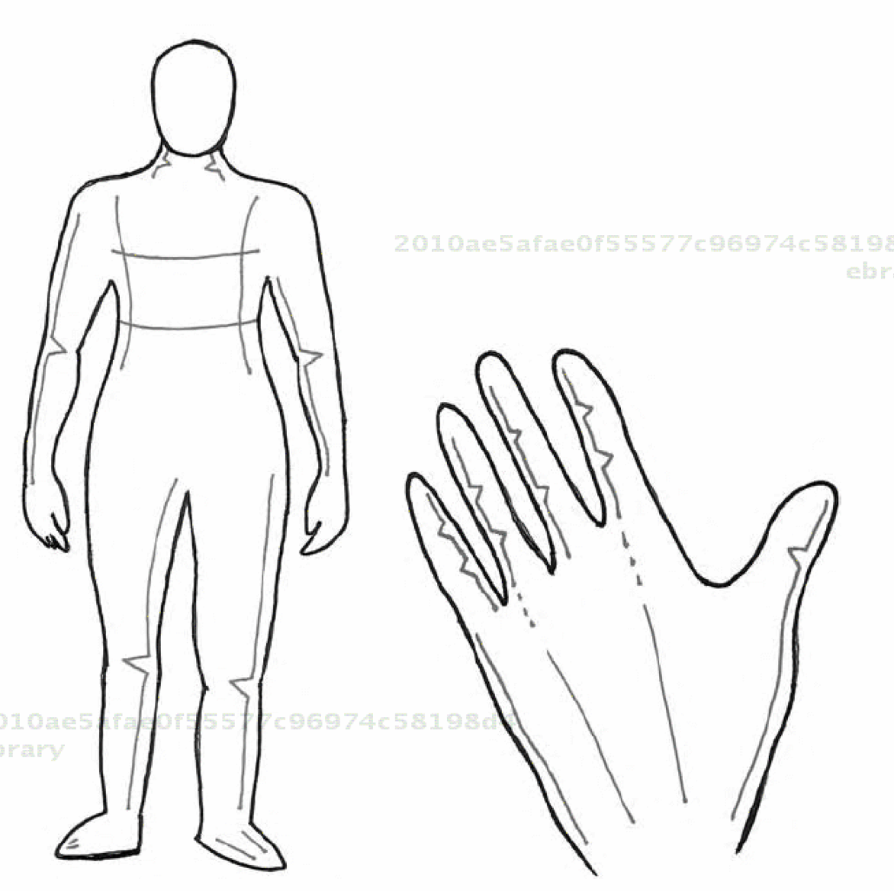
Surgical Interventions

Slide 24
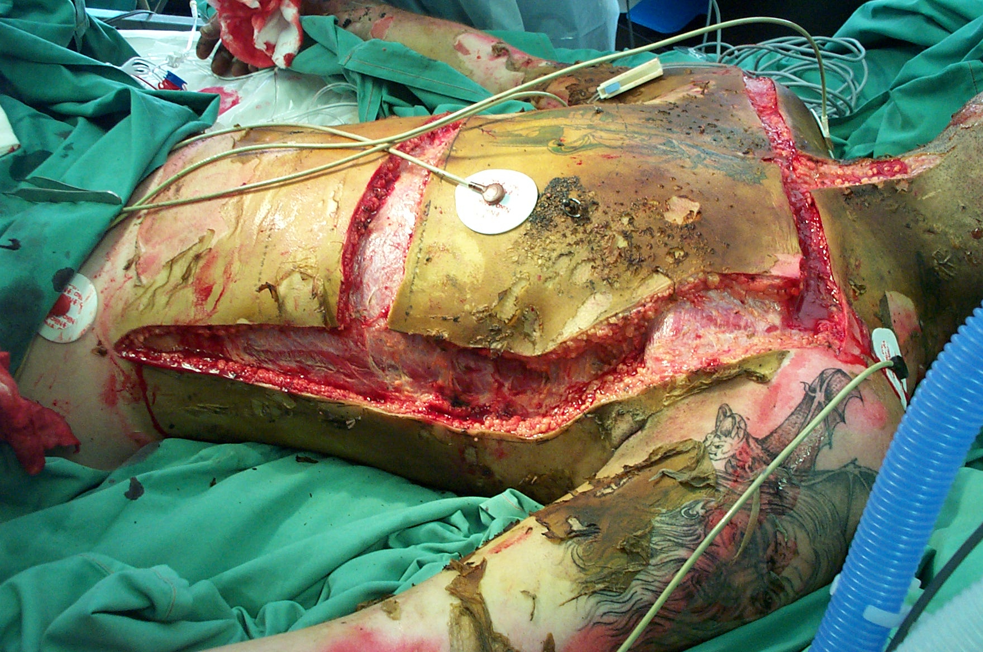
Surgical Interventions

Slide 25
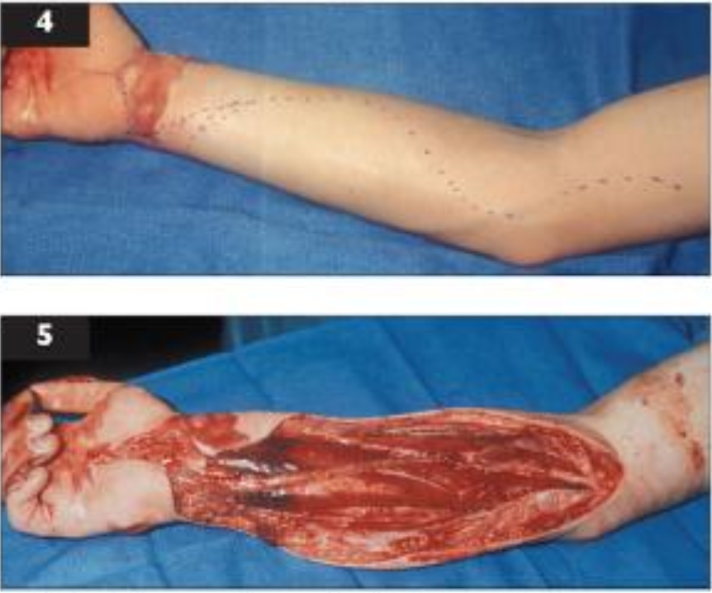
Surgical Interventions

Slide 26
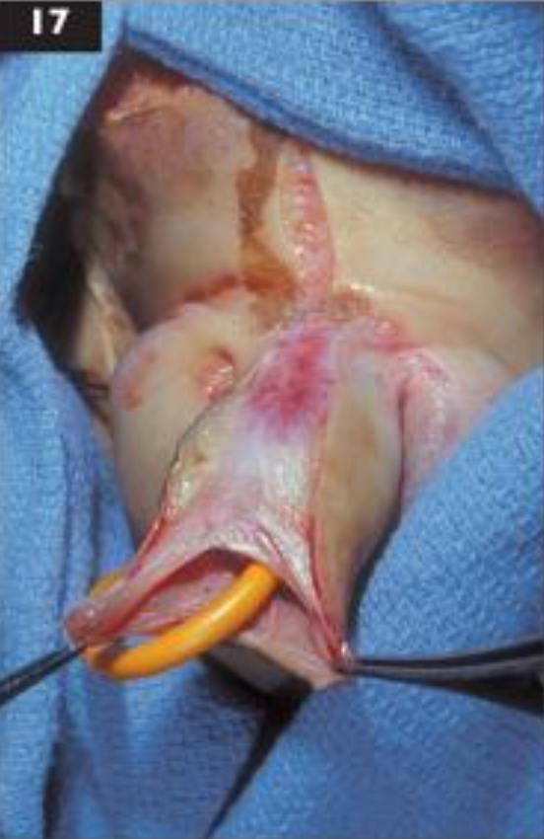
Surgical Interventions

Slide 27
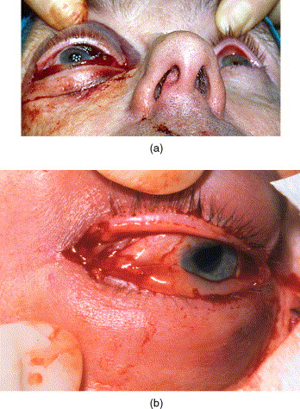
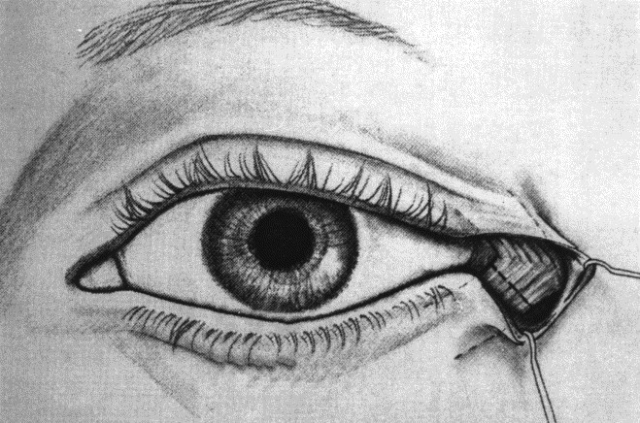
Surgical Interventions

Slide 28
Prognosis

Slide 29
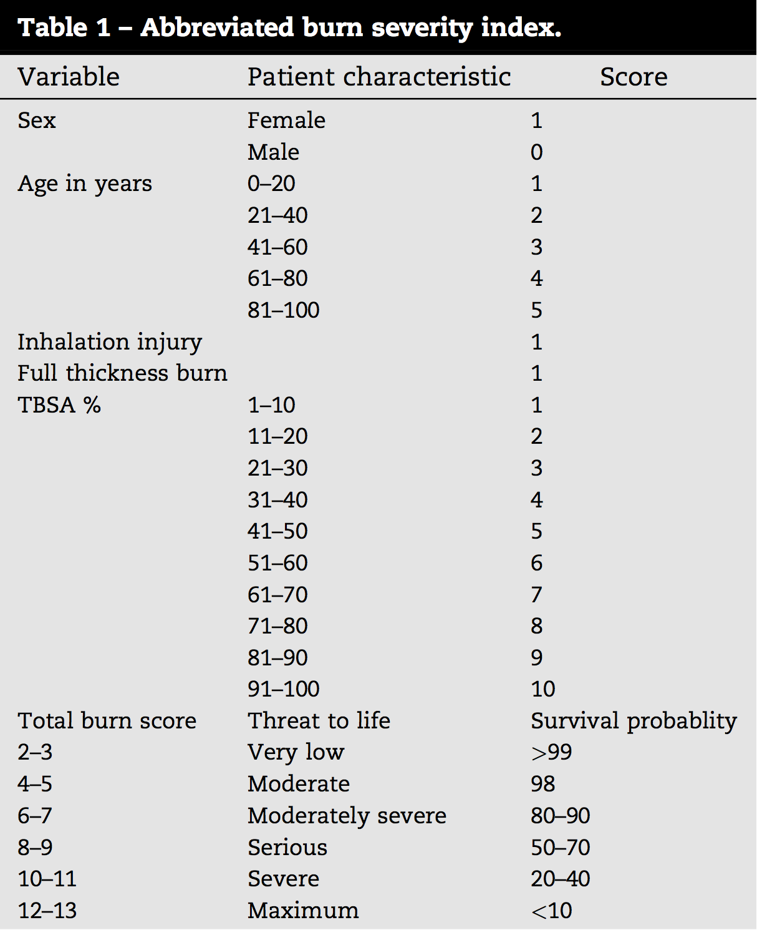

Slide 30
Prognosis
With regard to prognostic scoring systems for burns:
  “There is no evidence to support their use at the bedside for decision-making.” -Sheppard, NN, 2011

Slide 31

Questions

