Slide 1
Dog, cat and human bite
Dr. Bareqa

Slide 2
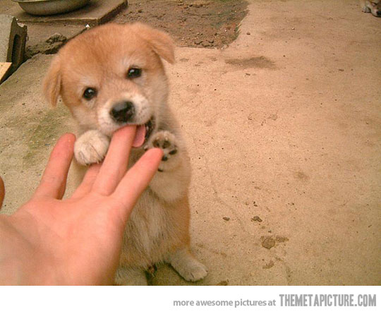

Dog bite
An adult dog can exert 200 pounds per square inch (psi) of pressure, with some large dogs able to exert 450 psi.
Such extreme pressure may damage deeper structures such as bones, vessels, tendons, muscle, and nerves.

Slide 3
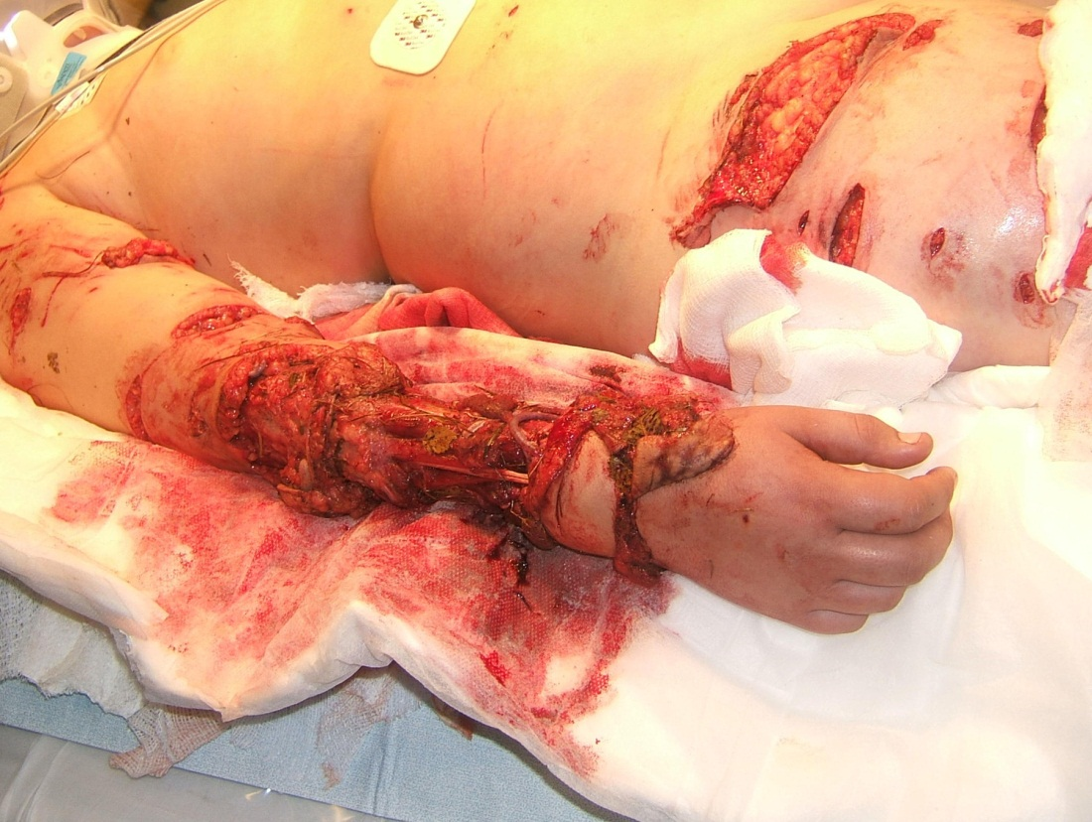
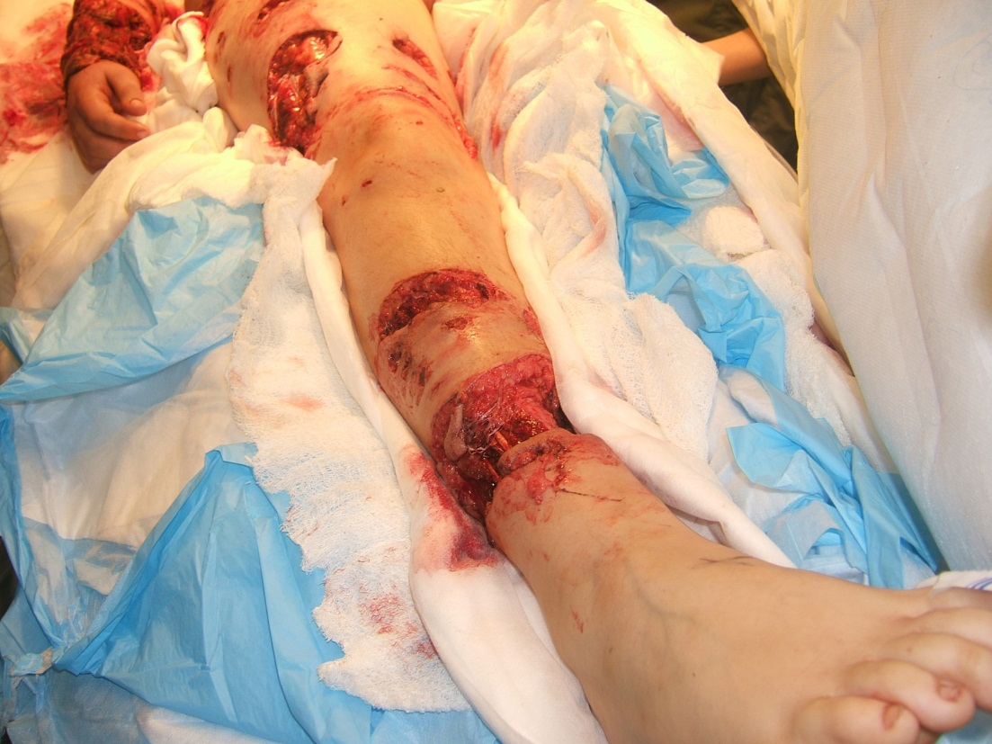
Dog bites typically cause puncture wounds, lacerations and crush injuries caused by rounded teeth and strong jaws.

Slide 4
Dog Bite - Microbiology
Staphylococcus species
Streptococcus species
Eikenella species
Pasteurella species (multocida, canis)
Proteus species
Klebsiella species
Haemophilus species
Enterobacter species
DF-2 or Capnocytophaga canimorsus
Bacteroides species
Moraxella species
Corynebacterium species
Neisseria species
Fusobacterium species
Prevotella species
Porphyromonas species
Dog bites contain Pasteurella multocida in about 25% of cases, other Pasteurella species in up to 25% of cases, as well as mixed anaerobes and Staphylococcus aureus

Slide 5
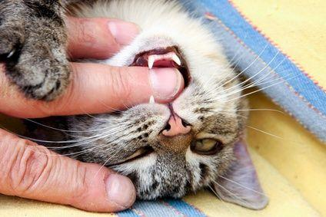

Cat bite
The sharp pointed teeth of cats usually cause puncture wounds and lacerations that may inoculate bacteria into deep tissues. Infections caused by cat bites generally develop faster than those of dogs.

Slide 6
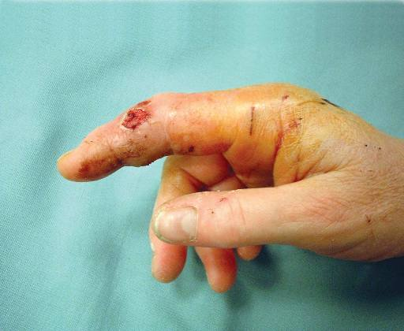
Cat bite - Microbiology
Pasteurella species**
Actinomyces species
Propionibacterium species
Bacteroides species
Fusobacterium species
Clostridium species
Wolinella species
Peptostreptococcus species
Staphylococcus species**
Streptococcus species
Cat bites also typically cause puncture wounds and contain Pasteurella multocida in about 50% to 75% of cases, as well as other aerobes and anaerobes, including S aureus .
28% to 80% of cat bites become infected
Finger infection from cat bite.
Animal and Human Bites of the Hand. American Society for Surgery of the Hand. Accessed 01/05/15 . Available on http://www.assh.org/handcare/hand-arm-injuries/animal-bites

Slide 7
What Is the Role of Preemptive Antimicrobial Therapy to Prevent Infection for Dog or Cat Bites?
Preemptive early antimicrobial therapy for 3–5 days is recommended for patients who
(a) are immunocompromised,
(b) are asplenic,
(c) have advanced liver disease,
(d) have preexisting or resultant edema of the affected area,
(e) have moderate to severe injuries, especially to the hand or face, or
(f) have injuries that may have penetrated the periosteum or joint capsule
Practice Guidelines for the Diagnosis and Management of Skin and Soft Tissue Infections. Clin Infect Dis. (2014)doi: 10.1093/cid/ciu296. First published online: June 18, 2014

Slide 8
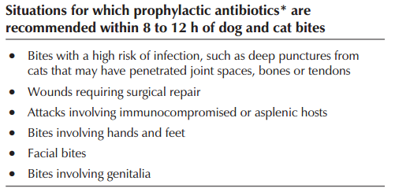
Dog and cat bites in pediatric
Management of dog bites in children. Canadian Family Physician October 2012 vol. 58 no. 10 1094-1096
When your best friend bites: A note on dog and cat bites. Can J Infect Dis. 2000 Sep-Oct; 11(5): 227–229.

Slide 9
What Is the Treatment for Infected Animal Bite–Related Wounds?
An antimicrobial agent or agents active against both aerobic and anaerobic bacteria such as amoxicillin-clavulanate should be used (strong, moderate).
Practice Guidelines for the Diagnosis and Management of Skin and Soft Tissue Infections. Clin Infect Dis. (2014)doi: 10.1093/cid/ciu296. First published online: June 18, 2014

Slide 10
Types of wound
Purulent, abscess | Usually polymicrobial (mixed aerobes and anaerobes) Pasteurella species are commonly isolated from both nonpurulent wounds with or without lymphangitis and from abscesses.
Nonpurulent | Staphylococci, streptococci, polymicrobial

Slide 11
Antibiotic of choice?
Antibiotics | Comment
Amoxicillin-clavulanate | Covers the most likely aerobes and anaerobes
Second-generation cephalosporins | plus anaerobic coverage (clindamycin or metronidazole)
Carbapenem
Moxifloxacin
Doxycycline
SMX-TMP or levofloxacin | plus anaerobic coverage (clindamycin or metronidazole)
Microlides | avoid due to variable activity against Pasteurella multocida and fusobacteria
Practice Guidelines for the Diagnosis and Management of Skin and Soft Tissue Infections. Clin Infect Dis. (2014)doi: 10.1093/cid/ciu296. First published online: June 18, 2014

Slide 12
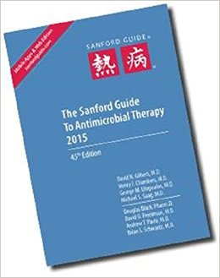
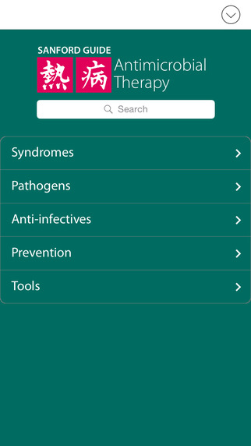
Sanford Guide Antimicrobial Therapy 2015
 | Sensitive | Resistance
P. canis (dog) | Ceftriaxone, Cefuroxime, Fluoroquinolone | Dicloxacillin, Cephalexin, Clindamycin, Erythromycin
P. multocida (cat) | Penicillin 2nd-3rd Gen Cephalosporin Fluoroquinolone Azithromycin??? | Dicloxacillin, Cephalexin, Clindamycin, Erythromycin
If culture is + for only P. multocida, switch to Pen VK PO or Pen G IV.

Slide 13
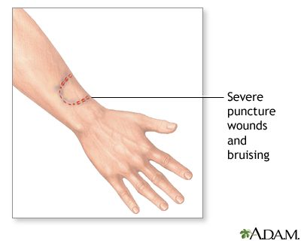
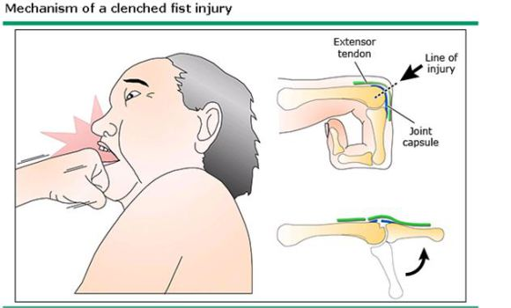
Human bite
Occlusion bites occur when the teeth are sunk into the skin with sufficient force to breach the integrity of the skin.
Clenched fist injuries occur when a closed fist impacts another individual's teeth, leaving an injury over the dorsal aspect of the third, fourth or fifth metacarpophalangeal (MCP) joints, most classically over the third MCP.

Slide 14
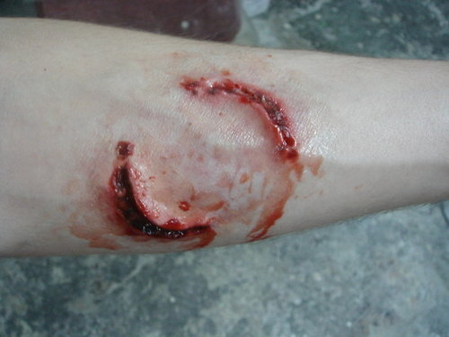
Occlusive bites
Occur when there is sufficient force to break the skin.
Hands have a higher infection rate than similar bites to other parts of the body because of the thinness of the skin in this area.

Slide 15
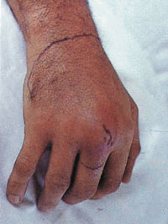
Clenched-fist injury
  most common ,greater clinical significance.
  small wound, usually 3-8 mm in length.
  As the fingers extend following injury, the bacterial inoculum may be carried proximally with the extensor tendons.
  This makes adequate irrigation of the wound more difficult.
  These are the most serious human bite wounds, and they require the most aggressive treatment.

Slide 16
Human bite- Microbiology & Etiology
Eikenella corrodens -30%
Staphylococcus aureus- 30%
Staphylococcus epidermidis-53%
Viridans Streptococcus-100%
Corynebacterium sp -41%
Bacteroides sp – 82%
Fusobacteria sp ?
Prevotella species ?
Peptostreptococcus sp- 26%
Hepatitis B (75% in saliva,100x>HIV)
HIV
Aggressive behavior,
Rough sexual play or sexual assault
Domestic violence
Child abuse
Occupational injury to dental personnel
Seizure-related tongue lacerations
Nose biting
Accidents during sporting events
Aggressive play of children in daycare centers
Self-inflicted wounds in persons who are emotionally disturbed or mentally handicapped

Slide 17
Antibiotic of choice?
 | Antibiotics | Comment
IDSA | Amoxicillin-clavulanate
 | Unasyn
 | Ertapenam
 | Ciprofloxacin plus Metronidazole | Hypersensitivity to β-lactams
 | Levofloxacin plus Metronidazole
 | Moxifloxacin
NAG | Amoxicillin-clavulanate
 | Clindamycin + Ciprofloxacin | Hypersensitivity to β-lactams
 | Clindamycin + Bactrim
Sanford | Amoxicillin-clavulanate | Early, not yet infected
 | IV Unasyn, Tazocin Carbapenem can be used if IV is required | Later, sign of infection
Eikenella corrodens
S: Fluoroquinolones, beta-lactam-beta-lactamase inhibitor combination
R: first-generation cephalosporins, macrolides, clindamycin, metronidazole, Bactrim, and aminoglycosides
Practice Guidelines for the Diagnosis and Management of Skin and Soft Tissue Infections. Clin Infect Dis. (2014)doi: 10.1093/cid/ciu296. First published online: June 18, 2014
Sanford Guide Antimicrobial Therapy 2015
National Antibiotic Guideline 2nd ed. V1.2. accessed on 16/6/15

Slide 18
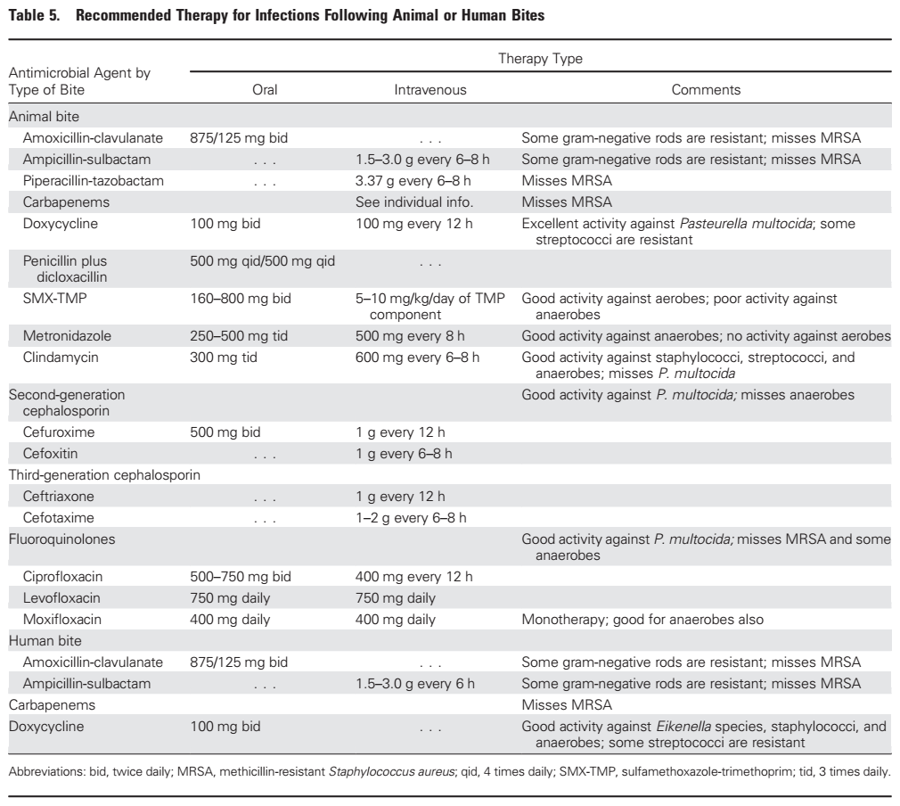

Slide 19
Dose in Sanford Guide
Animal | First choice | Alternative
Dog | PO Augmentin 875/125mg BD or 500/125 mg TDS | Adult: PO Clindamycin 300mg QID + Fluoroquinolone Pediatric: Clindamycin + Bactrim
Cat | PO Augmentin 875/125mg BD or 500/125 mg TDS | PO Cefuroxime 500mg Q12H or Doxycycline 100mg BD If culture is + for only P.multocida, switch to Pen VK PO.
Human | Early (not yet infected) Augmentin 875/125mg BDx5/7 Later (Sign of infection,3-4H) IV Unasyn 1.5-3g Q6H IV Tazosin 4.5g Q6-8H | Penicillin allergic Clindamycin+ (Ciprofloxacin or Bactrim)

Slide 20
Conclusion
Antibiotic prophylaxis is warranted if the wound is believed to be at higher risk for infection (eg, significant contamination is present; bone, tendon, or joint space is involved; the bite is on the hand; deep puncture wounds are present; or bites occurring in high-risk patients).
The clinician should be aware that the Infectious Diseases Society of America (IDSA) clinical practice guidelines state that all human bite wounds require antibiotic prophylaxis.[
However, a large clinical trial showed that prophylaxis of human bites that do not penetrate the epidermal layer or are not in high-risk areas is probably unnecessary
Cloxacillin, Cephalexin???

