Slide 1
Wound healing process

Slide 2
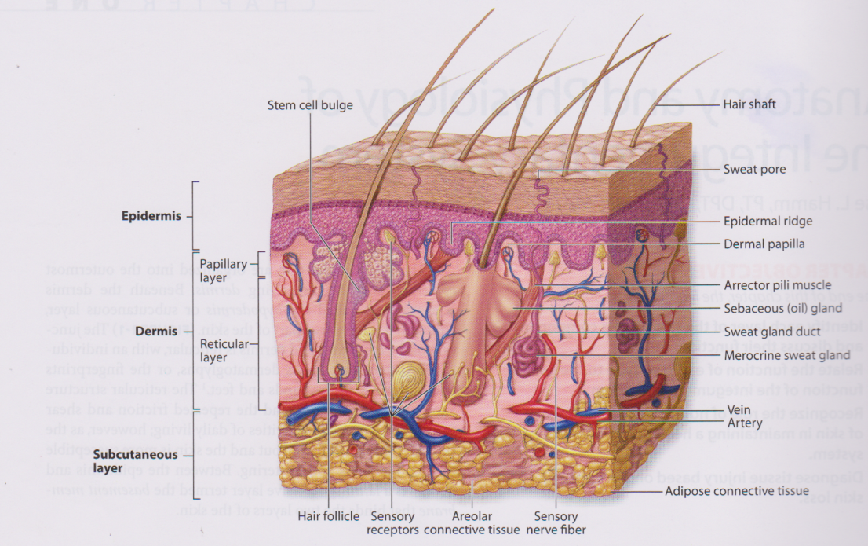
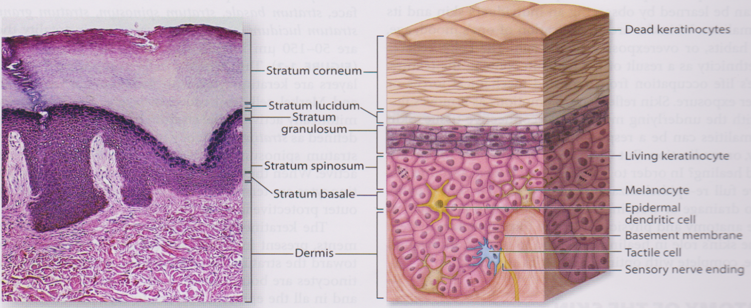
Anatomy of the skin

Slide 3
Physiology & Function of the skin
          Physiology→
          vascular supply
          nerve suply
          skin nutrition
          skin renewal
          Function→
          protection from enviroment
        sensation
          prevention of fluid loss
          immunity
          thermoregulation
          protection from ultraviolet rays
          synthesis & storage of vitamin D
          Esthetic & communication

Slide 4
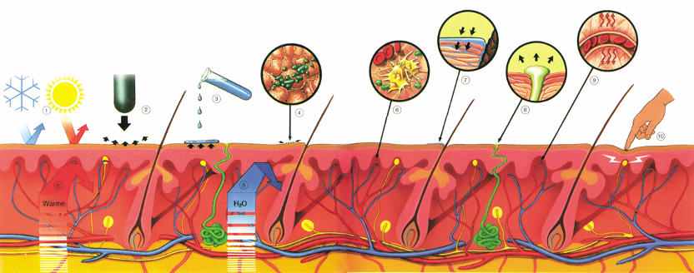
Skin: Constitution and Function
 Protection against cold, heat, radiation
❐ Absorption of active agents
● Protection against chemicals
 Regulation of circulation and temperature
□ Protection against microbes
 Protection against pressure and friction
7
9
1
2
3
6
4
8
10
5
5
■ Protection against loss of temperature and water
⬧ Sense of pressure, touch, pain and temperature

Slide 5
What’s is wound
Defines Wound ( Dorland medical dictionary) → a diruption in normal contuinity of a body structure
The term “Wound “→
  Usually related to an acute injury or an acute mechanicel trauma such as gunshot wound or a stab wound
  Chronic wound related to any wound that fails to heal within a reasonable periode

Slide 6
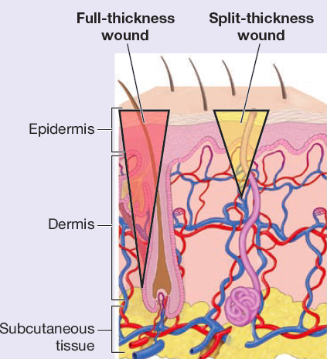
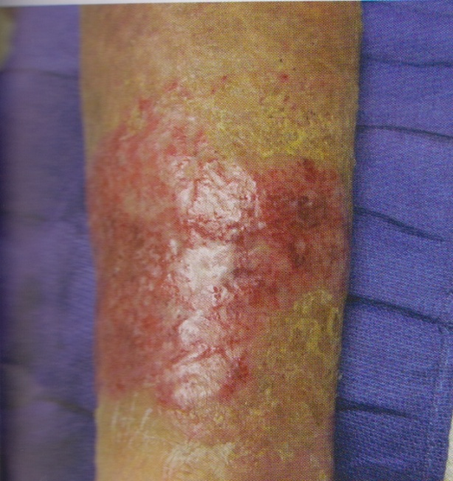
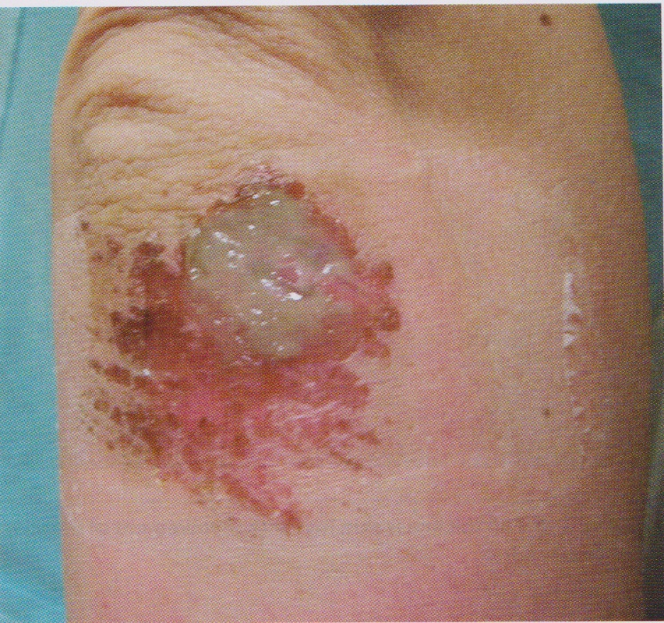
Definition of skin loss
Erosion→ loss of superficial epidermis, dermis no involvment
Partial thickness skin loss→ loss of epidermis & part of dermis

Slide 7
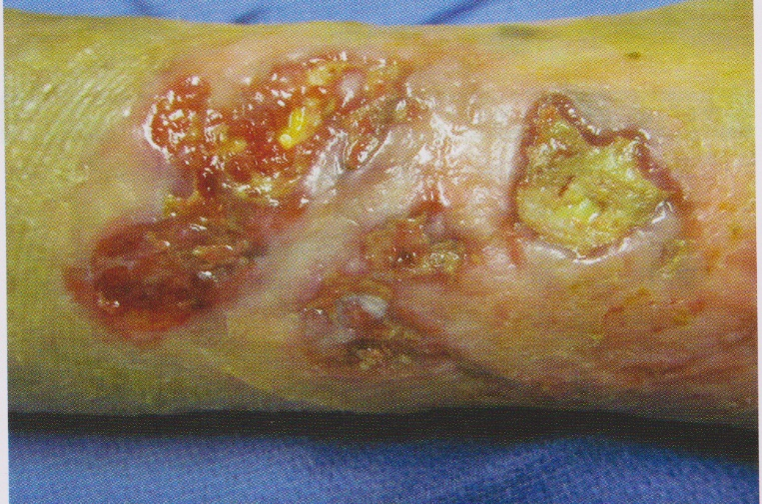
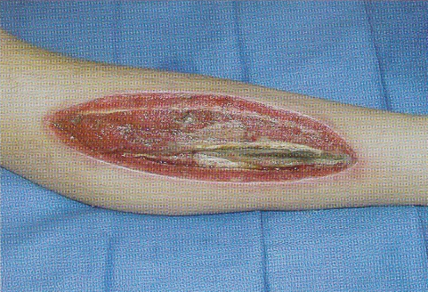
Full-thickness loss with envolvement of muscle, bone and tendon
Definition of skin loss…
Full-thickness loss
Loss of the epidermis & dermis extending into subcutaneous tissue, in some cases involving bone tendon or muscle

Slide 8

Why is it important to understand how wounds heal?
  An understanding of normal wound healing enables recognition of abnormal healing (Dealey 1994).
  Recognition of the phases of wound healing will assist with planning implementation and evaluation of wound management, including the selection of appropriate dressings.

Slide 9
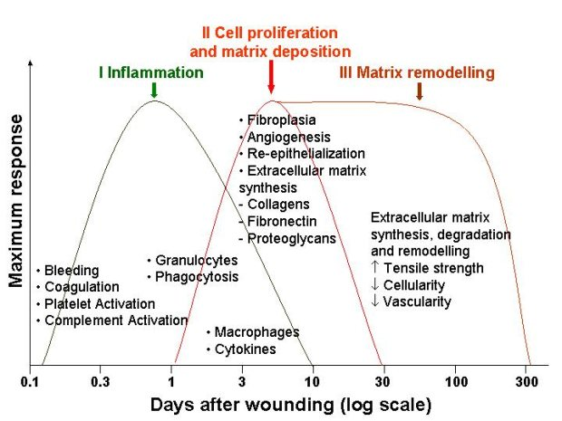
Wound healing stages
Inflammatory phase
Proliferative phase
Remodelling phase
Modules 2 & 3
International wound infection institute

Slide 10
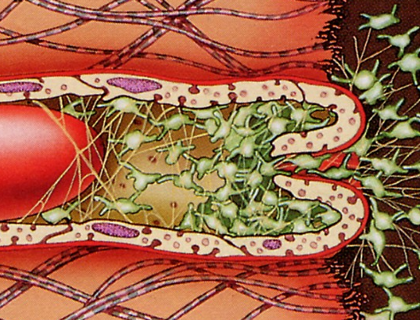
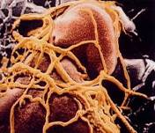
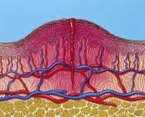
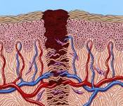
Physiology of Wound Healing
Wound Healing Phases
Vascular Response
Blood Coagulation
Inflammation
Formation of New Tissue
Vascularisation
Rebuilding of the connective tissue
Granulation
Epithelisation
Remodelling
    By the release of tissue factors vasoconstriction followed by vasodilatation
Plasma factors
Activation of the immune system

Slide 11
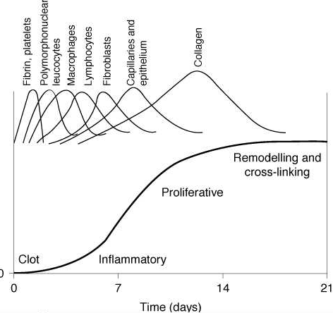
Wound Healing Phases
Vascular Response (VR)
by the release of tissue factors
vasoconstriction followed by vasodilation
Blood Coagulation (BC)
Platelets adhere to the exposed vessel wall
and change their form.
Afterwards they release substances
attracting further platelets.
Than they clump together to form a thrombus
leading to the release of platelet factors and
fibrin synthesis.
This induces the blood coagulation process,
which is a chain reaction involving 13 coagulation
factors.
Maturation
Proliferation
BC
Inflammation
VR

Slide 12
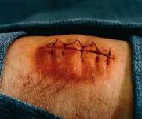
Wound Healing Phases
Inflammation
Catabolic processes by which the wound
is cleansed
Activation of the immune system consisting of
the non-specific defence system:
Complement factors, phagocytic cells, neutrophil
granulocytes, monocytes, macrophages
and the specific defence system:
B-lymphocytes, T-lymphocytes
Main symptoms of inflammation:
Redness of the skin
Increased temperature of the skin
Swollen skin
Pain
Functional disorder
Maturation
Proliferation
VR
BC
Inflammation

Slide 13
Wound Healing Phases
Formation of New Tissue (Proliferation)
Granulation formation / growth of blood vessels and connective tissue
Endothelial cells form capillary network growing into the wound.
Fibroblasts produce collagen network.
Fibroblasts divide and make up the dermis.
Wound contraction
Special fibroblasts start the process of wound contraction
allowing edges to come together.
Epithelialisation
Resurfacing of the wound by new epithelial cells.
Maturation
Proliferation
Maturation / Remodelling
For a long time after the injury,
the scar tissue is reorganised by
restructuring of the collagen.
collagen fibres are broken down again by collagenases
and are newly cross-linked.
VR
BC
Inflammation

Slide 14
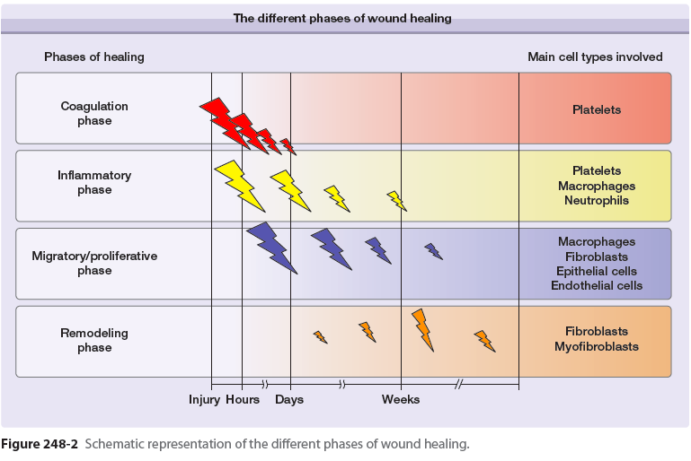
The phase of wound healing & key cell & events involved
Fitzpatrick’s, 2012

Slide 15
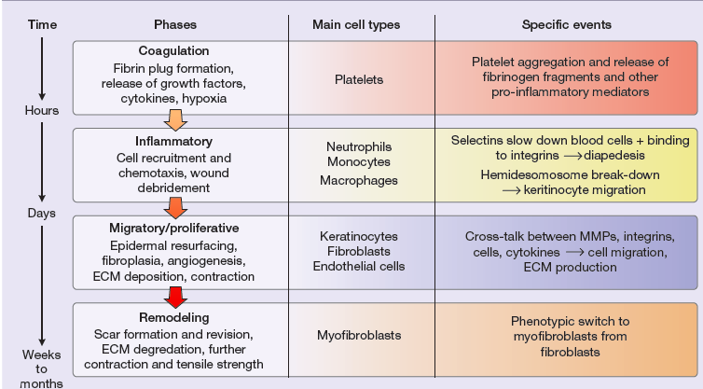
The phase of wound healing & key cell & events involved
Fitzpatrick’s, 2012

Slide 16
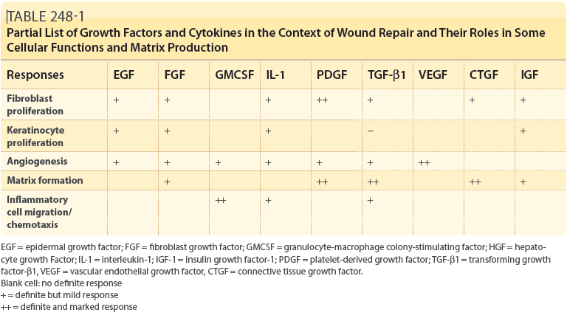
Growth factors &cytokine, the roles in some function & matrix production

Slide 17
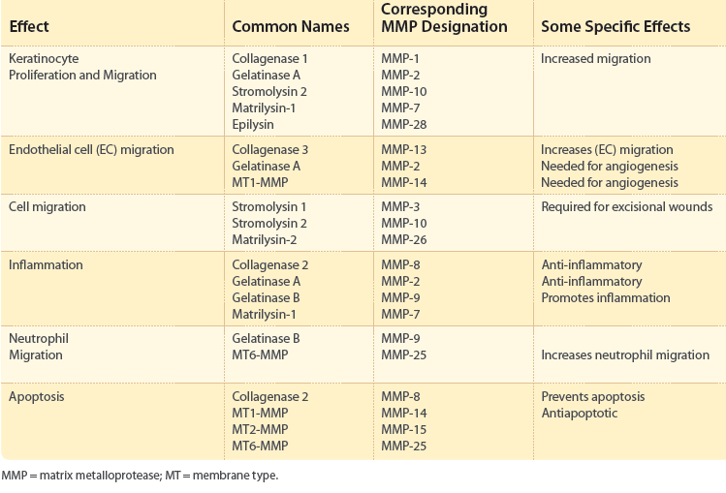
Matrixmetallo protein (MMP) functional effects on wound healing
Fitzpatrick’s, 2012

Slide 18
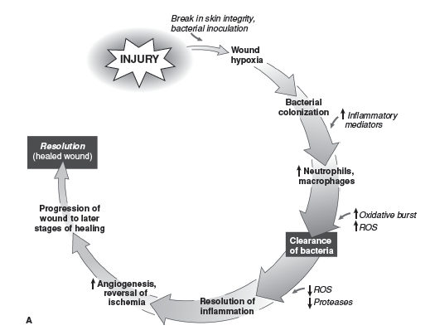
Grabb and Smith’s Plastic Surgery, 6^{ed}, 2007

Slide 19
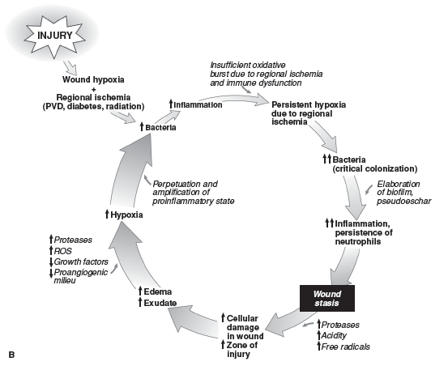
Grabb and Smith’s Plastic Surgery, 6^{ed}, 2007

Slide 20
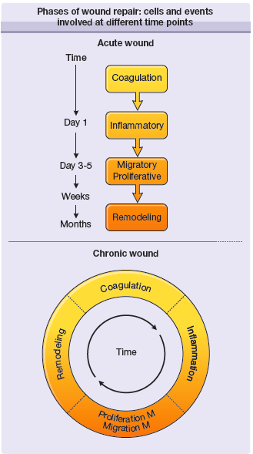
Phases of Wound repair
Acut wound
Chronic wound

Slide 21
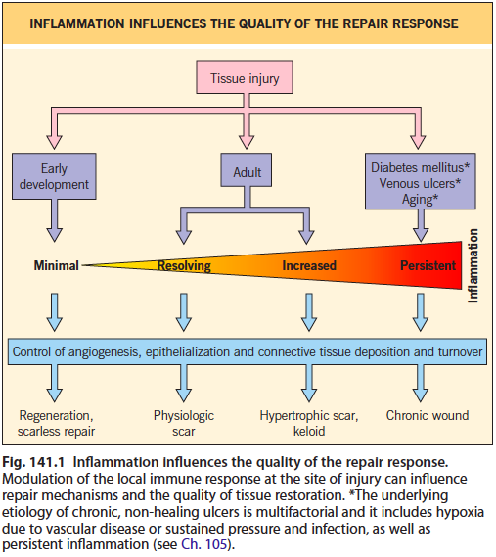
Inflammation influences the quality of the repair response

Slide 22
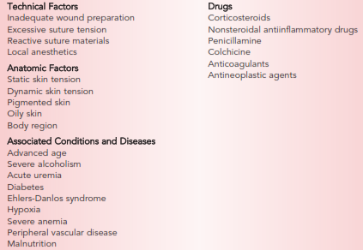
Interference with wound healing

Slide 23
Acute vs Chonic Wounds
 | Acute wounds | Chronic wounds
Healing Process | Regulated | Haphazard
Pathology | None | Underlying
Time to healing | Rapid | Slow
Inflammatory response | Short | Prolonged
Exudate | Reduced after 48 hours Promotes cellular proliferation | Prolonged Inhibits cellular proliferation
Bacterial Load | Low | High
Fibroblast proliferation | Active | Inactive
Excoriation/maceration | Infrequent | Frequent
Extracellular matrix | Normal remodelling | Defective remodelling
Vascular network | Good | Poor
Complications | Infrequent | Frequent
Progress | Heal | Fail to heal / recur
Modules 2 & 3
International wound infection institute

Slide 24
Acute vs Chonic Wounds
 | Acute wounds | Chronic wounds
Time bound | Of short duration | Do not heal within 4 weeks (Cullum et al 1997)
Recurrence | Unlikely to recur | Characterised by episodes of recurrence
Pathophysiology | No underlying disease process | Multiple underlying pathologies
Healing process | Orderly healing | Disordered healing, wound may improve and then deteriorate in a cyclical fashion
Inflammatory response | Progresses through inflammation to proliferative phase | Appears to be ‘stuck ‘ in late inflammatory phase (Hart 2002)
Exudate | Thought to be beneficial, exerts antimicrobial effect and contains growth factors | May be detrimental due to imbalance in production of MMPs and suppression of TIMPS
Quantity of exudate | Reduces as healing progresses | May remain high due to persistent inflammation
Aetiology | Surgical wounds, traumatic wounds, burns | Pressure ulcers, leg ulcers, diabetic foot ulcers, fungating wounds
Modules 2 & 3
International wound infection institute

Slide 25
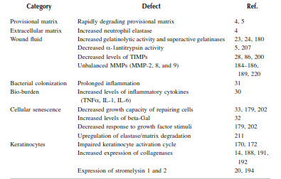
Abnormalities chronic dermal ulcers

Slide 26
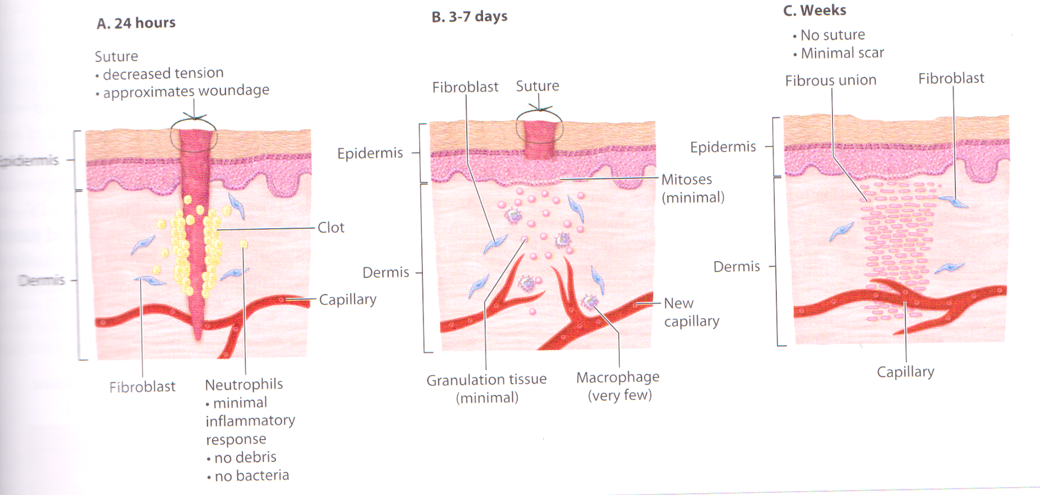
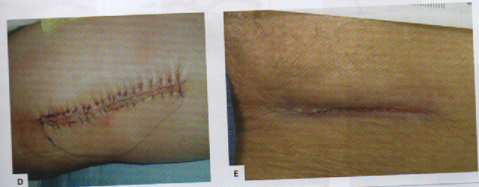
Type of healing response
Primary intention
Clean Incision surgical
No contamination from bacteria, yeast, forein bodies
mInimal tissue loss

Slide 27
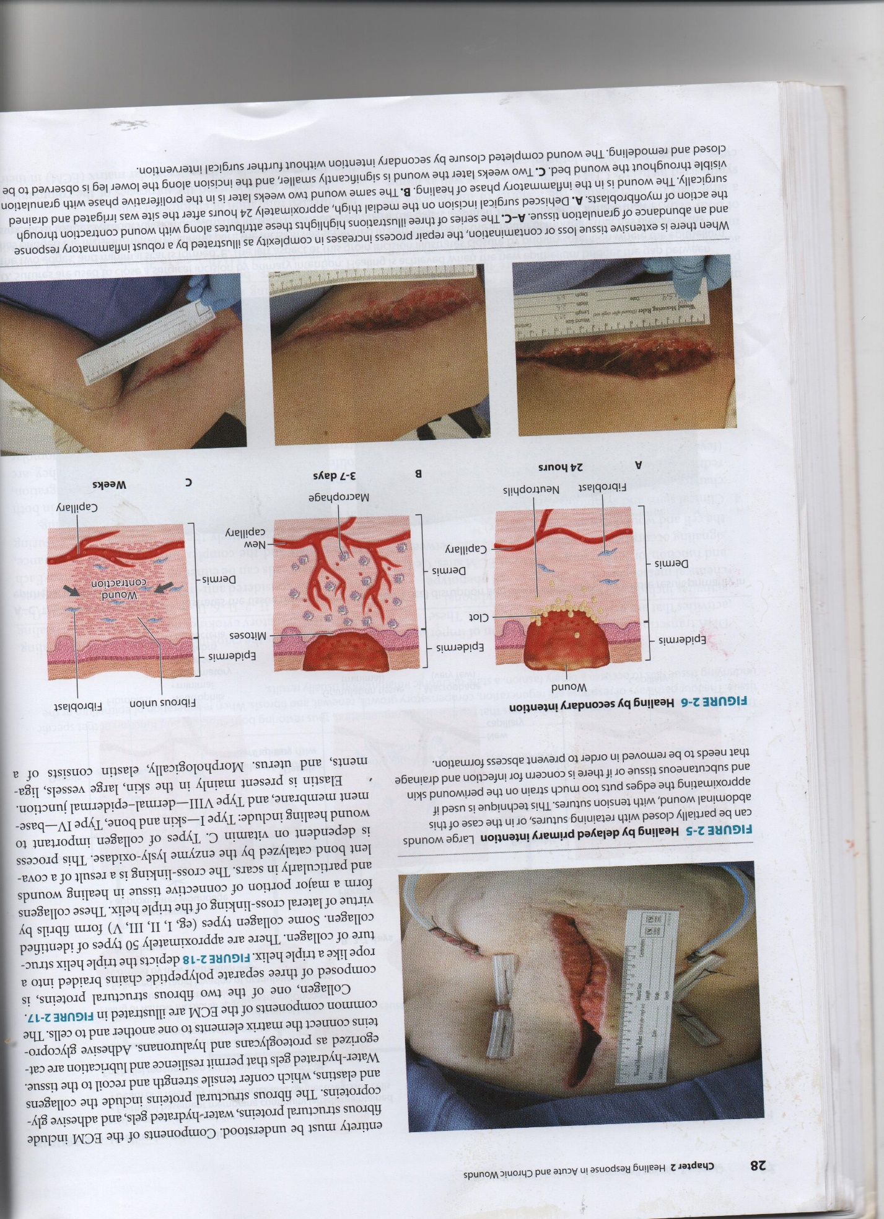
Classifications of healing response
Delayed primary intention
Wound edges are not approximated → the precence pathogen or debris, abcess or extensive tissue loss
Delayed surgical closure after surgical removal granuloma, abcess, debris

Slide 28
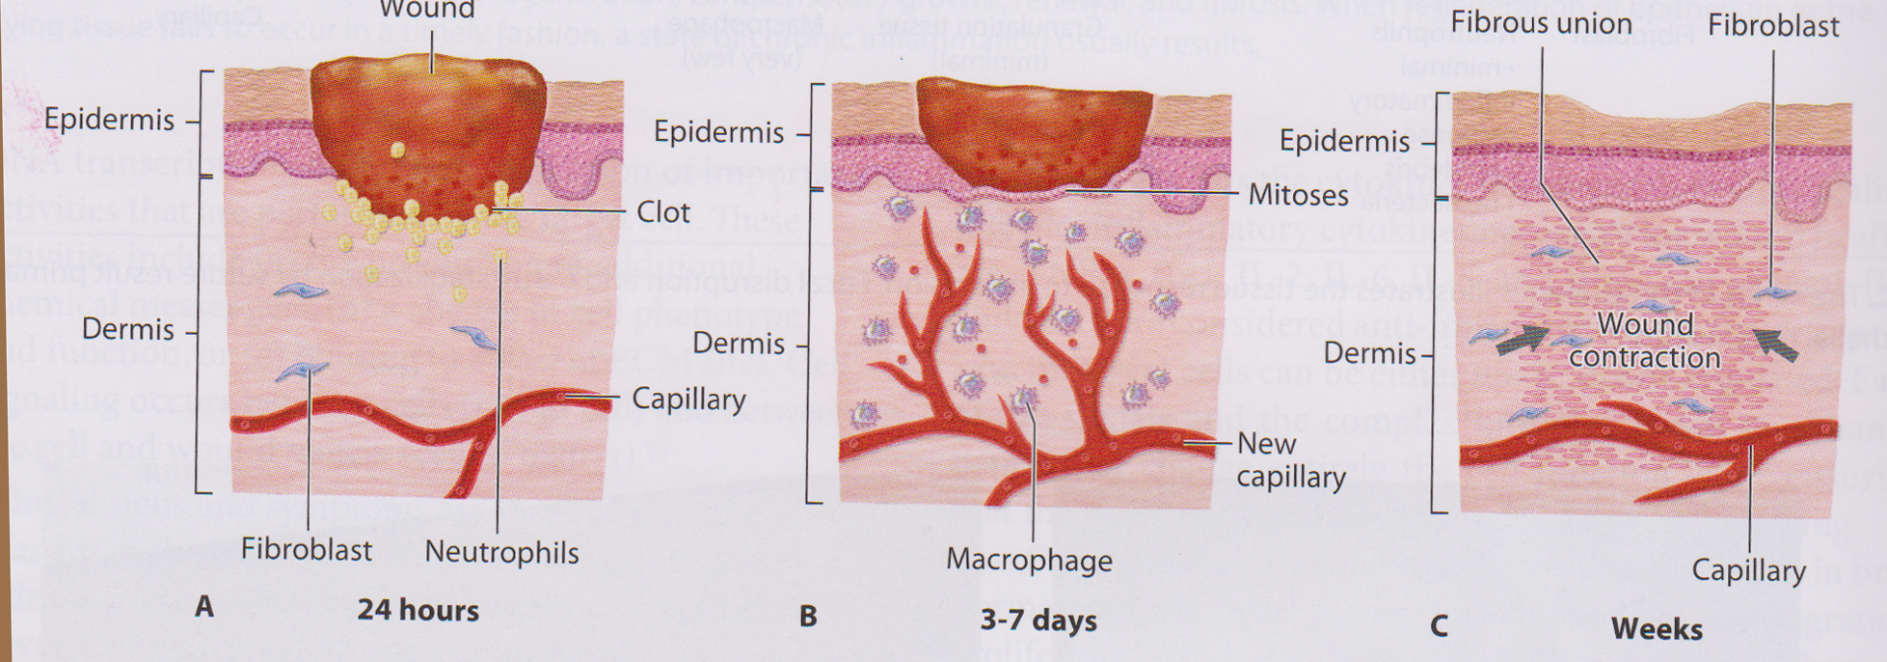
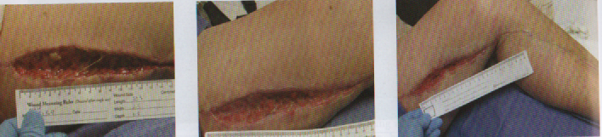
Healing by secondary intentions
Classifications of healing response
Dehisced surgical incision→ inflammation phase (24 hours)
Phase proliferatif with granulation visible through the wound bed (2 weeks)
Remodelling phase (2 weeks later)→ completed closure by secondary intention without surgical intervention

Slide 29
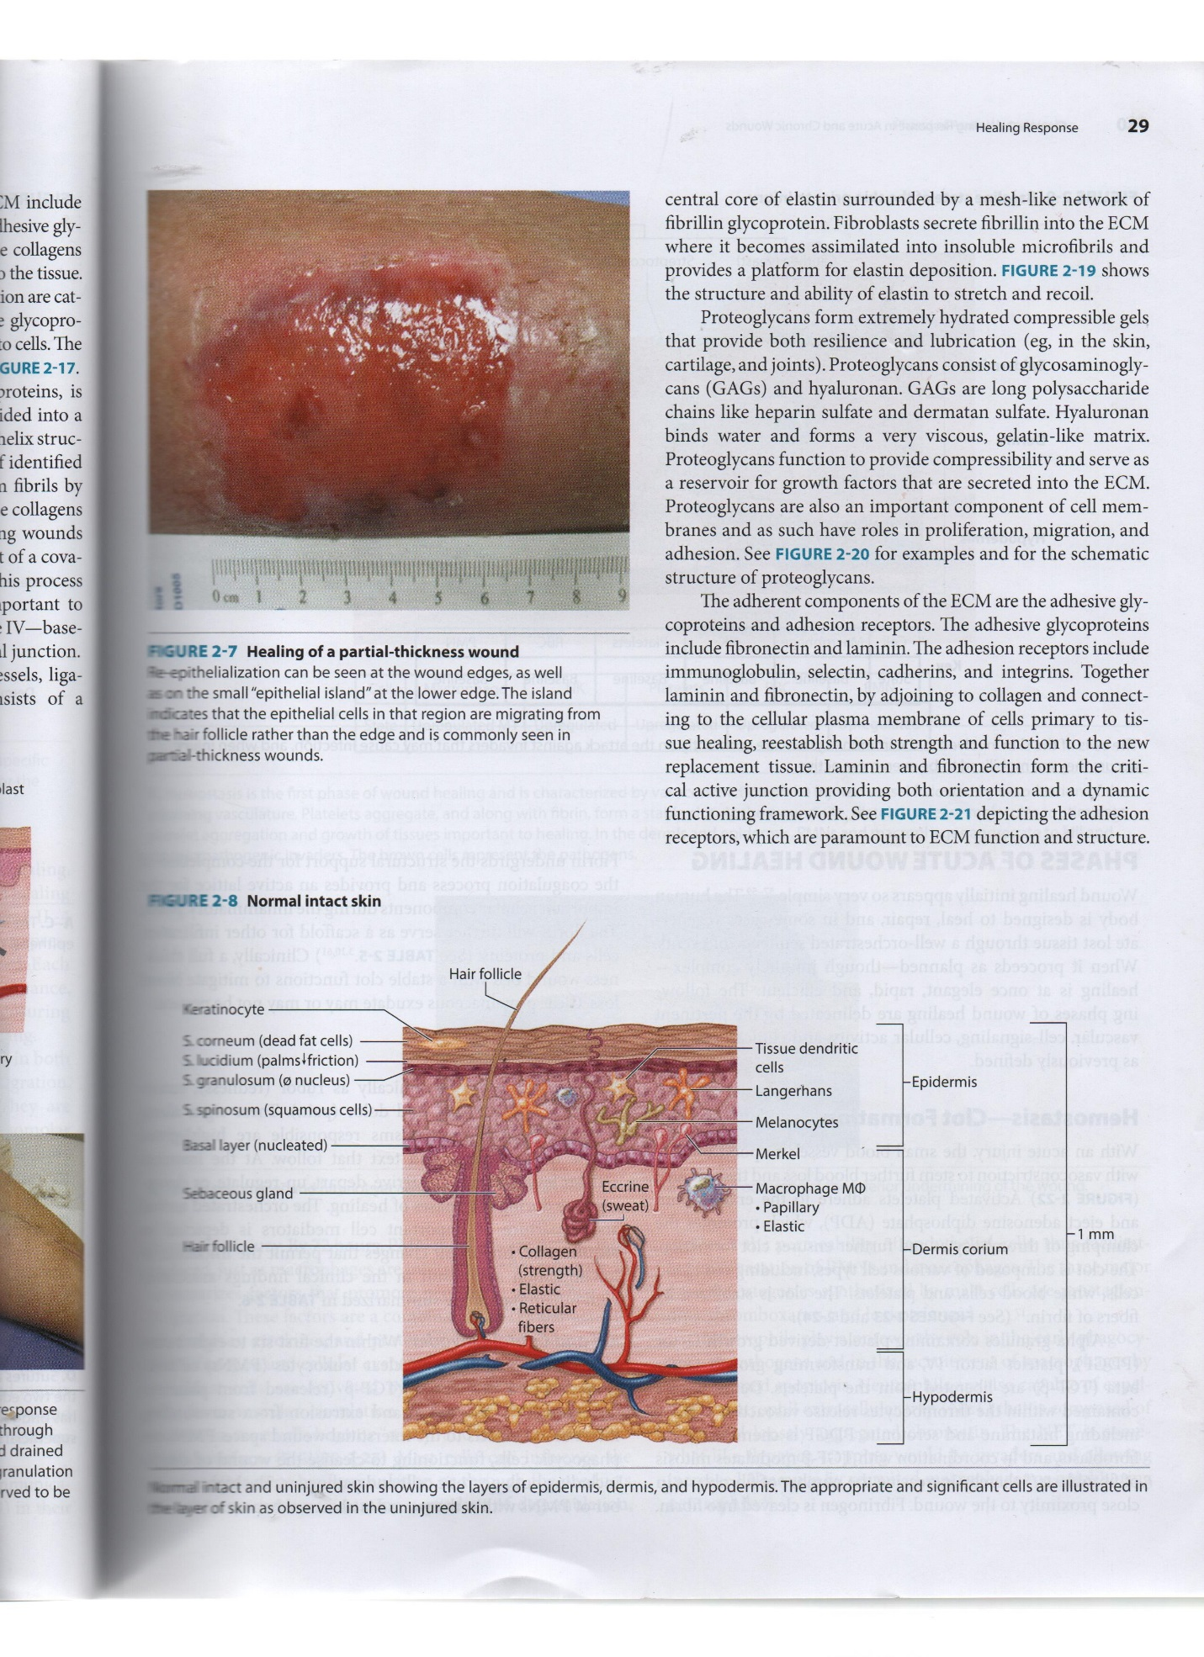
Classifications of healing response
Partial thickness wounding
Loss or partial loss of epidermis or epidermis & superficial dermis → the basement membrane is intact & hypodermis is not exposed

Slide 30
Pressure Ulcer Classification system (International NPUAP/EPUAP)
St 1: Non-blanchable erythema
  Intact skin, painful, firm, soft, warmer or cooler.
St 2: Partial thickness skin loss
  Partial-thickness loss of dermis, red pink wound bed, wo slough.
St 3: Full thickness skin loss
  Subcutaneous fat may be visible, but bone, tendon/muscle are not exposed.
St4: Full thickness tissue loss
  Full-thickness tissue loss where exposed bone, muscle, tendon., slough/eschar.
Unstageable: depth unknown
  Base of the ulcer is covered by slough and/or eschar in the wound bed.

Slide 31
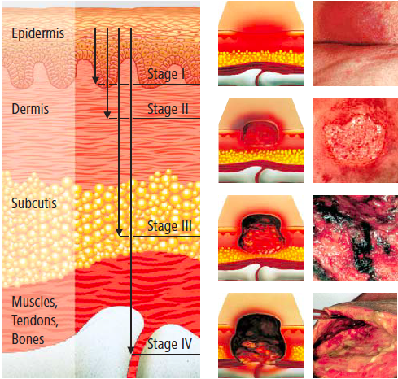

Slide 32
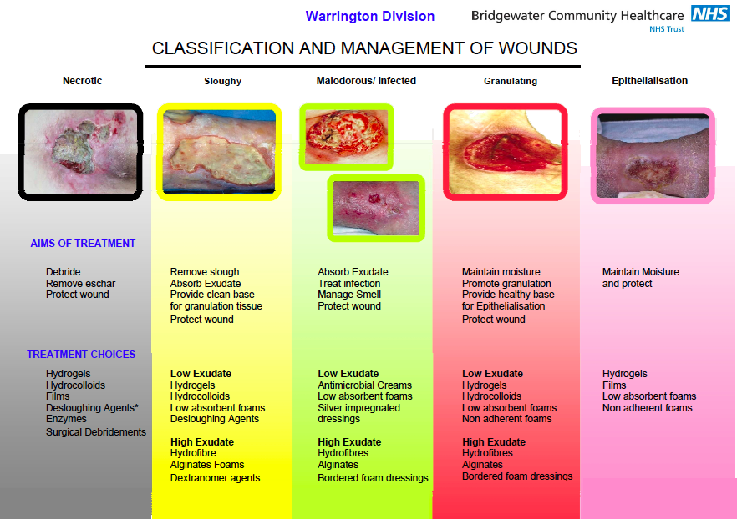
Wound Assessment
Cause of the wound
Clear picture of what the wound looks like
Comprehensive picture of the patient
Contributing factors
Components of the wound care plan
Communication to other healthcare providers
Continuity of care
Centralized location for wound care information
Complications from the wound

Slide 33
Conclusion
Skin → complex multilayer organ that function to protective organ & maintain homeostasis
Injury process can stimulate that cell to accomplish repair& regeneration
Acute wound healing→ phases hemostasis, inflammation, proliferation & remodeling
Inflammation phases subdivided 3 overlapping phases
Acute & chronic wound are different but overlap
Chronic wound → in one way relationship between different phase is lost
Chronic wound → complex result of ischemic, pressure, infection → healing dependent of this factor
Classification of wound → management

