Slide 1
DECUBETIC ULCER (Bed Sores)
Prepared by: DR. Bareqa

Slide 2
Objectives
After this presentation the student will be able to:
Define Decubetic ulcer
Identify the factors that can cause ulcer
Explain the pathophysiology of bed sore
Know the sites of bed sore
Describe the stages of Bed sore
Know the medical management of ulcer
Apply the nursing intervention to prevent ulcer

Slide 3
DEFINITION
A Pressure Ulcer or Pressure Sore or Decubitus Ulcer or Bedsore is localized injury to the skin and other underlying tissue, usually over a body prominence, as a result of prolonged unrelieved pressure.

Slide 4
RISK FACTORS THAT CAN CAUSE ULCER
Friction
Shear
Impaired Sensory Perception
Impaired Physical Mobility
Altered Level Of Consciousness
Fecal And Urinary Incontinence

Slide 5
7. Malnutrition
8. Dehydration
9. Excessive Body Heat
10. Advanced Age
11. Chronic Medical Conditions- Diabetes, Cardiovascular Diseases.

Slide 6
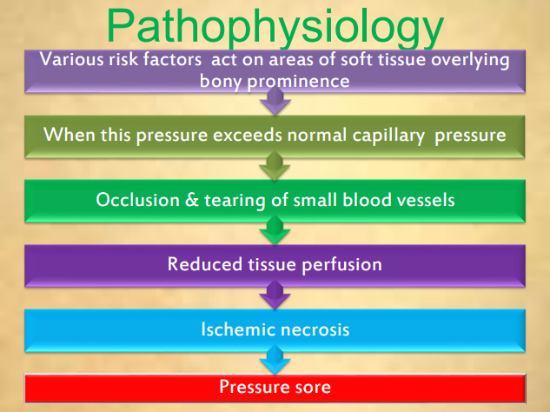

Slide 7
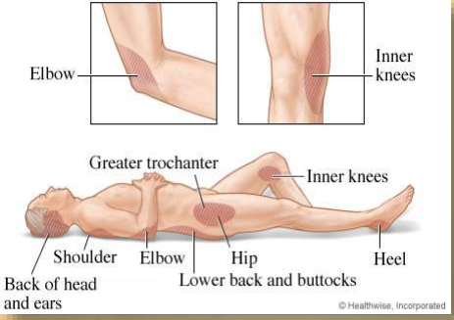
COMMON SITES OF ULCER

Slide 8
STAGES / CLASSIFICATION OF ULCERS
Staging systems for pressure ulcers are based on the depth of tissue destroyed.
Based on the depth there are four stages of bedsores
Stage I
Stage II
Stage III
Stage IV

Slide 9
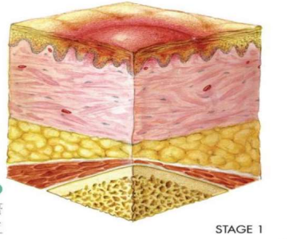
STAGE I: NONBLANCHABLE REDNESS OF INTACT SKIN
Intact skin presents with non-blanchable erythema of a localized area usually over a bony prominence.
Discoloration of the skin, warmth, edema or pain may also be present.
Stage I indicates “at-risk” persons.
Involves only the epidermal
layer of skin.

Slide 10
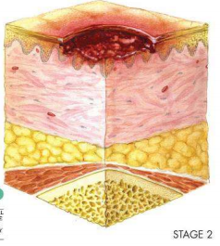
STAGE II: PARTIAL-THICKNESS SKIN LOSS OR BLISTER
A partial thickness loss of dermis presents as a shallow open ulcer with a red-pink wound bed without slough.
Stage II is damage to the epidermis
and the dermis. In this stage,
the ulcer may be referred to as a
blister or abrasion.

Slide 11
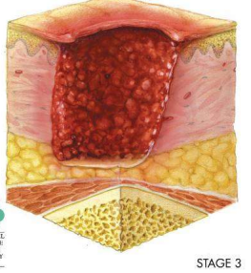
STAGE III: FULL-THICKNESS SKIN LOSS (FAT VISIBLE)
A stage III ulcer is a full-thickness tissue loss. Subcutaneous fat may be visible; but bone, tendon, or muscle is not exposed.
Epidermis, dermis and subcutaneous tissues involved.
subcutaneous layer has a relatively poor blood supply.
So its difficult to heal.

Slide 12
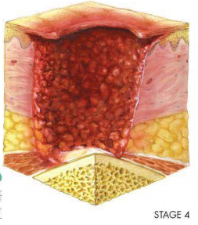
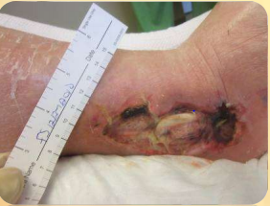
STAGE IV: FULL-THICKNESS TISSUE LOSS
A stage IV ulcer is is the deepest, extending into the muscle, tendon or even bone.
Full thickness tissue loss with exposed bone, tendon or muscle.

Slide 13
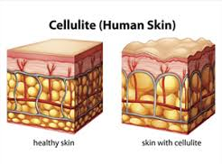
COMPLICATIONS
Cellulitis
Bone and joint infections
Sepsis
Cancer

Slide 14
Treatment
Changing positions often: Carefully follow the schedule for turning and repositioning, approximately every 15 minutes if in a wheelchair and at least once every two hours when in bed. If unable to change position on own, a family member or other caregiver must be able to help.
Using support surfaces: These are special cushions, pads, mattresses and beds that relieve pressure on an existing sore and help protect vulnerable areas from further breakdown.

Slide 15
3. Cleaning. It's essential to keep wounds clean to prevent infection. A stage I wound can be gently washed with water and mild soap, but open sores should be cleaned with a saltwater (saline) solution each time the dressing is changed.
4. Controlling incontinence
5. Removal of damaged tissue (debridement). To heal properly, wounds need to be free of damaged, dead or infected tissue.
6. Dressings.
7. Oral antibiotics.
8. Healthy diet.
9. Educating the caregiver

Slide 16
MEDICAL TREATMENT
1. Surgical repair.
2. Tissue flap.
3. Plastic surgery may be required to replace the tissue.
4. Other treatment options Researchers are searching for more effective bedsore treatments. Under investigation are hyperbaric oxygen and the topical use of human growth factors.

Slide 17
PREVENTION
Bedsores are easier to prevent than to treat. Although wounds can develop in spite of the most scrupulous care, it's possible to prevent them in many cases.

Slide 18
Role Of Nurse In Prevention & Management Of Bed Sores
The nurse should be continuingly assessing the client who are at risk for pressure ulcer development Assess the client for:
The predisposing factors for bed sore Development.
Skin condition at least twice a day.
Inspect each pressure sites. Evaluate circulatory status (eg. Peripheral pulses, edema).
Palpate the skin for increased warmth.

Slide 19
ROLE OF NURSE
1. Interventions for a patient with Decreased sensory perception:
• Assess pressure points for signs of bed sore development.
• Provide pressure-redistribution surface. Interventions for a patient with incontinence.
2. Assess need for incontinence management:
• Following each incontinent episode, clean area and dry thoroughly.
• Protect skin with moisture-barrier ointment.

Slide 20
3. Interventions to avoid Friction and shear:
• Reposition patient using draw sheet and lifting off surface.
• Use proper positioning technique.
• Avoid dragging the patient in bed.
• Use comfort devices appropriately.
4. Interventions for a patient with Decreased activity/ mobility:
• Establish individualized turning schedule.
• Change position at least once in two hours and more frequently for the high risk individuals.
5. Interventions for a patient with Poor nutrition:
• Provide adequate nutritional and fluid intake.
• Assist with intake as necessary.
• Consult dietician for nutritional evaluation R

Slide 21
Thank you

