Slide 1
INFECTIONS OF THE HAND
Dr.Bareqa

Slide 2
GENERAL CONSIDERATIONS
History
Occupation, injury and if so what type, foreign body?
General medical status -diabetes, rheumatoid arthritis, gout, medications
Tetanus Immunization Status
Radiographs
Foreign bodies, Gas in tissue, Calcification in joint/tissue
Bony changes: Fracture, Osteomyelitis, Gout

Slide 3
WORK-UP
ORGANISMS
Most common bugs
  Staph a., Strep., gram negative species
  Staph: 50-80% infections
Bites/farm injuries/Diabetics: polymicrobial
  1/3 Human bites: Eikenella corrodens
  Animal bites/scratch: Pasteurella multocida
Immunocrompromised
  M. avium intracellare, TB, Crypto., Histo, Aspergillosis
Indolent/chronic infection
  Fungi or atypical mycobacterium
Wound discharge
  Viral= “watery”
  Bacterial= “creamy”
  Fungal= “cheesy”
  Gram stain
Cultures
  Obtain prior to antibiotic treatment
CBC, ESR, CRP

Slide 4
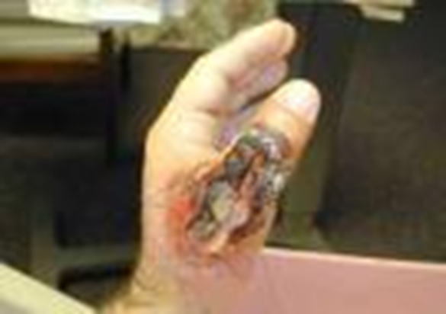
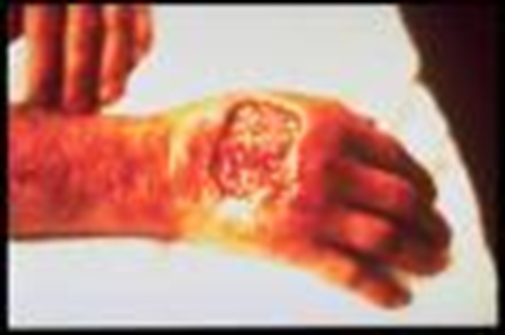
TREATMENT
Surgical management
  Adequate initial I & D
  Leave wound open
    Severe contamination
    Close by secondary intention
    Eventual graft or flap
Empiric treatment
Most will need I&D, antibiotic, Splint
2-3d IV, 7-10d PO
Antibiotics
  Empiric coverage: aerobes/anaerobes
    Cefazolin and Penicillin
  Diabetics/ farm injuries: add aminoglycoside
    Gentamycin
  MRSA
    Vancomycin: 3 case reports of VRSA in US
  Herpes: consider Acyclovir
Notes:
Initial antibiotic tx is aimed at only suspected organisms, since excessive coverage can select for resistant organisms.
Gram negatives can generally be effectively covered by cephlasporin or pcn, but gram negative coverage can be covered by an aminoglycoside.
Remember the side effects of an aminoglycoside; nephrotoxicity and otoxicity.
In MRSA, cephlasporins have no role in tx

Slide 5
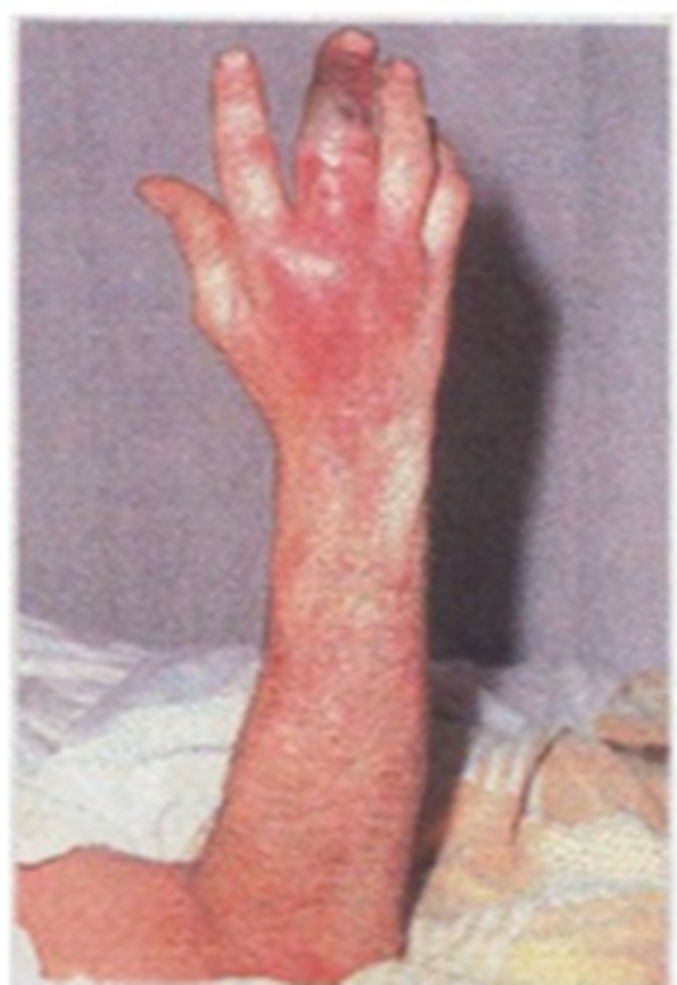
Cellulitis
Hyperemia, edema, lymphangitis
  What lies beneath?
Skin and subcutaneous tissue involvement
Offending Agent
  Group A-β-hemolytic Streptococccus
Early cellulitis: PO antibiotics for 24/48h
  Penicillin-V or cephalexin is best to cover both staph/strep
Otherwise IV

Slide 6
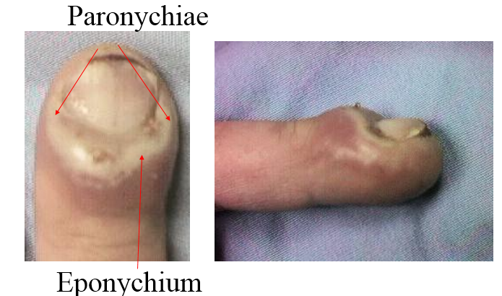
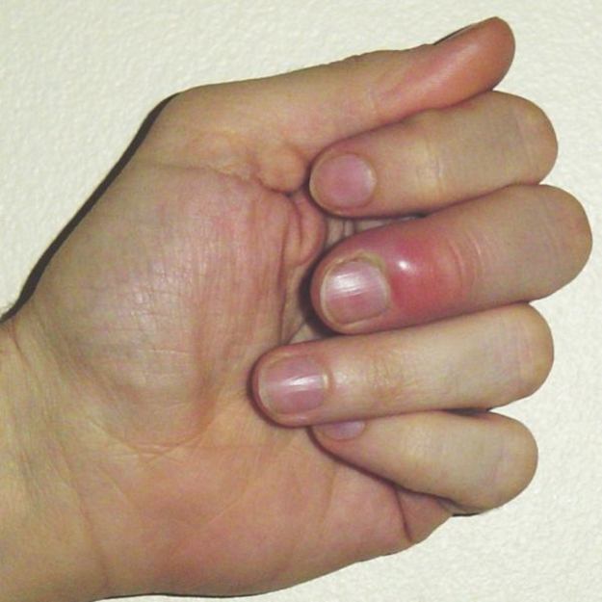
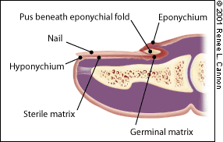
PARONYCHIA
Infection of the lateral nail fold
Most common acute infection of the hand
Etiology
  Fingernail biting, minor trauma, manicures
#1 cause
  Staphylococcus aureus
Management
Warm soaks
Oral antibiotics (cover Staph)
Surgical
  I&D
  Partial nail excision

Slide 7
Paronychia Infection
Chronic
  Intermittent inflammation due to constant moisture
  Eventual nail fold separation from plate
  Cheesy drainage
    Candida albicans
  Management
    Antifungal (Clotrimazole) + surgery
…
….
….
Notes:
Tolnaftate: Tinactin
Marsupialization: crescent-shaped incision is made 1 mm from the edge and all thickened tissue down to but not including the germinal matrix is excised within the confines of the cresencent . Some studies report that nail removal may improve your results.

Slide 8
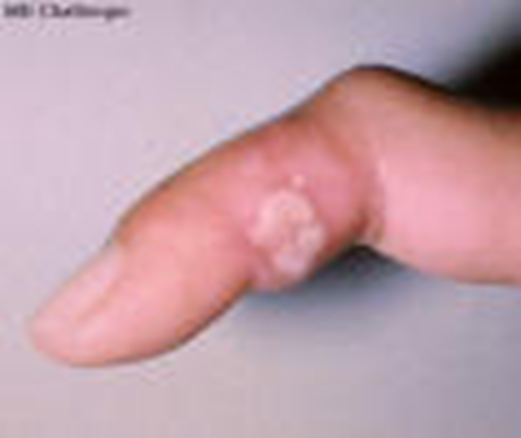
HERPETIC WHITLOW
Superficial Herpes 1 & 2 viral infection
Higher risk in medical & dental personnel
  Pre-school age children
Initial Symptoms = pain 2-14 days after exposure
Vesicular lesions: clear fluid
  Vesicles that coalesce, un-roof, ulcerate
Risk of infection until re-epitheliazation (2 weeks)
Recurrences associated with stress/sun
MANAGEMENT
  DON’T I & D: risk for superinfection! – Just cover with sterile dressing
  Self-limiting, resolving over 2-3weeks
  Acyclovir may help – in immunocompromised

Slide 9
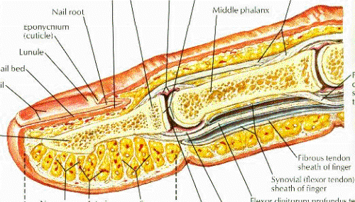
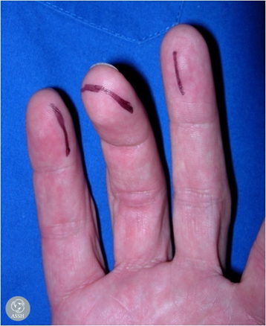
FELONS
Painful bacterial infection of the digital pulp
X-ray to rule out tumor, osteomyelitis or foreign body
Painful, swollen distal phalanx
Pus trapped by fibrous septa
True Abscess-DRAINAGE!
.
Notes:
The pulp is a lattice work of septa extending from the distal phal to the skin. Distal pahalnx vascularity can be compromised by distention within this compartment.
Sx include tense throbbing pain and swelling usually after penetrating trauma

Slide 10
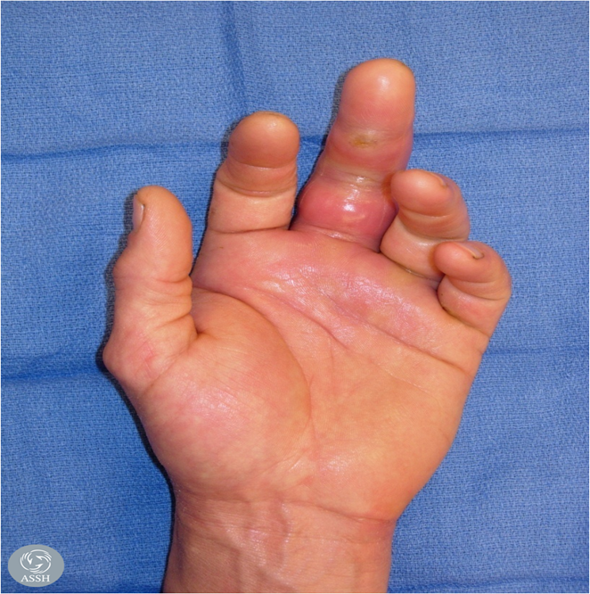
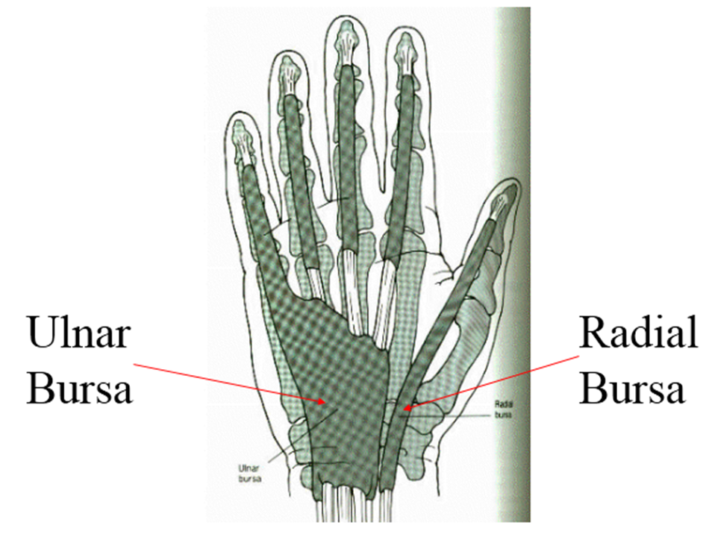
PYOGENIC FLEXOR TENOSYNOVITIS
Bacterial infection of tendon sheath
Kanavel’s Cardinal Signs
Flexed resting position of the digit
Fusiform swelling
Tenderness to palpation of the flexor tendon sheath
Pain on passive digital extension
Notes:
1. The flexor sheath is a mesothelial investing structure with it’s viseral layer adherent to the flexor tendon assisting in providing for its nutrition and health. The sheath extends from the proximal end of the A1 pulley to the level of the DIP.

Slide 11
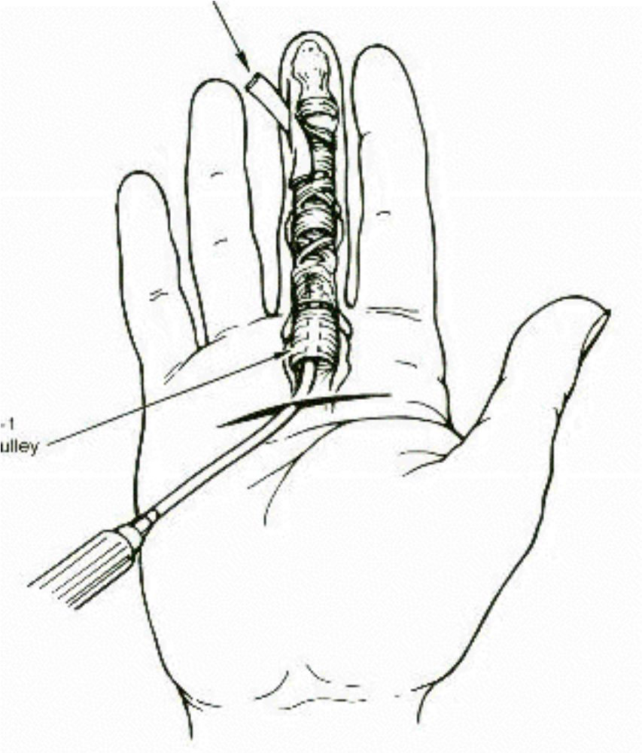
PYOGENIC FLEXOR TENOSYNOVITIS: TREATMENT
Elevation, splint, IV antibiotics for 24 hours
I & D and irrigation catheter
Followed by - Splint, irrigate 50cc NS q2hr
Catheter and wet dressing pulled at 48 hrs.
Notes:
1. ABSORPTIVE DRESSING in the drssings and splint.

Slide 12
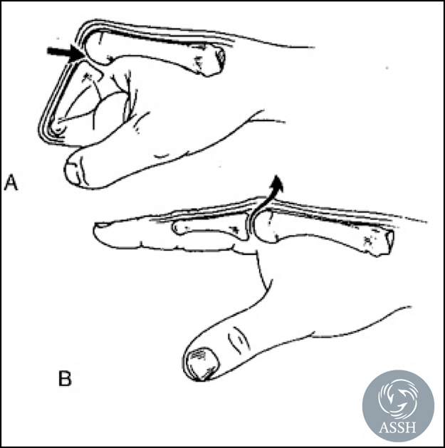
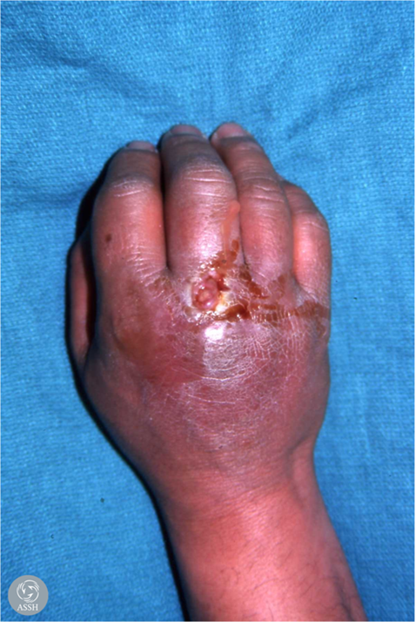
HUMAN BITES
Clenched fist: “fight bite”
  Wound over MC head, but proximal when hand extended
  Occur when clenched fist encounters opponents incisors
  Often innocuous appearing injury to the dorsum of the MP joint of the dominant long finger
  Swelling, redness and pain 24 hours later
Offending agents: aerobes and anaerobes
  Strep, Staph, E. corrodens
Notes:
1. PCN G provides the most adaquate coverage, followed by a 2nd generation cephalasporine

Slide 13
Human Bites: MANAGEMENT
Treat for bone and joint involvement
  Admit, elevate, IV antibiotics
    Penicillin-G, 2nd generation cephalosporin
    Combination of Amoxicillin and Clavulanic acid
  I & D, surgical exploration
  Heal by secondary intention
  Delayed tendon repair

Slide 14
ANIMAL BITES
Dogs>cats>rodents
  15-20% dog bites infected
  50% of cat bites infected
Usually combo of aerobe & anaerobe
Cats AND dogs
  Pasturella multocida
  Penicillin or cephalosporin sensitive
Don’t close any bites!!!
Rabies
  If healthy animal; observe 10 days
Notes:
1. Cat bites penetrate. Dog bites tear.

Slide 15
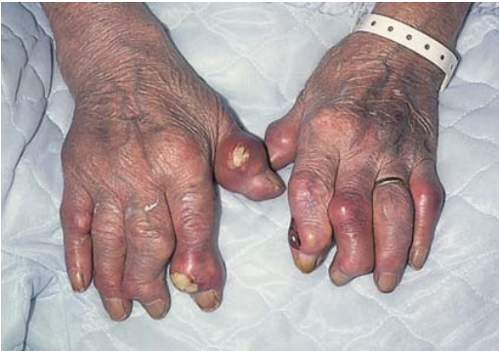
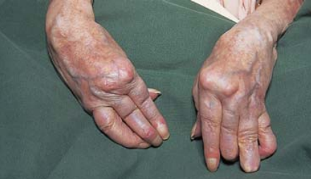
SIMULATORS
Gout
Rheumatoid arthritis of the hand

