Slide 1
Anaesthesia exam
Sixth month
By Yasmeen Hamdan

Slide 2
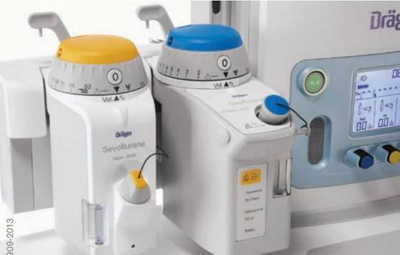
Question 1
1-Identify each vaporizer
A- sevoflurane
B- desflurane
2-Mention 2 differences between the vaporizers
1-color?
2– b is electric and give high temperature

Slide 3
Question 2
Pictures : Rocuronium, susccinylcholine, cisatracuriuom, neostagmine
1-can cause muscirinc activation
Neostagmine
2-fastest onset
Succinylcholine
3- doesnt relay on renal excretion
Cisatracurum
4-have compititive effect property: Rocuronium, cisatracuriuom

Slide 4
Question 3
160m, 130kg patient, free medical history in preop. Assesment clinic
1- asa score
2? Maybe 3
2- clear fluid fasting time
2 hours
3-what risk might she have for anasthesia
Difficult intubation because she is obese , aspiration
4-should u give her metoclopromide and why
Yes, risk of aspiration, it decrease LES tone

Slide 5
Question 4
Pictures of opioids
Morphine, fentanyl, remifentanyl
1-its metabolism affected by pseudocholinestarase deficiency
Non
2- cause nausea and vomiting
All
3-cause hypotension
All
4- can cause bradycardia: all

Slide 6
Question 5
Monitor with tachycardia, hypotension, high etco2 and fever, patient has rigid jaw
1-most common cause plus additional deferential
Malignant hyperthermia
Hypovolemic shock from bleeding?or hyperthyroid storm?
2- receptor affected in this condition
Ryr1 receptor
3-treatment
Dantrolene

Slide 7
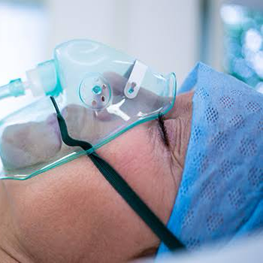
Question 6
1-what its called
Simple face mask
2-what type
Variable performane
3-highest fio2 it can give
60%
4-mention 2 disadvantages for it
1-patient cant eat and drink
2-risk of rebreathing

Slide 8
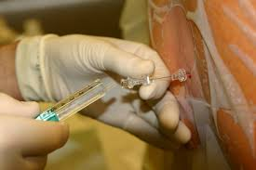
Question 7
1-last part punctured before arriving the wanted space
Dura
2-mention 3 factors influencing the block height
1-Position of the patient
2-spicific gravity
3-volume of drugs and csf

Slide 9
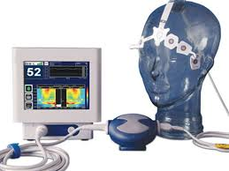
Question 8
1-whats the function of it
Monitors the level of consciousness of the patient.
2-How does it work
Eeg?
3-goal for general aneasthesia
40-60

Slide 10
Question 9
Patient with ACS on ACEI suddenly felt chest pain, o2 sat 75% hypotensive and has stridor
1-mention 4 possible causes of cardiac arrest
1- acute coronary syndrome (MI)
2-hypoxia
3-hypoperfusion?
4- airway obstruction because he has stridor?
Any other possible answer
2-Assesement you want to do for the patient
Ecg, x ray
Any other possible answer

Slide 11
Question 10
Picture for adult who has blue cannula on his hand attached to medication syringe
1-whats the gauge of the cannula
22
2- is it appropriate for his age?
No its used for children?
3- whats its function(or is it functioning?)
medication and fluid?

Slide 12
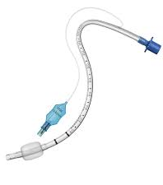
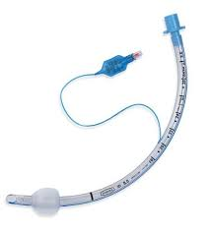
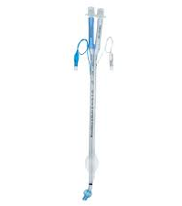
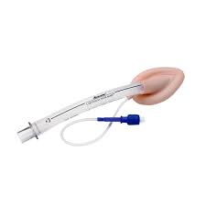
Question 11
1-which one is supraglottic
LMA
2-which one is used in sublingual drainage
N shaped tube
3-Used in hysteroscopy
LMA
4-used in cystoscopy
LMA

Slide 13
Question 12
8 yo child came after traffic accident, emergency, he is wearing c collar
1-ett tube size
6 non cuffed 5.5 cuffed
2-most appropriate induction
Inhalational agent, sevoflorane ? Maybe RSI
3-most important thing to asses
Fasting time and risk of aspiration, fluid status, any airway obstruction
Any other possible answer

Slide 14
Question 13
70 kg patient, his anterior torso is burnt
1-scale to assess percentage of burn
Rule of nine
2-whats the percentage
18%
3-how many fluid in first hour based on parkland formula
2.5 L?
4- appropriate type of fluid
Crystalloid

Slide 15
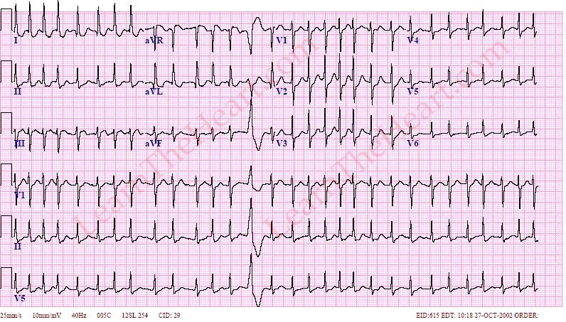
Question 14
Unstable (hypotensive maybe not sure) patient went through cardiac surgery and catheterization , attached ecg
1-type of arrythmia ?
Narrow complex tachyarrhythmia, irregular (afib)
2-management for the patient
Synchronized dc shock 3 attempts
2-why
Unstable (I forget why)

Slide 16
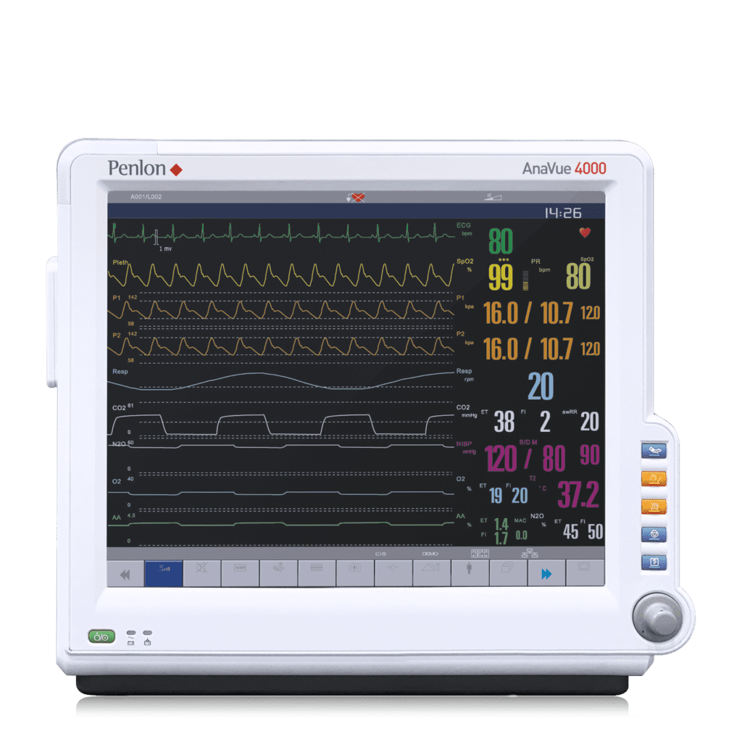
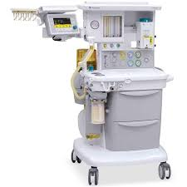







Question 15
I didn’t find the exact photo
1-patient monitor
D
2-machine monitor
B
3-give positive pressure
A
4-prevent rebreathing of co2
C

