Slide 1
SHOCK
Dr Ahmed Shahin

Slide 2
Learning Objectives
Definition of Shock
Pathophysiology of Shock
Classification of Shock
Management of Shock
Vasotherapy
Clinical Scenarios

Slide 3
Physiology
What determines tissue perfusion?
  BP = CO * SVR SVR: vessel length, blood viscosity, vessel diameter (ie, vessel tone)
    CO = HR * SV
        SV: Preload, Myocardial contractility, Afterload

Slide 4
Physiology
What determines oxygen delivery to the tissues?
  DO₂ = CO * CaO₂
  CO = SV * HR CaO₂ = (1.34 * Hgb * SaO₂) + (0.003 * PaO₂)

Slide 5
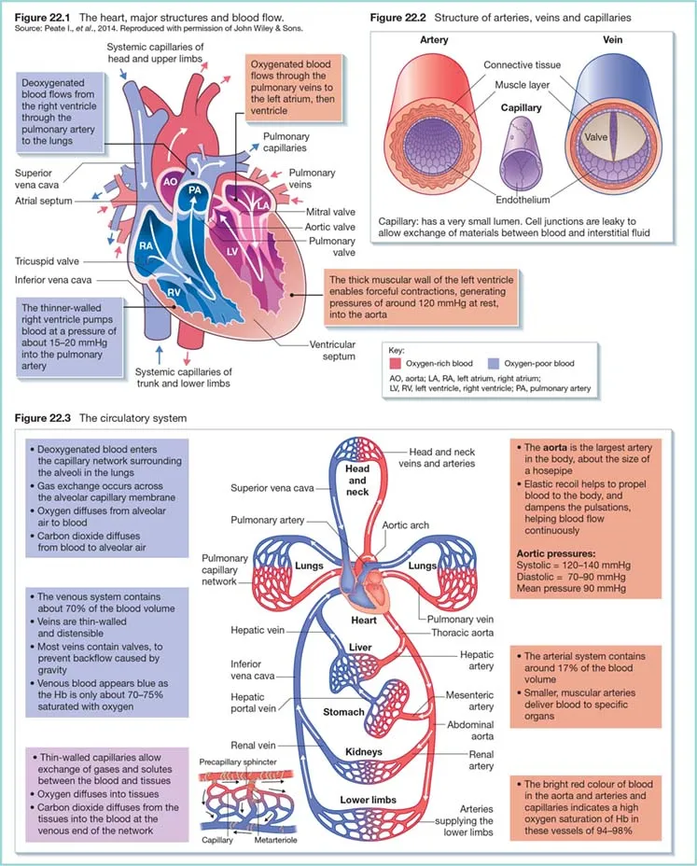
Circulation Physiology

Slide 6
Definition
A state of cellular and tissue hypoxia due to reduced oxygen delivery, increased oxygen consumption, inadequate oxygen utilization, or a combination of these processes.
A failure of circulation = Impaired tissue perfusion.
Most commonly manifested as hypotension, however it can be normotensive.

Slide 7
CLASSIFICATION
Hypovolemic Shock
Distributive Shock
Cardiogenic Shock
Obstructive Shock
Mixed/ Unknown Shock

Slide 8
Distributive
Severe peripheral vasodilatation (vasodilatory shock).
Septic shock:
  The most common cause of distributive shock.
  40-50% mortality.
  Antibiotic-resistant organisms are more common in septic shock compared to sepsis.
Systemic inflammatory response syndrome (SIRS):
  Usually does not progress to state of shock.
  Pancreatitis, Burns, trauma.

Slide 9
Distributive
Neurogenic shock:
  TBI, spinal cord injury.
  Interruption of sympathetic outflow → ↓ vascular resistance.
  Trauma → blood loss.
Anaphylactic Shock:
  Insects, food, medications.
  Perioperative period: Medications (antibiotics, NMBA), Latex.

Slide 10
Cardiogenic
Cardiac pump failure → ↓ C.O
Cardiomyopathic:
  MI > 40% of LV, acute exacerbation of heart failure, stunned myocardium, myocardial depression (ex. Sepsis, anesthetic meds).
Arrhythmic:
  Tachy- or Brady-arrhythmias. Ex. Complete heart block, atrial fibrillation.
Mechanical:
  Severe valvular diseases ex. Severe aortic stenosis, rupture of papillary muscles.
  Cardiac tumors ex. Atrial myxomas.

Slide 11
Hypovolemic
↓ Intravascular volume → ↓ C.O.
Hemorrhagic:
  Trauma, GI bleeding, ruptured aortic aneurysm, obstetric bleeding.
Non-hemorrhagic:
  Depletion of Na and H2O.
  GI: Diarrhea, vomiting, drainage.
  Skin: Burns, heat stroke.
  Renal: excessive diuresis.
  Third space loss: Surgery, trauma, bowel obstruction, peritonitis.

Slide 12
Obstructive
Mostly obstruction is extra cardiac.
Pulmonary vascular:
  Mostly RV failure due to massive PE or severe PH.
  Acute right heart syndrome.
  Avoid: fluid overload, hypoxia, ischemia (hypotension)
Mechanical:
  Mimic hypovolemic shock (decreased volume rather than pump failure).
  ↓ Venous return → ↓ preload.
  Tension pneumothorax, pericardial tamponade, constrictive pericarditis, abdominal compartment syndrome.

Slide 13
Combined
Commonly encountered.
Examples:
  Pancreatitis: distributive (non-septic) + hypovolemic (non-hemorrhagic) +/- cardiogenic (stress).
  Traumatic spinal cord injury: distributive (neurogenic) + hypovolemic (hemorrhagic).
  Ruptured LV aneurysm: cardiogenic (pump failure) + Obstructive (tamponade)

Slide 14
CLASSIFICATION
Hypovolemic |  | Distributive |  | Cardiogenic |  |  | Obstructive |  | Mixed/ Unknown
Hemorrhagic | Non-hemorrhagic | Septic | Non-septic | Cardiomyopathic | Arrhythmogenic | Mechanical | Pulmonary vascular | Mechanical
Trauma GI Bleeding Postoperative Obstetric hemorrhage Tumor Coagulopathies | GI losses : ex. Diarrhea Skin loss: ex. Burns Renal loss: Diuresis 3rd space loss: ex. Surgery | Gram +ve: ex. Staphylococcus , Streptococcus Gram –ve: ex. Escherichia, Klebsiella, Haemophilus Fungal:ex. candida Viral:ex. influenza Parasitic Mycobacterium | Inflammatory shock (SIRS): ex. Burns, Trauma Neurogenic shock: ex. Spinal cord injury Anaphylactic shock: ex. Drugs | ACS, LV MI: (>40% of LV) RV MI Dilated cardiomyopathy Stress-induced cardiomyopathy (ex. Sepsis) Myocarditis Trauma Stunned myocardium (ex. Post arrest) | Tachy-arrhythmias Brady-arrhythmias | Severe valvular disease Ruptured wall aneurysm Tumors | Massive PE Severe pulmonary hypertension | Tension pneumothorax Hemothorax Cardiac tamponade Aorto-caval compression | Adrenal insufficiency Thyrotoxicosis Hypothermia Acidosis Different shock types in poly trauma patients Poisoning ex. Cyanide

Slide 15
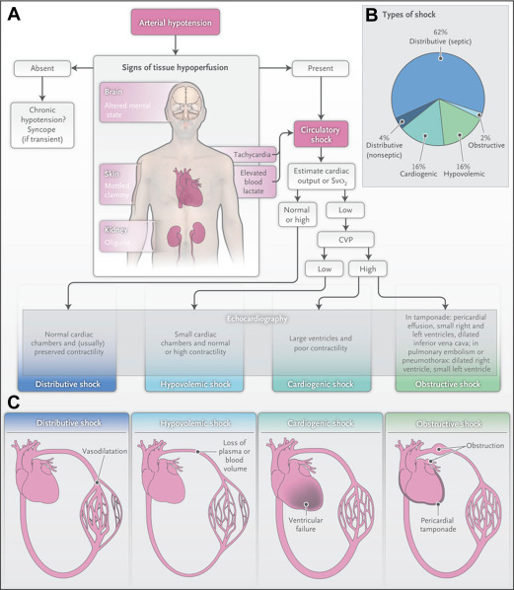

Slide 16
Distributive | Septic: Febrile, leukocytosis, possible focal infection Anaphylaxis: rapid onset, urticaria, hives, febrile, swelling, bronchospasm Neurogenic shock: spinal cord injury, loss of sensation and motor tone, altered reflexes
Cardiogenic | Cold extremities, rales, elevated JVD, slow capillary refill
Obstructive | Elevated JVD, tachycardic, distant heart sounds, pulsus paradoxus, electrical alternans
Hypovolemic | Hemorrhage, possible insensible losses, low JVD, dry mucus membranes

Slide 17
Physiology
What determines tissue perfusion?
  BP = CO * SVR SVR: Vessel length, Blood viscosity, Vessel diameter (ie, vessel tone)
    CO = HR * SV
        SV: Preload, Myocardial contractility, Afterload

Slide 18
Examples of altered physiology
Hypovolemic, cardiogenic, late obstructive:
  Low CO → Compensatory ↑ SVR
Distributive:
  Low SVR → Compensatory ↑ CO
Early shock: parameters might be normal
Can shock present with normal CO and SVR? Ex. Cyanide toxicity

Slide 19
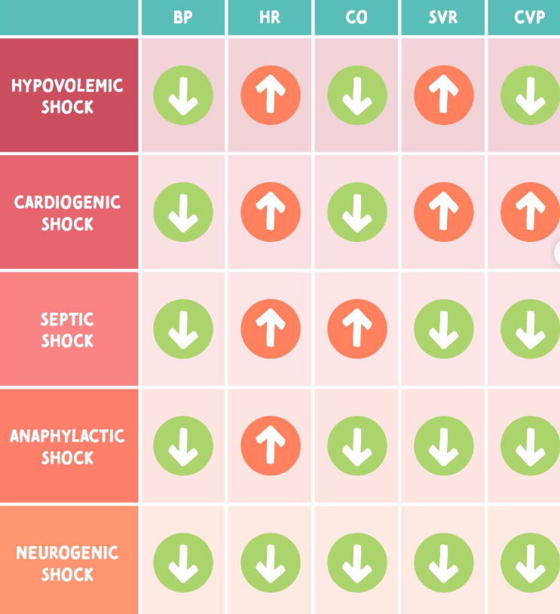

Slide 20
PATHOGENESIS AND PATHOPHYSIOLOGY
Low perfusion leads to cellular hypoxia and dysfunction.
Cell membrane ion pump dysfunction, intracellular edema, leakage of intracellular contents into the extracellular space, and inadequate regulation of intracellular pH.
Systemic acidosis and endothelial dysfunction: systemic inflammation
Lactate

Slide 21
Stages of Shock
Pre-Shock (compensated):
  Compensatory mechanisms to counter the hypoperfusion: tachycardia and peripheral vasoconstriction.
Shock:
  Compensatory mechanisms become insufficient.
  Classic signs and symptoms of shock.
End-organ dysfunction:
  The final stage.
  Irreversible organ dysfunction, multiorgan failure, and death.
  Early recognition and intervention is vital for survival

Slide 22
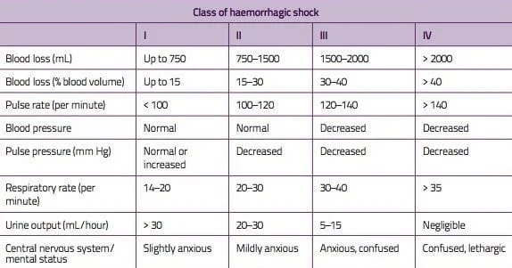
Hypovolemic Shock
The kidneys stimulate renin secretion from the juxtaglomerular apparatus.
Renin converts angiotensinogen to angiotensin I, which is then converted to angiotensin II by the lungs and liver.
Angiotensin 2 acts to vasoconstrict arteriolar smooth muscle and stimulate aldosterone secretion by the adrenal cortex.
Aldosterone causes sodium reabsorption and water conservation.
The neuroendocrine system helps respond to hypovolemia by increasing the secretion of antidiuretic hormone (ADH) from the posterior pituitary gland. ADH also promotes salt and water resorption.
The urine sodium concentration should be less than 20 meq/L in patients with hypovolemia.

Slide 23
Hypovolemic Shock – management
Volume resuscitation begins with a warm isotonic crystalloid solution (30 mL/kg) like normal saline or lactated Ringers (LR) in rapidly infused 500 mL boluses for adult patients.
Clinicians should monitor the patient’s response to each bolus by assessing vital signs, urine output, mental status, and signs of pulmonary edema.
Current guidelines recommend crystalloid fluids over colloid solutions for resuscitating patients with severe volume depletion not caused by hemorrhage.

Slide 24
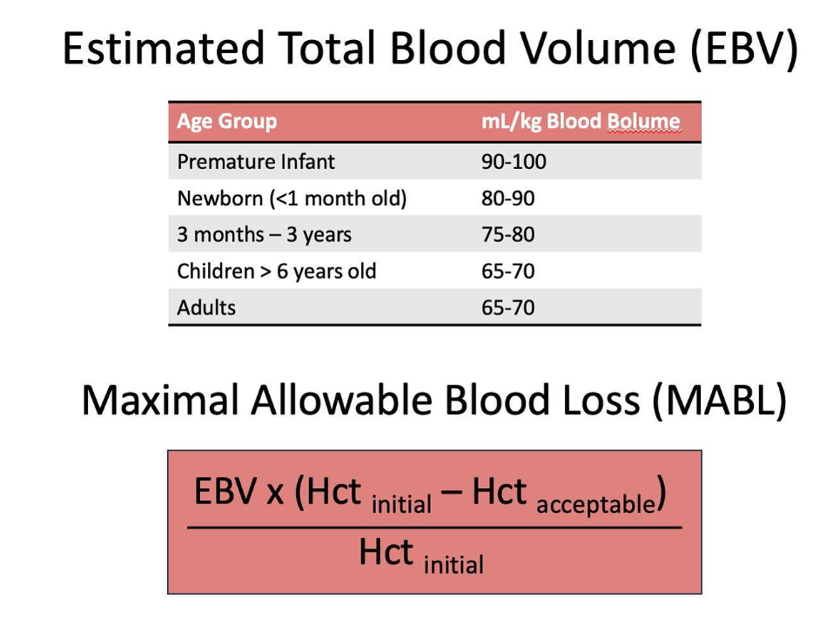
Hypovolemic Shock – management
Threshold for transfusion of blood is 7
and 10 for IHD patients
Male patient, 70kg, No known IHD,
Baseline Hb 12
70 * 70 = 4900 ml of EBV
4900 * ((12 – 7)/12) = 2000 ml

Slide 25
Parameters to monitor during the resuscitation
MAP above 65 mm Hg or above 85 mm Hg in patients with blunt trauma who may also have a spinal cord or traumatic brain injury.
Oxygen saturation of 94% or higher.
Heart rate between 60 and 100 bpm.
Urine output of more than 0.5 mL/h.
Serum lactate of less than 2 mmol/L.

Slide 26
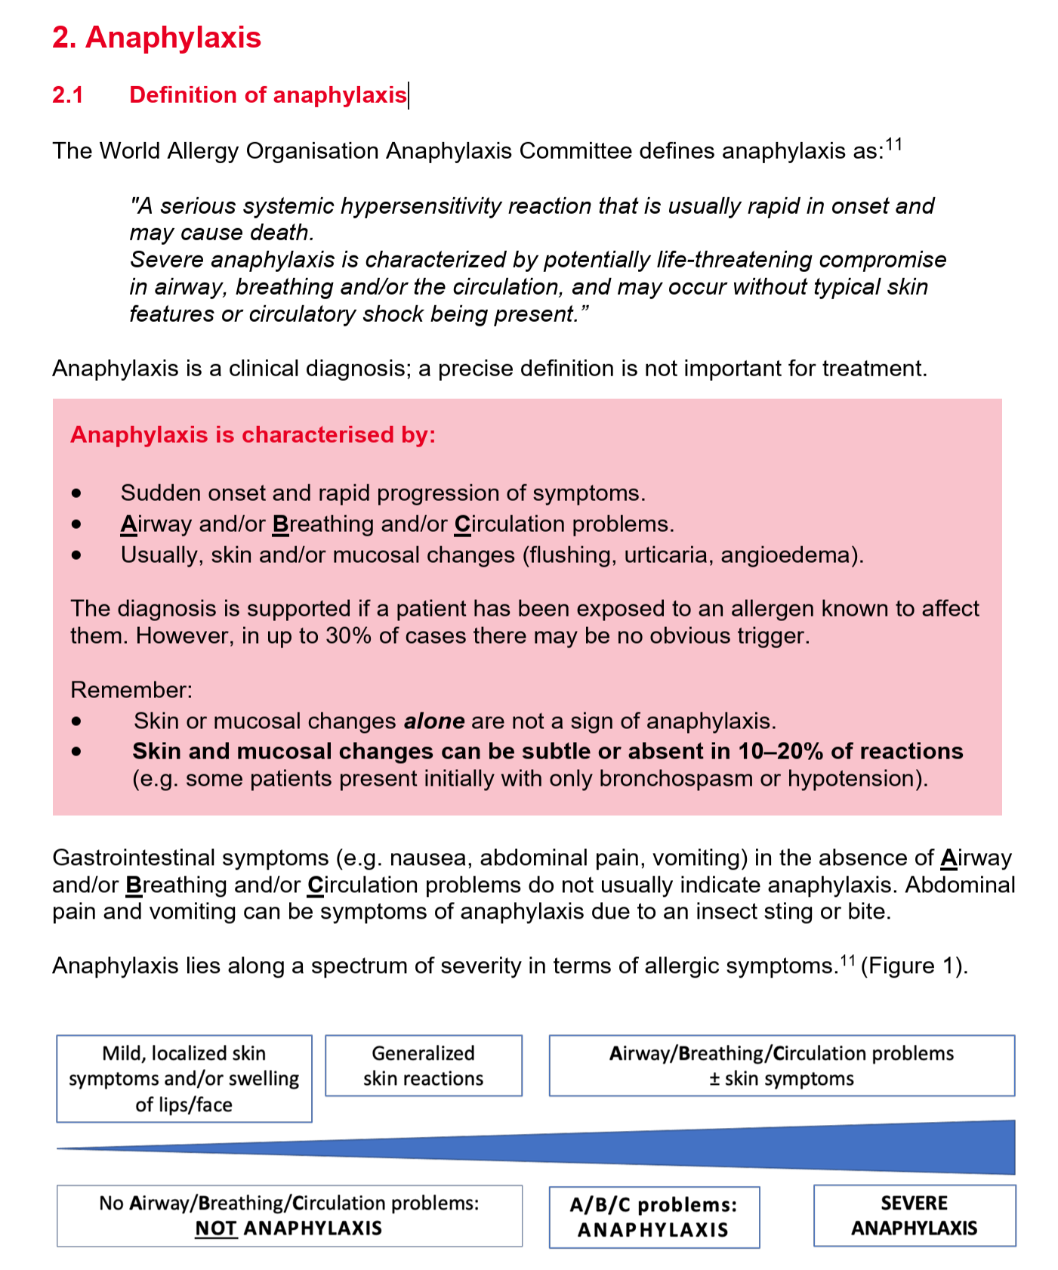
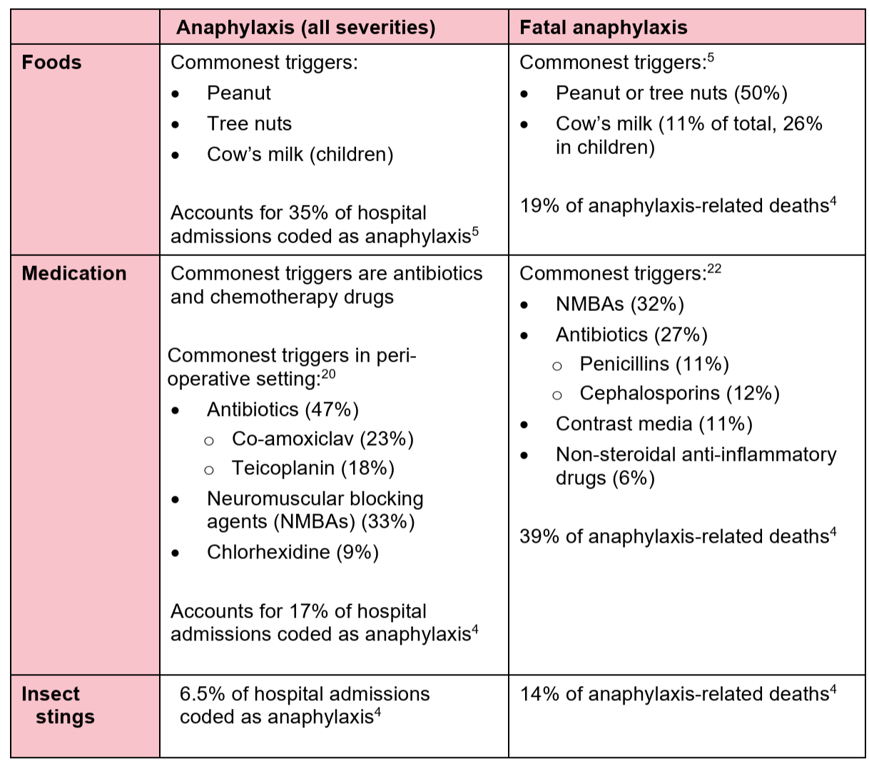
Anaphylactic Shock

Slide 27
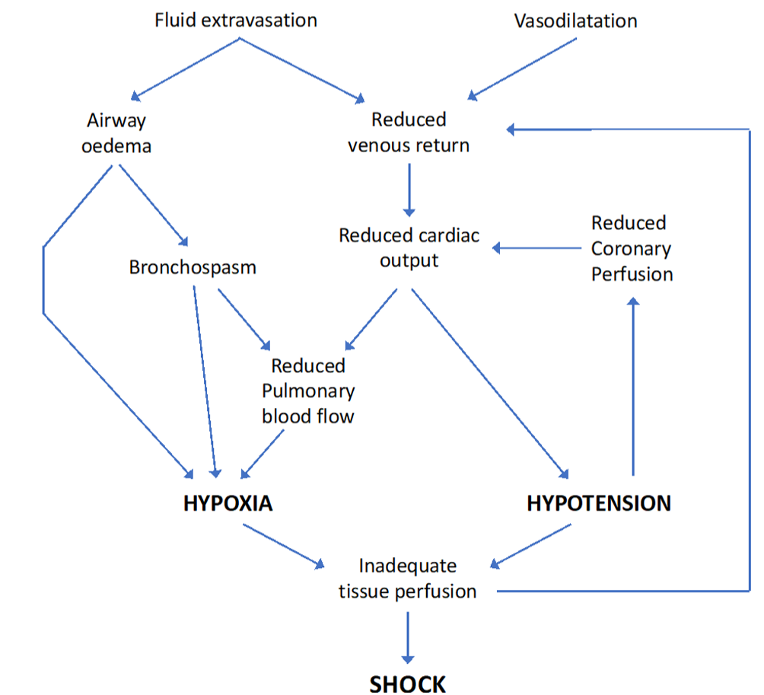
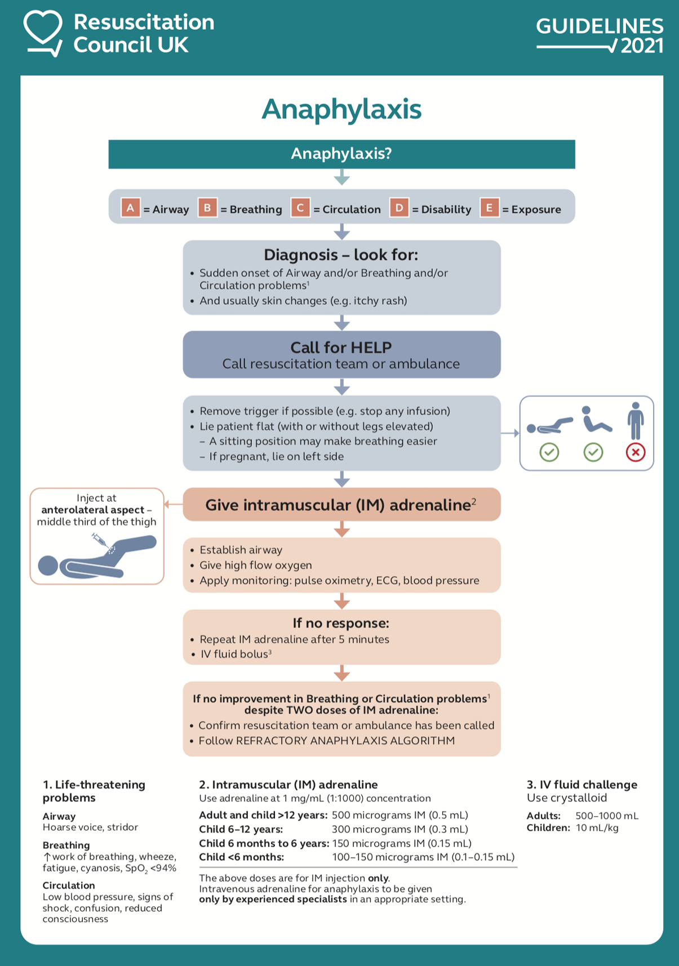
Anaphylactic Shock

Slide 28
Septic Shock
Sepsis is a clinical state that falls along a continuum of pathophysiologic states, starting with a systemic inflammatory response syndrome (SIRS) and ending in multiorgan dysfunction syndrome (MODS) before death.
Fever (temperature higher than 38 C or hypothermia (temperature less than 36 C)
Tachycardia (heart rate more than 90 beats per minute),
Tachypnea (respiratory rate more than 20 breaths per minute)
Leukocytosis (WBC greater than 12,000/cu mm) / leukopenia (white blood cells (WBC) less than 4,000/cu mm) with or without bandemia (more than 10%).

Slide 29
Septic Shock – management
  Source Control:
Broad-spectrum antibiotics within one hour of diagnosis for all patients.
Removal of infected/necrotic tissue if it is the source of septic shock, ie, patients with cellulitis, abscess, infected devices, or purulent wounds.
  Management of Shock:
Measures are most effective if achieved within the first six hours of diagnosis.
Restore CVP to 8 -12 mm Hg
Restore MAP > 65 mm Hg
Restore mixed venous saturation to 65%
Fluid resuscitation with crystalloid (less so colloids) up to 80 ml/kg
Mechanical ventilation to reduce metabolic demand
First-line vasoactive agents (epinephrine in cold shock versus norepinephrine in warm shock) when fluid-refractory
Enhancing Host Response
Corticosteroids indicated in vasoactive-refractory shock and or in patients with low (unstimulated) basal cortisol levels less than 150 μg/L)
Addition of vasopressin indicated in vasoactive-refractory shock

Slide 30
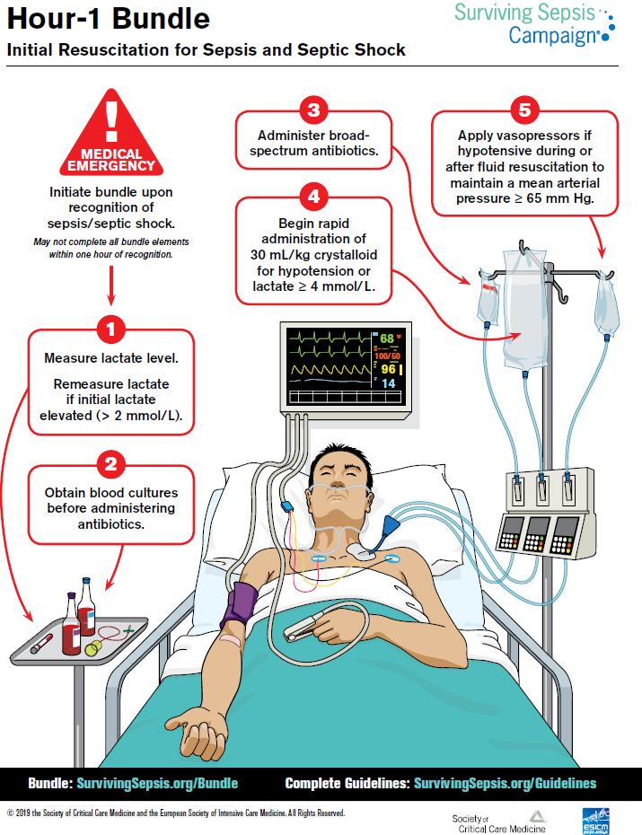
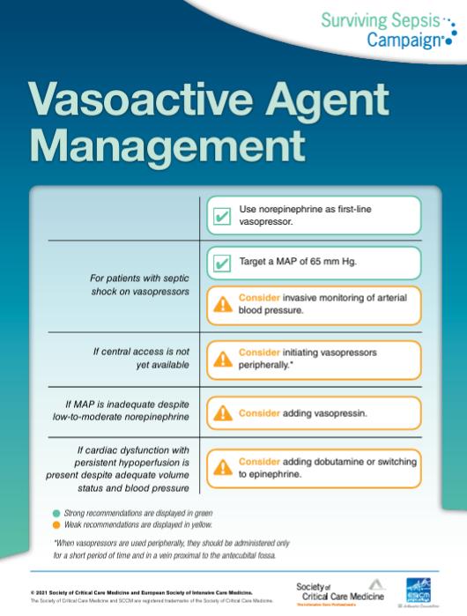
Surviving Sepsis Campaign

Slide 31

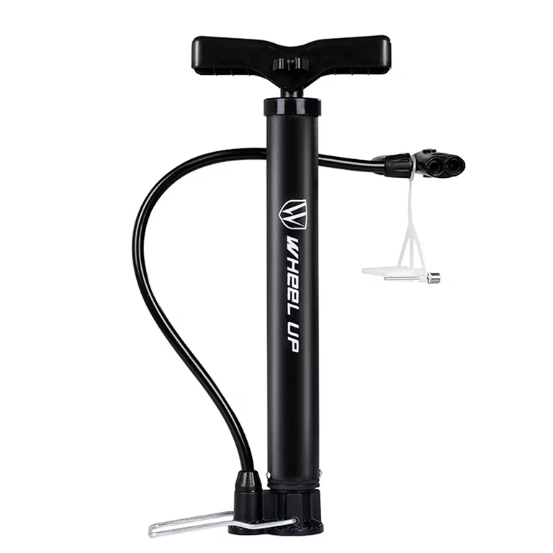
Vasopressors vs. Inotropes
VS

Slide 32
Vasopressors and Inotropes in clinical use
Noradrenaline | Strong α₁ and modest ß | 0.01–0.5 μg kg⁻¹ min⁻¹ | First-line in septic shock | Tachyarrhythmias Severe peripheral/visceral ischaemia
Adrenaline | ß: 0.01–0.1 μg kg⁻¹ min⁻¹ α₁: >0.1 μg kg⁻¹ min⁻¹ | 0.01–0.3 μg kg⁻¹ min⁻¹ | Cardiogenic shock Vasodilatory shock Cardiac arrest Severe bradycardia | Tachyarrhythmias High glucose/lactate Severe peripheral/visceral ischaemia
Phenylephrine | Strong α₁ | 0.4–4 μg kg⁻¹ min⁻¹ | Hypotension | Reflex bradycardia Severe peripheral/visceral ischaemia
Metaraminol | Strong α₁: stimulates noradrenaline release | boluses of 0.5–1 mg | Hypotension secondary to vasodilation | Reflex bradycardia Severe peripheral/visceral ischaemia

Slide 33
Vasopressors and Inotropes in clinical use
Dopamine | D_{1,2}: 1–5 μg kg⁻¹ min⁻¹ ß: 5–10 μg kg⁻¹ min⁻¹ α₁: 10–15 μg kg⁻¹ min⁻¹ | 1–15 μg kg⁻¹ min⁻¹ | Vasodilatory shock Severe bradycardia | Tachyarrhythmias Severe peripheral/visceral ischaemia Immunosuppression
Vasopressin | V_{1a}, V_{1b}, V₂ | 0.01–0.04 U min⁻¹ | Second-line in septic shock | Severe peripheral/visceral ischaemia
Terlipressin | V_{1a} (V_{1b}) > V₂ | Infusion 20–160 μg h⁻¹ or boluses 1–2 mg q.d.s | Vasodilatory shock Acute liver failure | Severe peripheral/visceral ischaemia

Slide 34
Clinical Scenarios
A 24-year-old male presents after a motorbike accident. On examination: He is pale, cold extremities, diaphoretic, and has a capillary refill time of 4 seconds. HR = 120/min, Bp = 80/50 mmHg. Upon exposure he has a deep laceration in his right thigh.
What is the most likely type of shock?
What is the underlying cause?
What is your approach?
What investigations might be required?
Notes:
1. Hypovolemic (Haemorrhagic), 2. Trauma, 3. ATLS: ABCDE, control bleeding, iv fluids, +/- blood transfusion, urinary catheter, 4. CBC, cross match, FAST, KFT, electrolytes, lactate

Slide 35
Clinical Scenarios
45-year-old lady brought to emergency department after being stung by an insect. She fainted few minutes later. her skin is warm and flushed. Her GCS is 11. SBP = 65 mmHg, HR = 130/min.
What is the likely type of shock?
What is the underlying cause?
How would you manage this patient?
Notes:
1. Distributive, 2. Anaphylaxis (insect), 3. ABCDE, Anaphylaxis algorithm, 4.

Slide 36
Clinical Scenarios
30-year-old lady is out having a smoke break next to her office. She is using crutches because of a recent leg fracture. She suffers from a syncope and brought to the emergency department. She starts to regain consciousness but her BP = 85/40 mmHg, HR = 105/min, RR =35/min, SpO2= 86%. On examination her lungs are clear. During assessment, her colleague mentions that she is on oral contraceptives.
What is the likely type of shock?
What is the underlying cause?
How would you manage this patient?
Notes:
1. Obstructive, 2. Pulmonary (PE), 3. ABCDE, iv fluids, +/- vasopressors, anticoagulants

Slide 37
Clinical Scenarios
77-year-old gentleman, a resident of a hospice, has been complaining of flank pain radiating to the lower abdomen for the last week. He was found by his nurse unresponsive and feeling warm. During your assessment you notice his skin to be mottled. Measurement of his vital signs reveals a BP of 73/40 mmHg, HR of 102/min, RR of 30/min, GCS of 7, and Temperature of 38C.
What is the type of shock?
What is the most likely underlying cause?
What is the immediate management of this patient?
Notes:
1. distributive, 2. sepsis (UTI), ABCDE, intubation and mechanical ventilation, sepsis bundle

Slide 38
Clinical Scenarios
A 68-year-old man with a history of hypertension, diabetes, and dyslipidemia. Starts to complaint of chest pain and dyspnea. Upon arrival to emergency department, he is confused. BP is 85/60 mmHg, HR 110 bpm. ECG shows ST elevation in V3, V4, and V5 leads.
What is the likely type of shock?
What is the underlying cause?
Notes:
1. Cardiogenic 2. ACS

Slide 39


