Slide 1

Introduction to Anesthesia
“Understanding the Concept”
Dr. Ahmad Arraqap
Anesthesia dept.
Faculty of Medicine
Jordan University

Slide 2
Learning Objectives
Define anesthesia and related terms
Understand types and stages of anesthesia
Recognize the triad of general anesthesia
Appreciate the scope and role of anesthesiologists
Review history and evolution of anesthesia
Notes:
Tell them this lecture is the foundation for their clinical rotations.

Slide 3
Anesthesiology is a young specialty historically, especially when compared with surgery or internal medicine.
Discoveries in anesthesiology have taken decades to build upon the observations and experiments of many people, and in some instances, we are still searching.
(i.e the ideal volatile)

Slide 4
Much of our current anesthesia equipment is the direct result of anesthesiologists being unhappy with existing tools and needing better ones to properly anesthetize patients.
Many safety standards have been established through the work of anesthesiologists who were frustrated by the status quo.

Slide 5
Consciousness:
Can perhaps be described as :
"Our continuing stream of Awareness of either our surroundings or our sequential thoughts"

Slide 6
Anesthesia
Anaesthesia: Loss of feeling or Sensation
  *Latin terminology:
  An ====➔ No aesthesia ➔ Sensation
  Partial or complete loss of sensation
  with or with out loss of consciousness
  result of disease, injury, or administration of an anesthetic agent, usually by injection or inhalation

Slide 7
Anesthesia has three main types:
1-General anesthesia :
Induces a reversible, controlled state of unconsciousness, along with a lack of sensation and memory during them procedure.
2- Regional anesthesia :
Blocks sensation in a larger region of the body, such as an arm or lower body (patient remain conscious).
3-Local anesthesia :
Numbs a small, specific area of the body (patient Remain conscious) .

Slide 8
The goal is to make the procedure pain-free and ensure the patient remains safe and relaxed.
The types of anesthesia, including local, regional, and general anesthesia, each used depending on the procedure and the patient's needs.

Slide 9
Hypnosis
Definition:
A pharmacologically induced state of sleep-like unconsciousness.
Key features:
Loss of awareness of surroundings.
Patient cannot be aroused by verbal command.
Still may respond to painful stimuli if analgesia is not also provided.
Clinical use:
One of the three pillars (triad) of general anesthesia (Hypnosis, Analgesia, Muscle Relaxation).
Achieved with drugs like propofol, thiopental, sevoflurane.

Slide 10
Narcosis
Definition: Drug-induced state of stupor or unconsciousness
Produced pharmacologically (e.g. opioids, sedatives)
More accurate than 'hypnosis' to describe drug-induced sleep
Rarely used today → replaced by 'general anesthesia' or 'sedation'
Narcosis may lack pain relief
Common misuse: 'narcotics' often refers to opioids of abuse
Notes:
Clarify difference: hypnosis (sleep-like), narcosis (drug stupor), sedation (continuum).

Slide 11
Sedation
A medical process where medications are used to:
Calm or relax a patient,
Reducing anxiety and discomfort,
Without fully putting them to sleep.

Slide 12
Sedation
Mild sedation (where the person is still awake and aware but feels relaxed)
Moderate sedation (more relaxed and may feel drowsy, but they are still conscious and can respond to verbal cues or physical stimuli.)
Deep sedation (where the person may be on the edge of consciousness but still able to respond to stimuli)

Slide 13
Sedation Levels vs Clinical Features
Feature | MILD | Moderate | Deep
Responsiveness | Normal response | Purposeful response to verbal/tactile stimuli | Purposeful response only after repeated/painful stimuli
Airway | Unaffected | Usually maintained | May require support
Spontaneous Ventilation | Unaffected | Adequate | May be inadequate
Cardiovascular Function | Unaffected | Usually maintained | Usually maintained
Use Examples | Anxiolysis (pre-op meds) | Endoscopy, minor surgery | Debridement, painful procedures

Slide 14
Feature | Hypnosis | Narcosis | Sedation
Definition | Drug-induced sleep-like unconsciousness | Drug-induced stupor/unresponsiveness | Continuum of reduced consciousness (mild → deep)
Patient Awareness | No awareness of surroundings | No awareness, stupor-like | Variable (relaxed, may respond)
Response to Stimuli | Absent unless very strong | Absent | Present in light/moderate; painful only in deep
Use in Anesthesia | Core part of Triad of GA | Historical term, rarely used | Common for minor procedures, anxiety control
Drugs | Propofol, thiopental, inhaled agents | Historically morphine/opioids | Benzodiazepines, low-dose propofol

Slide 15
Important Notes !!
Hypnosis ≠ Narcosis ≠ Sedation.
Sedation = lighter continuum, patient partly responsive.
Narcosis = drug-induced stupor, older term, not precise.
Hypnosis = controlled, reversible unconsciousness used in anesthesi

Slide 16
Pain vs. Nociception
The word "Painful Stimulus" should be restricted to conscious patients who are aware of the pain.
Under General Anesthesia, the word "Nociceptive stimulus" is better used.
A Nociceptive stimulus will cause pain in the conscious patient and reflex response (e.g. Tachycardia) in the unconscious one.

Slide 17
Analgesia
“The state of freedom from pain”
Can be effected locally, and the patient is still conscious “e.g. by use of local Anesthetics“.
Can be generalized and patient still coconscious
  - Systemic Analgesic Drugs.
  - “stage-one general Anesthesia“………… (see below)
Can be part of deep general Anesthesia.
**So, Anesthesia and analgesia are not interchangeable words!

Slide 18
Anxiolysis
A reduction in anxiety (Fear, apprehension, and stress due to awareness of an impending unpleasant experience).
Sedation will lead to Anxiolysis, but Anxiolysis can be effected by certain non-sedative drugs (e.g. Tranquilizers).

Slide 19
Muscle Relaxation
“ Rendering the muscles less tense by decreasing their tone, or even paralyzing them ”.
Can be obtained in different ways:
    By Central depression of the nervous system.
    By local anesthesia of peripheral nerves.
    By blocking the neuromuscular junction.
** Any drug which causes a muscle to relax could be called a Muscle Relaxant, but in anesthesia practice this term is almost exclusively reserved for the group of intravenously administered drugs which block the chemical transmission of a nerve impulse at the Neuromuscular Junction leading to muscle paralysis.

Slide 20
General Anesthesia
General Anesthesia clinically implies that:
The patient has been rendered reversibly unconscious by DRUGS
for the execution of a painful operative or diagnostic test.

Slide 21
Subdivisions of General Anesthesia
Are based on the route by which the drug is introduced into the body and thence via the blood stream to the brain:
    Intravenous.
    Inhalational.
    Intramuscular.
    Rectal.

Slide 22
Modern “Balanced” General Anesthesia
An altered physiologic state, characterized by Reversible loss of Consciousness, analgesia of the entire body, amnesia, and some degree of Muscle Relaxation.
This is brought about by different groups of drugs that has different specific actions:
    Hypnotic drugs for effecting Loss of Consciousness.
    Analgesic Drugs for effecting analgesia.
    Muscle relaxant Drugs for effecting muscle paralysis.
This is in comparison with “Old Anesthesia” where all of the above actions were effected by a single agent (e.g. Ether) at high concentrations with higher incidence of side effects.

Slide 23
Triad of General Anesthesia
Hypnosis
Analgesia
Muscle relaxant

Slide 24
General Anesthesia
IT is not a single, all-or-non state of altered Consciousness; rather, it is a continuum of alteration of Consciousness, brought about by increasing plasma and CNS levels of the anesthetic agent.
This continuum can be classified into stages characterized by cumulative development of different clinical states of consciousness.

Slide 25
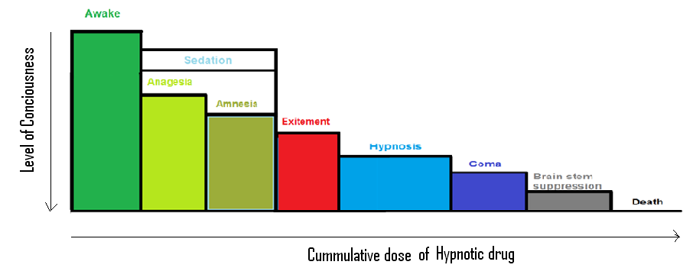

Slide 26
Stages of Anesthesia
FOUR STAGES:
STAGE 1: Stage of conscious sedation
STAGE2:Stage of Excitement
STAGE 3 : Stage of Surgical Anesthesia
STAGE 4: Stage of Medullary depression

Slide 27
STAGE 1: (Stage of conscious sedation):
Low anestheic Concentrations in CNS→ Decrease activity of neurons in cells of Substantia Gelatinosa in Spinal Cord → interruption of the function of Spinothalamic tract → some degree of Analgesia.
Clinically: The patient initially experiences analgesia without amnesia. However, later in stage 1 both analgesia and amnesia ensue.

Slide 28
Stage 2: (Stage of Excitement):
  complex neuronal actions take place, including blockade of many small inhibitory neurons such as Golgi type II cells, together with a paradoxic facilitation of excitatory neurotransmitters.
  During this stage the patient appears to be delirious and excited but definitely is amnesic.

Slide 29
Stage 2: (Stage of Excitement):
    Respiration is irregular in rate and volume.
    Retching and vomiting may occur.
    Incontinence and struggling sometimes occur.
    Regular breathing marks the end of this stage.

Slide 30
Stage 3: Stage of Surgical Anesthesia:
There will be a progressive depression of pathways in the reticular activating system, together with suppression of spinal reflex activity that contributes to muscle relaxation.
It begins with the recurrence of regular breathing and extends to complete cessation of spontaneous respiration.

Slide 31
Stage 3: Stage of Surgical Anesthesia:
Four planes of stage III have been defined, representing increasing depth of anesthesia:
Plane 1: From the return of regular respirations to the cessation of REM.
Plane 2 :The Surgical Plane: from the cessation of REM to the onset of paresis of the intercostal muscles.
Plane 3 :From the onset to the complete paralysis of the intercostal muscles.
Plane 4: From the paralysis of the intercostal muscles to the paralysis of the diaphragm - at the end of this plan the patient will be apneic.

Slide 32
Stage 4: Stage of Medullary depression:
At high CNS drug concentrations, the activity of neurons in the respiratory and vaso-motor centers in the brain stem - which are relatively insensitive to anesthetic drugs – is depressed, leading to Cardio-Respiratory Collapse.
Full Respiratory and Circulatory support are a must, Otherwise, Coma and Death will ensue.

Slide 33
The stages of General Anesthesia used to be clinically distinct in old anesthesia because of slow onset time of older drugs ( Ether, etc…).
In Modern Anesthesia, the distinctive signs of each of the 4 stages are obscured due to:
  Use of drugs with rapid onset of action.
  Use of means of mechanical ventilation.
  Pre or intra-operative use of drugs that influence the signs of anesthesia.

Slide 34
You Might Like Anesthesia If…
You Enjoy Performing Procedures
You Are Interested In Critical Care
You Enjoyed:
  Pharm, Physio, Cardiology, Pulmonology.
You Like All Areas Of Medicine
You Like To See Immediate Results.
Notes:
Students tend to enjoy the procedural portion of anesthesia such as IVs, intubations, and spinals. Anesthesiology is a very hands-on field and at the same time involves a great deal of medical knowledge. For this reason, it can provide a perfect solution for students who enjoy both surgery and medicine. One one hand you are the one placing central lines and intubating prior to surgery. On the other hand you are the one determining how much medication a patient should get, if they need a blood transfusion, or how their medical diseases may affect the interventions you plan. Students with prior experience in emergency medicine (e.g EMT, emergency room technician, paramedic) tend to enjoy anesthesiology. Those experiences may provide the very basic skills foundation for the specialty (e.g. mask ventilation, IVs, intubation) so it makes for a natural transition. The basic science foundation of anesthesiology, although broad, lies mainly in physiology and pharmacology so students who enjoyed those courses tend to enjoy anesthesia. In practice, anesthesiologists have the training and ability to work in all areas of medicine. Depending on the practice environment, you may be providing anesthesia for a psychiatric patient undergoing electroconvulsive therapy, a pediatric patient undergoing a tonsillectomy, an obstetric patient undergoing a Cesarean section, or a trauma patient after a motor vehicle crash. One can also specialize and provide anesthesia mainly for one type of patient population, such as pediatrics or pain management. Anesthesiology is a field of immediate results. Almost all medications are given via the intravenous route and many have near immediate onset of action. Induction of anesthesia renders a patient unconscious within seconds. Life threatening emergencies such as cardiac arrhythmias, pneumothorax, hypovolemia, or malignant hypertension are managed on-the-fly. Anesthesiologists plan ahead to hopefully avoid any emergency. It is the successful management of these emergencies however that makes this field so exciting and rewarding. Many anesthesiologists also feel great satisfaction in carrying a patient through a difficult surgery without an issue. They are the silent heroes of the operating room.

Slide 35
Scope of Anesthesia
Work In Every Area Of Medicine
  OR, PACU, ICU, OB, Peds, Pain Clinic
Work With The Most Diverse Patient Population
  Premature Infants To Geriatrics
Provide Medical Care & Critical Care
  Prior To, During, And After Surgical Procedures
Work With Advanced Technology

Slide 36
Role of the Anesthetist
Anesthetist is the perioperative physician.
Provides medical care to each patient:
  Pre-operative evaluation.
  Patient counseling and informed consent.
  Consultation with surgical team.
  Providing pain control.
  Supporting life functions during surgery.
  Supervising immediate post-operative care.

Slide 37
Brief History
Pre-1800: Surgery Without Anesthesia.
1846: First Ether Anesthetic.
1847: Chloroform was introduced by James Simpson.
1884: Cocaine For Local Anesthesia.
1910s-1930s: Endotracheal Intubation.
1921: Epidural Anesthesia Described.
1943: Curare Clinical Trial Success (Montreal).
Mid 1950s: halothane.
1960: Short Acting Opioids.
1982: Transesophageal Echo.
1983: Laryngeal Mask Airway.
Notes:
Although the ancient Greeks used potions and poppy extracts to ablate surgical pain, the origins of anesthesia as we know it today began in the late 18th century. Humphry Davy discovered the analgesic properties of nitrous oxide, although they were ignored for almost 50 years. Anton Mesmer claimed he could induce a trancelike state that would allow for surgery without drugs, although it did not work. Horace Wells used nitrous oxide in 1844 for painless dentistry, but his success was thwarted by an unsuccessful attempt in front of an audience at the Massachusetts General Hospital. William Morton successfully used ether in 1846 at the Massachusetts General Hospital. This day, “Ether Day”, is seen as one of the most significant advances in the history of medicine. Local anesthetics were soon being used after the discovery of cocaine’s analgesic properties. Today similar local anesthetics (e.g. lidocaine) are used all over the world. The first epidural anesthetic was described in 1921 and became widely used starting a decade later. Today epidural anesthesia is the technique of choice for procedures such as Cesarean sections. With the improvement of tracheal intubation, neuromuscular blocking agents (e.g. curare) were widely used. Today newer forms of these agents are used in a great deal of surgical procedures. The use of short-acting opioids starting in the 1960s had a profound impact on the practice of anesthesia. Most recent development including the use of transesphageal echo in anesthesia, the laryngeal mask airway, and the pulse oximeter have vastly improved the field.

Slide 38
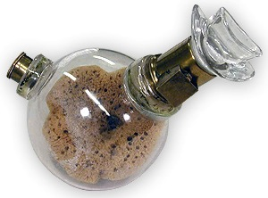
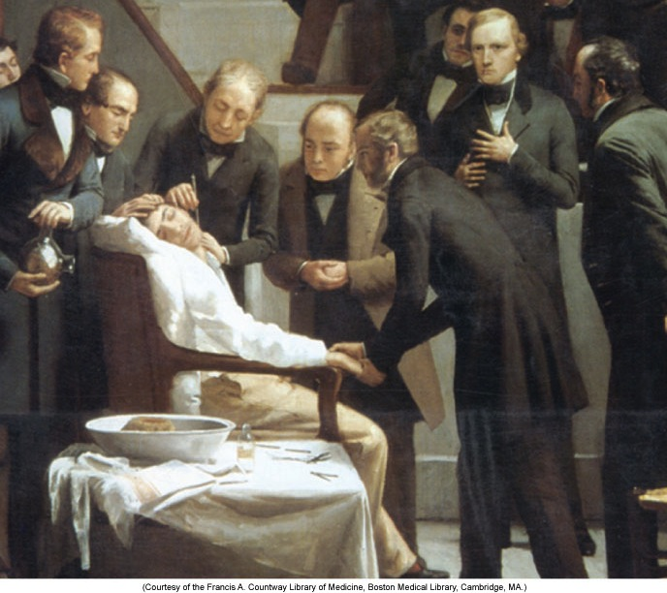
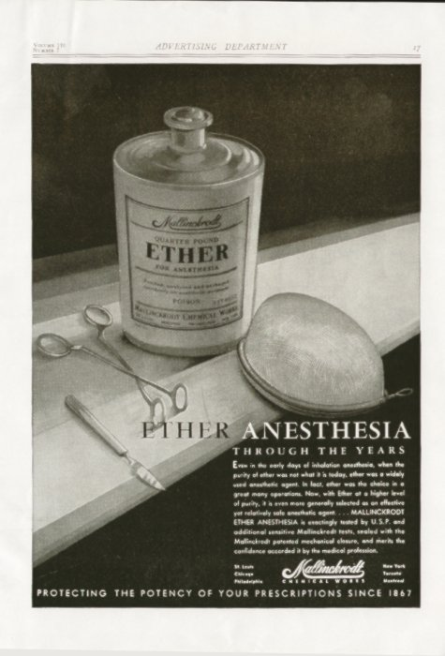
Ether Day – October 16th, 1846
Notes:
Robert Hinkley’s painting from 1882 depicting the first ether anesthetic. William T. G. Morton (left) is holding the globe inhaler while surgeon John C. Warren operates on Gilbert Abbott (neck mass excision). Surgery performed at the Massachusetts General Hospital. Top right image is an ether bulb inhaler.

Slide 39
Before anesthesia:…
..... Surgery was a terrifying last resort in a final attempt to save life.
Dr D J Wilkinson, past Honorary Treasurer and Archivist, Association of Anaesthetists of Great Britain and Ireland

Slide 40
Liston, an eminent surgeon, was once operating for a bladder stone.
The panic stricken patient finally broke loose from the brawny assistants, ran out of the room, down the hall and locked himself in the lavatory.
Liston, hot on his heels and a determined man, broke down the door and carried the screaming patient back to complete the operative procedure.
(Rapier HR. Man against Pain London 1947;49).

Slide 41
Fanny Burney, a well-known literary artist from the early 19th century, described a mastectomy she endured after receiving a “wine cordial” as her sole anesthetic.
As seven male assistants held her down, the surgery commenced: “When the dreadful steel was plunged into the breast-cutting through veins-arteries-flesh–nerves, I needed no injunction not to restrain my cries. I began a scream that lasted unintermittently during the whole time of the incision–and I almost marvel that it rings not in my Earsstill! So excruciating was the agony. Oh Heaven!–I then felt the knife racking against the breast bone–scraping it! This performed while I yet remained in utterly speechless torture.”
Burney’s description illustrates the difficulty of overstating the impact of anesthesia on the human condition.

Slide 42
Anaesthesia is now very safe, with mortality of less than 1 in 250,000 directly related to anaesthesia.
===========cf.===========
The global mortality rate due to traffic accidents was 19 per 100 000 population (1:5263)

Slide 43

Thank You

