Slide 1
Acne
Dr. Rand Murshidi
Department of Dermatology
Jordan university hospital

Slide 2
Introduction
Acne is a multifactorial disorder of the pilosebaceous unit
All age groups may be affected, peak incidence is during adolescence.
Psychological impact, social isolation, anxiety, depression even suicidal ideation

Slide 3
Underlying factors
Genetic factors (number , size, activity of sebaceous glands), tendency of severe acne runs in families
Dietary factors controversial: Skim milk, whey protein , high glycemic diets, dietary supplements vitamin B12
Androgenic hormones increase size of sebaceous glands and sebum amount
Iatrogenic corticosteroid, androgens combined OCP, antiepileptics, EGFR inhibitor
Other factors: Fluid retention (premenstrual), stress (inflammation), seasons, , cosmetics(comedogenic)

Slide 4
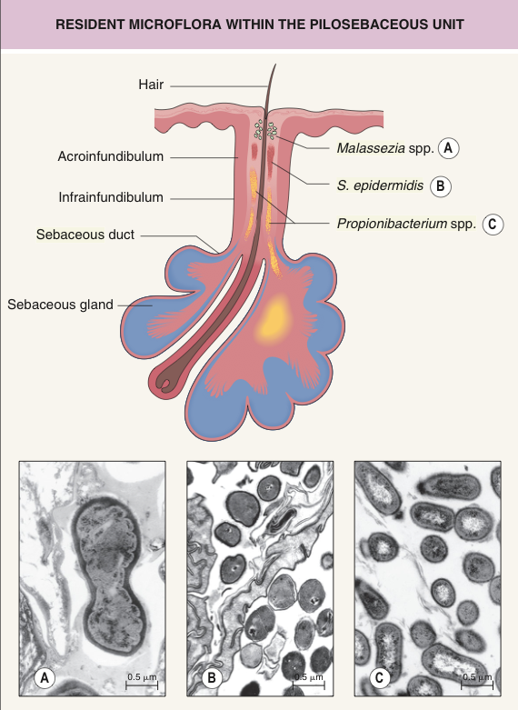
Pilosebaceous unit

Slide 5
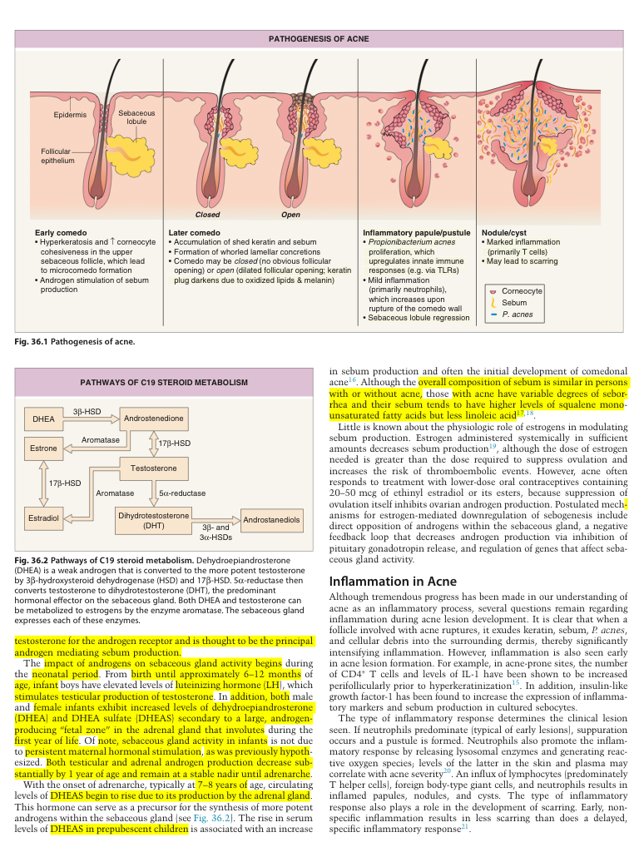
Pathogenesis

Slide 6
Follicular hyperkeratinisation corneocytes normally extruded in acne accumulate , hyperkeratotic plug
Hormonal influences on sebum production and composition testesterone and dihydrotestesterone most potent
Inflammation in acne Propionibacterium acnes which uses sebum as a substrate. and produces lipases which break down the triglycerides in sebum to form free fatty acids

Slide 7
Clinical features
Localisation :sites of well developed sebaceous glands.
Non-inflammatory vs inflammatory
Non-inflammatory : Open vs closed comedones
Closed comedone (white heads) small papules , no follicular opening , no erythema
Open comedone (black heads) dilated follicular opening with core of shed keratin ( colour due to melanin and lipid oxidation).

Slide 8
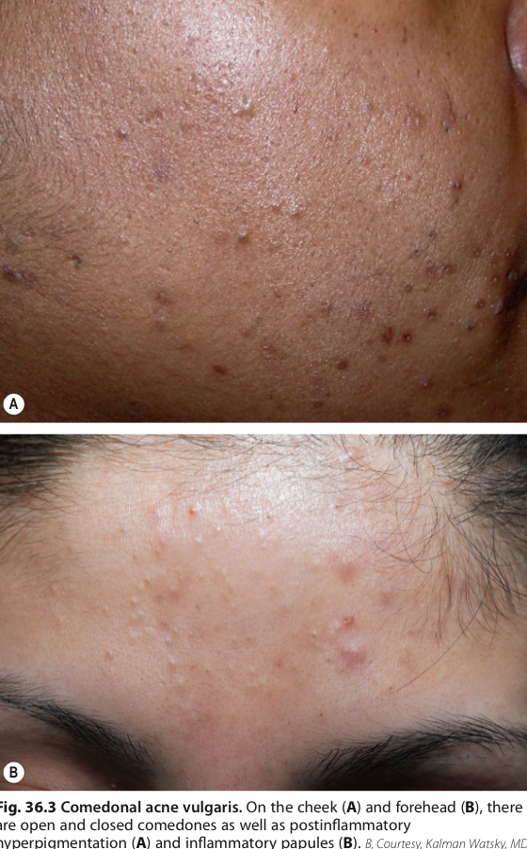

Slide 9
Inflammatory acne : papules , pustules , nodules, pseudocystes( filled with pus and serosanguinus fluid) may combine to sinus tracts .

Slide 10
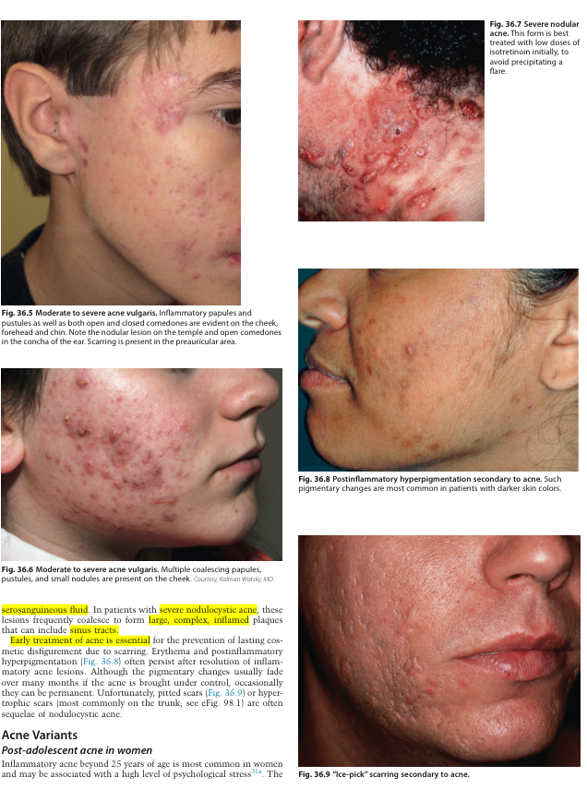

Slide 11
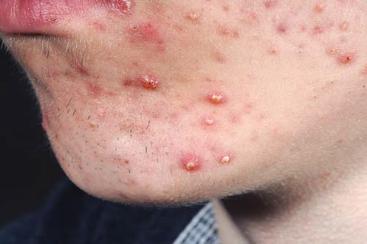
Variants of acne
  1- Acne vulgaris
  -Acne vulgaris, the common type of acne, occurs during puberty and affects the comedogenic areas of the face, back and chest. There may be a familial tendency to acne.
  -Acne vulgaris is more common in boys, 30–40% of whom develop acne between the ages of 18 and 19
  -In girls, the peak incidence is between 16 and 18 years
  -Adult acne is a variant affecting 3% of
  men and 5% of women over the age of 40

Slide 12
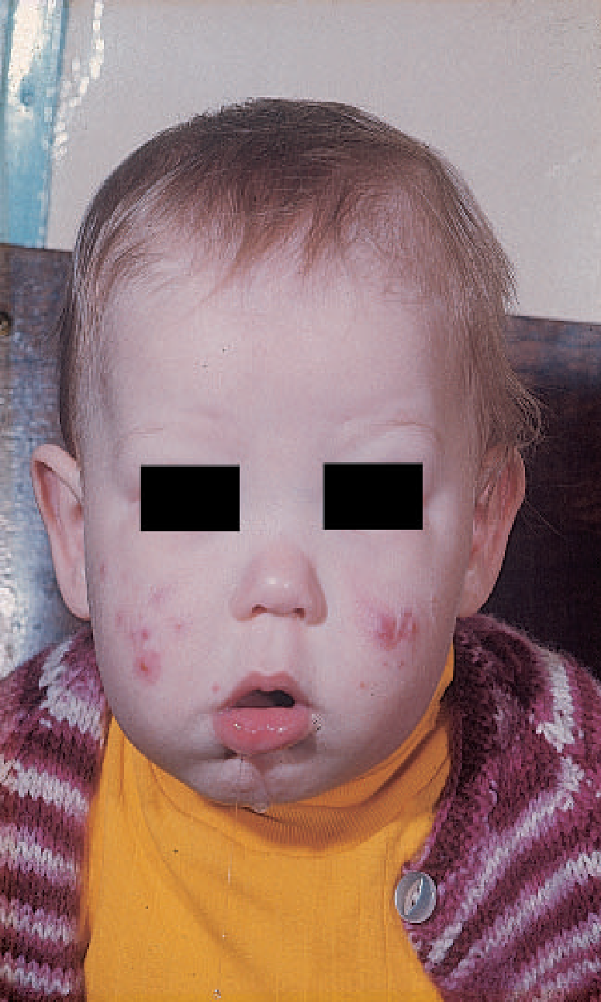
2. Infantile Acne
Localised acne lesions occur on the face in the first few months of life. Infantile acne may require topical or systemic therapy as although it will resolve spontaneously it may last up to 5 years and can cause scarring.
There is an association with severe adolescent acne.
Endocrine abnormalities are very rare, but should be considered, especially in a girl with signs of virilism

Slide 13
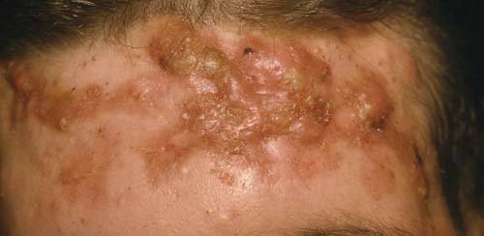
3. Acne conglobata/fulminans
severe form of acne, more common in boys and in tropical climates. There is extensive, nodulocystic acne and abscess formation affecting particularly the trunk, face and limbs
Acne fulminans is similarly severe but is associated with systemic symptoms of malaise, fever and joint pains

Slide 14
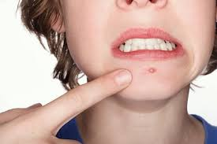
  4. Occupational Acne.
  5. Drug Induced Acne.
  6. Cosmetic-induced Acne.

Slide 15
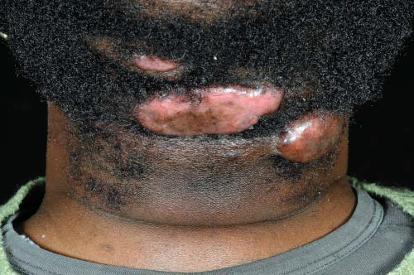
7. Acne keloidalis
is a type of scarring acne seen particularly on the neck in men

Slide 16
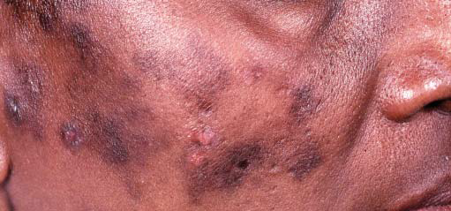
8.Acne excoriée( des jeunes ﬁ lles)
is typically seen in teenage girls who present with facial excoriations but very few primary lesions. There are no comedones. This is a form of neurotic excoriation , and patients need to be given a clear explanation and helped to try and reduce the self - inﬂicted damage.

Slide 17
Treatment of acne

Slide 18
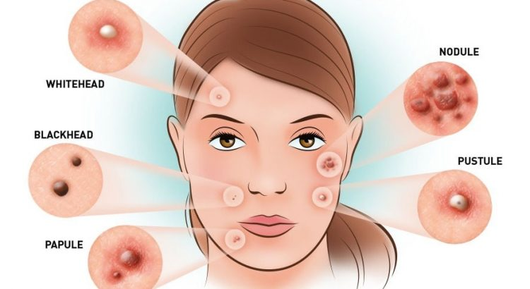
General measures
Full explanation and active therapy are essential.
Avoid precipitating factors

Slide 19
Cleansers
Topical
Systemic treatments

Slide 20
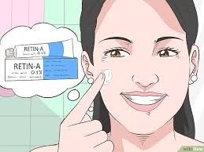
Topical treatments
Benzoyl peroxide has been available for the treatment of acne for many years; it has bacteriostatic effects against P. acnes and is mildly comedolytic.
Salicylic acid promotes desquamation of follicular epithelium and therefore inhibits the formation of comedones
Topical retinoids are vitamin A derivatives that are anti inflammatory and comedolytic. Treatments currently available include tretinoin, adapalene

Slide 21
Topical antibiotics are effective through their bactericidal activity against P. acnes and consequent anti-inflammatory effects. The most commonly prescribed antibiotics include erythromycin and clindamycin either alone or in combination with other agents such as zinc or benzoyl peroxide.
Phototherapy with ultraviolet or visible light is an alternative therapy that may be helpful in those unresponsive to or unable to tolerate conventional treatments.

Slide 22
Systemic therapy
Oral antibiotics.
Hormonal treatments.
Oral retinoids.

Slide 23
Hormone therapies.
These include certain types of OCPs that
increase sex hormone-binding globulin and consequently reduce
free testosterone levels.These are generally OCPs that have higher
oestrogen and lower androgen potential

Slide 24
Oral antibiotics
Tetracyclines remain the mainstay of treatment in those over the age of 12 years (below this age, they may cause dental hypoplasia and staining of teeth)
Tetracyclines should be avoided in pregnancy/breastfeeding and
children <12 years. Erythromycin and trimethoprimare good alternatives.

Slide 25
Oral retinoids
Isotretinoin has revolutionised the treatment of
severe acne, but it is usually reserved for resistant disease unresponsive
to other oral therapies

Slide 26
Rosacea

Slide 27
Introduction
encompasses a costellation of clinical findings with the key components ( persistent facial erythema and inflammatory papulopustules).
Clinical types:
1. erythematotelangiectatic: flush , facial erythema +- telangectasia
2.papulopustular : centrofacial eruption multiple small papules
3.phymatous: thickened nodular skin, prominrnt pores , can affect nose (rhinphyma), chin, forehead, ears, eyelids
4.ocular : dry gritty, blepharitis, conjunctivitis

Slide 28
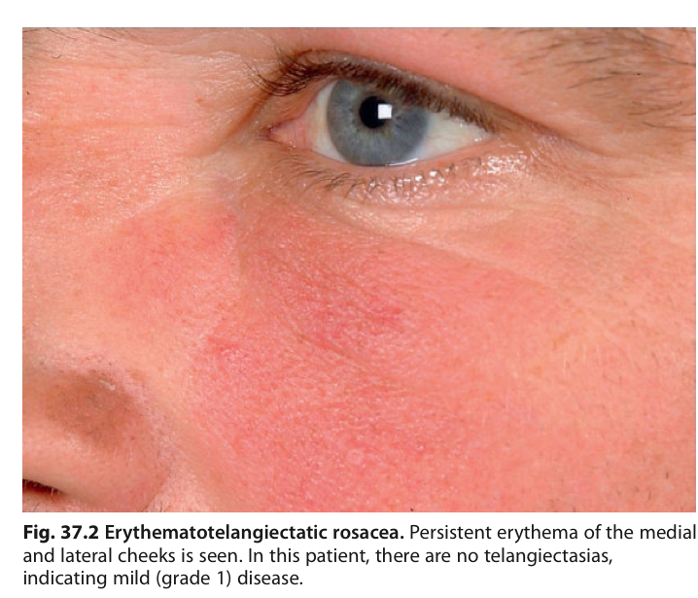
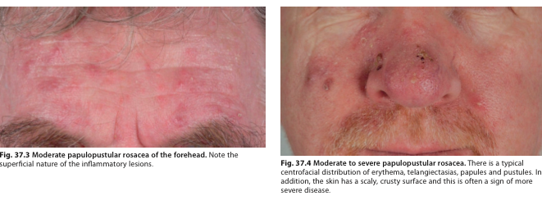

Slide 29
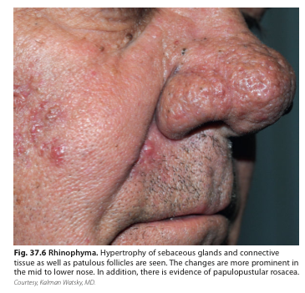
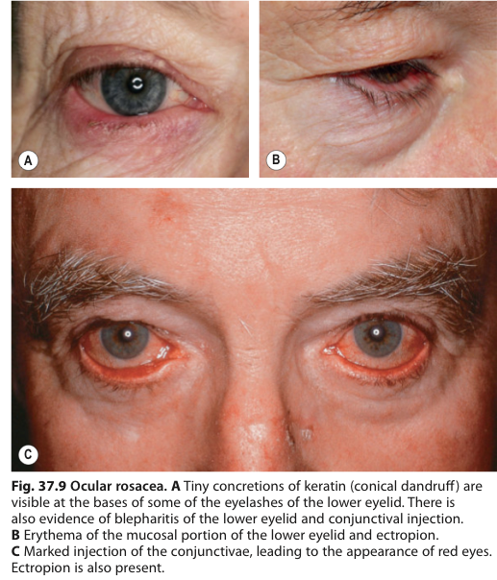

Slide 30
Exacerbated by heat, exercise, hot food, spicy food, emotion, alcohol and sunlight

Slide 31
Management
Avoid trigger factors.
Sun screen
Avoid skin irritants
Topical treatment :Metronidazol, azelic acid, a adrenoreceptors ( temporary effect).
Oral antibiotics
Low dose isotretinoin
Laser, surgery

Slide 32
Thank you for your attention

