Slide 1
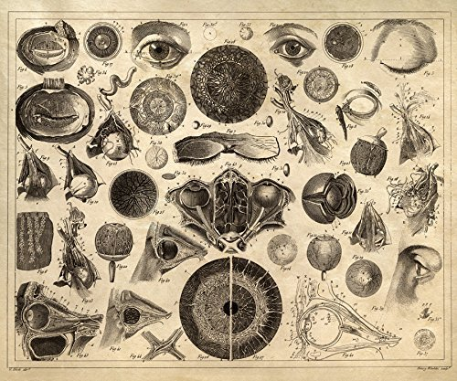
Introduction to Ophthalmology
Anatomy of the Eye

Slide 2
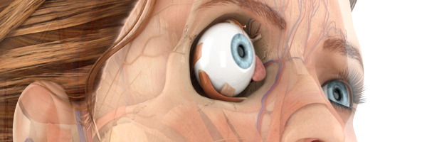
Anatomy the Eye

Slide 3
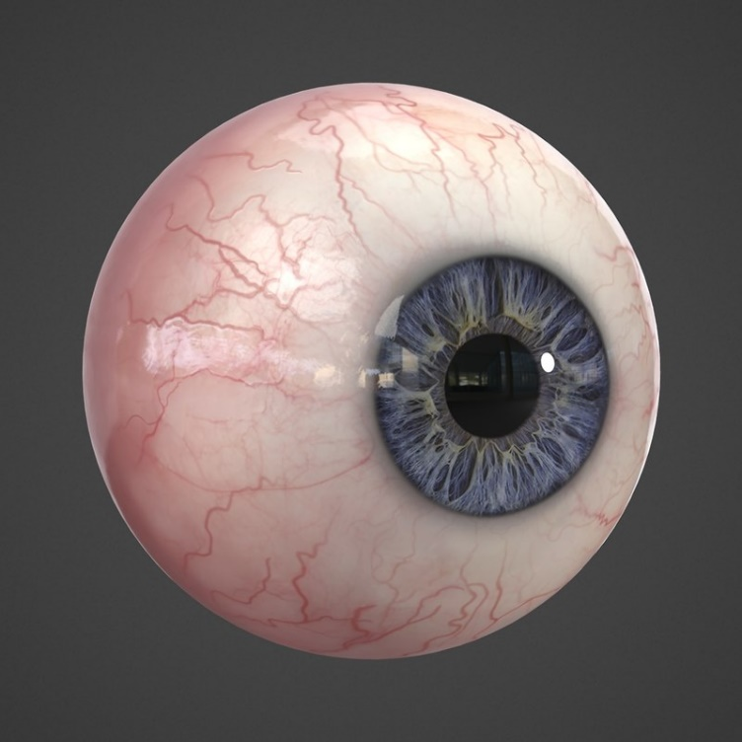
Anatomy the Eye
The eye is a spherical structure that lies within the orbital cavity
Also known as the Eyeball or Globe

Slide 4
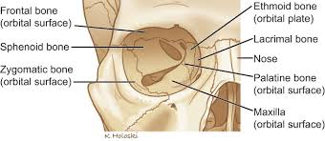
Orbit

Slide 5
Orbit: Anatomy and Clinical Relevance
Structure: Pear-shaped cavity with the optic canal as its stalk.
Roof: Formed by the lesser wing of sphenoid and frontal bone; defects may cause pulsatile proptosis.
Lateral Wall: Formed by the greater wing of sphenoid and zygomatic bone; anterior globe vulnerable to trauma.

Slide 6
Floor: Made of zygomatic, maxillary, and palatine bones; weak posteromedial maxillary portion prone to blowout fractures; maxillary carcinoma can displace the globe.
Medial Wall: Composed of maxillary, lacrimal, ethmoid, and sphenoid bones; lamina papyracea is thin, allowing spread of infections (orbital cellulitis) from the ethmoidal sinus.

Slide 7
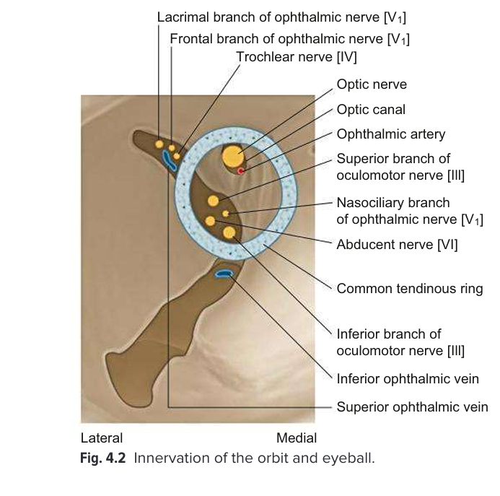

Slide 8
Superior Orbital Fissure: Connects orbit to cranium; passage for cranial nerves & veins.
Superior portion: Lacrimal, frontal, trochlear nerves, superior ophthalmic vein.
Inferior portion: Oculomotor nerve divisions, abducens nerve, nasociliary nerve, sympathetic fibers.
Inferior Orbital Fissure: Connects orbit to pterygopalatine/infratemporal fossae; contains maxillary nerve, zygomatic nerve, pterygopalatine ganglion branches, and inferior ophthalmic vein.

Slide 9
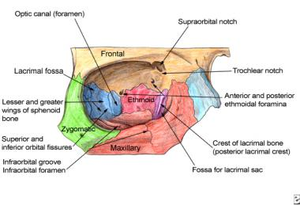
Orbit

Slide 10
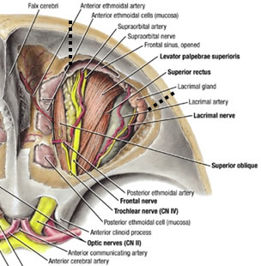
Orbital Structures
Eyeball
Nerves
Muscles
Blood Vessels
Lacrimal Gland
Fat

Slide 11
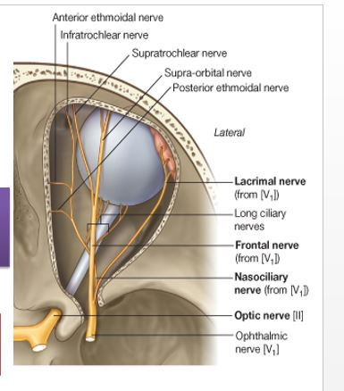
Orbital Structures- Cranial Nerves
Optic- CN ІІ
Oculomotor- CN ІІІ
Trochlear- CN ІV
Trigeminal- CN V¹ and V²
Abducent- CN VІ

Slide 12
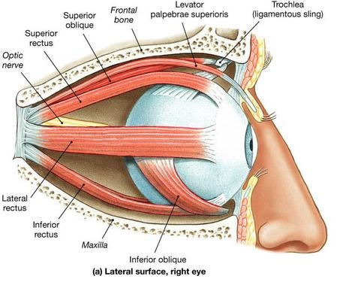
Orbital Structures- Muscles
Extraocular Muscles- EOM
Levator Palpebrae Superioris

Slide 13
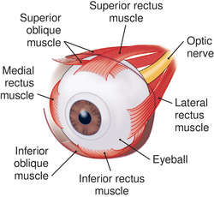
Orbital Structures- Muscles
EOM:
  Recti : Superior
  Inferior
  Medial
  Lateral
  Obliques: Superior
  Inferior

Slide 14
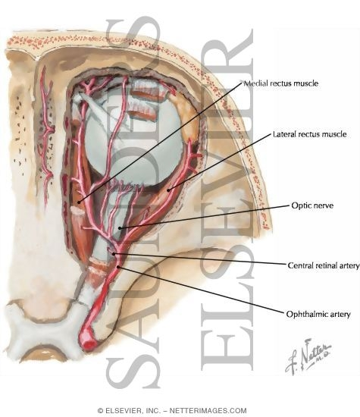
Orbital Structures-Blood Vessels

Slide 15
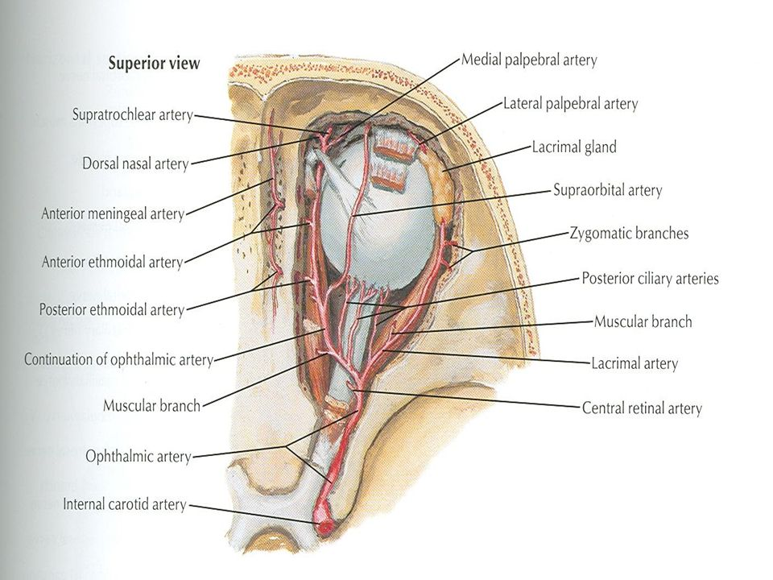
Orbital Structures-Blood Vessels

Slide 16
Blood Supply of the Orbit
1. Main Arterial Supply
Ophthalmic artery (branch of the internal carotid artery)
  Enters through the optic canal alongside the optic nerve
  Gives off multiple branches supplying the orbit and eye
2. Key Branches of the Ophthalmic Artery
Central retinal artery → Supplies the inner retina
Lacrimal artery → Supplies lacrimal gland, eyelids, and conjunctiva
Ciliary arteries:
  Short posterior ciliary arteries → Supply the choroid & optic nerve head
  Long posterior ciliary arteries → Supply anterior uvea
  Anterior ciliary arteries → Supply the rectus muscles & anterior segment
Ethmoidal arteries (anterior & posterior) → Supply ethmoidal sinuses & nasal cavity
Supraorbital & supratrochlear arteries → Supply forehead and scalp
3. Venous Drainage
Superior ophthalmic vein → Drains into the cavernous sinus
Inferior ophthalmic vein → Communicates with pterygoid venous plexus
Clinical Significance: Infection from the face (danger triangle) can spread via these veins → Cavernous sinus thrombosis

Slide 17
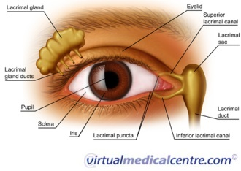
Orbital Structures- Lacrimal Gland

Slide 18
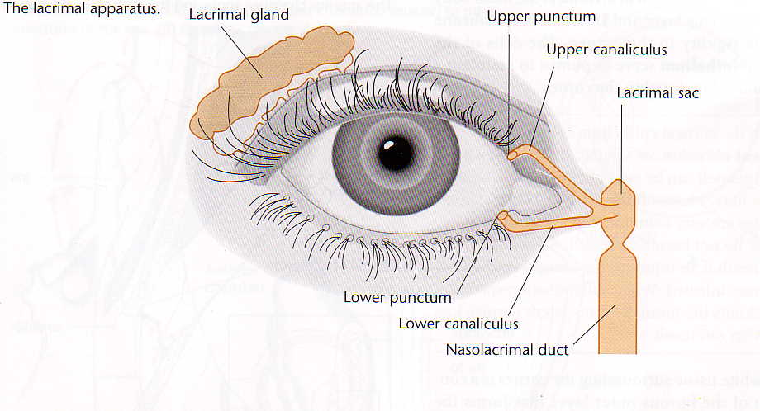
Lacrimal Apparatus

Slide 19
Lacrimal Gland: Key Points
Location: Superolateral orbit, divided into orbital and palpebral portions.
Function: Produces tears; drains via lacrimal puncta → canaliculi → lacrimal sac → nasolacrimal duct → inferior meatus.
Blood Supply: Lacrimal artery (ophthalmic branch); venous drainage to cavernous sinus.
Innervation:
  Parasympathetic (CN VII via pterygopalatine ganglion) → Stimulates tears.
  Sympathetic (superior cervical ganglion) → Controls blood flow.
  Sensory (Lacrimal nerve - V1).
Clinical Relevance:
  Dry Eye Syndrome → Tear deficiency.
  Dacryoadenitis → Inflammation (viral/bacterial).
  Lacrimal tumors → May cause proptosis & globe displacement.

Slide 20
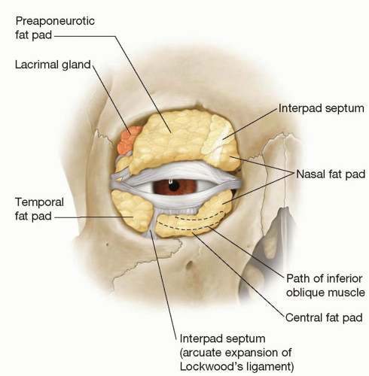
Orbital Structures- Fat

Slide 21
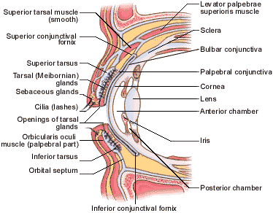
Eyelid

Slide 22
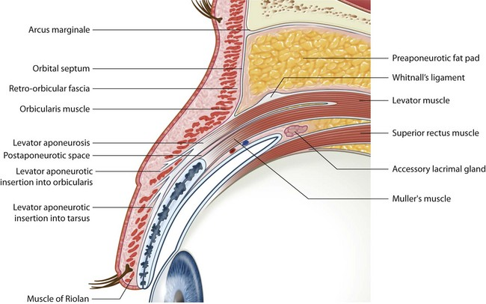
Eyelid

Slide 23
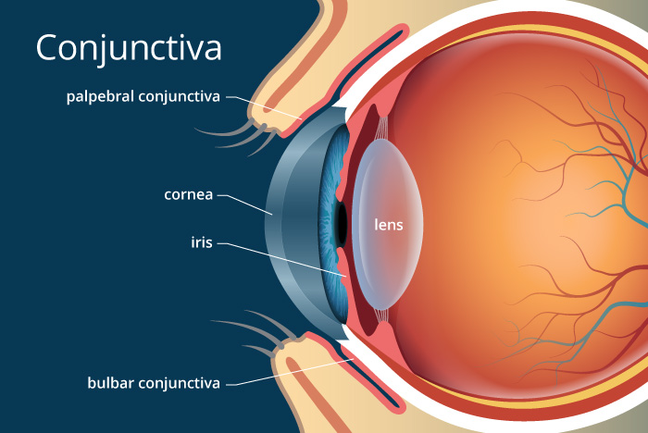
Conjunctiva

Slide 24
Conjunctiva: Key Points
Thin, transparent mucous membrane covering the anterior sclera and inner eyelids.
Functions: Lubrication, protection, and immune defense.
2. Parts of the Conjunctiva
Palpebral (Tarsal) Conjunctiva → Lines the inner eyelids.
Bulbar Conjunctiva → Covers the anterior sclera (not the cornea).
Fornix (Conjunctival Sac) → Junction between palpebral and bulbar conjunctiva.
It has a non-keratinized stratified squamous epithelium about five cell layers deep, containing mucus-secreting goblet cells, immune system Langerhans’ cells, and occasional melanocytes.

Slide 25
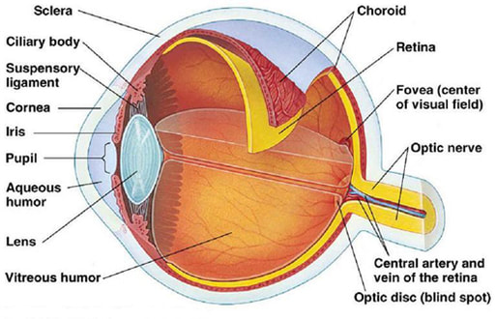
Anatomy of The Eye

Slide 26
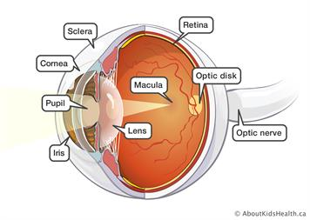

Slide 27
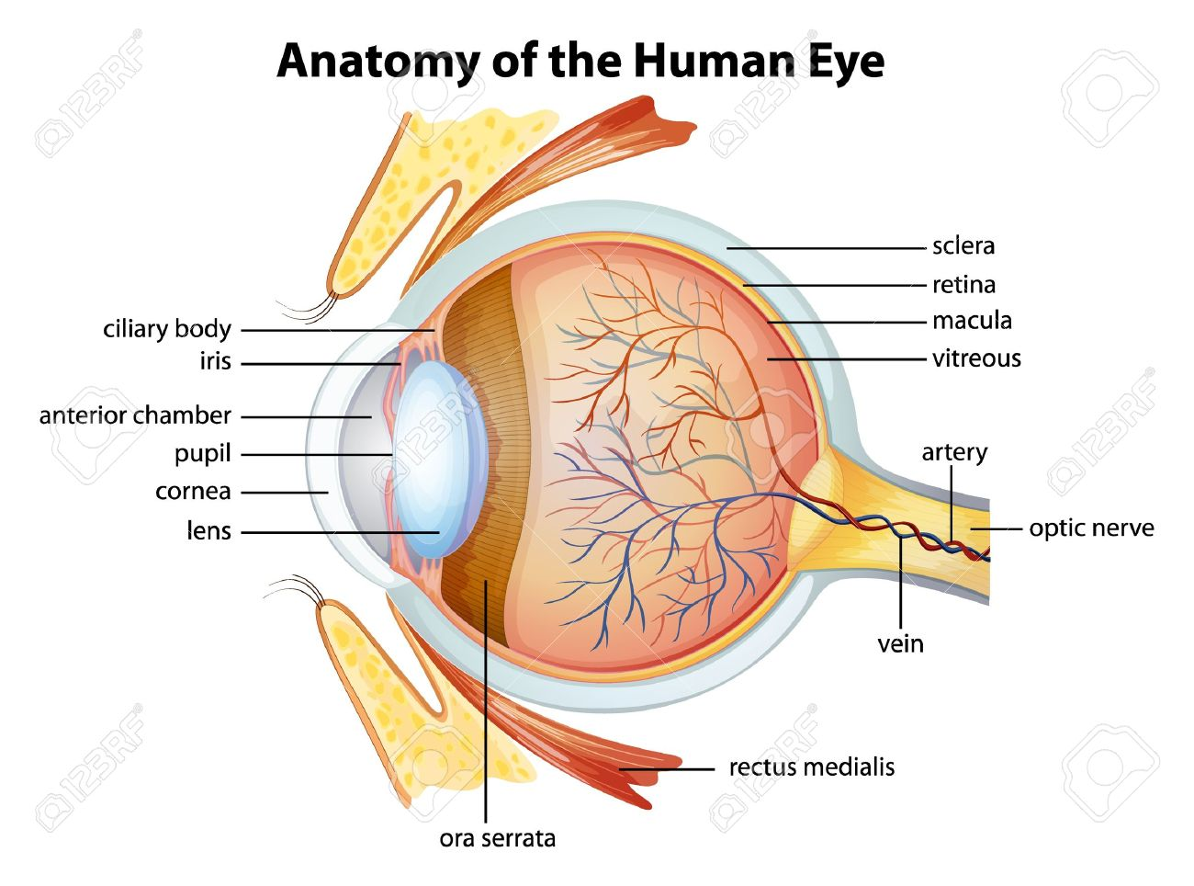

Slide 28
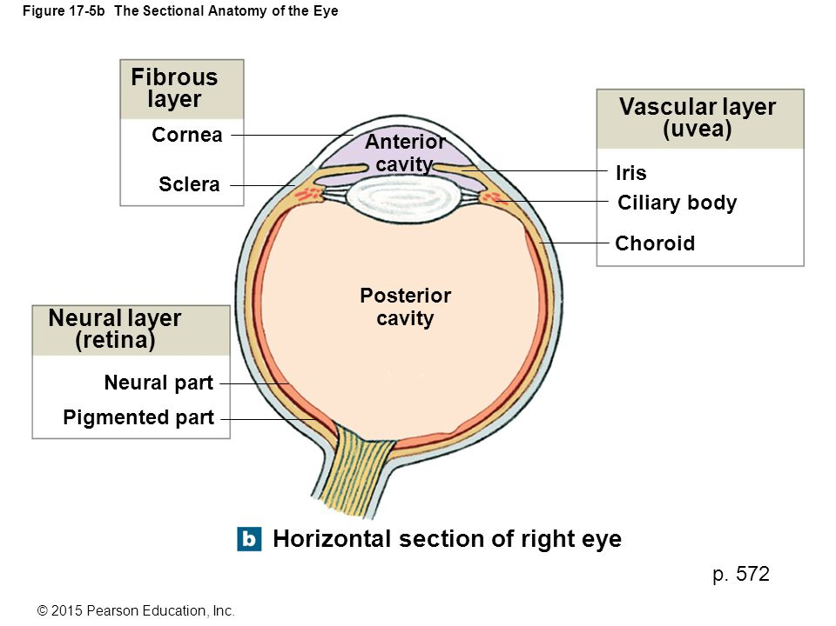

Slide 29
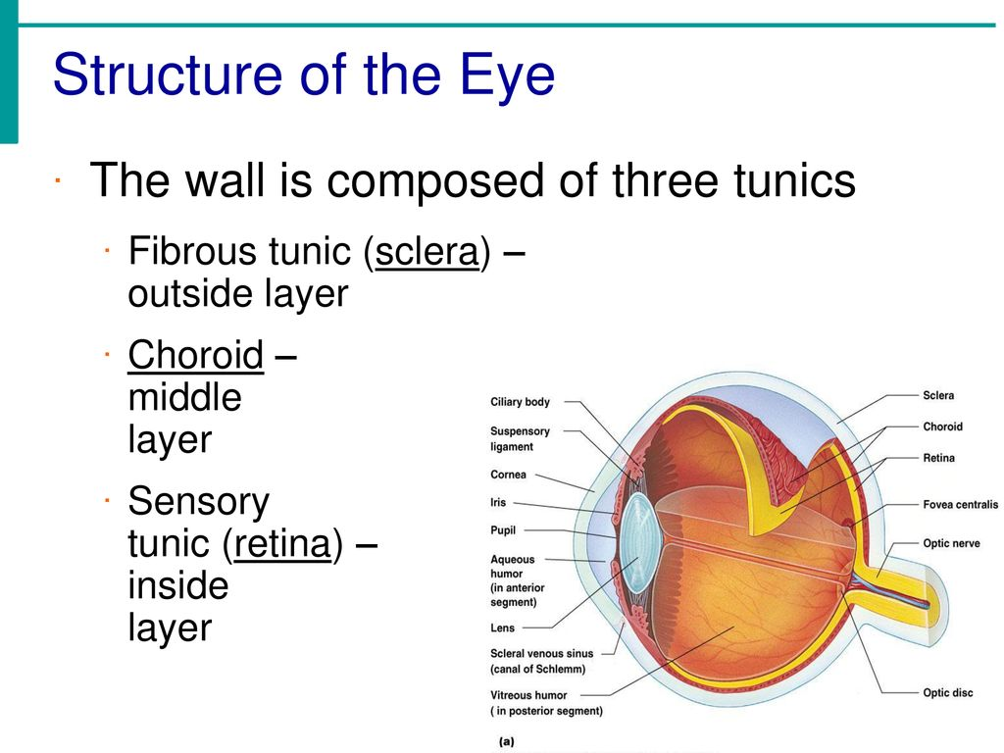

Slide 30
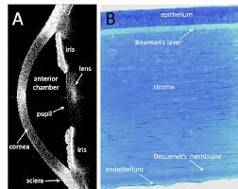
Cornea
Transparent dome shaped structure at the front of the eye
Responsible for 2/3rds of the refractive power of the eye
Has an important protective role
Avascular structure
Mainly made of collagen type 1
Notes:
N type

Slide 31
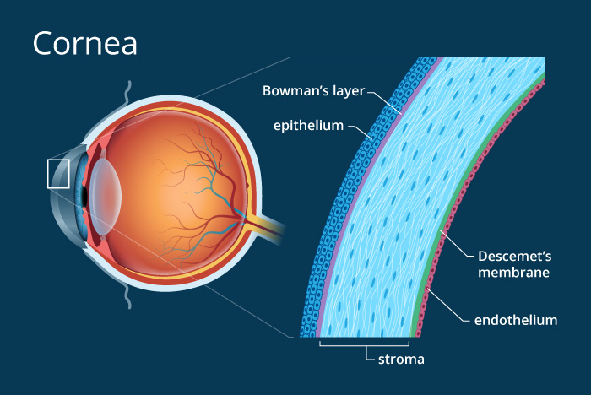
Cornea

Slide 32
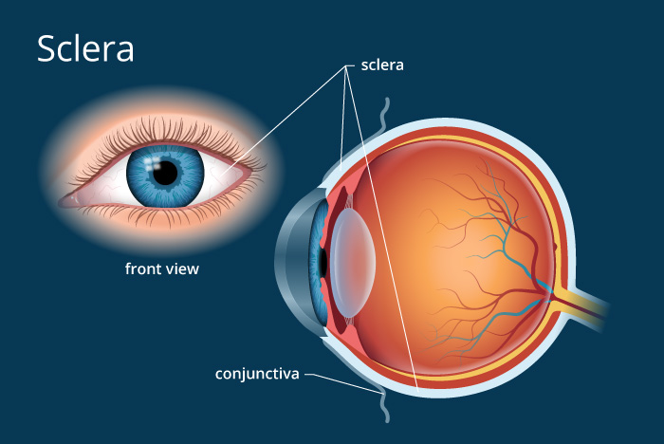
Sclera

Slide 33
Sclera
Also known as the “white” of the eye.
The sclera is covered by the conjunctiva anteriorly.
It is thickest in the area surrounding the optic nerve.
The sclera is made up of three divisions: the episclera, loose connective tissue, immediately beneath the conjunctiva; sclera proper, the dense white tissue that gives the area its color; and the lamina fusca, the innermost zone made up of elastic fibers.

Slide 34
Sclera
It is the opaque, fibrous and protective outer layer of the eye containing mainly collagen
Gives attachment to extraocular muscle
Allows the passage of the optic nerve posteriorly

Slide 35
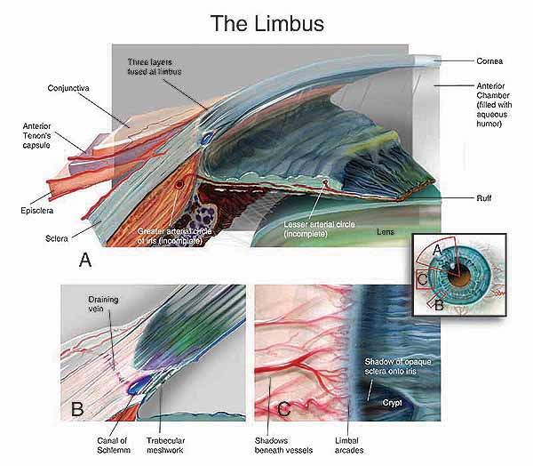
Limbus

Slide 36
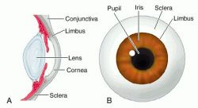
Limbus-Corneoscleral Junction
Common site for surgical incisions
Contains stem cells

Slide 37
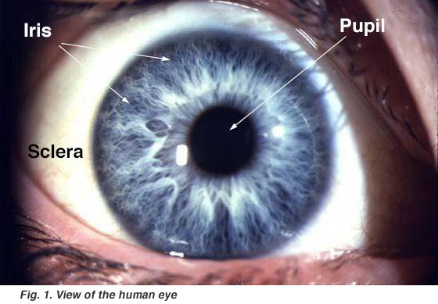
Iris

Slide 38
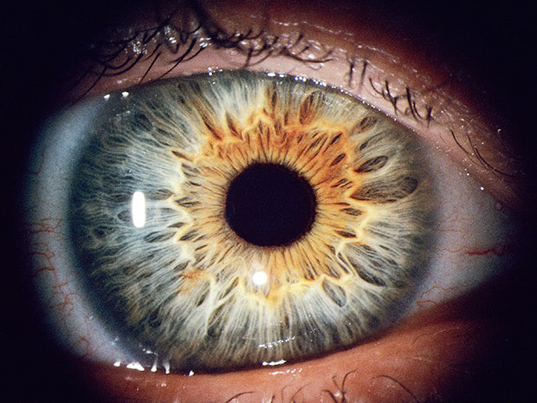
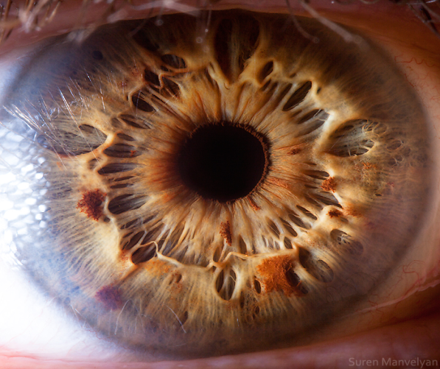
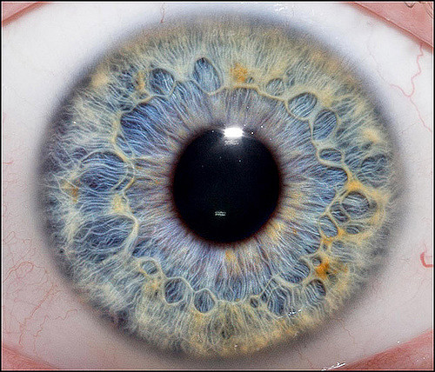
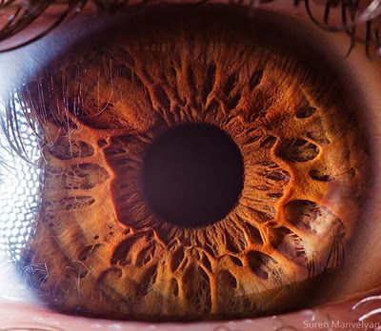
Iris
Contains melanin pigment with variable density resulting in different colors

Slide 39
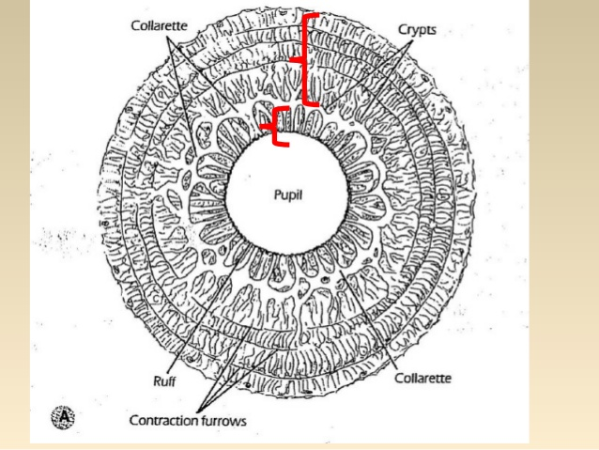
Iris

Slide 40
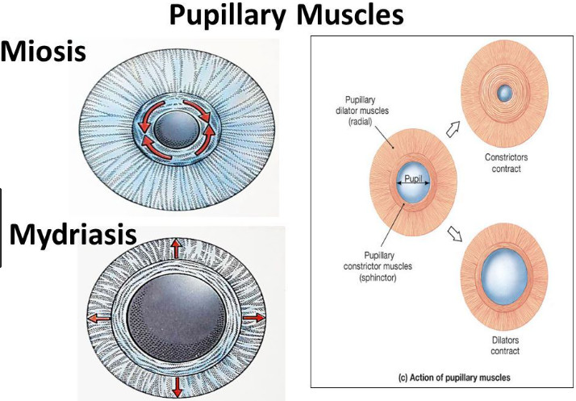
Iris

Slide 41
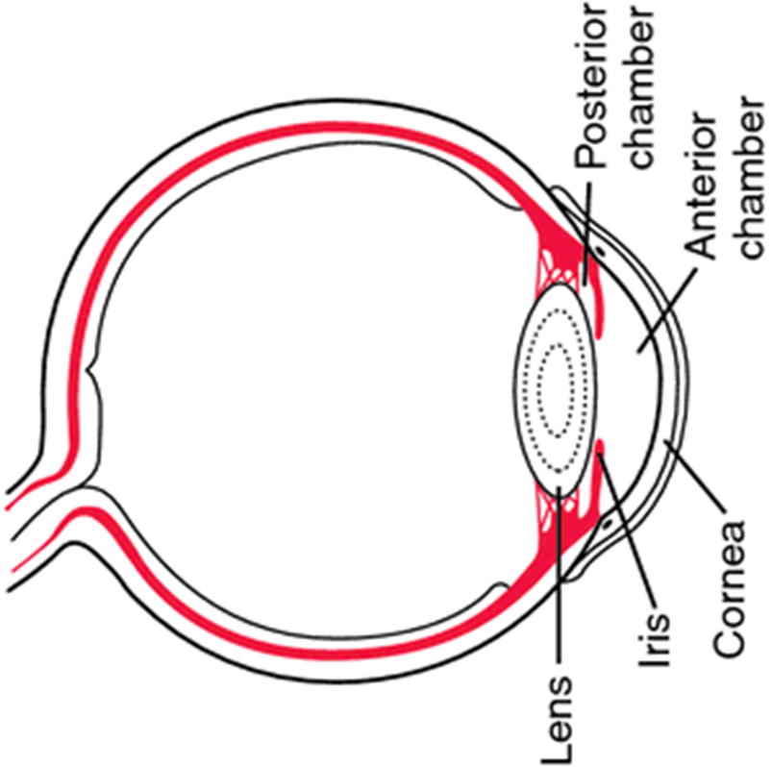
Anterior Chamber
It is the space bound anteriorly by the back surface of the cornea and posteriorly by the iris and lens
It is filled by aqueous
humor

Slide 42
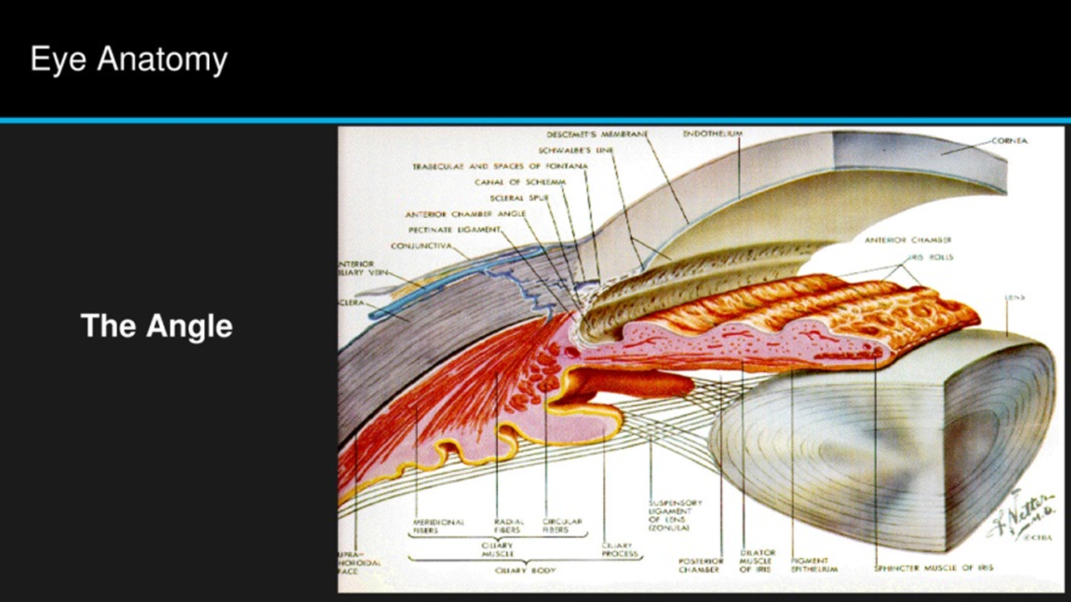
Irido-corneal Angle

Slide 43
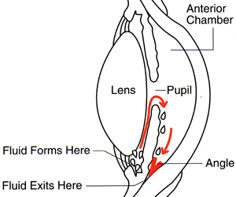
Irido-corneal Angle
The area where the iris and the cornea meet
Contains the trabecular meshwork and Schlem’s canal. They constitute the aqeuous drainage system

Slide 44
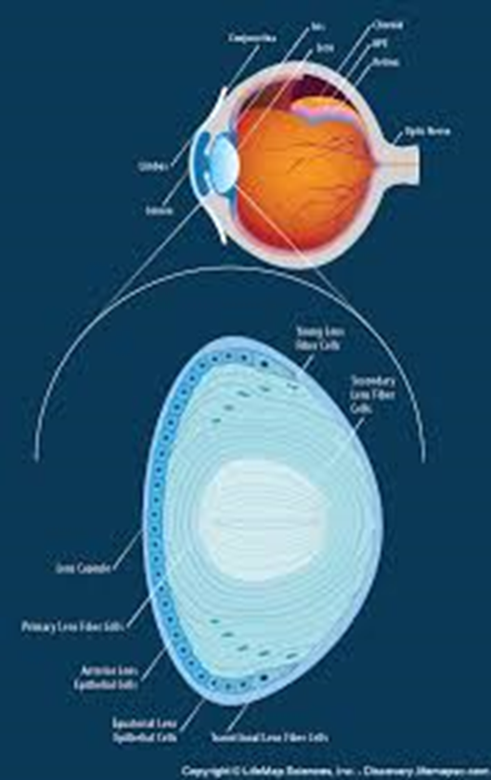
Crystalline Lens
Responsible for the remaining
1/3 rd of the refractive power of
the eye
Fixed in place by zonules
(suspensory ligaments) of the
ciliary body

Slide 45
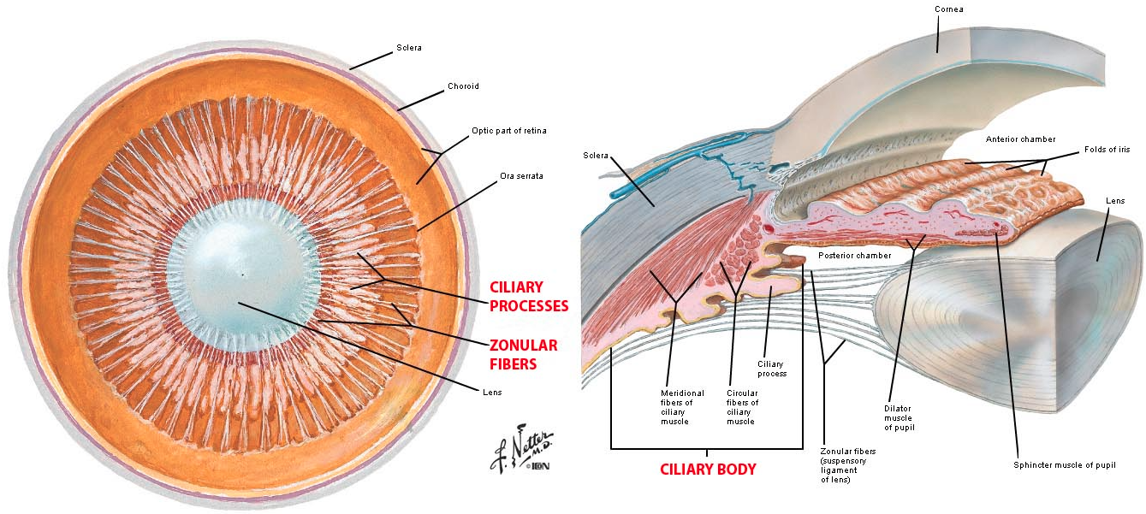
Ciliary Body

Slide 46
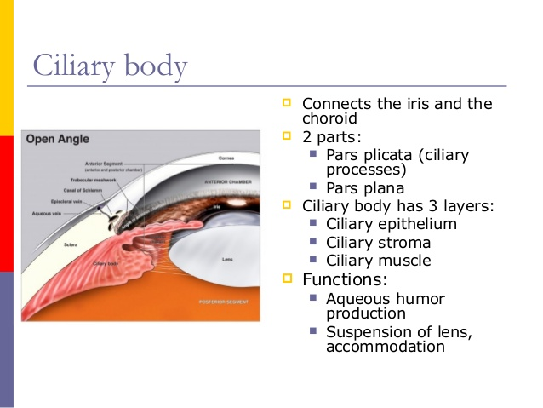
Ciliary Body

Slide 47
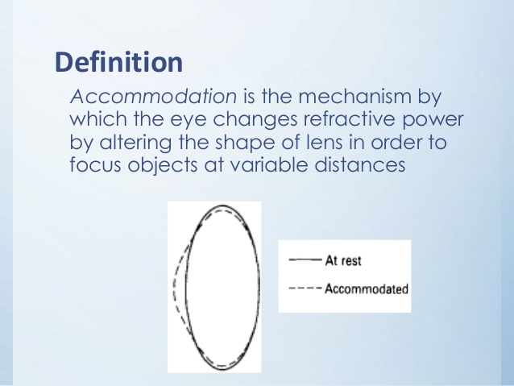
Accommodation

Slide 48
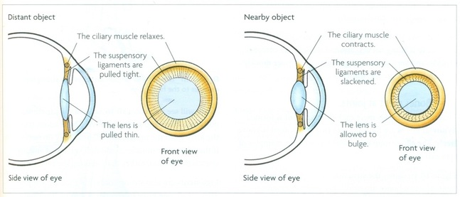
Accommodation

Slide 49
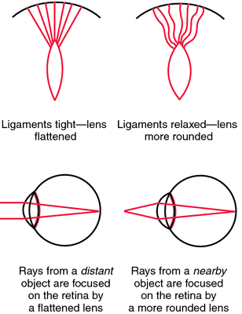

Slide 50
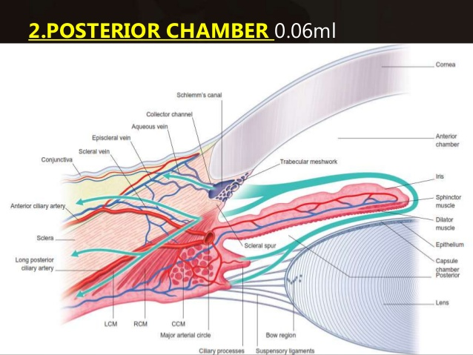
Posterior Chamber
The space that lies between ciliary body, iris and lens

Slide 51
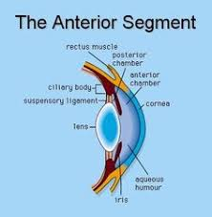
Anterior Segment

Slide 52
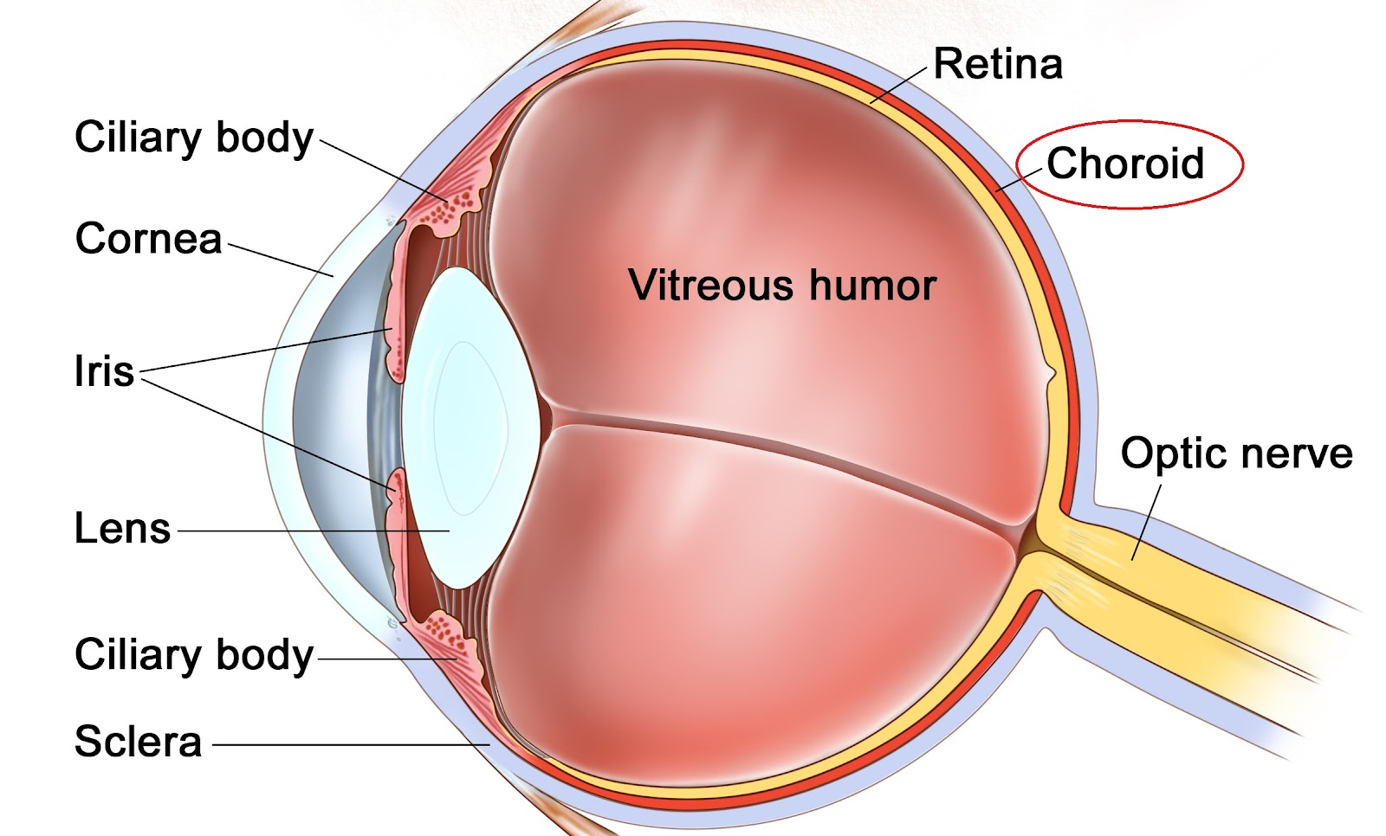
Choroid

Slide 53
Choroid
Thin, highly pigmented, vascular loose connective tissue
Rich in melanocytes gives characteristic dark color
Situated between sclera and retina
Extends from optic nerve to ciliary body (at ora serrata)

Slide 54
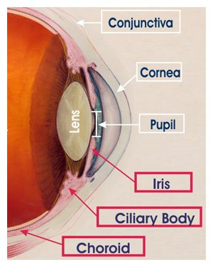
Uveal Tract

Slide 55
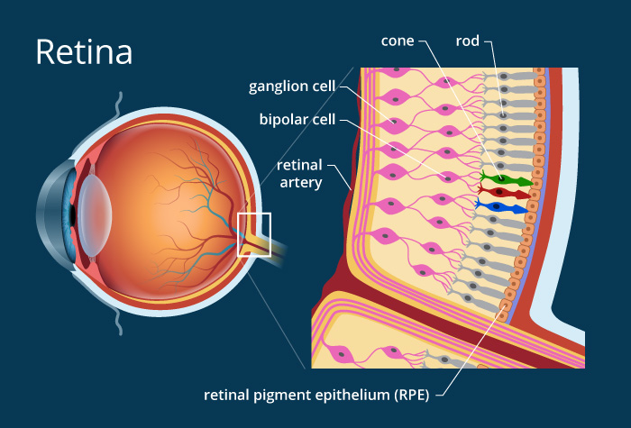
Retina

Slide 56
Retina
The retina is the light-sensitive tissue that lines the inside of the eye
Functions in a manner similar to film in a camera
The optical elements within the eye focus an image onto the retina , initiating a series of chemical and electrical events
Nerve fibers within the retina send electrical signals to the brain, which then interprets these signals as visual images

Slide 57
Retina
The center of the retina provides the greatest resolving power of the eye
This area, responsible for central vision, is known as the macula
The center of the macula is called the fovea

Slide 58
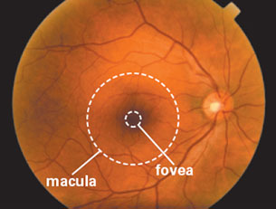
Retina

Slide 59


Slide 60

Peripherally, retina has dentate/teeth like processes called Ora Serrata

Slide 61

The Optic Nerve- CN 2
The optic nerve is formed by the convergence of axons from the retinal ganglion cells.
These cells in turn receive impulses from the photoreceptors of the eye (the rods and cones).

Slide 62


Slide 63

Vitreous Body
The vitreous body is the clear gel that fills the space between the lens and the retina.
Occupies 80% of the volume of the eye
It is a clear matrix composed of collagen, hyaluronic acid, and water
Often referred to as the vitreous humour or simply "the vitreous"

Slide 65
The End

