Slide 1


Eczema
Dr. Rand Mhailan
Dermatology Department
Jordan university hospital

Slide 2
Definition
▪ Dermatosis : Condition of the skin.
▪ Dermatitis : Inflammation of the skin.
▪ Eczema : Type of dermatitis.
▪ 'Ekze', in Greek means “to boil over”.
▪ Definition : Eczema is type of dermatitis characterized by erythema, edema papulo-vesicles, oozing in acute stage, crusting and scaling in subacute & lichenification in the chronic stages and histologically characterized by spongiosis.
“All eczemas are dermatitis, but not all dermatitis are eczemas.”

Slide 3
Classification
▪ Exogenous eczemas : External cause for the eczema is identifiable.
▪ Endogenous eczemas : An internal cause or an inherent property of the skin is responsible.
▪ Some types of eczema are precipitated by both external and internal factors. Eg: Xerotic eczema

Slide 4
Exogenous eczemas
▪ Irritant dermatitis
▪ Allergic contact dermatitis
▪ Photodermatitis
Endogenous eczemas
▪ Atopic dermatitis
▪ Pityriasis alba
▪ Seborrhoeic dermatitis
▪ Discoid eczema
▪ Hand eczema
▪ Asteatotic eczema
▪ Gravitational eczema
▪ Lichen simplex chronicus ▪ Prurigo nodularis

Slide 5
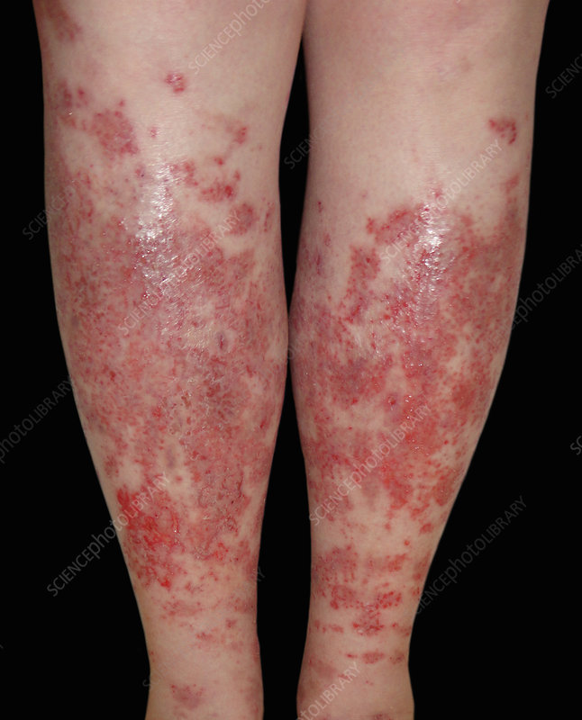
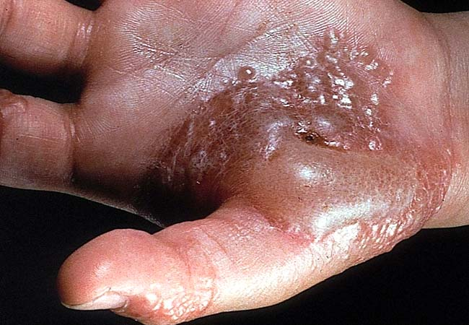
Acute eczema
Acute eczema Classical clinical features
Intense itching
Intense erythema
Oedema
Papulovesicles
Oozing

Slide 6
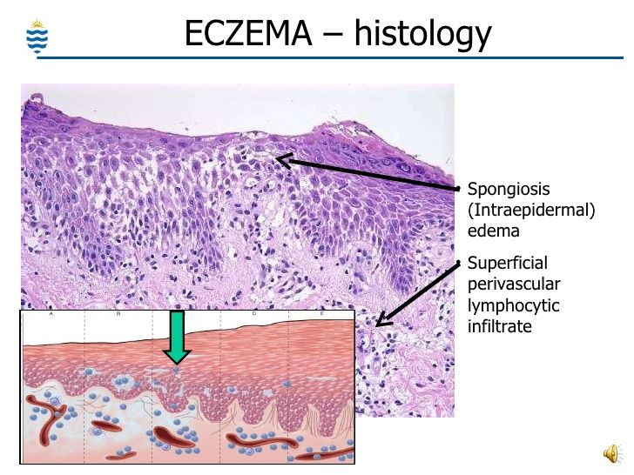

Slide 7
Subacute eczema Classical clinical features
▪ Erythema (lesser than in acute stage)
▪ Crusting and scaling
▪ Fissuring
▪ Slight to moderate itching
Chronic eczema Classical clinical features
▪ Dryness of skin
▪ Excoriation
▪ Fissuring
▪ Lichenification - combination of thickening, hyperpigmentation & increased skin markings.

Slide 8
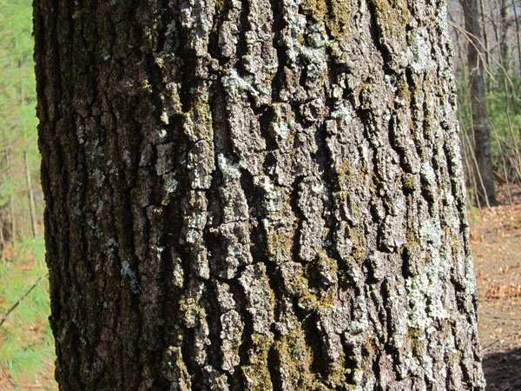
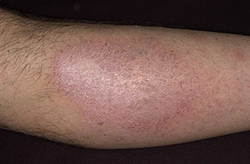
Sub-acute and chronic eczema
Edema tends to diminish, and acanthosis (an increase thickness of the spinous layer) develops. In addition, there are parakeratosis and hyperkeratosis.
The increase thickness of the epidermis with the underlying edema and infiltrate produces areas of skin in which the normal skin lines become greatly exaggerated, so the skin looks rather like the bark of tree (lichenification).
This often associated with severe itching.

Slide 9
Pathophysiology:
Genetic factors in endogenous eczema , filaggrin gene defects lead to impaired skin barrier.
The balance between T helper 2 vs Th1 and Th 17.

Slide 10
Complications
infection , hyper/hypopigmentation superimposed allergic reaction and impaired quality of life.

Slide 11
Causes of eczema
1.Exogenous cause(due to external factors)
contact dermatitis:
2.Endogenous cause(constitutional)
Atopic eczema.
Seborrhoeic eczema.
Gravitational (varicose) eczema.
Asteatotic eczema.
Discoid eczema.
lichen simplex
Juvenile plantar dermatosis
Irritant contact dermatitis
Allergic contact dermatitis
Photosensitive dermatitis

Slide 12
Atopic eczema
* atopy : a genetically mediated predisposition to an excessive IgE reaction
* Atopic triad : eczema , asthma , allergic rhinitis
* It runs in families . Environmental , immunological
* Mostly affects infants and young children
In infants : mostly affects face and scalp
In children : mostly affects flexor surfaces as popliteal fossa , and wrist
* Resolves in childhood , remain susceptible to the effects of primary irritants => recrudescence of eczema

Slide 13
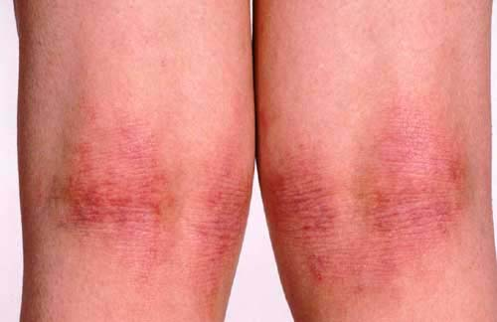
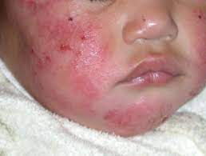
ATOPIC ECZEMA
patches of red , dry , itchy scaly skin
Later on : lichenification may be seen

Slide 14
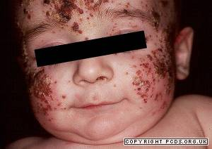
-eczema herpeticum:
Eczema herpeticum is herpes simplex viral infection superimposed onto the skin affected by eczema (usually in atopics). There is frequently a history of close contact with an adult with herpes labialis
Clinically, there are multiple small ‘punched-out’ looking ulcers, especially around the neck and eyes.
Eczema herpeticum is a serious complication of eczema that may be life threatening (systemic acyclovir)

Slide 15
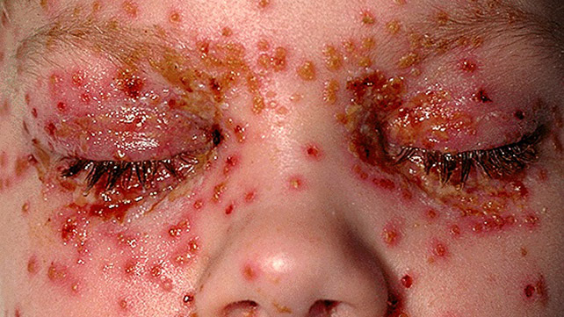

Slide 16
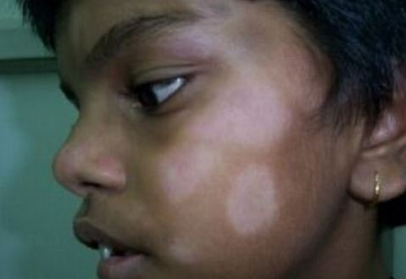
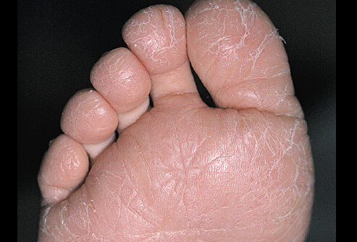
Pityriasis alba is a variant of atopic eczema in which pale patches of hypopigmentation develop on the face of children.
Juvenile plantar dermatosis is another variant of atopic eczema in which there is dry cracked skin on the forefoot in children

Slide 17
ATOPIC ECZEMA
* The most common complication is 2ry bacterial infection causing impetigo
Viral warts
Pitryasis alba
Juvenile plantar dermatosis
* Eczema herpeticum is a life threatening complication
* Treatment :
- Identify and avoid irritants
- Emollients at bath time
- Topical steroids , mild for young children, potent for older
- If 2ry infection occurs then use systemic antibiotics
- Antihistamines ,Tacrolimus ( topically ) , cyclosporine , UV light may be used also

Slide 18
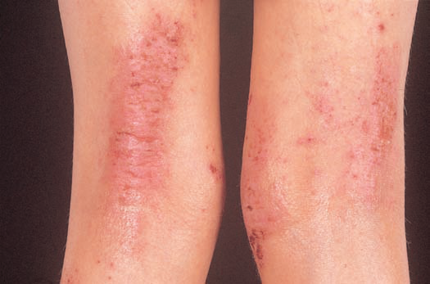
Flexurai involvement in atopic dermatitis
The presence of licheninfication and fissuring tells us this is chronic eczema

Slide 19
Seborrhoeic eczema
* linked to malassezia
papulosquamous disease, which characteristically involves areas rich in sebaceous glands with high sebum production and large body folds.
* In general it appears as greasy yellowish scaling over red inflamed skin
* Bimodal age , men > women
* DDx : psoraiasis

Slide 20
Clinical features (Infants)
▪ Commonly affects within first 3 months of life; rare after 6 months of age; affects both sexes equally.
▪ Usually starts in 1st week after birth.
▪ Affects the scalp (vertex and frontal areas; the ‘cradle-cap’ area), diaper area, face (forehead, eyebrows, eyelids, nasolabial folds, temples), retroauricular folds, neck and the axillae.
▪ Lesions comprise tiny papules covered with yellow, greasy scales; and redness in the diaper area and axillae.

Slide 21
Clinical features (Adults)
▪ Affects hairy areas; mostly men (30 to 60 years).
▪ Scalp : Earliest sign is dandruff; later followed by greasy scales and retroauricular fissuring. Inflammation and itching are associted with dandruff in seborrheic dermatitis.
▪ Face : Scaling & erythema of forehead, medial portion of eyebrows, eyelids, nasolabial folds, lateral part of nose and retroauricular region.
▪ Trunk : Papules, greasy scales.
▪ Flexural areas : erythema, greasy scaling and secondary infection.

Slide 22
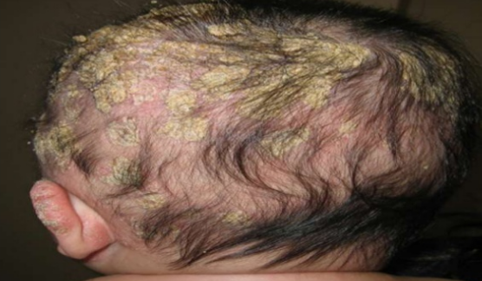
Seborrhoeic eczema

Slide 23
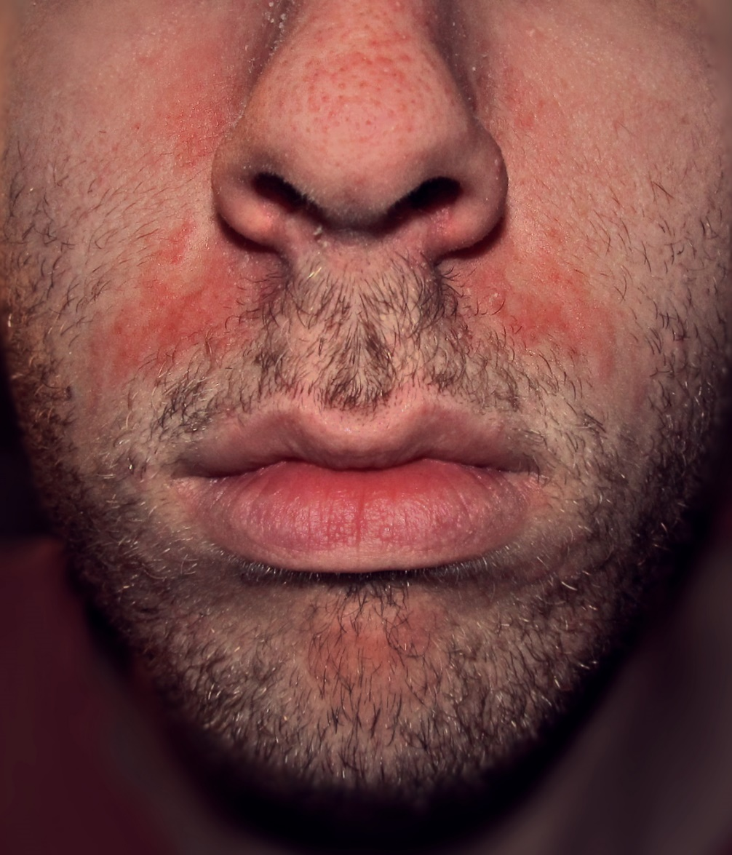

Slide 24
Seborrhoeic dermatitis usually requires treatment over many years, as there is no cure for this condition. It is important to make this clear to patients, who otherwise tend to try many treatmentsin their quest for a permanent solution to the problem.
Topical hydrocortisone is effective,but the problem recurs when treatment is stopped.
Steroid lotions or gels and tar shampoos will help
the scalp
Ketoconazole shampoo and cream
imidazole/hydrocortisone combinations, are also effective.

Slide 25
Asteatotic eczema
* Low humidity : desert, high altitude, travel
* Excessive bathing especially using soaps and detergents
* dry, itchy ,scaly, cracked skin with network of shallow erythematous fissures in the epidermis that produce an appearance that resembles ‘crazy paving’.
* Usually starts on the shins , common in elderly
* Treated simply by emollients and mild topical steroid ointment

Slide 26
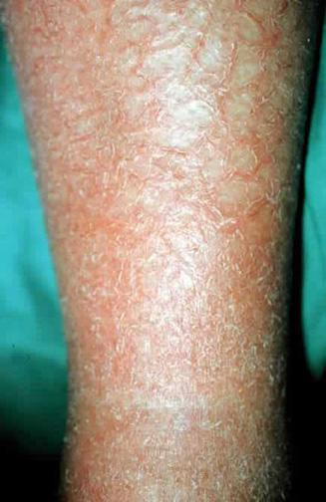
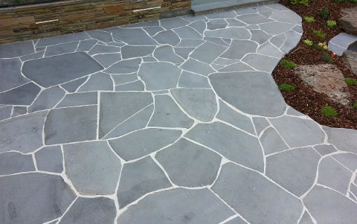
crazy paving

Slide 27
Pompholyx – vesicular eczema
* cheiropompholyx : endogenous eczema of palms
* Pedopompholyx :endogenous eczema of soles
* Usually occurs in people aged 20– 40 years
* itchy rash presents on plams and soles centers and with tiny vesicles that may evolve into bullae
* In severe cases : nail dystrophy + paronhycia
* 2ry bacterial infections is common
* Tt : potassium permanganate soaks + potent corticosteroid cream …. Systemic antibiotics may be needed

Slide 28
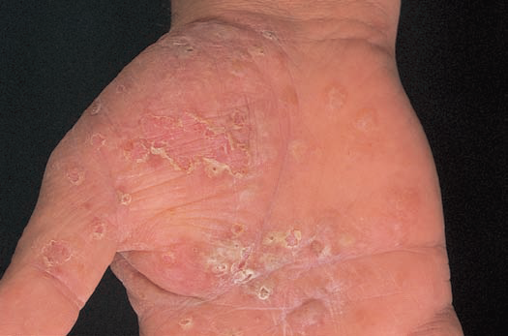
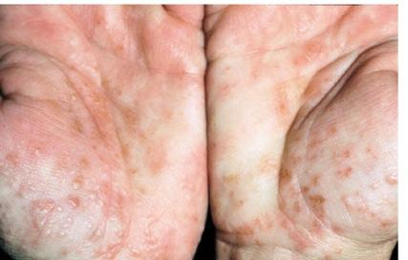
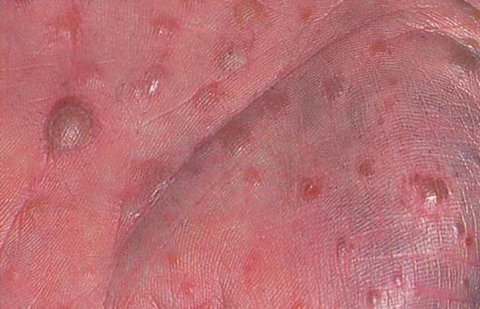
Pompholyx – vesicular eczema

Slide 29
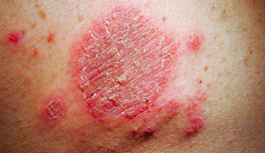
Discoid eczema
* Well defined , scattered coin – disc shaped plaques that are extremely itchy with vesicles or crusting
* Usually in the middle age …. On the limbs
* Tt : emollients and potent corticosteroid ointment

Slide 30
Stasis eczema
* Common in patients with chronic venous HTN , DVT, varicose veins , obesity , pregnancy
* Diffuse erythema , scaling , crusting and itching
* lower third of both legs without pain
* Hyperpigmentation , venous ulcers are common
* Tt : treatment of underlying condition + moderately potent corticosteroid cream+ emollients
Notes:
Varicose exzema
Gravitational eczema

Slide 31
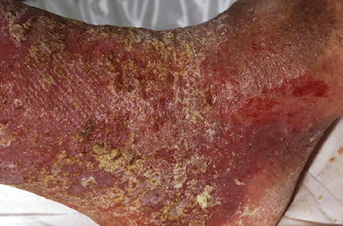
Stasis eczema

Slide 32
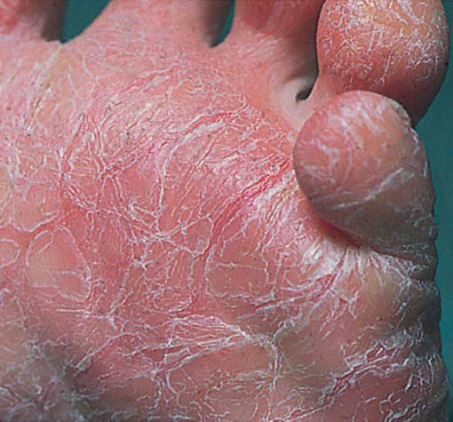
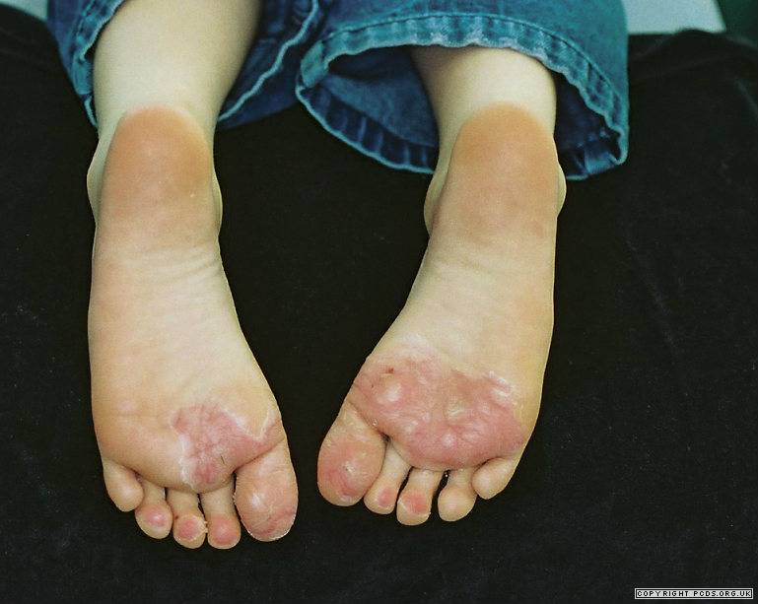
Juvenile plantar dermatosis
* Mainly due to the socks and shoes that are impermeable ( low humidity , dryness )
* Weight bearing areas
* Treated by emollients and changing the type of shoes or socks

Slide 33
Exogenous causes
“ Contact dermatitis “

Slide 34
Primary Irritant Contact dermatitis
  A primary irritant is a substance which, if applied in high enough concentration to normal skin is capable of producing an eczematous response following a single exposure.
  Examples: caustic liquids such as acids and alkalis (strong), detergents and mineral oils (mild).
  A primary irritant will cause eczema in everyone if it is applied in sufficient concentration for a sufficient time.

Slide 35
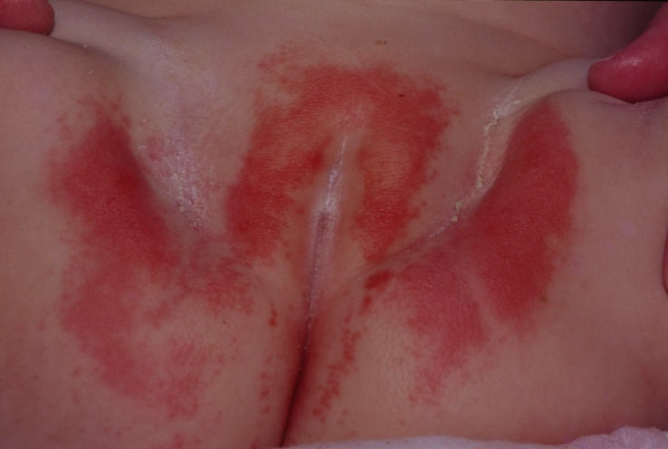
  Wear and tear eczema in housework and in many industries is examples .
  Napkin dermatitis (nappy rash) is another type of this eczema. In this type of eczema the skin folds are spared, whereas the reverse is true for candidosis. This due to prolonged contact with urine or faeces, and results of ammonia production by bacteria.

Slide 36
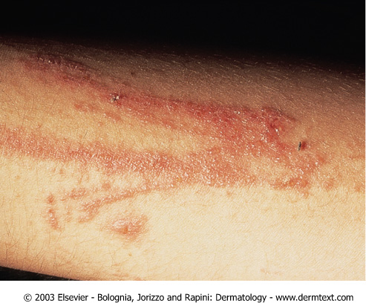
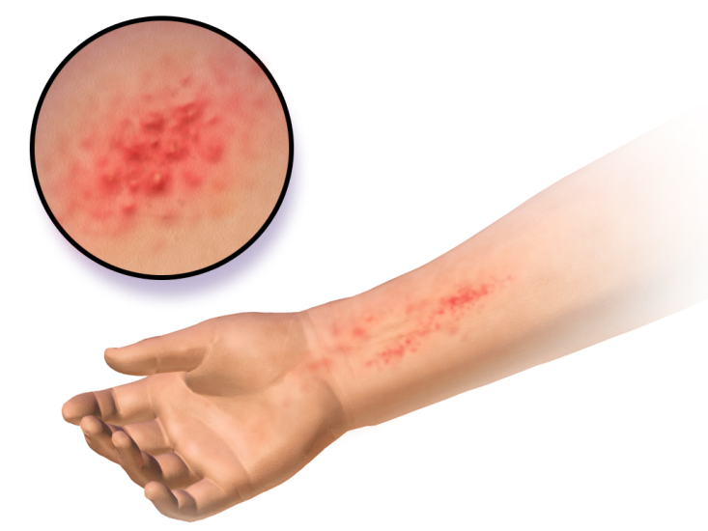
Allergic Contact dermatitis (Hypersensitivity Dermatitis)
This is due to the development of delayed hypersensitivity (type 4 allergy) to a specific chemical (sensitizer or allergen).
Such allergens will not cause eczema even in high concentration in a normal person, but sever eczema may be provoked by brief exposure to a very low concentration in a sensitized person.

Slide 37
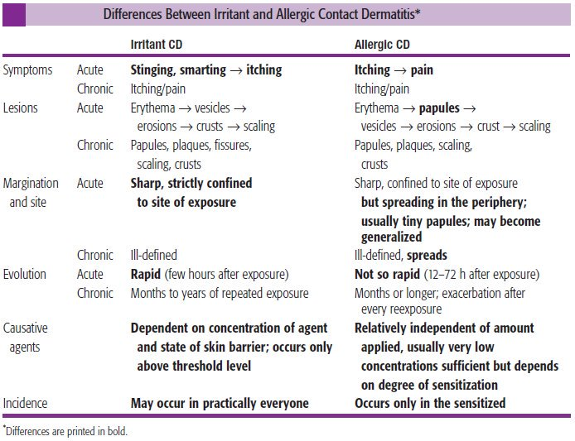

Slide 38
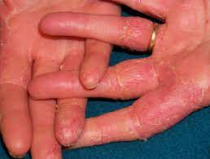
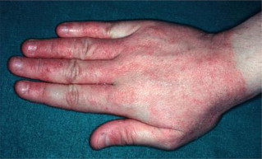
Irritant contact dermatitis

Slide 39
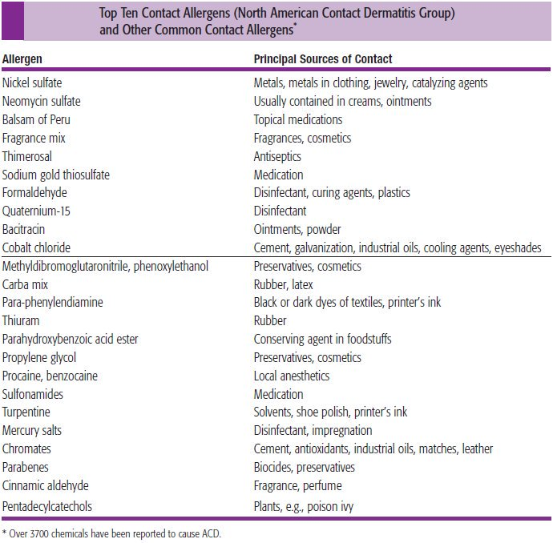

Slide 40
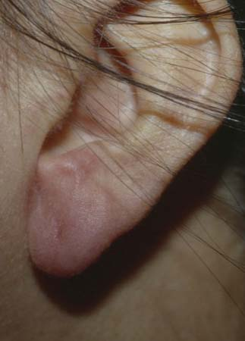
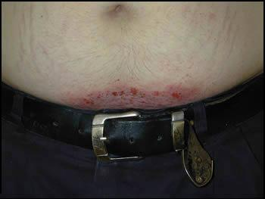
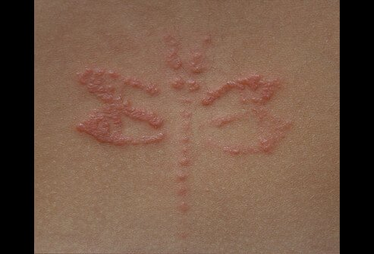
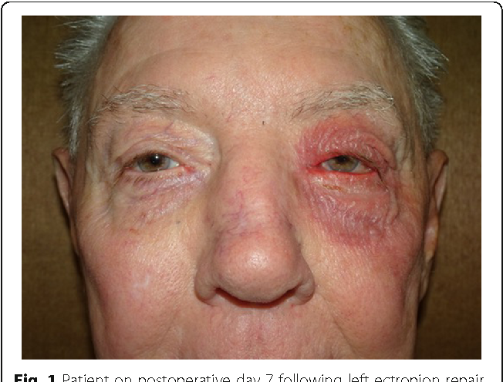
Allergic contact dermatitis

Slide 41
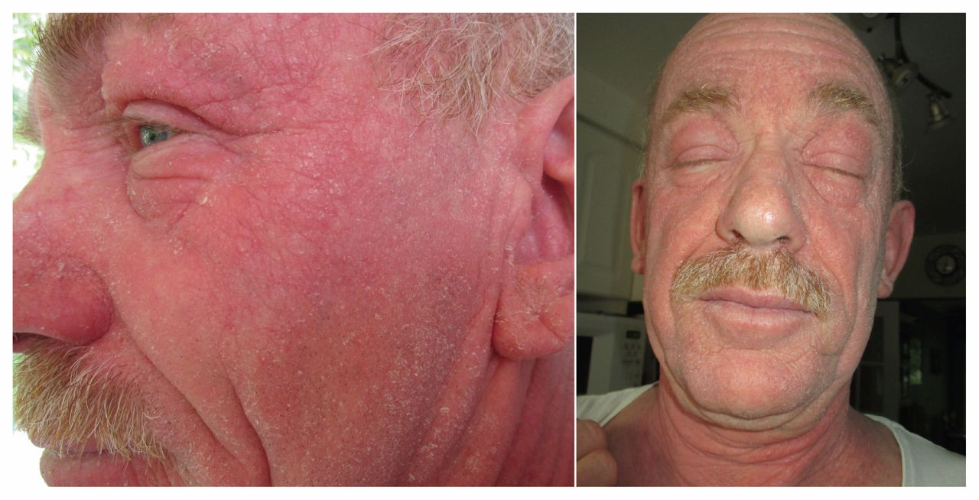
Photodermatitis
Interaction of light and chemicals absorbed by the skin.
Allergic vs toxic
Drugs systemic vs local.
Phytophotodermtitis due to contact with plant material and sulight.
-Patients with chronic actinic dermatitis (chronic eczema on sun-exposed skin) are allergic to sunlight.

Slide 42
Occupational dermatitis
1. first occurred during employment
2. improves away from work
3. exposure to a known irritant/ allergen
Occupational irritant contact dermatitis
Occupational allergic contact dermatitis

Slide 43
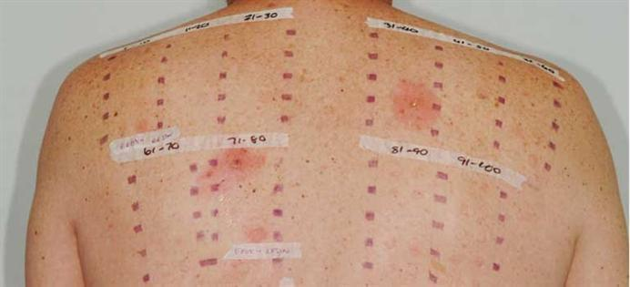
Patch Test
      This is a test for allergic contact dermatitis.
      It may be tested by applying a substance which is suspected to cause the eczema (in a solution form) to an area of unaffected skin under a small patch of adhesive tape. The patch is removed after 48 hrs or earlier if sever irritation develops.
      Positive reactions consist of erythema, some times with swelling and vesiculation.
      This test should be avoided in acute phase.

Slide 44
-Management OF ECZEMA:
The general treatments are:
1- Topical steroids.
2- emollient.
-Steroids have different potencies, twice daily in general. (occlusion increases the potency by 100* Folds).
-Antibiotics (macrolide, fusidic acid) for 2 weeks,( risk of resistance).
-Antihistamine ( cetirizine ).
-Unresponsive types of eczema could be treated with immunomodulator and inhibitors. ( azathioprine, tacrolimus, ciclosporins, MTX).

Slide 45
Thank you for your attention

