Slide 1
Hydrocephalus
Dr.Qussay Salih Alsabbagh

Slide 2
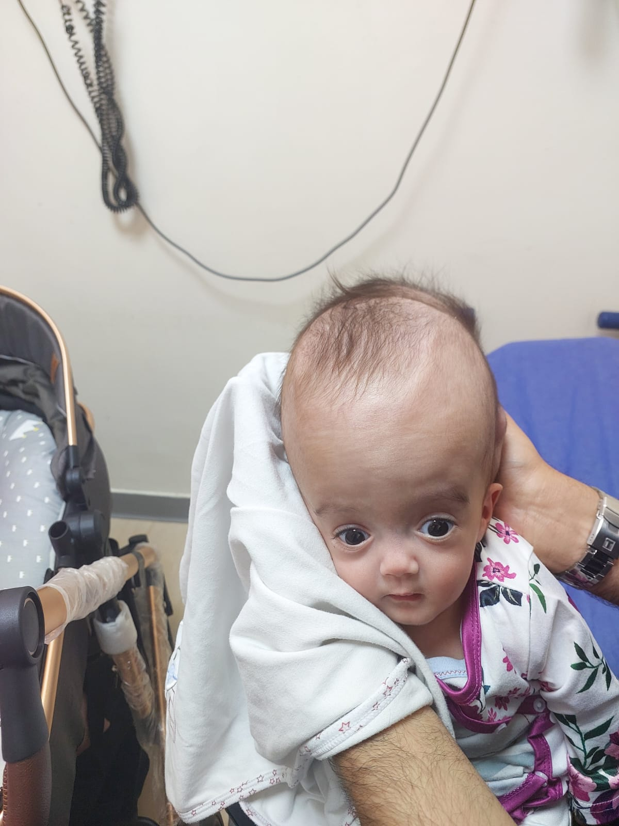
A 2 months old infant.
Big head!!!
Head circumference was 42 cm
1- Is the H.C. normal?
2- Differential diagnosis?
3-How to investigate?
4-How to treat?
5-What is the outcome?

Slide 3
Outlines
Definition
Pathophysiology
Etiology
Types
Clinical presentation
Diagnosis
Treatment

Slide 4
What is hydrocephalus?
Is an accumulation of cerebrospinal fluid (CSF) within the ventricular space at an inappropriate pressure.
Estimated prevalence is 1-1.05%
Incidence of congenital cases is 0.9-1.8/1000 live birth.

Slide 5
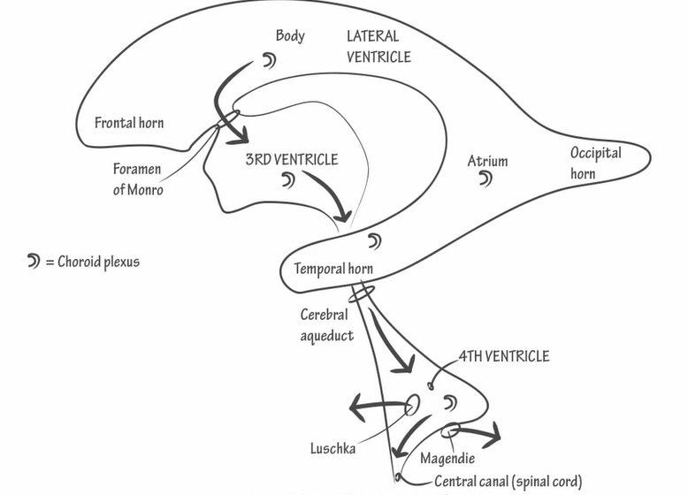
Physiology of CSF circulation

Slide 6
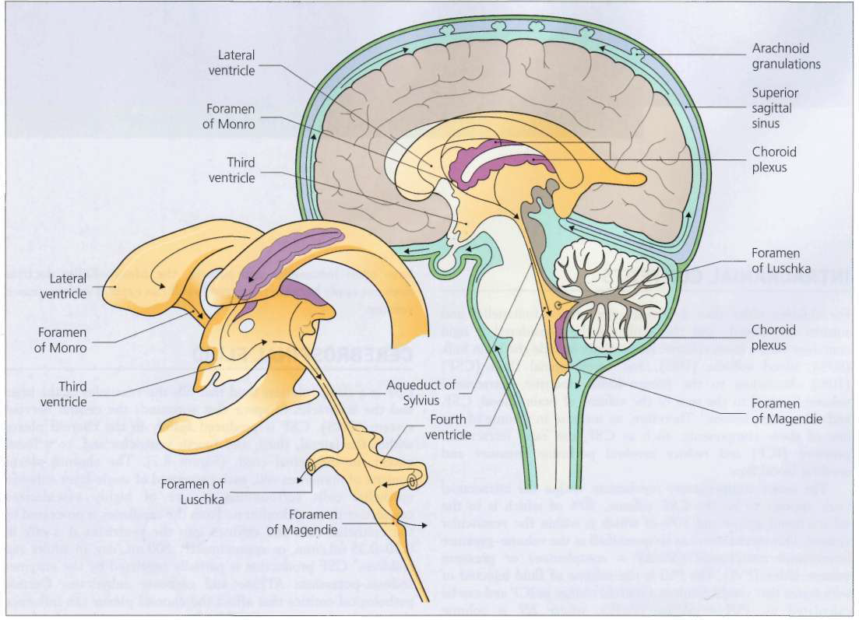
The ventricular system

Slide 7
The cerebrospinal fluid (CSF)production
CSF is produced mainly in the choroid plexus.
Clear colorless fluid
Total volume: 150mls(40-50 ml in neonates and 65-140 ml in children).
25mls in ventricles + 125 mls in subarach.space
Production: 500mls/day and turnover: 3-4 times
CSF production is partially regulated by :
-sodium-potassium ATPase …and
- carbonic anhydrase.

Slide 8
What is cerebrospinal fluid(CSF)?
⦿ Contents:
1.Acellular ( <5 lymphocytes, if higher: Pleocytosis)
2. Similar Na+/ higher Cl-/ less K+ compared to plasma
3. ≈15-40mg/dl of proteins depending on site/age
4. 2/3 of sugar concentration in plasma

Slide 9
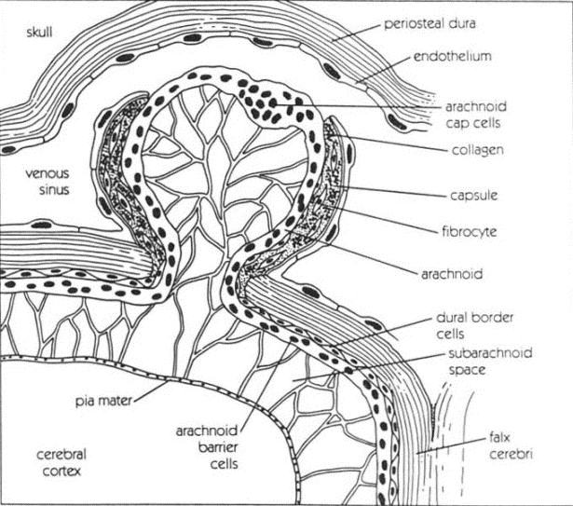
CSF is absorbed by arachnoid villi, which are diverticula of arachnoid that invaginate within the sagittal sinus and nearby major cortical veins.
Clusters of arachnoid villi, called arachnoid granulations, are grossly visible.

Slide 10


IN GENERAL CSF WILL ACCUMULATE(HYDROCEPHALUS) DUE TO:
Increase production
Decrease absorption
Obstruction to flow

Slide 11
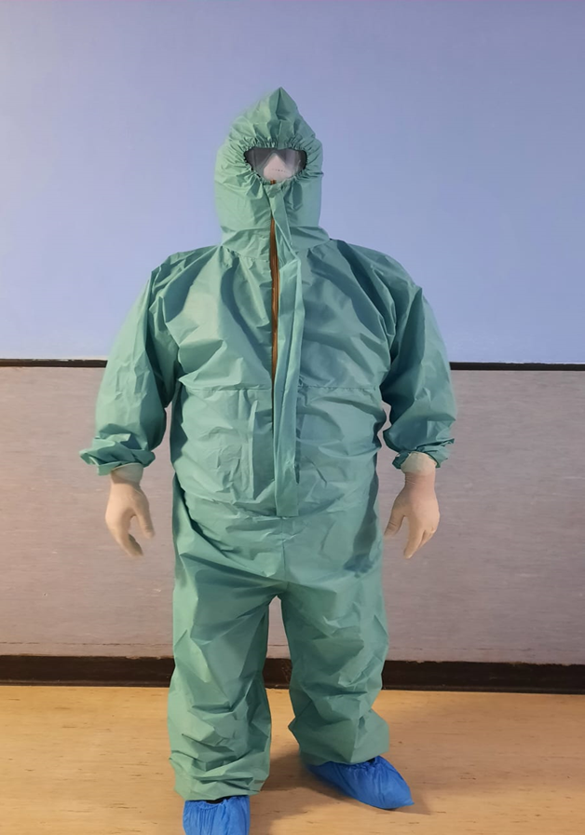
Clinically---intracranial hypertension
If progressive ventricular dilatation separates ependymal cells lining the ventricles, interstitial cerebral edema will develop.
PATHOPHYSIOLOGY OF HYDROCEPHALUS

Slide 12
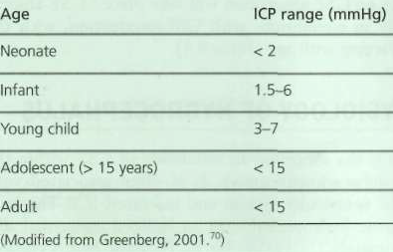
Normal ICP by age

Slide 13
CLASSIFICATIONS
Communicating or Non-communicating.
Congenital versus Acquired.
Its symptomatology as either compensated or
noncompensated.
Its chronicity: acute versus chronic hydrocephalus.
Internal or external

Slide 14
CAUSES OF HYDROCEPHALUS:
Hydrocephalus is almost always a result of an interruption of CSF flow and is rarely because of increased CSF production.

Slide 15
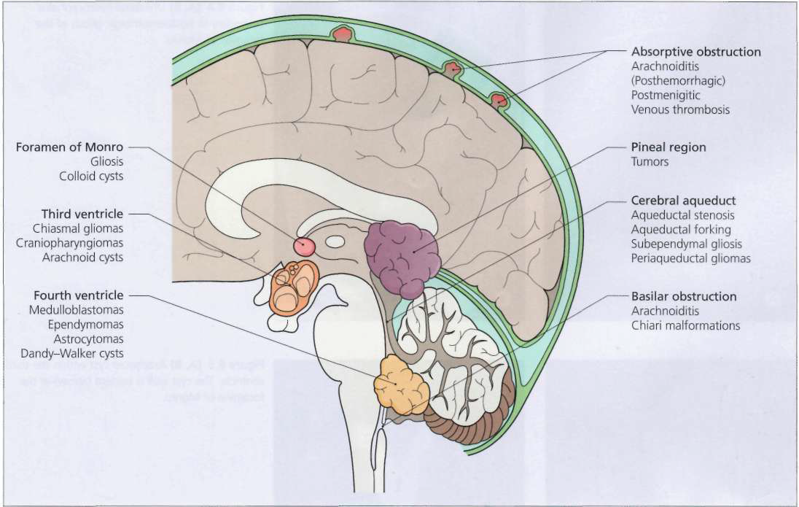
Common sites and causes of CSF obstruction.

Slide 16
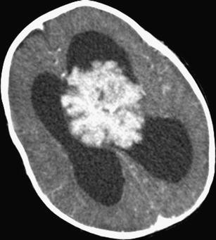
AETIOLOGY - SITE
Lateral ventricles
Choroid plexus tumors:
Rare in the general population(0.4 to 0.6% of all CNS tumors).
With CSF production rates three to four times the normal.
Endoscopic coagulation of the choroid plexus or surgical removal of the papilloma .

Slide 17
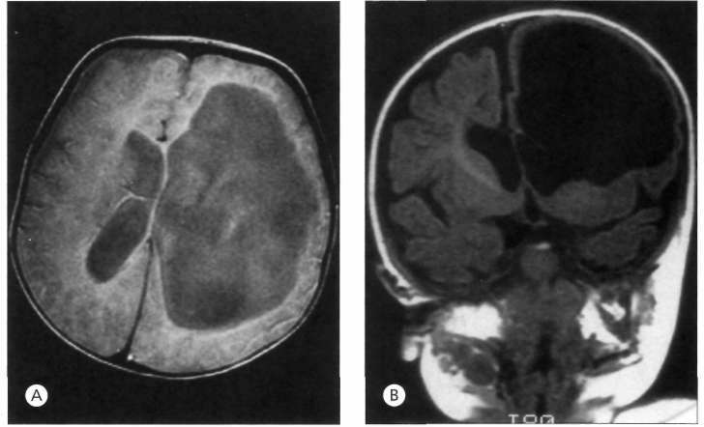
2-Foramina of Monro

Slide 18
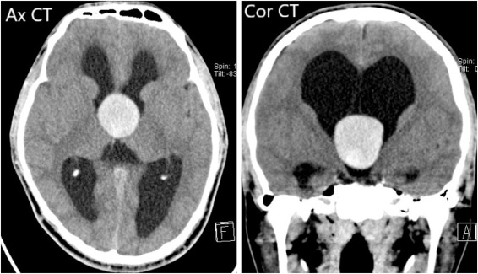
3-Third ventricle
Cysts and neoplasms within the third ventricle commonly cause hydrocephalus.
-Colloid cysts are uncommon neoplasms
-Ependymal and arachnoid cysts within the third ventricleThe endoscopic
fenestration is a treatment option.

Slide 19
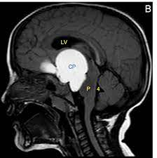
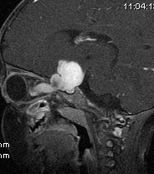
Third ventricle
The most common pediatric neoplasms that obstruct the third ventricle are craniopharyngiomas and chiasmal-hypothalamic
gliomas.

Slide 20
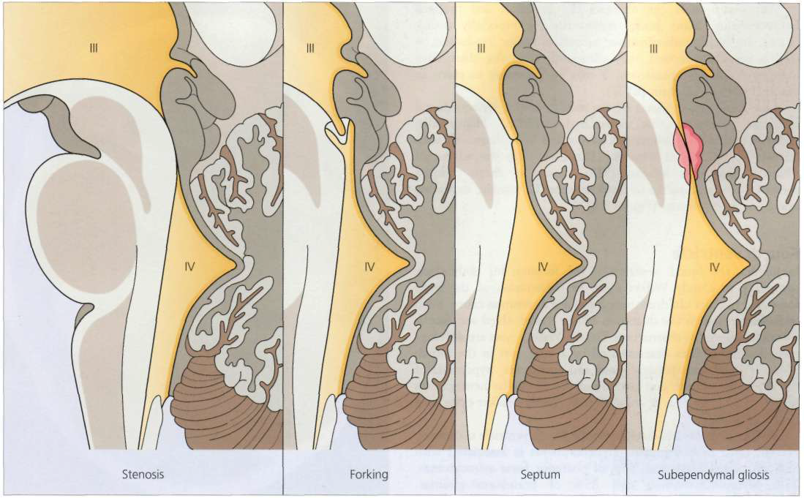
4-Sylvian aqueduct
The normal aqueduct of a neonate is 12-13 mm in length and only 0.2-0.5 cm in diameter,
Thus, it is prone to obstruction from a variety of lesions, including congenital aqueductal stenosis(classified as true stenosis, forking, septum, or subependymal gliosis)
It may be secondary to in utero infections (e.g. toxoplasmosis), intraventricular hemorrhage, or mumps encephalitis.
Aqueductal congenital malformations: (from left to right) stenosis, forking, septum, and subependymal gliosis.

Slide 21
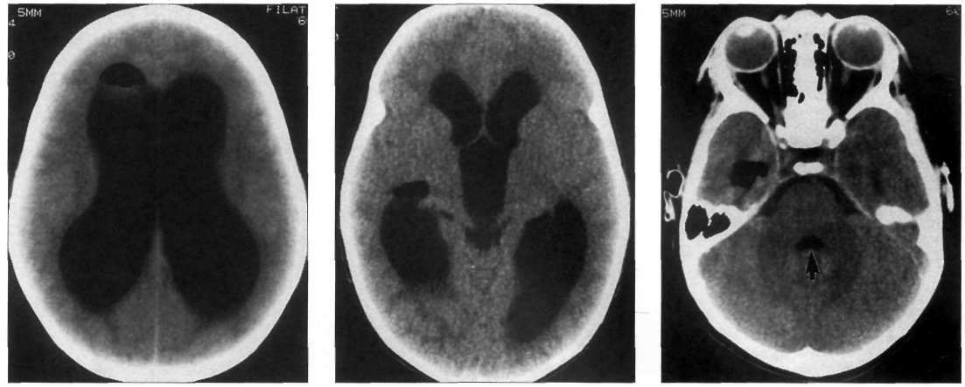
Sylvian aqueduct stenosis
Is the commonest cause of congenital hydrocephalus
Less than 2% of cases -recessively inherited X-linked Bickers-Adams-Edwards syndrome, which is associated with flexion-adduction of the thumbs ("cortical thumbs").
CT scan of infant with aqueductal stenosis, demonstrating lateral and third ventricular distension, separation of the thalami, and compression of the cerebral hemispheres . The fourth ventricle (arrow) is normal.

Slide 22
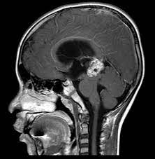
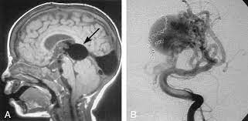
Sylvain aqueduct
Pineal region neoplasms,
Arteriovenous malformations, and Periaqueductal neoplasms.
Low-grade astrocytomas are the most common periaqueductal pediatric neoplasms that cause hydrocephalus.

Slide 23
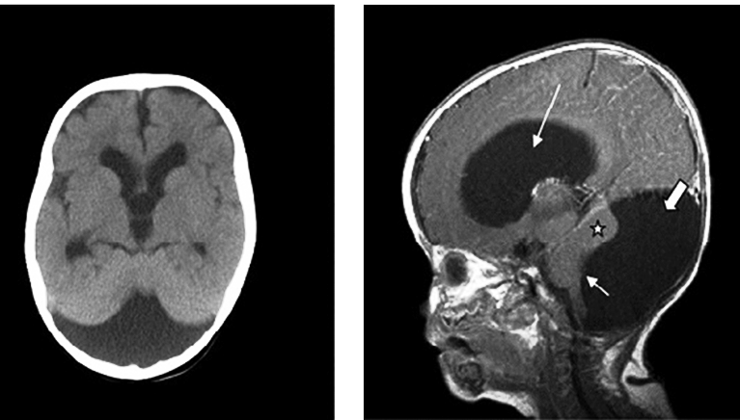
4-Fourth ventricle
In infants, the fourth ventricle is the location for obstruction secondary to Dandy-Walker cysts .
In older children, neoplasms are a common cause.
Dandy-Walker cysts are developmental abnormalities characterized by a large cyst in the fourth ventricle, hypoplasia of the cerebellar vermis, and atrophy of the cerebellar hemispheres.
Over 85% of children with Dandy-Walker cysts have hydrocephalus.

Slide 24
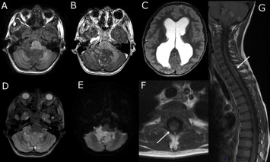
4TH Ventricle tumors
Hydrocephalus is associated with
-85% of medulloblastomas,
-65% of posterior fossa astrocytomas,
-75% of ependymomas,
-and 25% of brainstem gliomas.

Slide 25
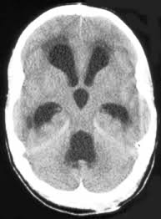
5-Arachnoid granulations
Sclerosis or scarring of the arachnoid granulations can occur after meningitis, subarachnoid hemorrhage, or trauma.
Occasionally can be seen in cases with disseminated meningeal malignancies(meningeal carcinomatosis)
Dilated fourth ventricle

Slide 26
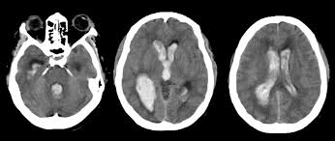
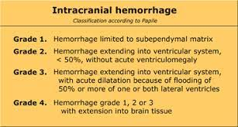
Etiology by age
1-Premature infants
Hydrocephalus in premature infants is predominantly caused by(intraventricular hemorrhage) IVH. The hemorrhage occurs in the germinal matrix,

Slide 27
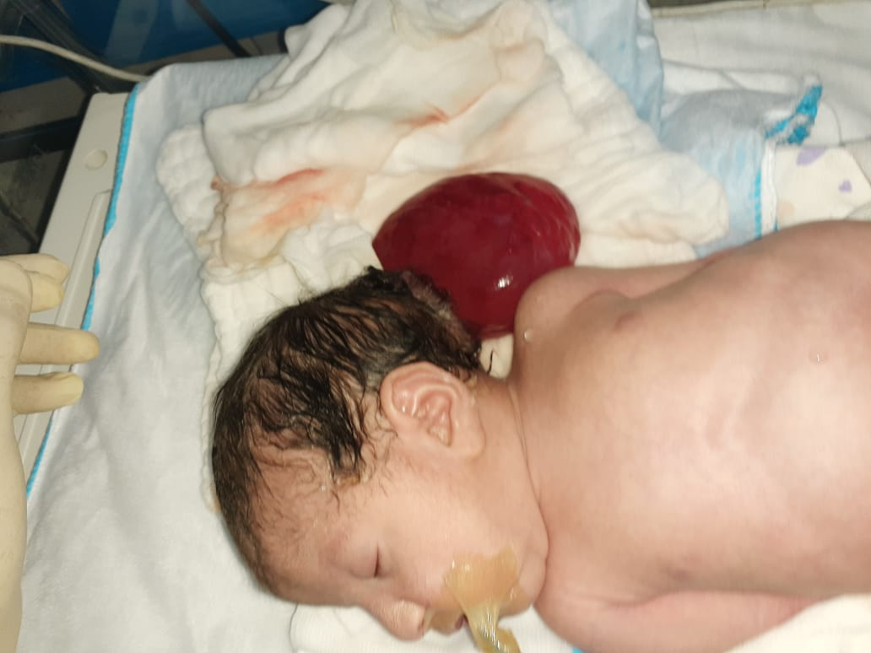
2-FULL TERM INFANT
Aqueduct stenosis
Chiari malformation
Dandy walker malformation
Cerebral malformation ..Encephalocele
Neoplasm
Vein of Galen aneurysm

Slide 28
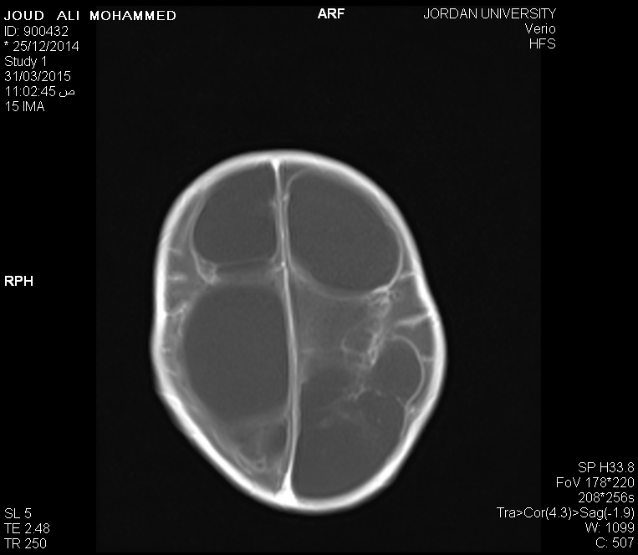
3-Older children
Hydrocephalus after infancy is usually secondary to trauma, meningitis or neoplasms.

Slide 29
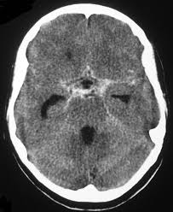
4-Adults
30% idiopathic
The rest :
Subarachnoid hemorrhage
Head injury
Brain tumors
Cranial surgery
Aqueduct stenosis
Meningitis

Slide 30
SIGNS AND SYMPTOMS

Slide 31
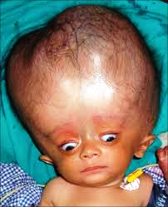
Full and tense anterior fonatanelle
Dilated scalp veins
Suture widening
Setting sun eyes

Slide 32
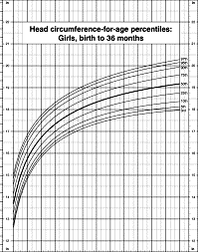
Head circumference
Normal head circumference for full-term infants is 33-36 cm at birth.
Head circumference increases by 2 cm/month during the first 3 months, by 1 cm/month from 4 to 6 months, and by 0.5 cm/month from 7 to 12 months.
Head circumference above95%---abnormal

Slide 33
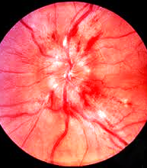
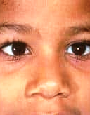
Signs of hydrocephalus in children and adults
Fudoscopic examination showing advanced optic disc swelling suggestive of frank papilloedema resulting from intracranial hypertension
Right abducent nerve palsy

Slide 34
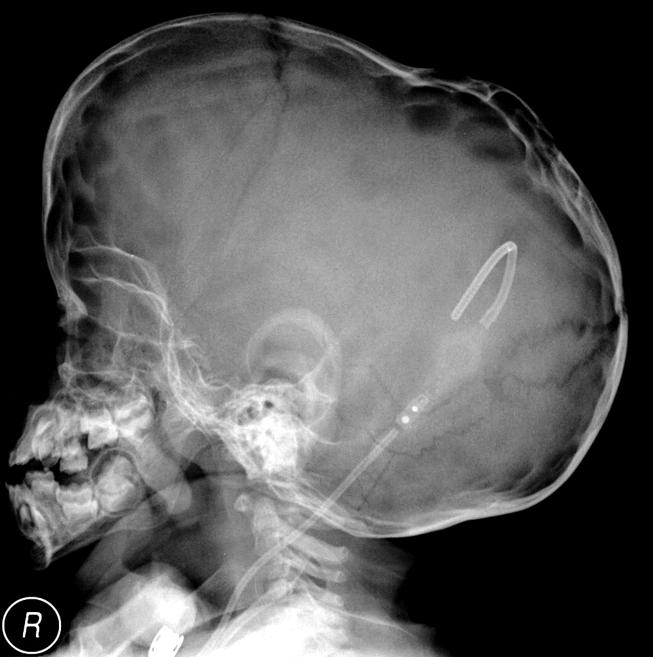
DIAGNOSTIC STUDIES
A
Skull X-ray-
B
C

Slide 35
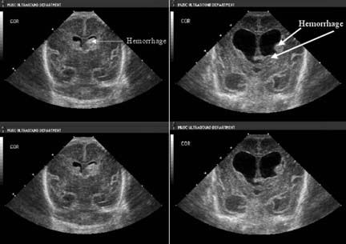
Cranial ultrasonography
Evaluation of premature infants with IVH,&the detection and monitoring of ventricular size.

Slide 36
CT scanning
From 1976 to 1986, CT scanning was the definitive method of diagnosing pediatric hydrocephalus.
limitations: only in the axial plane,
Require irradiation, and have less resolution than MRI.

Slide 37
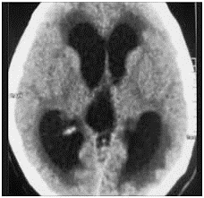
Periventricular fluids
3rd vent.,

Slide 38
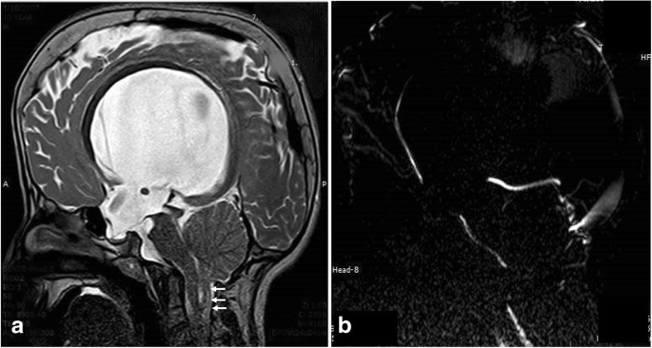
Brain MRI
Since 1986,
-can project the brain in axial,coronal, and sagittal projections.
–better soft tissue resolution
-determine CSF flow across the aqueduct.
-no radiation.

Slide 39
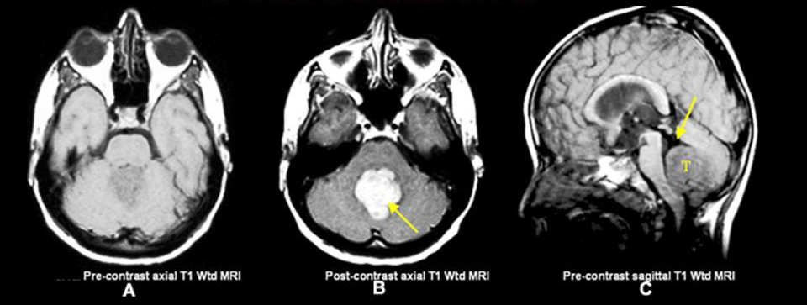
The same previous infant, MRI was done postoperatively after V-P shunt insertion.
You can notice the reduction of the size of the ventricles with the posterior fossa tumor that caused the non communicating hydrocephalus

Slide 40
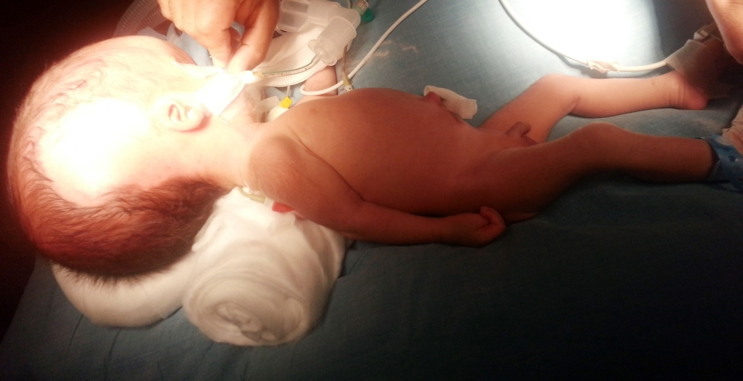
Treatment
The goal is:
Optimal neurological outcome
Preservation of cosmosis
Normal sized ventricles should not be considered the goal
Non surgical
Surgical
Shunting
Non shunting

Slide 41
Non surgical
Not defintive treatment.
Acetazolamide and frusamide
Serial LP or ventricular tap
Head rapping ,radioactive gold…..

Slide 42
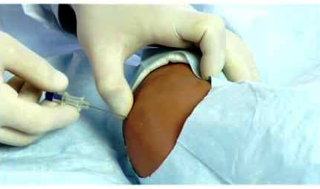
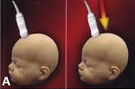
Lumbar puncture to drain the CSF
Transfontanelle u/s preparing for tapping of the ventricles

Slide 43
Surgical – non-shunting options
1-Whenever possible, the obstructing lesion that causes the
hydrocephalus should be surgically removed.
2-For CSF obstruction at or distal to the aqueduct, a potential surgical treatment is the endoscopic third ventriculostomy(ETV).

Slide 44
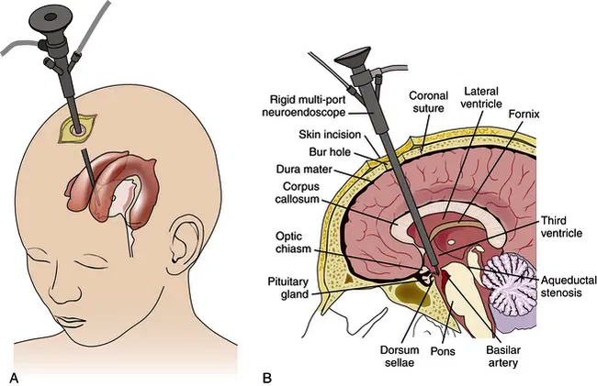
Endoscopic Third Ventriculostomy(ETV)

Slide 45
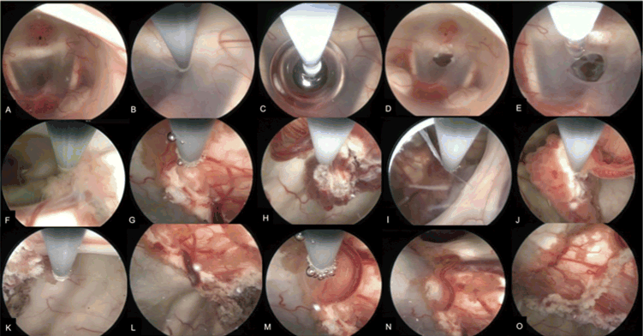
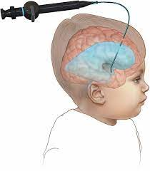
ETV-CPC-choroid plexus coagulation

Slide 46
Surgical - CSF shunts
CSF shunts are usually silastic tubes that divert CSF from the ventricles to other body cavities (i.e. peritoneal, atrium or pleural
space), where normal physiologic processes can absorb the fluid.

Slide 47
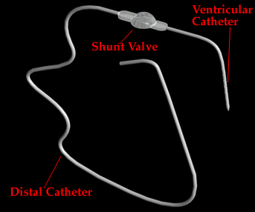
Components of the shunt

Slide 48
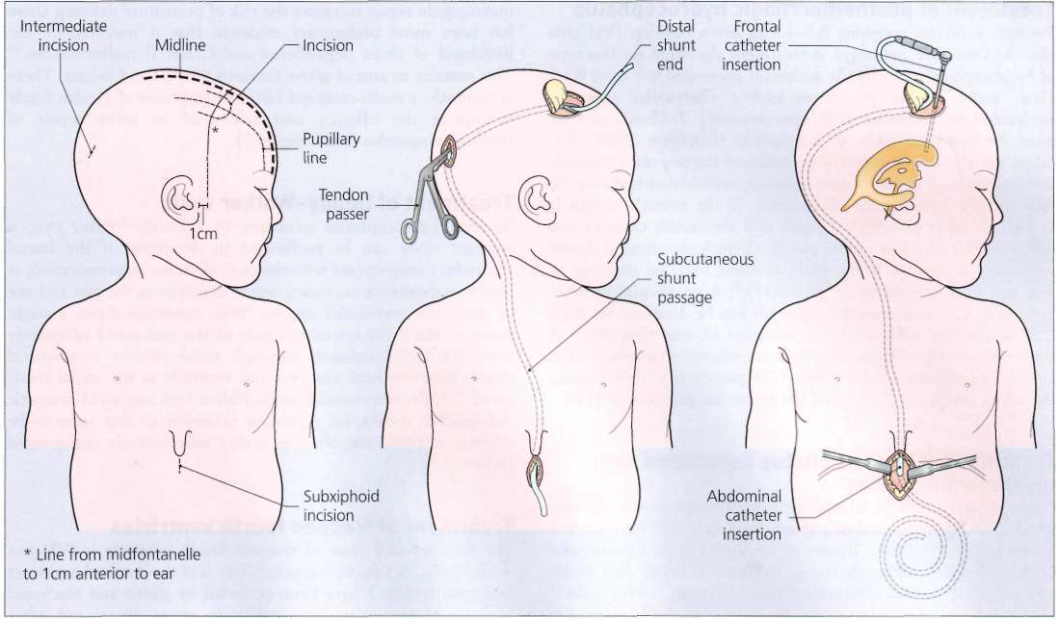
Surgical techniques
Placement of a frontal ventriculoperitoneal shunt. Patient positioned and coordinates marked; subcutaneous shunt passage; ventricular catheter insertion; peritoneal catheter insertion.

Slide 49
Shunt complications
?a tube
?a foreign body
Shunt complications and failures remain a significant problem in treating hydrocephalus.
(1) mechanical failure of the device,
(2) functional failure because of too much or too little flow of CSF( malfunction), and
(3) infection of the CSF or the shunt device.

Slide 50
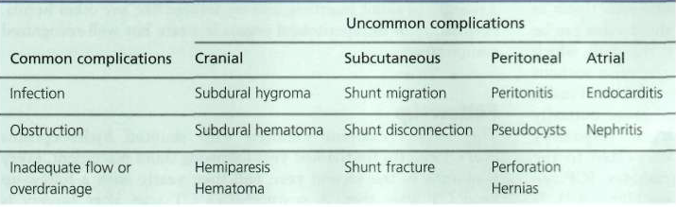
Shunt complications

Slide 51
Shunt Infection
In general, approximately 1-15% .
Premature infants have an increased risk.
Nearly 90% of all shunt infections are recognized within 12 months
it is believed that most bacteria are introduced at the time of surgery.
Staphylococcus epidermidis causes approximately 60% of shunt infections,
Staphylococcus aureus is responsible for 30%,
and coliform bacteria, propionibacteria, streptococci, or Haemophilus influenzae cause the remainder.

Slide 52
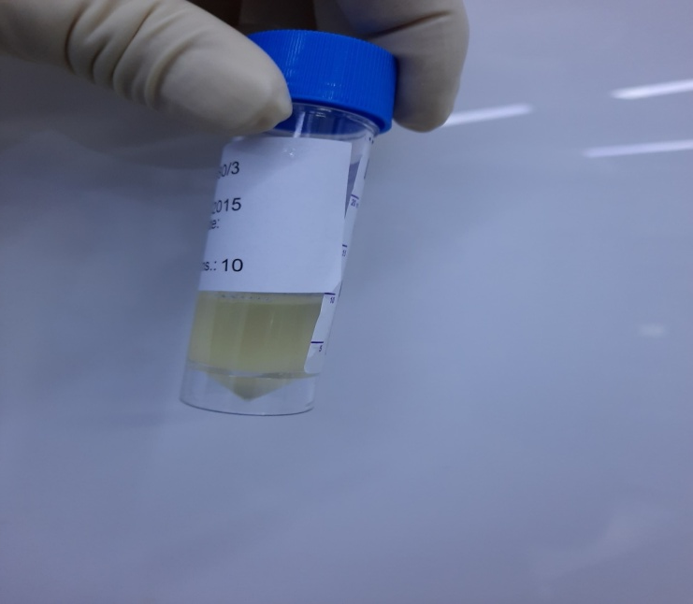
Diagnosis is confirmed by CSF sampling from the shunt reservoir ;with the findings of leukocytosis and positive culture .
Treatment usually involves
removal of the infected shunt
placement of an EVD.
appropriate intravenous antibiotics, based on culture and sensitivity results.
When the infection is cleared, i.e. (1) at least 3 consecutive daily CSF cultures that are negative, (2) CSF white blood cell count < 50, and (3) CSF protein < 500 mg/dL, a new shunt system is implanted, and the EVD is removed.

Slide 53
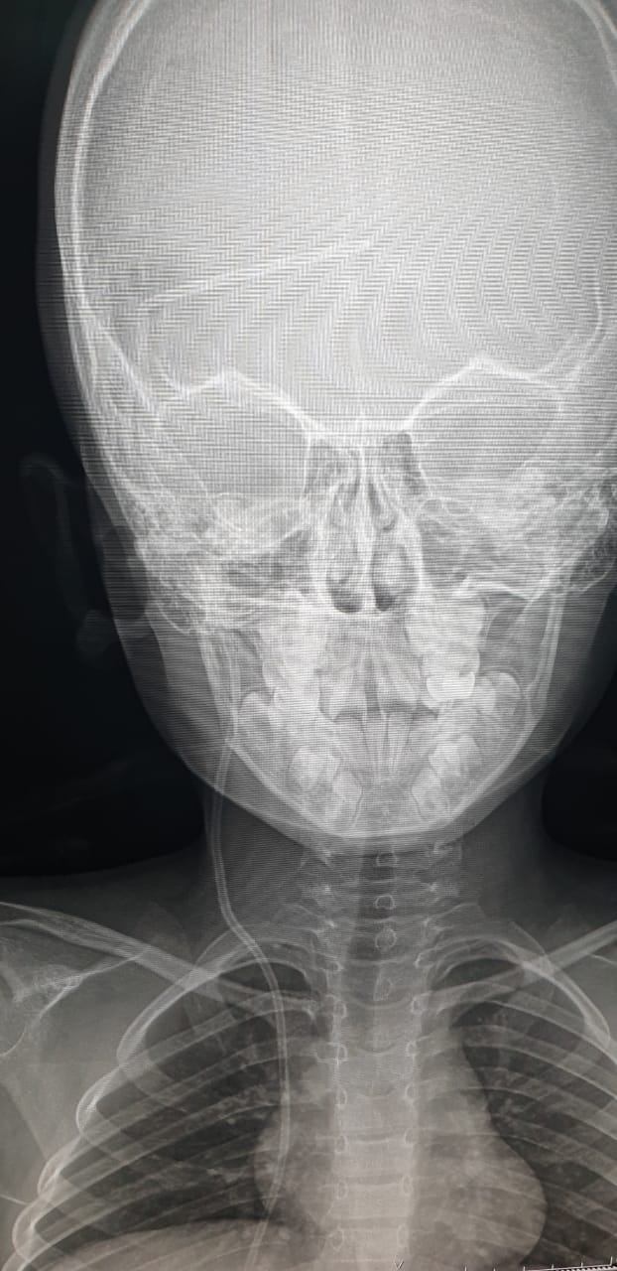
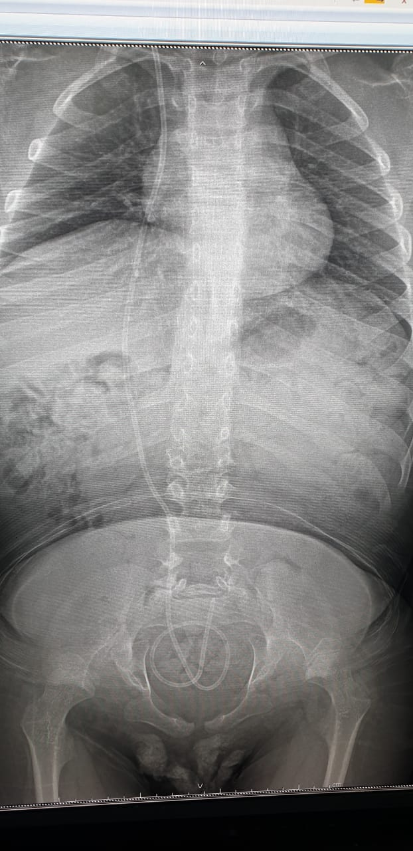
shunt obstruction
A child with a shunt malfunction often presents with signs and symptoms of increased ICP.
headache, irritability, lethargy, nausea, and/or vomiting.
The shunt itself can be examined for evidence of obstruction..
A head CT, as well as shunt survey Xrays

Slide 54
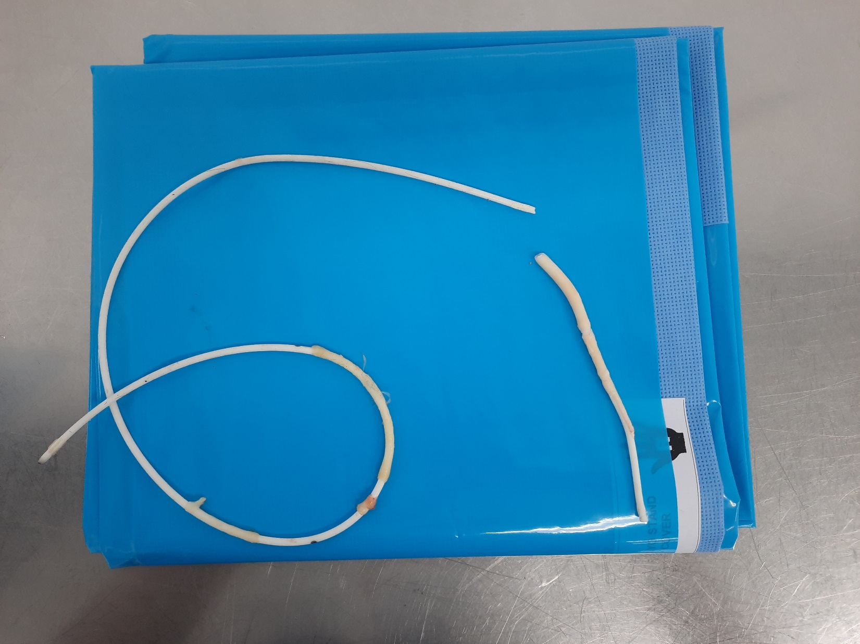
Shunt obstructions/malfunctions are treated by replacing the occluded or nonfunctioning components, or by replacing the entire system.

Slide 55
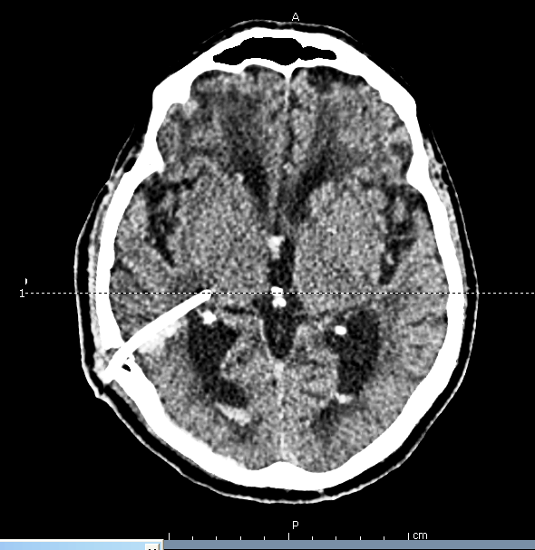
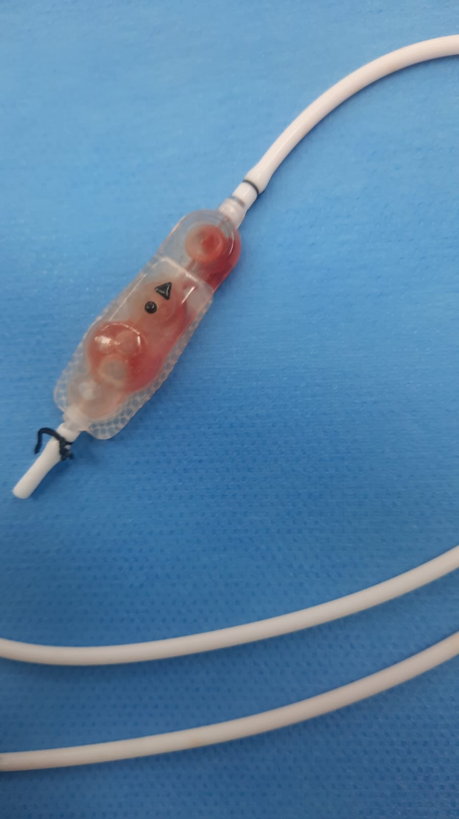
Hematoma at sit of shunt insertion
Intracerebral Hematoma around the catheter
Ventricular catheter

Slide 56
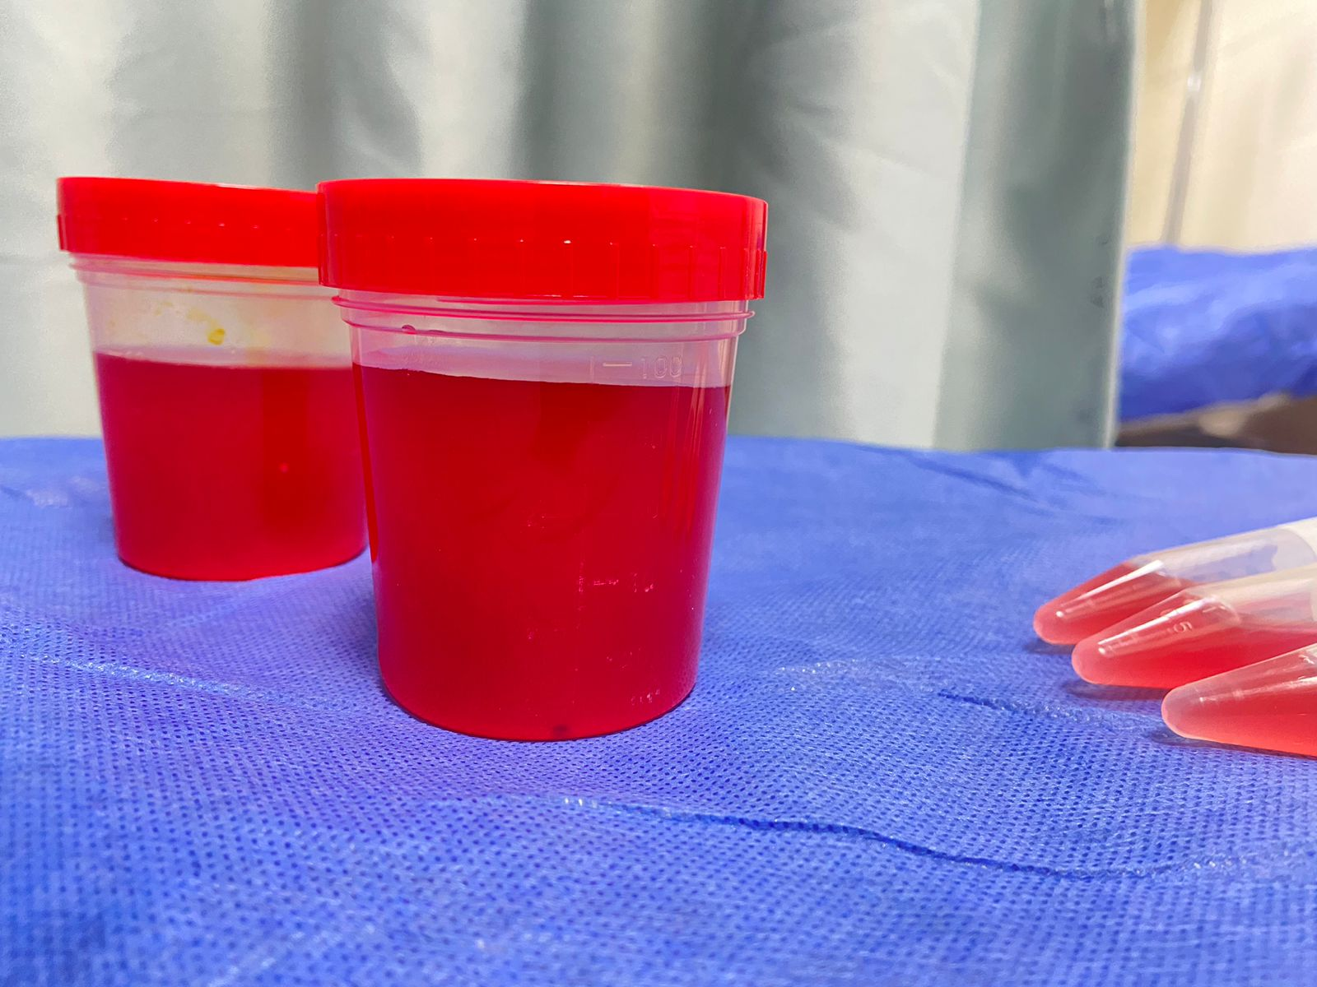
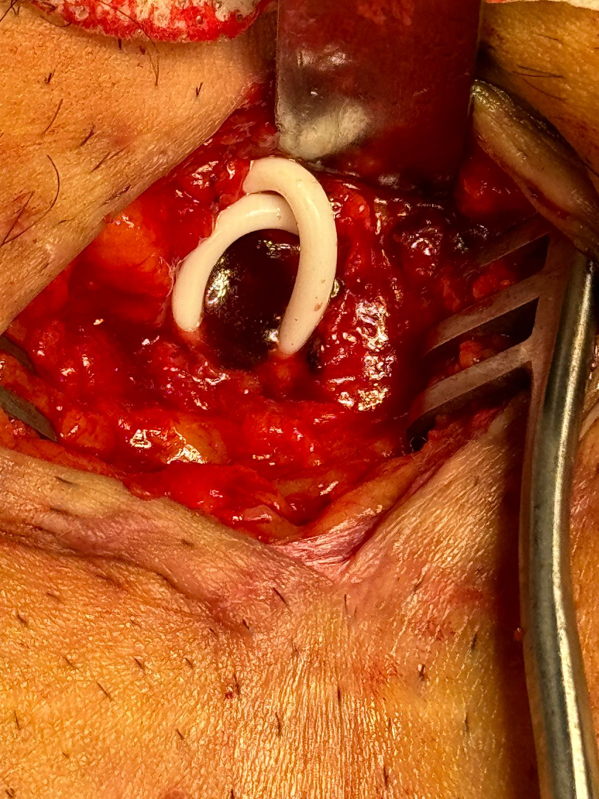


Slide 57

Swelling around the valve of the shunt highly suggestive of shunt malfunction

Slide 58






Slide 59
Chronic or normal pressure hydrocephalus (NPH)
Chronic hydrocephalus of adulthood presents more insidiously, often weeks or even years after the inciting cause, sometimes without apparent cause at all.
. The affected patient exhibits a combination of motor dysfunction, urinary incontinence, and Dementia the so called Hakim -Adams triad.
The early motor signs are most prominent in the lower extremities and are related to difficulty initiating walking, the so-called"magnet gait" phenomenon.
. Advanced cases show frontal release signs, such as suck and grasp reflexes.
Parkinsonian and other dyskinesias have been described. In the early stages of hydrocephalus, the patient is well aware of the urge
to void, but urinary incontinence results from an uninhibited bladder and a gait-induced inability to reach the bathroom in time.

