Slide 1
HEAD INJURIES (1)
Mahmoud Abdallat
Associate professor of Neurosurgery
UNIVERSITY OF JORDAN

Slide 2
Introduction
Head injuries are a major cause of morbidity
and mortality in the community/
Trauma is the 4th most common cause of death in the Jordan, preceded only by cardiac diseases, cancer and vascular diseases, with between 500 and 800 lives lost every year due to trauma
Head injuries contribute to over half of trauma related death.

Slide 3
EPIDIMIIOLOGY
DEATHS: 9:100.000 in UK. 25:100.000 in
USA and JORDAN 8:100.000
OF ALL DEATHS = 1%
MEN > WOMEN
YOUNG > OLD

Slide 4
EPIDIMIIOLOGY
CAUSES IN CIVIL LIFE
  ROAD TRAFFIC 60%
  DOMESTIC 30%
  INDUSTRIAL
  ASSSAULTS
  SPORTS

Slide 5
PATHOLOGY
PRIMARY
  CLOSED OR OPEN = SIMPLE OR COMPOUND
    SCALP
    SKULL
    BRAIN
SECONDARY
COMPLICATIONS
  EARLY
  LATE

Slide 6
CLINICAL PICTURE
HISTORY
  TIME OF TRAUMA
  TYPE OF TRAUMA
  HISTORY OF CONVULSIONS
  HISTORY OF L.O.C. (LUCID INTERVAL)
  POST TRAUMATIC AMNESIA (PTA)
  RETROGRADE AMNESIA

Slide 7
CLINICAL PICTURE (cont.))
EXAMINATION
  BLOOD PRESSURE AND RESPIRATION (SHOCK IS RARE EXCEPT IN ENFANTS OR SEVERE SCALP INJURIES).
  PATENCY OF AIRWAYS
  LEVEL OF CONSCIOUSNESS
    GLASGOW COMA SCALE (GCS)
    TRAUMA SCALE (SCORE)
  PUPILLARY SIZE

Slide 8
ASSESSMENT OF THE SEVERITY IN HEAD INJURIES
(Glasgow Coma Scale: GCS)
Best Motor | Best Verbal | Eye Opening | Points
Follows commands | … | … | 6
Localizes pain | Oriented | … | 5
Withdraws to pain | Confused | Spontaneous | 4
Flexion (decorticate) | Inappropriate words | In response to voice | 3
Extension (decerebrate) | Incomprehensible Sounds | In response to pain | 2
None | None | None | 1

Slide 9
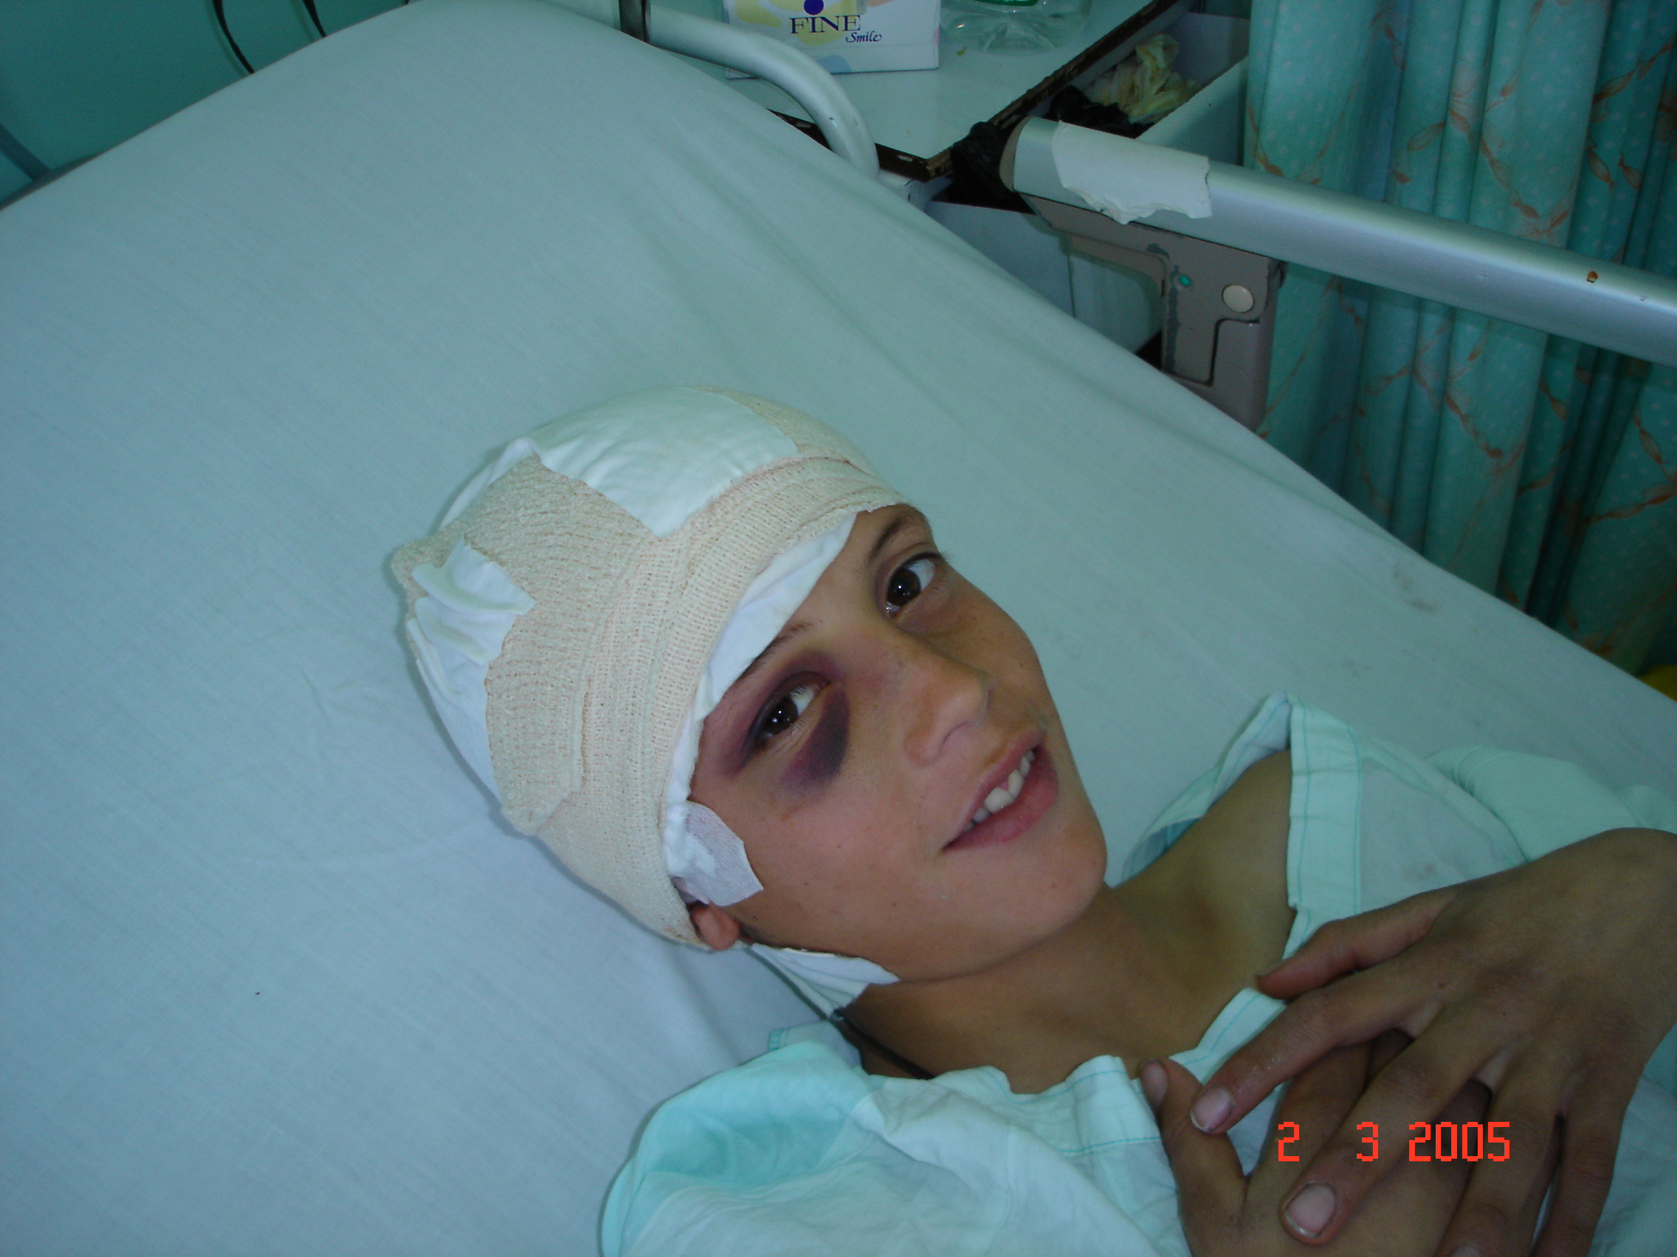
CLINICAL PICTURE (cont.)
  SCALP EXAMINATION
    SCALP WOUNDS
    SCALP HEMATOMAS
    BATTLE’S SIGN
    RACOON EYE
  NEUROLOGICAL EXAMINATION
  EXAMINATION OF OTHER SYSTEMS

Slide 10
MANAGEMENT
EXAMINATION
MAKE SURE AIRWAY IS PATENT
INSERT I.V. LINE
SKULL X-RAYS: 3 VIEWS
CERVICAL SPINE X-RAYS: 16% ASSOCIATED
CT AS INDICATED (See later)
  FRACTURES
  DISTURBED LEVEL OF CONSCIOUSNESS
  NEUROLOGICAL DEFICITS

Slide 11
MANAGEMENT (cont.)
INDICATIONS FOR CT
Patients below 5 and over 65 years of age
In case of drug and alcohol consumption
Concussion more than 5 minutes
Amnesia more than 5 minutes
Glasgow coma score (GCS) of 14 & below
Abnormal neurological signs
The presence of skull fractures
The presence of CSF leak
The presence of epilepsy
Abnormal skull x-rays

Slide 12
MANAGEMENT (cont.)
INDICATIONS FOR ADMISSIONS
Patients below 5 & over 65 years of age
In case of drug & alcohol consumption
Concussion more than 5 minutes
Amnesia more than 5 minutes
Glasgow coma score (GCS) of 14 & below
Abnormal neurological signs
In multi trauma
Patients with co morbidity
The presence of skull fractures
The presence of CSF leak
The presence of epilepsy
Abnormal CT scan
If you are in doubt

Slide 13
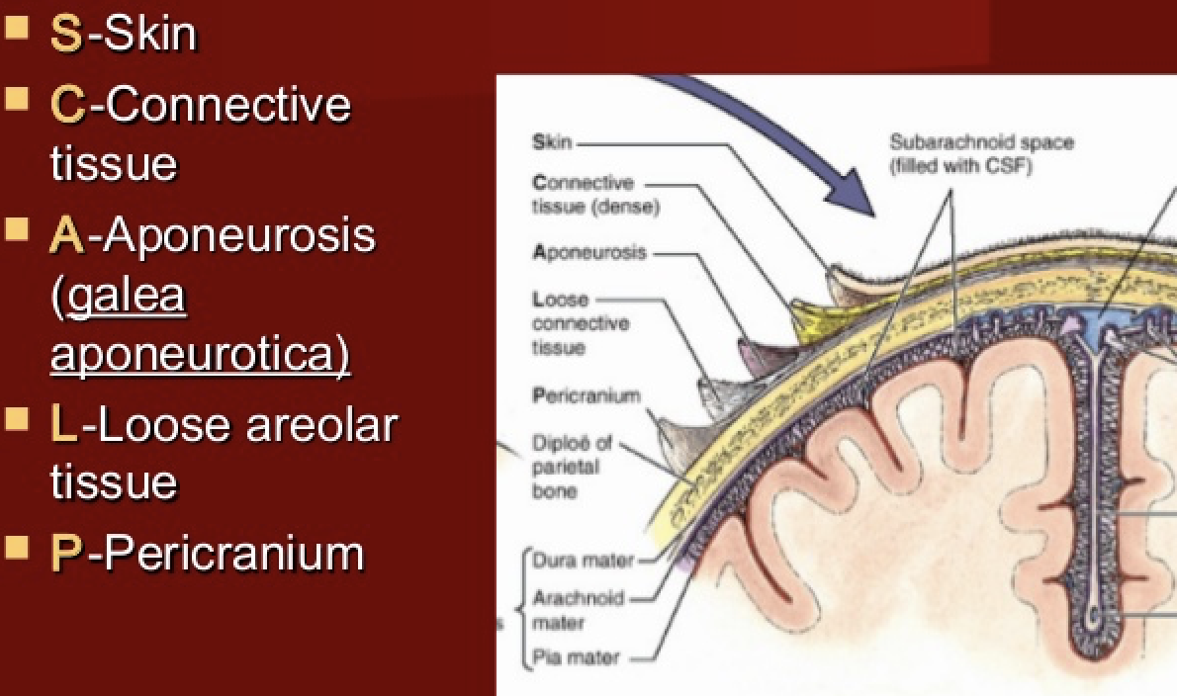
SCALP INJURIES

Slide 14
SCALP INJURIES
TYPES
  ABRASIONS
  CONTUSIONS
  WOUNDS
  AVULSIONS
  HEMATOMAS
    SUB-GALEAL HEMATOMA
    SUB-PERIOSTEAL HEMATOMA

Slide 15
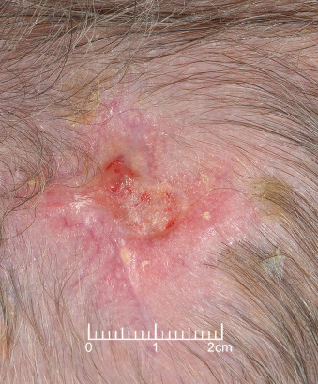
SCALP INJURIES
ABRASION
  Clean with antiseptic solution
  Apply antibacterial ointment
  Cover with gauze.

Slide 16
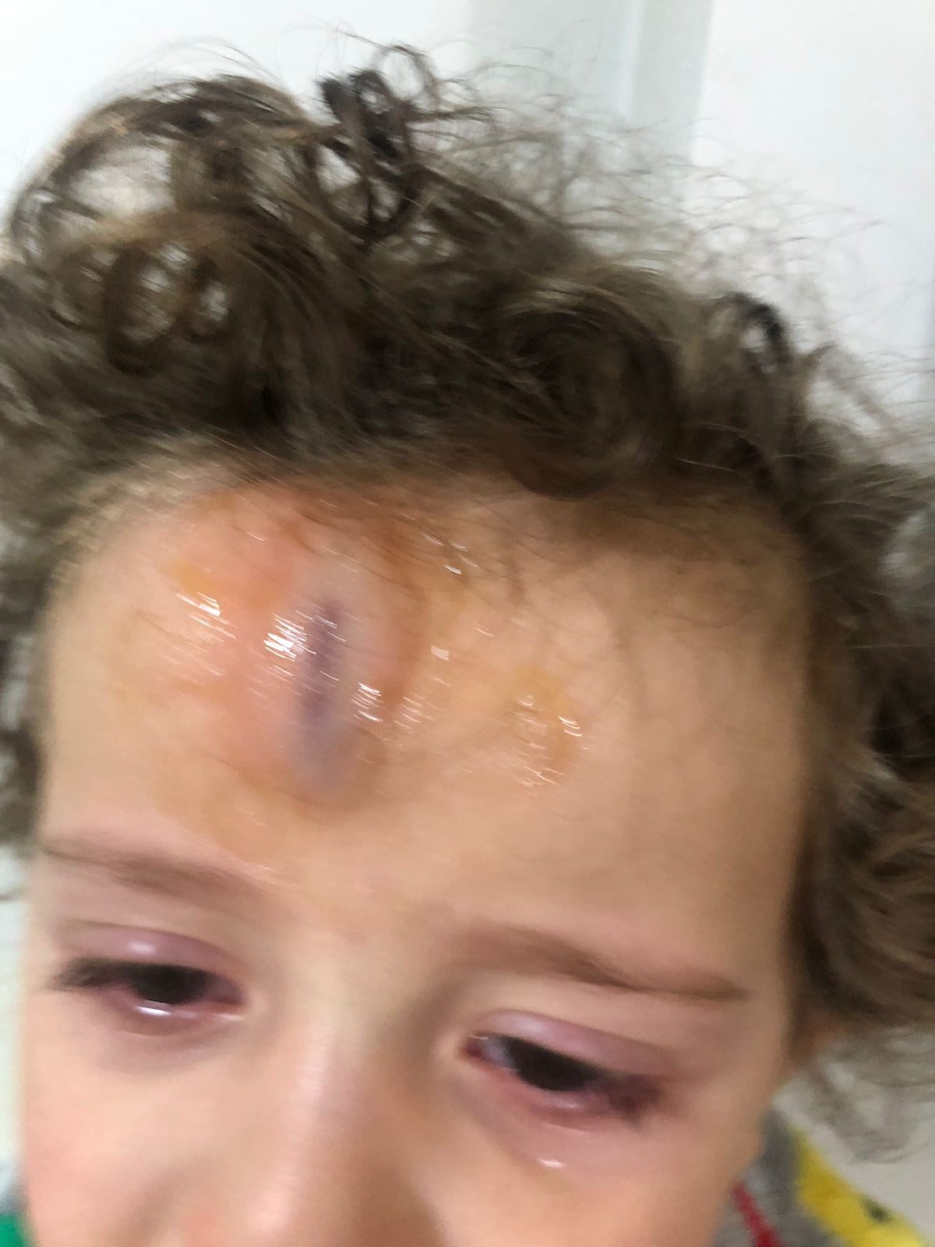
SCALP INJURIES
CONTUSION
  Do not require treatment
  Cold compresses
  Analgesia

Slide 17
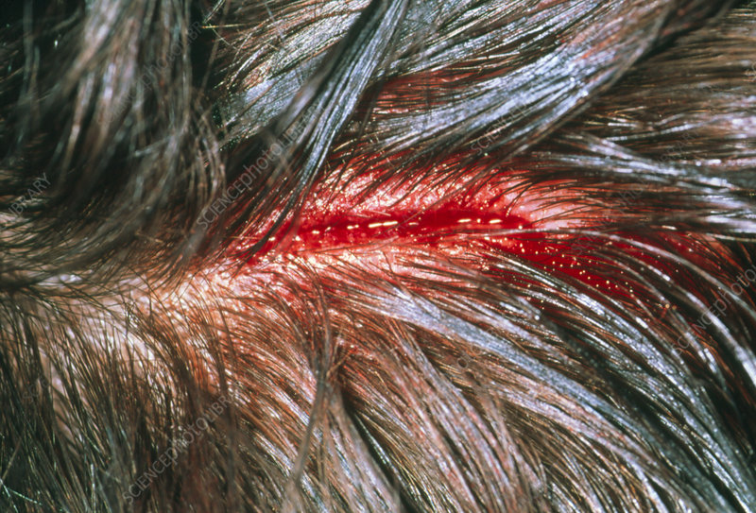
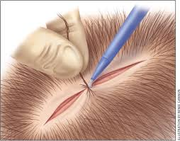
SCALP INJURIES
CUT WOUND
  Shave around wound
  Inspect wound and feel floor for fractures
  Clean wound and remove foreign material
  Stop bleeding
  Approximate edges
  Suture in two layers using a deep inverted suture.

Slide 18
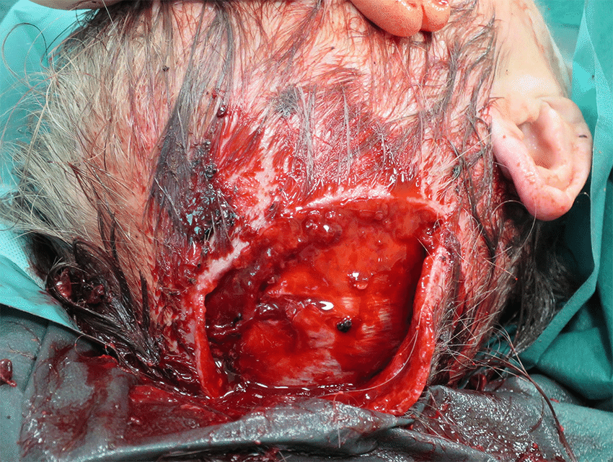
SCALP INJURIES
LACERATED WOUND
  Shave around wound
  Inspect wound and feel flooe for fractures
  Clean wound and remove foreign material
  Stop bleeding
  Do debridement.
  Approximate edges if you can . You may need to rotate flaps or graft.
  Suture in two layers using a deep inverted suture.

Slide 19
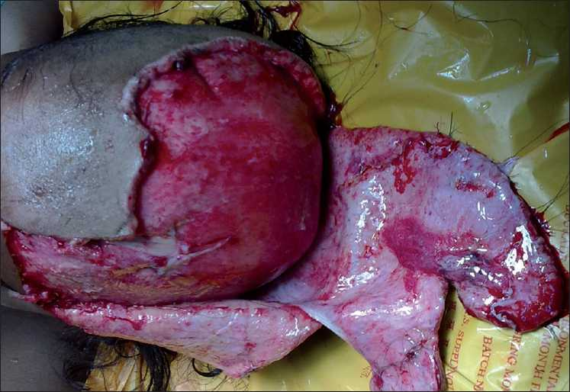
SCALP INJURIES
SCALP AVULSION
  PARTIAL
    Stop bleeding
    Clean with antiseptic solution
    Do debridement.
    Approximate edges if you can . You may need to rotate flaps or graft.
    Suture in two layers using a deep inverted suture
  COMPLETE
    Stop bleeding
    Graft

Slide 20
SCALP INJURIES
SUBGALAEAL HEMATOMA
  A peri-natal injury
  Follows vacuum extraction of baby
  Due to torn emissary vein
  Collects underneath the galea aponeurotica
  Could be extensive
  May lead to hypovolemic shock
  Soft and boggy swelling
  Extends across midline
  TREATMENT BY COMPRESSION. TRY TO AVOID ASPIRATION FOR FEAR OF INFECTION. ATTENTION TO BLOOD VOLUME.

Slide 21
SCALP INJURIES
SUBPERICRANIAL HEMATOMA
  A peri-natal injury
  Follows vacuum extraction of baby
  Due to torn emissary vein
  Collects underneath the pericranium
  Usually limited by skull sutures and do not cross midline
  Firm swelling
  TREATMENT BY COMPRESSION. TRY TO AVOID ASPIRATION FOR FEAR OF INFECTION.

Slide 22
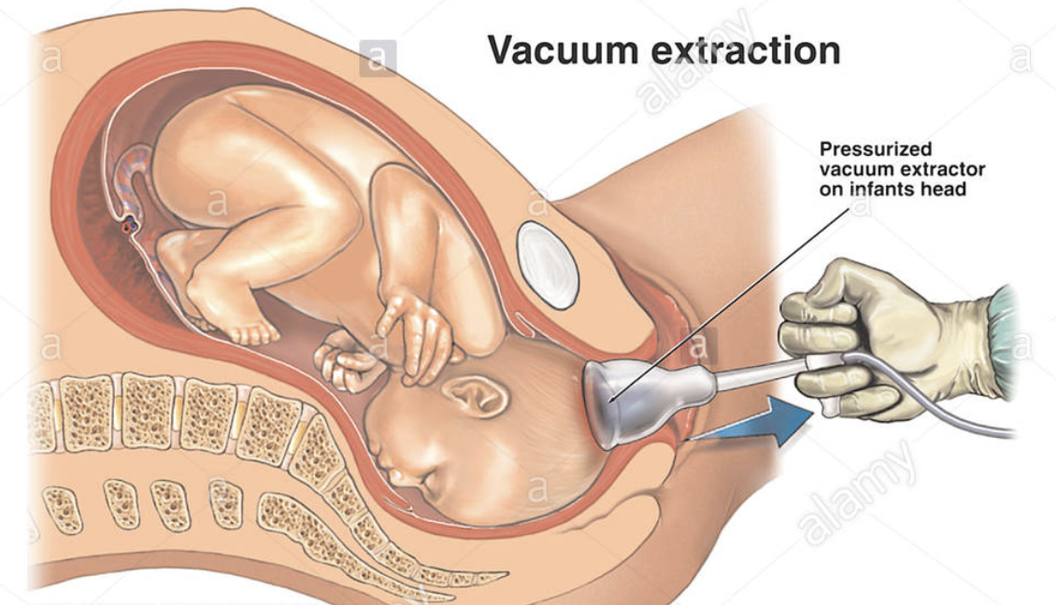
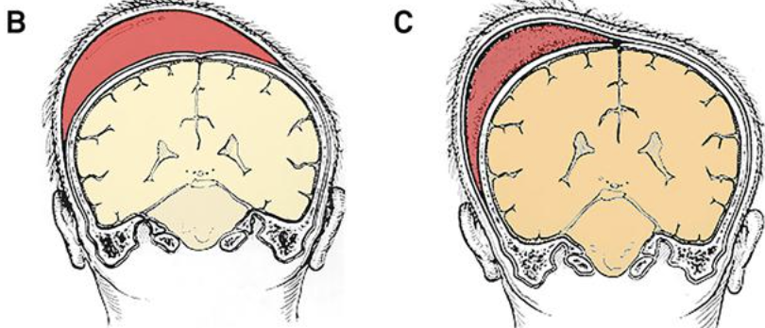
SCALP INJURIES
SUBGALAEAL AND SUBPERICRANIAL HEMATOMAS

Slide 23
SKULL FRACTURES
A fracture is an interruption to the continuity of the skull bone.
The trauma is significant and may provide an indication to the presence of an extradural hematoma or brain injury.
Diffuse trauma causes linear fractures
Localized trauma causes depressed fractures
They could be seen on plain x-rays or on CT scans in special views called “Bone Windows”.
THE PATIENT SHOULD BE ADMITTED .

Slide 24
SKULL FRACTURES
There are ONLY 2 types:
LINEAR FRACTURES
DEPRESSED FRACTURES:
  ONE FRAGMENT
  COMMINUTED (MULTIPLE FRAGMENTS)

Slide 25
SKULL FRACTURES
LINEAR SKULL FRACTURES
They are divided geographically into:
  THOSE IN THE VAULT OF THE SKULL AND ARE HAIR-LINE FRACTURES
  THOSE IN THE BASE OF THE SKULL AND ARE BASILAR FRACTURES
  THOSE WHICH RUN IN SUTURE AND ARE DIASTATIC FRACTURES

Slide 26
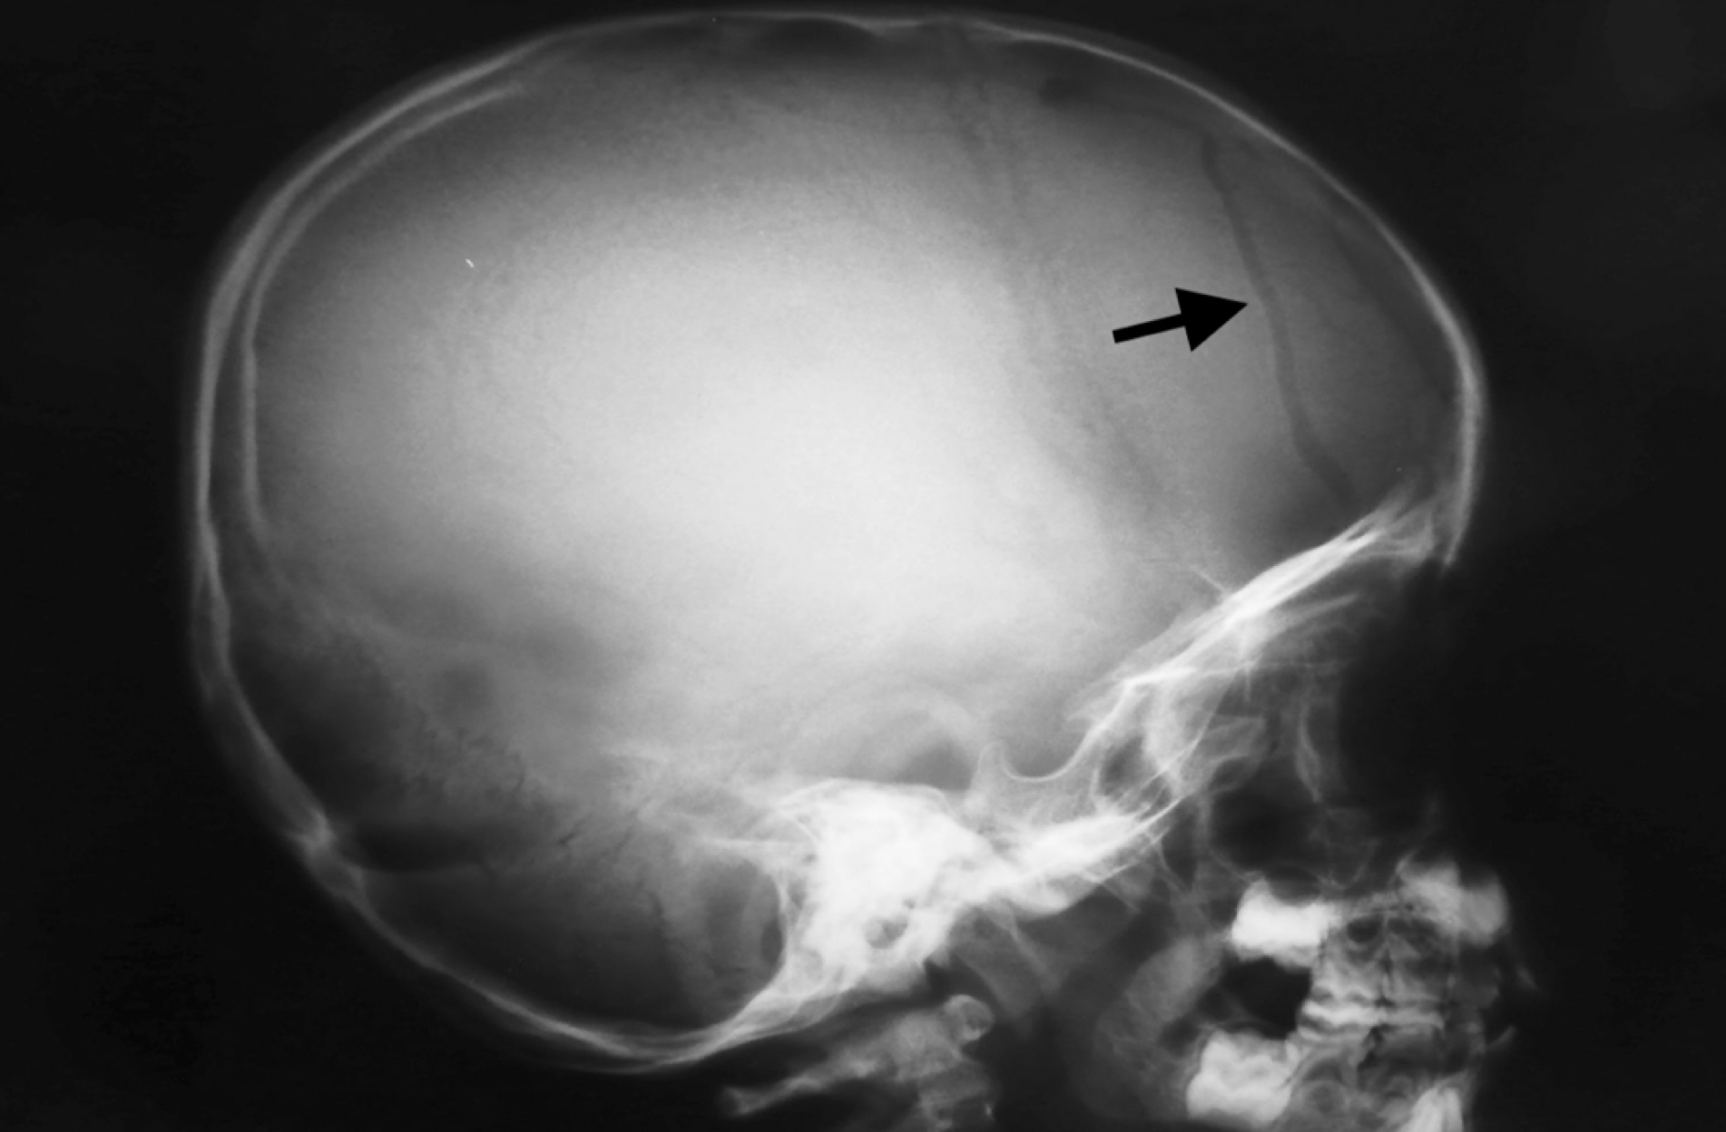
SKULL FRACTURES
LINEAR SKULL FRACTURES
  HAIR-LINE FRACTURES
  They occur in the vault of the skull in the area covered normally b y the hair, hence their name

Slide 27
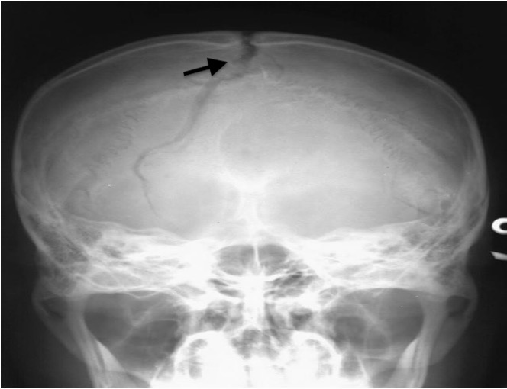
SKULL FRACTURES
LINEAR SKULL FRACTURES
  DAISTATIC FRACTURES
  They occur in the vault of the skull within the sutures, or start as hair line and then reach the sutures

Slide 28
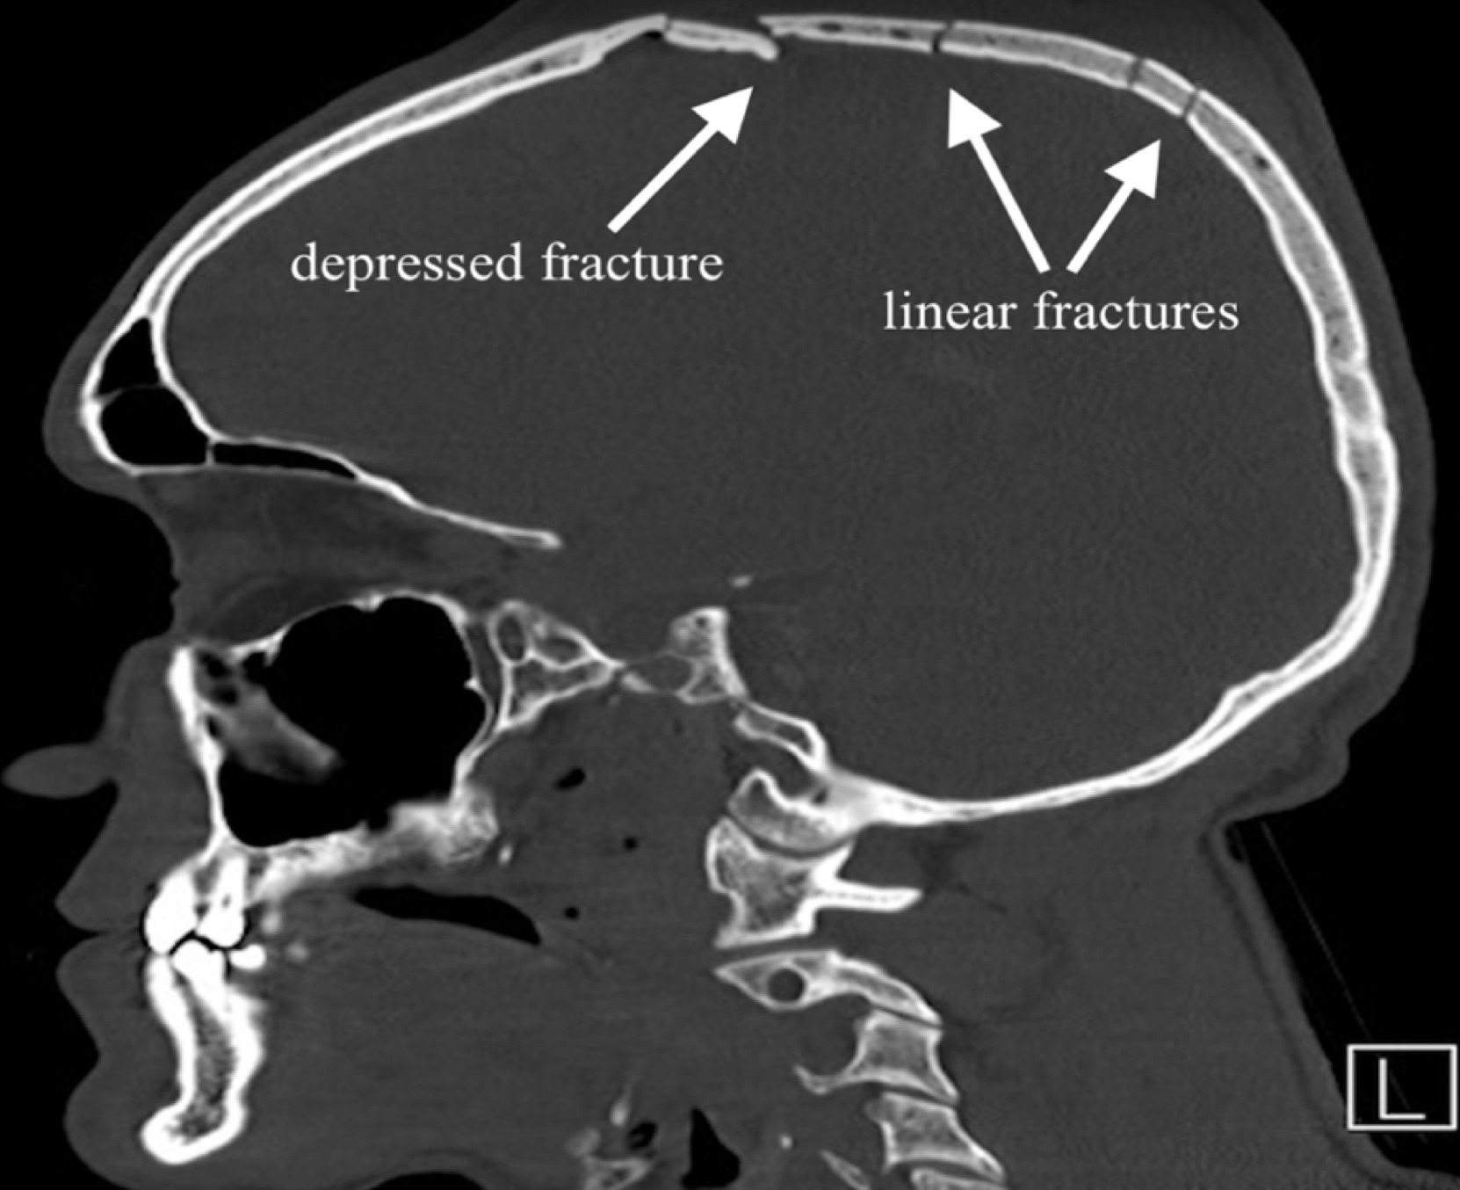
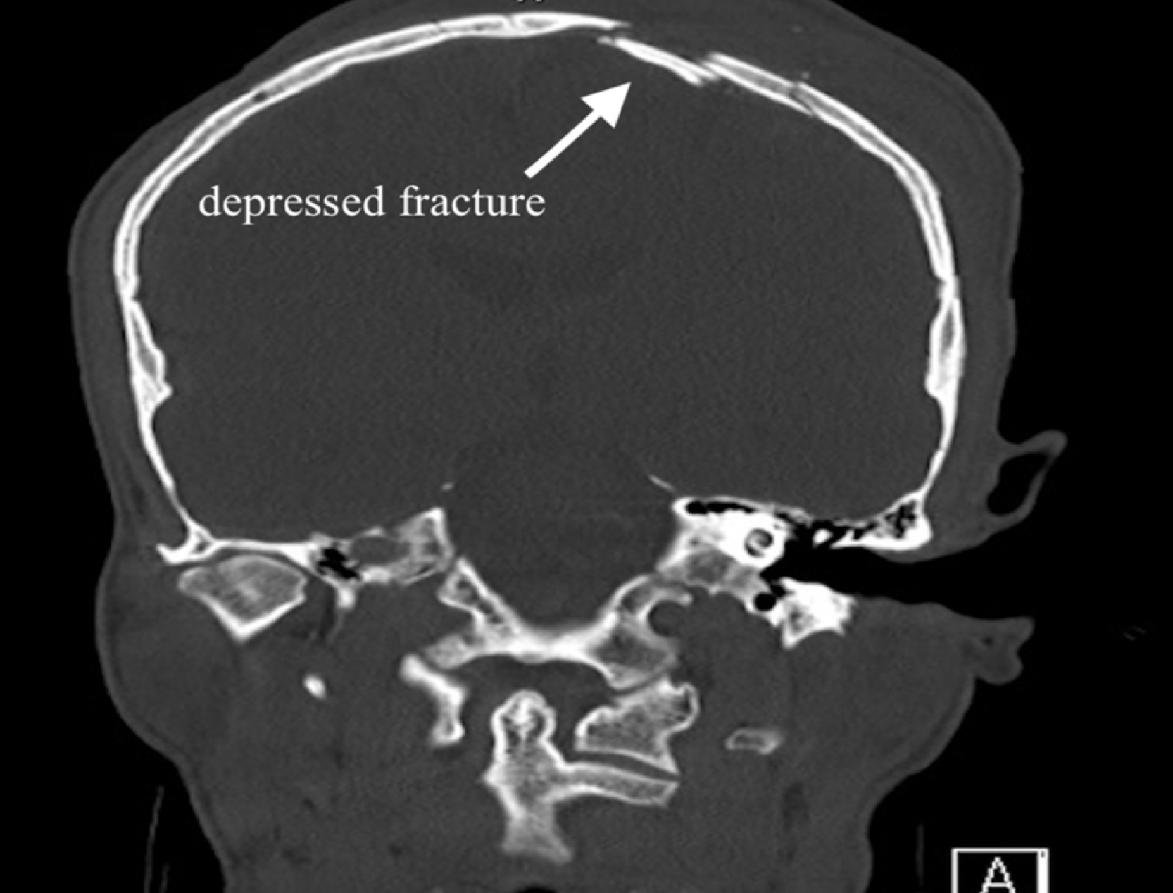
SKULL FRACTURES
LINEAR ASSOCIATED WITH DEPRESSED FRACTURE ON CT BONE WINDOW RECONSTRUCTION

Slide 29
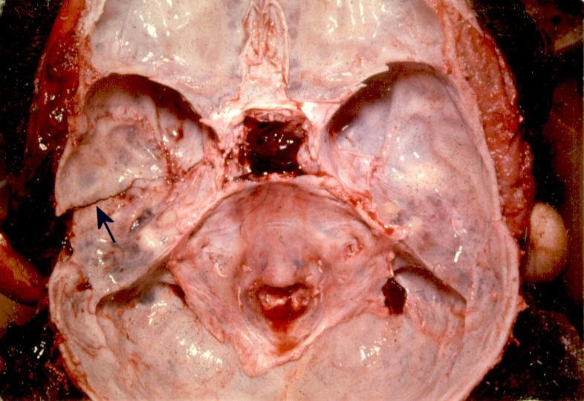
SKULL FRACTURES
BASE OF SKULL SHOWING LEFT TEMPORAL FOSSA BASILAR FRACTURE
BASILAR SKULL FRACTURES
    They tend to occur anywhere in the base but usually in the anterior and middle cranial fossae, and therefore, run into the paranasal sinuses.
    They will also run along the many foramina in the base leading to nerve and vascular injury.

Slide 30
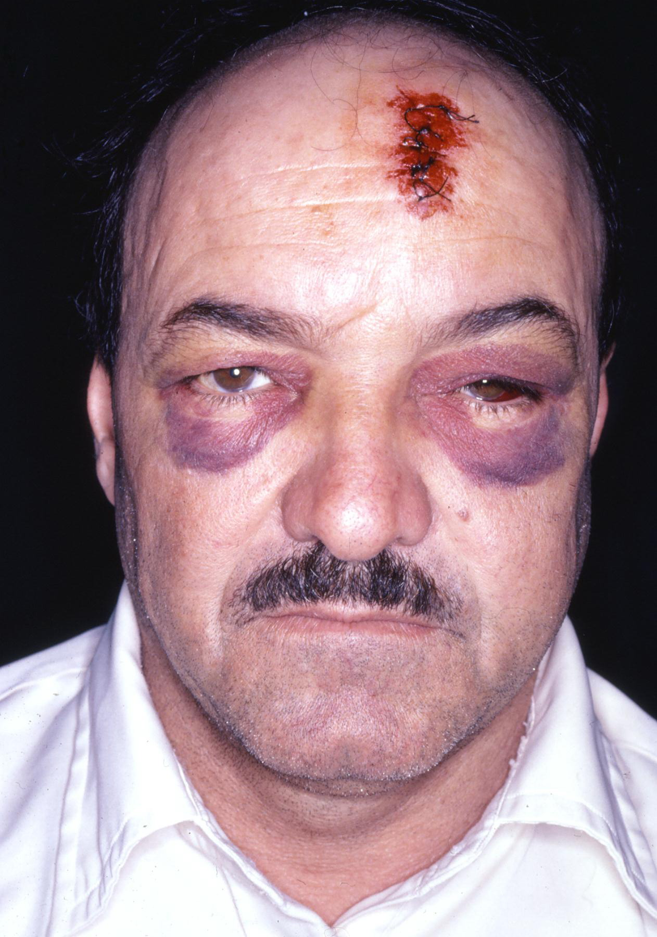
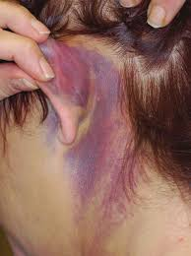
SKULL FRACTURES
PRESENTATION IN BASILAR ANTERIOR CRANIAL FOSSA FRACTURES :
  Bruising around the eye called racoon or panda eye.
  Subconjunctival hemorrhage
  Occasionally nerve and or cranial nerve injury
  Occasionally CSF leak
PRESENTATION IN BASILAR MIDDLE CRANIAL FOSSAFRACTURES:
  Bruising behind the ear called battle sign
  May be hemotympanum
  Occasionally CSF leak
RACOON (PANDA) EYES
Bilateral racoon eyes
Left subconjunctival hemorrhage
BATTLE’S SIGN

Slide 31
SKULL FRACTURES
MANAGEMENT OF LINEAR SKULL FRACTURES
There is no specific management for linear skull fractures unless they are complicated. They will heal spontaneously within weeks to months
Just admit for observation and if the patient deteriorates do CT scan to rule out hematomas.
Open basal skull fractures should be covered with antibiotics and the nose and ear should be observed for CSF leak

Slide 32
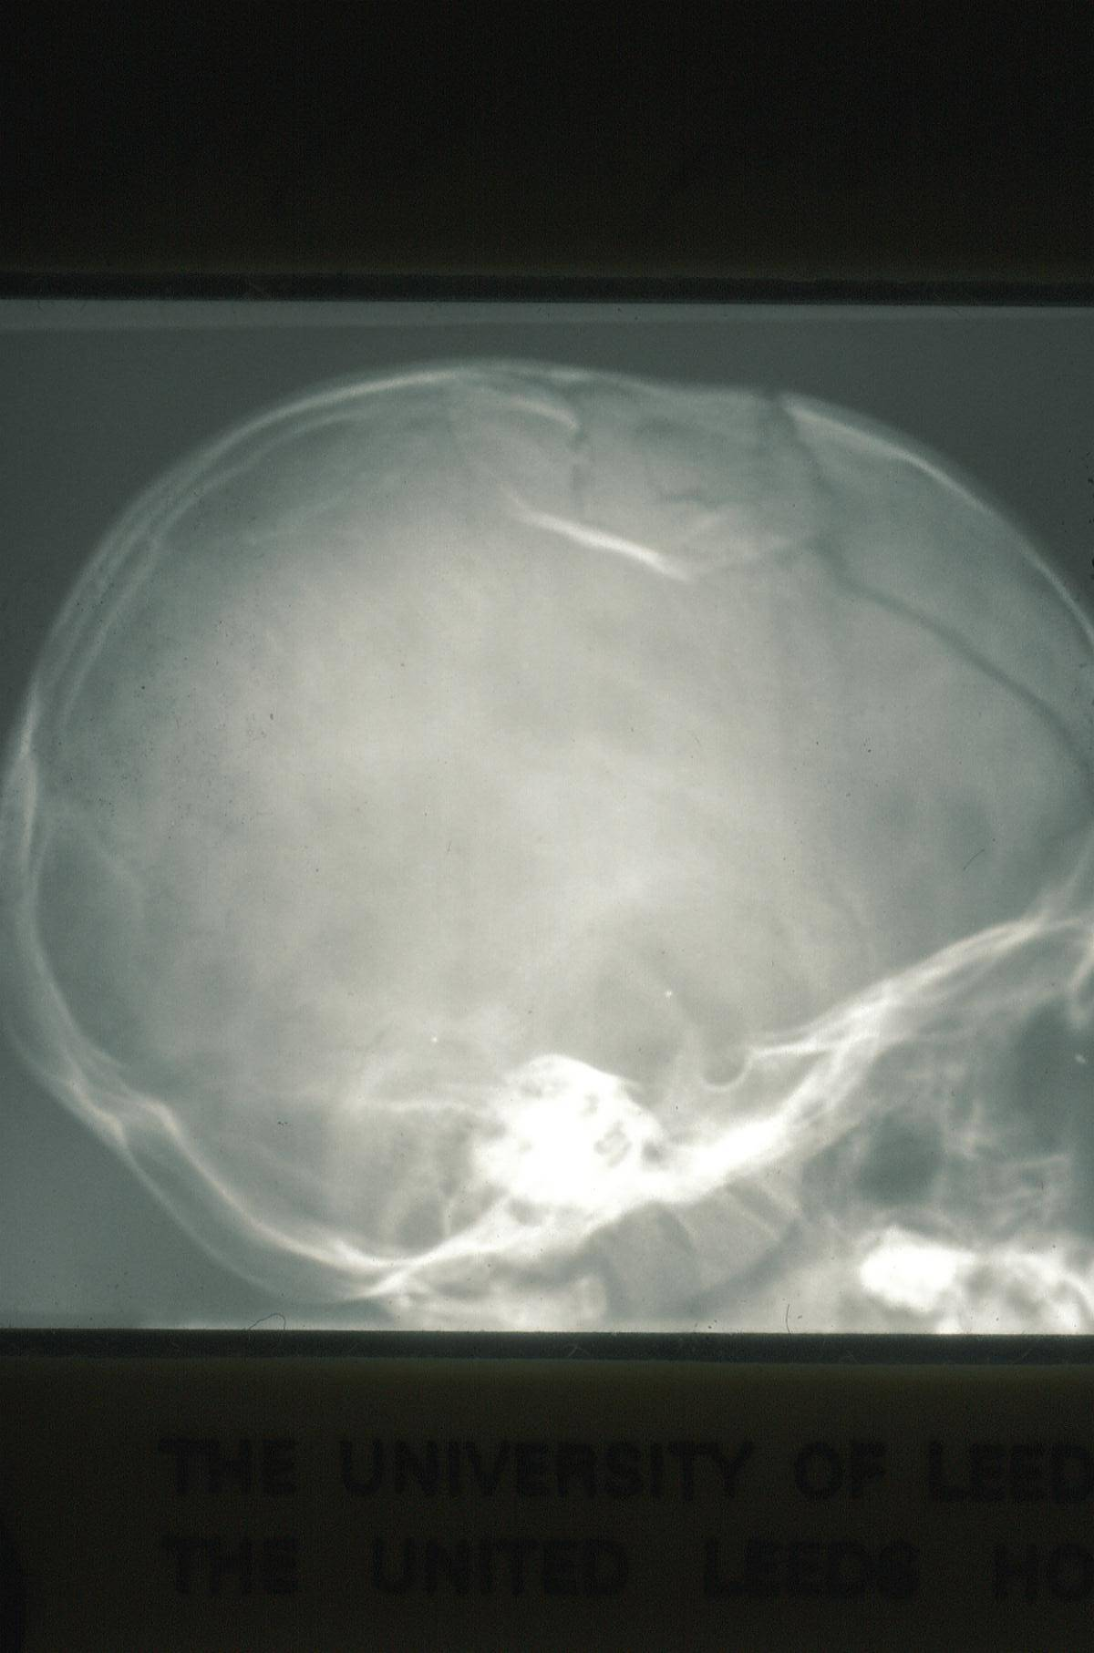
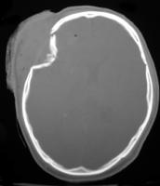
SKULL FRACTURES
LATERAL XRAY VIEW WITH DEPRESSED FRACTURE
COMMINUTED DEPRESSED FRACTURE ON BONE WINDOW OF A BRAIN CT
DEPRESSED SKULL FRACTURES:
They could be:
  One depredded segment of bone
  Multiple small depresssed pieces of bone (comminuted).

Slide 33
SKULL FRACTURES
MANAGEMENT OF DEPRESSED SKULL FRACTURES
THEY NEED TO BE OPERATED UPON IF:
  The depression is more than the thickness of the adjacent skull.
  If they are compound and open
  If associated with seizures
  If associated with neurological signs.
  If they overlie an important area
  Cosmotic.

Slide 34
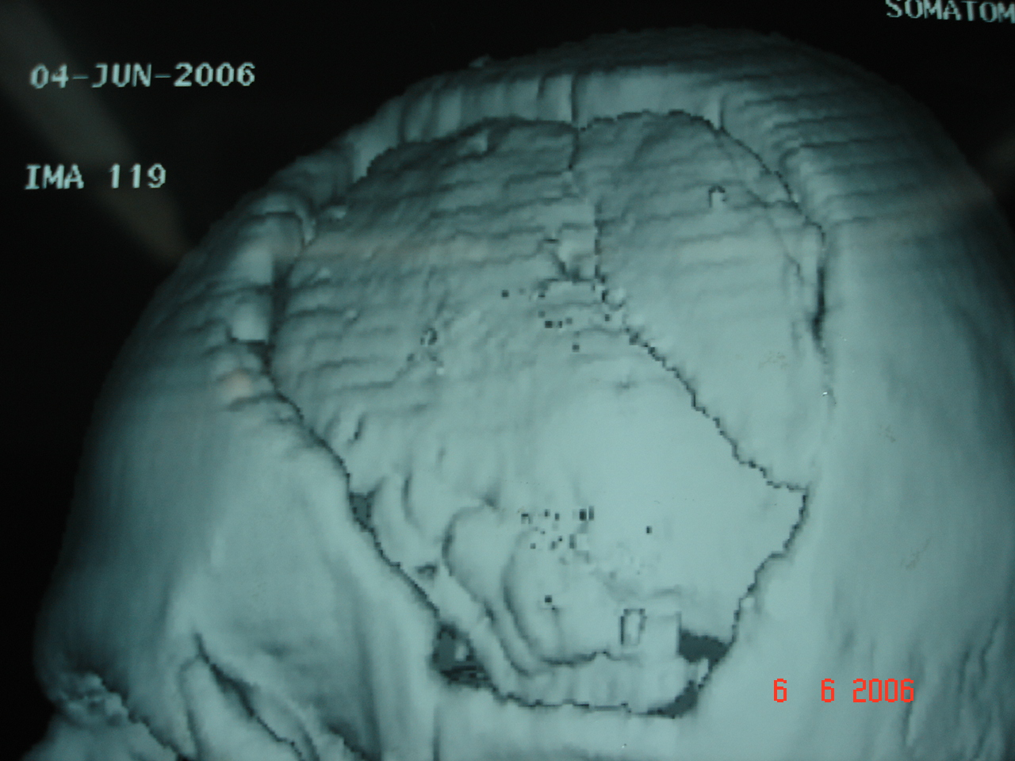
SKULL FRACTURES
MANAGEMENT OF DEPRESSED SKULL FRACTURES
The operation could be:
    Simple elevation
    Craniectomy, this will need to be repaired by an operation called Cranioplasty, which could be immediate or delayed if the fracture was compound.
CRANIOPLASTY WITH ACRYLIC MATERIAL

Slide 35
BRAIN INJURIES
MECHANISMS OF BRAIN INJURIES
  Direct trauma
  Acceleration deceleration injury
  Shearing

Slide 36
BRAIN INJURIES
  PRIMARY INJURIES
    Concussion
    Contusion.
    Laceration
    Diffuse axonal injury (DAI)
  SECONDARY EVENTS
    Brain edema
    Hypoxia
    Ischemia

Slide 37
BRAIN INJURIES
CONCUSSION
Here the patient will lose his consciousness for a brief period of time. When he wakes up; he will be amnesic. Examination will show no abnormality . CT scans are usually normal.

Slide 38
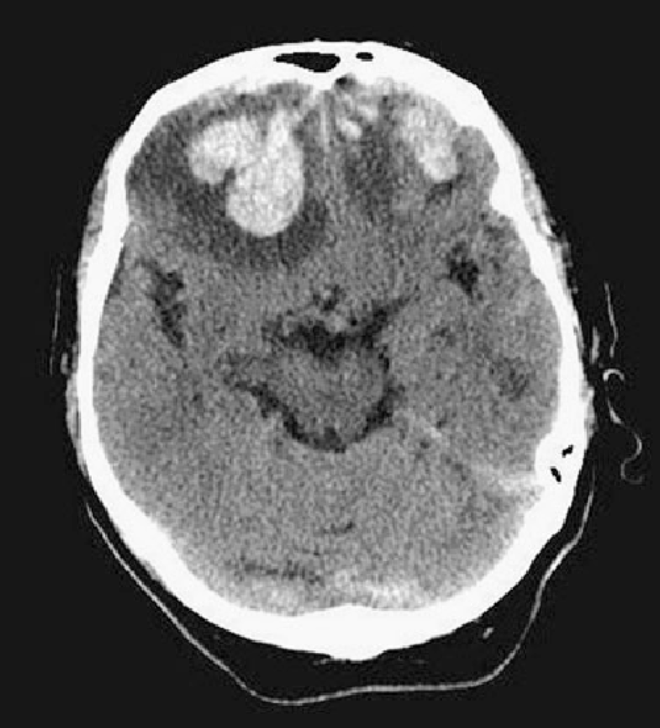
BRAIN INJURIES
CONTUSION
Here the brain will suffer from a contused area or areas as a result of the direct trauma or the acceleration deceleration injury.
The most common sites for this latter is the under surface of the brain and the tips of the lobes in what is called coup contre-coup injuries.
Contusions are notorious for being associated with brain edema which makes their management difficult.
Bilateral frontal contusions associated with edema
Bilateral frontal contusions associated
with edema

Slide 39
BRAIN INJURIES
LACERATION
Here the brain will suffer from a lacerated area or areas as a result of the direct trauma especially if penetrating, or the acceleration deceleration injury. The neurological deficits which result are usually permanent.

Slide 40
BRAIN INJURIES
DIFFUSE AXONAL INJURY
Will usually result from shearing injury which acted upon the interface of grey and white matter. If extensive the patient will be in deep coma (3/15).

Slide 41
BRAIN INJURIES
MANAGEMENT OF BRAIN IJNURIES
BRAIN INJURIES ARE DIVIDED INTO 3 CATEGORIES DEPENDING ON THE GCS:
  MILD with GCS 14 AND 15
  MODERATE With GCS BETWEEN 9 AND 13
  SEVERE With GCS 8 AND BELOW

Slide 42
BRAIN INJURIES
MANAGEMENT OF BRAIN INJURIES
ABC then
    CONCUSSION:
      Observation for 24 hours.
    CONTUSION & LACERATION:
      ?steroids, diuretics.
      Anticonvulsants
      May need ventilation and ICP monitoring
      Surgery?
    DIFFUSE AXONAL INJURY:
      As above but will definitely need ventilation, ICP monitoing and anticonvulsants

