Slide 1




By
Tasneem Alremawi

Slide 2

Hallucinogens
Cannabis (tetrahydrocannabinol)
LSD (Lysergic acid diethylamide)
Psilocybin (mushrooms)
Mescaline (from amanita muscaria)
Phencyclidine

Slide 3
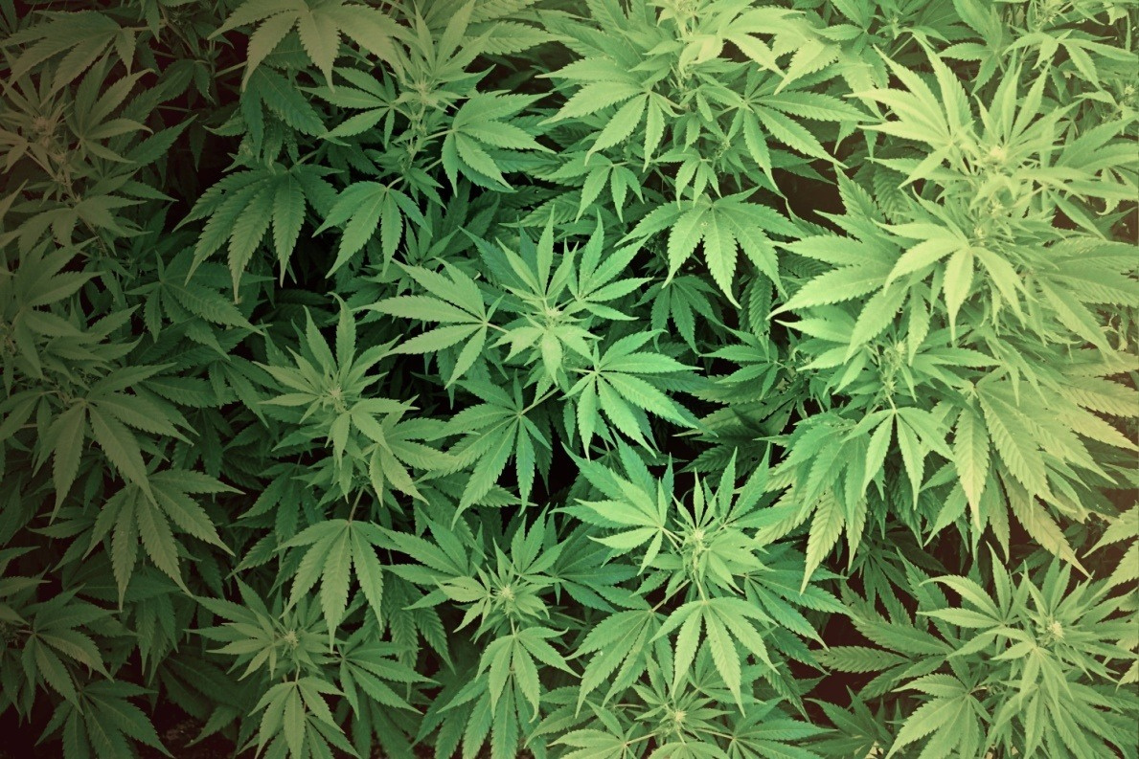
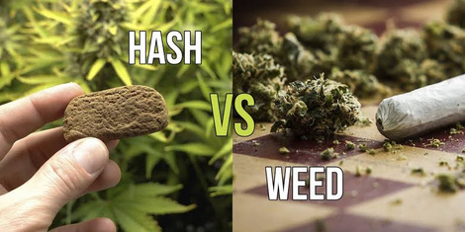
Cannabis
Source:
From the dried leaves & flowers of the indian hemp plant cannabis sativa.
It comes in 2 major forms:
• Marijuana: leaves/flowers → lower THC
• Hashish: compressed resin → higher THC
Others: hash oil, pipe resin…

Slide 4
Cannabis use
Global Burden:
243 million users (2023)
Most common illicit drug
~42% of substance use disorder
Legal: Canada,Germany, some U.S. states
Medical Use for chronic pain, chemo nausea , MS spasticity...
Not first-line,controlled prescription.

Slide 5
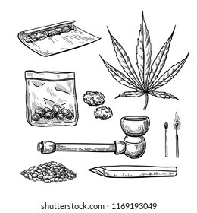
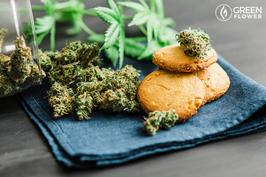
Absorption
Inhalation (most common):
Small pipes, bongs, paper-wrapped joints
Rapid pulmonary absorption
Onset : few min & lasts 2-3 h
Bioavailability: relatively high
Ingestion:
Onset: 30 min & lasts 5 – 8 hrs
Plasma T1\2 =18 hr – 4 days
Bioavailability: low & variable due to first-pass metabolism
High lipid-solubility- can be detected after 30 days.

Slide 6

Pathophysiology
The term cannabinoid: compounds that can activate either the cannabinoid receptor 1 (CB1) or CB2 receptor, or both.
50-60 additional substances have been isolated from cannabis that do not activate the CB1 or CB2 receptors.

Slide 7
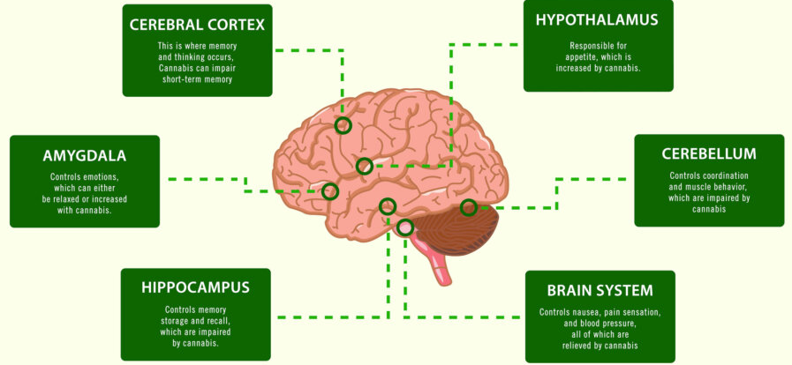
THC
Delta-9-tetrahydrocannabinol (THC) is the major psychoactive component of cannabis. THC potently activates the G-protein–coupled cannabinoid receptor CB1 (brain) and modulates the cannabinoid receptor CB2 (immune).
CB1 receptors are found in the cerebral cortex (especially frontal), basal ganglia, cerebellum, anterior cingulate cortex, and hippocampus (limbic system). Relatively absent in the brainstem nuclei.

Slide 8
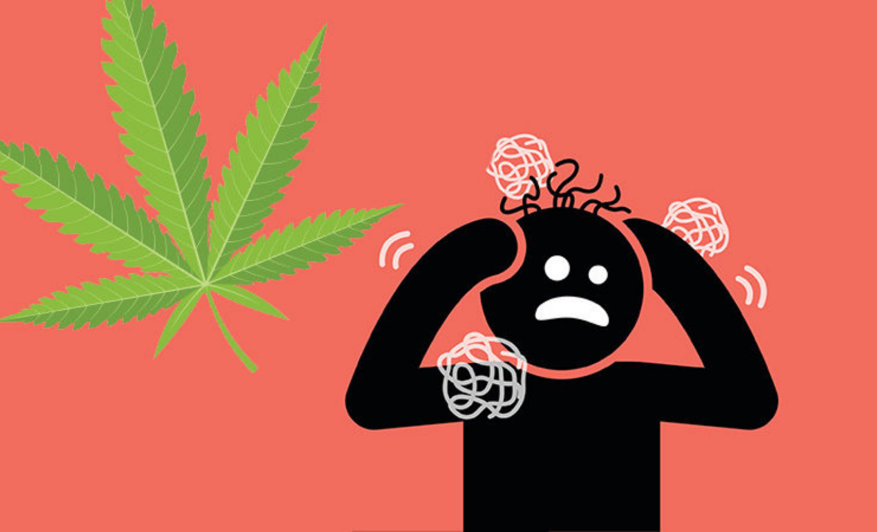
  Stimulation of these receptors causes monoamine and amino acid neurotransmitters (Dopamine) to be released.
  high doses can induce acute psychosis and may precipitate schizophrenia in predisposed individuals.

Slide 9
Manifestations
Low dose (~ 2mg THC)
Relaxation
Euphoria (high or stoned) Increased visual ,auditory & gustatory perception
Moderate dose (5-7)
Disturbance in thoughts Ataxia
short term memory impairment
High dose (>15)
Paranoia –depersonalization-disorientation Tachycardia-sensory disturbances
Decreased libido
BUT NO LOC

Slide 10
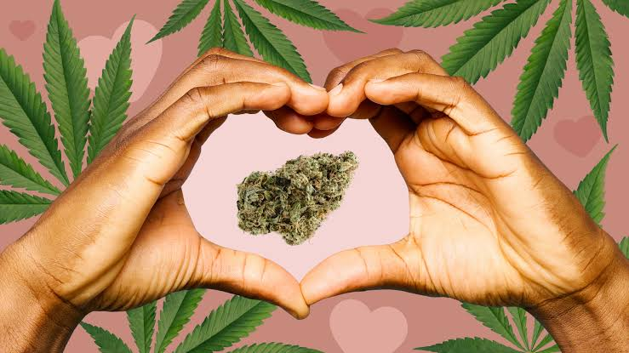
Cannabis Dependence
Dependence is mainly psychological (craving, compulsive use).
Physical dependence and withdrawal → controversial.

Slide 11
Cannabis Withdrawal
Cessation of heavy, prolonged cannabis use (daily/almost daily for ≥ few months) → withdrawal syndrome.
Within ~1 week, ≥3 of the following:
Irritability / anger / aggression
Nervousness / anxiety
Sleep disturbance (insomnia, vivid/disturbing dreams)
↓ Appetite or weight loss
Restlessness
Depressed mood
At least one of the following physical symptoms causing significant discomfort:
abdominal pain, shakiness/tremors, sweating, fever, chills, or headache.

Slide 12

Acute poisoning
Very rare (after intravenous injection):
Nausea & vomiting
Abdominal pain
Fever
Hypotension
Pulmonary edema
AKI
DIC
Death

Slide 13
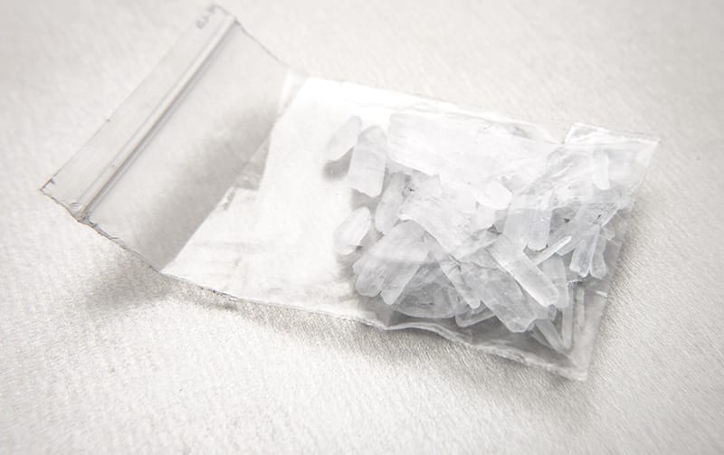
Synthetic Cannabinoids
Ex. Spice or K2
Full CB1 agonists → extreme toxicity
Routine toxicology screens → usually negative
Much more dangerous, can cause:
Seizures
Acute psychosis
Rhabdomyolysis
AKI
MI

Slide 14

Investigations
Urine testing: Cannabinoids can be detected in the urine
for as many as 21 days after use in people
chronically using marijuana (fat stores).
Blood testing:
measuring the quantitative level of THC can distinguish between recent use and residual excretion.

Slide 15


