Slide 1
INTRACRANIAL PRESSURE(ICP)
5TH YEAR MEDICAL STUDENTS
Prof.Abdulrahman Al-Shudifat MD,PhD
Neurosurgery Department
THE UNIVERSITY OF JORDAN,AMMAN

Slide 2
CONCEPT
The Monro-Kelly doctrine and components of ICP:
V_{brain}+V_{blood}+V_{CSF}=K
Where V_{brain} = brain volume, V_{blood} = blood volume, V_{CSF} = cerebrospinal fluid volume, K = constant

Slide 4
PATHOPHYSILOGY OF INCREASED ICP

Slide 6
MEASUREMENTS &MONITORING

Slide 8
WAVES

Slide 9
VALUES

Slide 10
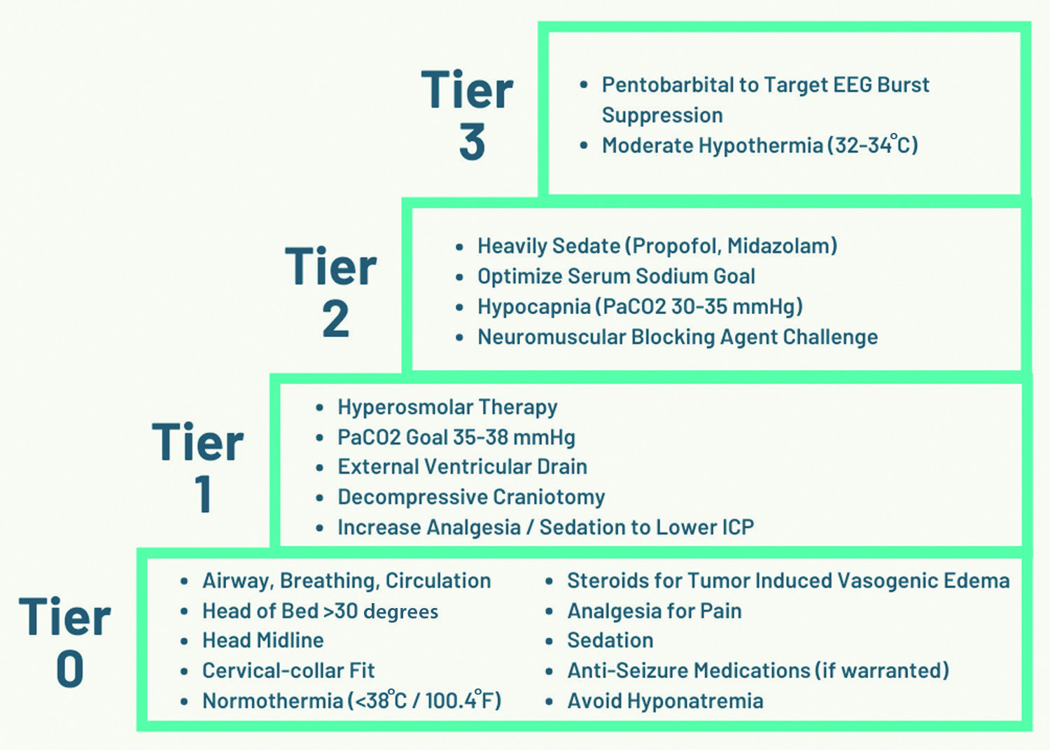
MX OF INCREASED ICP

Slide 11
Idiopathic Intracranial Hypertension

Slide 13
Mx of IIH

Slide 14
CLINICAL CASE

Slide 15
THANK YOU ALL FOR ATTENTION

