Slide 1
MALE INFERTILITY

Slide 2
Definition of Infertility
Failure to conceive after 12 months of regular, unprotected intercourse
WHO definition is the same (applies to both primary and secondary infertility)
Can be male, female, combined, or unexplained

Slide 3
Epidemiology
Affects approximately 15% of couples worldwide
Male factor infertility:
  Solely responsible in ~40% of cases
  Contributes in an additional 20% (combined factor)
Female factors: ~40%
Unexplained infertility: ~10%

Slide 4
Classification of Infertility
Primary Infertility:
  Couple has never conceived despite unprotected intercourse
Secondary Infertility:
  Couple previously achieved pregnancy at least once (same or different partner)
Distinction is important for prognosis and management

Slide 5
Special Infertility Categories
Unexplained Infertility
  Infertility of unknown origin
  Normal sperm parameters
  Female partner evaluation normal
Idiopathic Male Infertility
  Infertility with abnormal semen analysis
  Normal physical exam, endocrine profile, and genetic testing

Slide 6
MALE REPRODUCTIVE PHYSIOLOGY

Slide 7
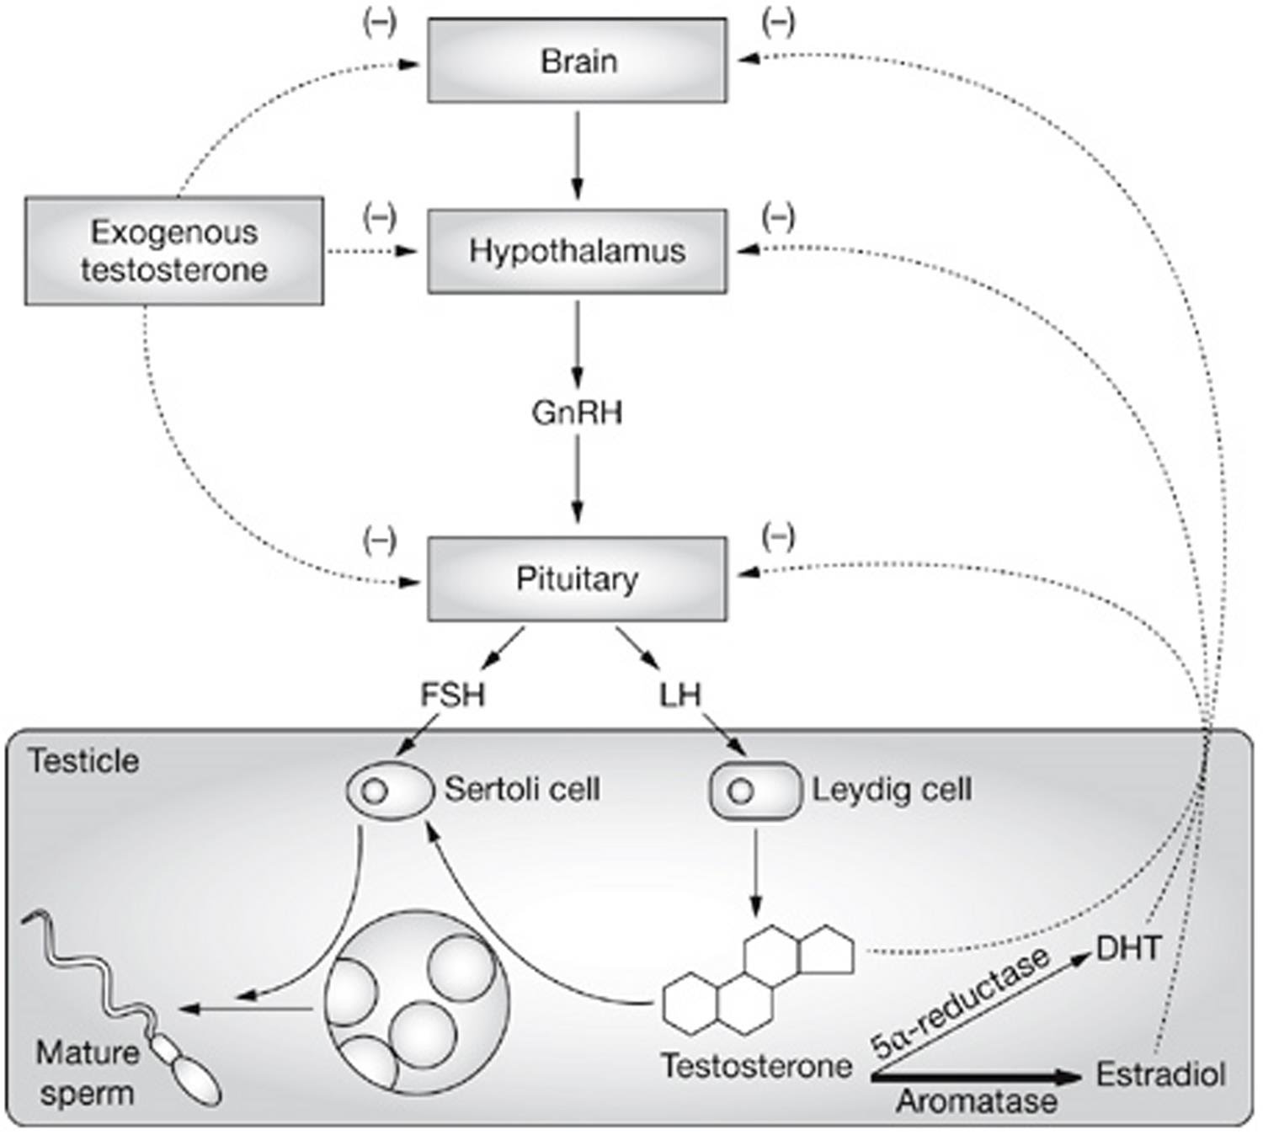
The Hypothalamic–Pituitary-Gonadal pathway

Slide 8
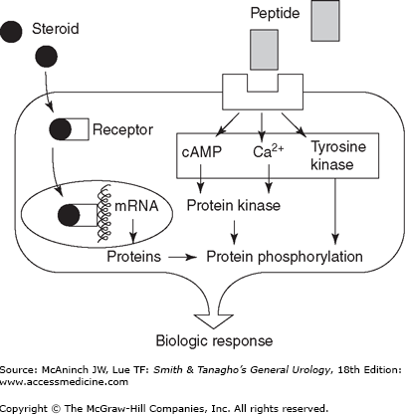
Hormonal Regulation of Male Reproduction
Hypothalamic-Pituitary-Gonadal (HPG) Axis
  Hypothalamus: GnRH release
  Pituitary: LH, FSH secretion
  Testis: Testosterone & spermatogenesis regulation
Hormonal Communication requires both peptide and steroid hormones
Receptor binding: location-specific (cell surface vs intracellular)

Slide 9
Peptide Hormones in Male Reproduction
Characteristics:
  Small secretory proteins
  Bind cell surface receptors
  Activate second-messenger pathways
Intracellular effect:
  Phosphorylation of proteins
  Altered cell function & gene expression
Key Peptide Hormones:
  Luteinizing Hormone (LH): acts on Leydig cells → testosterone
  Follicle-Stimulating Hormone (FSH): acts on Sertoli cells → spermatogenesis support

Slide 10
Steroid Hormones – General Features
Derived from cholesterol
Secretion limited by rate of production (not stored)
Lipophilic → freely diffuse across cell membranes
In plasma:
  Mostly bound to serum proteins (SHBG, albumin)
  ~2% free fraction = biologically active component

Slide 11
Steroid Hormone Mechanism of Action
Free steroids diffuse into cells
Bind intracellular receptors
Hormone–receptor complex → translocates to nucleus
Binds DNA recognition sites
Regulates transcription of target genes → protein synthesis
Key Steroid Hormones in HPG axis:
  Testosterone (T)
  Estradiol (E2)

Slide 12
Prolactin and Male Fertility
Secreted by anterior pituitary
Physiologic roles:
  Maintenance of libido (normal levels)
Pathologic roles:
  Elevated prolactin → disrupts GnRH pulsatility
  Decreases LH/FSH secretion → infertility, low testosterone
Prolactinoma:
  Pituitary adenoma with excess prolactin
  Requires evaluation (MRI, endocrine workup)

Slide 13
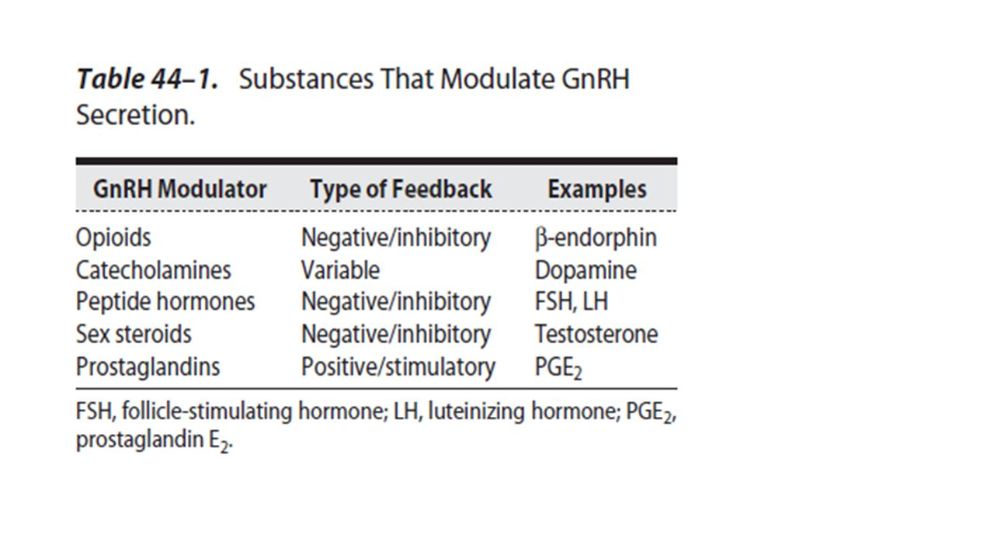

Slide 14
Testicular Functions
Dual role:
  Endocrine: steroid hormone production (Leydig cells → testosterone)
  Exocrine: spermatogenesis (Sertoli cells & seminiferous tubules)
Both regulated by the HPG axis

Slide 15
Testosterone Production
Leydig cells in interstitial compartment → main site
Daily production: ~5 g/day in adult men
Serum distribution:
  ~2% free (active)
  Majority bound to Sex Hormone binding Globulin (SHBG) and albumin
Factors affecting SHBG:
  ↑ Estrogens, thyroid hormone → ↓ SHBG → ↑ free T
  ↑ Androgens, GH, obesity → ↑ SHBG → ↓ free T
  Aging → SHBG ↑ with age → ↓ active T fraction

Slide 16
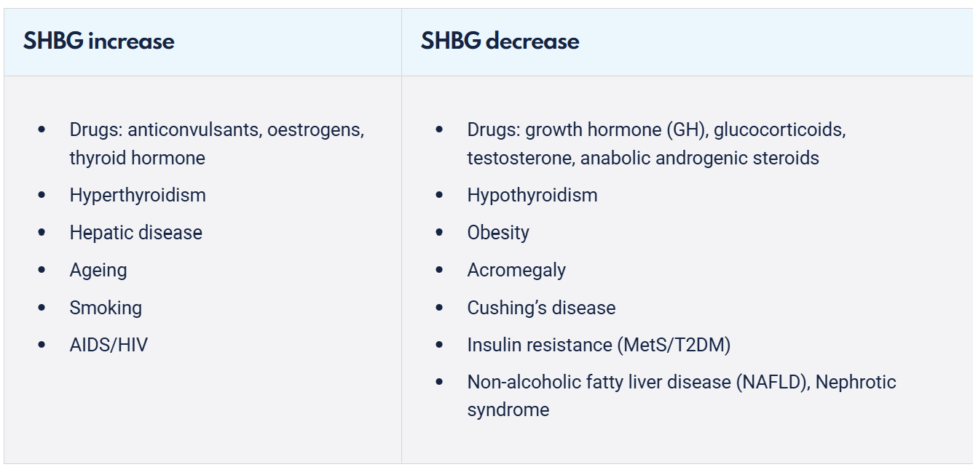

Slide 17
Role of FSH and Sertoli Cells
FSH action:
binds to Sertoli cells in seminiferous tubules
Stimulates production of proteins required for spermatogenesis
Supports seminiferous tubule growth during development
Initiates sperm production at puberty
Maintains sperm production throughout adulthood

Slide 18
Spermatogenesis – Overview
Definition: Complex process transforming primitive stem cells (Spermatogonia) → spermatozoa
Location: Occurs in seminiferous tubules (80–90% of testicular volume)
Phases:
  Mitosis → renewal of stem cells & production of spermatogonia
  Meiosis → formation of haploid spermatids

Slide 19
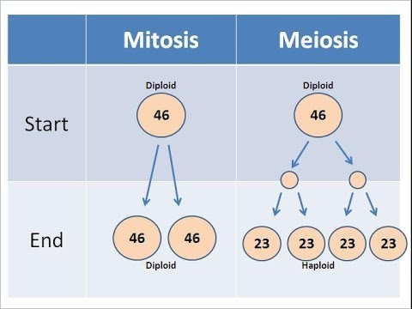

Slide 20
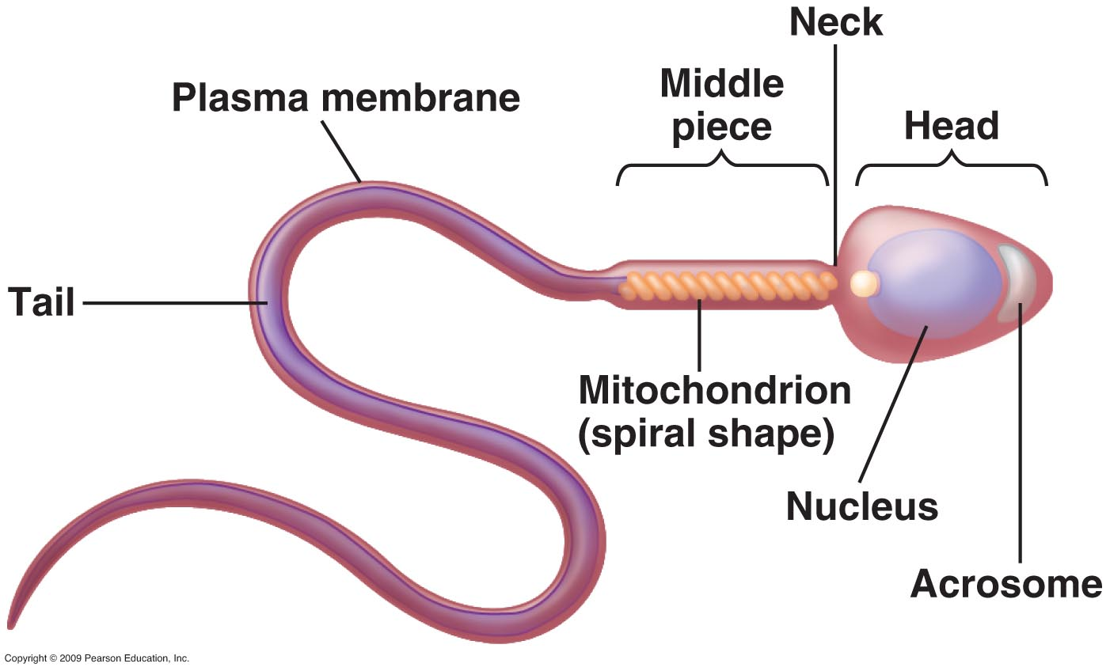
Spermiogenesis (Final Maturation Step)
Transformation of spermatids → spermatozoa
Occurs in the basilar compartment of seminiferous tubules
Key steps:
  Acrosome formation (from Golgi)
  Flagellum development (from centriole)
  Mitochondrial reorganization around midpiece
  Nuclear compaction
  Cytoplasmic shedding (residual body elimination)
Duration of spermatozoa formation from Spermatogonia : 72 days

Slide 21
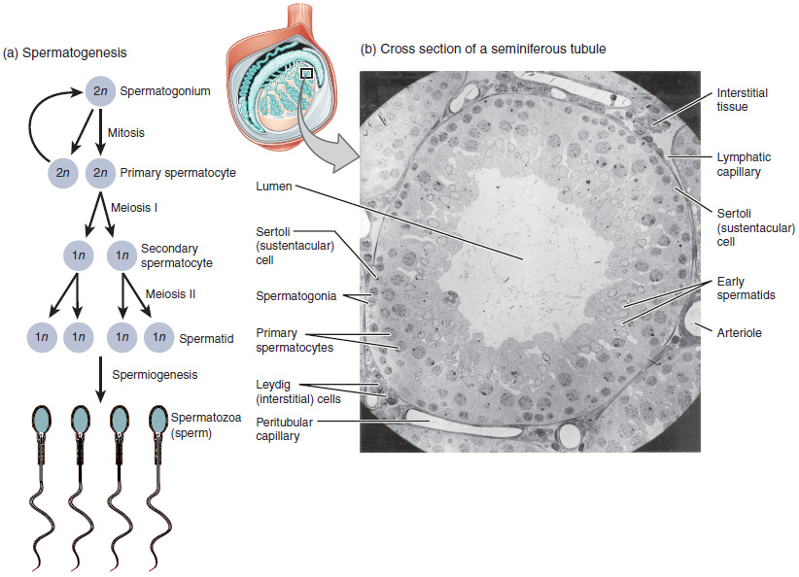

Slide 22
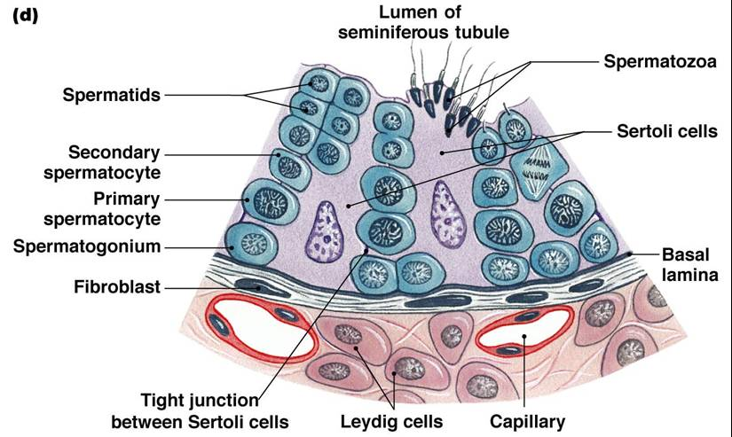

Slide 23
CAUSES OF MALE INFERTILITY

Slide 24
Classification of Causes
Pretesticular: hypothalamic-pituitary dysfunction
Testicular: intrinsic gonadal defects
Post-testicular: obstruction, ejaculation disorders

Slide 25
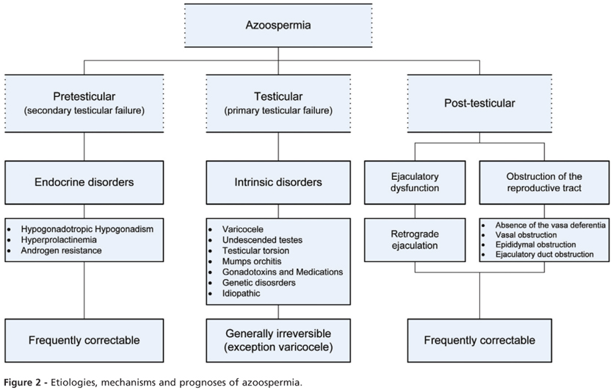

Slide 26
Testicular Causes of Male Infertility
Genetic syndromes: Klinefelter, Noonan, Myotonic dystrophy, Vanishing testis, Sertoli-cell-only, Y chromosome microdeletions
Other causes: cryptorchidism, gonadotoxins, systemic diseases, orchitis, torsion, trauma, varicocele, idiopathic

Slide 27
Klinefelter Syndrome
Most common chromosomal aneuploidy causing azoospermia
Classic triad: small, firm testes; gynecomastia; azoospermia
Other features: tall, reduced IQ, obesity, diabetes, ↑ malignancy risk (extragonadal germ cell tumors, and breast cancer)
90% = 47,XXY; 10% = mosaic (XXY/XY)

Slide 28
Noonan Syndrome
‘Male Turner syndrome’ (46,XY or mosaic)
Features: webbed neck, short stature, low-set ears, wide-set eyes, cardiac anomalies
75% have cryptorchidism at birth → high infertility risk
Descended testes → fertility is possible

Slide 29
Drug-Induced Infertility
Gonadotoxic medications
Calcium channel blockers, Allopurinol, Cimetidine, Sulfasalazine, Nitrofurantoin
Valproic acid, Lithium, Spironolactone, Colchicine
Tricyclic antidepressants, Antipsychotics

Slide 30
Varicocele
Varicocele is defined as dilated and incompetent veins within the pampiniform plexus of spermatic cord.
Varicocele has been described as the most common surgically correctable cause of male subfertility.
A left-sided varicocele is found in 15% of healthy young men. In contrast, the incidence of a left varicocele in subfertile men approaches 40%.

Slide 31
Varicocele – left side predominance
Several anatomic features contribute to the predominance of left-sided varicoceles.
The left internal spermatic vein is longer than the right and it typically joins the left renal vein at a right angle compared with the oblique insertion of the right spermatic vein into the inferior vena cava.
As a result of these characteristics, higher venous pressures are transmitted to the left spermatic cord veins and result in retrograde reflux of blood.

Slide 32
Varicocele – Clinical Impact
Associated with testicular atrophy; correction may reverse in adolescents
Negatively affects semen quality: concentration, motility, morphology, viscosity
Most profound effect on motility
Most common indication for surgery: semen abnormalities in infertile men

Slide 33
Varicocele – Treatment Options
Surgical and nonsurgical: open/microsurgical ligation, laparoscopy, embolization
Goal: eliminate retrograde venous flow
Complication rates: Open ~1%, Laparoscopy ~4%, Embolization 10–15% (technical failures is common)

Slide 34
epididymo-orchitis or Orchitis
Bacterial cause: most commonly epididymo-orchitis
Viral cause: mumps orchitis
Occurs in ~30% of postpubertal males with mumps parotitis
Sequelae:
  Testicular atrophy (common with viral, less with bacterial)
  Possible long-term infertility

Slide 35
Testicular Torsion
Twisting of spermatic cord → ischemic injury
Common in prepubertal and postpubertal boys
Time-sensitive: salvage possible if corrected <6 hours
May expose immune system to testis antigens → autoimmune infertility
Contralateral “normal” testis may show histologic abnormalities

Slide 36
Testicular Trauma
Mechanisms:
  Immune response against testicular tissue
  Direct parenchymal damage
Testicular fracture (tunica albuginea rupture):
  Requires urgent surgical exploration and repair
  Minimizes antigen exposure and tissue loss

Slide 37
Undescended Testis (Cryptorchidism)
Developmental defect → ↑ infertility and ↑ risk of testicular germ cell cancer
The degeneration of germ cells is apparent even after the first year of life
Degeneration varies depending on the position of the testes
During the second year, the number of germ cells declines further.
Contralateral descended testis also at risk of germ cell abnormalities
Both unilateral and bilateral cases have a risk long-term infertility risk

Slide 38
Idiopathic Male Infertility
Likely multifactorial: genetic, endocrine, environmental
Modifiable lifestyle contributors: obesity, smoking, alcohol, stress, sedentary lifestyle

Slide 39
Post-Testicular Causes of Infertility
Epididymal (30–67%): infection, trauma, iatrogenic, congenital
Vas deferens: vasectomy, congenital absence (CAVD)
Ejaculatory ducts: obstruction (cyst, stone, calcification)
Functional: anejaculation, retrograde ejaculation, neurologic dysfunction, coital disorders
Sperm motility disorders: immotile cilia syndrome

Slide 40
DIAGNOSIS OF MALE INFERTILITY

Slide 41
Clinical History in Male Infertility Evaluation
Infertility-specific history:
  Duration of infertility
  Coital frequency & timing
  Prior fertility or treatments
Partner history: gynecological evaluation
Past medical history:
  Childhood illnesses (e.g., mumps orchitis)
  Systemic diseases, infections, medications
  Prior surgeries/trauma (pelvic, testicular, hernia, prostate)
Lifestyle & environmental factors:
  Heat, radiation, toxins, pesticides, solvents

Slide 42
Physical Examination in Male Infertility
General assessment:
  Body habitus, virilization, secondary sexual characteristics
  Signs of androgen deficiency (gynecomastia, ↓ body hair, small testes)
Scrotal exam:
  Testis size and consistency
  Epididymis, vas deferens palpation
  Presence of varicocele
  Any scars or prior surgical changes
Other systems:
  Signs of systemic endocrine or genetic disorders

Slide 43
Physical Examination in Male Infertility
Examination of the Testis
Two principal features should be assessed during clinical examination of the testis: size and consistency.
1. Size
Testicular size is measured by determining the longitudinal axis (length) and transverse axis (width).
Normal reference values in adult males:
  Mean testis length: ~4.6 cm
  Mean testis width: ~2.6 cm
  Mean testis volume: ~18.6 mL (normal range: 15–25 mL)
Measurement can be done clinically using an orchidometer or radiologically by ultrasonography (more accurate).
2. Consistency
Normal testes are firm in consistency.
A soft testis is considered abnormal and often indicates impaired spermatogenesis or underlying pathology (e.g., partial tubular atrophy, prior orchitis, varicocele, or genetic causes).

Slide 44
Physical Examination in Male Infertility
Peritesticular & Genital Findings
Epididymis: check for irregularities, induration, cysts
Vas deferens: absence suggests congenital absence (CAVD, ~2% of infertile men)
Varicocele: dilated pampiniform plexus veins – 'Bag of worms', more evident with Valsalva
Penile abnormalities: hypospadias, curvature, phimosis → impaired semen delivery

Slide 45
Physical Examination in Male Infertility
Rectal examination
Prostate: Tender, boggy → prostatitis; Hard nodule → prostate cancer
Seminal vesicles: enlarged, palpable → ejaculatory duct obstruction (EDO)
Important for excluding infection, obstruction, malignancy

Slide 46
LABORATORY TESTING

Slide 47
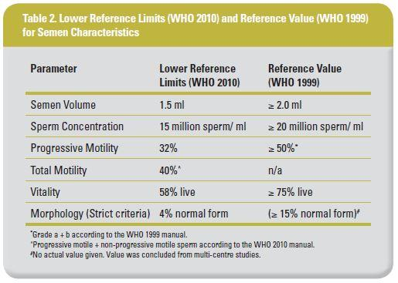

Slide 48
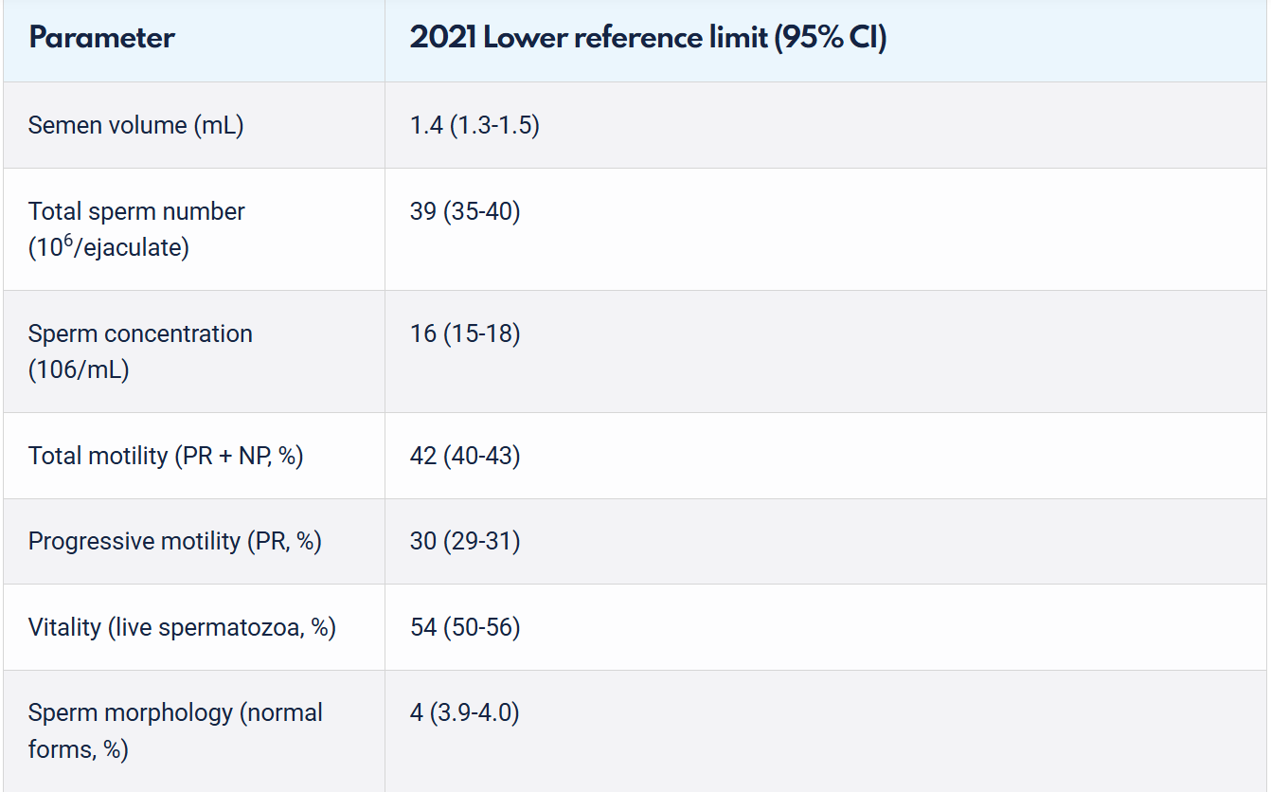

Slide 49
Terminology
Decreased sperm count → Oligozoospermia
Sperm concentration <16 million/mL or total count <39 million/ejaculate.
Decreased semen volume → Hypospermia
Ejaculate volume <1.4 mL.
Increased semen volume → Hyperspermia (>6 mL).
Reduced motility → Asthenozoospermia
Total motility <42% or progressive motility <30%.
Abnormal sperm morphology → Teratozoospermia
<4% normal forms by strict (Kruger) criteria.
Increased leukocytes in semen → Leukocytospermia
1×10⁶ peroxidase-positive leukocytes/mL (suggests infection or inflammation).
No sperm in ejaculate → Azoospermia
Complete absence of sperm after centrifugation.
No semen emission → Aspermia
Absence of ejaculate (may indicate ejaculatory duct obstruction or retrograde ejaculation).
Sperm clumping or antibody reaction → Sperm agglutination / Antisperm antibodies.

Slide 50
Terminology
Combined Abnormalities:
Oligoasthenozoospermia → ↓ count + ↓ motility
Oligoteratozoospermia → ↓ count + abnormal morphology
Asthenoteratozoospermia → ↓ motility + abnormal morphology
Oligoasthenoteratozoospermia (OAT syndrome) → ↓ count + ↓ motility + ↓ morphology

Slide 51
Semen Analysis
Collection: after 72 hours of abstinence
At least 2 samples needed , To establish a baseline of semen quality.
Analyze within 1 hour of ejaculation
Keep at body temperature during transport

Slide 52
Semen Analysis
Semen analysis alone cannot distinguish fertile from infertile men.

Slide 53
Hormonal & Genetic Evaluation
Hormonal studies: assess FSH, LH, Testosterone, Prolactin, Estradiol
Identifies endocrine causes of infertility

Slide 54
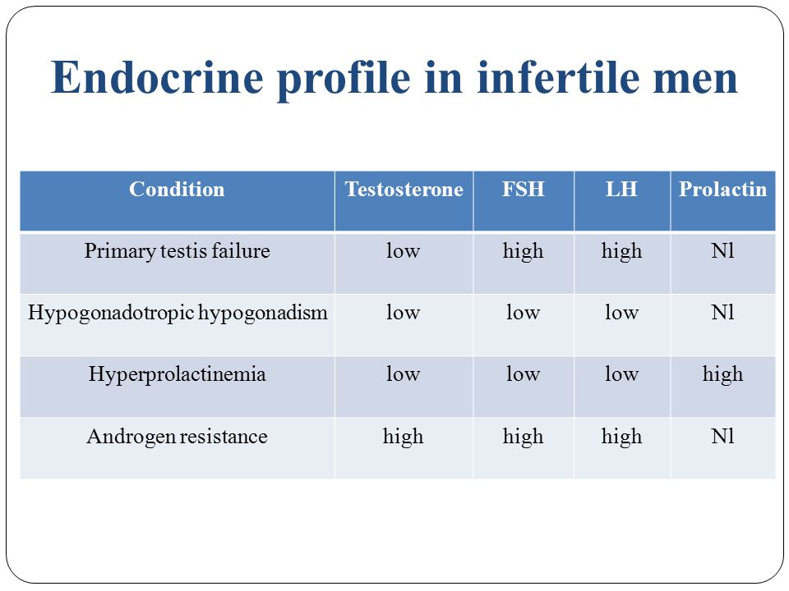

Slide 55
Hormonal & chromosomal Evaluation
Chromosomal analysis (karyotype): severe oligospermia or azoospermia →indicated in severe oligozoospermia (spermatozoa <5 million/mL) or azoospermia
Y microdeletion test → indicated with sperm concentrations of ≤ 1 million sperm/mL
2–15% show chromosomal abnormalities

Slide 56
Radiologic
Testing

Slide 57
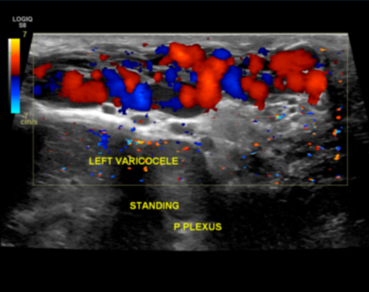
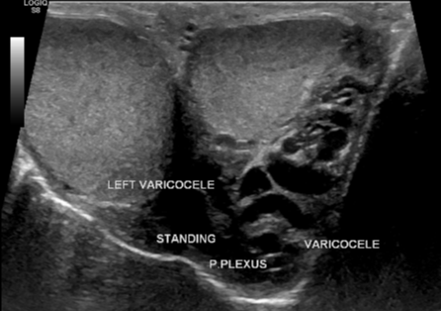
Scrotal ultrasound
to assess testis, epididymis, scrotal lesions such as Testicular tumors
Doppler US → Varicocele: vein >3 mm, retrograde flow with Valsalva → a key radiologic feature of a varicocele.

Slide 58
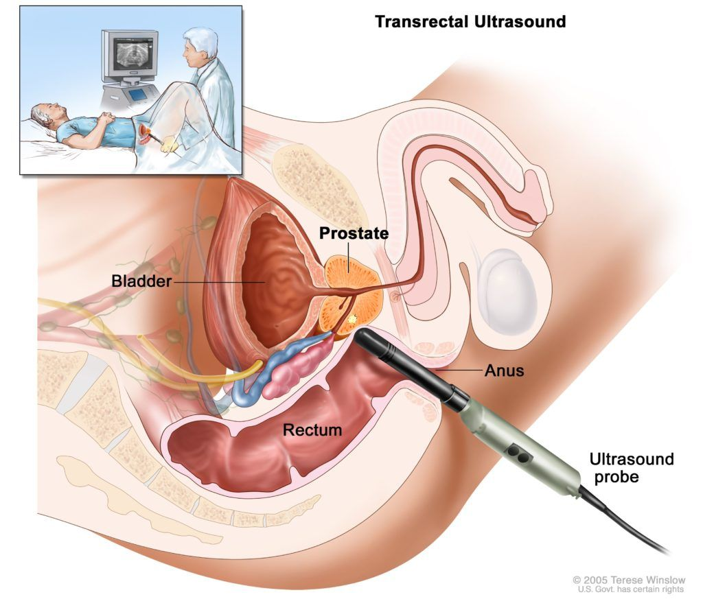
Transrectal US
prostate, seminal vesicles, ejaculatory ducts
Suggestive findings: SV dilation >1.5 cm, ED dilation >2.3 mm, cysts/calcifications , Those findings give high suggestion of obstruction
Indicated in low ejaculate volume (<1.5 mL) if not explained by previous evaluation (inadequate sampling of semen , retrograde evaluation and absence of vas deference

Slide 59
SURGICAL TREATMENTS

Slide 60
Varicocele – Treatment Approaches
Goal: Stop retrograde venous flow in the internal spermatic veins
Modalities:
  Open/Microsurgical ligation (inguinal or subinguinal)
  Laparoscopic ligation
  Percutaneous embolization

Slide 61
Varicocele – Outcomes & Complications
Efficacy: improvement in semen quality and fertility outcomes
Complications:
  Open/microsurgical: ~1%
  Laparoscopic: ~4%
  Radiologic occlusion: 10–15%
    Main issue = technical failure (difficulty accessing/occluding spermatic vein)

Slide 62
Vasectomy Reversal
>500,000 vasectomies/year (U.S.); ~6% request reversal
Indications: remarriage, child loss
Techniques: vasovasostomy (single or double-layer), vasoepididymostomy
Success depends on interval, obstruction site, surgeon expertise

Slide 63
Microsurgical Reconstruction in Obstructive Azoospermia
1. Vasovasostomy (VV)
Definition: Surgical reconnection of the severed vas deferens.
Indication:
– Post-vasectomy obstruction
– Traumatic/iatrogenic vasal obstruction
2. Vasoepididymostomy (VE)
Definition: Anastomosis between vas deferens and epididymal tubule.
Indication:
– Epididymal obstruction (e.g., post-infective, congenital, post-surgical).
Done by Bypasses epididymal blockage, connecting vas to single epididymal tubule.

Slide 64
Sperm Retrieval Techniques
Epididymal aspiration:
MESA (microsurgical) – targeted, closed with suture
PESA (percutaneous) – risk of tubule injury

Slide 65
Sperm Retrieval Techniques
Testicular retrieval:
TESA (needle)
Indications: spermatogenesis is known or suspected to be normal
TESE (biopsy fragment), Micro-TESE (microscope-assisted)
Indications: unreconstructable blockage in the epididymis, or in cases of severe testis failure

Slide 66
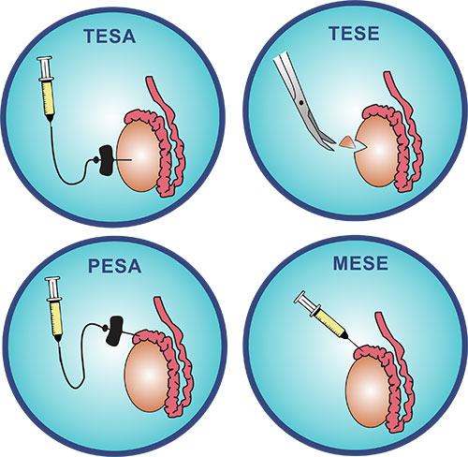

Slide 67
Cryptorchidism & Orchidopexy
Undescended testis: 0.8% boys at 1 year
Associated with infertility and increase the risk of germ cell tumors
Early orchidopexy (<2 years) improves spermatogenesis potential

Slide 68
Case study

Slide 69
Case study
Patient: 32-year-old male, married for 2 years, presenting with inability to conceive despite regular unprotected intercourse.
Partner: 28-year-old, normal gynecologic evaluation and regular cycles.
History:
No history of orchitis, trauma, or surgery.
No erectile or ejaculatory dysfunction.
No chronic medical illness or medication use.
Non-smoker, moderate alcohol use.
Physical Examination:
Normal virilization.
Testes small (10 mL bilaterally), firm consistency.
No palpable varicocele.
Vas deferens palpable bilaterally.

Slide 70
What are the possible causes of male infertility in this patient?
What initial investigations would you request?

Slide 71
Investigations and Findings
Initial Diagnostic Work-Up
Semen Analysis (2 samples):
  Volume: 2.5 mL
  Concentration: 0 sperm/mL (Azoospermia)
  pH: 7.6
Hormonal Profile:
  FSH: ↑
  LH: ↑
  Testosterone: ↓ 7 nmol/L
  Prolactin: normal
Karyotype: 47,XXY
Scrotal Ultrasound: small testes with homogenous echotexture; no varicocele.

Slide 72
What is the most likely diagnosis?
How does the hormonal profile support your diagnosis?
→ Klinefelter Syndrome (Primary Testicular Failure – non-obstructive azoospermia).

Slide 73
Management :
Goals:
Assess fertility potential
Manage hypogonadism
Genetic counseling
Options:
Hormonal therapy (Testosterone replacement) – for symptoms, not fertility.
Assisted Reproductive Techniques (ART):
  Micro-TESE (testicular sperm extraction) with ICSI → may retrieve sperm in 50–60% of cases.
Sperm cryopreservation if sperm retrieved.
Genetic counseling: risk of chromosomal abnormalities in offspring.
Psychological and sexual counseling

Slide 74
Case Study
Patient: 35-year-old male, married for 4 years, presenting with primary infertility.
Partner: Normal gynecologic assessment.
History:
- Normal puberty and sexual function.
- No prior orchitis or testicular trauma.
- Past bilateral inguinal hernia repair at age 10.
No history of chronic illness or medications.
Physical Examination:
- Normal secondary sexual characteristics.
- Testicular volume: 20 mL bilaterally (normal, firm).
- Vas deferens not palpable bilaterally.
- Epididymidis normal.
- No varicocele.

Slide 75
→ What could explain azoospermia with normal testicular size and absent vas deferens?
→ Which investigations would confirm your suspicion?

Slide 76
Semen Analysis (×2):
- Volume: 0.9 mL (low)
- pH: 7.8
- Azoospermia confirmed
- Fructose test: Negative
Hormonal Profile:
- FSH: (normal)
- LH: (normal)
- Testosterone: (normal)
Scrotal Ultrasound: Normal testicular parenchyma
TRUS: Dilated seminal vesicles and ejaculatory ducts
Genetic test: CFTR gene mutation detected

Slide 77
→ What is the likely diagnosis?
→ Which findings help distinguish this from non-obstructive azoospermia?

Slide 78
Management aim : Achieve conception using available sperm and correct any surgically reversible obstruction.
Options:
- Genetic counseling – mandatory (CFTR mutation implications).
- Surgical correction (if acquired obstruction): Vasovasostomy or Vasoepididymostomy.
- Sperm retrieval for ART: PESA/MESA (epididymal) or TESA/TESE (testicular).
- ART: ICSI using retrieved sperm
- Partner genetic screening for CFTR mutations before ART.

