Slide 1
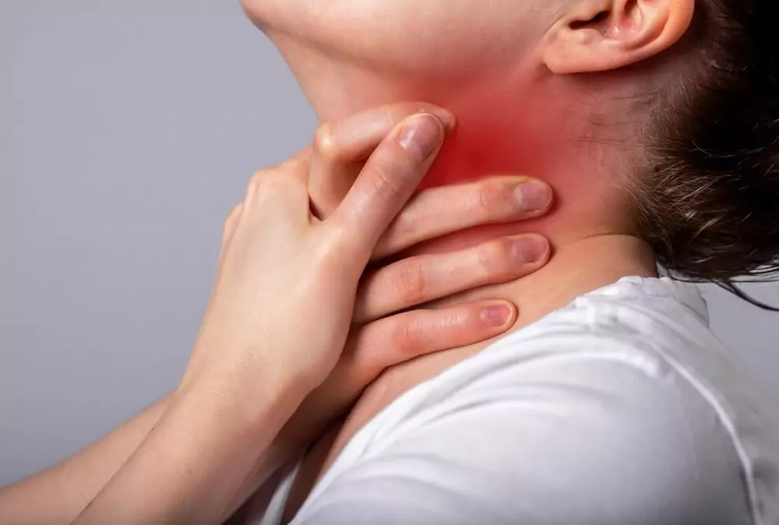
Breathless Clues
The Forensics
of Violent Asphyxia
Make sure to check the notes!!

Slide 2
Circumstances Surrounding Death
  Cause
  Manner
  Mechanism
  Mode
Notes:
Basic revision before we start:
Cause: the disease or injury that causes death
Manner: natural vs unnatural (suicide, accidental, homicide)
Mechanism: the physiological derangement that causes death (e.g., “exsanguination” due to an axe wound)
Mode: the abnormal physiological state in an individual at the time of death (eg, asphyxia)

Slide 3
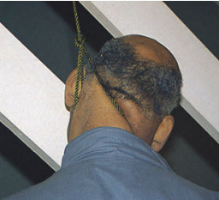
A 45-year-old man was found deceased in his living room, suspended from a ceiling beam using a rope.
A suicide note was present.
Autopsy showed an oblique ligature mark below the thyroid, conjunctival petechiae, and neck muscle hemorrhage.
Notes:
Cause: Hanging Ligature strangulation
Manner: Suicide
Mechanism: Cerebral Hypoxia due to neck compression, vascular compromise...
Mode: Asphyxia

Slide 4
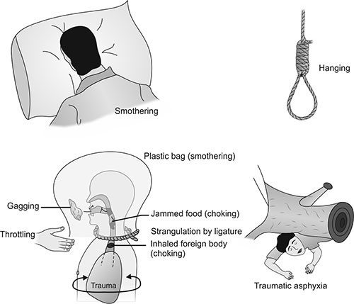
Notes:
In all of these cases, asphyxia is the MODE of death!

Slide 5
Asphyxia: Etymology Vs Convention
Etymologically:
Asphyxia means "absence of pulsation."
  (from Greek a- = "without" + sphyxis = "pulse")
Conventionally:
Asphyxia means "lack of oxygen."
  Broadly referring to any process that impairs oxygen delivery to tissues.
Notes:
It is a generic term that indicates a condition resulting from an interference with respiration due to the lack of oxygen in the air or the blood, a failure of cells to utilize oxygen, or a failure of the body to eliminate carbon dioxide
- Body does not receive or utilize an adequate amount of oxygen
- Impairment of oxygen and carbon dioxide exchange
- Loss of consciousness and death result from progressive hypoxia/anoxia

Slide 6
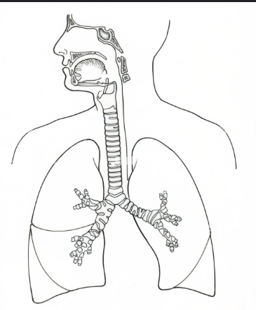
‘Level’ of Asphyxia
  external atmosphere
  external obstruction
  internal obstruction
  thoracic restriction
  lung pathology
  cardiac dysfunction
  O2 use inability
Notes:
The usual relevance of asphyxia in a forensic context is in mechanical asphyxia, rather than some of the internal conditions mentioned above, which are more likely to arise as a result of natural disease or toxic conditions. (So only the first 4 points)

Slide 7
Classification of asphyxia
  Mechanical
    Strangulation
    Hanging
    Choking
    Smothering
  Non-Mechanical
    CO/ CN poisoning
  Misc.
    Drowning
Notes:
This is the most relevant classification of asphyxia. As in the second part of the lecure, we will be discussing mechanical causes only.

Slide 8
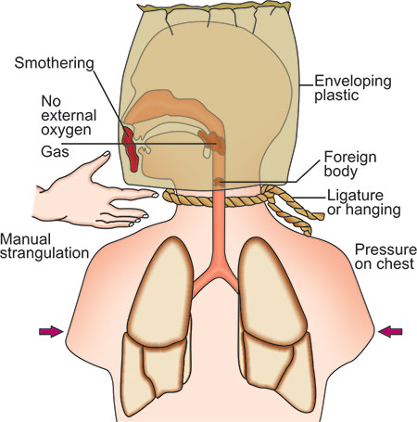
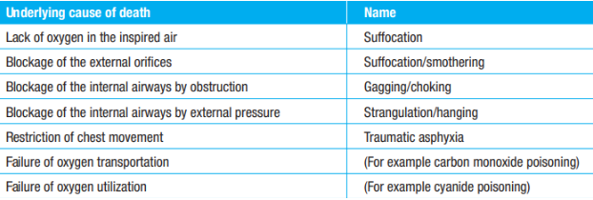
Basic Terminology

Slide 9
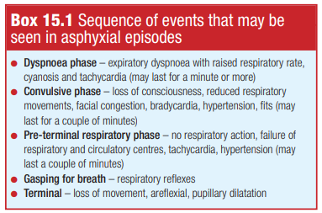
Pathophysiology of Asphyxia
Phases and signs of
Asphyxia
Impairment of 3 components; single or combined
  Respiratory
    obstruction of the airways or impairment of respiration.
  Vascular
    compression of the neck vessels.
  Nervous:
    compression/stimulation of specific reflex areas of the neck
Notes:
These components will vary between hanging and suffocation, for example.
The box shoes asphyxia phases in the living person, not important.

Slide 10
‘CLASSIC’ SIGNS OF ASPHYXIA
  Petechial hemorrhages
  Congestion and edema
  Cyanosis
  ‘Right heart congestion and abnormal fluidity of the blood’
**Nonspecific, may support the diagnosis in the context of a thorough medicolegal investigation.
Notes:
- The last one is considered forensic mythology

Slide 11
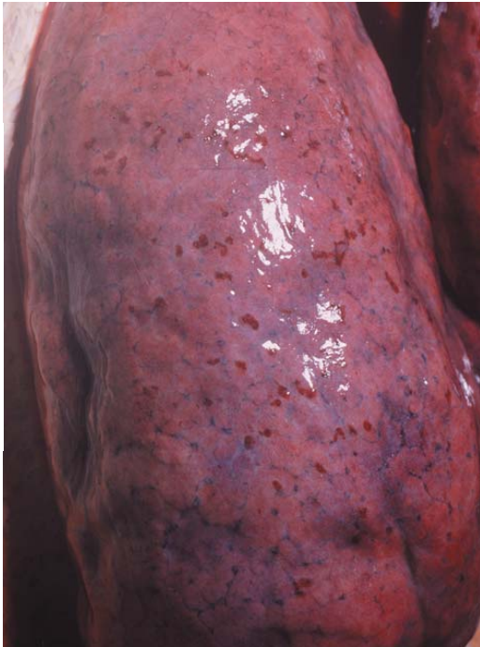
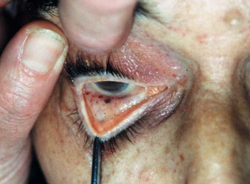
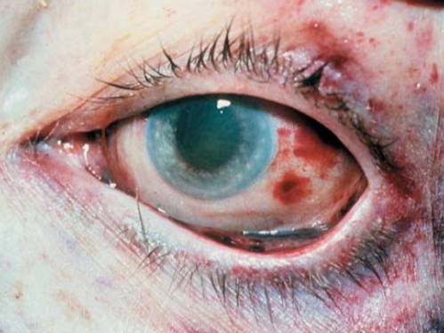
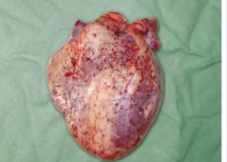
Petechial Hemorrhages
Notes:
Small pin-point collections of blood lying in the skin, the sclera or conjunctivae, and under thoracic serous membranes such as the pleura or pericardium
These are caused by an acute rise in venous pressure that in turn causes overdistension and rupture of thin-walled peripheral venules, especially in lax tissues, such as the eyelid, and in unsupported serous membranes, such as the pleura and epicardium.
Found most often in the face and eyes of victims of compression of the neck or fixation of the chest.
THE MORE petechial hemorrhages present, THE MORE FORCE USED.

Slide 12
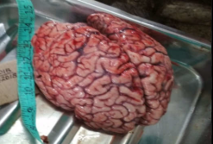
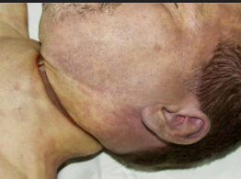
Congestion and Edema
Notes:
Congestion is often associated with tissue swelling if the
venous obstruction continues.
The oedema is the result of
rapid transudation through capillary and venule walls, again mainly a function of back pressure in the venous system.
Tissue fluid also escapes rapidly into the brain in strangulation that continues for even a few minutes, though here, the well-known effect of hypoxia might be an added factor.
Pulmonary oedema, causing excess fluid to enter the alveoli, is often found in hypoxic deaths.

Slide 13
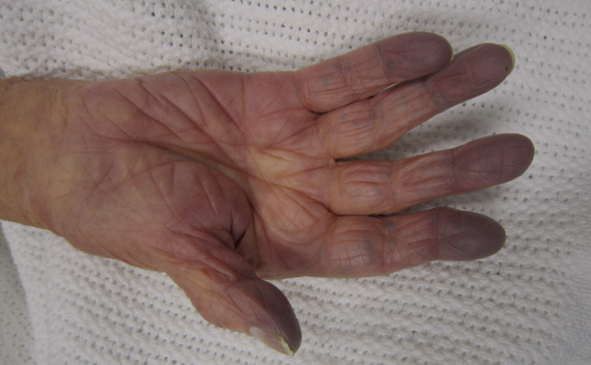
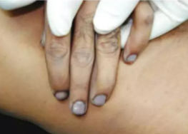
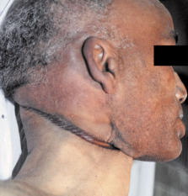
Cyanosis
  Depends on the absolute amount of reduced hemoglobin in the arterial blood.
  In neck compression: on the face as a result of jugular veins obstruction, which prevents adequate venous return from the cerebral circulation.
Notes:
In the common forensic event of constriction of the
neck, cyanosis almost invariably follows congestion of the
face, as venous blood containing much reduced haemoglobin after perfusing the head and neck is dammed back and
becomes more blue as the blood accumulates.
If and when
the airway becomes blocked, then impaired oxygenation in
the lungs leads to a diminution in the oxygen content of
arterial blood. This will lead to a darkening of all organs
and tissues, and will accentuate the cyanosis of the face
Descriptions of an abnormal fluidity of the blood seen at
autopsy in asphyxial deaths are part of forensic mythology

Slide 14
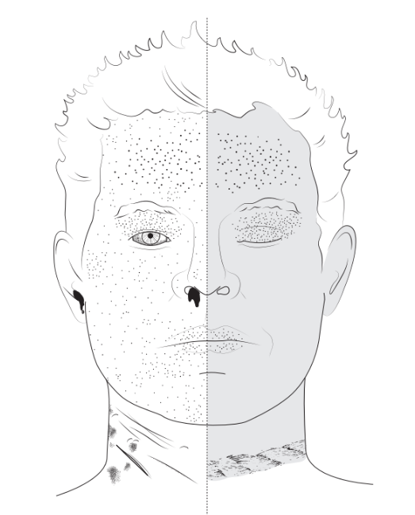
Notes:
Repeat overview, with some more specific local signs such as imprint abrasion in ligature strangulation to the right, vs scratch marks and six penny signs in manual strangulation to the left.

Slide 15
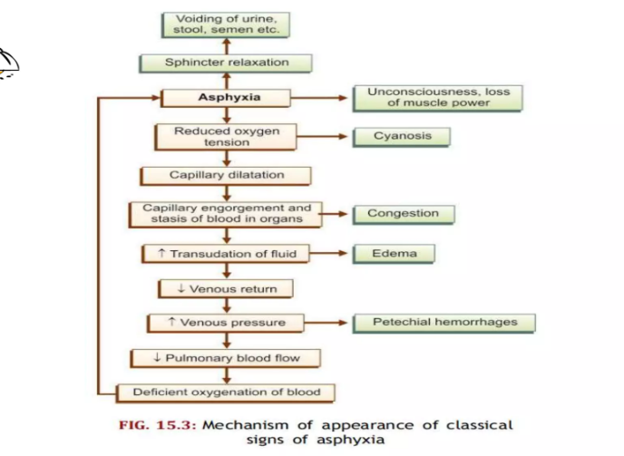
Notes:
Overview of mechanisms

Slide 16
A 45-year-old man was found deceased in his living room, suspended from a ceiling beam using a rope.
A suicide note was present.
Autopsy showed an oblique ligature mark below the thyroid, conjunctival petechiae, and neck muscle hemorrhage.
Notes:
Revisiting this case to use it for a Mini-OSCE style question.

Slide 17
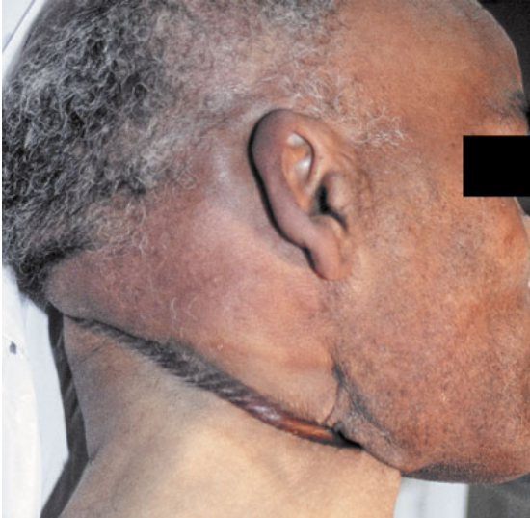
  What are these deep furrowed marks called?
  What is the mode of death?
  Name 2 classical changes associated with this case?
Notes:
ANS: Imprint or pressure abrasion, asphyxia, petechial hemorrhage, cyanosis, and congestion.

