Slide 1
Labor & Intrapartum Maternal Monitoring
Dr Amal Barakat
5th Year Medical Students
Jordan University
July/2025

Slide 2
OBJECTIVES
1. Revise the anatomy of female pelvis
2. Identify different types of female pelvic cavity
3. Define True Labor & False Labor
4. Identify mechanism of labor in first and second stage of labor
5. Define the four stages of labor
6. Describe the management of each stage of labor
7. Describe the methods used to assess the progress of labor
8. Discuss the available methods for Augmentation & Induction of labor and their complications.
9. Describe the active management of the third stage of labor
10. Interpret labor partogram

Slide 3

The start of the journey

Slide 4
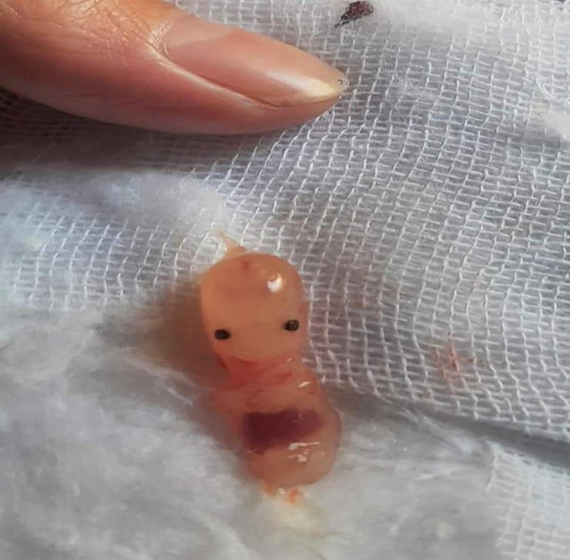
﴿وَلَقَدْ خَلَقْنَا الْإِنْسَانَ مِنْ سُلَالَةٍ مِنْ طِينٍ (12) ثُمَّ جَعَلْنَاهُ نُطْفَةً فِي قَرَارٍ مَكِينٍ (13) ثُمَّ خَلَقْنَا النُّطْفَةَ عَلَقَةً فَخَلَقْنَا الْعَلَقَةَ مُضْغَةً فَخَلَقْنَا الْمُضْغَةَ عِظَاماً فَكَسَوْنَا الْعِظَامَ لَحْماً ثُمَّ أَنْشَأْنَاهُ خَلْقاً آخَرَ فَتَبَارَكَ اللَّهُ أَحْسَنُ الْخَالِقِينَ (14)﴾

Slide 5
Labor
True Labor pain is defined as regular, rhythmic, progressive and painful uterine contractions that cause progressive dilation and effacement (thinning and shortening) of the cervix and subsequent expulsion of the fetus, and are not relieved by rest, hydration, or pain medications.

Slide 6
Braxton-Hicks contractions (False labor pain)
Braxton Hicks contractions are irregular in duration and intensity, occur infrequently, are unpredictable and non-rhythmic, and are more uncomfortable than painful.
Unlike true labor contractions, Braxton Hicks contractions do not increase in frequency, duration, or intensity.
Women often mistake Braxton Hicks contractions for true labor. They often seek care and undergo unnecessary evaluation for these contractions.
There is no medical treatment for Braxton Hicks contractions.
Changing position or activity level, take a warm bath, get a massage, read a book, listen to music, or take a nap & drinking water to rehydrate may help.

Slide 7
Stages of Labor
The First stage of Labor
1- Latent
2-Active (Established)
The Second stage of labor
The Third stage of labor
The Fourth stage of labor

Slide 8
Anatomy of the female pelvis
The Female Bony Pelvis
The Pelvic inlet(The Brim)
The Midpelvis (The Midcavity)
The Pelvic outlet
The Pelvic Floor
The Perineum

Slide 9
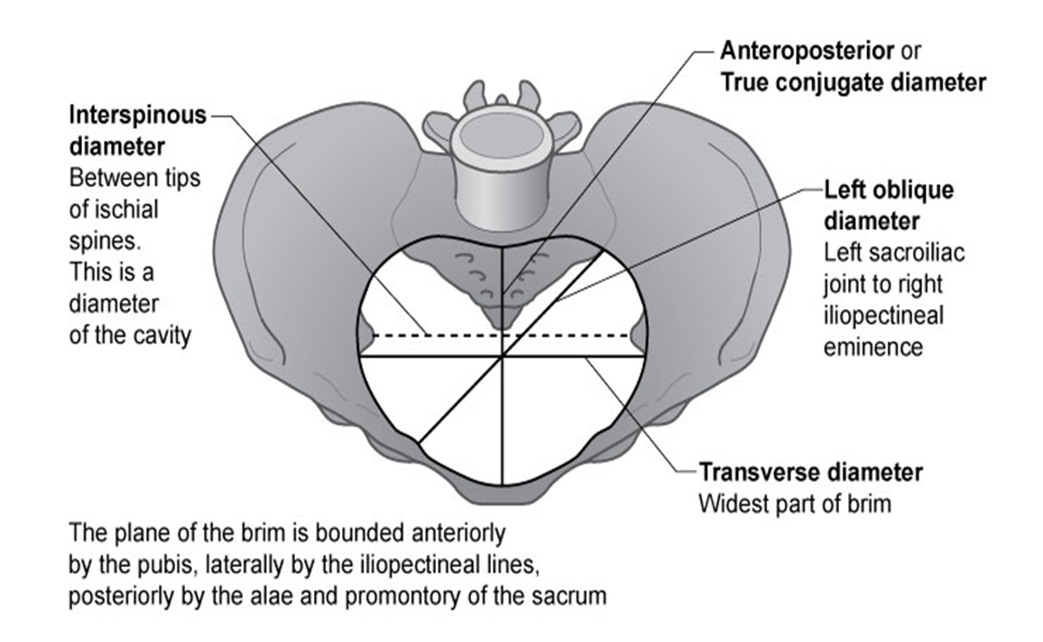
The Female Bony Pelvis

Slide 10
Shapes of the pelvis
The gynaecoid pelvis is the most common shape & most favorable for labor.
The android pelvis is said to predispose to failure of rotation and deep transverse arrest.
The anthropoid shape encourages an occipito-posterior (OP) position.
The platypelloid pelvis is also associated with an increased risk of obstructed labor due to failure of the head to engage, rotate or descend.

Slide 11
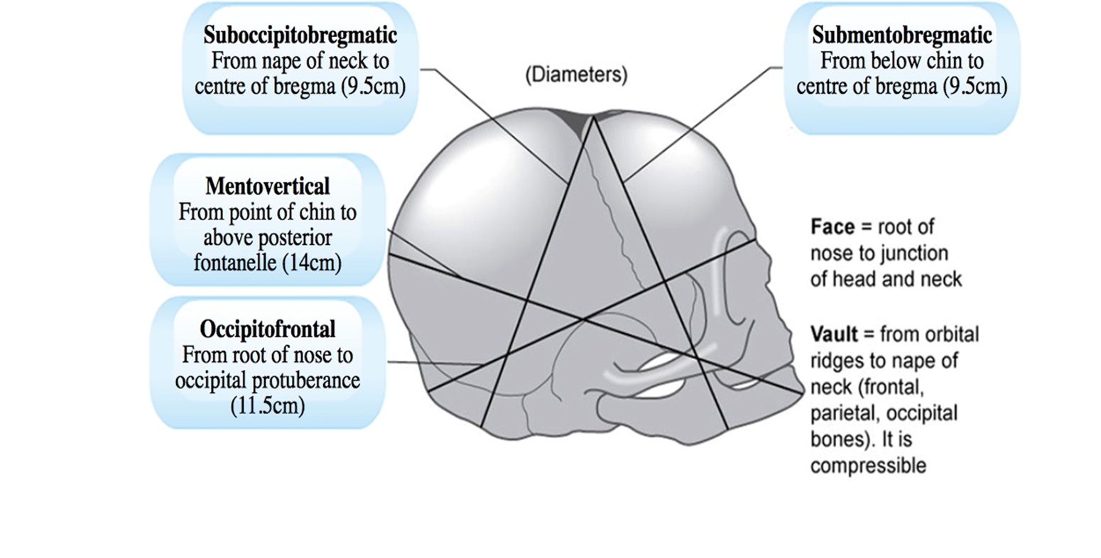
Anatomy of the fetal skulls

Slide 12
Normal labor
The fetal head enters the pelvic inlet in a transverse position, rotates in the midpelvis and delivers in an AP position (OA, OP)
The transverse is the widest diameter at the inlet, but at the outlet it is the AP diameter, and the fetal head must rotate from a transverse to an AP position as it passes through the pelvis.
Typically, this happens in the midpelvis where the transverse and AP diameters are similar.

Slide 13
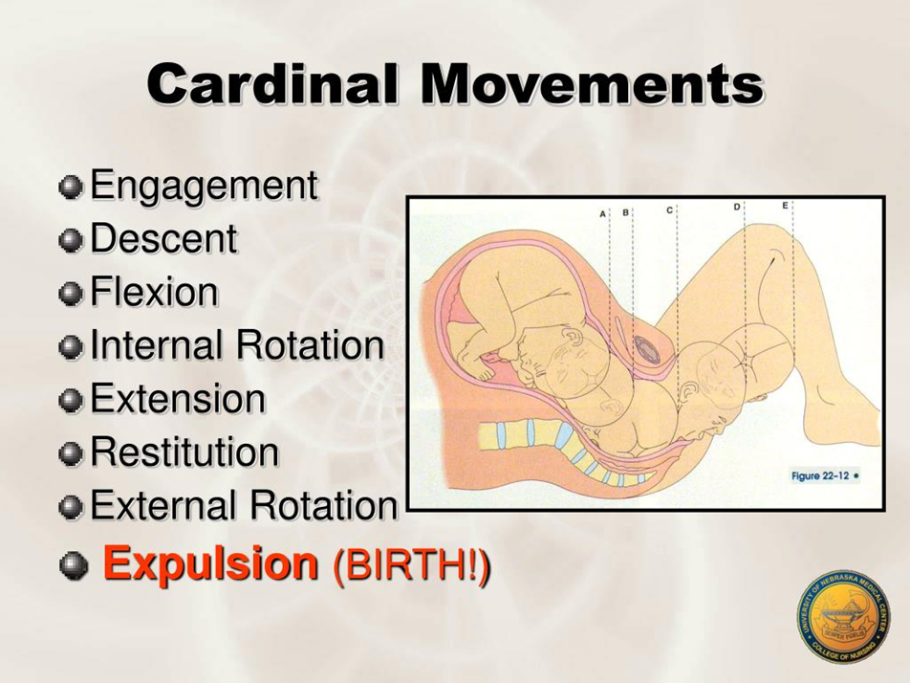
Cardinal Movements
The cardinal movements that occur during the mechanism of labor describe the movement of the fetus through the birth canal

Slide 14
Engagement
Engagement is said to have occurred when the widest part of the presenting part has passed successfully through the inlet.
Engagement has occurred in the vast majority of nulliparous women prior to labor, usually by 37 weeks’ gestation, but not so for the majority of multiparous women.

Slide 15
Engagement
The number of fifths of the fetal head palpable abdominally is used to describe whether engagement has taken place.
If more than two-fifths of the fetal head is palpable abdominally, the head is not yet engaged.
2/5 up Engaged

Slide 16
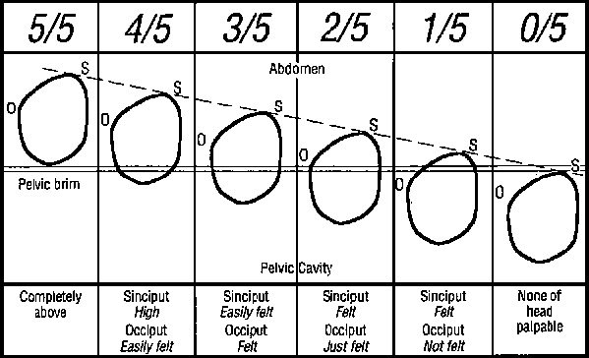
Rule of 5

Slide 17
Engagement
“0 Station” is an important landmark for engagement, when the presenting part at the level of the ischial spine.

Slide 18
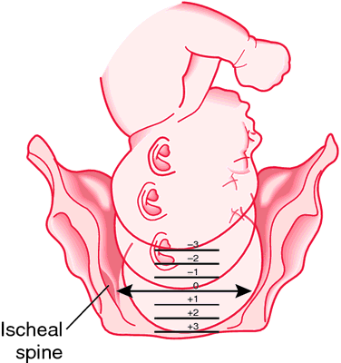
Engagement/ 0 Station

Slide 19
The ischial spines
The ischial spines are palpable vaginally and are used as important landmarks for two purposes:
1- To assess the descent of the presenting part on vaginal examination (e.g. station zero is at the level of the ischial spines, −1 is 1 cm above the spines and +1 is 1 cm below the spines).
2- To provide a local anesthetic pudendal nerve block.
The pudendal nerve passes behind and below the ischial spine on each side.

Slide 20
Fetal Lie
Fetal lie refers to the relationship between the longitudinal axis of the baby with respect to the longitudinal axis of the mother.
Longitudinal lie
Transverse lie
Oblique lie

Slide 21
Fetal Presentation
Presentation: that part of the fetus entering the pelvis first, e.g. vertex of head, face, brow, breech, shoulder or compound (hand & vertex).

Slide 22
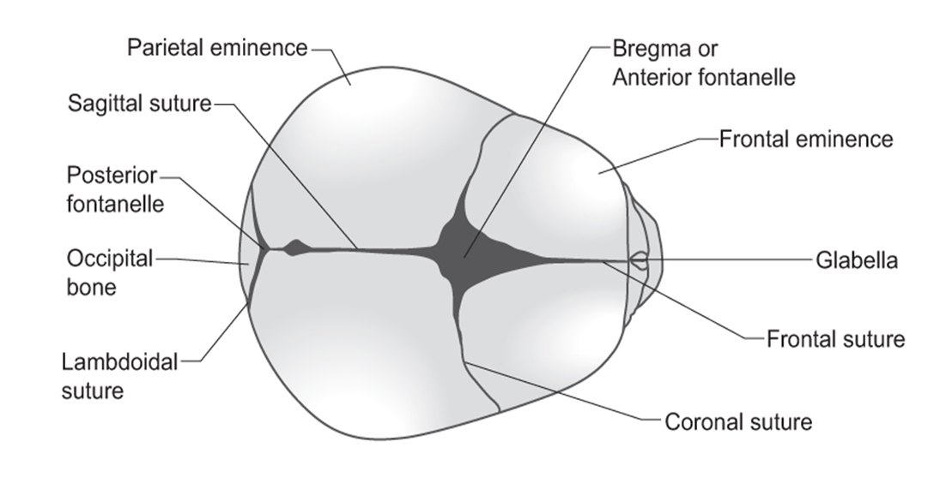
The vertex

Slide 23
Vertex
The vertex is the area bounded by the anterior (Bregma) and posterior fontanelle and the parietal eminence.
In normal labor the vertex of the fetal head is the presenting part and the posterior fontanelle (indicating the occiput) is used to define the position of the fetal head in relation to the pubic symphysis (OA,OT,OP)

Slide 24
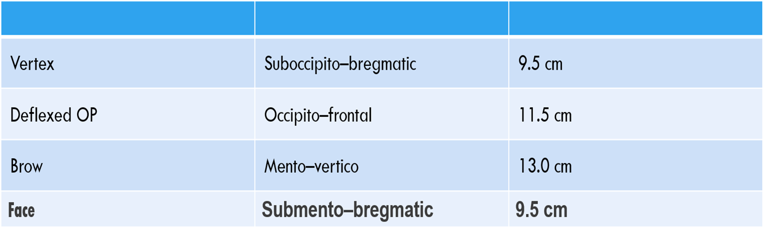
Summary of Presenting diameters

Slide 25
Fetal Position
Position: orientation of the presenting part in relation to the maternal symphysis pubis, e.g. occipito-anterior, occipito-posterior, occipito-transverse.

Slide 26
Position
The occipito-anterior (OA) position is the most favorable for a spontaneous vaginal birth.
The occipito-transverse (OT) position or occipito-posterior (OP) position is a malposition and may result in prolonged labor, instrumental delivery or caesarean section.

Slide 27
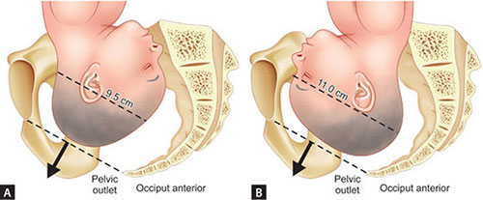
The Occiput Anterior position is ideal for normal delivery: smallest presenting diameter

Slide 28
Molding
The parietal bones usually slide over the frontal and occipital bones. Furthermore, the bones themselves are compressible.
These characteristics of the fetal skull allow a process called ‘molding’ to occur, which reduces the diameters of the fetal head and encourages progress through the bony pelvis, while still protecting the underlying brain.
Severe molding, or molding early in labor, can be a sign of obstructed labor due to a fetal malposition (failure of the head to rotate) or cephalopelvic disproportion (a mismatch between the size of the fetal head and maternal pelvis).

Slide 29
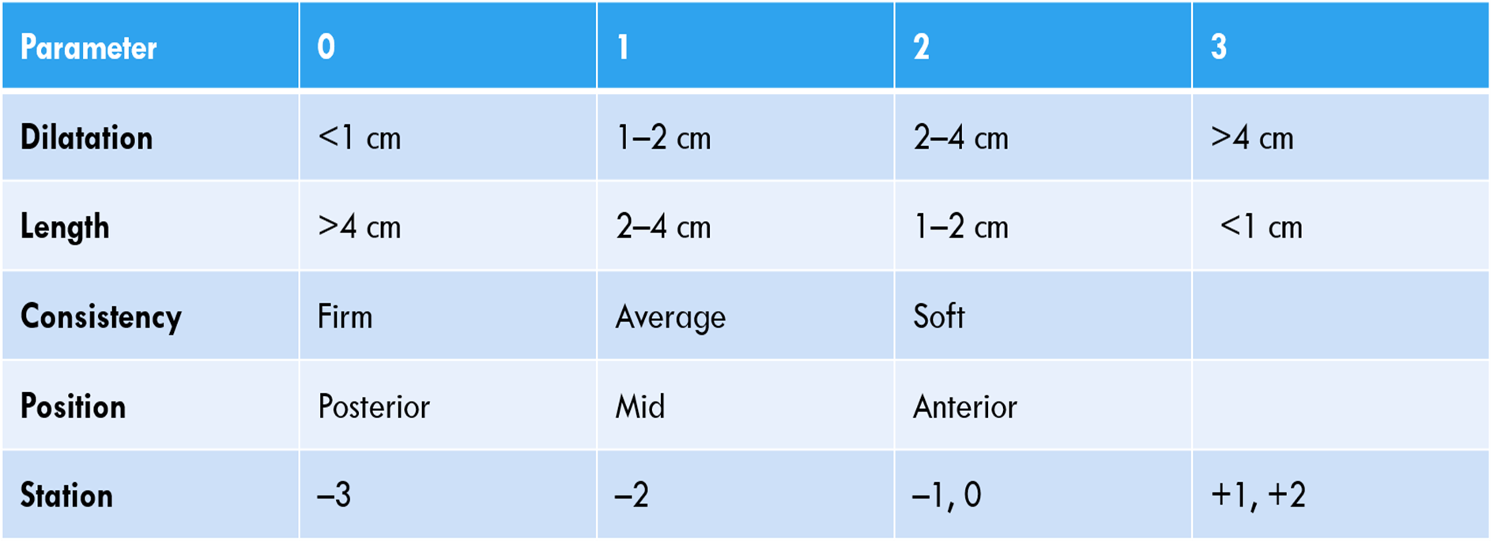
Original Bishop score
To assess cervical condition

Slide 30
Simplified Bishop Score
The most common modification to the Bishop score is a simplified scoring system that just takes into account dilation, effacement, and station (each scored 0 to 3 points).
Range (0-9)
In this shortened modification, a score of more than 5 is considered favorable

Slide 31
Factors possibly linked to controlling cervical ripening including
prostaglandins
Estrogens
Progesterone and antiprogesterones
Relaxin
Inflammatory mediators
Nitric oxide
Apoptosis

Slide 32
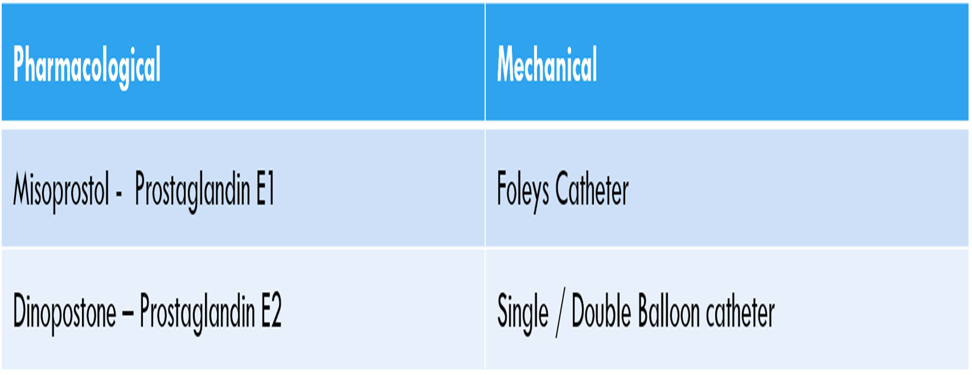
Methods commonly employed to encourage cervical ripening in clinical practice

Slide 33
The First stage of Labor
The first stage of labor is divided into two phases:
The Latent phase
The active phase
This describes the time from the diagnosis of labor to full dilatation of the cervix (10 cm).

Slide 34
The Latent Phase of 1st Stage of Labor
Latent first stage of labor is the presence of irregular contractions which become progressively coordinated, discomfort is minimal, and the cervix effaces and dilates to 4 cm.
The latent phase is difficult to time precisely, and duration varies, averaging 8 hours in nulliparas and 5 hours in multiparas.
Duration is considered abnormal if it lasts > 20 hours in nulliparas or > 14 hours in multiparas

Slide 35
Management of ladies in their latent phase of the first stage of labor
Women who are in the latent phase of labor should be encouraged to mobilize and should be managed away from the labor suite where possible.
Intervention during this phase is best avoided unless there are identified risk factors.
Simple analgesics are preferred
There is no reason to restrict eating and drinking, although lighter foods and clear fluids may be better tolerated.
Encouragement and reassurance are extremely important.

Slide 36
The active phase of 1st Stage of Labor
A woman is considered to be in active or established labor when there is regular contractions and progressive dilation beyond 4 cm (RCOG), 5 cm (WHO), 6 cm (ACOG)
Cervical dilatation during the active phase occurs typically at 1 cm/hour or more in a normal labor, but is only considered abnormal if it occurs at less than 1 cm in 2 hour.
The active phase pf labor is variable in length, usually lasting between 2 and 8 hours, shorter in multiparous women.

Slide 37
Management of Ladies in their active phase of the first stage of labor
One-to-one midwifery care should be provided.
Additional emotional support from a birth partner should be encouraged.
Obstetric and anesthetic care should be available as required.
Maternal and fetal wellbeing should be monitored.
Vaginal examinations are performed 4 hourly or as clinically indicated.
Progress of labor is monitored using a partogram with timely intervention if abnormal.
Appropriate pain relief should be provided consistent with the woman’s wishes.
Ensure adequate hydration and light diet to prevent ketosis

Slide 38
Methods of Augmentation & Induction of Labor
Artificial Rupture of Membranes (Amniotomy)
Oxytocin
Prostaglandins
Intracervical Ballon or Foley

Slide 39
Rupture of the fetal membranes
Rupture of the fetal membranes is a vital part of normal labor.
During spontaneous labor at term, the membranes remain intact until after the onset of labor in 90% of women.
In only 10% of women do they rupture prior to the onset of labour (prelabour or premature rupture of the membranes, PROM).
If managed conservatively, 70% of mothers will establish in labor spontaneously within 24 hours, and 90% will establish by 48 hours.
As the interval between rupture of the fetal membranes at term and birth increases, so may the risk of fetal and maternal infection

Slide 40
Artificial Rupture of Membranes
(Amniotomy)
Done in the active phase of the first stage of labor.
Benefits of Amniotomy:
It is a method of augmentation (Prostaglandin Release, as a result, labor may progress more rapidly)
The status of amniotic fluid is detected (e.g. Meconium-stained liquor)
Amniotomy during this stage may be necessary for specific indications, such as facilitating internal fetal monitoring & fetal scalp PH Blood Sampling (FBS) to confirm fetal well-being.
Contraindications of Amniotomy
Amniotomy should be avoided in women with HIV infection or hepatitis B or C, so that the fetus not exposed to these organism.
Floating head with or without out polyhydramnios (???)

Slide 41
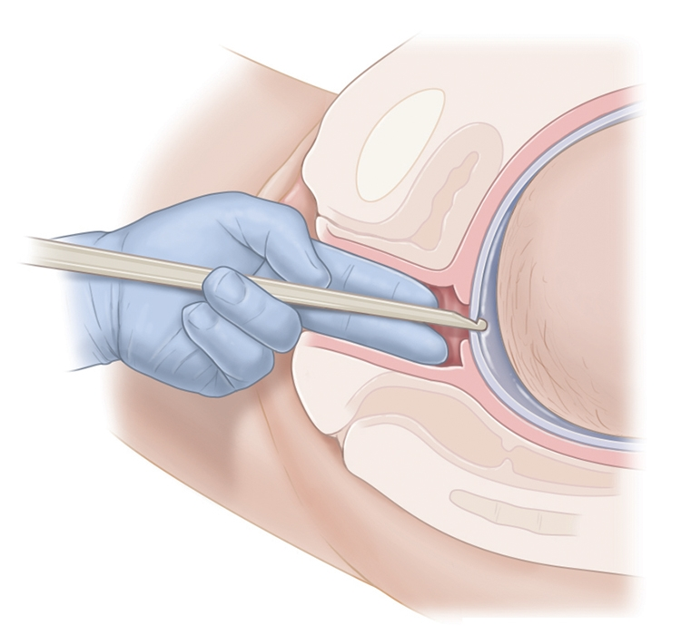
Artificial Rupture of Membranes
(Amniotomy)

Slide 42
Oxytocin
Oxytocin (Oxt or OT) is a neuropeptide hormone normally produced in the hypothalamus and released by the posterior pituitary
Oxytocin is a natural hormone that stimulates uterine contractions in childbirth and lactation after childbirth. It also affects aspects of human behavior and the male and female reproductive systems.
In the mid-1950s, synthetic oxytocin was successfully synthesized by a biochemist named Vincent du Vigneaud; he was later recognized with a Nobel prize for his work.

Slide 43
Oxytocin
Uses:
Augmentation of labor
Management of post partum hemorrhage
Side Effects: nausea, vomiting, hypotension, hyponatremia, water retention & overstimulation of the uterus.
Augmentation of labor with an oxytocin infusion will often correct inefficient uterine contractions and may help correct a fetal malposition.
Augmentation of labor with oxytocin can be dangerous in multiparous, women with a uterine scar, a malpresentation and where there are concerns about fetal wellbeing.

Slide 44
Prostaglandins
Prostaglandins:
Prostaglandin E2 (PGE2) (Brand names: Cervidil, Prepidil)
Prostaglandin E1 (PGE1) (Brand name: Misoprostol (Cytotec))
Side Effects: nausea, vomiting, diarrhea, or fever
Risk: Uterine Hyperstimulation which can lead to fetal distress or uterine rupture in rare case

Slide 45
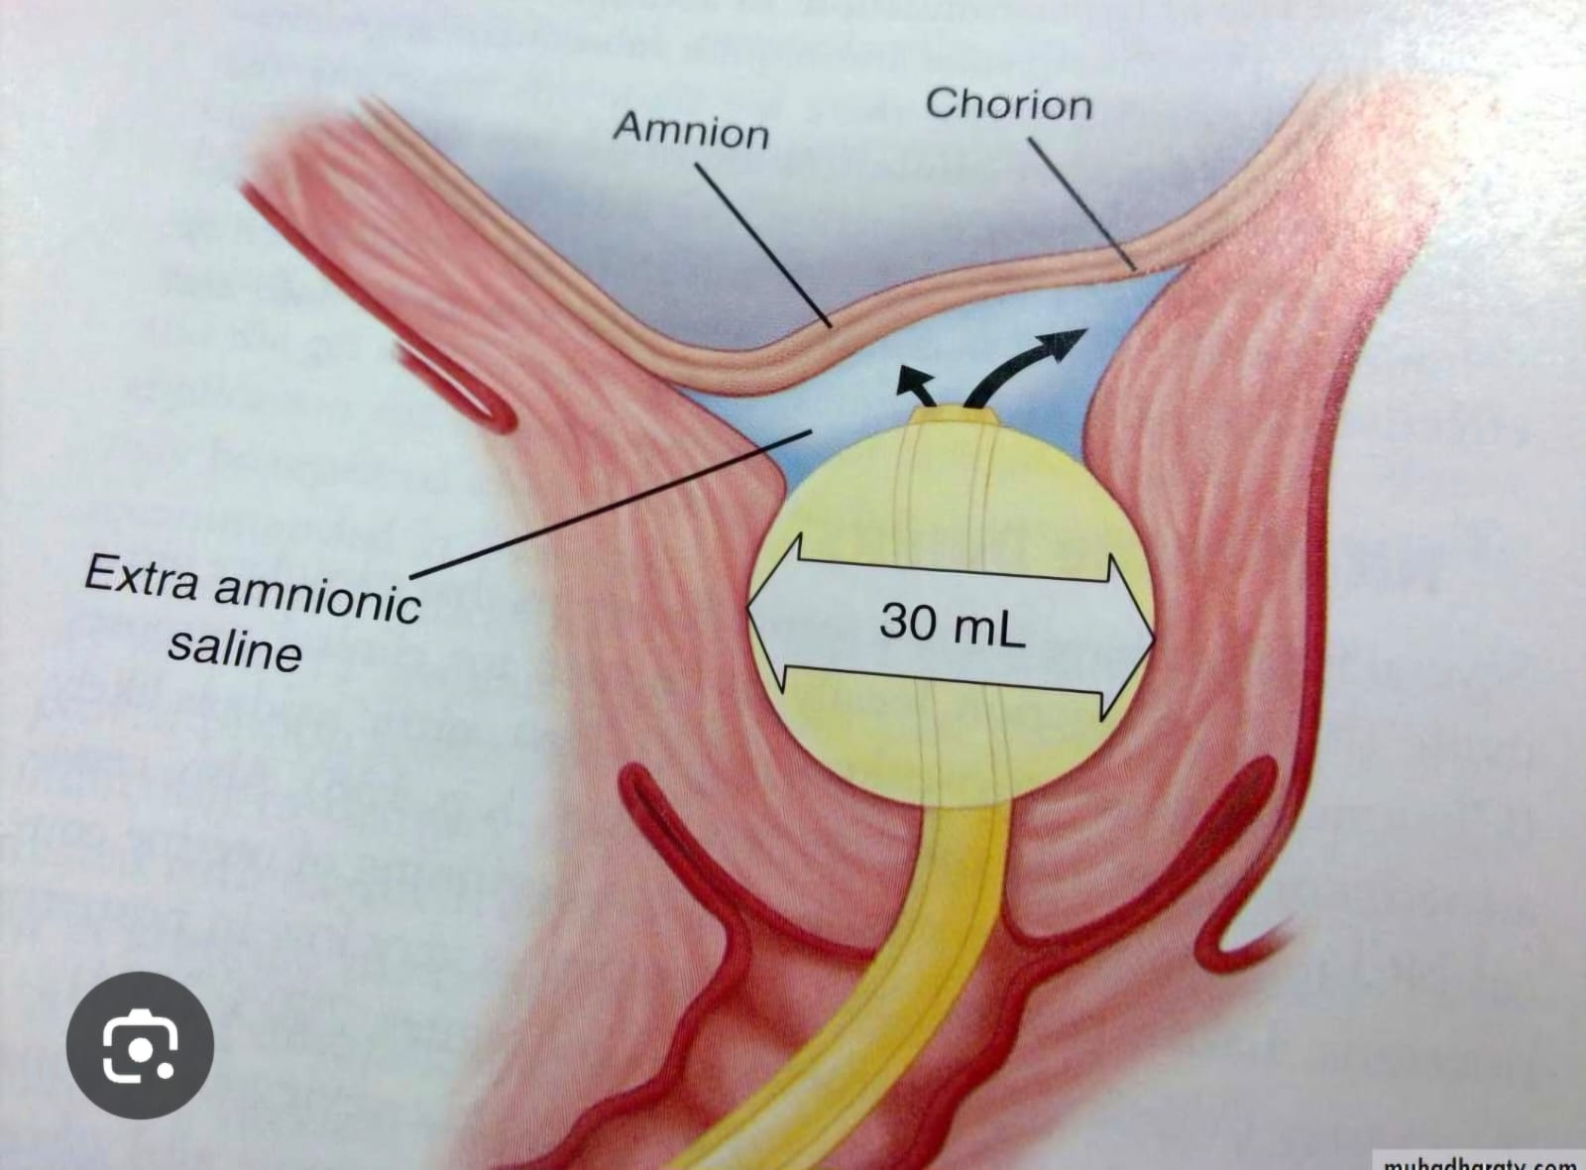
Intracervical Ballon or Foley

Slide 46
Second stage of labor
This describes the time from full dilatation of the cervix (10 cm) to delivery of the fetus or fetuses.

Slide 47
Second stage of labor
Duration of the second stage of labor in PG
2 hrs without epidural anesthesia (RCOG), 3 hrs (ACOG)
3 hrs with epidural anesthesia (RCOG), 4 hrs (ACOG)
Duration of the second stage of labor in multiparous
1 hr without epidural anesthesia (RCOG), 2 hrs (ACOG)
2 hrs with epidural anesthesia (RCOG), 3 hrs (ACOG)

Slide 48
Third Stage of Labor
The third stage is the interval between delivery of the baby and the complete expulsion of the placenta and membranes.
This normally takes between 5 and 10 minutes and is considered prolonged after 30 minutes.
A third stage lasting more than 30 minutes is defined as abnormal.
The risk of postpartum hemorrhage almost doubles by the time the duration of third stage reaches twenty minutes.

Slide 49
Signs of Placental Separation in the Third Stage of Labor
Apparent lengthening of the cord
A small gush of blood from the placental bed
Rising of the uterine fundus to above the umbilicus
Uterine contraction resulting in firm globular feel on palpation

Slide 50
Active management of the third stage
Intramuscular injection of 10 IU oxytocin, given as the anterior shoulder of the baby is delivered, or immediately after delivery of the baby.
Early clamping and cutting of the umbilical cord.
Controlled cord traction.

Slide 51
Methergine (Methylergometrine)
Methergine is a uterotonic medication
Used in prevention and treatment of postpartum hemorrhage due to uterine atony.
Causes sustained uterine contractions (used postpartum only)
Forms of Administration: Oral tab, IM injections, IV (slowly)
Side Effects: Nausea, vomiting, headack, cold extremities, numbness, chest pain, seizures (rare)
Contraindications: Hypertension (Preclampsia), Coronary Artery Disease, Peripheral Vascular Disease & allergy to ergot alkaloids.
Can cause acute hypertension, stroke, or MI.

Slide 52
Modified approach to active management of the third stage
Delayed cord clamping for between 1 and 3 minutes.
This approach allows autotransfusion of placental blood to the neonate while maintaining the benefit of a reduced risk of PPH.
It is of particular importance in preterm birth
WHO Recommendations: Delayed umbilical cord clamping (not earlier than 1 min after birth) is recommended for improved maternal and infant health and nutrition outcomes.

Slide 53
Fourth stage of Labor
The fourth stage of labor is the first two hours after birth, though close monitoring may continue longer in high-risk cases.
Monitoring for:
Vital signs (BP, HR, temp)
Uterine firmness & Vaginal bleeding
Bladder status
Pain level and maternal emotional response
Keeping skin-to-skin contact with the baby as this is best way to help the baby learn to breastfeed and keep them warm and calm.
During this time, the patient may experience:
Tremors and chills
Discomfort from pain, episiotomy, tears, or hemorrhoids
Weakness and dizziness, especially while standing up
Difficulty in urination

Slide 54
Normal birth
The World Health Organization (WHO) defines normal birth as follows:
The birth is spontaneous in onset and low risk at the start of labor and remains so throughout labor and delivery.
The infant is born spontaneously in the vertex position between 37 and 42 weeks of pregnancy.
After birth, mother and infant are in good condition

Slide 55
What are the 3 types of delivery?
Vaginal delivery.
Assisted vaginal delivery (Vacuum or Forceps).
C-section (Cesarean birth)

Slide 56
Admission history to the D/R
Previous births and size of previous babies. Previous caesarean section.
Onset, frequency, duration and perception of strength of the contractions.
Whether membranes have ruptured and, if so, color and amount of amniotic fluid lost.
Presence of abnormal vaginal discharge or bleeding.
Recent activity of the fetus (fetal movement).
Medical or obstetric issues of note (e.g. diabetes, hypertension, fetal growth restriction).
Any special requirements (e.g. an interpreter or particular emotional/psychological needs).
Maternal expectations of labor and delivery?

Slide 57
Assessing progress of labor
Contractions
Cervical dilatation
Cervical effacement
Decent of the head

Slide 58
PARTOGRAM
Partogram is a key tool in detecting an abnormal or prolonged labor.
It should be done for all women who are in labor, either low risk or high-risk groups.
Maternal and fetal monitoring are essential to pick up problems early and thus institute timely intervention.
Documented evidence for medico-legal purpose.
Educational value for all grades of staff.

Slide 59
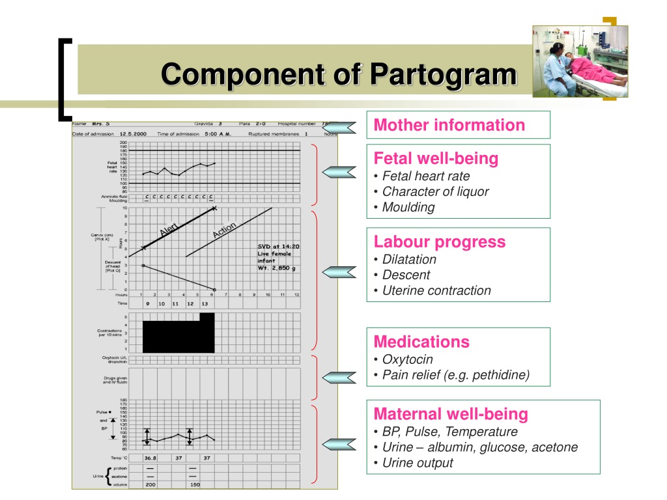
Component of Partogram

Slide 60
Labor Patterns
Normal Labor
Prolonged Latent phase
Primary Dysfunctional Labor
Secondary Arrest

Slide 61
Normal labor progression
Normal labor progression requires consideration of 3 "Ps," representing power, passage, and passenger.
Power refers to uterine contractions and maternal expulsive efforts.
Passage is the maternal pelvis
The passenger is the fetus (size, presentation & position)

Slide 62
Abnormal Labor Indicators
Indication | Nullipara | Multipara
Prolonged latent phase | >20 h | >14 h
Average second stage | 50 min | 20 min
Prolonged second stage without (with) epidural | >2 h (>3 h) | >1 h (>2 h)
Protracted dilation | < 1.2 cm/h | < 1.5 cm/h
Protracted descent | < 1 cm/h | < 2 cm/h

Slide 63
Causes of abnormal labor patterns
(Labor Dystocia)
Inefficient uterine contractions
Cephalopelvic disproportion: (a mismatch between the size of the fetal head and maternal pelvis).
Macrocosmic fetus
Contracted Pelvis
Malpresentation (Mentum or Brow)
Malposition (Asynclitism or extension of the fetal head, occiput posterior or transverse positions)

Slide 64
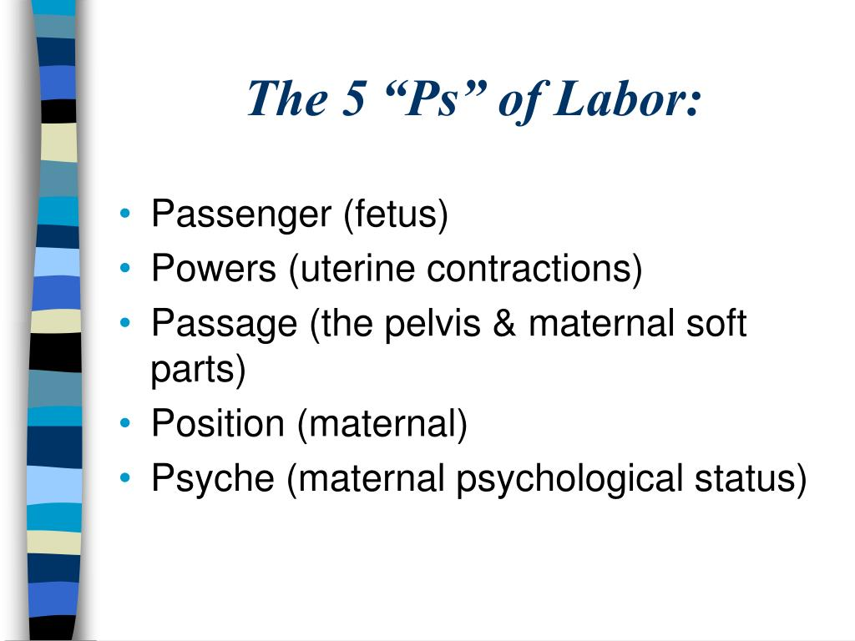
Three or Five “Ps” of Labor

Slide 65
Adverse maternal and fetal outcomes which are associated with labor Dystocia
Roughly 20% of labors are associated with prolongation, protraction, or an arrest abnormality.
Complications of Labor Dystocia:
Infection (maternal & fetal), operative birth, low Apgar score at 5 minutes, prolonged hospitalization for both mother and baby, third- and fourth-degree maternal perineal tears, above-average blood loss, and NICU (neonatal intensive care unit) admissions.
Obstetric fistula (vesicovaginal or rectovaginal) is one of the most distressing late complications of prolonged obstructed labor.

Slide 66
Clinical Signs of Obstructed Labor
The labor has been prolonged
The mother is exhausted and anxious
Signs of dehydration +_ Acidosis
The mother is tachycardiac, tachypneic with low grade fever
The urine is concentrated
The vulva is edematous
The vagina is dry and hot
Cervix: is fully or partially dilated, edematous and hanging
The vertex showed shows excessive molding and large caput
Bandl’s ring may be seen

Slide 67
Bandl's ring
Bandl's ring (also known as pathological retraction ring)
A Bandl ring may be associated with protracted or arrested labor.
A Bandl ring is a constriction between the thicker upper contractile and thinner lower uterine segments.
It is unclear why this constriction develops during parturition, although prolonged labor and labor dystocia have been suggested as possible causes.

Slide 68
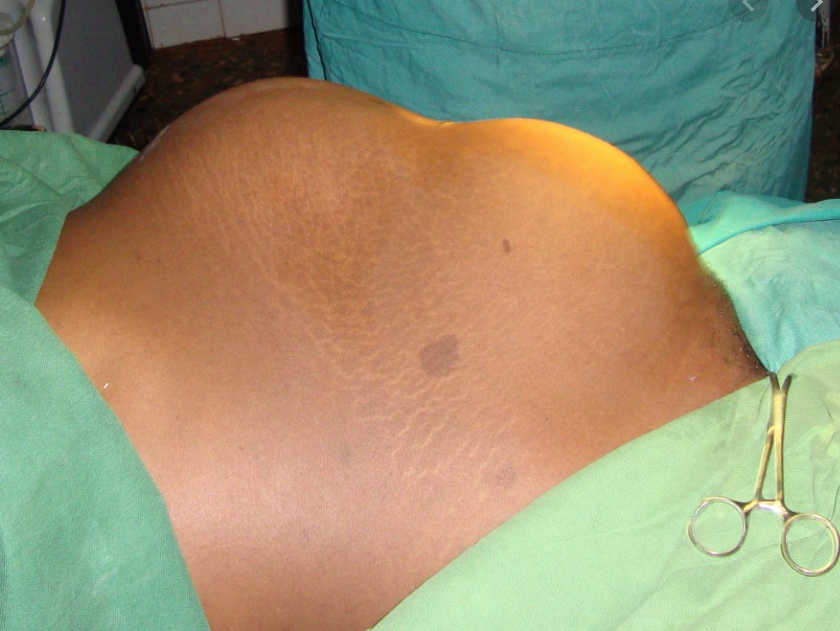
Bandl's ring

Slide 69
RECOMMENDED TEXT BOOKS
Hacker & Moore's Essentials of Obstetrics and Gynecology
Obstetrics by Ten Teachers by Philip N. Baker and Louise Kenny
Williams Obstetrics by Marlene M. Corton

Slide 70
Dr Amal Barakat
Thank You
The End of Labor & Intrapartum Maternal Monitoring

