Slide 1
MULTIPLE PREGNANCY
Dr Amal Barakat
5th Year Medical Students
University of Jordan
April/2026

Slide 2
OBJECTIVES
1. Identify types of multiple pregnancy
2. List risk factors of multiple pregnancy
3. Name maternal complications of multiple pregnancy
4. Name fetal complications of multiple pregnancy
5. Outline the management of patient with multiple pregnancy including ANC, time and mode of delivery
6. Identify strategies to reduce the risk of high order multiple pregnancies

Slide 3
MULTIPLE PREGNANCY
A pregnancy with more than one fetus is called a multiple pregnancy

Slide 4
TERMINOLOGY
Two offspring – twins //Twins are by far the most common form of multiple births in humans
Terms used for the number of offspring in a multiple birth, where a number higher than three ends with the suffix -uplet:
three offspring – triplets
four offspring – quadruplets
five offspring – quintuplets
six offspring – sextuplets
seven offspring – septuplets
eight offspring – octuplets
nine offspring – nonuplets
ten offspring – decuplets

Slide 5
Incidence and epidemiology
Twin pregnancies and higher-order multiple births comprise an increasing proportion of the total pregnancies in the developed world.
The incidence of multiple gestation continues to increase, and now accounting for more than 3% of all live births.
DZ twins are more common than MZ twins, 69 and 31 % of twins, respectively.
The incidence of MZ twins is relatively stable worldwide at 3 - 5 /1000 births

Slide 6
Differential Diagnosis of Large for Date Uterus
Incorrect dating
Multiple gestation
Macrosomia
Polyhydramnios
Uterine fibroid
Maternal Obesity
Molar Pregnancy

Slide 7
MATERNAL COMPLICATIONS
Multiple gestations are associated with significantly higher risks for:
  Hypertension
  Preeclampsia (26%)
  HELLP syndrome (9%)
  APH (Placental abruption, Placenta previa)
  Anemia (24%)
  Preterm labor
  Preterm premature rupture of membranes (preterm PROM) (24%)
  Gestational diabetes (14%)
  Acute fatty liver (4%)
  Chorioendometritis (16%)
  Postpartum hemorrhage (9%)
  Miscarriage
  Operative Delivery
  Postnatal illness
  Maternal mortality

Slide 8
MATERNAL COMPLICATIONS
The risk of pre-eclampsia for women with twin pregnancies is almost three times that for singleton pregnancies, while the risk for triplet pregnancies is increased nine-fold.
Maternal mortality associated with multiple births is 2.5 times that for singleton births.

Slide 9
FETAL COMPLICATIONS
Prematurity with with its complications
Monochorionicity with its complications
Growth restriction.
Stillbirth
Infant mortality rates increase
long- term morbidity increase (especially neurodevelopmental disability and chronic lung disease)
The incidence of severe handicap among neonatal survivors of multiple gestation is also increased.
Major congenital abnormalities are 4.9% more common in multiple pregnancies than in singleton pregnancies.

Slide 10
PRETERM & TWIN PREGNANCY
Preterm birth occurs in more than 50% of twin and 75% of triplet gestations.
Duration of pregnancy becomes shorter with increasing numbers of fetuses.
Predictive Factors of preterm labor:
Presence of risk factors (Multiple pregnancy)
Cervical shortening on ultrasound (<25 mm before 24 weeks):
Cervicovaginal Fetal fibronectin (fFN) – Positive fFN in cervicovaginal secretions between 22–34 weeks is predictive of preterm labor.

Slide 11
PRETERM & TWIN PREGNANCY
Interventions to prevent preterm labor and prolong pregnancy for patients with multiple gestations :
  prophylactic cervical cerclage (????)
  Supplemental progesterone (????)
  Bedrest (????)
  Tocolytic drugs (????)

Slide 12
Dizygotic (DZ) Twin
Dizygotic (DZ), resulting from the fertilization of two separate ova during a single ovulatory cycle.
DZ twins have dichorionic-diamniotic (DCDA) placentas.
Dizygotic twins are always diamniotic, dichorionic (i.e., have 2 sacs and 2 placentas).
The 2 placentas may fuse but do not have vascular connections.

Slide 13
Factors influencing the incidence of DZ twins are:
Factors influencing the incidence of DZ twins are:
Expanding use of Fertility drugs (Drugs used for induction of ovulation) & Increasing use of assisted reproduction techniques, including In Vitro Vertilization (IVF).
Up to 24% of successful IVF procedures result in multiple pregnancies
  Maternal age (One-third of the increase in multiple births in recent decades has been attributed to increasing age at childbirth)
  Race/geographic area (1.3/1000 Japan, 8/1000 United States and Europe, 50/1000 Nigeria)
  Parity (high parity)
  Family history
  High BMI & Maternal height (taller women ??)

Slide 14
Monozygotic (MZ)
Monozygotic (MZ), resulting from a single fertilized ovum that subsequently divides into two separate individuals.
Monozygotic (identical) twins do not run in families.
The incidence of MZ twins is relatively stable worldwide at 3 - 5 /1000 births.
Monozygotic twins have different amnionicity and chorionicity depending on the stage of cleavage of the single fertilized ovum.

Slide 15
Monozygotic (MZ)
Monozygotic twins have different amnionicity and chorionicity depending on the stage of cleavage of the single fertilized ovum
In MZ Twin the timing of egg division determines placentation
    Diamniotic, dichorionic (DCDA) placentation occurs with division prior to the morula stage (within 3 days post fertilization). This occurs in 29% of the cases.
    Diamniotic, monochorionic (MCDA) placentation occurs with division between 4-8 days postfertilization. This occurs in 70% of the cases.
    Monoamniotic, monochorionic (MCMA) placentation occurs with division between 8-12 days postfertilization. This occurs in 1% of the cases.
    Division at or after day 13 results in conjoined twins. This is an extremely rare condition occurring in up to 200,000 births

Slide 16
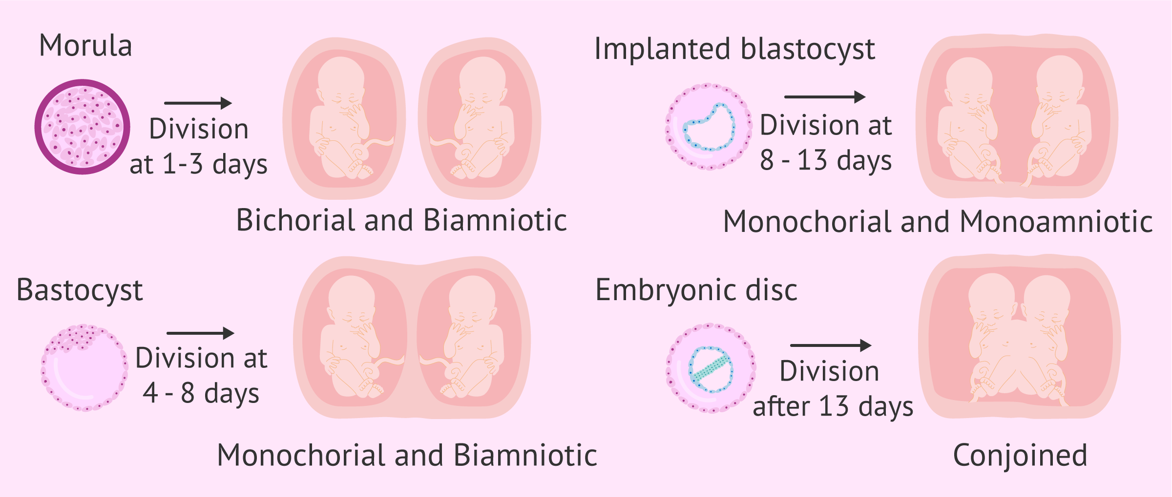
In MZ twins, the timing of egg division determines placentation

Slide 17
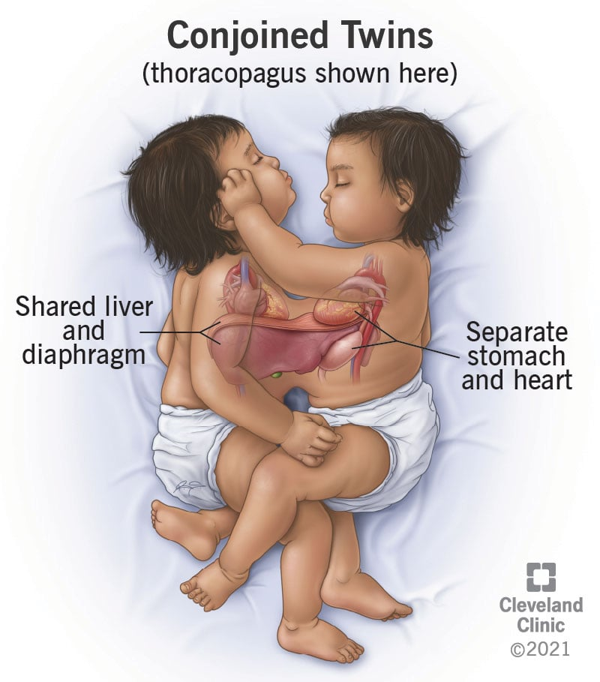
    Division at or after day 13 results in conjoined twins.

Slide 18
Ultrasound in Twin pregnancy
Diagnosis:
Visualization of multiple gestational sacs with yolk sacs by 5 weeks, or multiple embryos with cardiac activity by 6 weeks.

Slide 19
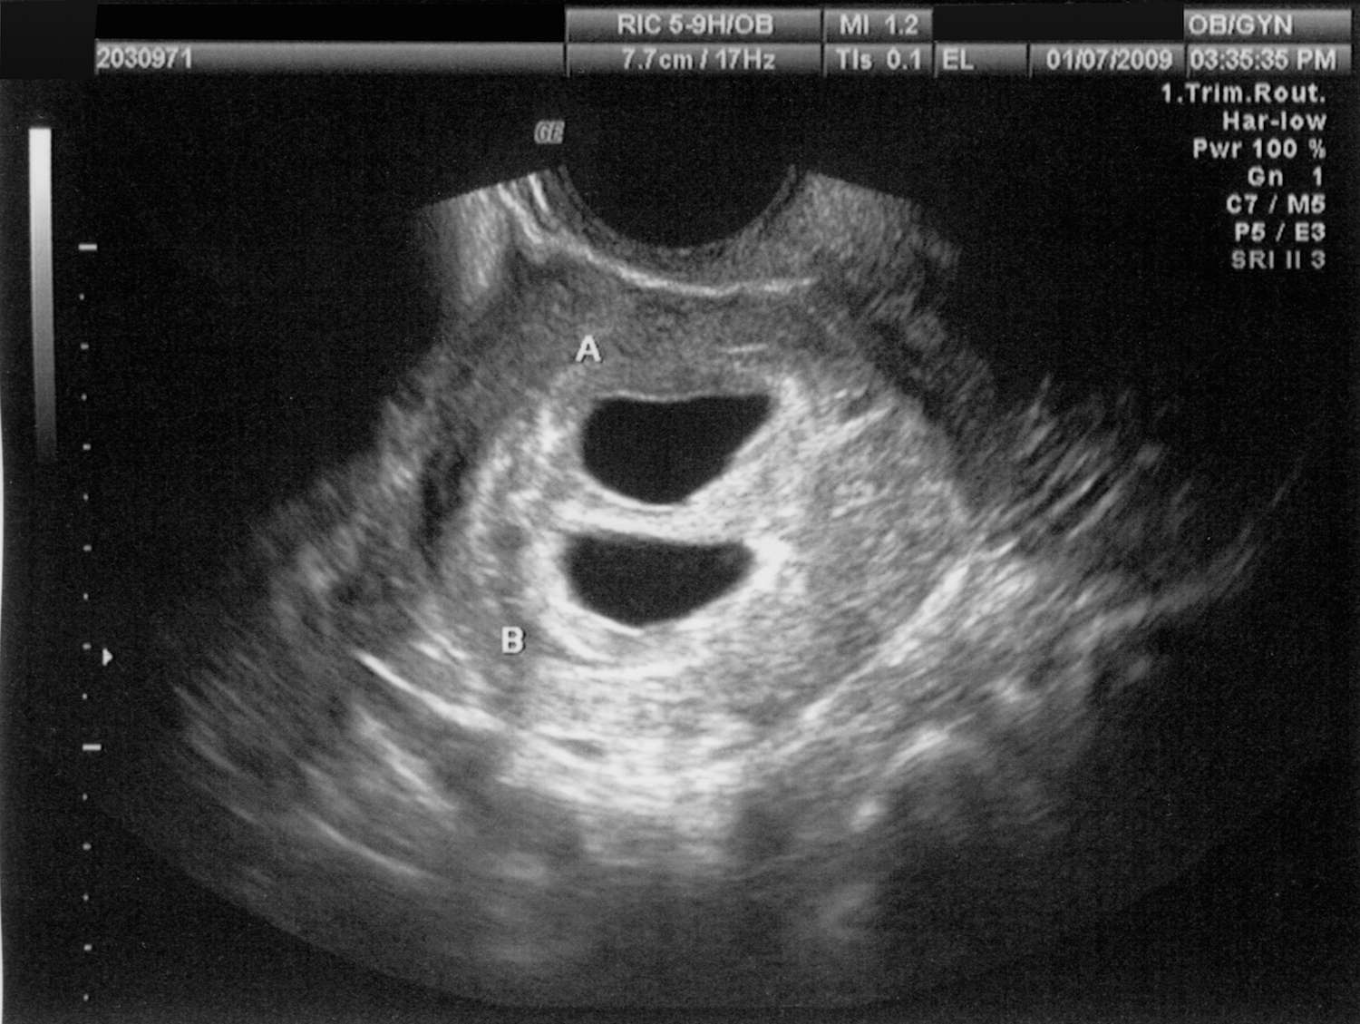
Clearly separate gestational sacs, each surrounded by a thick echogenic ring, is suggestive of dichorionicity.

Slide 20
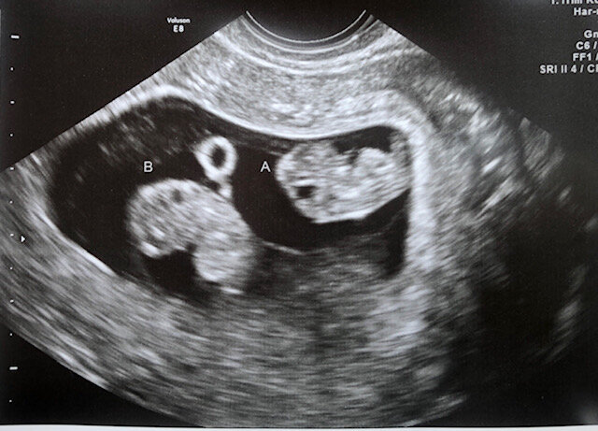
Visualization of multiple gestational sacs with yolk sacs by 5 weeks, or multiple embryos with cardiac activity by 6 weeks.

Slide 21
Ultrasound in Twin pregnancy
All women with a twin pregnancy should be offered an ultrasound examination at 10–13 weeks of gestation to assess:
Viability
Chorionicity
Major congenital malformation and
Nuchal translucency.
Careful sonographic surveys of fetal anatomy at (16-24 weeks) are indicated in multifetal pregnancies, because the risk for congenital anomalies is increased (3-5 fold higher).

Slide 22
Chorionicity
Chorionicity is the main determinant of the perinatal outcome in twin pregnancies: perinatal mortality and morbidity are significantly higher in monochorionic versus dichorionic twins.
The most reliable sonographic signs are the lambda and T-sign and the number of the placental masses evaluated before 14 weeks of gestation.

Slide 23
The twin peak sign (the lambda (λ) sign)
Seen in Dichorionic Diamniotic twin pregnancy.
This sign is a triangular projection of placental tissue which extends from the placenta between the layers of amniotic and chorionic membranes of each fetus
It is best seen in the first trimester (between 10-14 weeks)

Slide 24
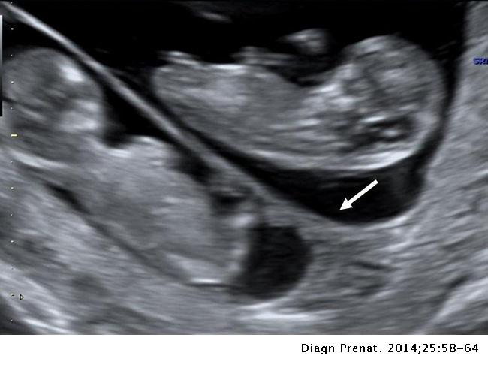
The twin peak sign (the lambda (λ) sign)

Slide 25
The T sign
Seen in Monochorionic Twin
It refers to the lack of chorion extending between the layers of the intertwin membrane, and the appearance of the thin intertwin membrane as it takes-off from the placenta at a 90-degree angle, denoting a monochorionic pregnancy.

Slide 26
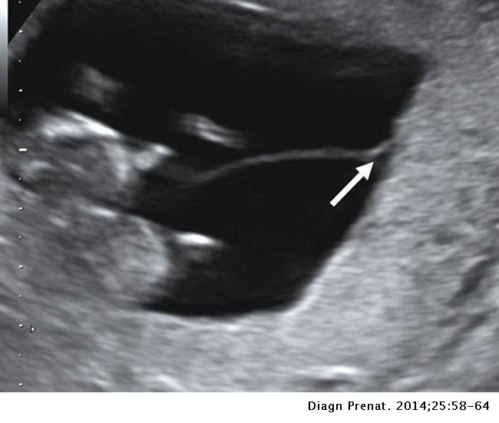
The T sign

Slide 27
Ultrasound in Twin pregnancy
Fetal growth should be assessed by serial ultrasonography.
Assess for growth discordance (discordance greater than 20% has also been shown to be an important predictor for adverse perinatal outcomes).
Assess cervical length in multiple gestation to identify those at increased risk for preterm delivery.
A cervical length of less than 20 mm in a twin pregnancy at 20 to 24 weeks gestation was associated with a 10-fold positive likelihood ratio for preterm birth before 32 weeks gestation.

Slide 28
Fetal Gender in Twins
The identification of discordant fetal gender indicates dichorionic twinning.
The positive predictive value of discordant gender (when correctly identified) is 100%.

Slide 29
Antenatal corticosteroid prophylaxis for reducing perinatal morbidity
A single course of corticosteroids is recommended for pregnant women between 24 0/7 weeks and 33 6/7 weeks of gestation who are at risk of preterm delivery within 7 days, including for those with ruptured membranes and multiple gestations. (NICE Guidelines)

Slide 30
Timing and Method of delivery
Chorionocity, fetal presentations and size of twin should be determined before choosing the mode of delivery.
Electronic fetal heart monitoring should be available for both fetuses during labor.
Epidural anesthesia is recommended

Slide 31
Timing and Method of delivery
The Royal College of Obstetricians and Gynecologists (RCOG) and National Institute for Health and Care Excellence (NICE) recommend:
DCDA twins to be delivered between 37 and 38 weeks.
Uncomplicated MCDA twins to be delivered between 36 and 37 weeks
Monoamniotic twins:
  In MCMA twins' delivery at about 32-34 weeks should be considered because of the increasing risk of perinatal mortality and unexpected fetal loss in the third trimester, largely because of sudden cord accidents.
  Cesarean birth is recommended to avoid complications from cord entanglement.

Slide 32
Cesarean section or Vaginal delivery??
In Summary:
Cesarean delivery in multiple pregnancy is needed when:
First twin is in non cephalic presentation
When it is a Monoamniotic twin pregnancy.
Higher-Order Multiple Gestations (Triplets, ..)
If there is medical or obstetric indication
Conjoined Twin

Slide 33
Complications associated with monochorionicity
Complications associated specifically with monochorionicity:
Twin to Twin transfusion syndrome (TTTS), (FFTs)
Selective Fetal Growth Restriction (sFGR)
Twin Reverse Arterial Perfusion Syndrome (TRAP)

Slide 34
Twin to Twin transfusion syndrome (TTTS)
TTTS occurs almost exclusively in monozygotic twins with monochorionic-diamniotic (MCDA) placentation.
It occurs in 15% of MC twin pregnancies, and accounts for about 20% of stillbirths in multiple pregnancies
It can develop at any point during pregnancy but typically emerges in the second trimester.
Vascular communication is present virtually in all monochorionic twins; in most cases, the blood flow is balanced with no net transfusion of blood from one twin to the other
TTTS occurs because of an imbalance in blood flow through vascular communications in the placenta, which leads to overperfusion of one twin and underperfusion of its co-twin.

Slide 35
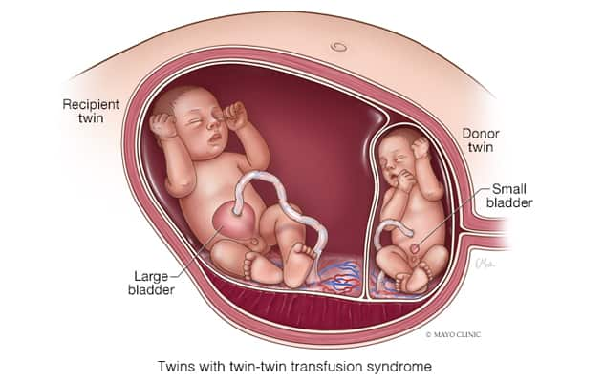
Twin-Twin Transfusion Syndrome

Slide 36
Twin to Twin transfusion syndrome (TTTS)
Ultrasonographic criteria for diagnosis of TTTS include :
  Presence of a single placenta
  Sex concordance
  Significant growth discordance (approximately 20%)
  Discrepancy in amniotic fluid volume between the two amniotic sacs (usually oligohydramnios and polyhydramnios)
  Presence of fetal hydrops or cardiac dysfunction
  Abnormal umbilical artery Doppler findings, such as absent end-diastolic flow in the donor fetus

Slide 37
Twin - Twin transfusion syndrome (TTTS)
The donor fetus is hypoperfused, demonstrating signs of intrauterine growth restriction, anaemic and oligohydramnios.
The recipient fetus is hyperperfused, hypertensive, demonstrate biventricular hypertrophy and diastolic dysfunction, and polyhydramnios.
TTTS is associated with a high risk of fetal/neonatal mortality, and fetuses who survive are at risk of severe cardiac, neurologic, and developmental disorders.
Management approaches for the treatment of severe TTTS (24 to 26 weeks) gestation:
  Serial reduction amniocenteses
  Amniotic septostomy
  Fetoscopic Laser Photocoagulation (FLP) is the best treatment option for stages 2 through 4 and is approved by the Food and Drug Administration (FDA) for use during 16 to 26 weeks' gestation

Slide 38
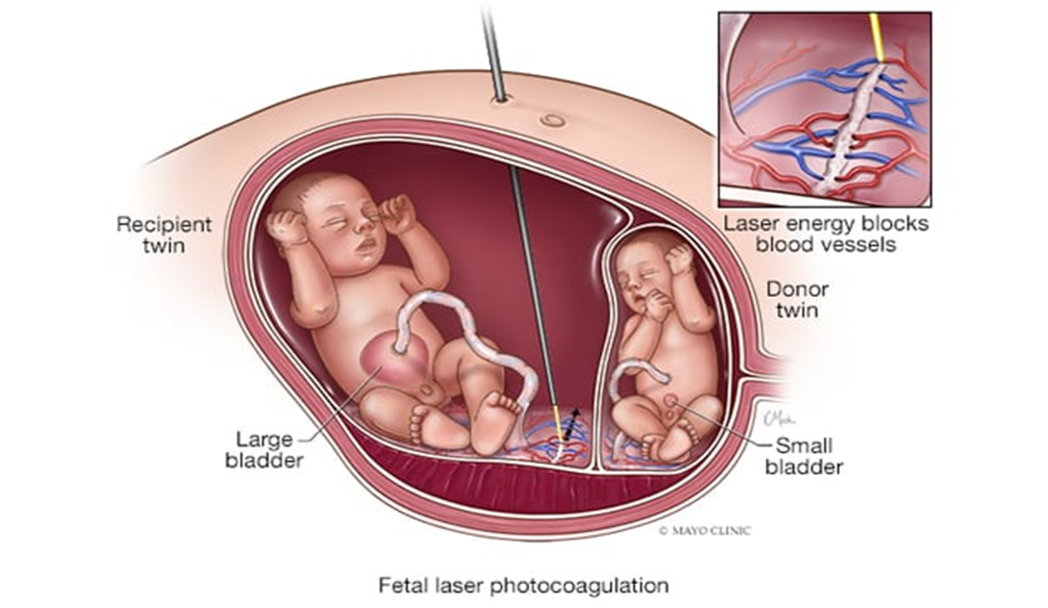
Twin to Twin transfusion syndrome

Slide 39
Intrauterine Demise of One Fetus
Loss of one twin in the first trimester:
Does not appear to impair the development of the surviving twin.

Slide 40
Intrauterine Demise of One Fetus
Loss of one twin after mid gestation may increase the risk of:
Intrauterine Growth Restriction (IUGR), preterm labor, preeclampsia, and perinatal mortality.
After the death of one twin in a MC gestation, approximately 15% of remaining fetuses also die, compared with approximately 3% of remaining fetuses in a DC gestation.
The risk for significant neurologic morbidity is increased after intrauterine death of one fetus in a MC, but not in a DC gestation.
Maternal coagulopathy, the most feared complication following twin demise, appears to be uncommon. However, coagulopathy has been reported to occur about 3–5 weeks following fetal demise.

Slide 41
Multifetal Pregnancy Reduction(MFPR)
High order multifetal pregnancies are at higher risk of maternal, fetal, and neonatal complications than singleton pregnancies.
Higher order multifetal gestations should be prevented by using use single embryo transfer in all situations if a top-quality blastocyst is available.
Selective reduction was developed in the mid-1980s.
MFPR is defined as a first-trimester or early second-trimester procedure for reducing the total number of fetuses in a multifetal pregnancy by one or more.

Slide 42
Multifetal Pregnancy Reduction
Operative techniques that may be used are chemical, thermal, radiofrequency and laser, depending on chorionicity as well as other factors.
Intracardiac potassium chloride is appropriate to employ when there is independent chorionicity. It carries a lower risk of pregnancy loss.
Vascular occlusion using radiofrequency ablation, bipolar coagulation or intrafetal laser can be employed in monochorionic fetuses and twin reversed arterial perfusion pregnancies, but carry a higher risk of pregnancy loss.

Slide 43
Multifetal Pregnancy Reduction(MFPR)
MFPR is usually performed between 10 and 13 weeks of gestation.
Under continuous ultrasound guidance, a needle is placed into the thorax of the targeted fetus, 2 to 3 mL of potassium chloride is injected, and asystole is observed for at least 3 minutes.
Potassium chloride injection must not be used for MFPR in a single fetus of a MC pair because of the risk for co-fetal demise or neurologic injury.
A lot of medical, ethical and religious issues where raised with and against this procedure.

Slide 44
RECOMMENDED TEXT BOOKS
Hacker & Moore's Essentials of Obstetrics and Gynecology
Obstetrics by Ten Teachers by Philip N. Baker and Louise Kenny
Williams Obstetrics by Marlene M. Corton

Slide 45
Dr Amal Barakat
THANK YOU
THE END OF MULTIPLE PREGNANCY

