Slide 1
Patient’s management

Slide 2


Outline
A
Introduction
Objectives
Process

Slide 3
Introduction
family medicine is: primary , continuing , comprehensive and personal health care for individuals

Slide 4
Objectives for the consultation

Slide 5
Tasks to be achieved in the consultation
1-Management of presenting problem
2-Management of continuing problem
3-Modification of help seeking behaviour
4-Opportunistic health promotion

Slide 6


Patient presenting with a problem
A 32 of age female patient presenting to you with left heel pain , started 3 weeks ago when she began working out to lose weight .
Her past medical history is unremarkable
How do you manage ?

Slide 7
Content
Doctor agenda
Patient agenda
History taking
physical examination
Differential diagnosis
Investigation
Treatment
Referral
Ideas and believes
Concerns and worries
Expectations for now and future

Slide 8
History taking
The chief complaint is typically sharp and stabbing heel pain that is most severe in the morning or standing after rest.
The pain usually improves with ambulation but may worsen after activity or at the end of the day
there is localized tenderness upon palpation of the medial calcaneal tubercle. Passive dorsiflexion of the hallux may cause pain or discomfort in the plantar fascia.
Onset , duration, associated symptoms, previous history .
Family history , past medical and surgical history
Personal history

Slide 9
Differential diagnosis
Origin of heel pain | musculoskeletal | vascular | dermatological | neurological
 | Planter fasciitis | Peripheral arterial disease | Planter verruca | Tarsal tunnel syndrome
 | Stress fracture | Vascular insufficiency | Ulcers | Medial or lateral planter neuritis
 | Bone cyst |  | Foreign body
 | Calcaneal stress fracture Achilles tendinitis

Slide 10
So, from patient complain and history you suspect Planter fasciitis

Slide 11
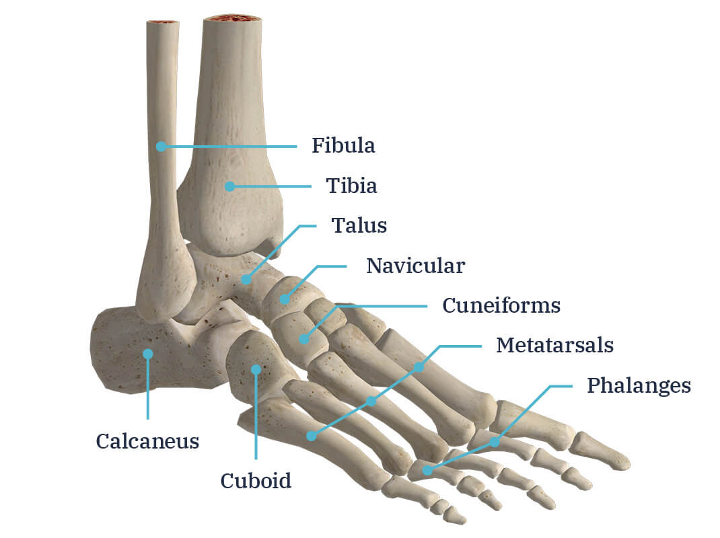

Slide 12
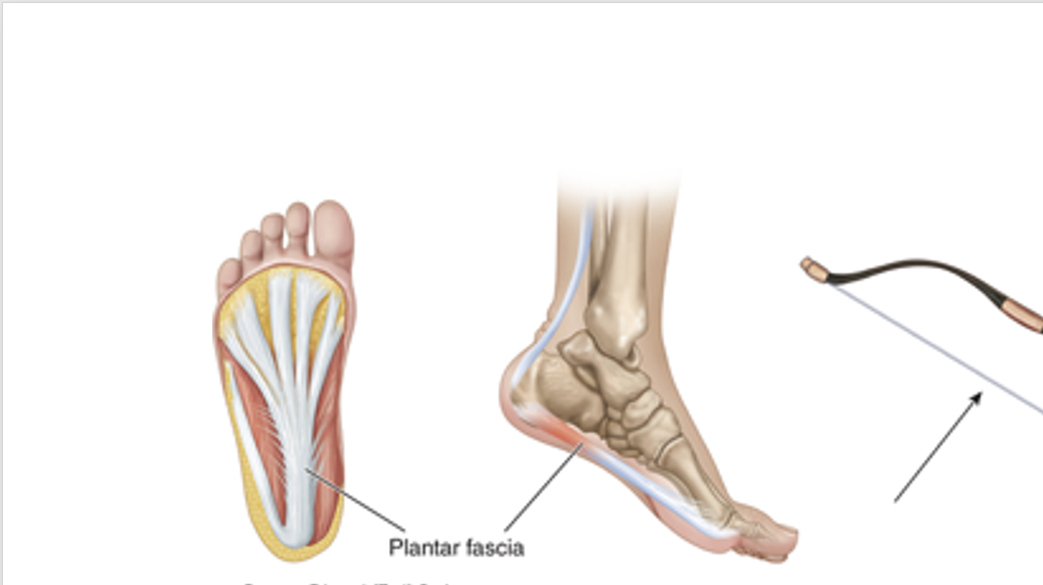
The plantar fascia, which spans the bottom of the foot, is a tense band of connective tissue that acts like the string on a bow to help maintain the arch.

Slide 13
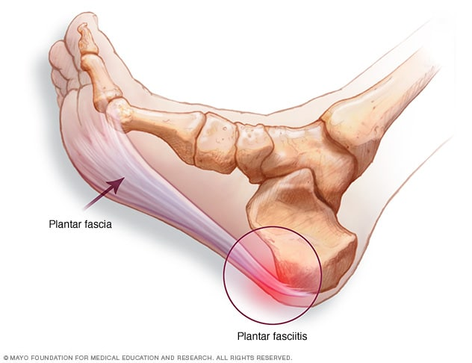

Slide 14

Clinical finding
Epidemiology
Symptoms and Signs
Plantar fasciitis is the most common cause of heel pain.
Each year, an estimated 2 million Americans are affected, resulting in more than 1 million clinician visits.
Risks factors include pes planus as well as pes cavus foot types, obesity, limb length discrepancy, Achilles tendon tightness, and occupations that require prolonged standing or walking.
The chief complaint is typically sharp and stabbing heel pain that is most severe in the morning or standing after rest.
The pain usually improves with ambulation but may worsen after activity or at the end of the day
there is localized tenderness upon palpation of the medial calcaneal tubercle. Passive dorsiflexion of the hallux may cause pain or discomfort in the plantar fascia.

Slide 15
Imaging
Treatment
imaging is rarely needed since the diagnosis of plantar fasciitis is usually clinical.
Initial treatment of plantar fasciitis consists of stretching the Achilles and plantar fascia
oral nonsteroidal anti-inflammatory drugs, night splints, and corticosteroid injections.
Plantar fasciotomy done through either open or endoscopic technique may be effective for plantar fasciitis that does not respond to conservative treatment after 1 year

Slide 16
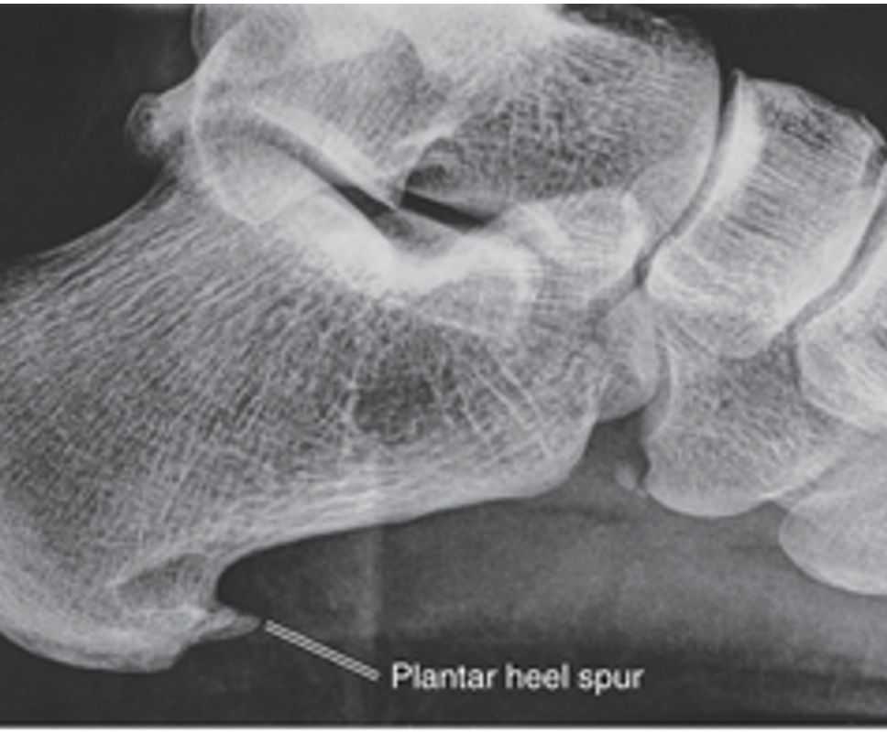
note to be
Heel spur
In the case of plantar fasciitis, the chronic inflammatory changes occur at the insertion point of the plantar fascia onto the calcaneus, and the fascia at this point may calcify, forming the plantar heel spur
It is important to note that the plantar heel spur is the result of the chronic, local ischemic conditions associated with plantar fasciitis, not the cause of the planter fasciitis

Slide 17
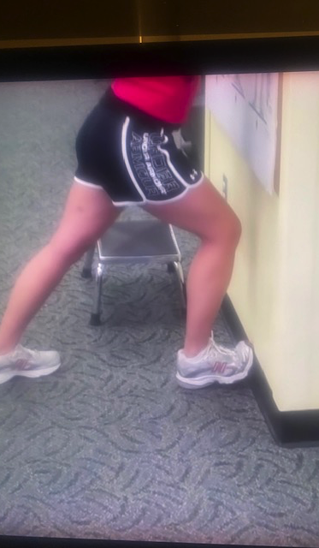
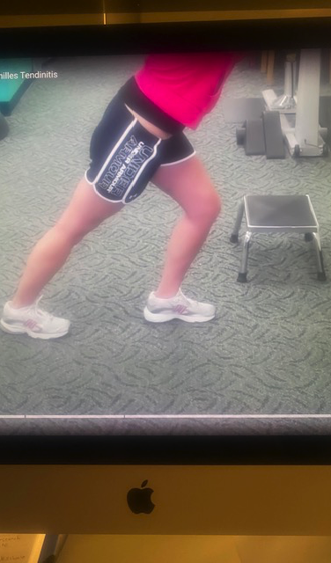
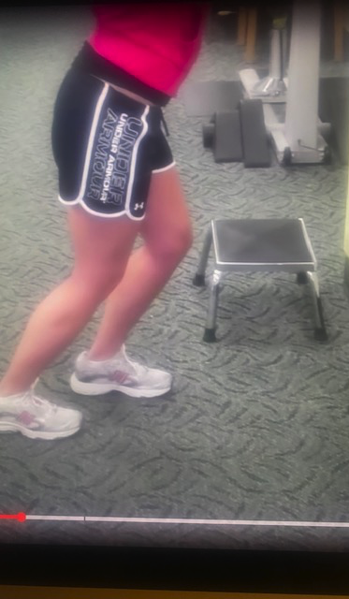

Slide 18
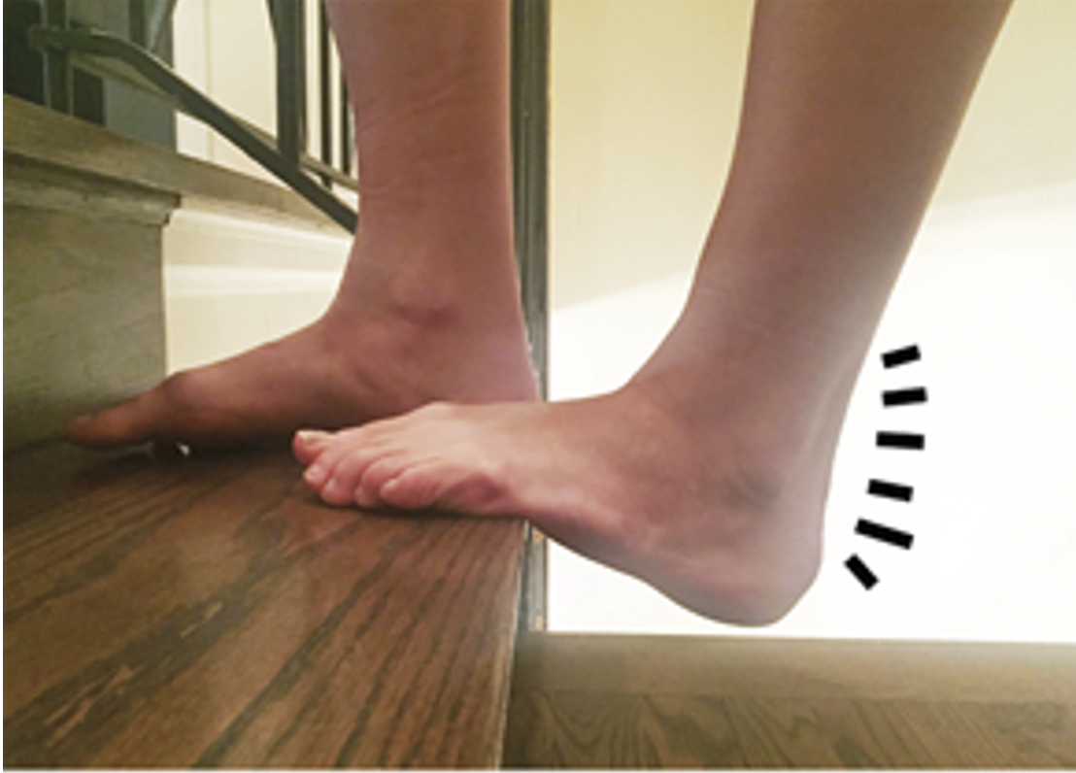


Slide 19


summary planter fasciitis
ESSENTIALS OF DIAGNOSIS
Heel pain worse in the morning with initial weight bearing or after a period of rest.
Heel pain precipitated by a recent increase in activity.
Localized tenderness at the medial calcaneal tubercle.
Pain with passive dorsiflexion of the great toe.

Slide 20
Tasks of consultation
2
3
4
-Management of continuing problem
-Modification of help seeking behavior
-Opportunistic health promotion

Slide 21

Thank you
Farihan f Barghouty
Professor of family medicine

