Slide 1
5th year nuclear medicine lecture

Slide 2
Panel
GENERAL
THYROID
LUNG
Cardiac
bone
miscellaneous
Q1
Q6
Q11
Q16
Q21
Q26
Q2
Q7
Q12
Q17
Q22
Q27
Q3
Q8
Q13
Q18
Q23
Q28
Q4
Q9
Q14
Q19
Q24
Q29
Q5
Q10
Q15
Q20
Q25
Q30

Slide 3
What is the half-life of ⁹⁹Tc?
general · q1
Notes:
6 hours

Slide 4
What is the parent isotope of ⁹⁹Tc?
general · q2
Notes:
Mo-99

Slide 5
Why does FDG accumulate within malignant cells?
general · q3
Notes:
because of their high rate of glucose metabolism

Slide 6
What is the half-life of ¹³¹I?
general · q4
Notes:
8 days

Slide 7
Name a commonly used positron-emitting substance in PET scans?
general · q5
Notes:
radioactive fluorine (most important), radioactive oxygen, radioactive carbon, radioactive nitrogen, and gallium.

Slide 8
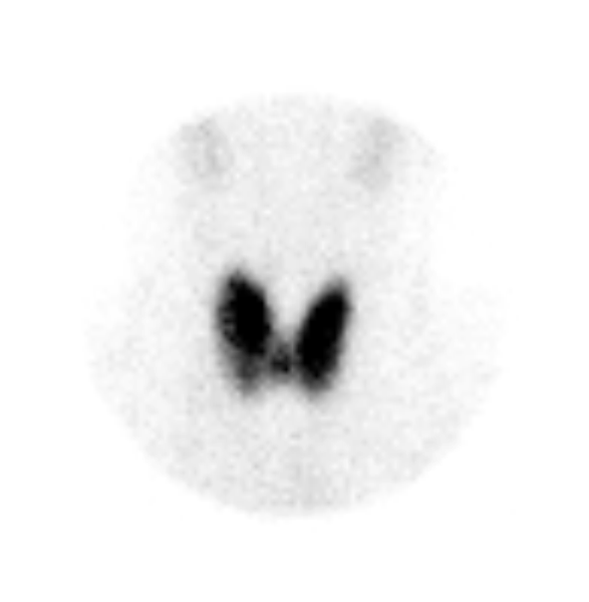
thyroid · Q6
57.4%
Notes:
Graves

Slide 9
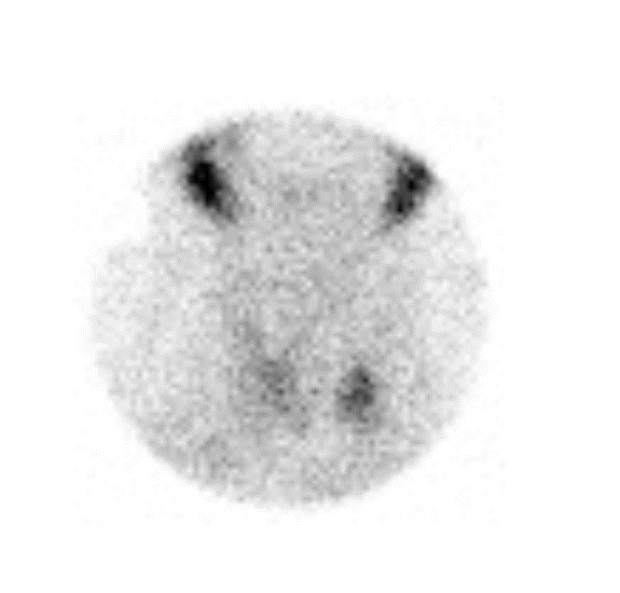
thyroid · Q7
0.4%
Notes:
Subacute thyroiditis

Slide 10
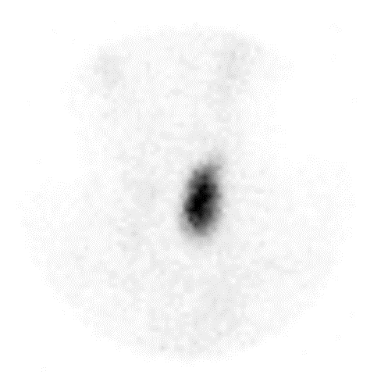
THYROID · Q8
Notes:
Large toxic nodule

Slide 11
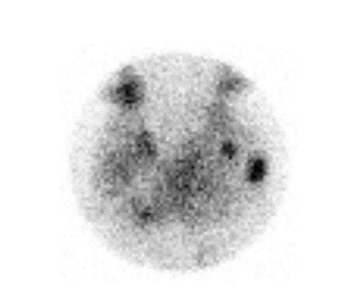
THYROID · Q9
33.6%
Notes:
MNG

Slide 12
True or False
Radioactive Iodine has an important role in the treatment of medullary thyroid cancer
THYROID · Q10
Notes:
False
Although thyroid follicular cells have the cellular mechanism to absorb iodine, medullary thyroid cancer does not arise from this type of thyroid cell. Medullary thyroid cancers are derived from the parafollicular C cell which does not possess the iodine symporter receptor or the ability to produce thyroid hormone. Therefore, radioactive iodine therapy is not useful for the treatment of medullary thyroid cancer. Similarly, if medullary thyroid cancer spreads to distant sites, it cannot be found by iodine scanning the way that distant spread from papillary or follicular cancer can sometimes visualized.

Slide 13
Name one radiopharmaceutical used in lung perfusion scans?
LUNG · Q11
Notes:
99mTc-macroaggregated albumin (MAA)

Slide 14
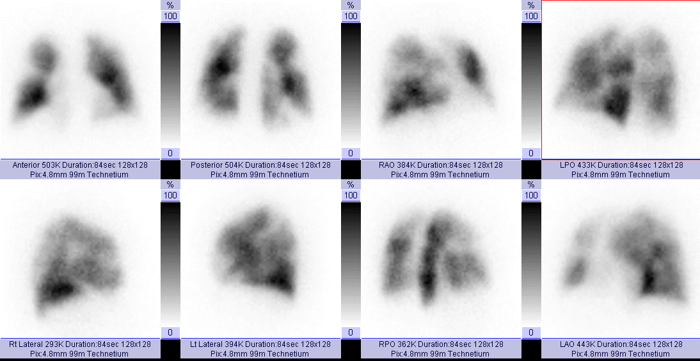
LUNG · Q12
Notes:
376940

Slide 15
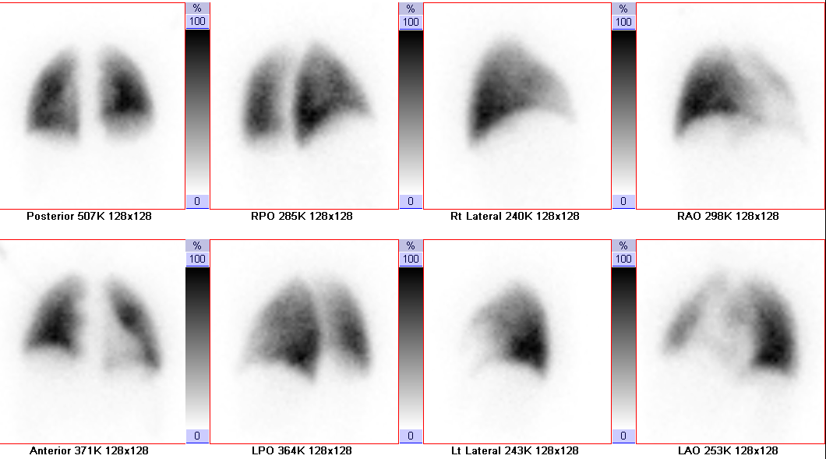
LUNG · Q13
Notes:
916495

Slide 16
What finding in lung perfusion/ventilation (V/Q) scans is usually indicative of pulmonary embolism?
LUNG · Q14
Notes:
Mismatch defect

Slide 17
Name one radiopharmaceutical used in lung ventilation scans?
LUNG · Q15
Notes:
Tc99 labeled DTPA or Xe-133

Slide 18
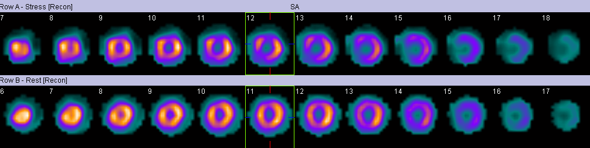
CARDIAC · Q16
Notes:
719773, anterior LAD inferoseptal RCA ischemia

Slide 19
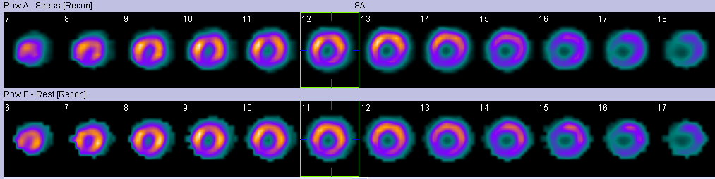
CARDIAC · Q17
Notes:
829248, RCA inferoseptal infarction

Slide 20
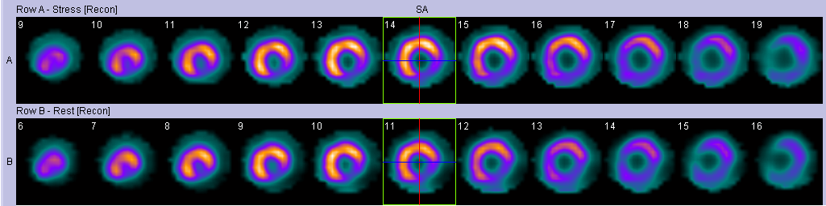
CARDIAC · Q18
Notes:
903891, circumflex coronary artery inferolateral infarction

Slide 21
Name one radiopharmaceutical used in myocardial perfusion imaging?
CARDIAC · Q19
Notes:
Tc99 tetrofosmin, sestamibi, and thalium (analogue ofpotassium)

Slide 22
Name two methods of inducing stress in myocardial perfusion images
CARDIAC · Q20
Notes:
Exercise and medication (Adenosine, Dobutamine, Dipirydamole)

Slide 23
Name one radiopharmaceutical used in bone scintigraphy?
BONE · Q21
Notes:
MDP: methylene diphosphonate, HEDP: hydroxyethelenediphosophonate, HMDP: hydroxymythelenediphosphonate

Slide 24
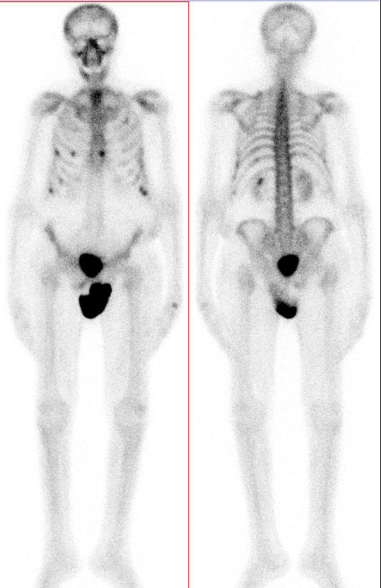
BONE · Q22
Notes:
1282639

Slide 25
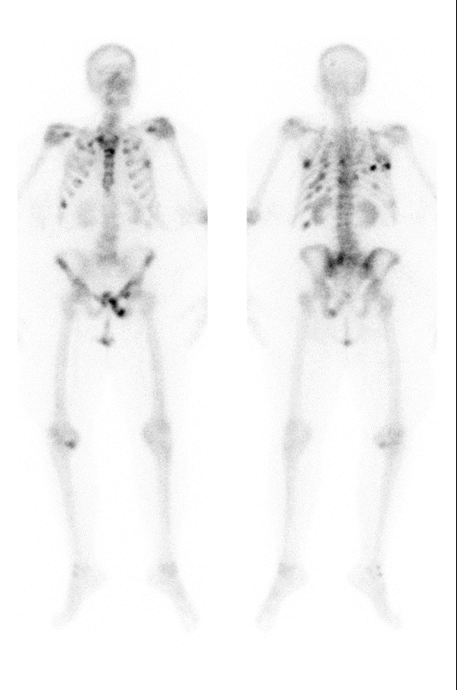
BONE · Q23
Notes:
348487

Slide 26
True or False
Bone scintigraphy is highly sensitive for the detection of all types of bone metastases
BONE · Q24
Notes:
False, only osetoblastic

Slide 27
True or False
PET scan has higher sensitivity in detection of Multiple Myeloma than bone scintigraphy
BONE · Q25
Notes:
True, because it is usually osteolytic

Slide 28
What type of renal scintigraphy is most useful in detecting cortical scars?
misc · Q26
Notes:
DMSA

Slide 29
True or False
PET/CT is useful in evaluating response to treatment in the middle of chemotherapy for lymphoma
misc · Q27
Notes:
True

Slide 30
What does SPECT stand for?
MISC · Q28
Notes:
Single photon emission computer tomography

Slide 31
What type of scintigraphy is used for diagnosing acalculous cholecystitis ?
MISC · Q29
Notes:
HIDA

Slide 32
What type of renal scintigraphy is useful for detecting PUJ stenosis?
MISC · Q30
Notes:
MAG3, DTPA

