Slide 1
Neurogenic bladder and Urodynamic study

Slide 2
Neurophysiology of the bladder

Slide 3
Bladder Neurophysiology
The urinary bladder is a complex visceral organ controlled by intricate neural networks.
It functions through coordinated activity of the detrusor muscle, internal and external urethral sphincters.
Neural control integrates sympathetic, parasympathetic, and somatic systems regulated by spinal and supraspinal centers.

Slide 4
Receptor Types in the Bladder and Related Structures
Bladder (Detrusor muscle):
- Muscarinic (M2, M3): Parasympathetic, stimulate contraction.
- Beta-3 adrenergic: Sympathetic, mediate relaxation.
Internal urethral sphincter:
- Alpha-1 adrenergic: Sympathetic, cause contraction.

Slide 5
Sympathetic vs Parasympathetic Control
Sympathetic (T11-L2):
- Hypogastric nerve
- Beta-3 receptors → Detrusor relaxation
- Alpha-1 receptors → Internal sphincter contraction
Parasympathetic (S2-S4):
- Pelvic nerve
- M3 receptors → Detrusor contraction
- Inhibits sympathetic tone during voiding.

Slide 6
Central Control: Pontine and Cortical Centers
Pontine Micturition Center (PMC):
- Coordinates bladder contraction and sphincter relaxation.
- Located in the dorsolateral pons.
Cerebral Cortex (Frontal lobes):
- Provides voluntary control and conscious awareness.
- Inhibits PMC until appropriate time for voiding.

Slide 7
Sensory Afferents in Bladder Control
Afferents travel via pelvic and hypogastric nerves:
- A-delta fibers: Respond to bladder filling/stretch.
- C fibers: Respond to noxious stimuli or inflammation.
Relay stretch and pain information to spinal cord and brain.

Slide 8
Pudendal Nerve and Onuf's Nucleus
Pudendal nerve (S2-S4):
- Somatic control of external urethral sphincter.
- Originates from Onuf’s nucleus in the anterior horn of sacral spinal cord.
- Enables voluntary control of micturition.
- Maintains continence via tonic contraction.

Slide 9
Reflexes for continence and voiding
Guarding reflex:
spinal somatic reflex that occurs during the filling phase of the bladder to maintain urinary continence.
As the bladder stretches, low-level afferent signals from the bladder wall activate Onuf's nucleus in the sacral spinal cord (S2–S4), which in turn stimulates the pudendal nerve. This causes tonic contraction of the external urethral sphincter, preventing involuntary leakage of urine.
- Promotes storage
- Sympathetic + Onuf’s nucleus are active, Parasympathetic is inhibited
Voiding reflex:
  - Promotes emptying
  - Parasympathetic is active, Sympathetic & Onuf’s nucleus are inhibited

Slide 10
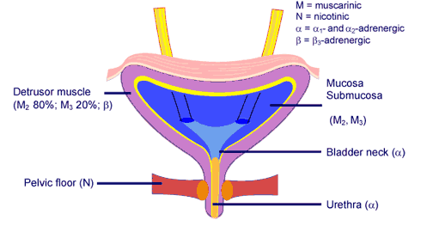
Bladder neuronal control

Slide 11
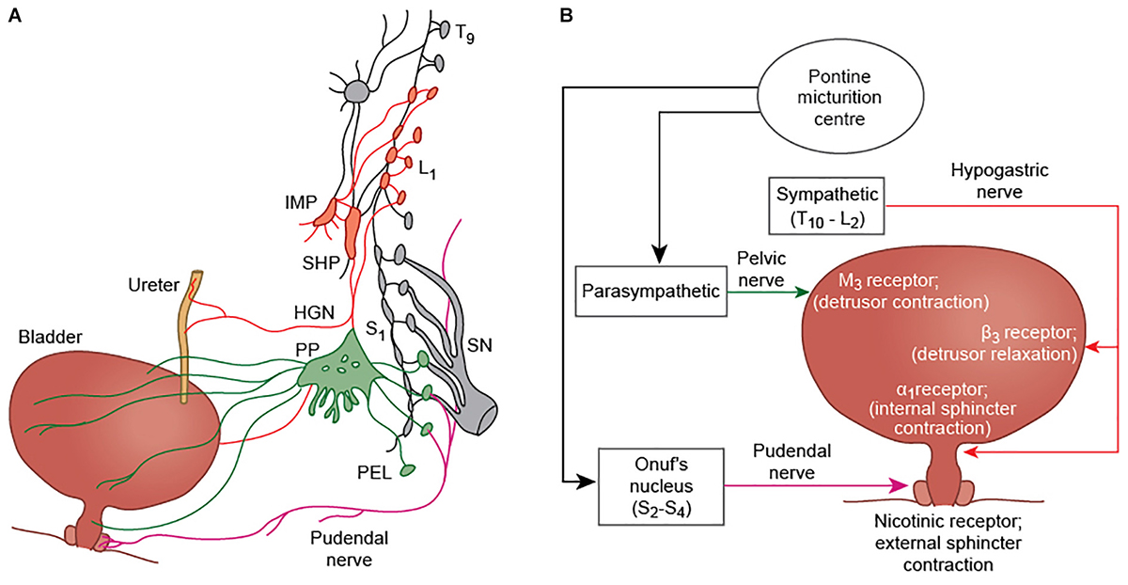
Notes:
(A) Efferent innervation of the bladder, ureter, and external urethral sphincter (modified from Fowler et al., 2008). Parasympathetic fibers (green) arise from S2-4 nerve roots. They travel in the pelvic nerve and pass via the pelvic plexus to innervate the bladder detrusor muscle of the bladder. Sympathetic fibers (red) arising from T11-L2 segments, pass via the inferior mesenteric plexus (IMP) and travel in the hypogastric nerve (HGN) to innervate the ureter and the detrusor smooth muscle. Somatic innervation of the external urethral sphincter is via the pudendal nerve, and arises from Onuf’s nucleus at S2-S4. (B) A simplified schematic showing the major nerves and neurotransmitters involved in bladder control. The pudendal nerve causes contraction of the external urethral sphincter via nicotinic receptors (+N); parasympathetic fibers produce contraction of the detrusor muscle by acting at M3 receptors; and sympathetic innervation inhibits detrusor contraction through β3 receptors, and contraction of the internal urethral sphincter by α1 receptor activation.

Slide 12
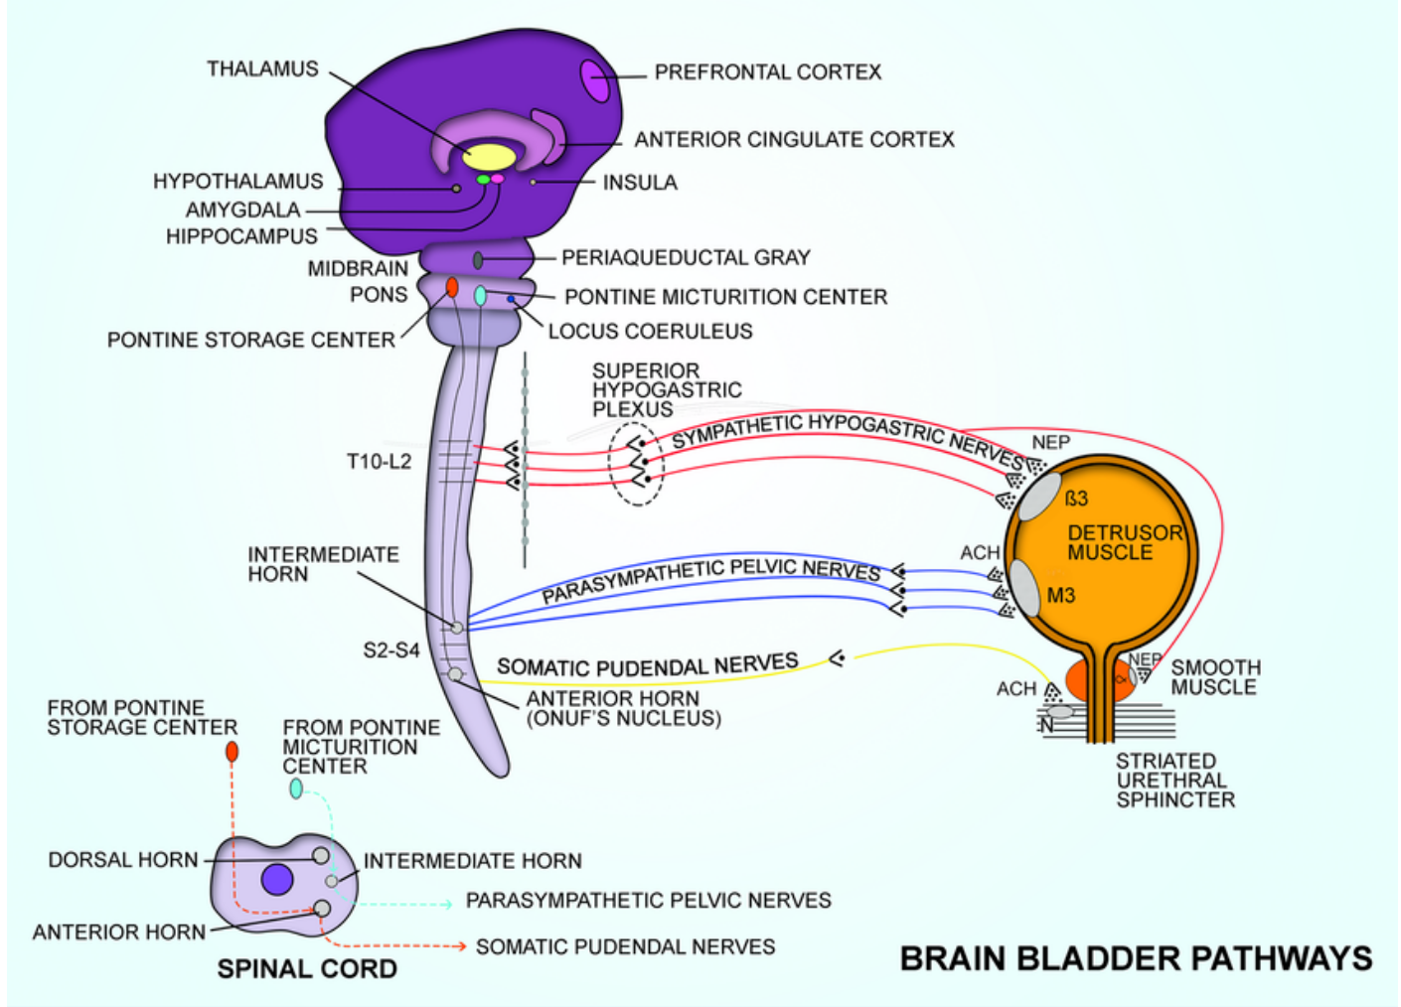
/

Slide 13
Neuroanatomic pathway
Frontal Cortex (medial prefrontal, anterior cingulate)
↓
Basal Ganglia (caudate nucleus and putamen)
↓ inhibitory projection
Thalamus
↓
Periaqueductal Gray (PAG)
↓
Pontine Micturition Center (PMC)
↓
Sacral parasympathetic nuclei (S2–S4) → Bladder contraction

Slide 14
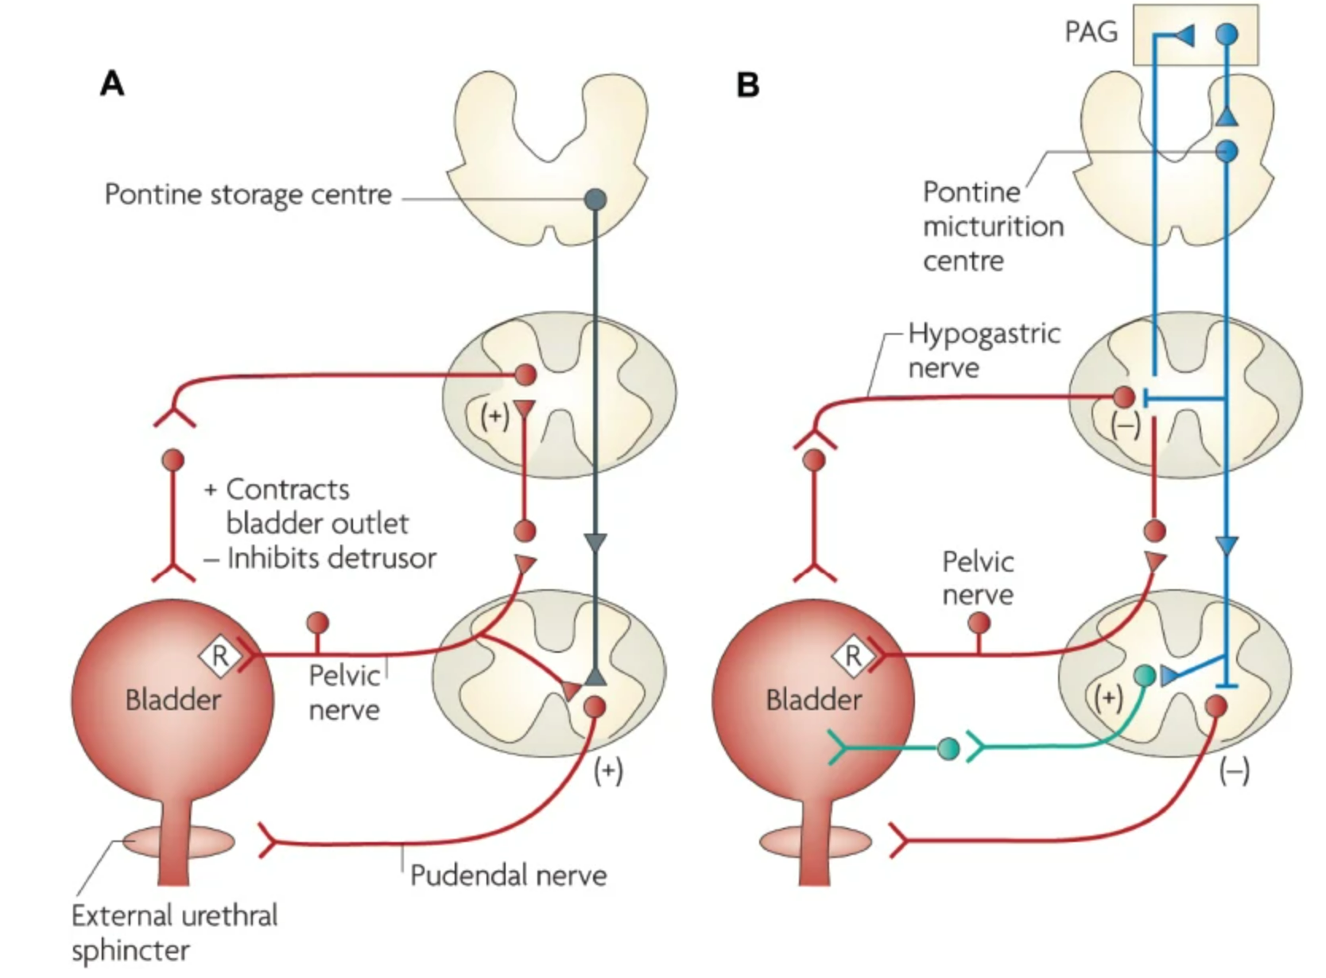
Notes:
Neural circuits that control continence and micturition. (A) Urine storage reflexes. During the storage of urine, distention of the bladder produces low-level vesical afferent firing. This in turn stimulates the sympathetic outflow in the hypogastric nerve to the bladder outlet (the bladder base and the urethra) and the pudendal outflow to the EUS. These responses occur by spinal reflex pathways and represent guarding reflexes, which promote continence. Sympathetic firing also inhibits contraction of the detrusor muscle and modulates neurotransmission in bladder ganglia. A region in the rostral pons (the pontine storage center) might increase striated urethral sphincter activity. (B) Voiding reflexes. During the elimination of urine, intense bladder-afferent firing in the pelvic nerve activates spinobulbospinal reflex pathways (shown in blue) that pass through the pontine micturition center. This stimulates the parasympathetic outflow to the bladder and to the urethral smooth muscle (shown in green) and inhibits the sympathetic and pudendal outflow to the urethral outlet (shown in red). Ascending afferent input from the spinal cord might pass through relay neurons in the PAG before reaching the pontine micturition center. Note that these diagrams do not address the generation of conscious bladder sensations, or address the mechanisms that underlie the switch from storage to voluntary voiding, both of which presumably involve cerebral circuits above the PAG

Slide 15
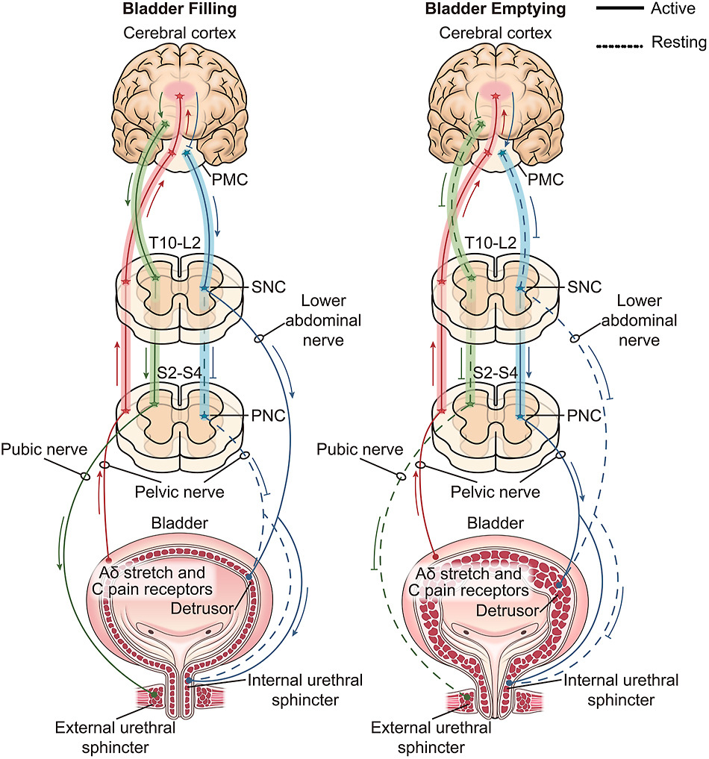
Physiological functional innervation of the LUT. PMC, pontine micturition center; SNC, sympathetic nerve center; PNC, parasympathetic nerve center; LUT, lower urinary tract.

Slide 16
Neurogenic bladder

Slide 17
Definition of Neurogenic Bladder
Lower urinary tract dysfunction due to clinically relevant neurological disorder
May involve storage, voiding, or both
Risk: renal deterioration if high pressure persists

Slide 18
Neurogenic Bladder - Levels of Neurological Lesions
1. Suprapontine lesions:
- Loss of voluntary control, detrusor overactivity.
2. Suprasacral (spinal cord above S2):
- Detrusor-sphincter dyssynergia (DSD), hyperreflexic bladder.
3. Sacral lesions (S2-S4):
- Areflexic (flaccid) bladder, retention.
4. Peripheral (cauda equina):
- Similar to sacral: sensory loss, incontinence.

Slide 19
Pathophysiology of Detrusor Sphincter Dyssynergia (DSD)
Definition:
- DSD is a condition where there is a lack of coordination between detrusor muscle contraction and external urethral sphincter relaxation during voiding.
Neurophysiological Basis:
- Normally, the Pontine Micturition Center (PMC) ensures synchronized detrusor contraction and sphincter relaxation.
- In spinal cord injuries above the sacral level (suprasacral), descending inhibitory control from the PMC is lost.
- This leads to simultaneous contraction of detrusor and external sphincter (via Onuf's nucleus).
- Sequalae of DSD: Increased bladder pressure, incomplete emptying, risk of hydronephrosis, UTIs.

Slide 20
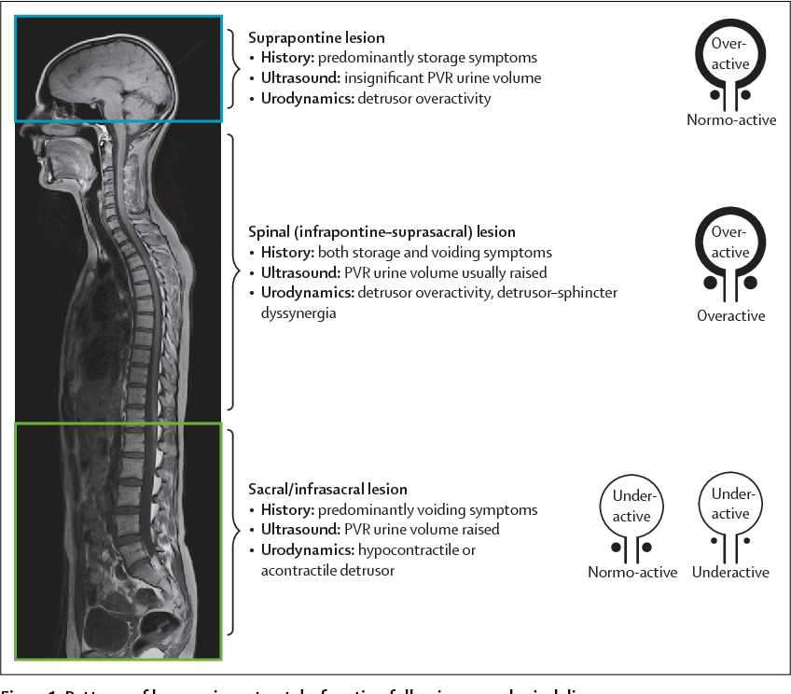

Slide 21
Diabetes Mellitus and Neurogenic Bladder
Pathophysiology:
- Chronic hyperglycemia leads to autonomic neuropathy.
- Damage to afferent and efferent fibers → impaired bladder sensation and detrusor underactivity.
Symptoms:
- Hesitancy, incomplete emptying, overflow incontinence, nocturia.
Incidence:
- Up to 43–87% of diabetics show some bladder dysfunction over time.

Slide 22
Parkinson's Disease and Neurogenic Bladder
Pathophysiology:
- Loss of dopaminergic inhibition in basal ganglia affects the frontal micturition center.
- Leads to detrusor overactivity due to reduced suppression of PMC.
Symptoms:
- Urgency, frequency, urge incontinence.
Incidence:
- 27–85% of patients with PD have lower urinary tract symptoms (LUTS).

Slide 23
Multiple Sclerosis and Neurogenic Bladder
Pathophysiology:
- Demyelination in CNS
- Can cause detrusor overactivity or detrusor-sphincter dyssynergia (DSD) according to the level of the disease.
Symptoms:
- Urgency, incontinence, hesitancy, retention.
Incidence:
- 10% of MS patients present with voiding dysfunction at disease onset, 75% of patients will develop it after 10 years of MS

Slide 24
Spina Bifida and Neurogenic Bladder
Pathophysiology:
- Congenital neural tube defect affects sacral spinal cord or peripheral innervation.
- Results in absent or disorganized control of bladder and sphincter.
Symptoms:
- Incontinence, retention, frequent UTIs, risk of kidney damage.
Incidence:
- Nearly all children with spina bifida have some degree of neurogenic bladder.

Slide 25
Other causes of neurogenic bladder
Spinal cord injuries
Stroke
Dementia
Brain tumors
Normal pressure Hydrocephalus
Disc prolapse and lumbar canal stenosis

Slide 26
Management of Neurogenic Bladder
Goals:
- Preserve renal function
- Prevent infections
- Achieve continence
- Improve quality of life
Management depends on the type of dysfunction:
- Detrusor overactivity
- Detrusor-sphincter dyssynergia (DSD)
- Acontractile bladder
- Sphincter underactivity

Slide 27
Management of Detrusor Overactivity
1. Behavioral Therapy:
- Timed voiding, bladder training
2. Pharmacologic:
- Antimuscarinics (e.g., oxybutynin, solifenacin)
- Beta-3 agonists (e.g., mirabegron)
3. Advanced Interventions:
- Intradetrusor botulinum toxin A injections
- Sacral neuromodulation
- Bladder augmentation (in severe cases)

Slide 28
Management of DSD (Detrusor Sphincter Dyssynergia)
1. Clean Intermittent Catheterization (CIC)
- Prevents retention and protects kidneys
2. Pharmacologic:
- Alpha-blockers (e.g., tamsulosin) to relax sphincter
3. Botulinum Toxin:
- Injection into external sphincter to reduce dyssynergia
4. Surgical:
- Sphincterotomy (rare, irreversible)

Slide 29
Management of Acontractile Bladder
1. Clean Intermittent Catheterization (CIC):
- Gold standard for emptying bladder
2. Indwelling Catheters:
- Foley or suprapubic catheter if CIC not feasible
3. Pharmacologic (limited efficacy):
- Cholinergic agonists (e.g., bethanechol)
4. Electrical Stimulation:
- Sacral neuromodulation

Slide 30
Management of Underactive External Urethral Sphincter
1. Pelvic Floor Muscle Training (PFMT):
- Kegel exercises
2. Biofeedback Therapy:
- Helps improve muscle awareness
3. Electrical Stimulation:
- Used to strengthen sphincter tone
4. Surgical Options:
- Urethral sling or artificial urinary sphincter for severe incontinence

Slide 31
Urodynamic study

Slide 32
Definition of Urodynamic study (UDS)
UDS: Physiological tests assessing LUT function
Simulates bladder cycle (filling & voiding)
Evaluates: bladder, sphincter, urethra coordination
general term to describe all the measurements that assess the function and dysfunction of the LUT by any appropriate method.

Slide 33
Components of UDS
Non-invasive
  Free uroflowmetry
  Post-void residual (PVR)
Invasive (Multichannel UDS)
  Cystometry (filling)
  Pressure-flow study (voiding)
  Electromyography (optional)

Slide 34
Free Uroflowmetry
Parameters:
  Voided volume (>150 ml for valid test)
  Maximum flow rate (Qmax)
  Mean flow rate
  Curve shape (bell-shaped = normal)
  Voided percentage (Void%)= [(volume voided/volume voided + PVR) × 100]
Post Void residual (PVR): Measured by ultrasound or catheterization

Slide 35
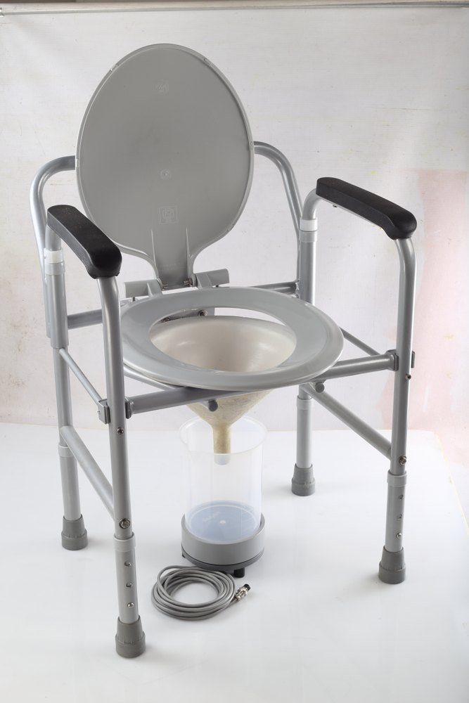

Slide 36
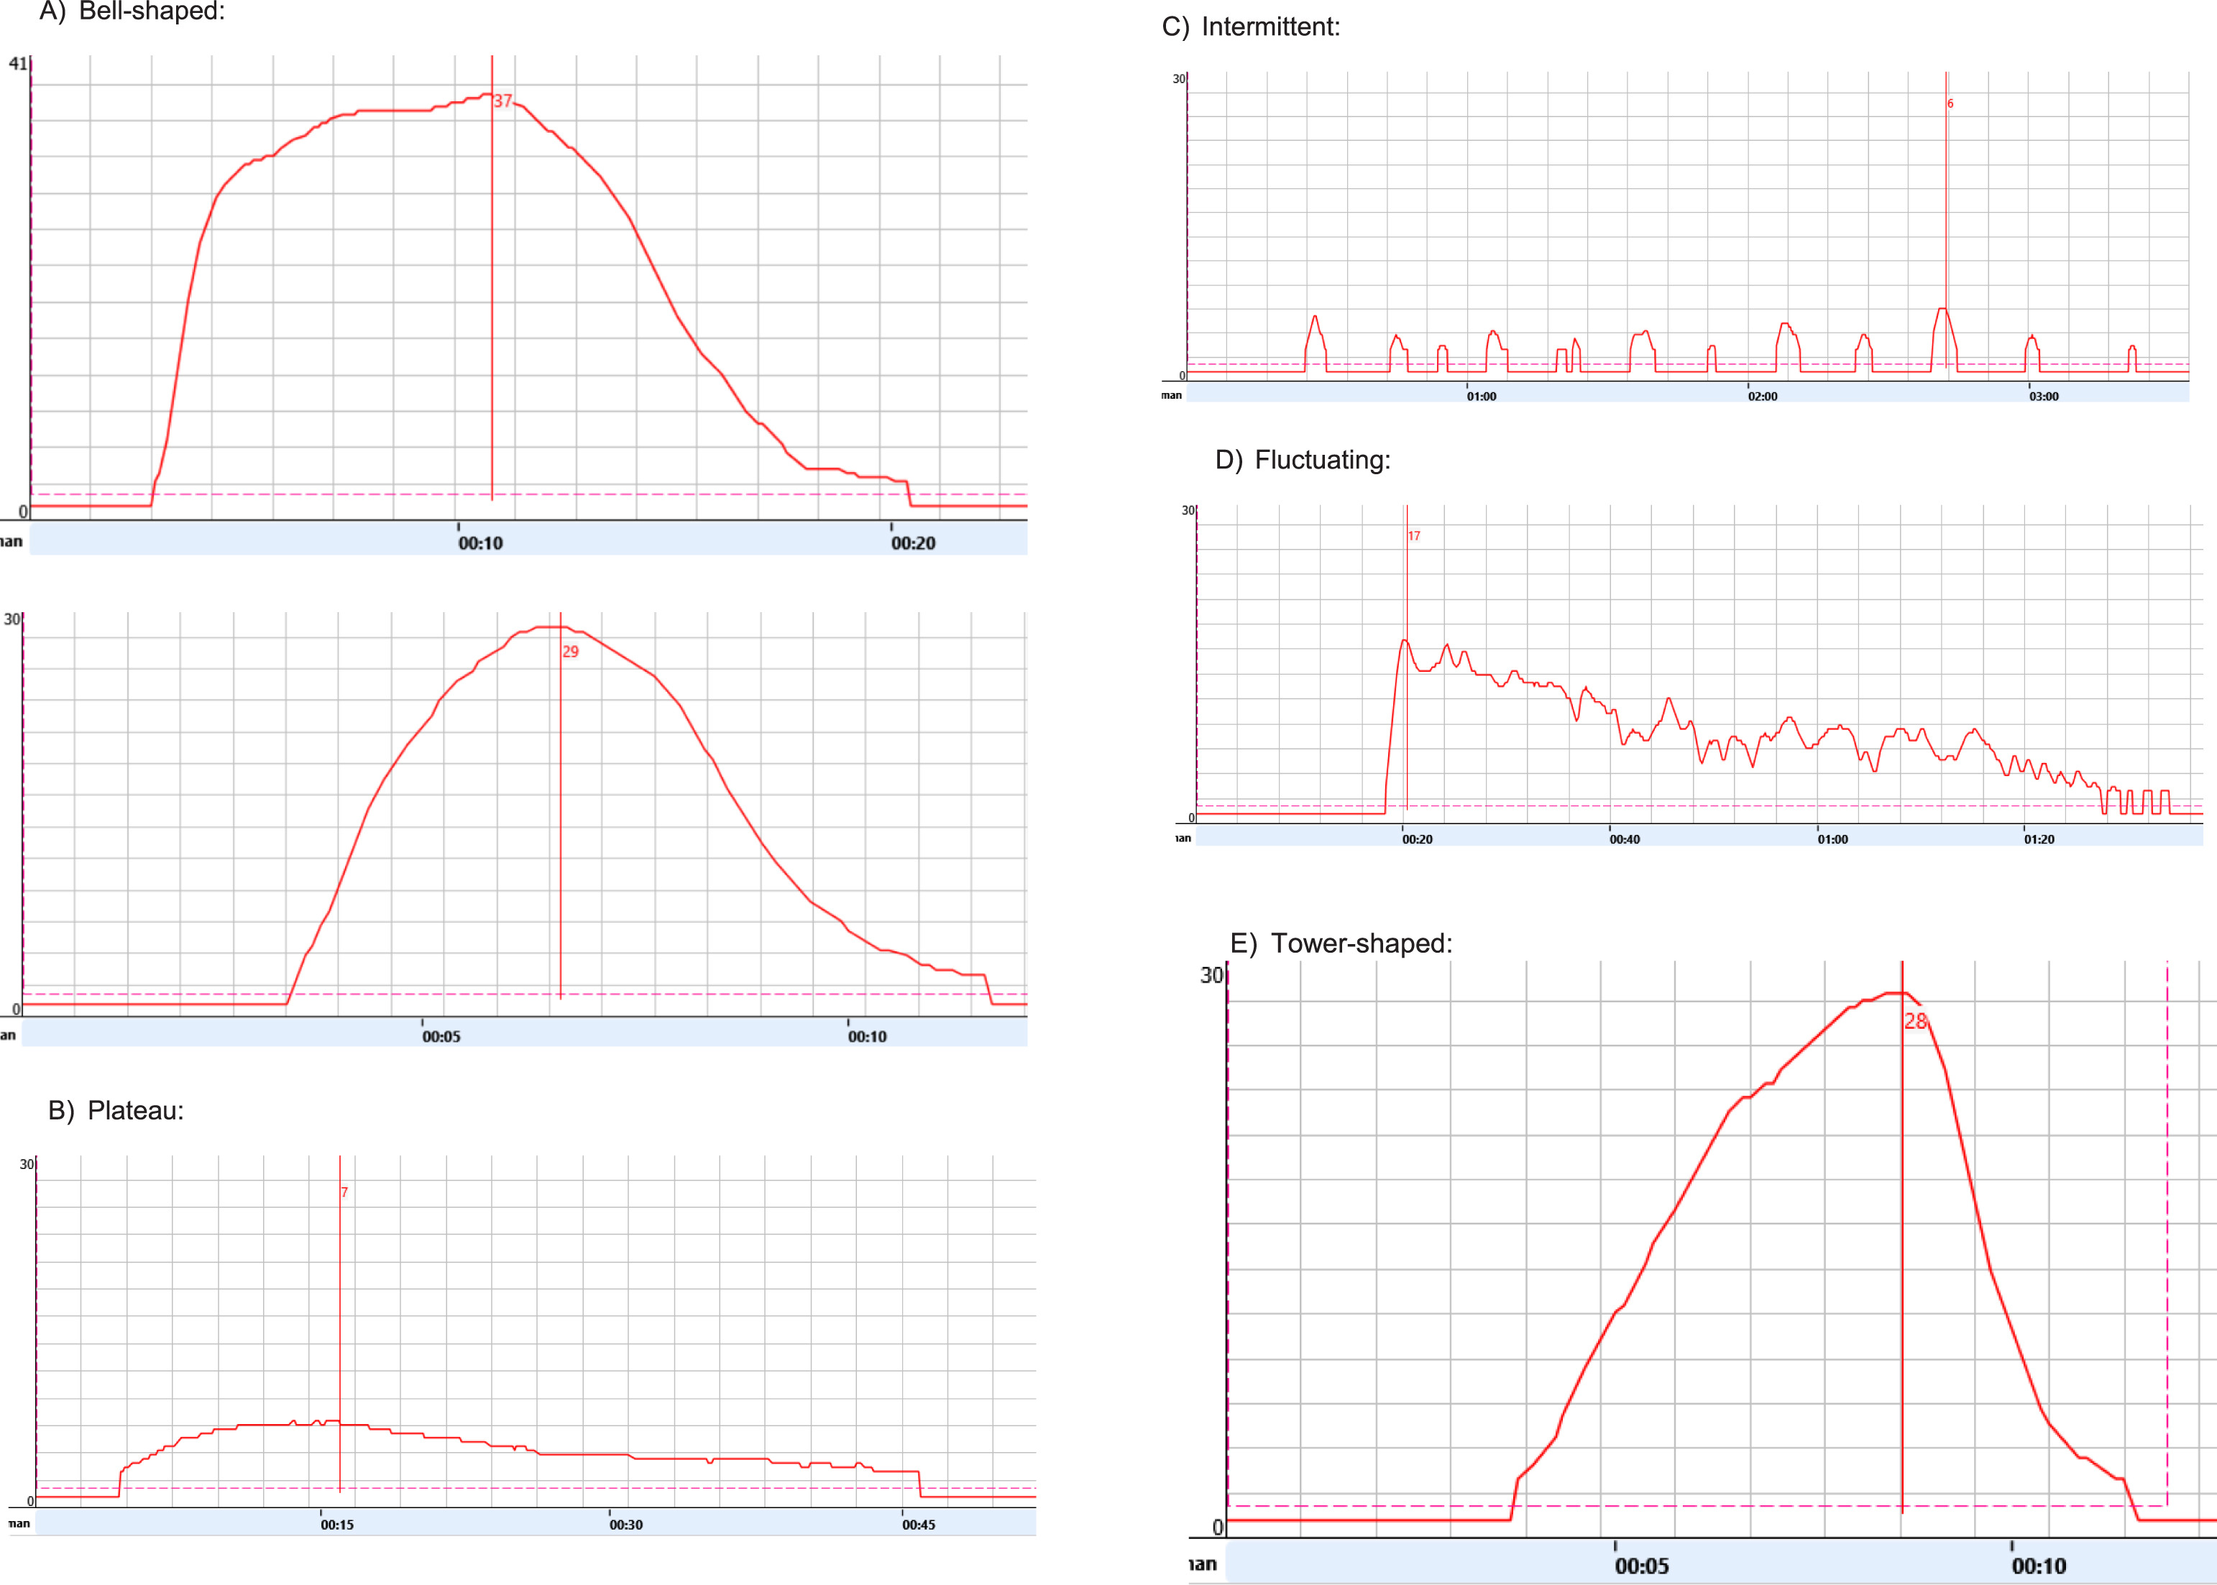
Free Uroflowmetry pattern
Notes:
The flow curve has a “bell” shape: is reached in the first 30% of VV and within 3 to 10 s from the flow start.
Similarly, women with “normal” findings (bell-shaped curve, greater than 15 mL/s and a postvoid residual volume of less than or equal to 20% of bladder volume) on non-intubated uroflowmetry might be diagnosed with various forms of LUTD on comprehensive urodynamic studies

Slide 37
Multichannel UDS Setup
Two catheters:
  Urethral (Pves)
  Rectal/vaginal (Pabd)
Calculations:
  Pdet = Pves – Pabd
Ensures differentiation between detrusor vs abdominal activity
Two phases to study
Filling cystometry study ( filling phase)
Pressure flow study ( voiding phase)

Slide 38
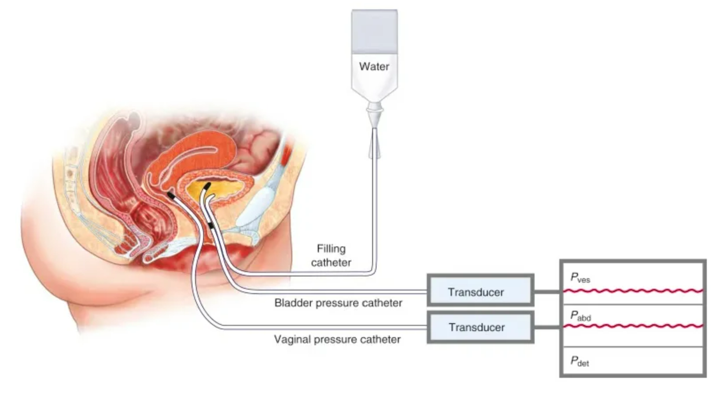

Slide 39
Filling Cystometry findings
Bladder sensations (ICS standard):
  First sensation of filling (~100–200 ml)
  First desire to void (~150–250 ml)
  Strong desire (~350–450 ml)
  Urgency → pathological sensation
Bladder capacity:
  Adults: ~400–600 ml
  Pediatrics: (Age + 2) × 30 ml
Compliance: ΔV/ΔP (normal >20 ml/cmH₂O)
Abnormalities:
  Detrusor overactivity (DO)
  Low compliance

Slide 40
Filling Cystometry findings
Leak Point Pressures
- Abdominal Leak Point Pressure (ALPP): In stress incontinence (Valsalva/cough)
- Detrusor Leak Point Pressure (DLPP): In neurogenic bladder (>40 cmH₂O = high risk for upper tract damage)

Slide 41
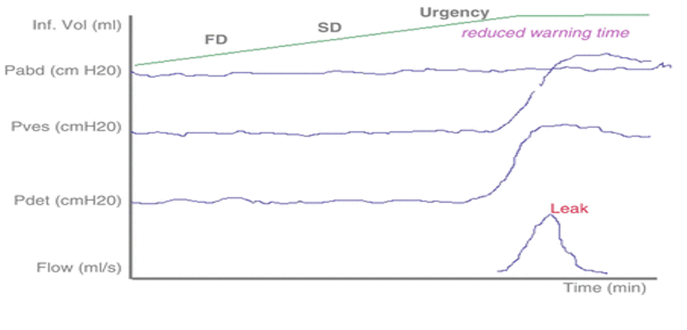
Low compliance

Slide 42
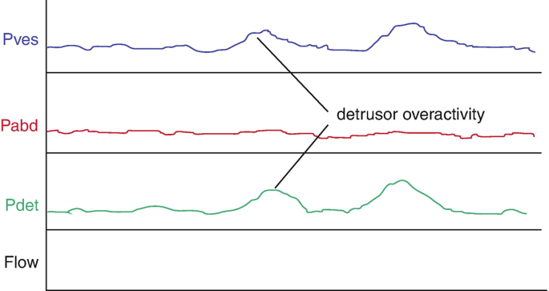
Detrusor overactivity

Slide 43
Pressure-Flow Study
Parameters:
  Voided volume
  Maxmium flow rate (Qmax)
  Average flow rate
  Detrusor pressure (Pdet) at Qmax
  Post void residual
Interpretation:
  High Pdet + low Qmax → Bladder outlet obstruction
  Low Pdet + low Qmax → Detrusor underactivity

Slide 44
Electromyography (EMG) in Urodynamic Studies (UDS)
EMG records electrical activity of striated muscles in the pelvic floor, especially:
External urethral sphincter
Perineal muscles
In filling cytometry:
Evaluate coordination of pelvic floor during bladder filling
In Pressure flow study:
Identify Detrusor Sphincter Dyssynergia (DSD)

