Slide 1



Why Prevention ?
Suha khalifa MD,FAAFP
Notes:
While preventive care costs much less than treatments in terms of money, it is much more of a long-term investment in terms of time and effort.
Education, time management, and dedication are all critical to practicing effective preventive care.

Slide 2

Prevention
Routine mammograms in women ages 50 to 64 have been shown to significantly reduce deaths from breast cancer.
Early detection of breast cancer can save up to 35 percent of the net cost of treatment and follow-up care,

Slide 3
Family doctors
Play an important role in cancer control that often goes beyond screening and diagnosis to treatment, survivorship, and palliative care.
Family medicine is a privileged reference for health policymakers being the source of information on the feasibility, effectiveness, and economic sustainability of the adopted policies.
MTCC

Slide 4
Why Prevention
Prevention and Early Diagnosis are priority strategies in view of the diminishing economic resources and the skyrocketing prices of treating advanced diseases.
Disability and death associated with chronic conditions is preventable
Despite cost effectiveness many preventive services remain underutilized.
Notes:
.
We need to improve our current healthcare system’s focus on treating later stages of disease to one where effective primary prevention and early detection is the norm.

Slide 5
Insurance companies
All employers should understand that increasing their investment in clinical preventive services will reduce cost and increase employee loyalty.
They must devote more attention to prevention, particularly among older workers, to reduce the prevalence and costs of chronic illness and disability.
Notes:
Working adults aged 50 to 65 are estimated to loose 20 % of total hours per week health-related productivity loss (19.6 percent of the total hours of health-related productivity loss per week

Slide 6
The importance of primary care model as providers of service .
There has been an emerging recognition of the need for innovative delivery systems that integrate prevention into both health and community systems
Patients should be connected to health care providers to ensure they get needed preventive services to decrease health risks, identify problems early, and manage chronic conditions to minimize their impact on their lives .
Family physicians play an important role in cancer control that often goes beyond screening and diagnosis to treatment, survivorship, and palliative care.
Notes:
. Many adults aged 50 to 64, are not connected to a regular healthcare provider who can ensure they get all the preventive services they need.
Furthermore, adults in this age group are often unaware of the clinical preventive services recommended for their age, gender and risk factors – or do not consider themselves to be at risk.2
n 2007, men 15 to 65 years of age were significantly less likely than women to seek preventive care services from a primary care physician (15% vs. 44% of total visits, respectively).³ In 2000, one in three men reported not having a primary care physician, compared with one in five women
Preventive services are more likely to be discussed when patients have an established relationship with an identified clinician.

Slide 7
Anticipatory Care Aims to :
1. Enhancing patient outcomes and quality of life improvement .
2. Increase life expectancy
3. Promoting of advances in cancer care , reducing social and economic barriers in Cancer care .
4. Reduce the burden of premature disability .

Slide 8
Health promotion :
Health promotion activities are non-clinical life choices, for example, eating nutritious meals and exercising daily, that both prevent disease and create a sense of overall well-being.
Preventing disease and creating overall well-being, prolongs our life expectancy.
Health-promotional activities do not target a specific disease or condition but rather promote health and well-being on a very general level .

Slide 9
Levels of Preventions :
1. Primary – prevent risk factor .
2. Secondary – prevent subclinical illness from advancing .
3. Tertiary – prevent clinical illness from advancing .

Slide 10

Primary prevention
1- Health education, Behavioral counseling , lifestyle changes
Provide information, in the hope that they will modify their behavior, ex: education about smoking related diseases.
2- Prophylaxis
Active medical intervention to protect from disease, ex: vaccination, immunization.

Slide 11
Secondary prevention
1- Screening
Systematic attempts to detect disease in an apparently healthy at-risk population

Slide 12
Wilson’s criteria for screening tests
• The condition should be prevalent problem.
• The natural history of the condition should be understood.
• There should be a recognizable latent or early symptomatic stage.
• There should be a test that is easy to perform and interpret, acceptable, accurate, reliable, sensitive and specific.
• There should be an accepted treatment recognized for the disease.
• Treatment should be more effective if started early.
• Diagnosis and treatment should be cost-effective.

Slide 13
Tertiary prevention
Monitoring of the patient with an established disease to prevent or minimize complications
Ex: - prevention of end-organ damage in hypertensive/diabetic patients
- Rehabilitation of stroke patients

Slide 14
What is the USPSTF
Created in 1984, the U.S. Preventive Services Task Force is an independent, volunteer panel of national experts in prevention and evidence-based medicine.
The Task Force works to improve the health of all Americans by making evidence-based recommendations about clinical preventive services such as screenings, counseling services, and preventive medications.
All recommendations are published on the Task Force’s Web site and/or in a peer-reviewed journal.

Slide 15

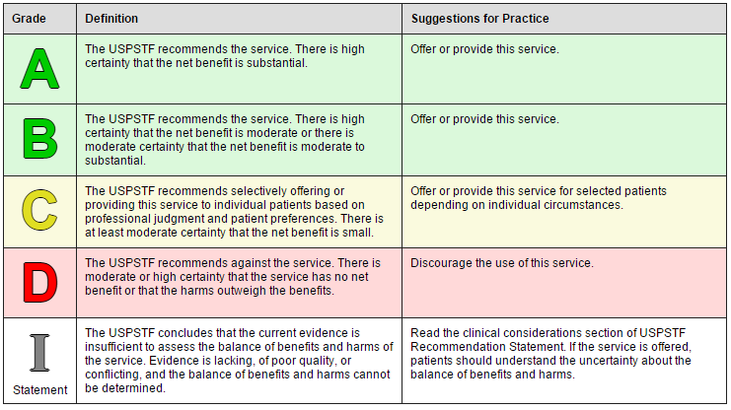
Notes:
An asterisk (*) in this presentation mean that the topic is in the process of being updated (cervical, breast, colon CA, lipid disorders

Slide 16

Challenges
Priorities
Coverage
Possible harms
Patient preferences
Busy practices
Notes:
1.Clinicians need to prioritize according to every patient’s needs
2. Harm from inappropriate tests .
3. Clinicians also must find a way to deliver preventive services within a busy clinical practice
patients have a limited understanding of probabilities.
)
Further, scheduled preventive interventions (eg, cancer screenings) may need to be deferred due to intercurrent individual illness or a larger public health crises
Periodic check ups.
Discussing stopping or reducing screening
Supportive office systems
Anxiety
Overdiagnosis
Cost

Slide 17
Wellness visit
Generally during a wellness check up the physician :
Assess the general health
Take a medical history
Family history
Conduct an exam
Order blood tests and imaging
Lifestyle changes
Help create a plan to improve your overall health

Slide 18
US Preventive Services Task Force (USPSTF)
Members of the panel are volunteers and represent the primary care disciplines of family medicine, internal medicine, nursing, obstetrics/gynecology, pediatrics, and behavioral medicine.
The purpose of the panel is to conduct scientific evidence reviews of a broad range of clinical preventive healthcare services and develop recommendations for primary care clinicians and health systems, with the goal of improving clinical practice and promoting public health.
Notes:
Overview of USPSTF recommendations — The USPSTF publishes evidence-based recommendations for multiple clinical preventive services based upon systematic reviews
Most primary care guidelines come from the U.S. Preventive Services Task Force (USPSTF) and have been adopted by the American Academy of Family Physicians (AAFP).^{1,2} Some subspecialty guidelines offer additional guidance but may have conflicting recommendations.

Slide 19
CARDIOVASCULAR DISEASE
CVD remains the leading cause of mortality in adults worldwide
Patients aged ≥20 years should undergo cardiovascular risk assessment every three to five years.
Prevalence varies with race and ethnicity .
Risk can be estimated using several widely available tools.
Notes:
cardiovascular disease (CVD),, are leading causes of morbidity and mortality in adults worldwide
Cardiovascular disease (CVD) risk can be estimated using one of several widely available tools, each with advantages and disadvantages. no single tool will be appropriate for all patients.
Usptf doesn’t recommend using Abi and crp and calcium score in its assessment
Only one model the reyolds risk score uses crp

Slide 20
Risk factors
The USPSTF recommends offering or referring adults with cardiovascular disease risk factors to behavioral counseling interventions to promote a healthy diet and physical activity.
●Smoking
●Overweight and obesity
●Unhealthy diet
●Physical inactivity
●Dyslipidemia
●Hypertension
●Diabetes mellitus (considered in some guidelines as a coronary heart disease [CHD] risk equivalent)
Notes:
Nontraditional measures — Coronary artery calcium testing may be useful as a complement to CVD risk assessment in select patients (see "Coronary artery calcium scoring (CAC): Overview and clinical utilization"). We do not recommend screening low-risk patients with other nontraditional measures (eg, C-reactive protein, carotid artery intima-media thickness, homocysteine, or lipoprotein[a]).
However, as discussed separately, these measures may be warranted for patients without known CVD who are at intermediate risk for CVD and for whom a more definite estimate of CVD risk would change management:
●C-reactive protein (see "C-reactive protein in cardiovascular disease")
●Carotid artery intima-media thickness (see "Carotid intima-media thickness")
●Homocysteine (see "Overview of homocysteine")
●Lipoprotein(a) (see "Lipoprotein(a)")
.

Slide 21
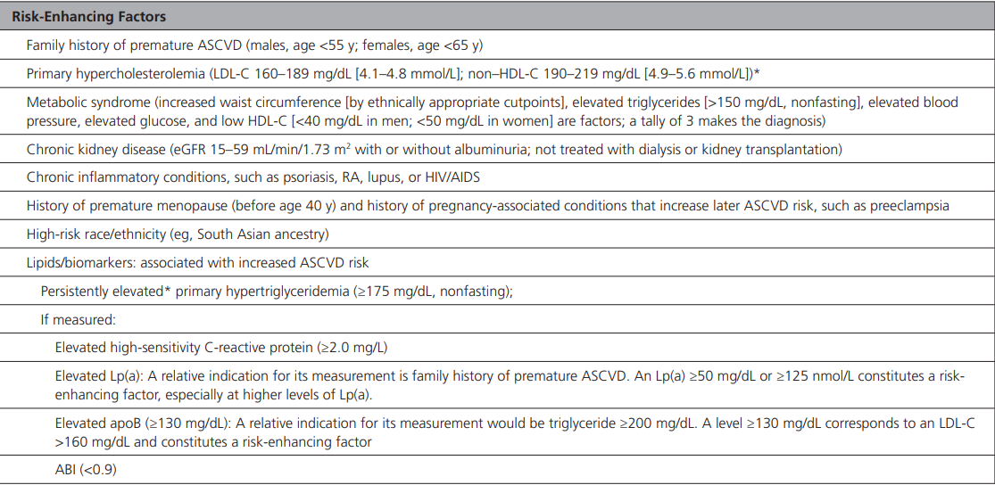
Risk factors

Slide 22
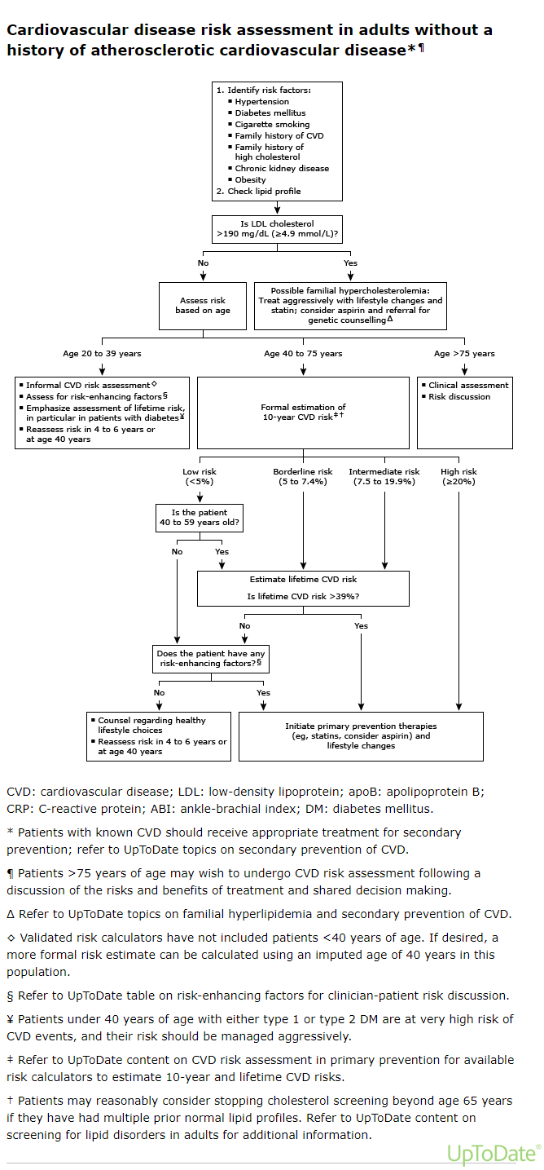

Slide 23
Hyperlipedemia screening
The USPSTF recommends that screening for lipid disorders :
● The U.S. Preventive Services Task Force (USPSTF) strongly recommends that clinicians routinely screen men aged 35 years and older and women aged 45 years and older for lipid disorders and treat abnormal lipids in people who are at increased risk of coronary heart disease. A recommendation

Slide 24
Hyperlipemia
● The USPSTF recommends that clinicians routinely screen younger adults (men aged 20 to 35 years and women aged 20 to 45 years) for lipid disorders if they have other risk factors for coronary heart disease.
B recommendation.
● The USPSTF makes no recommendation for or against routine screening for lipid disorders in younger adults (men aged 20 to 35 years or women aged 20 to 45 years) in the absence of known risk factors for coronary heart disease.

Slide 25
Risk factors
● Risk factors
Diabetes –
A family history of cardiovascular disease before age 50 years in male relatives or age 60 years in female relatives –
A family history suggestive of familial hyperlipidemia –
Multiple coronary heart disease risk factors (e.g., tobacco use, hypertension)

Slide 26
Hyperlipidemia
What does the USPSTF recommend?
B For adults aged 40 to 75 years who have 1 or more cardiovascular risk factors (ie, dyslipidemia, diabetes, hypertension, or smoking) and an estimated 10-year cardiovascular disease (CVD) risk of 10% or greater: Initiate a statin.
C For adults aged 40 to 75 years who have 1 or more cardiovascular risk factors (ie, dyslipidemia, diabetes, hypertension, or smoking) and an estimated 10-year CVD risk of 7.5% to 10%: Selectively offer a statin.
For adults 76 years or older: The evidence is insufficient to recommend for or against starting a statin
Notes:
For young adults who have not been screened as children, we obtain a baseline lipid profile at the time of initiation of care with an adult primary care practitioner to screen for familial hyperlipidemia and to assess cardiovascular disease (CVD) risk. If the results are normal, the timing and frequency of future screening should be guided by the patient’s risk of CVD and potential for interventions to improve patient outcomes.
(diabetes, tobacco use, hypertension, family history of cardiovascular disease before age 50 in male relatives or age 60 in female relatives, or a family history suggestive of familial hyperlipidemia
To whom does this recommendation apply? These recommendations apply to adults 40 years or older who do not already have CVD or signs or symptoms of CVD. They do not apply to adults with a low-density lipoprotein cholesterol level greater than 190 mg/dL (4.92 mmol/L) or known familial hypercholesterolemia. These populations are at very high risk for CVD and considerations on the use of statins in these populations can be found in other organization’s guidelines on management of hypercholesterolemia.
.
Other patients for whom a fasting lipid profile should be considered as the better approach include those who are overweight, have diabetes, or are taking medications that are known to raise triglyceride values such as steroids.
Many patients will undergo screening for a lipid disorder but not have preventive therapies started due to having a CVD risk below some threshold. We suggest assessing CVD risk and repeating measurements every five years. In patients near a threshold for treatment (whether based on total CVD risk or an LDL cholesterol goal), we suggest repeating measurements every three years. We also repeat measurements at least every three years in those found to be at increased CVD risk based on their lipid measurements. AHA/ACC 2018 guidelines for screening for dyslipidemia

Slide 27
Hypertension
Hypertension screening is recommended for adults ≥18 years of age .
Most patients have their blood pressure checked at each primary care visit.
Adults aged 18 to 39 years without elevated blood pressure (ie, <130/80 mmHg) and without cardiovascular disease risk factors should be rescreened every three to five years.

Slide 28
Diabetes mellitus
Screen asymptomatic adults aged 35 to 75 years of age who are obese or overweight .
Clinicians should consider screening at an earlier age in persons from groups with disproportionately high incidence and prevalence or in persons who have a family history of diabetes, a history of gestational diabetes, or a history of polycystic ovarian syndrome, and at a lower BMI in Asian American persons.
Patients with prediabetes should be referred to dietary interventions
Recommends screening women at 24 weeks of gestational age .
Notes:
Testing should be considered in overweight or obese (BMI >25 kg/m2 or > 23 kg/m2 in adults who have one or more of the following risks factors:
First degree relative with diabetes •
High-risk race/ethnicity (e.g. African American, Latino, American Indian, Alaska People, Asian American, Pacific Islander) •
History of CVD •
Hypertension (>140/90 mmHg or on therapy for hypertension) • HDL Cholesterol Level 250 mg/dL (2.82 mmol/) •
Women with polycystic ovary syndrome •
Physical inactivity •
Other clinic conditions associated with insulin resistance (e.g., severe obesity, acanthosis nigricans)
If results are normal, testing should be repeated at a minimum of 3-year intervals, with consideration of more frequent testing depending on initial results and risk status

Slide 29
Diabetes
US Preventive Services Task Force — 2021 guidelines from the US Preventive Services Task Force (USPSTF)
Screen asymptomatic adults aged 35 to 75 years of age who are obese or overweight .
Patients with pre diabetes should be referred to dietary interventions .screen all other patients with higher risk groups .
Recommends screening women at 24 weeks of gestational age
American Diabetes Association — The American Diabetes Association (ADA) recommends testing for diabetes or prediabetes in adults with body mass index (BMI) ≥25 kg/m²have one or more additional risk factors for diabetes, as well as in persons with gestational diabetes mellitus or HIV
All other adults, it recommends that testing begin at age 35 years.
People with prediabetes (A1C ≥5.7 percent [39 mmol/mol], impaired glucose tolerance, or impaired fasting glucose) should be tested for diabetes yearly.
If the screening test is negative, repeat testing every three years is reasonable.)

Slide 30
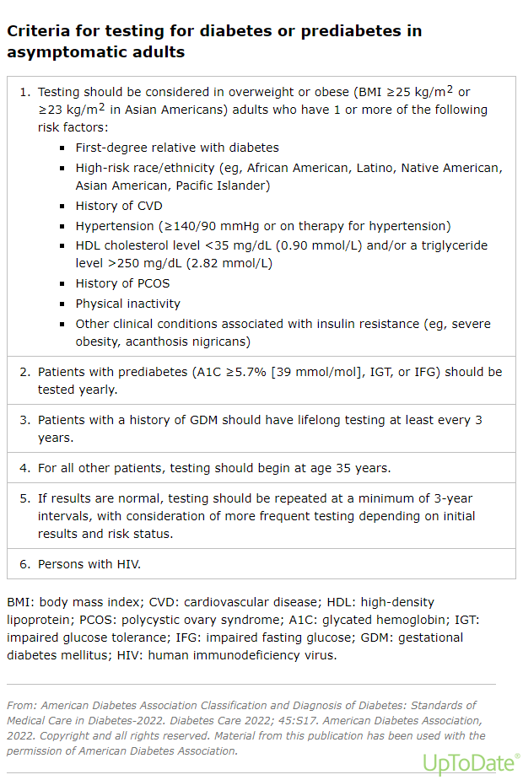

Slide 31
Screening modality
Fasting blood sugar.
Hba1c.
Glucose tolerance test.
Random blood sugar testing .

Slide 32
Aspirin
Decisions regarding aspirin for primary prevention of CVD should be made on an individual basis.
Low-dose aspirin may prevent cardiovascular disease (CVD) in some patients but also increases the risk of bleeding.
New evidence , published in JAMA from the US Preventive Services Task Force (USPSTF) concludes with moderate certainty that aspirin use for the primary prevention of CVD events in adults aged 40 to 59 years who have a 10% or greater 10-year CVD risk has a small net benefit.
The USPSTF concludes with moderate certainty that initiating aspirin use for the primary prevention of CVD events in adults 60 years or older has no net benefit.
Notes:
Task Force (USPSTF) commissioned a systematic review on the effectiveness of aspirin to reduce the risk of CVD events (myocardial infarction and stroke), cardiovascular mortality, and all-cause mortality in persons without a history of CVD. The systematic review also investigated the effect of aspirin use on colorectal cancer (CRC) incidence and mortality in primary CVD prevention populations, as well as the harms (particularly bleeding) associated with aspirin use.
Population Adults 40 years or older without signs or symptoms of CVD or known CVD (including history of myocardial infarction or stroke) who are not at increased risk for bleeding (eg, no history of gastrointestinal ulcers, recent bleeding, other medical conditions, or use of medications that increase bleeding risk). According to the statement, they conclude "with moderate certainty" that low-dose aspirin for primary prevention has a "small net benefit" in relation to risk of bleeding based on the evidence from the systematic review that included 11 randomized trials of low-dose aspirin (100 mg daily or less) in adults 40 to 50 years old and those over 60 years old
Evidence Assessment The USPSTF concludes with moderate certainty that aspirin use for the primary prevention of CVD events in adults aged 40 to 59 years who have a 10% or greater 10-year CVD risk has a small net benefit. The USPSTF concludes with moderate certainty that initiating aspirin use for the primary prevention of CVD events in adults 60 years or older has no net benefit.
Recommendation The decision to initiate low-dose aspirin use for the primary prevention of CVD in adults aged 40 to 59 years who have a 10% or greater 10-year CVD risk should be an individual one. Evidence indicates that the net benefit of aspirin use in this group is small. Persons who are not at increased risk for bleeding and are willing to take low-dose aspirin daily are more likely to benefit. (C recommendation) The USPSTF recommends against initiating low-dose aspirin use for the primary prevention of CVD in adults 60 years or older. (D recommendation)

Slide 33
Aspirin
low-dose aspirin continues to be recommended, for secondary prevention for patients with ASCVD or who have existing heart problems, including a history of a heart attack or stroke, angioplasty, PCI or CABG
The USPSTF recommends the use of low-dose aspirin (81 mg/day) as preventive medication after 12 weeks of gestation in persons who are at high risk for preeclampsia..

Slide 34
CANCER PREVENTION
Avoidance of tobacco
Being physically active
Maintaining a healthy weight
Eating a diet rich in fruits, vegetables, and whole grains and low in saturated/trans fat
Limiting alcohol consumption
Protecting against sexually transmitted infections (including receiving human papillomavirus [HPV] vaccination)
Avoiding excess sun exposure

Slide 35
Breast cancer
All women should get screened for breast cancer every other year, starting at age 40 and continuing through age 74, to reduce their risk of dying from this disease. B
Task Force to recommend for or against additional screening with breast ultrasound or MRI. I
Notes:
For women who are at average risk for breast cancer, most of the benefit of mammography results from biennial screening during ages 50 to 74 years. Of all of the age groups, women aged 60 to 69 years are most likely to avoid breast cancer death through mammography screening. While screening mammography in women aged 40 to 49 years may reduce the risk for breast cancer death, the number of deaths averted is smaller than that in older women and the number of false-positive results and unnecessary biopsies is larger. The balance of benefits and harms is likely to improve as women move from their early to late 40s.

Slide 36
Breast Cancer
Women who are at high risk for breast cancer based on certain factors should get a breast MRI and a mammogram every year, typically starting at age 30. This includes women who:
Have a lifetime risk of breast cancer of about 20% to 25% or greater, according to risk assessment tools that are based mainly on family history
Have a known BRCA1 or BRCA2 gene mutation (based on having had genetic testing)
Have a first-degree relative (parent, brother, sister, or child) with a BRCA1 or BRCA2 gene mutation, and have not had genetic testing themselves
Had radiation therapy to the chest before they were 30 years old
Have Li-Fraumeni syndrome, Cowden syndrome, or Bannayan-Riley-Ruvalcaba syndrome, or have first-degree relatives with one of these syndromes

Slide 37
Screening modality
Mammogram .
What about ultrasound ?
What about MRI?
What about self breast exam?
Clinical exam?
Notes:
The USPSTF recommends biennial screening mammography for women aged 50 to 74 year\
The USPSTF concludes that the current evidence is insufficient to assess the balance of benefits and harms of adjunctive screening for breast cancer using breast ultrasonography, magnetic resonance imaging, DBT, or other methods in women identified to have dense breasts on an otherwise negative screening mammogram

Slide 38
Breast cancer
The USPSTF recommends that primary care clinicians assess women with a personal or family history of breast, ovarian, tubal, or peritoneal cancer or who have an ancestry associated with breast cancer susceptibility 1 and 2 (BRCA1/2) gene mutations with an appropriate brief familial risk assessment tool.
Women with a positive result on the risk assessment tool should get genetic counselling and testing.
Notes:
The USPSTF recommends that clinicians offer to prescribe risk-reducing medications, such as tamoxifen, raloxifene, or aromatase inhibitors, to women who are at increased risk for breast cancer and at low risk for adverse medication effects.

Slide 39
Colorectal cancer
The age of initiation and frequency of colorectal cancer screening varies with the risk:
Average-risk patients aged 45 -75 and older be screened for colorectal cancer A
Screen from age 50-75 years B
The USPSTF recommends that clinicians selectively offer screening for colorectal cancer in adults aged 76 to 85 years. Evidence indicates that the net benefit of screening all persons in this age group is small. In determining whether this service is appropriate in individual cases, patients and clinicians should consider the patient's overall health, prior screening history, and preferences. C
.
The recommended interval varies depending upon the screening strategy.
Notes:
Patients should be advised of the risks and benefits of different screening options. The decision about which option to select should be made between the patient and clinician, weighing factors of effectiveness, safety, cost, and availability of the screening tests.
What is an “Average” Risk of Colorectal Cancer?
Your risk level is considered average if you have:
No history of colorectal cancer or polyps
No family history of colorectal cancer
No history of Crohn’s disease or ulcerative colitis
No history of or suspected hereditary cancer syndrome (familial adenomatous polyposis or Lynch syndrome
No history of previous cancer treatment in the abdomen or pelvic area

Slide 40
Recommended intervals for colorectal cancer screening tests include
Recommended intervals for colorectal cancer screening tests include
High-sensitivity gFOBT or FIT every year
sDNA-FIT every 1 to 3 years
CT colonography every 5 years
Flexible sigmoidoscopy every 5 years
Flexible sigmoidoscopy every 10 years + FIT every year
Colonoscopy screening every 10 years

Slide 41

Lung cancer
Annual screening with low-dose helical computed tomography (CT).
Start at age 50-80 years , who have a 20-pack year smoking history within past 15 years or currently smoking
Notes:
Its is calculated by multiplying the number of packs of cigarettes smoked per day by numbrr of years the person smoked

Slide 42

Prostate cancer
Health care providers should periodically discuss prostate cancer screening with patients 55 and above who have average risk factors and are expected to live at least 10 years .
Discussions about periodic screening should begin at age 40 to 45 in those at high risk for prostate cancer; those with a family history of prostate cancer, particularly in relatives younger than age 65; and individuals who are known or likely to have the BRCA1 or BRCA2 mutations)
Notes:
For men 55-65 discussion to undergo periodic screening with PSA , discuss potential benefit and harm (C recommendation)
Men above 70 it a d recommendation

Slide 43
Cervical cancer
The available methods for cervical cancer screening are the Papanicolaou (Pap) test (ie, cytology),
HPV testing, and co-testing
Screening every 3 years from age 21-30 with cytology .
Screening every 5 years with both cytology and HPV.
No screening for patients with hysterectomy .
Notes:
Cervical cancer screening uptake among Jordanian women is significantly low; determining factors for the decision to undergo screening include encouragement from the healthcare provider, the number of years of marriage, and use of the private healthcare sector. To improve uptake, structured screening programmes need to be implemented in collaboration with national partners and institutions to decrease the incidence of cervical cancer in Jordan.
Infection with oncogenic strains of HPV (ie, high-risk HPV [hrHPV]) and persistence of hrHPV infection are the most important determinants of progression to cervical cancer
In co-testing, both a Pap test and HPV test are collected, and results are provided concurrently; screening interval for co-testing is every five years.
Co-testing results in a doubling of tests being performed (Pap and HPV testing) and therefore may not be sustainable in all settings.

Slide 44
Primary HPV testing
HPV test is performed alone, without cervical cytology; the suggested screening interval for primary HPV testing is every five years.
If HPV testing is positive (abnormal), reflex genotyping for HPV types 16 and 18 and reflex cytology are performed (ie, a Pap test is performed as a result of the positive HPV test
Self-collection of HPV samples may be useful for patients with barriers to collection.
Notes:
The incidence of high-grade cytologic abnormalities is very low within three years of a normal Pap test (10 to 66 per 10,000) [27], and modeling studies have suggested cancer detection rates to be similar with annual or triennial screening, while doubling or tripling the number of downstream interventions, including colposcopies with annual screening
HPV test is performed alone, without cervical cytology; the suggested screening interval for primary HPV testing is every five years. Only certain HPV tests are approved by the US Food and Drug Administration (FDA) for primary hrHPV testing (ie, Cobas, BD Onclarity), and these tests are not available at all institutions (table 1). However, other countries (eg, Australia, Netherlands, United Kingdom) have transitioned to nationwide screening with this method.
If hrHPV testing is positive (abnormal), reflex genotyping for HPV types 16 and 18 and reflex cytology are performed (ie, a Pap test is performed as a result of the positive HPV test). This is discussed in more detail elsewhere. (See 'Follow-up of abnormal results' below.)
Self-collection of HPV samples may be useful for patients with barriers to screening (eg, patients with limited access to health care, gender minority patients, patients with a history of abuse/trauma) [32]. Though not approved by the FDA, self-sampling devices are available in the Netherlands and Australia [33,34] and in some resource-limited settings. This is discussed in more detail elsewhere

Slide 45
Osteoporosis
Postmenopausal women <65 years with risk factors for osteoporosis
Men with clinical manifestation of low bone mass, history of low trauma fracture, risk factors for fracture (such as androgen deprivation therapy for prostate cancer, hypogonadism, primary hyperparathyroidism, or intestinal disorders).
All women ≥65 years.
There are several modalities to evaluate bone density. Dual-energy x-ray absorptiometry (DXA)

Slide 46
Psychological disorders
Screen adults for depression .
Systems should be in place to ensure appropriate follow-up and management of patients who screen positive.
There is limited evidence to guide the optimal frequency of screening for depression.
Anxiety — A 2020 guideline from the Women's Preventive Services Initiative (WPSI) recommends screening for anxiety in women and adolescent girls aged 13 years .
Intimate partner violence __routine screening for all patients on all visits to primary care clinicians, to obstetrician-gynecologists, to the emergency department, and on hospital admission
Notes:
For practices choosing to screen, the two-item Patient Health Questionnaire (PHQ), either as a verbal or written screen, is easily administered , To facilitate ease of implementation, screen at the time of a routine health visit
A positive screen should be followed by a clinical interview, facilitated with the PHQ-9 to diagnose depression

Slide 47
Psychological disorders
Anxiety — A 2020 guideline from the Women's Preventive Services Initiative (WPSI) recommends screening for anxiety in women and adolescent girls aged 13 years .
Intimate partner violence __routine screening for all patients on all visits to primary care clinicians, to obstetrician-gynecologists, to the emergency department, and on hospital admission

Slide 48
Substance abuse
Alcohol, Single-item screen question, "Do you sometimes drink beer, wine, or other alcoholic beverages?" If yes, then the clinician can follow up with,
How many times in the past year have you had five (four for women) or more drinks in a day?“
Drugs The screening question is:
“How many times in the past year have you used an illegal drug or used a prescription medication for nonmedical reasons?”
Notes:
If asked to clarify the meaning of “nonmedical reasons,” add "for instance because of the experience or feeling it caused.”

Slide 49
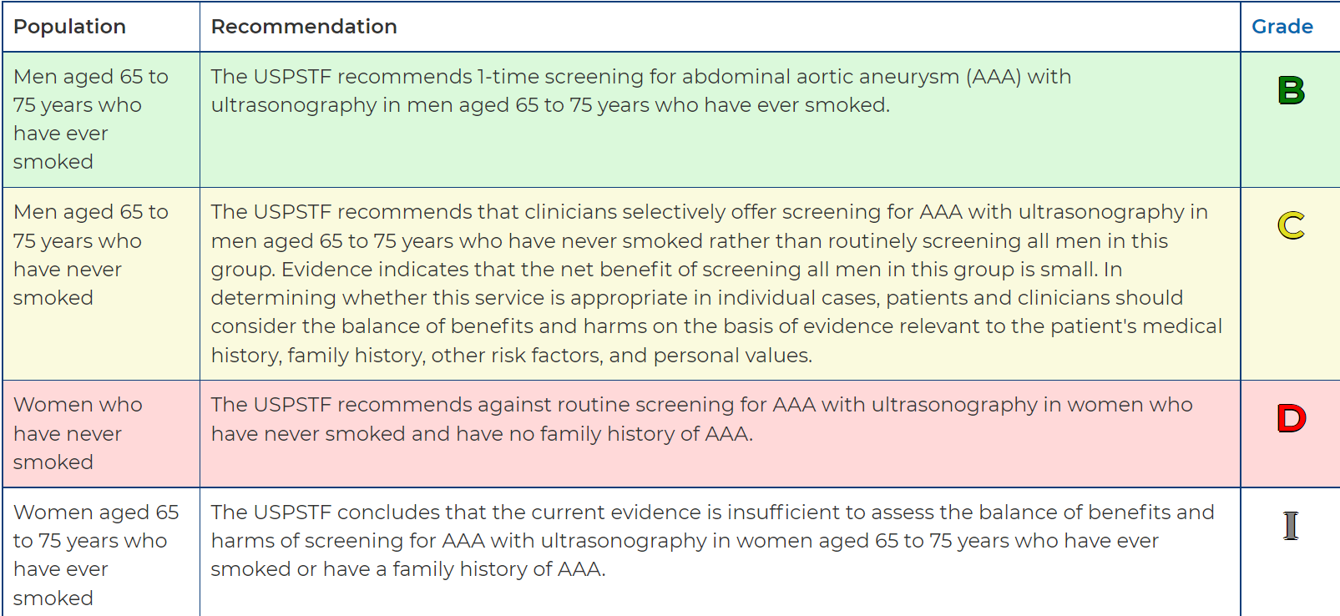
Abdominal aortic aneurysm

Slide 50
Immunization
Influenza vaccine
Tetanus, diphtheria, and acellular pertussis vaccination (Td/Tdap)
Human papillomavirus vaccines
Zoster vaccine
Pneumococcal vaccines
Meningococcal vaccines
Hepatitis B vaccination
COVID-19
RSV

Slide 51
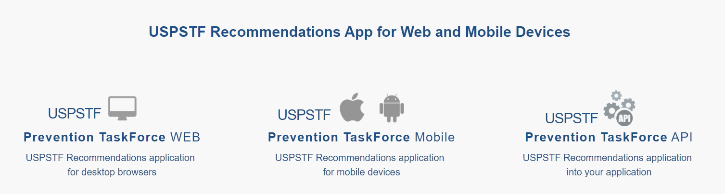
Options

Slide 52
Thank you

