Slide 1

Death
Done by Salam Omoosh and Zahar ALhamaideh

Slide 2
Thanatology (Greek thanatos: death)
Is the scientific study of death in all its aspects including its cause and phenomena.
It also includes bodily changes that accompany death (post-mortem changes) and their medico-legal significance.
Medically and scientifically, death is not an event; it is a process in which cellular metabolic processes in different tissues and organs cease to function at different rates.
Legally defined as the irreversible cessation of function of 3 systems:
- CNS
- RS
- CVS

Slide 3
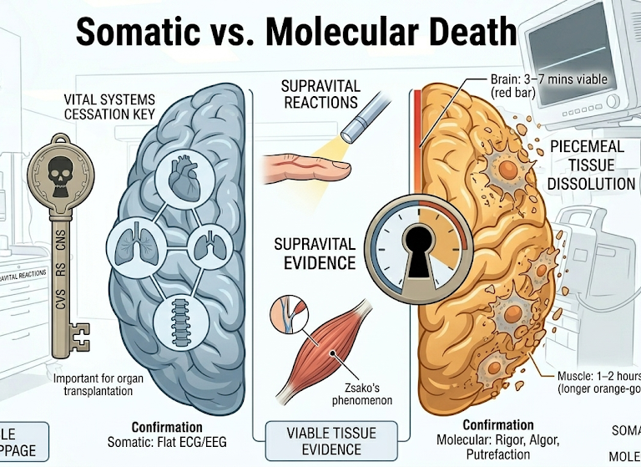
Stages Of Death

Slide 4
Somatic Death
The question of death is important in resuscitation and organ transplantation.
Skin and bone remains metabolically active for many hours, and these cells can be successfully cultured days after somatic death.
Complete and irreversible cessation of function of brain, and stoppage of the circulation and respiration.

Slide 5
Molecular Death
Molecular death occurs piecemeal. Initial changes occur due to metabolic dysfunction and later from structural disintegration.
Progressive disintegration of body tissues with death of individual tissues and cells. Nervous tissues die rapidly, the vital centres of the brain in about 3–7 minutes(min), but muscles survive upto 1–2 hours (h).

Slide 6
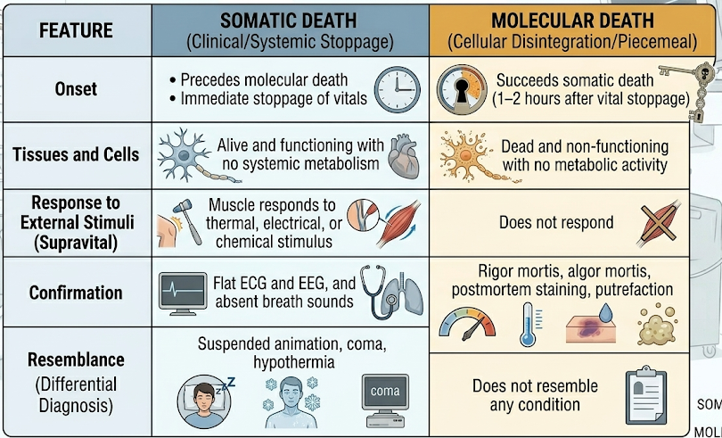

Slide 7
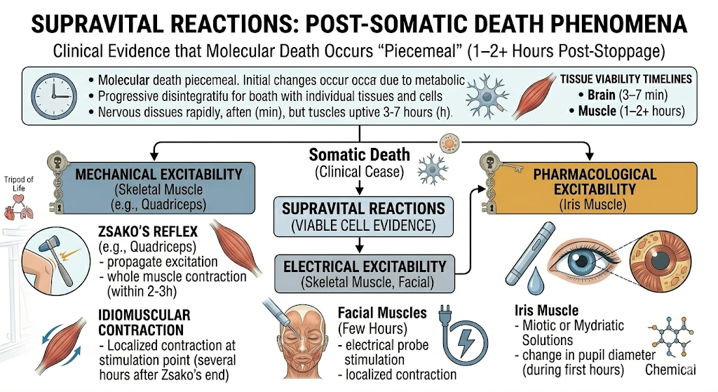

Slide 8
Cause Of Death
Is any injury or disease producing physiological derangement, briefly or over a prolonged period and which results in the death of the individual, e.g. A gunshot wound to the abdomen, a stab wound to the chest, adenocarcinoma of the lung or coronary atherosclerosis

Slide 9
Mechanism Of Death
Is the physiological derangement produced by the cause of death that results in death, e.g. Haemorrhage, septicaemia, metabolic acidosis or alkalosis, ventricular fibrillation or respiratory paralysis. A particular mechanism of death can be produced by multiple causes of death and vice versa. Thus, if an individual dies of haemorrhage, it can be produced by a gunshot wound or a stab wound or a malignant tumour of the lung eroding into a blood vessel. A cause of death, e.g. A gunshot wound of the abdomen can result in many possible mechanisms of death, like haemorrhage or peritonitis

Slide 10
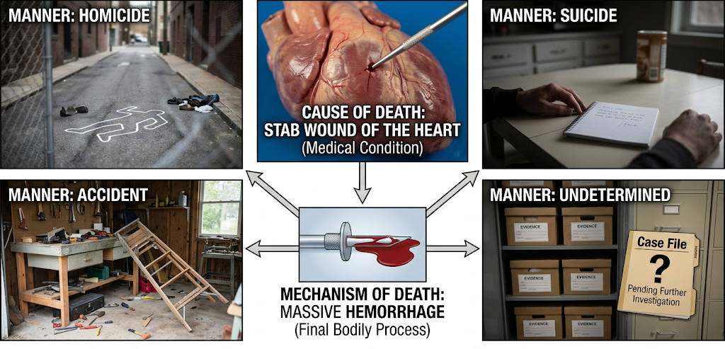
Manner Of Death
Explains how the cause of death came about. Manner of death can generally be categorized as natural (death due to disease), homicide, suicide, accident or undetermined

Slide 11
Agonal Period: is the time between a lethal occurrence and death.
Mode Of Death: refers to an abnormal physiological state that pertained at the time of death, e.g. Coma, congestive cardiac failure, cardio-respiratory failure, cardiac arrest and pulmonary edema. According to Xavier Bichat, a French physician, there are three modes of death depending upon the system most obviously affected, irrespective of what the remote cause of death may be:
i. Coma.
ii. Syncope.
iii. Asphyxia.

Slide 12
Scenario to practice
​A 65-year-old individual is found deceased in their home. Forensic investigation reveals a severe, untreated infection in the abdominal cavity resulting from a ruptured appendix. The individual had been unconscious for several hours before passing away.

Slide 13
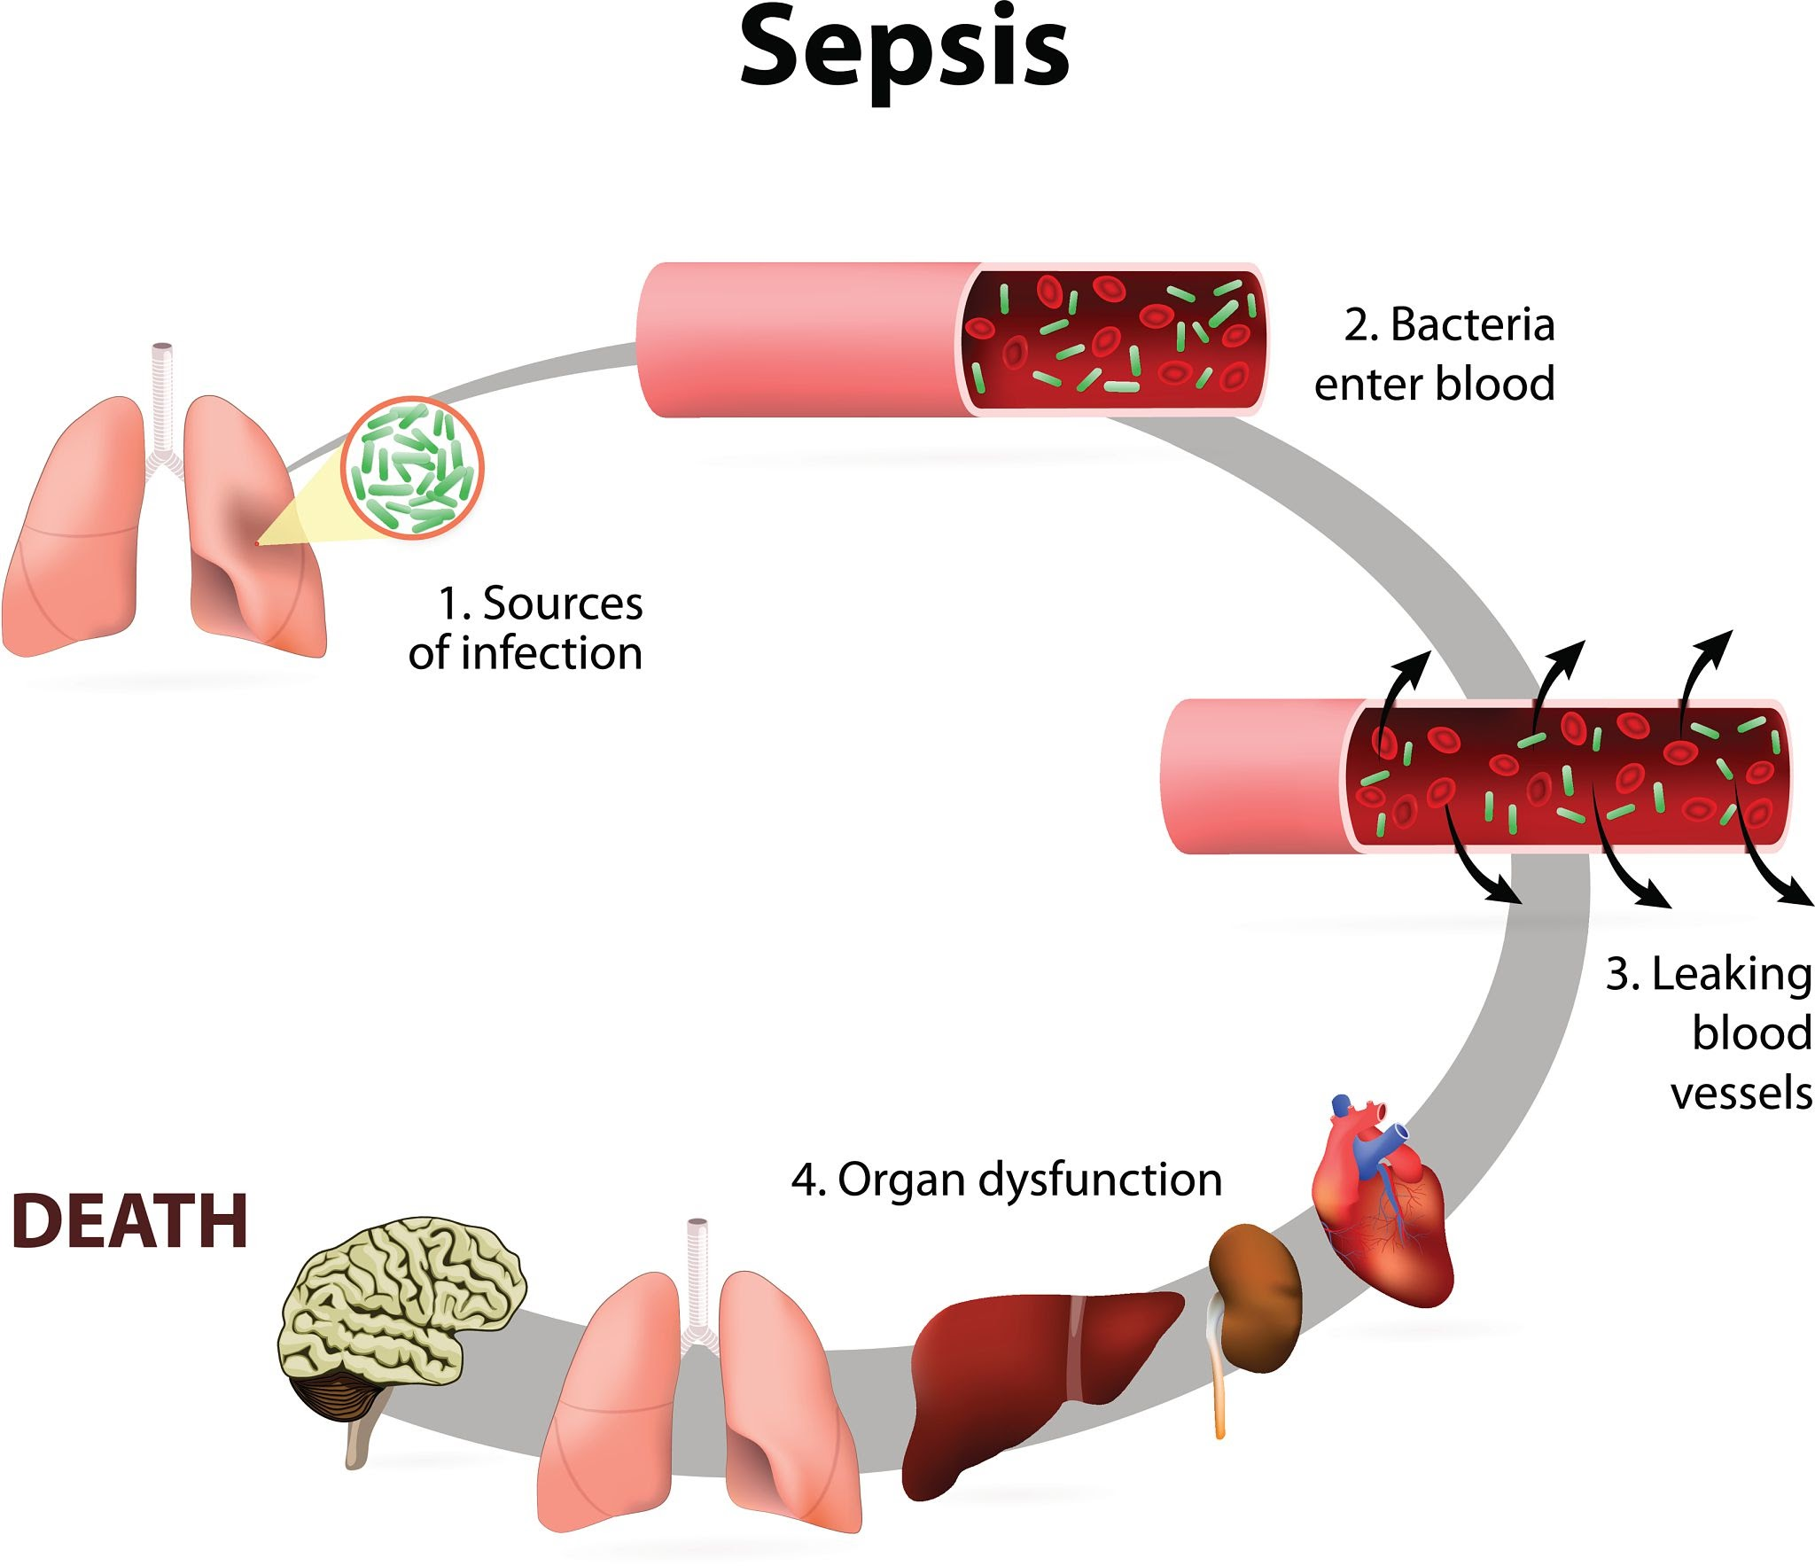
Cause Of Death: Ruptured appendicitis.
Mechanism Of Death: septicemia
Manner Of Death: Natural
Agonal Period: several hours
Mode of death: Coma

Slide 14
Signs Of Death
The accurate determination of time of death is important due to its role in explaining possible criminal acts and determination of appropriate civil repercussions.

Slide 15
Suspended Animation (Apparent Death)
Suspended animation is a condition in which vital signs of life (heartbeat and respiration) are not detected by routine clinical methods, as the functions are interrupted for some time or are reduced to a minimum.
Mechanism: The metabolic rate is greatly reduced so that the requirement of the individual cell for oxygen is satisfied through the dissolved oxygen in body fluids

Slide 16
Types:
Voluntary: Seen in practitioners of yoga or in trance.
Involuntary: Seen in hypothermia, poisoning with barbiturates or opiates, newborns, drowning, electrocution, heatstroke, cholera, post anesthesia, shock, cerebral concussion or insanity.
The patient can be resuscitated by cardiac massage or electric stimulator and artificial respiration. The death certificate should not be issued without an ECG or EEG record.

Slide 17
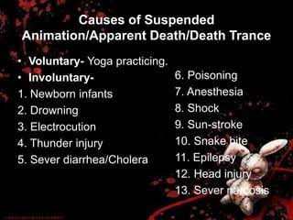

Slide 18
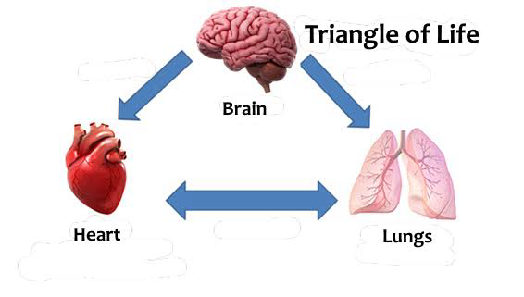

Slide 19
Immediate Changes (Somatic Death)
a. Irreversible cessation of the function of brain including brainstem:
This is the earliest sign of death with stoppage of functions of the nervous system. There is insensibility, and loss of both sensory and motor functions. There is loss of reflexes, no response and no tonicity of the muscles. Pupils are widely dilated.
b. Irreversible cessation of respiration: Complete stoppage of respiration for > 4 minutes (min) usually causes death.
c. Irreversible cessation of circulation: Stoppage of heart beat for > 3–5 min is irrecoverable and results in death.

Slide 20
Early Changes (Molecular Death)
Changes in the skin and facial pallor: Skin becomes pale and ash-white due to stoppage of circulation and drainage of blood from the capillaries and the small vessels. The skin loses its elasticity, and the face looks younger due to loss of creases. The lips appear brownish, dry and hard due to drying.
Primary relaxation or flaccidity of the muscles: Muscles loose their tonicity and become flaccid, but the muscular tissues are still alive, their chemical reaction is alkaline and responds to electrical stimuli.

Slide 21
Contact flattening and pallor: The areas which remain in contact with the ground, become flat and the blood from vessels of these areas is pressed out, this continues even after the formation of postmortem staining over the surrounding areas.
Changes in the eye:
Loss of corneal and pupillary reflexes
Pupils: The pupils are dilated after death, because of the relaxation of muscles of the iris. Later, they are constricted
pupil can be changed in shape , and the change may persist during the stage of rigor mortis of the muscles.
Tache noire : If the eyelids remain open for 3–4 h after death, there is formation of two yellow triangles ) on the sclera at each side of the iris, which become brown and then black. Cause: Drying/desiccation, and deposition of cellular debris, mucus and dust on the exposed conjunctiva and the sclera underneath.

Slide 22
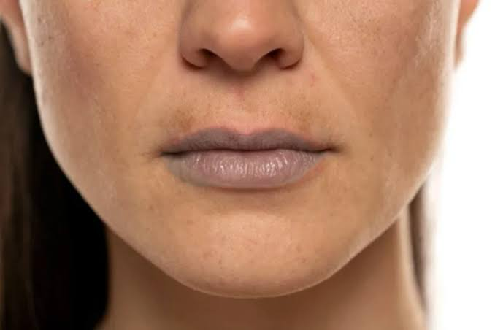
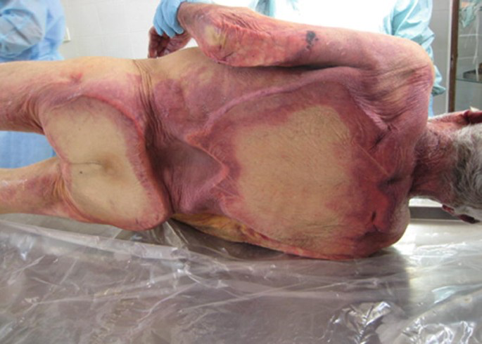
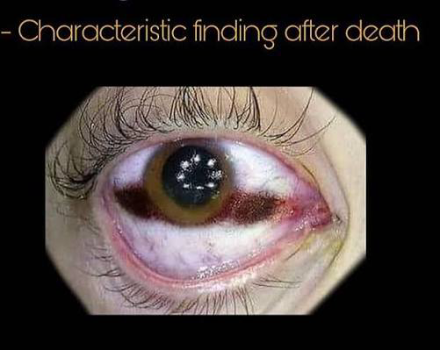
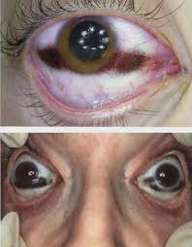

Slide 23
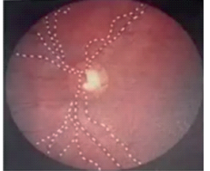
Loss of intraocular tension: Intraocular tension falls rapidly after death. It becomes zero in 4–8 h from 10–22 mmHg during life. The eyeballs look sunken in the orbit.
Changes in the retina: The blood in retinal vessels appears fragmented or segmented (cattle trucking or shunting) within seconds to minutes after death and persists for about an hour (Kevorkian sign).

Slide 24
Cooling of the Dead Body (Algor Mortis)
is the cooling of the body that normally takes place after death, where the body temperature equilibrates with its environmental temperature.
The fall of temperature of the cadaver occurs due to cessation of energy production and inactivity of the heat regulating center after somatic death.
For estimation of time passed after death, the measurement of the inner core temperature is important and is more reliable than the outer surface temperature .
The average rate of fall of the body temperature is 1°C/h, and the body attains environmental temperature in 16–20 h after death.

Slide 25
Medico-legal Importance of Algor Mortis:
It is a sign of death.
It helps in the estimation of the time of death.
Rapid cooling of a dead body delays the processes of rigor mortis and decomposition. If the heat is preserved for a longer period, then both the processes start early.

Slide 26
Postmortem Staining (Livor Mortis)
Postmortem staining or PM staining is bluish or purplish-red discoloration resulting from gravitational settling of blood in the toneless capillaries and venules of the dependant parts of the dead body.
Site: It is present at the undersurface of skin in the superficial layers of the dermis.
Cause: After the stoppage of circulation, there is stagnation of blood in the vessels, and it tends to sink by force of gravity in the capillaries and venules of the dependent parts of the body.

Slide 27
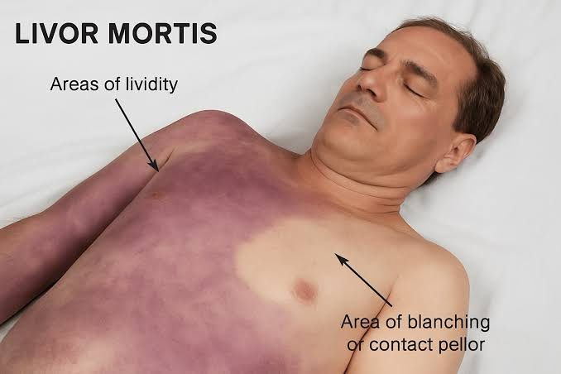
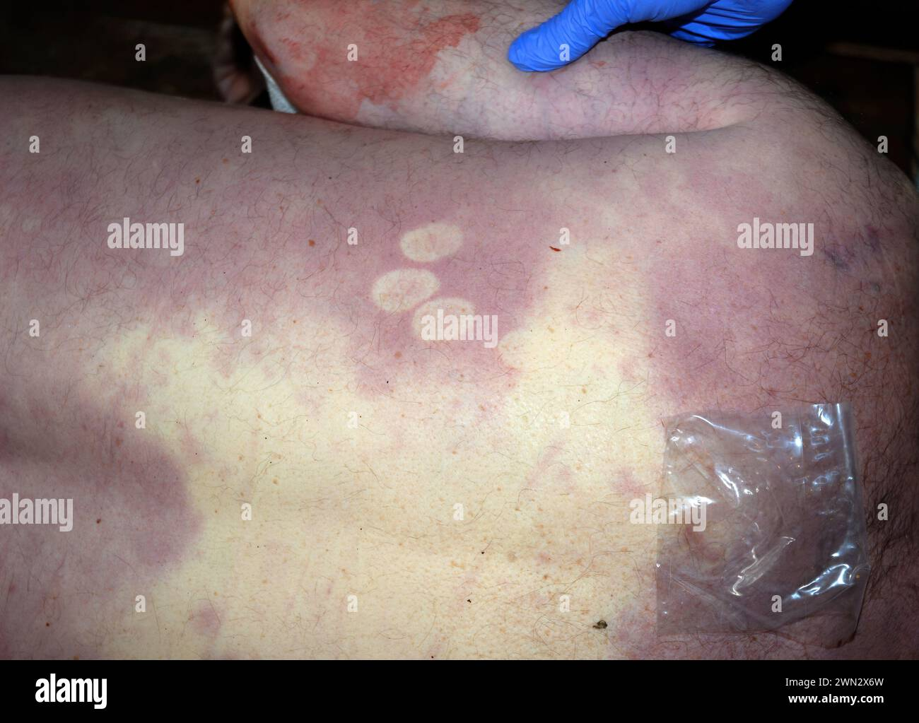

Slide 28
Development of PM Staining
In early stages (30 min to 1 h), it consists of discolored patches of 1–2 cm in diameter on the dependent parts of the body, having the same color as blood which can be mistaken for bruises. Gradually, in 3–4 h, the small patches increase in size and coalesce with each other to form uniformly stained large areas. It is usually well-developed within 4 h, complete in 5–6 h
After complete formation of the postmortem staining, if the body is undisturbed, the staining gets ‘fixed’ in 8–12 h and persists until putrefaction Development of PM Staining In early stages (30 min to 1 h), it consists of discolored patches of 1–2 cm in diameter on the dependent parts of the body, having the same color as blood which can be mistaken for bruises. Gradually, in 3–4 h, the small patches increase in size and coalesce with each other to form uniformly stained large areas. It is usually well-developed within 4 h, complete in 5–6 h  After complete formation of the postmortem staining, if the body is undisturbed, the staining gets ‘fixed’ in 8–12 h and persists until putrefaction

Slide 29
Distribution of PM Staining:
It depends on the position of the body.
In a body lying supine, it appears in the neck and then spreads over the entire back except for the areas directly pressed on the ground or the bed, i.e., occipital area, shoulder blades, buttocks, posterior aspects of thighs, calves and heels, which do not show any staining and appear rather pale .This phenomenon is known as contact pallor

Slide 30
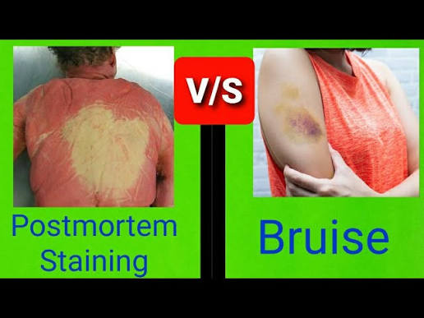

Slide 31
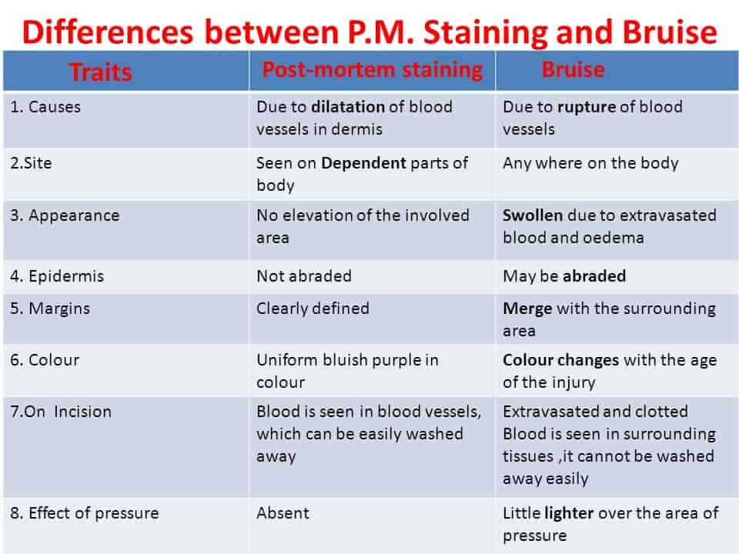

Slide 32
