Slide 1
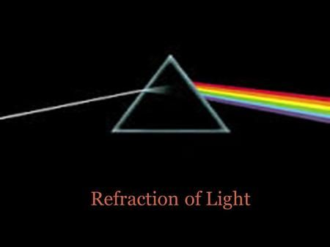
Optics and Refraction for 5th year students
Mutaz Gharaibeh,MD

Slide 2
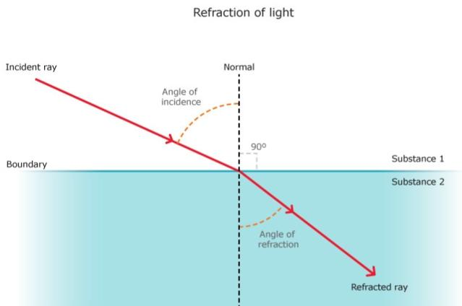
Light travels in a straight line. But when it reaches another medium it will bend. This is called refraction.
This is how lenses work, and also how we see.

Slide 3
The focus must be adjustable to allow clear vision for both near & distant objects (accommodation).
Refractive components of the eye or the focusing power is :
** 2/3 (cornea and “air/tear” interface), fixed power
** 1/3 lens, power increases with accommodation
These two elements converge parallel rays because :-
Cornea has higher refractive index than air.
lens has higher refractive index than aqueous and vitreous humours.
Cornea & lens are spherically convex in shape

Slide 4
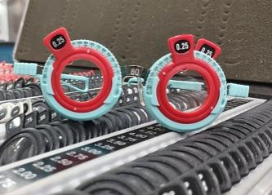
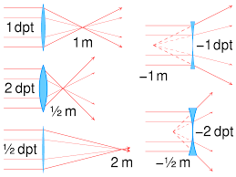
Diopter (D) : measurement of the refractive power of a lens, equal to the reciprocal of the focal length in meters “ 1/meters” . Simply describes the power of the lens.
Notes:
If the lens is biconvex or plano-convex, a collimated beam of light passing through the lens converges to a spot (a focus) behind the lens. In this case, the lens is called a positive or converging lens. The distance from the lens to the spot is the focal length of the lens, which is commonly abbreviated f in diagrams and equations.
The focal length f is positive for converging lenses, and negative for diverging lenses. The reciprocal of the focal length, 1/f, is the optical power of the lens. If the focal length is in metres, this gives the optical power in dioptres (inverse metres).

Slide 5
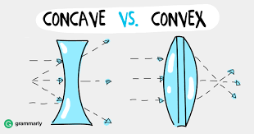
**** A negative lens is a diverging lens ,concave ,corrects for myopia
**** A positive lens is a converging lens ,convex ,corrects for hypermetropia.

Slide 6
causes
Refractive errors can be caused by:
Eyeball length (when the eyeball grows too long or too short)
Problems with the shape of the cornea (the clear outer layer of the eye)
Aging of the lens (an inner part of the eye that is normally clear and helps the eye focus)

Slide 7
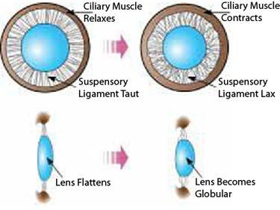
Accommodation
Near focusing of the eye.
Ciliary muscle contraction……..zonules relax……..lens more spherical,thick and globular)
Eyes converge, pupils constrict.

Slide 8
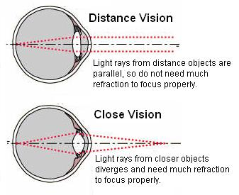
Why do we need accommodation in near vision???

Slide 9
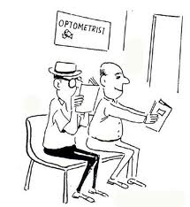
Presbyopia
A normal aging process, when near images can’t be focused on the retina due to reduced accommodative ability.
The focus is behind the retina as in hyperopia.
Makes it hard for middle-aged and older adults to see things up close. It happens because the lens (an inner part of the eye that helps the eye focus) stops focusing light correctly on the retina (a light-sensitive layer of tissue at the back of the eye).
Presbyopia is a normal part of aging. Everyone gets presbyopia as they get older — usually after age 45. Many people have another refractive error in addition to presbyopia.

Slide 10
Definitions
There are 4 common types of refractive errors:
Nearsightedness (myopia) makes far-away objects look blurry
Farsightedness (hyperopia) makes nearby objects look blurry
Presbyopia: Loss of accommodative ability of the lens resulting in difficulties with near tasks. i.e. makes it hard for middle-aged and older adults to see things up close
Astigmatism: the curvature of the cornea and/or lens is Not spherical and therefore causes image blur on the retina. Optical power on different planes is not equal. i.e. can make far-away and nearby objects look blurry or distorted
Aniseikonia: a difference of image size between the 2 eyes as perceived by the patient.
Anisometropia: a refractive power difference between the 2 eyes (usually > 2D)
Aphakia: ( Phakos=lens), aphakia is no lens.
Pseudophakia: artificial lens in the eye.
Notes:
Presbyopia begins after age 40, and is due to decrease in the elsticity of the lens

Slide 11
symptoms
The most common symptom is blurry vision. Other symptoms include:
Double vision
Hazy vision
Seeing a glare or halo around bright lights
Squinting
Headaches
Eye strain (when your eyes feel tired or sore)
Trouble focusing when reading or looking at a computer

Slide 12
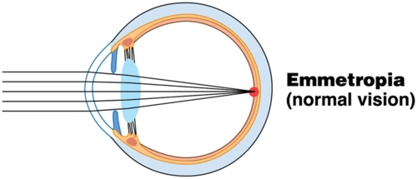
Refractive errors
Emmetropia :- when parallel rays of light from a distant object are brought to focus on the retina with the eye at rest “not accommodating “.

Slide 13
Hypermetropia
Aka Farsightedness (Hyperopia)
a refractive error that makes nearby objects look blurry. It happens when the shape of the eye makes light focus behind the retina (a light sensitive layer of tissue at the back of your eye), instead of on it.
A lot of children are farsighted ,this makes sense as they have small weak eyes. So it’s a stage in normal development of the eye (physiologic) , or due to any cause that shortens the globe (pathological Hyperopia).
Special forms: Ectopia lentis(displacement of lens from its normal position.
Post operative aphakia.
Rays of light converge behind the retina, which causes blurring of vision for near objects ± distant objects.
Hypermetropes must accommodate with distant gaze to bring image into retina.
Notes:
Aphakia is a highly hypermetropic eye that occurs after cataract extraction (removal of an opaque lens).

Slide 14
Hypermetropia- why?
Farsightedness happens when your eyeball grows too short from front to back, or when there are problems with the shape of your cornea (clear front layer of the eye) or lens (an inner part of the eye that helps the eye focus).
These problems make light focus behind the retina, instead of on it — and that makes nearby objects look blurry.
Most people who are farsighted are born with it, but it may not cause vision problems until you get older. You’re more likely to be farsighted if other members of your family are farsighted too.
The length of the eyeball is shorter than it should be.
stage in normal development of the eyes—at birth eyes are hypermetropic
When persists in adulthood it represents an imperfectly developed eye.
Notes:
Cataract p.118

Slide 15
Hypermetropia -symptoms
The most common symptoms of farsightedness are:
Trouble seeing things up close
Eye strain ; ciliary muscle is straining to maintain accommodation (when your eyes feel tired or sore)
Headaches — especially when reading
If you have mild farsightedness, you may not notice any symptoms. That’s why it’s important to get regular eye exams
Children with severe farsightedness may also be at higher risk for other eye problems, like strabismus (crossed eyes) or amblyopia (lazy eye).
In a child with an equal degree of long sight in both eyes, a convergent squint may develop because of increased accomodative effort to focus distant, and particularly nearby objects.

Slide 16
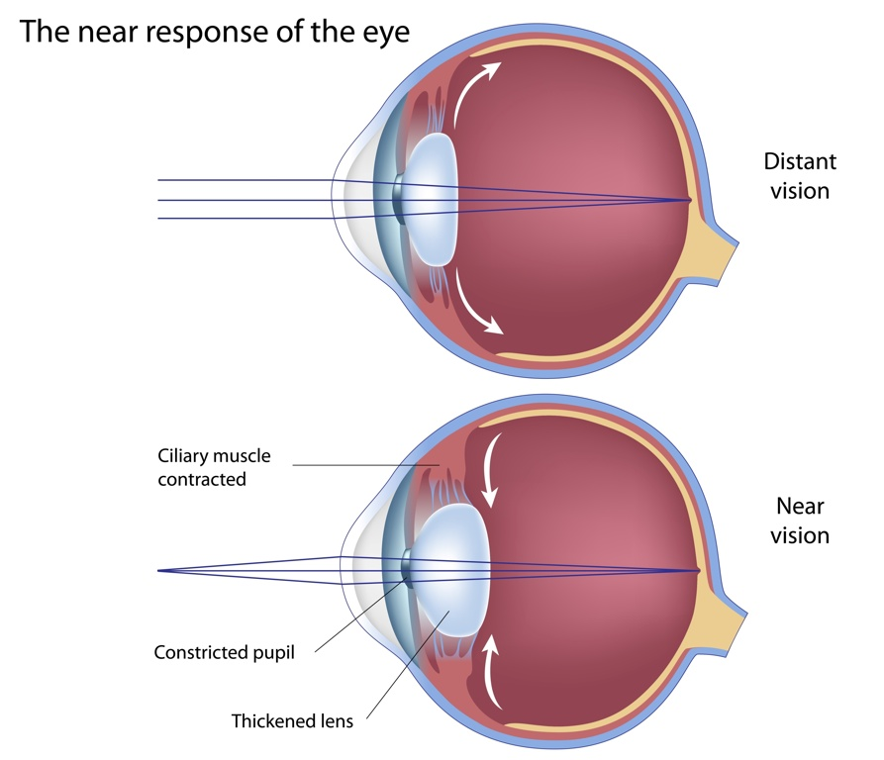

Slide 17
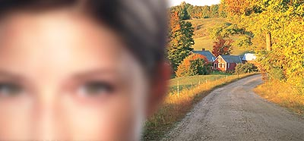
Clinical features:
Youth: usually don’t require glasses, they have sufficient accommodative ability to focus the image on the retina, but may develop accommodative EsoTropia(convergent squint).
- >50s: blurring of distance vision due to severely decreased accommodation. corrected by adding a powerful lens, a converging (convex) lens.
Complications: Angle-closure glaucoma, particularly later in life.

Slide 18
Myopia
Nearsightedness
a refractive error that makes far-away objects look blurry. It happens when the shape of the eye makes light focus in front of the retina (a light sensitive layer of tissue in the back of your eye), instead of on it.
usually starts between ages 6 and 14 and gets worse until your early twenties
Usually presents in 1st or 2nd decades ,rarely begins after the age of 25,except in pts with D.M or cataract.
Keratoconus(conical cornea) is a pathological cause of myopia, (comes also with irregular stigmatism).
Blurring of distance vision, the near isn’t affected .
Complications ( though rare) : retinal tear or detachment, macular hole, and open angle glaucoma.
Not prevented with refractive correction.
Management: corrected by a diverging lens “concave”, or refractive eye surgery.
People who have severe nearsightedness (also called high myopia) may also be at higher risk for other eye conditions, like retinal detachment (when the retina is pulled away from its normal position).

Slide 19

Astigmatism
Light rays aren’t refracted uniformly in all meridians due to non spherical shape of cornea or lens, parallel rays passing through theses different planes are brought to different points of focus.
The cause of astigmatism is unknown. It is usually present from birth, and often occurs together with nearsightedness or farsightedness.
Astigmatism makes it difficult to see fine details, either close up or from a distance.
Corrected with a cylindrical lens(planoconvex or planoconcave) or refractive eye surgery.
Astigmatism is a common eye problem that can make your vision blurry or distorted. It happens when your cornea (the clear front layer of your eye) or lens (an inner part of your eye that helps the eye focus) has a different shape than normal.

Slide 20
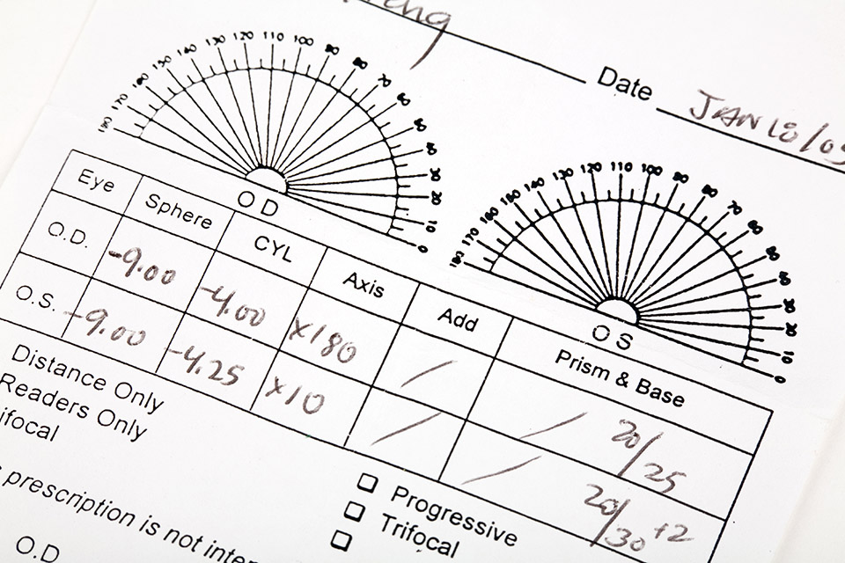

Slide 21
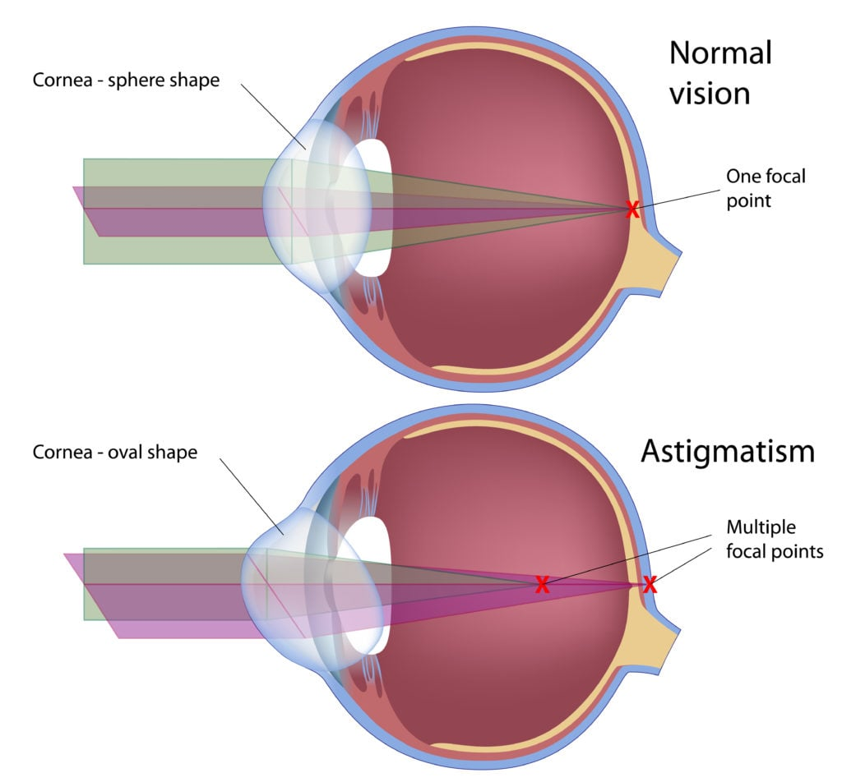

Slide 22
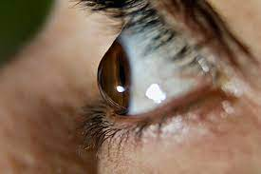
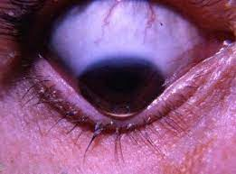

Slide 23
Any alternatives for glasses
Contact lenses
Corneal refractive surgery : Laser / LASIK
Lens refractive surgery

Slide 24
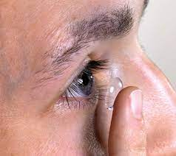
Contact lens
Soft
Rigid
Complications:
- giant papillary conjunctivitis
- corneal hypoxia
- neovascularization
- Corneal abrasion
- corneal ulcer
- keratitis

Slide 25
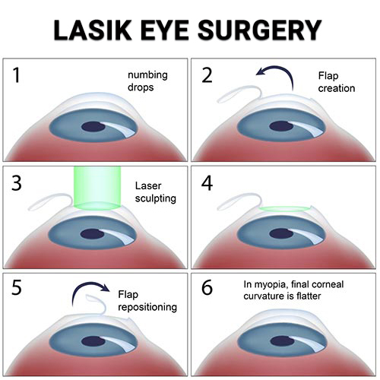
PRK/LASIK

Slide 26
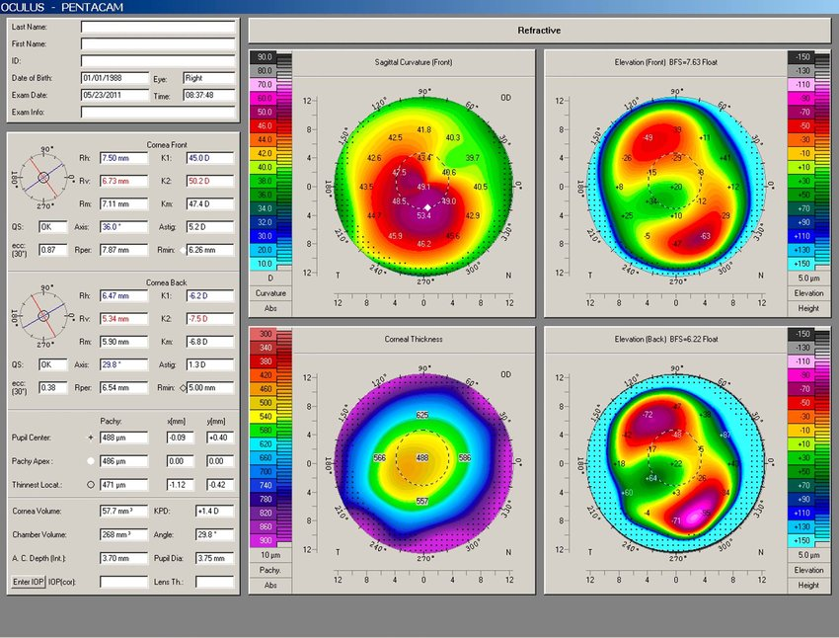
Prerequisites for corneal refractive surgery
Age
Stability
Contraindications :
Collagen tissue disease
Pregnancy
Lactation
Keratoconus
Active corneal disease
Dryness
Etc

Slide 27
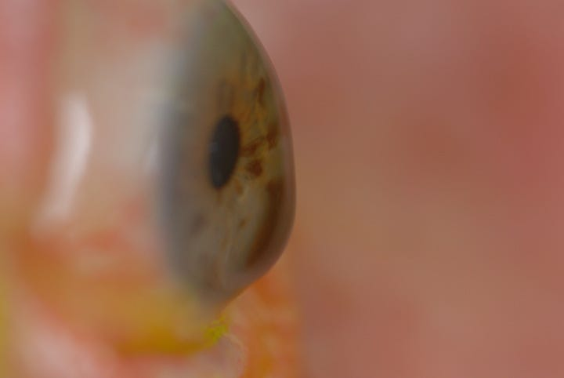
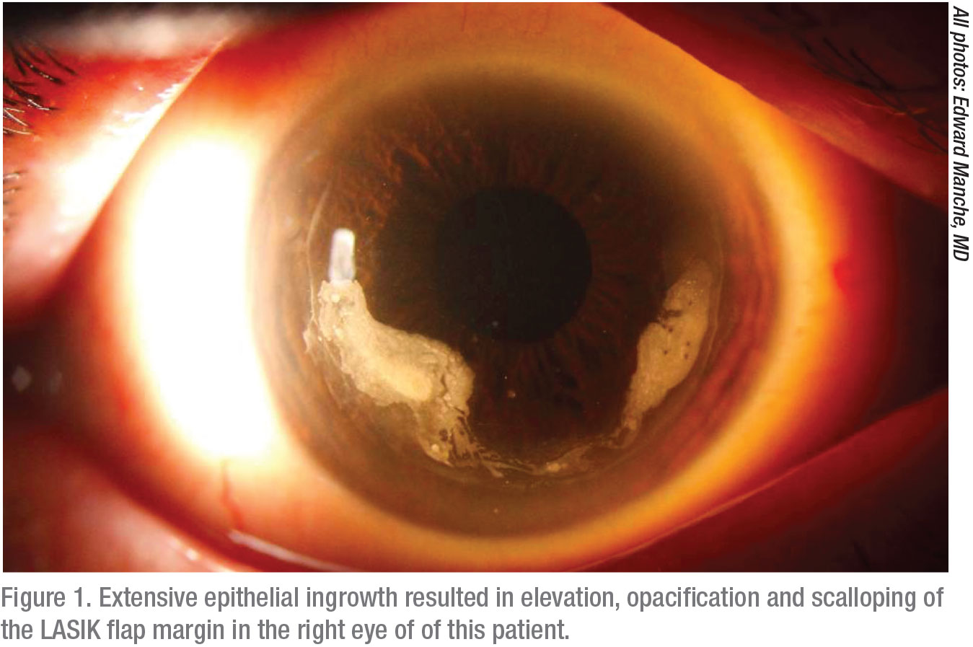
complications
Incomplete flap
Free flap
Flap subluxation
Corneal opacification
Corneal perforation
Under/overcorrection
Recurrence
Corneal ectasia
etc

Slide 28
THANK You ☺

