Slide 1
paracetamol poisoning

Slide 2

History of Paracetamol
1880s University of Strasburg, Professor Adolf Kussmaul and his two young assistants, Arnold Cahn and Paul Hepp, experimented with phenacetin.
Phenacetin was widely used for about 90 years until
mounting concerns over carcinogecity and
kidney damaging properties.

Slide 3
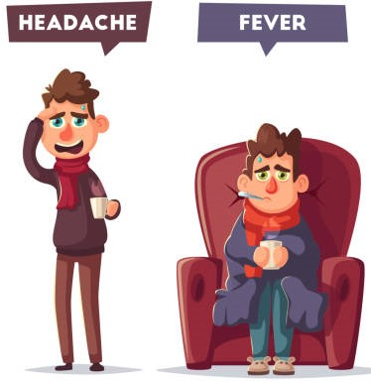
In 1887, the Bayer company introduced the 4-ethoxy derivative, phenacetin, as a less toxic analogue of Acetanilide.
In 1889 it was demonstrated that paracetamol was a urinary metabolite of acetanilide. These discoveries, however, failed to attract much attention and were largely ignored at the time.
It 1948-1949, Brodie and Axelrod discovered that paracetamol was the main metabolite of both acetanilide and phenacetin,

Slide 4
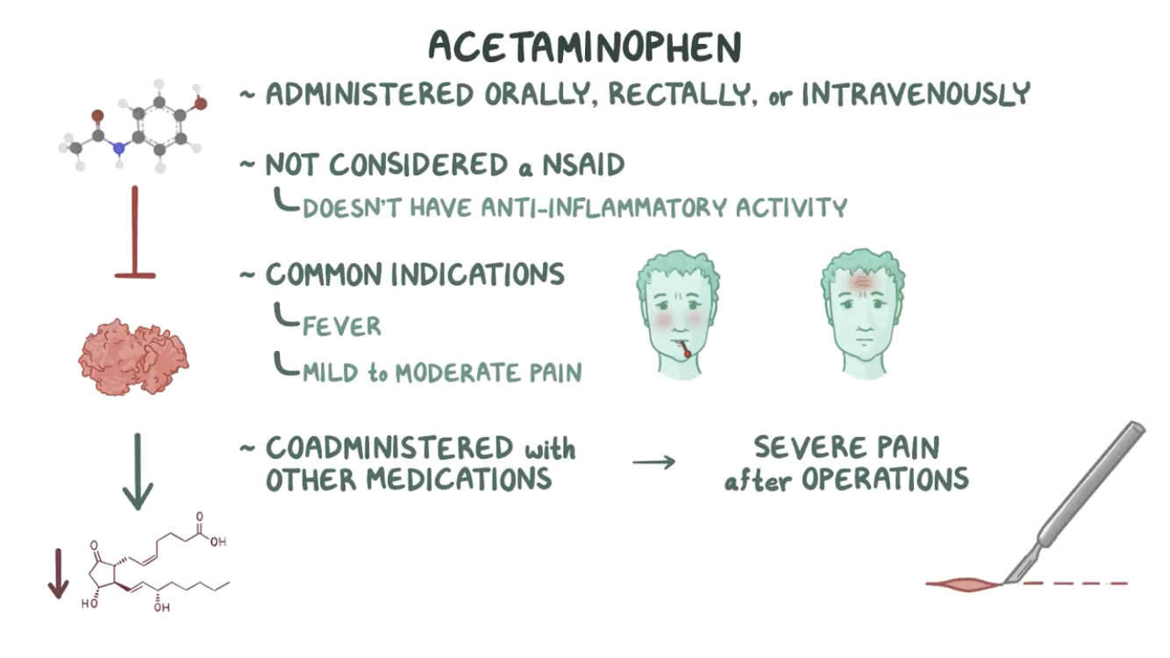

Slide 5
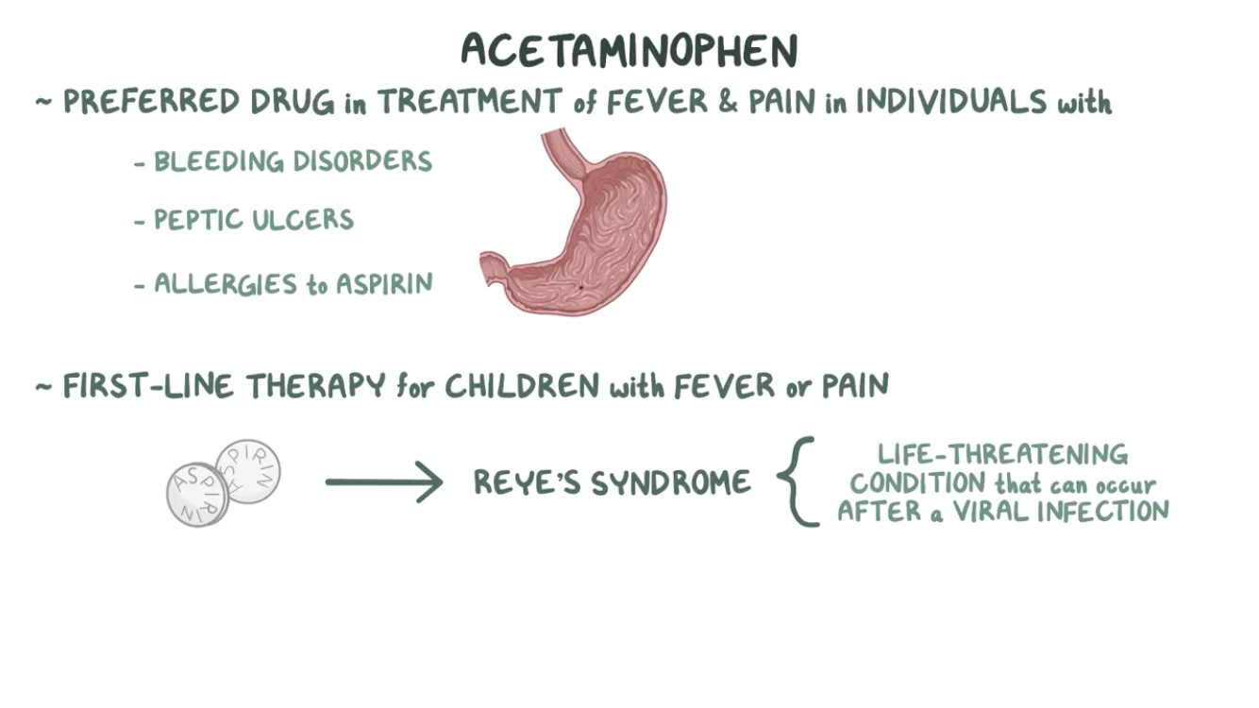

Slide 6
Paracetamol Overdose
Most common drug taken in overdose
Responsible for 50% of acute liver failure cases in the US
30% of patients with acute paracetamol toxicity develop ALF, third of them eventually need liver transplantation
Since the FDA limitation on acetaminophen doses in combined opioid formulations in 2010 there was a substantial decreases in the incidence of accidental nonintentional toxicity
Few symptoms or early signs
As little as 12g can be fatal

Slide 7
Toxic dose of paracetamol
◆ Toxicity is unlikely to result from a single dose of less than 150 mg/kg in a child or 7.5 to 10 g for an adult
◆ Toxicity is likely to occur with single ingestions greater than 250 mg/kg or those greater than 12 g over a 24-hour period
◆ Virtually all patients who ingest doses in excess of 350 mg/kg develop severe liver toxicity (defined as peak aspartate aminotransferase [AST] or alanine aminotransferase [ALT] concentrations greater than 1000 IU/L) unless appropriately treated

Slide 8
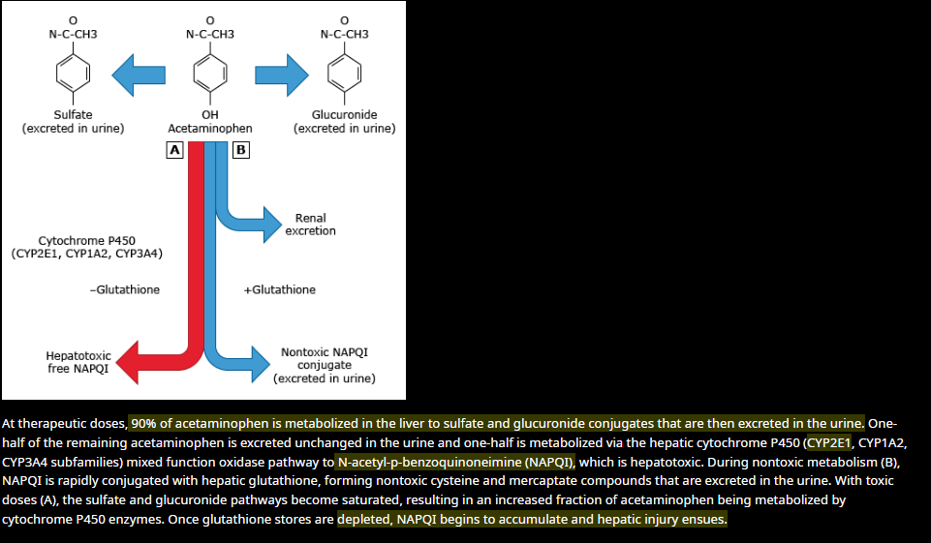

Slide 9

◆ The clinical course of acetaminophen toxicity
Divided into 4 phases.
◆ Physical findings vary, depending primarily on the level of hepatotoxicity.
◆ May not exist for mild poisoning

Slide 10
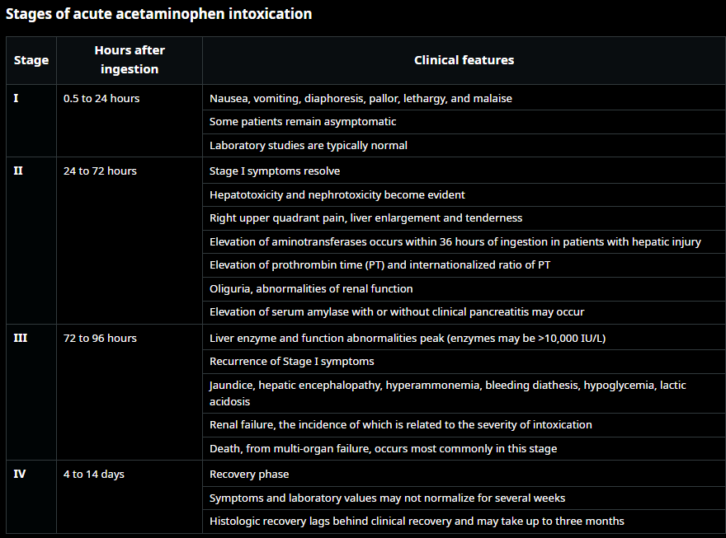

Slide 11
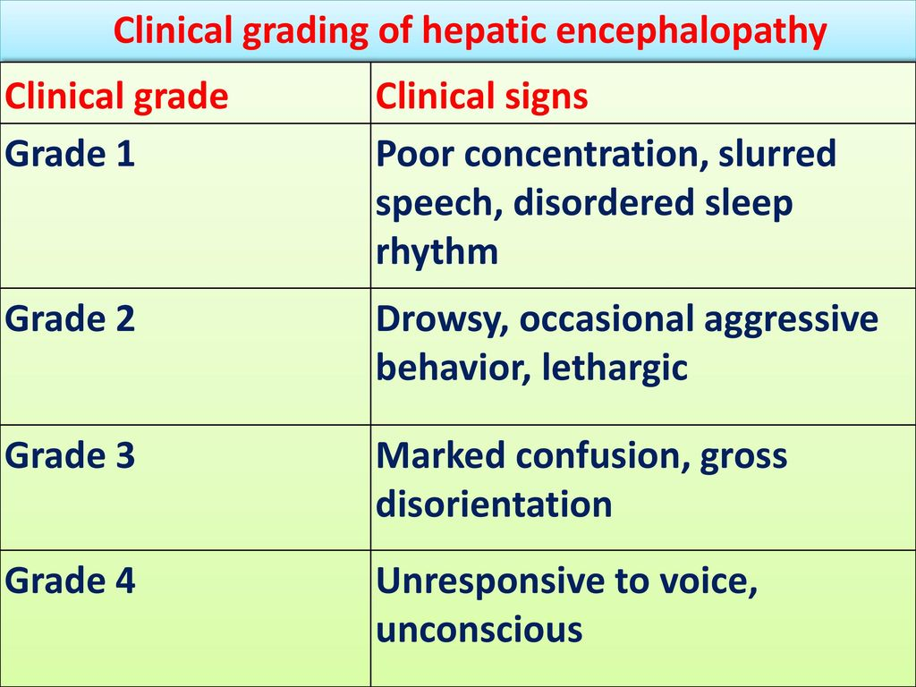
Other Consequences of
Severe Toxicity
◆ Hepatic Encephalopathy
◆ Grade III – Confusion
◆ Grade IV – Coma

Slide 12
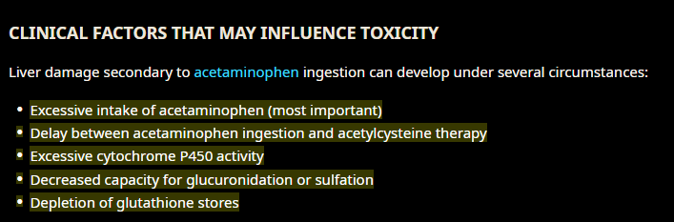
Most important factor affecting mortality
Time of presentation – cysteine within 8 hours abolishes significant liver injury
Alcohol (mixed effect)
Tobacco (worse prognosis)
Chronic liver disease (no effect)
Nutritional status (depleted Glut)
Age
Genetics (Gilbert, Crigler Najjar?)
Concomitant drugs (CYP2E1 inducers, inhibitors, competition on Phase 1 reactions)

Slide 13
investigations :
Whenever possible, evaluation should include identification of the agents involved, assessment of severity, and prediction of toxicity. In all patients with suspected acetaminophen overdose, a history should be obtained to elicit the dose, intent of use (ie, suicidal or not), pattern of use (eg, acute or repeated doses), time of the ingestion, presence of coingestants, and existence of comorbid conditions that may predispose to the development of hepatic injury (eg, alcohol use, Gilbert disease, antiseizure medication use, recent fasting).
In all patients with suspected acetaminophen poisoning, obtain the following:
serum acetaminophen concentration at least 4 hours after ingestion (if unknown or after 4 hours since ingestion order immediately), aminotransferases (AST, ALT), PT/INR, and basic chemistry panel (electrolytes, BUN, creatinine), amylase and ABGs.
In all patients with a suspected intentional overdose, obtain serum salicylate concentration, fingerstick glucose, ECG, and qualitative pregnancy test in females of childbearing age.
If the timing of ingestion is unknown or unclear, then we immediately obtain a serum acetaminophen concentration. If the initial concentration is undetectable (≤10 mcg/mL), the patient does not have clinical signs or symptoms of liver injury, and the AST and ALT are normal (or the patient’s baseline values), acetylcysteine therapy is not needed. Otherwise, or if there is any doubt (eg, patient has symptoms, signs, or laboratory values inconsistent with the history), acetylcysteine therapy should be started.

Slide 14
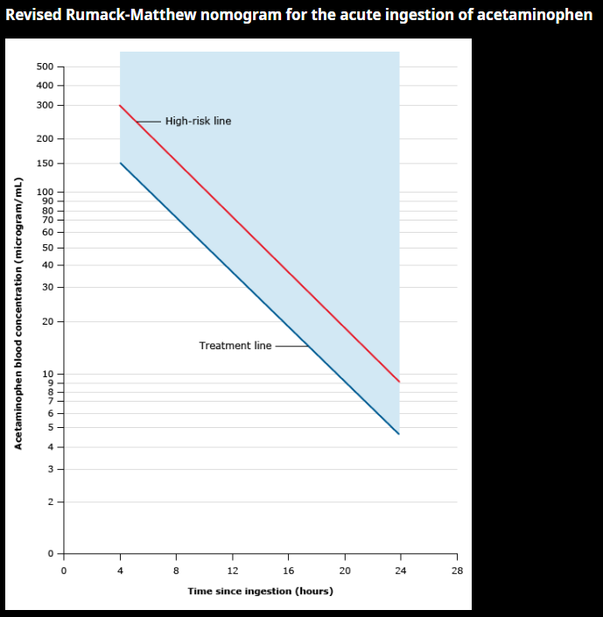
This nomogram should only be used after an acute acetaminophen ingestion. A serum acetaminophen concentration should be obtained 4 to 24 hours after an ingestion to ensure that a peak has occurred. The concentration should be plotted in relationship to the time of ingestion to determine the likelihood of toxicity and the need for treatment. Points on or above the treatment line indicate that acetylcysteine therapy is indicated since hepatoxicity is possible. Many experts would provide an increased dose of acetylcysteine for points on or above the high-risk line. This nomogram cannot be used if history of ingestion is unreliable or unknown or for ingestions that occurred greater than 24 hours prior to presentation, repeated supratherapeutic oral ingestions, or iatrogenic intravenous overdose.
Untreated patients with serum acetaminophen concentrations above the line joining 300 mcg/mL (1980 micromol/L) at 4 hours and 37.5 mcg/mL (250 micromol/L) at 16 hours ("high hepatic toxicity" or "high-risk ingestion") have a 90 percent incidence of severe hepatotoxicity and a mortality rate of up to 24 percent

Slide 15
If Unknown Time of overdose
Determine serum acetaminophen levels (acetaminophen concentration >10 mcg/mL (66 μmol/L).
Determine INR levels, RFT, LFT
Treat with Acetylcysteine if serum Acetaminophen or transaminases (ALT, AST) are elevated above baseline.

Slide 16
Management
Secure airway, breathing, and circulation as necessary.
Give activated charcoal (AC) 50 g to all adult patients presenting within 4 hours of ingestion unless contraindicated; AC may be useful for co-ingestants or extended-release formulation beyond 4 hours. Pediatric AC: 1 g/kg (maximum 50 g).
Treat with acetylcysteine if:
Serum acetaminophen concentration drawn at 4 to 24 hours after an acute ingestion is above the treatment line on the Revised Rumack-Matthew nomogram (refer to UpToDate graphic on Revised Rumack-Matthew nomogram for the acute ingestion of acetaminophen).
Serum acetaminophen concentration is unavailable or will not return within 8 hours of time of ingestion and suspected ingestion of >150 mg/kg (7.5 g total dose regardless of weight) of acetaminophen.
Reliable history with repeated supratherapeutic ingestion (ie, multiple ingestions during a period greater than 24 hours) and a serum acetaminophen concentrations ≥20 mcg/mL (132 micromol/L) or AST/ALT is elevated (unless the elevation is patient's baseline value) or symptomatic.
Unreliable history (eg, time of ingestion is unknown) and serum acetaminophen concentration >10 mcg/mL (66 micromol/L) or AST/ALT is elevated (unless the elevation is patient's baseline value).
There is evidence of any liver injury with a history of acetaminophen ingestion.
High-risk ingestion (reliable history of >30g acetaminophen ingestion; signs of parent-compound toxicity such as hemodynamic instability, altered mental status, metabolic acidosis early following ingestion; acetaminophen concentration above the high-risk line on the Revised Rumack-Matthew nomogram).

Slide 17
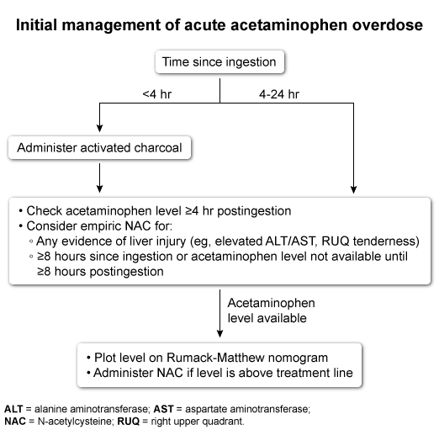

Slide 18
INDICATORS OF A POOR OUTCOME
◆ Grade IV hepatic coma
◆ Acidosis - pH less than 7.30
◆ PT - prolongation
◆ Renal failure - Serum creatinine > 3.3
◆ Falling ALT with worsening PT

Slide 19
Treatment
IV dosing of acetylcysteine: Many protocols exist. For a patient with an acute ingestion, whichever is chosen should deliver at least 300 mg/kg acetylcysteine during the first 20 to 24 hours of treatment. For a patient with repeated supratherapeutic ingestion or an unreliable history with detectable acetaminophen concentration, the acetylcysteine regimen should be continued for at least 12 hours.
We suggest the 2-bag protocol: 200 mg/kg (maximum 20 g) over 4 hours (50 mg/kg per hour), followed by 100 mg/kg (maximum 10 g) over 16 hours (6.25 mg/kg per hour).
◆ Two treatment methods
◆ Activated Charcoal
◆ Works by absorbing unabsorbed drug in the stomach
◆ N-acetylcysteine (NAC)
◆ Works by increasing hepatic glutathione stores.
Another common protocol involves 3 bags: 150 mg/kg loading dose (maximum 15 g) over 60 minutes, followed by 50 mg/kg (maximum 5 g) over 4 hours (12.5 mg/kg per hour), followed by 100 mg/kg (maximum 10 g) over 16 hours (6.25 mg/kg per hour).
Patients weighing <41 kg: Use reduced diluent volume
Either protocol should be followed by a continuous IV infusion at 6.25 mg/kg per hour until stopping criteria are met.
IV dosing is acceptable in all cases of acetaminophen toxicity but should be used instead of oral dosing in patients unable to tolerate oral acetylcysteine (eg, intractable vomiting), patients with a medical condition precluding administration of oral acetylcysteine (eg, corrosive ingestion, gastrointestinal bleed), high-risk ingestion, signs of parent compound toxicity, patients with hepatic failure, and pregnant patients.

Slide 20
Side effects of NAC
Allergic phenomena (urticaria, angioedema, pruritis) – common
→ Tx with Chlorpheneramine + observe
◆ Nausea, vomiting, and epigastric discomfort
Wheeze (occur <10%)
Fatal shock

Slide 21
Methionine
In patients known to be sensitized to NAC
Give : oral 2.5g/4H for 16H (total 10g)

Slide 22
Liver transplantation
If signs of hepatic failure (e.g., progressive jaundice,coagulopathy, confusion) occur despite N-acetylcysteine therapy for acetaminophen hepatotoxicity, liver transplantation may be the only option.
 The United Kingdom King's College Hospital criteria for the determination of the urgent need for transplantation after acetaminophen-induced fulminant hepatic failure include any one of the following:
➢ Arterial pH less than 7.3 after fluid
resuscitation(lactate levels >3.5 mmol/L)
➢ Grade III or IV encephalopathy
➢ Prothrombin time (PT) greater than 100 seconds
➢ Serum creatinine level greater than 3.4 mg/dL

Slide 23
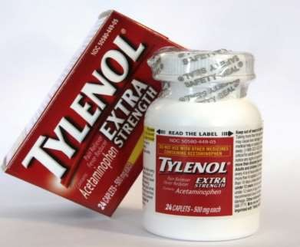
Patient Education
◆ Patient should not take over 4 grams of Acetaminophen/day (10-15mg/kg/day in children younger than 12)
◆ Threshold may be lower for patients with liver
disease or cirrhosis
◆ Increased risk of hepatotoxicity with chronic alcohol use

Slide 24
THANK YOU

