Slide 1
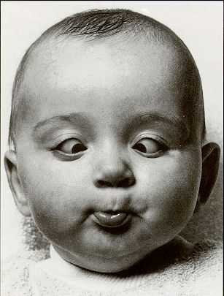
Strabismus for 5th yr medical students
Prof. Mutaz Gharaibeh,MD

Slide 2
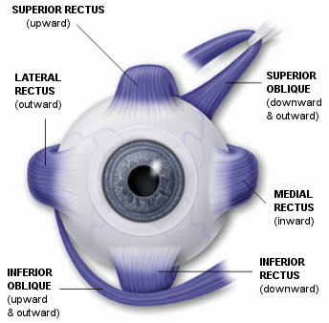
Normal movement of the eye ( 6 extraocular muscles )
Nerve supply
Third CN : MR, IR, SR, IO
Fourth CN : Superior Oblique
Sixth CN : Lateral Rectus

Slide 3
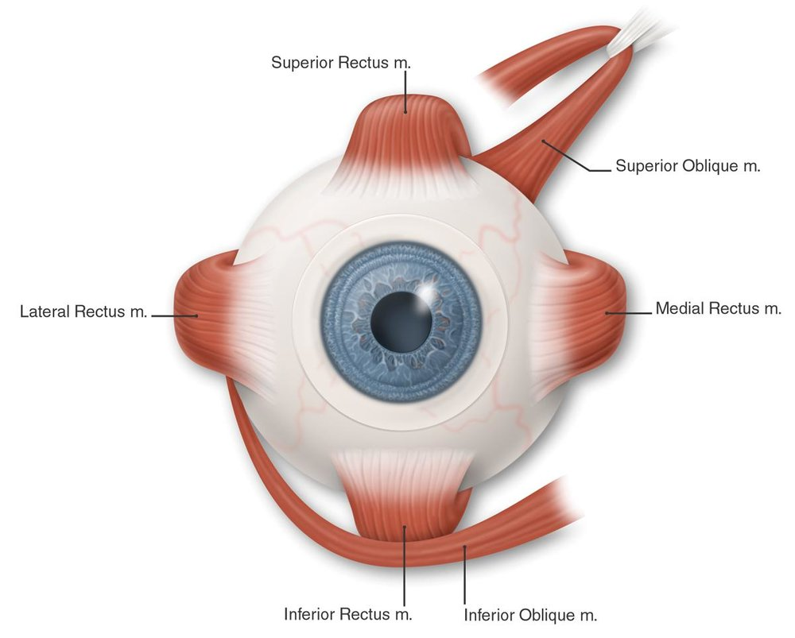
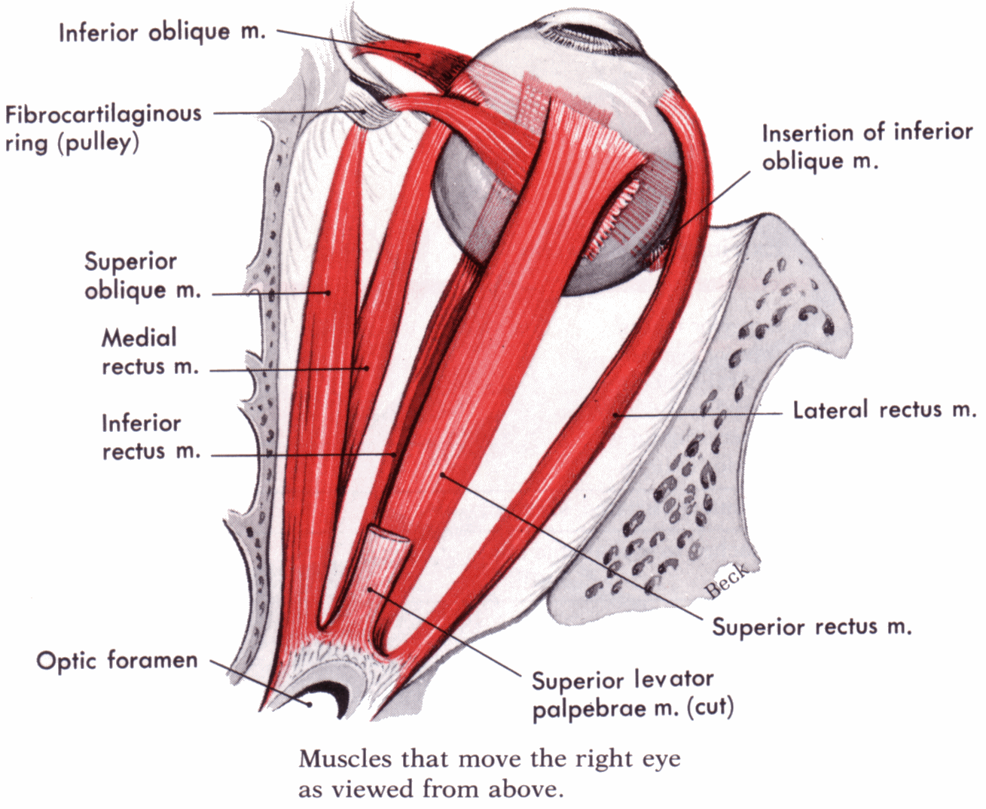

Slide 4
These six positions of gaze are called the cardinal positions of gaze.
In addition to these, there are another 3 position of gaze :
the primary position – looking straight ahead
Looking up
Looking down
So the total number of the positions of gaze is 9

Slide 5
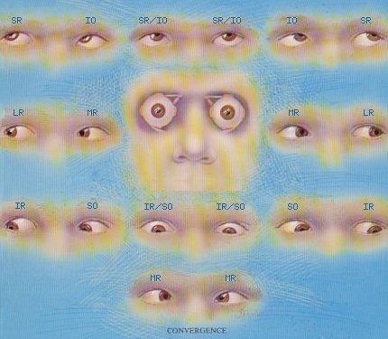

Slide 6
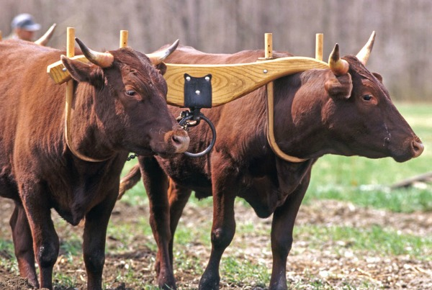
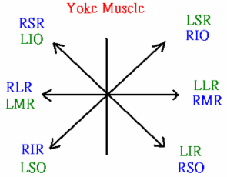
Yoke muscles are pair of muscles (one muscle in each eye) moving the eye into the same direction of gaze

Slide 7
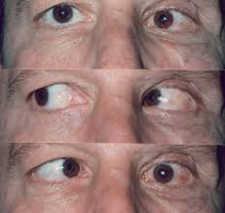
Evaluation of binocular eye movement
ask the patient to follow your target in all positions of gaze
Under action of specific muscle could be :
- true paresis or paralysis
- restrictive myopathy
- underlying strabismus

Slide 8
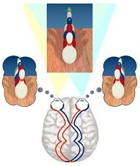
Binocular Single vision and Stereopsis
Normally both eyes are directed toward the same object and an image of that object is created on each retina, these images are fused centrally and interpreted by the brain as a single image.

Slide 9
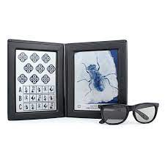
Importance of Stereopsis
Increase field of vision
Eliminate the blind spot since the
blind spot of an eye fall on the
opposite eye’s visual field.
Binocular acuity is greater than
monocular
Depth perception
Estimation of Distance

Slide 10
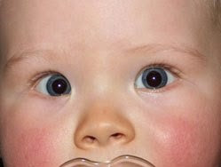
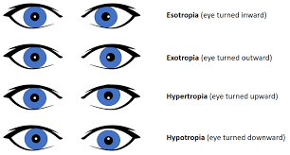
Strabismus/Squint definition
Squint is a misalignment of the two eyes so that both the eyes are not looking in the same direction

Slide 11
Work up
History:
Frequency
Onset
Family history
Past medical/surgical history
Examination:
Visual acuity
Epicanthus (Be very cautious as its presence doesn't exclude strabismus )
Facial asymmetry
Cover/uncover test
Alternate cover test( latent squint→phoria)
Refractive error (topical atropine/cyclopentolate)

Slide 12
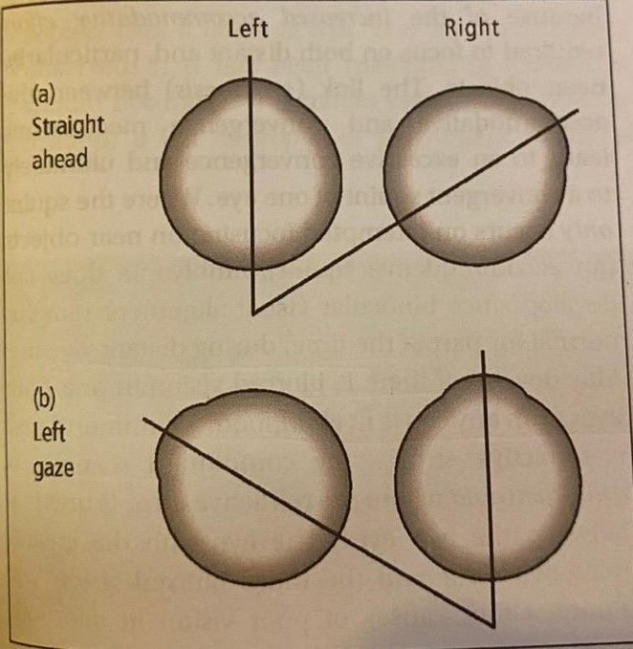
Non-Paralytic Squint ( Concomitant Squint)
Both eyes are capable of performing full movement, but only one eye is directed toward the fixated target.
Angle of deviation is constant.
This is the type commonly seen in children
No Diplopia but amblyopia can occur
Usually congenital but can develop in
a child with hypermetropia or blurred
Vision.

Slide 13
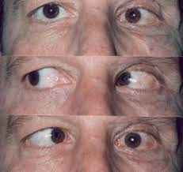
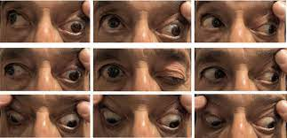

Slide 14
Non-Paralytic Squint ( Concomitant Squint)
Treatment :
1- Glasses
2- if Amblyobia is present -> patching of the better seeing eye
3- Surgery

Slide 15
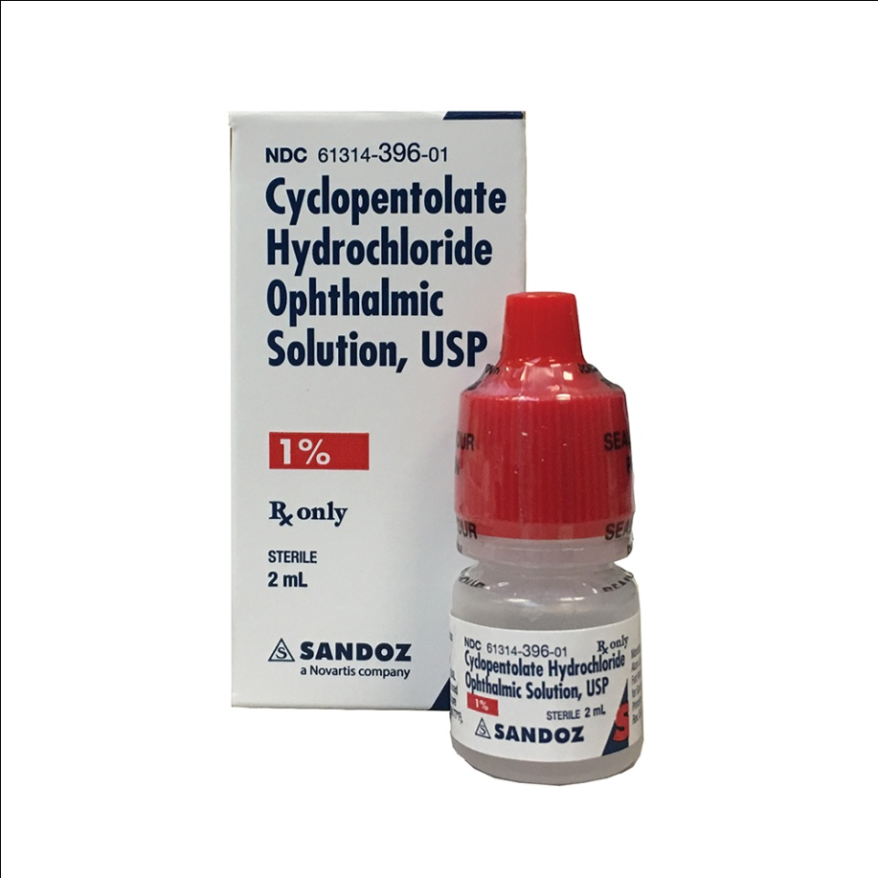
Cycloplegic refraction
To know the total anount of refractive error

Slide 16
Paralytic Squint ( Incomitant squint)
Decreased action of one or more of the extra-ocular muscles due to a nerve palsy or mechanical restriction.
Indicates an isolated nerve palsy or an extra-ocular muscle disease
Usually acquired
The size of the squint depends on the direction of gaze.
Diplopia is present.

Slide 17
Paralytic Squint ( Incomitant squint)
The causes of isolated nerve palsy :
1)Orbital diseases-neoplasia
2)Vascular disease -Diabetes , Aneurysm (3rd nerve ), HTN
3) Trauma
4)Neoplasia -(meningioma/acoustic neuroma/glioma)
5)Raised ICP -may cause a 3rd or 6th nerve palsy
6)Inflammation -Sarcoidosis/ vasculitis (e.g giant cell arteritis) /GB syndrome
7) Cavernous sinus thrombosis

Slide 18
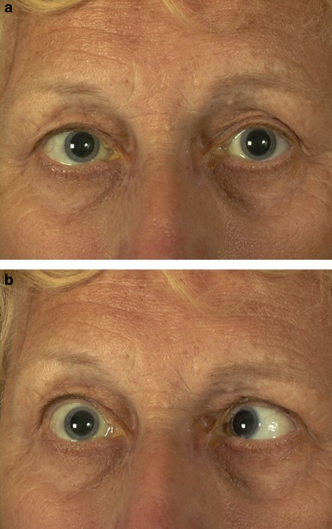
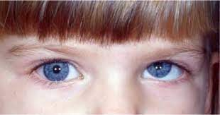
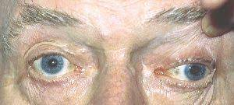
Isolated Nerve Palsies
6th nerve: Failure of Abduction.
4th nerve: defective depression of the eye when in adduction.
3rd nerve: failure of adduction,
elevation and depression of the eye,
ptosis and in some cases dilated pupil.

Slide 19
Paralytic Squint ( Incomitant squint)
Extraocular muscles diseases:
Dysthyroid eye disease
Myasthenia gravis
Ocular myositis
Ocular myopathy
Browns Syndrome
Duane’s Syndrome

Slide 20
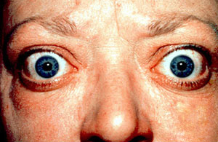
Dysthyroid eye disease
Infiltration of the extraocular muscles with lymphocytes and the depositions of glycosaminoglycans in the tissues causing proptosis, exposure of the globes and limitation of eye movements.
Occur mainly in hyperthyroidism but can occur in hypothyroidism

Slide 21
Myasthenia gravis
Acetylcholine receptor targeted antibodies
Females > males, 15-50 years of age
40% show involvement of Extraocular muscles only.
Variable diplopia and ptosis due to fatigue.
Diagnosis: Edrophonium test
Treatment: neostigmine ( acetylcholine esterase inhibitor), thymectomy.

Slide 22
Cover – Uncover test
Orthophoria

Slide 23
Cover – Uncover test
Esophoria
Note OS does not move.

Slide 24
Cover – Uncover test
Exophoria,
Only seen when eye is covered
Note OS does not move
G.Vicente,MD

Slide 25
Alternate Cover test
Exotropia, intermittent
May have intermittent diplopia, especially when tired or sick
G.Vicente,MD

Slide 26
Alternate Cover test
Exotropia, Constant
May be visible with or without alternate cover
G.Vicente,MD

Slide 27
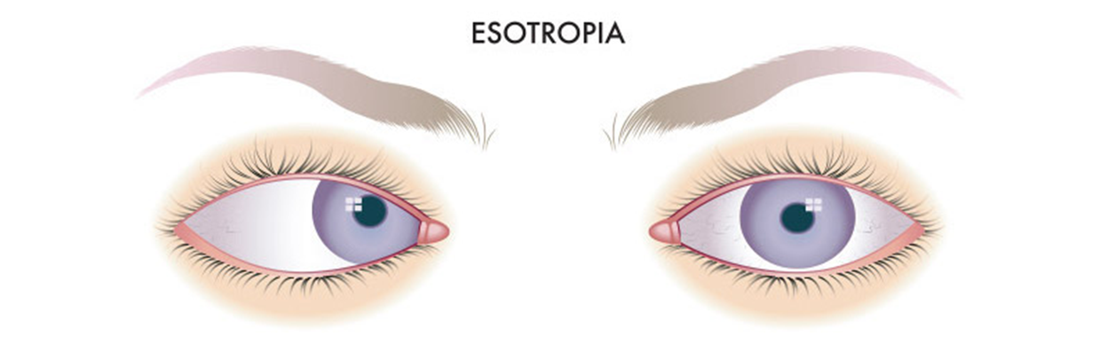
Esotropia
Right, left or alternating( variable fixation)
Concomitant or Incomitant
1ry, 2ry or Consecutive(overcorrection)

Slide 28
Concomitant Esotropia
1- Congenital (Infantile) esotropia
2- Accommodative
3- Non-Accommodative

Slide 29
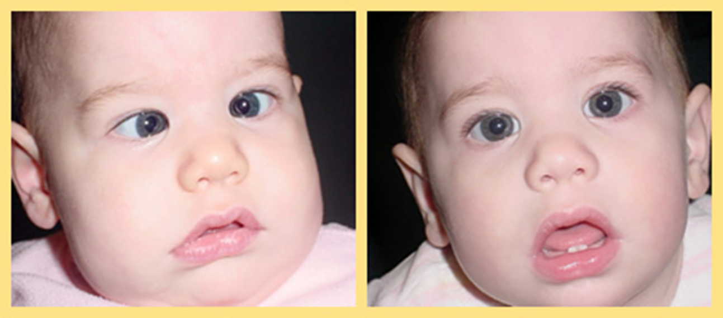
Congenital (Infantile) esotropia
Occur in the first 6 months of life in otherwise neurologically health child.
Not associated with hypermetropia
Large angle of deviation
Treatment: Recession of both
medial recti

Slide 30
Accommodative Esotropia
Accommodative esotropia is often seen in patients with a moderate amount of hypermetropia.
The hypermetrope, in an attempt to "accommodate" or focus the eyes, converges the eyes as well, as convergence is associated with activation of the accommodative reflex (synkinesis).

Slide 31
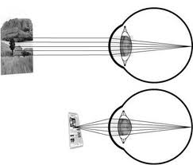
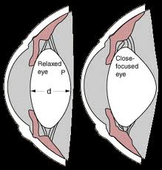

Slide 32
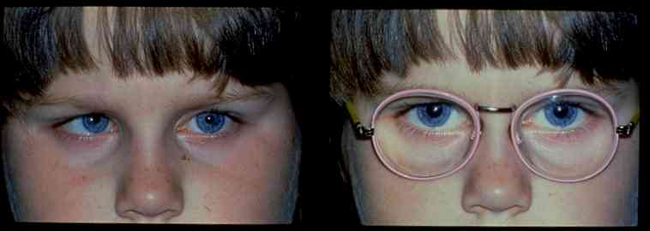
Glasses are not an alternative to surgery or visa versa

Slide 33
Non- accommodative esotropia
Induced by :
1- Emotional or physical stress (illness)
2- Sensory deprivation (untreated congenital cataract, optic atrophy)
3- Retinoblastoma

Slide 34
Exotropia
1- Intermittent Exotropia
2- Constant Exotropia

Slide 35
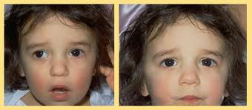
Intermittent Exotropia
-Onset before 5 years.
-Manifests during times of :
1- visual inattention.
2- Fatigue
3- Stress
4- During illness
-If exposed to bright light causes reflex closure of one eye

Slide 36
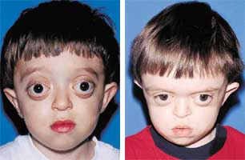
Non-accommodative exotropia
Crouzon’s syndrome:
Defect in Fibroblast growth factor receptor 2
Autosomal dominant, chromosome 10
shallow eye sockets after early fusion of surrounding bones
Craniosynostosis
Hypertelorism (greater than normal distance between the eyes)
PDA and aortic coarctation

Slide 37
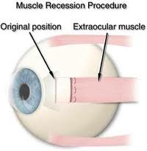
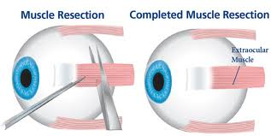
Management
1- Early detection
2- Glasses
3- Surgery (Recession or Resection)

Slide 38
Amblyopia
Unilateral permanent reduction in visual acuity with the absence of organic pathologoy.
Types:
1- Strabismic
2- Anisometropic
3- Form Deprivation

Slide 39
Strabismic Amblyopia
Occur in the squinting eye if the squint is prolonged and constant.
* In children

Slide 40
Anisometropic Amblyopia
When there is unequal refractive error between the 2 eyes, the eye that provide a clearer image become the dominant eye while the image in the other eye is blurred resulting in abnormal development of that side.

Slide 41
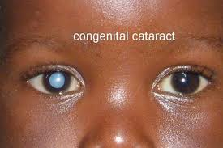
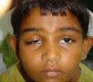
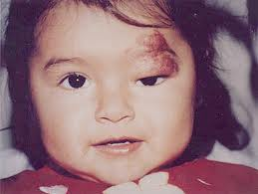
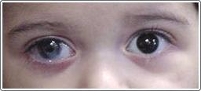
Form-deprivation amblyopia
results when the ocular media become opaque such as is the case with cataracts or corneal scarring from forceps injuries during birth.

Slide 42

Take home messages
Strabismus is a symptom/sign (similar to fever ) which might be the presenting sign of life threatening conditions.
Parents are always true about their complaint of presence of squint.
There is nothing called Pseudo strabismus.
Never patch the eye of a child.

