Slide 1
Spinal dysraphism (spina bifida)
Dr.Qussay Alsabbagh

Slide 2
Definition
A major birth defect and a type of neural tube defect that involves an opening in the vertebral column caused by the failure of the neural tube to close properly during embryonic development
The term ‘spina bifida’ was first used in Observationes Medicae in 1685
Dysraphism is from the Greek words dys (bad) and rhaphḗ (suture).

Slide 3
Epidemiology
Neural tube defects are the second most common type of birth anomaly after congenital heart disease
an estimated prevalence of about one to three per 1000 live births.
The lumbosacral spine 90% of cases, followed by the thoracic spine (6%–8%) and cervical spine (2%–4%) .

Slide 4
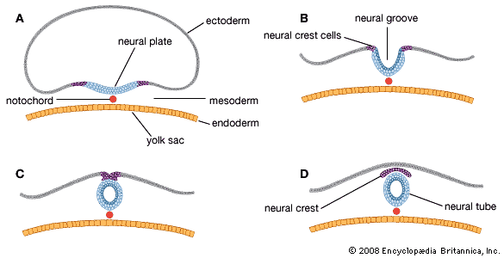
Embryology
The process of primary neurulation occurs in the first month of gestation. Neural development begins quite early, neural plate and groove appear at 18 days and complete closure of neural tube by the end of the 4th week.

Slide 5
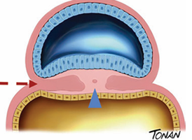
1-Gastrulation
Gastrulation is defined by transformation of the bilaminar embryonic disk into a trilaminar embry onic disk through addition of a third interposed layer—the mesoderm.
ends in the middle of the 3rd gestational week

Slide 6
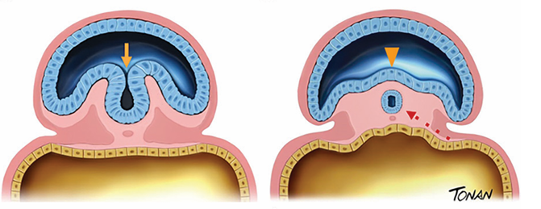
2-Primary Neurulation
Primary neurulation extends during weeks 3 and 4 of gestation starting with formation of the neural plaque in the ectoderm and ending with closure of the neural tube in the mesoderm

Slide 7
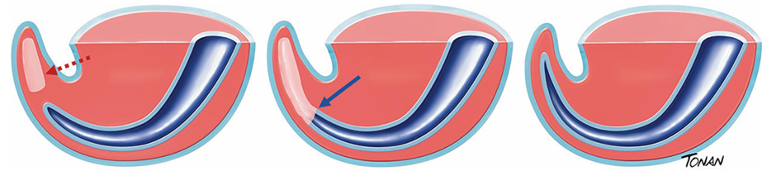
3-Secondary Neurulation
Secondary neurulation—the last embryologic step—begins at the end of primary neurulation and occurs during weeks 5 and 6 of gestation

Slide 8
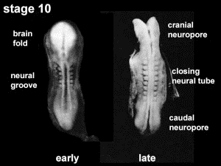

Slide 9
Etiology
predisposing factors are:
Genetic factors:
The methylene tetrahydrofolate reductase (MTHFR) gene is the most studied
Family history —> (0.36 and 1.7 per 1000 live births. The risk of recurrence is 2–5% in couples with one previous child with MM, and up to 15% in cases with two previous affected children )*
However, 90–95% of MM cases occur in pregnancies of so-called low-risk couples that do not have a history of affected children.
More common in females than males
*(Gynecologists ACoOa 1986; Kallen et al. 1994)

Slide 10
Nutritional deficiency of Folic Acid supplementation of folic acid at a dose of 4 mg/day in women with a history of children with MM reduced the risk of recurrence by approximately 70% (Lumley et al. 2001).
Others: inositol, vitamin B12 , choline, retinoic acid, and iron
Medications like. Anticonvulsants(valproate)
Conditions like:. Diabetes, obesity and fever also increases the chances of delivering of a baby with a spina bifida

Slide 11
Types of spina bifida
Spina bifida occulta
Congenital absence of a spinous process and variable amounts of lamina. No visible exposure of meninges or neural tissue .
Spina bifida aperta (aperta from the Latin for “open”) or spina bifida cystica.

Slide 12
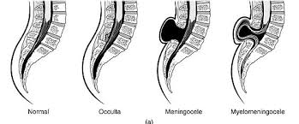

Slide 13
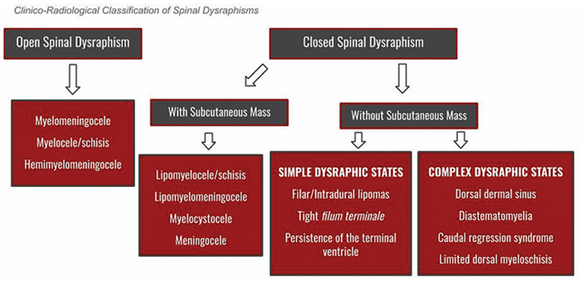

Slide 14


Slide 15
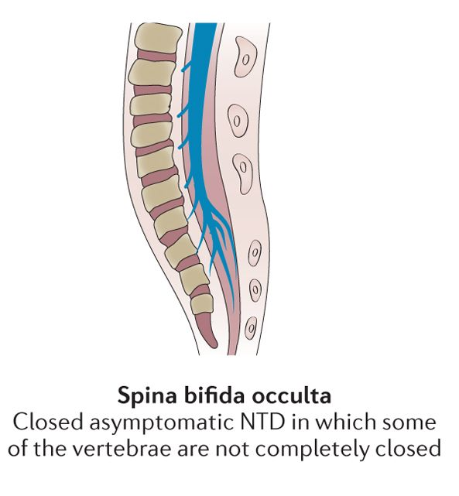
SPINA BIFIDA OCCULTA (SBO)
Reported prevalence range of SBO: 5-30% of North Americans (5-10% is probably more realistic).
The defect may be palpable, and there may be overlying cutaneous manifestations
Often an incidental finding, usually of no clinical importance when it occurs alone.

Slide 16
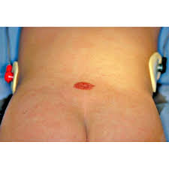
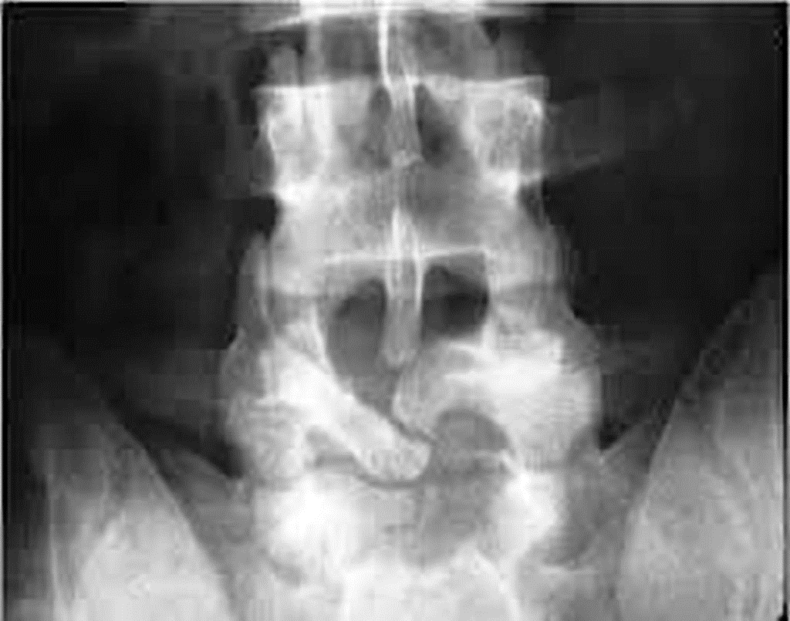
No statistical association of SBO with nonspecific Low back pain. An increased incidence of disc herniation was shown in one study.
SBO may occasionally be associated with diastematomyelia, tethered cord, lipoma, or dermoid tumor.
When symptomatic from one of these associated conditions, the presentation is usually that of tethered cord (gait disturbance, leg weakness and atrophy, urinary disturbance, foot deformities…,).

Slide 17
Spina bifida cystica
Meningocele :Congenital defect in vertebral arches with cystic distension of meninges, but no abnormality of neural tissue. One third have some neurologic deficit.
Myelomeningocele :Congenital defect in vertebral arches with cystic dilatation of meninges and structural or functional abnormality of spinal cord or cauda equina .
MM is the most common anomaly of the CNS that is compatible with life and has a mortality rate of approximately 10%

Slide 18
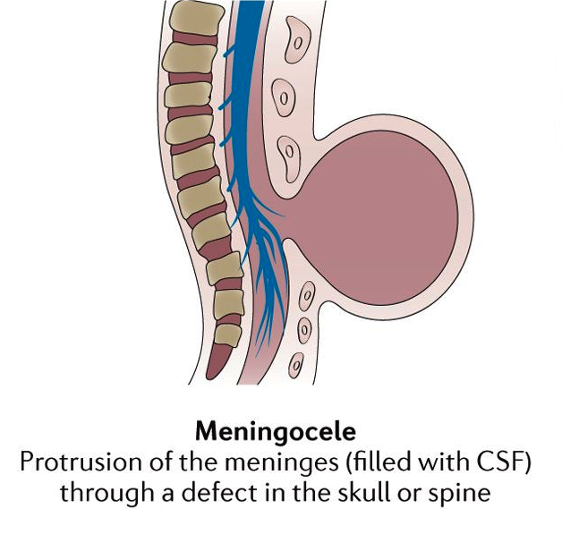
Meningocele

Slide 19
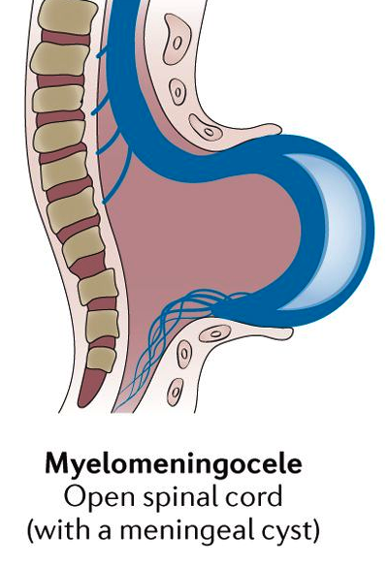
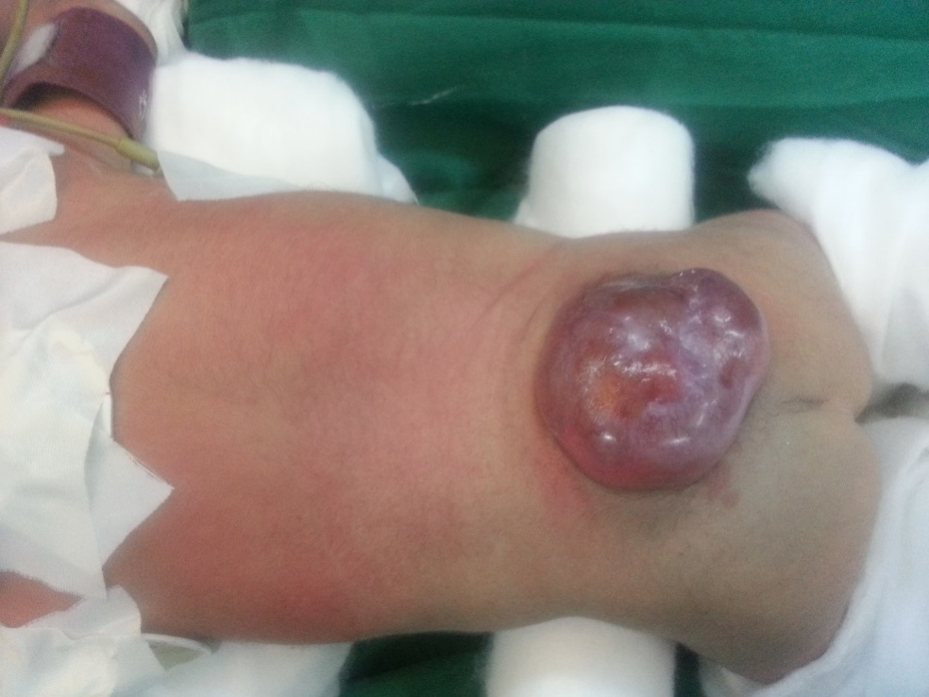
Myelomeningocele

Slide 20
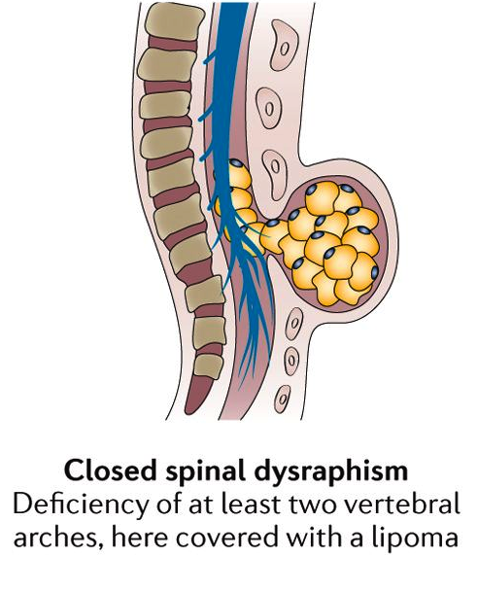
Lipomyelomeningoceles

Slide 21
PRENATAL DETECTION OF NEURAL TUBE DEFECTS
Serum alpha-fetoprotein (AFP)
A high maternal serum AFP (≥ 2 multiples of the median for the appropriate week of gestation) between 15-20 weeks gestation carries a relative risk of 224 for neural tube defects.
Ultrasound
Prenatal ultrasound will detect 90-95% of cases of spina bifida, and thus in cases of elevated AFP, it can help differentiate NTDs from non-neurologic causes of elevated AFP (e.g. omphalocele),and can help to more accurately estimate gestational age.

Slide 22
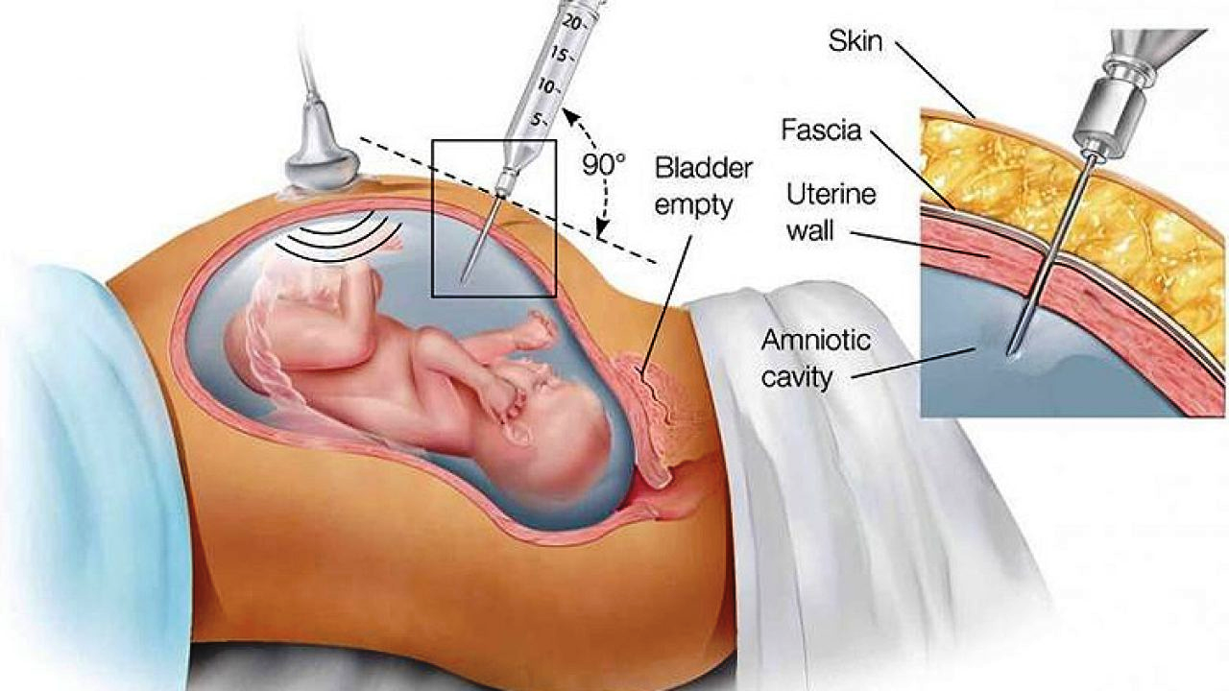
Amniocentesis
Amniocentesis
For pregnancies subsequent to a MM, if prenatal ultrasound does not show spinal dysraphism, then amniocentesis is recommended (even if abortion is not considered, it may allow for optimal post-partum care if MM is diagnosed). Amniocentesis also carries a ≈ 6% risk of fetal loss in this population.

Slide 23
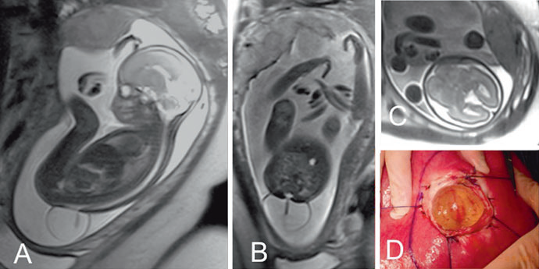
Fetal Magnetic Resonance-complementary.

Slide 24
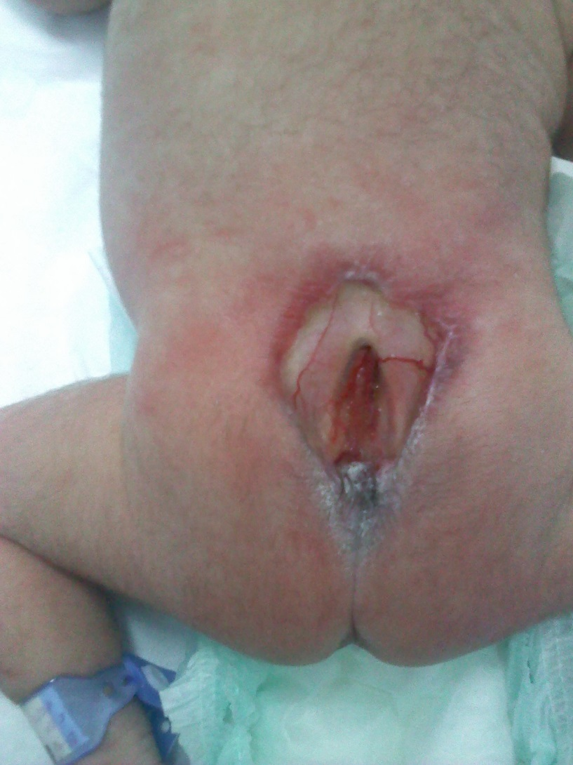
Clinical presentation
Neurological assessment :
Items related to spinal lesion
Watch for spontaneous movement of the LLs
2. Assess lowest level of neurologic function by checking response of LLs to painful stimulus:..
Items related to the commonly associated Chiari type 2 malformation:
Measure OFC(occipitofrontal circumference): risk of developing hydrocephalus.
2. Head U/S within ≈ 24 hrs
3. Check for inspiratory stridor, apneic episodes

Slide 25
Ancillary assessment and management:
Evaluation by neonatologist to assess for other abnormalities, especially those that may preclude surgery (e.g. pulmonary immaturity). There is an average incidence of 2-2.5 additional anomalies in MM patients
Bladder: start patient on regular urinary catheterizations, obtain urological consultation(non-emergent)
AP & lat spine films: assess scoliosis (baseline)
Orthopedic consultation for severe kyphotic or scoliotic spine deformities and for hip or knee deformities

Slide 26
Management
ADMISSION
assessment and management of lesion:
measure size of defect
assess whether lesion is ruptured or unruptured
ruptured: start antibiotics
2. unruptured: no antibiotics necessary
cover lesion with telfa or wet dressing , to prevent desiccation
Trendelenburg position.
perform surgical closure within 36 hrs unless there is a contraindication to surgery

Slide 27
SURGICAL REPAIR
Van Forestus (1610).
TIMING OF CLOSURE:
Early closure of MM defect is not associated with improvement of neurologic function, BUT evidence supports lower infection rate with early closure.
MM should be closed within 24 hrs whether or not membrane is intact (after ≈ 36 hrs the back lesion is colonized and there is increased risk of postoperative infection).

Slide 29

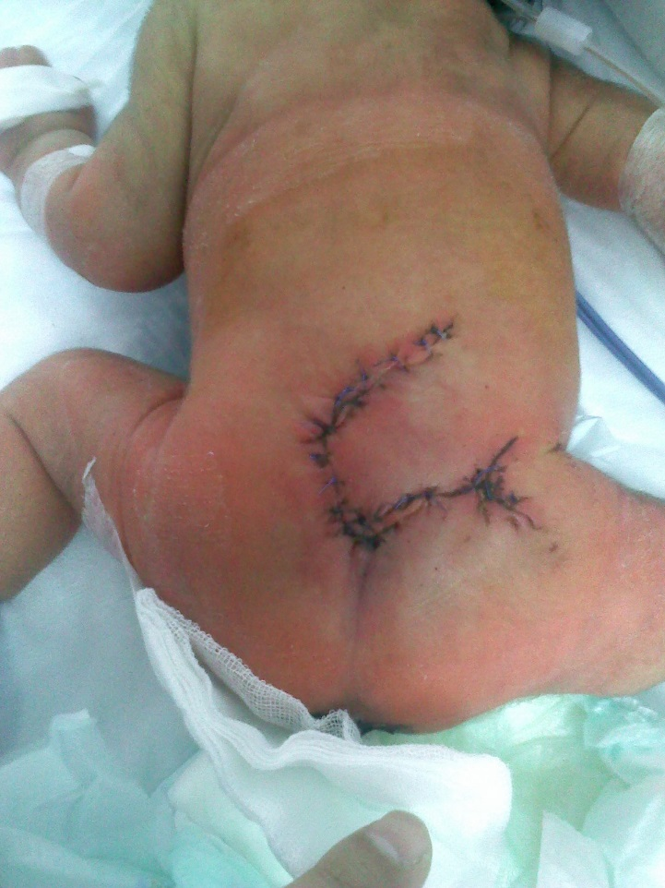
MMC repair-from our series

Slide 30
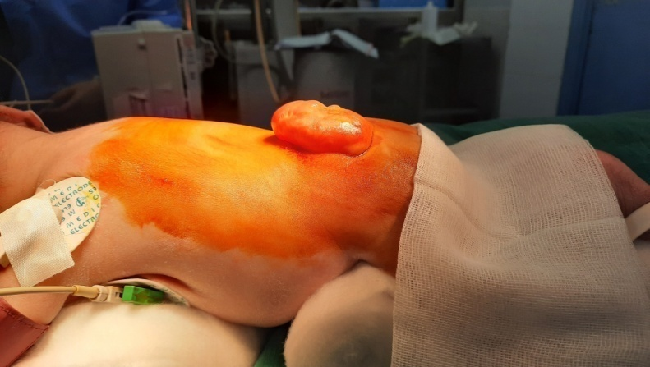
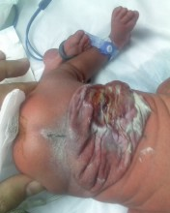
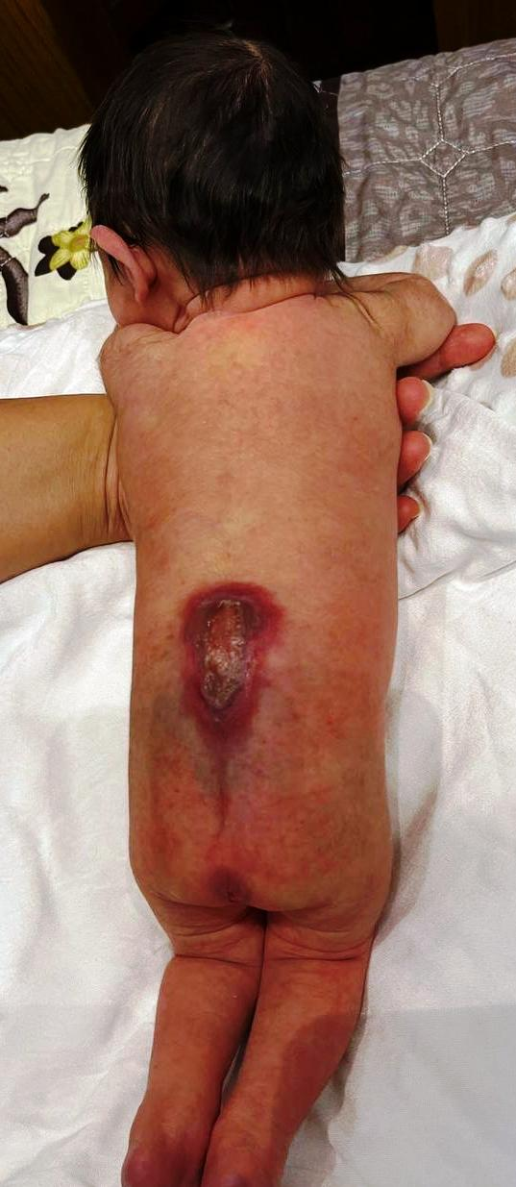
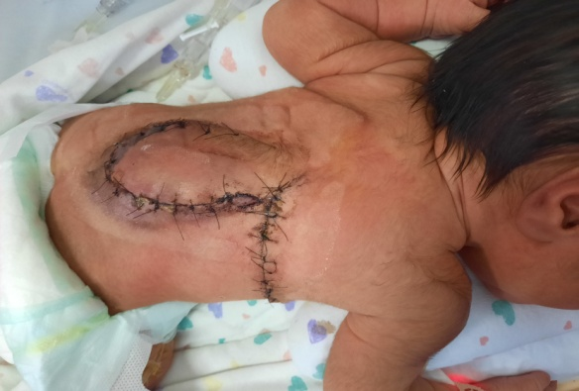
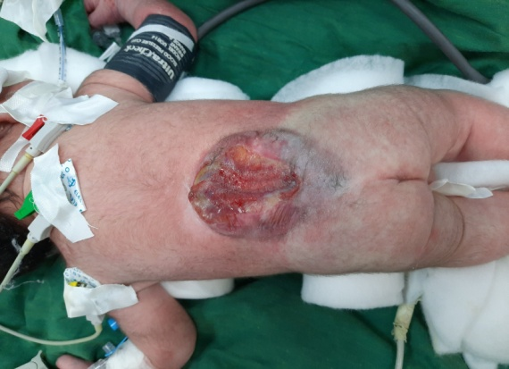
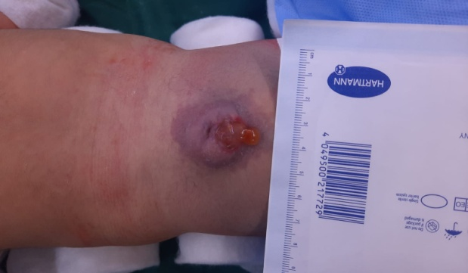
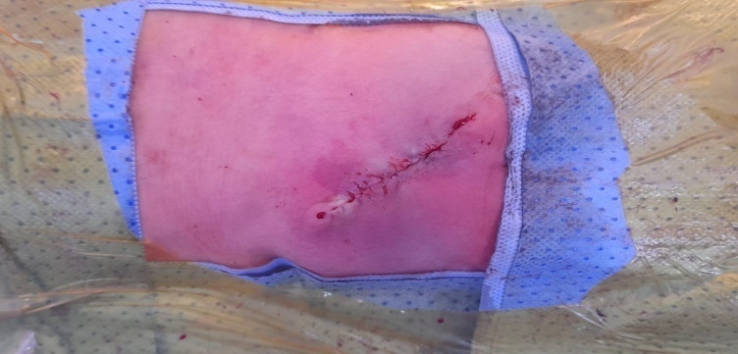
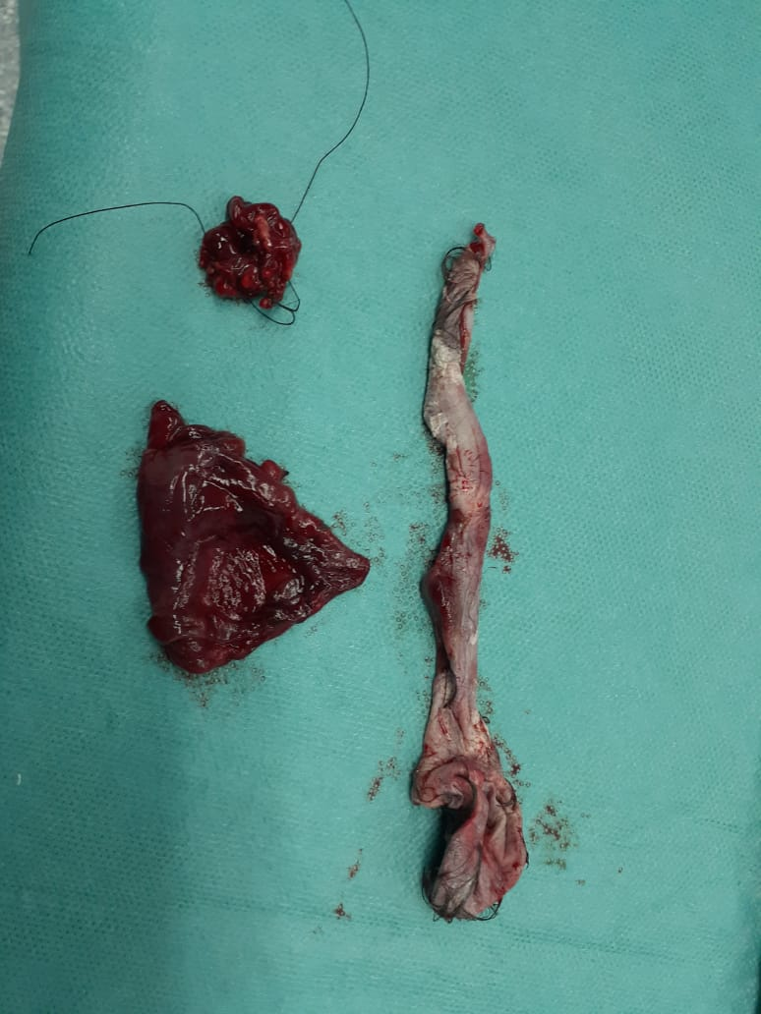
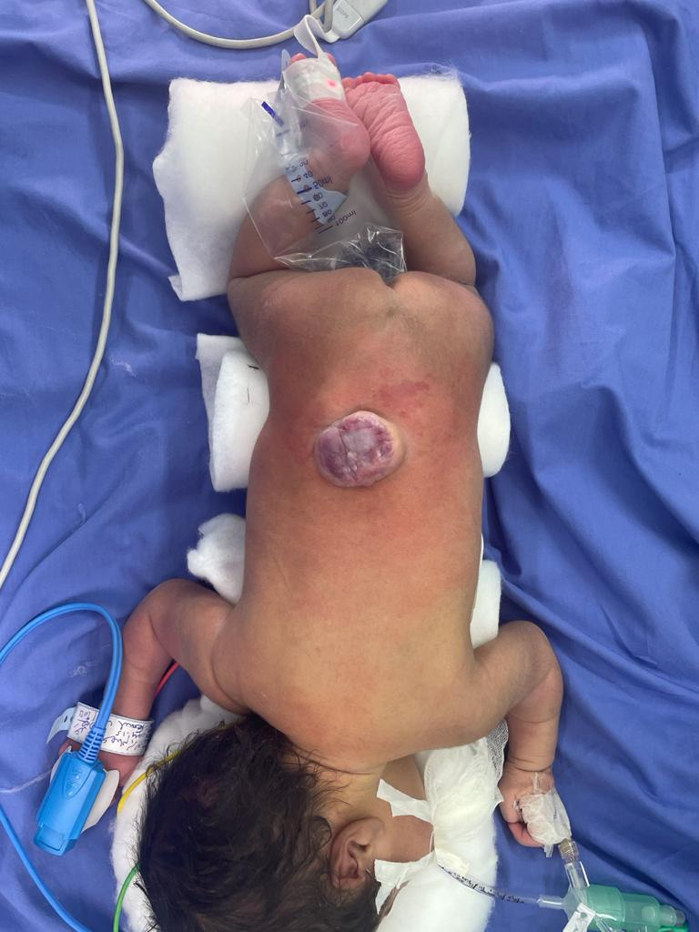
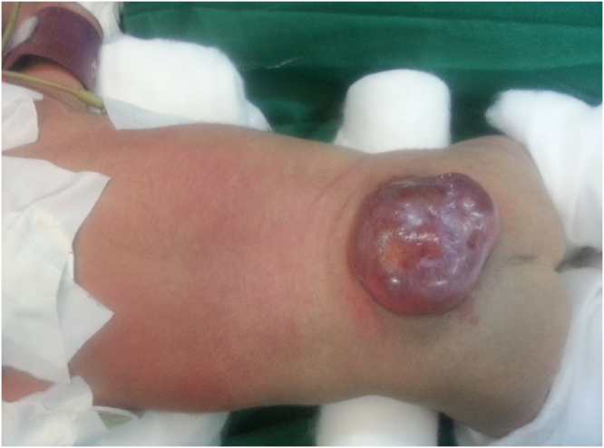

Slide 31
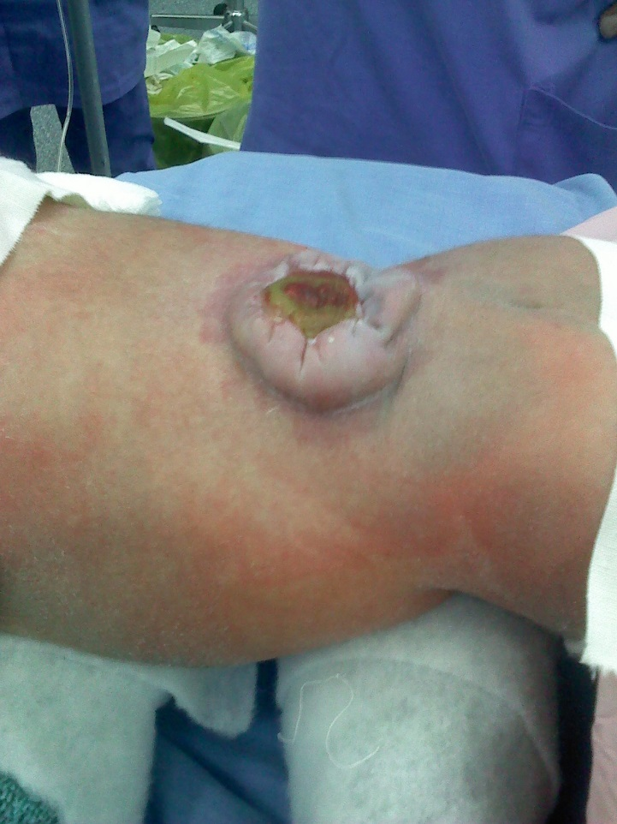
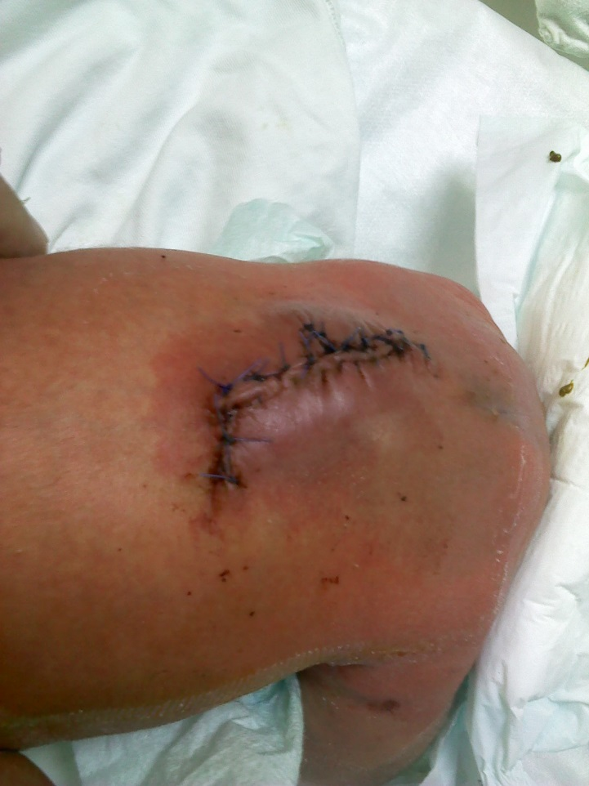

Slide 32


Slide 33
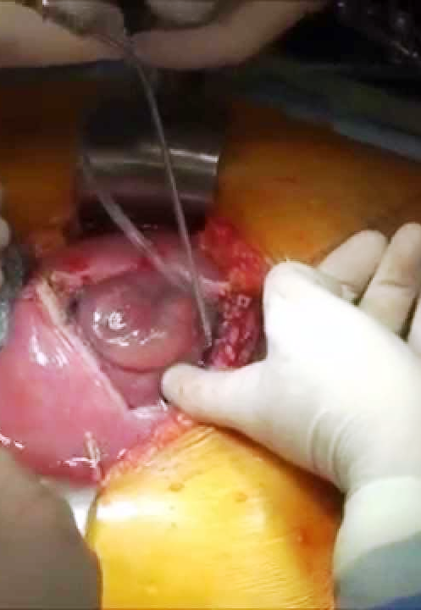
Intrauterine closure of MM defect
Controversial.
Does reduce incidence of Chiari II defect, but it has not been determined if this is
clinically significant.
Argued whether this reduces incidence of hydrocephalus.
Does not improve distal neurologic function.

Slide 34
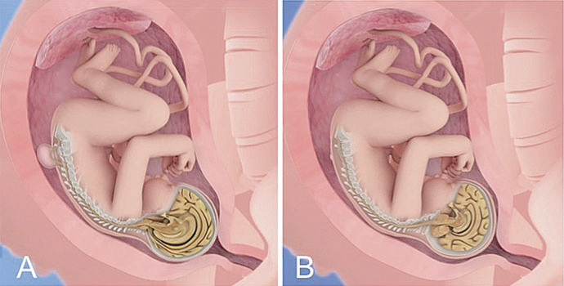

Slide 35
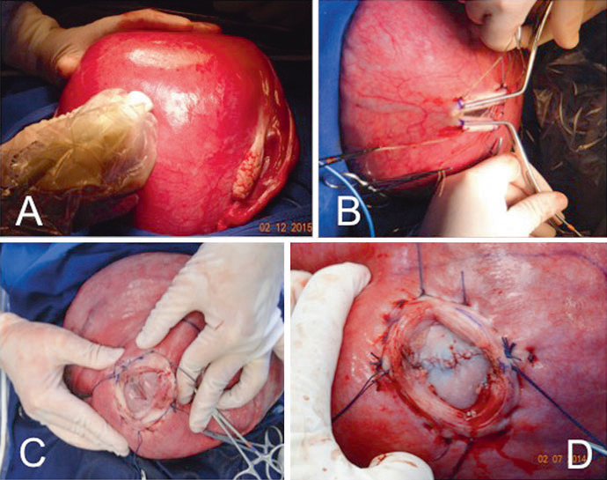

Slide 36
MMC and hydrocephalus
Incidence of hydrocephalus is 85-90% of all cases of myelomeningocele.
Usually it is a part of type 2 (arnold)-chiari malformation.
May not be apparent after birth immediately, may be seen as far as 2 years ,but most cases will need shunt by the age of 6 months.

Slide 37
Tethered cord syndrome
Abnormally low conus medullaris. Usually associated with a short, thickened filum terminale, or with an intradural lipoma (other lesions, e.g. lipoma extending through dura, or diastematomyelia are considered as separate entities). Most common in myelomeningocele (MM).

Slide 38
A sagittal T1-weighted magnetic resonance image through the lumbar region demonstrates a thickened filum terminale.
The hyperintensity ( arrows ) indicates fatty infiltration of the filum

Slide 39
Detethering(release of the tethered cord)

Slide 40
Chiari malformations
Basically they are hindbrain malformations, with associated anomalies that may involve the rest of the CNS.
The term “Chiari malformation” (after pathologist, Hans Chiari) is preferred for type 1 malformations, with the commonly used term “Arnold-Chiari malformation” reserved for type 2 malformation.

Slide 41
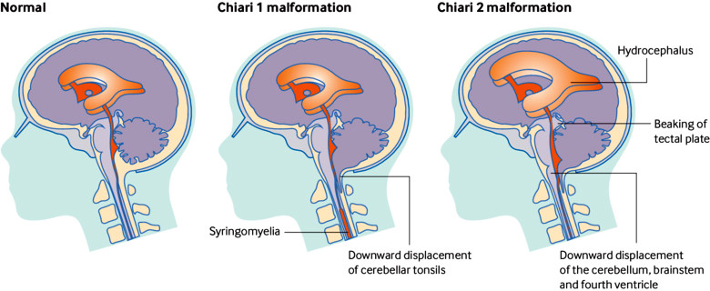
The Chiari malformations consists of four types of hindbrain abnormalities, probably unrelated to each other.
The majority are types 1 or 2), a very limited number of cases comprise the remaining types

Slide 43
LATE PROBLEMS/ISSUES
Include:
1. Hydrocephalus: may mimic ≈ anything listed below. always rule out shunt malfunction when a MM patient deteriorates
2. Syringomyelia (and/or syringobulbia):
3. Tethered cord as many as 70% of MM patients have a tethered cord radiographically (some quote 10-20%), but only a minority are symptomatic.
4. Dermoid tumor at the MM site131: incidence ≈ 16% .
5. Medullary compression at foramen magnum (symptomatic Chiari II malformation.

Slide 44
OUTCOME
Without any treatment, only 14-30% of MM infants survive infancy; these usually represent the least severely involved.
With modern treatment, ≈ 85% of MM infants survive.
The most common cause of early mortality are complications from the Chiari malformation (respiratory arrest, aspiration…), where late mortality is usually due to shunt malfunction.

Slide 45
80% will have normal IQ. Mental retardation is most closely linked to shunt infection. 40-85% are ambulatory with bracing, however, most choose to use wheelchairs for ease.
3-10% have normal urinary continence, but most may be able to remain dry with intermittent catheterization.

Slide 46
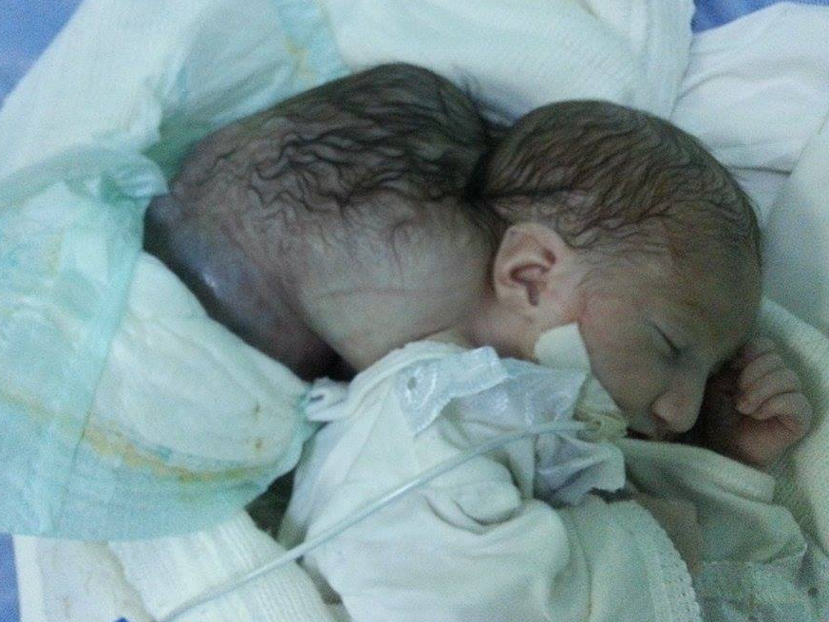
Huge occipital encephalocele

Slide 47
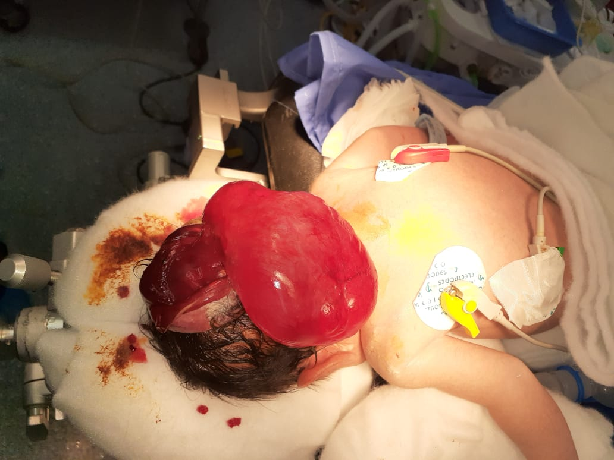
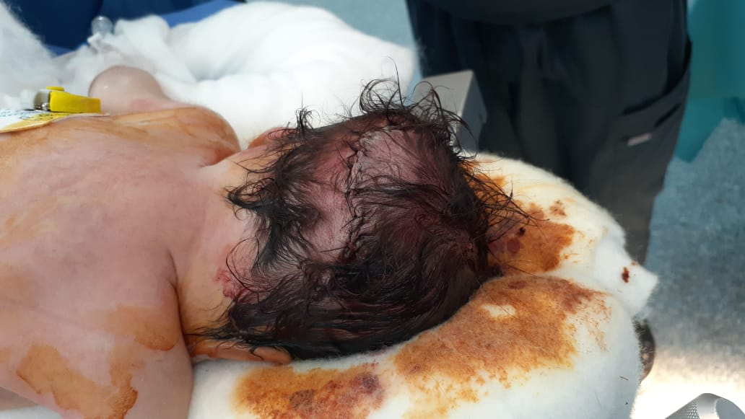
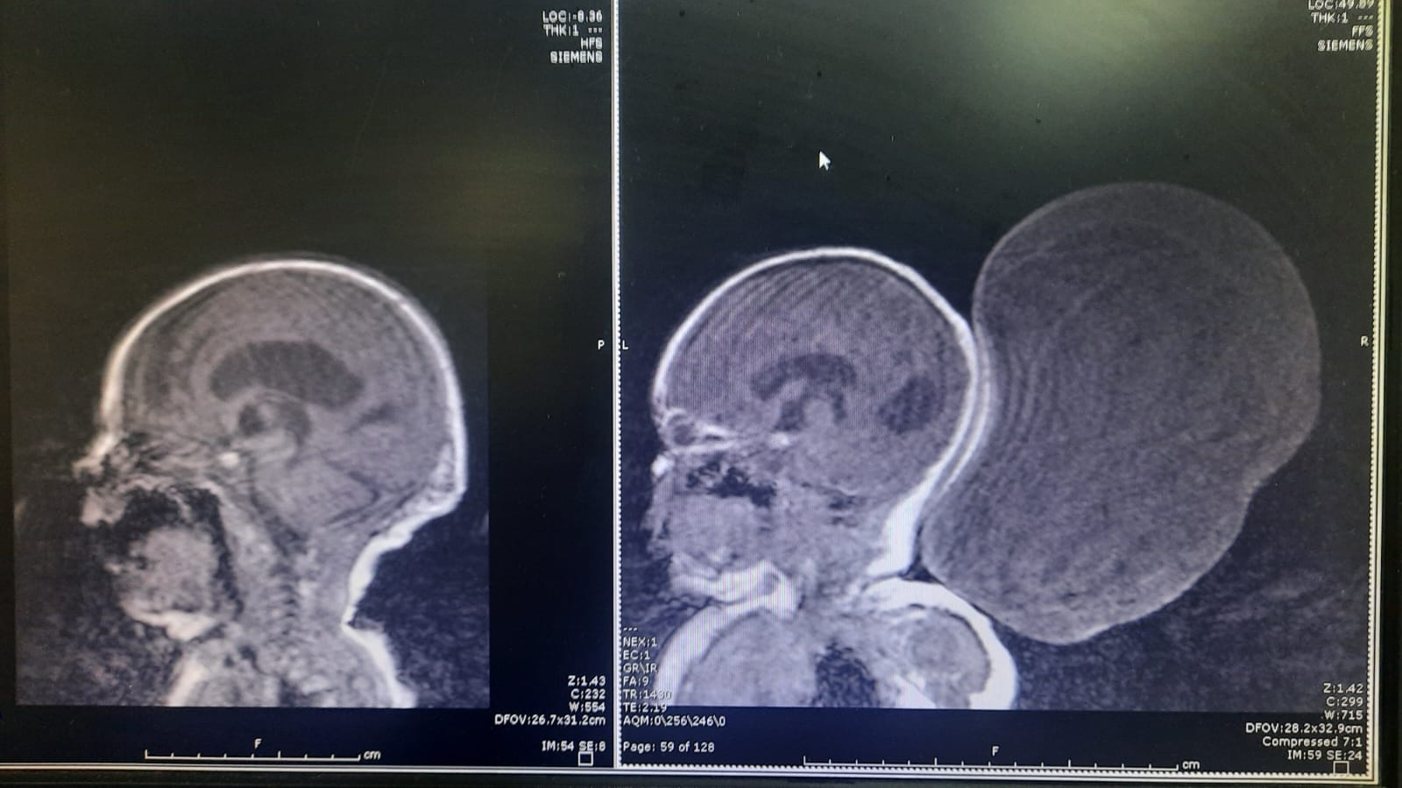
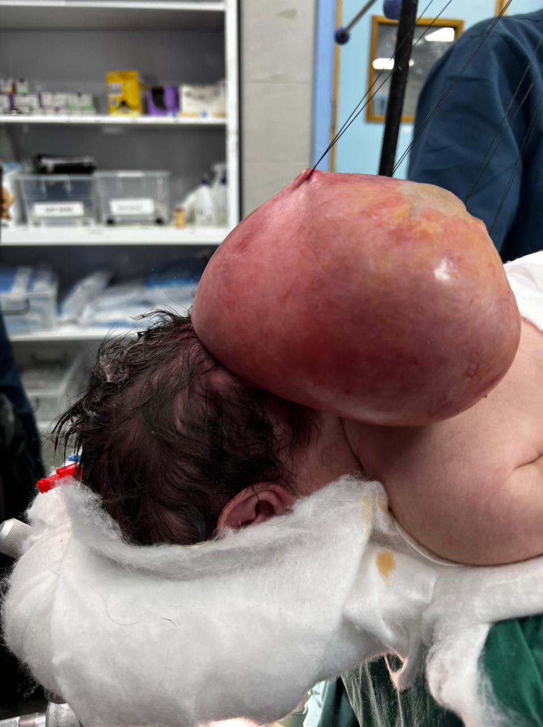
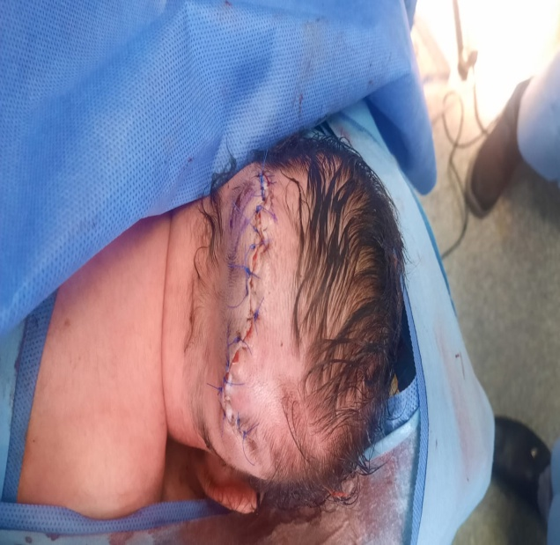

Slide 48
