Slide 1
Sudden Natural Death
Sadil Bani Khaled , MD student
School of Medicine , University of Jordan

Slide 2
Objectives
Define Sudden natural death
Explain the medicolegal importance of sudden natural death
Identify and classify the major causes of sudden natural death
Describe sudden infant death syndrome (SIDS) and its main characteristics

Slide 3
Natural death : Death occurring due to some natural disease or pathological condition , old age , debility or devitalization ; here the death is not intended or attempted or accidental .
Sudden Deaths : Mostly natural deaths that occur immediately or within 24 hours of the terminal symptoms , which may be completely different from the symptoms that the patient was having so long .
Forensic ???

Slide 4
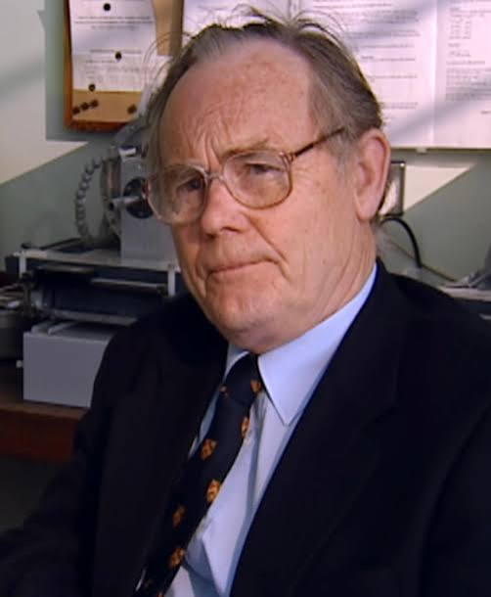
Why ?
Avoid the danger of acceptance of the obvious
Screening and recommendations

Slide 5
Cardiovascular system
Sudden Cardiac Death (SCD): the unexpected natural death from a cardiac cause within a short time period, generally ≤ 1 hour from the onset of symptoms, in a person without any prior condition that would appear fatal.
The most common cause of sudden natural death and it includes :
Diseases of the heart
Diseaess of the valves
Diseases of the arteries

Slide 6
Diseases of the heart
Coronary artery disease
Hypertensive heart disease
Aortic stenosis
Senile cardiac degeneration
Primary heart disease
Myocarditis and cardiomyopathies
Channelopathies
Diseases of the arteries

Slide 7
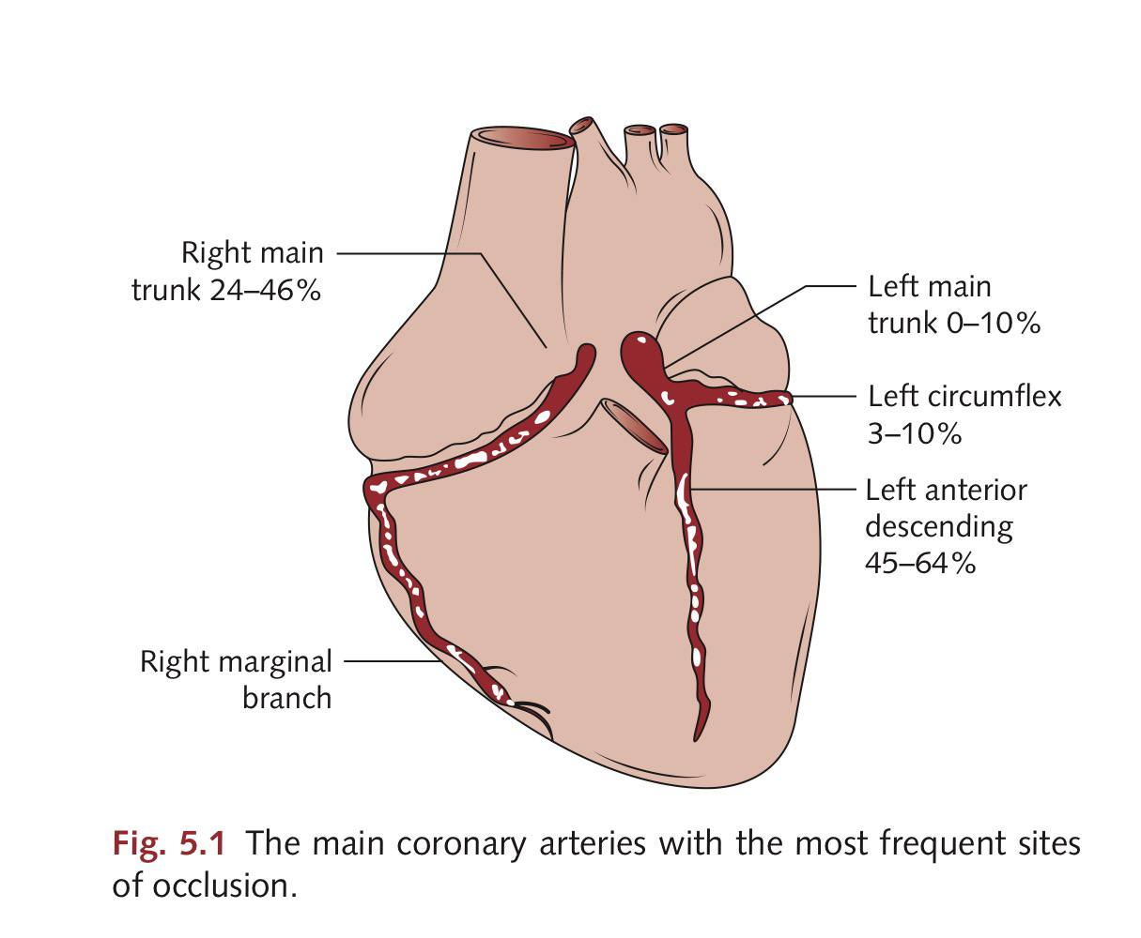
Coronary arteries anatomy

Slide 8
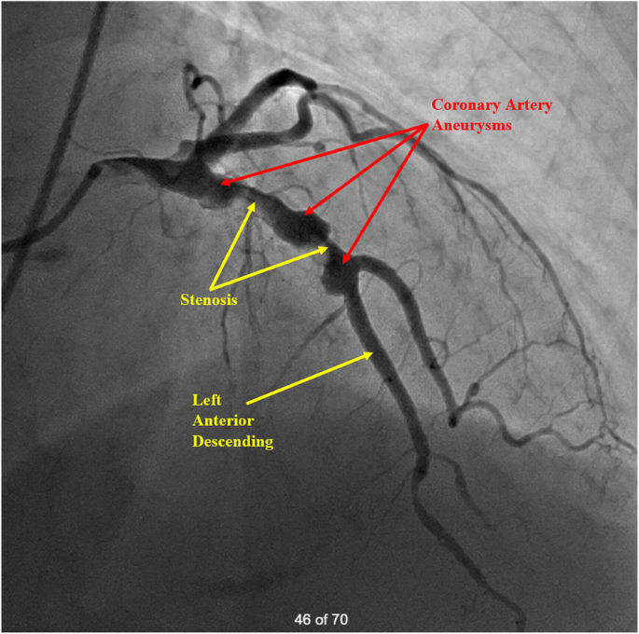
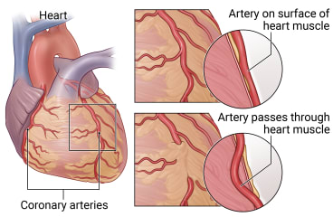
Coronary arteries diseases
Coronary stenosis or complete occlusion due to atheroma
Coronary artery spasm
Dissecting coronary aneurysm
Myocardial bridging

Slide 9
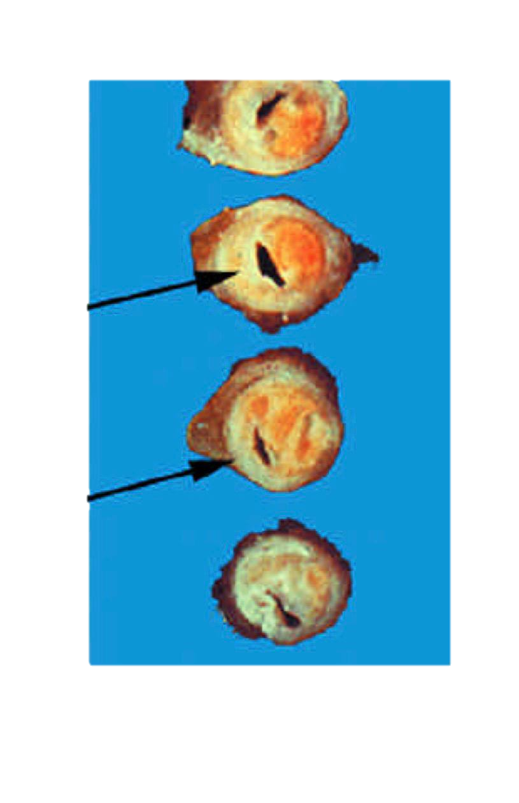
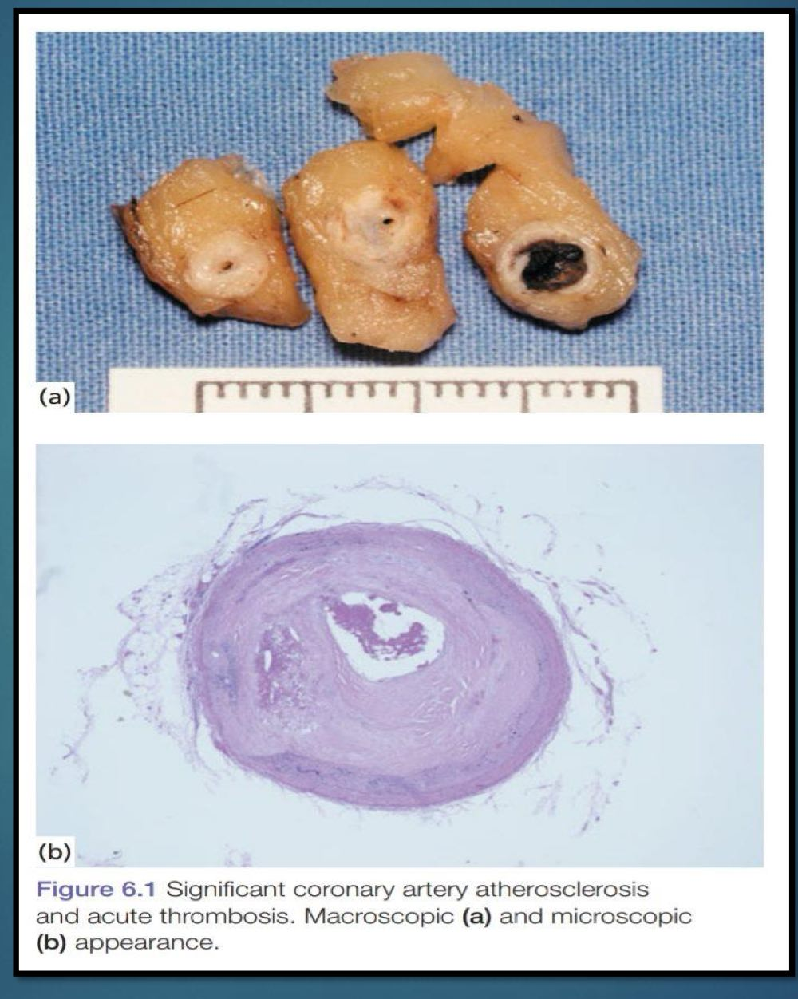
Coronary atherosclerosis
The most common cause of sudden death .
The basic mechanism is stenosis or occlusion of one or more major branches of the coronary arteries by atheromatous lesion , or one of the complications of such a lesion .
Complications include (ulceration , hemorrhage , thrombosis )
Severity of stenosis is debatable !

Slide 10
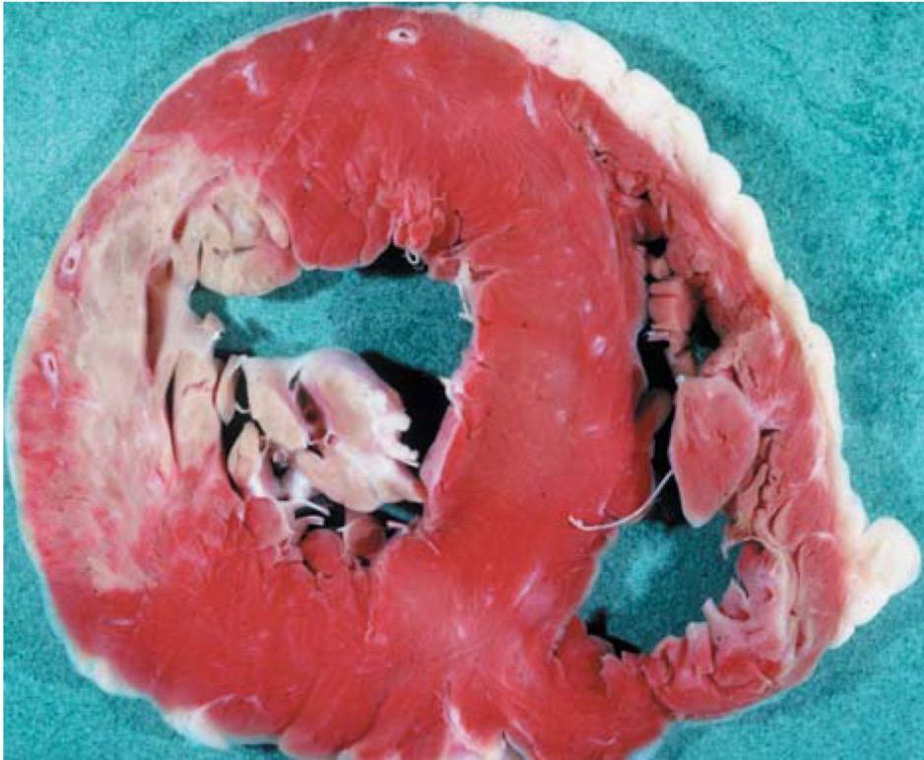
Myocardial infarction
Almost all myocardial infarcts are caused by atheromatous lesions and their complications . A few are the result of other types of coronary obstruction (polyarteritis , vasculitis , aortic stenosis , congenital anomalies…etc)
The original lumen must be reduced to 20% or less before the ischemia in the distribution zone is sufficient to cause MI .
Death can be attributed to coronary artery disease (CAD) with less stenosis if other signs of chronic myocardial ischemia are apparent (left ventricular hypertrophy [LVH], fibrosis, previous infarct).

Slide 11
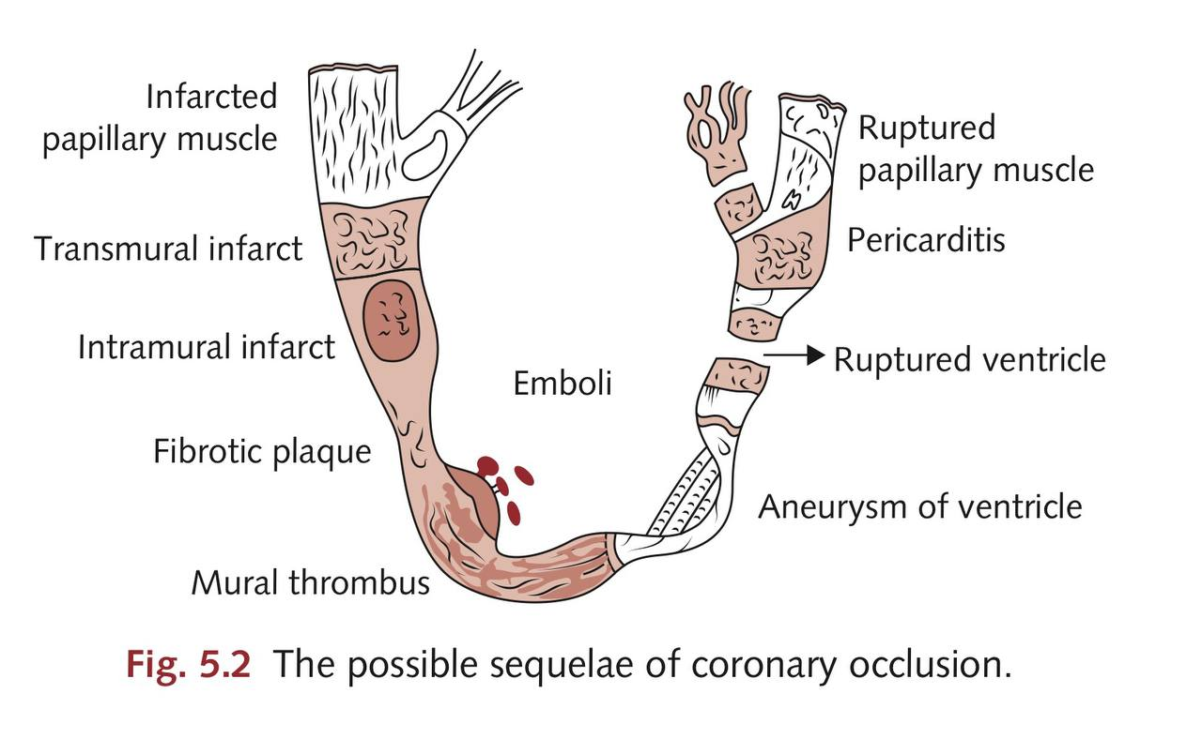
MI complications

Slide 12
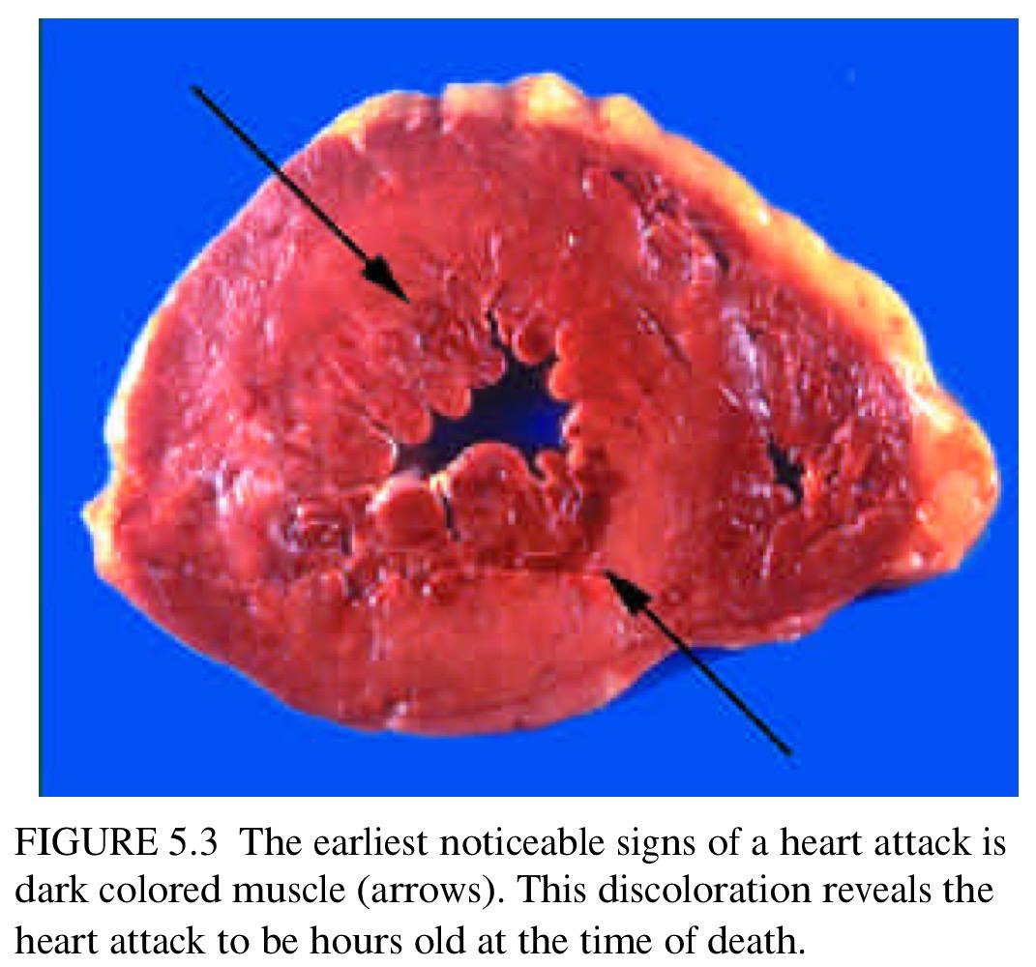
Early complications of MI
In the first 24 hours ,the most common complications are (ventricular fibrillation and cardiogenic shock)
Gross necrosis of the myocardium appears after 24 hours , while histopathological changes (necrosis) begin to appear on microscopy after 6 hours

Slide 13
Late complications of MI
Rupture of myocardial infarct :
The area of the myocardial infarct is weakest between 3 days and 14 days after the clinical onset of the infarct, due to the beginning of the healing process using granulation tissue (which is relatively weak). and it is at this time that the weakened area of myocardium may rupture, leading to sudden death from :
Hemopericardium
Cardiac tamponade
The rupture occasionally occurs through the interventricular septum, resulting in a left– right shunt

Slide 14
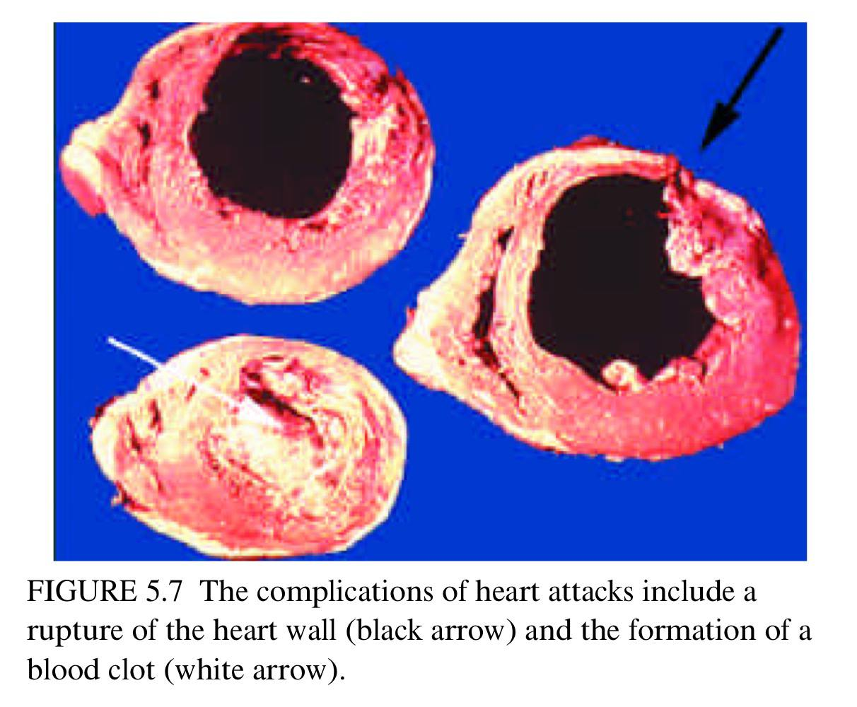
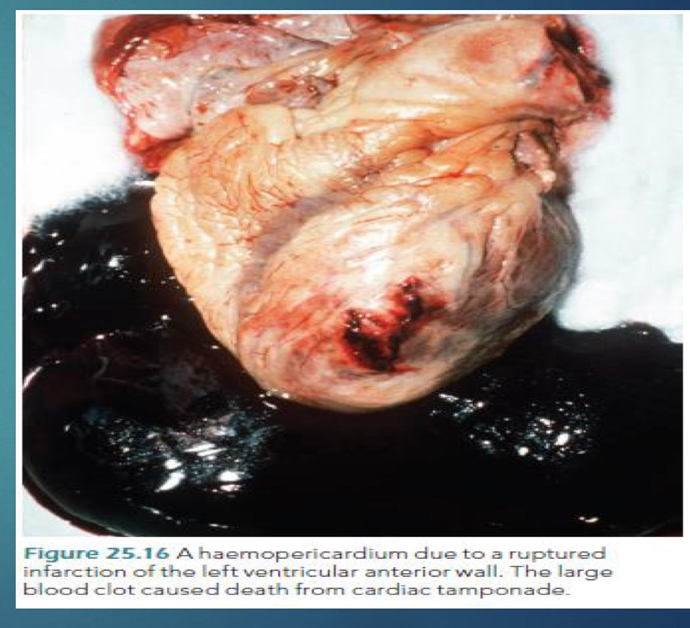
Late complications of MI …cont

Slide 15
Late complications of MI …cont
Papillary muscle rupture :
2-7 days post MI.
Allow part of the mitral valve to prolapse or may present as a sudden onset of valve insufficiency.
Posteromedial vs anterolateral ???

Slide 16
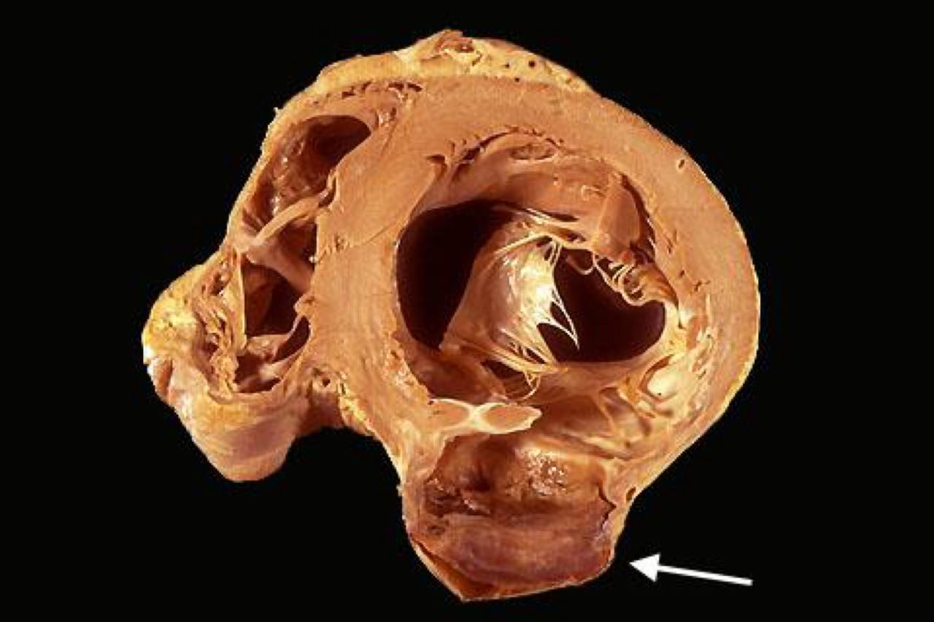
Late complications of MI …cont
Cardiac aneurysm :
3-14 days post MI
May form at sites of infarction . They may calcify and they may rupture

Slide 17
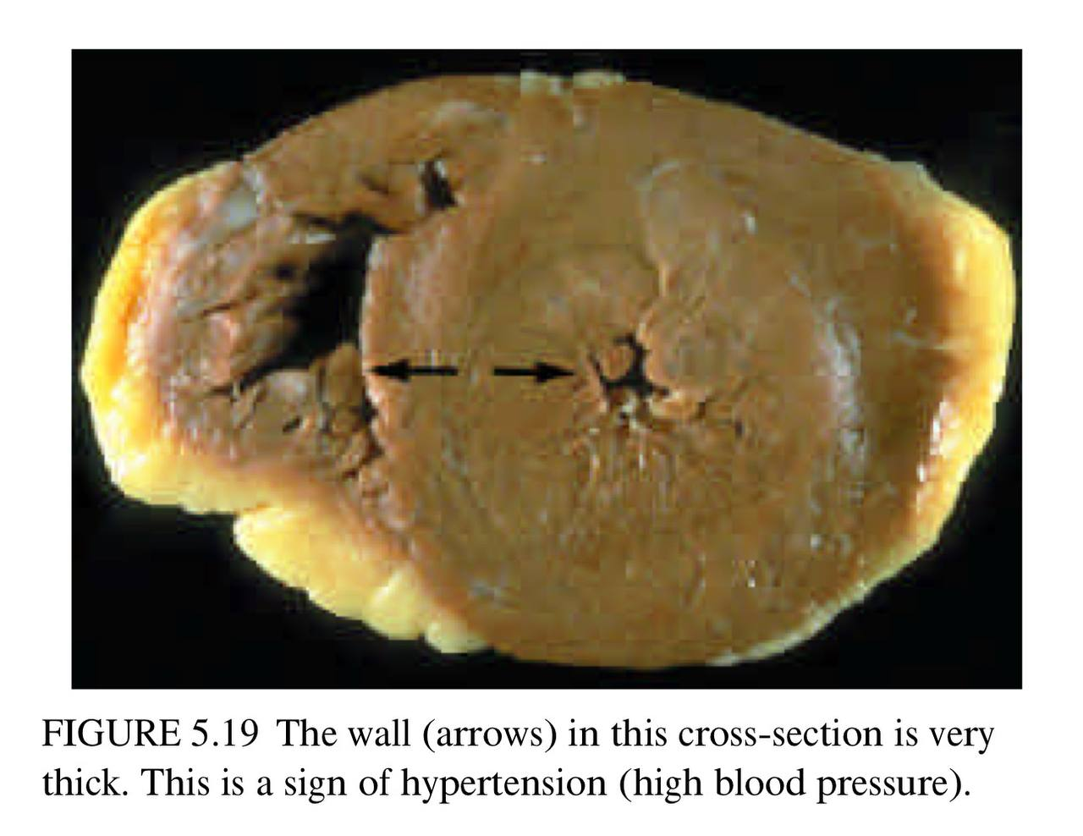
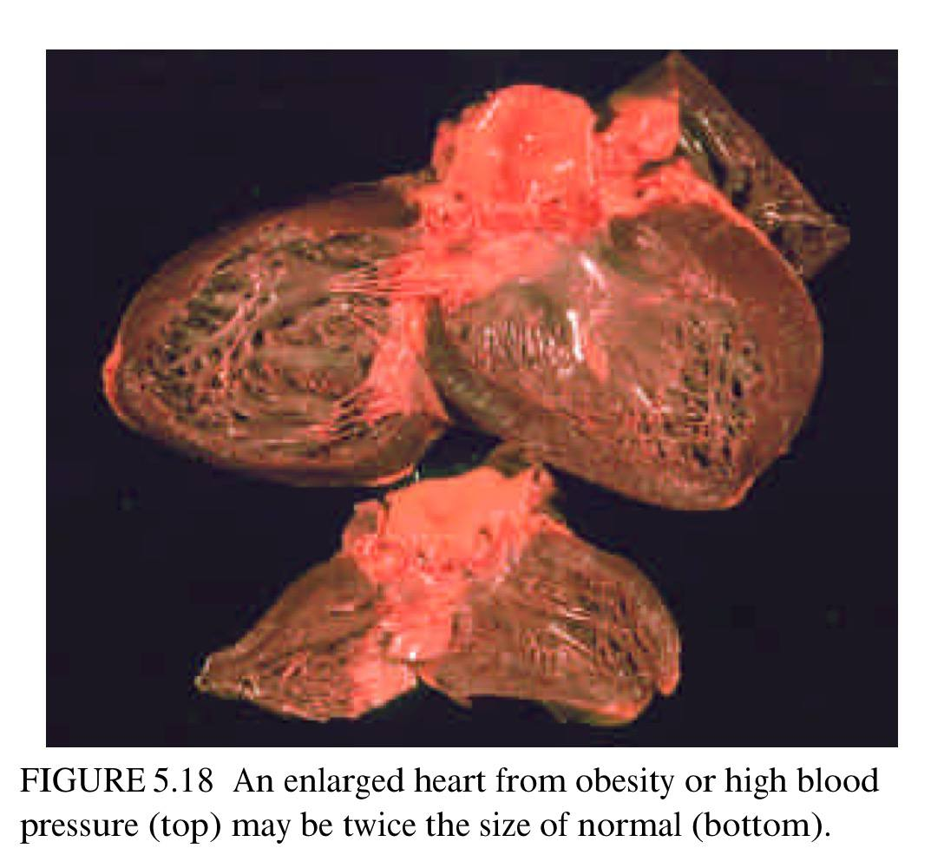
Hypertensive heart disease
There is an etiological connection between hypertension and coronary atheroma , so the two conditions are often present together in a victim of sudden death .
Presence of concentric hypertrophy in the absence of valve disease or cardiomyopathy , with characteristic changes in other vessels and organs .
chronic myocardial hypoxia and electrical instability which, when combined with a ‘trigger’ , can result in a fatal arrhythmia
Heart size ??? (variable )

Slide 18
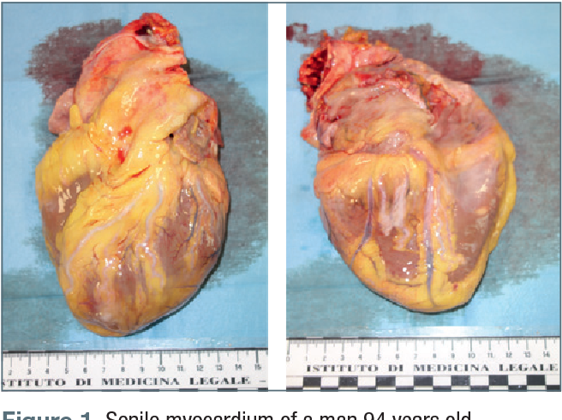
Senile myocardial degeneration
Senescence is a well-accepted concept in all animals, and few humans survive beyond 90 –100 years.
The cause of a sudden death in these elderly individuals can be very difficult to determine.
The senile heart is small, the surface vessels are tortuous, and the myocardium is soft and brown owing to accumulated lipofuscin in the cells

Slide 19
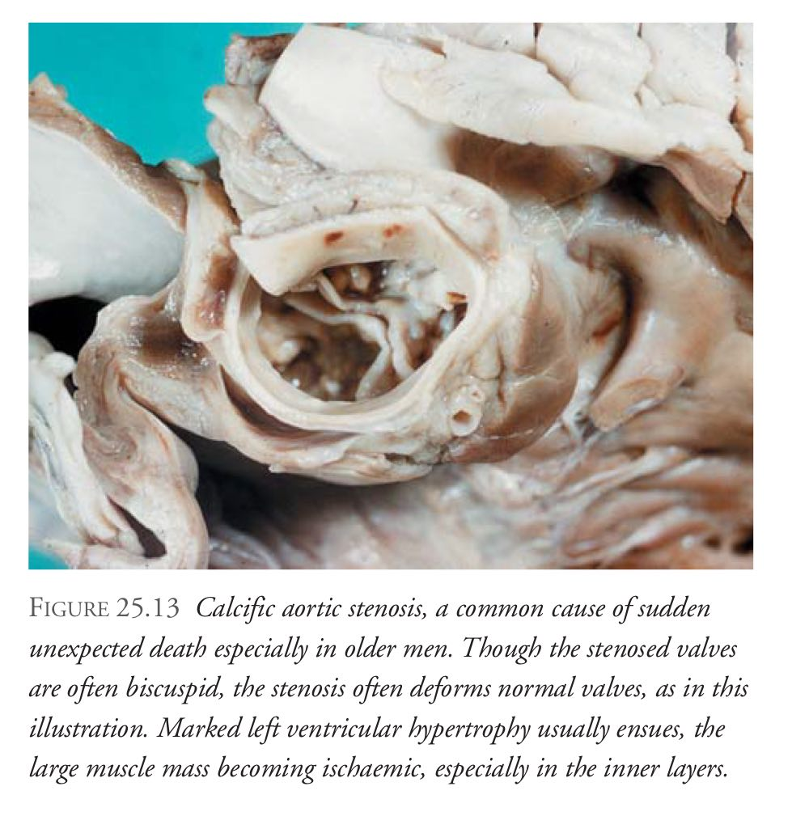
Aortic stenosis
Affects older individuals with calcified tricuspid aortic valve , or younger individuals who have a congenital bicuspid aortic valve
The accompanied myocardial hypertrophy is similar to that caused by hypertension , and myocardial perfusion is reduced by the narrow valve , which results in a lower pressure in the coronary ostia and hence , the coronary arteries .
Sudden death is common .

Slide 20
Primary diseases of the Myocardium (Myocarditis)
The fourth most common cause of SCD
Many infective diseases produce an acute myocarditis ,which may be the immediate cause of death (diphtheria).
The clinical manifestation of the acute picture may range from none to acute heart failure to sudden death , days to weeks after the main clinical symptoms

Slide 21
Myocarditis …cont
More important is “Isolated myocarditis” , where the condition is primary and usually of unknown etiology (Aka , Fiedler’s or Saphris myocarditis )
Complications include sudden death, arrhythmias, heart block, mural thrombus with systemic emboli

Slide 22
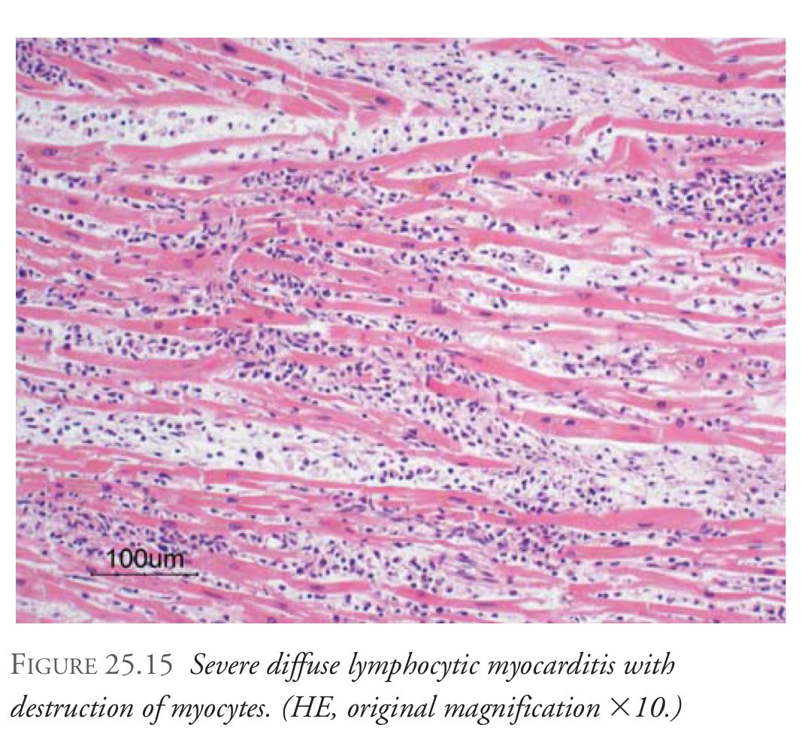
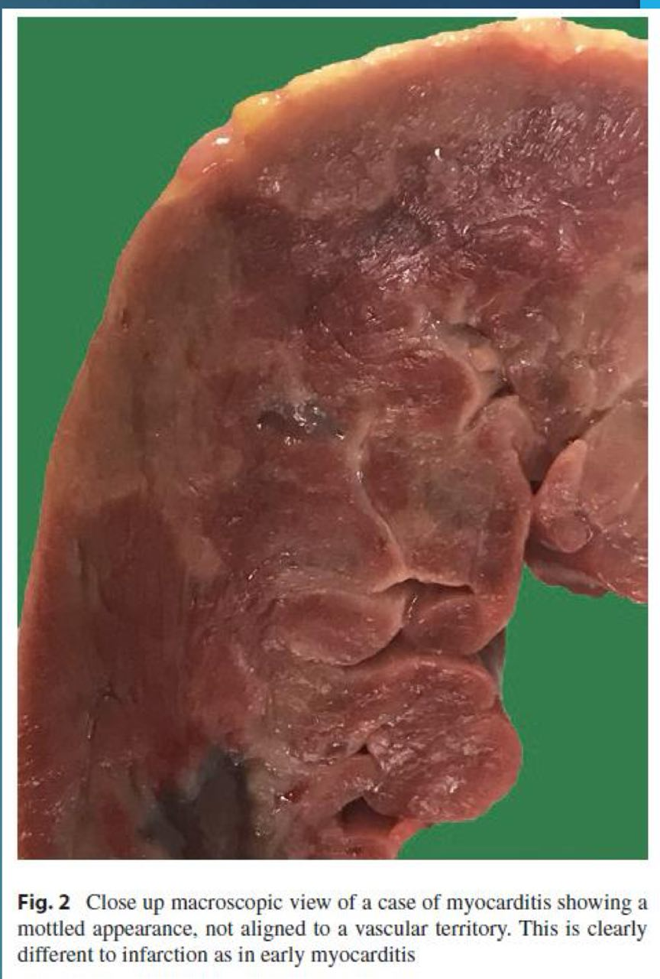
Myocarditis…cont
Histological confirmation of multifocal inflammatory cell infiltrates and associated myocyte necrosis requires extensive sampling at post-mortem examination .
macroscopically pale or hemorrhagic foci in the myocardium (having a ‘mottled’ appearance)

Slide 23
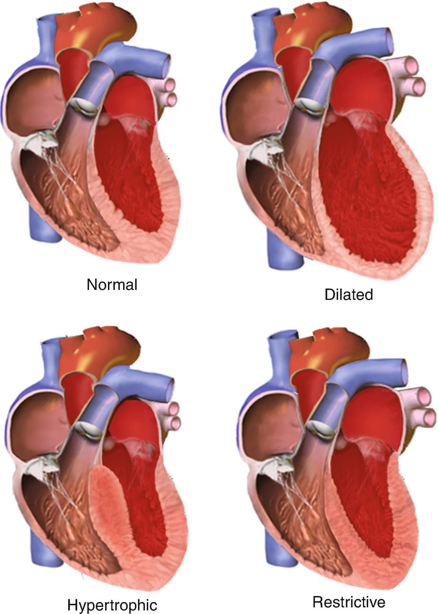
Cardiomyopathies
The second most common cause of SCD .
Cardiomyopathies are a heterogeneous group of diseases of the myocardium associated with mechanical and/or electric dysfunction that usually exhibit inappropriate ventricular hypertrophy or dilatation and are due to a variety of causes that frequently are genetic.
They include :
Dilated cardiomyopathy (DCM)
Hypertrophic cardiomyopathy (HCM)
Restrictive cardiomyopathy
Arrithmogenic right ventricular cardiomyopathy (ARVCM)

Slide 24
Cardiomyopathies ….cont
Dilated cardiomyopathy(DCM)
The most common cause of congestive heart failure
It can be familial , idiopathic , viral , immune or toxic
Characterized by dilated ventricular camper and reduced contractility without coronary , valvular or pericardial disease
Arrhythmogenic right ventricular cardiomyopathy (ARVCM):
an inherited condition which is characterized by predominantly right-ventricular thinning with fibro fatty myocyte replacement.
Restrictive cardiomyopathy
Decreased compliance of the ventricular endomyocardium that restricts filling during diastole
Associated with: amyloidosis , sarcoidosis , post-radiation fibrosis and hemochromatosis.

Slide 25
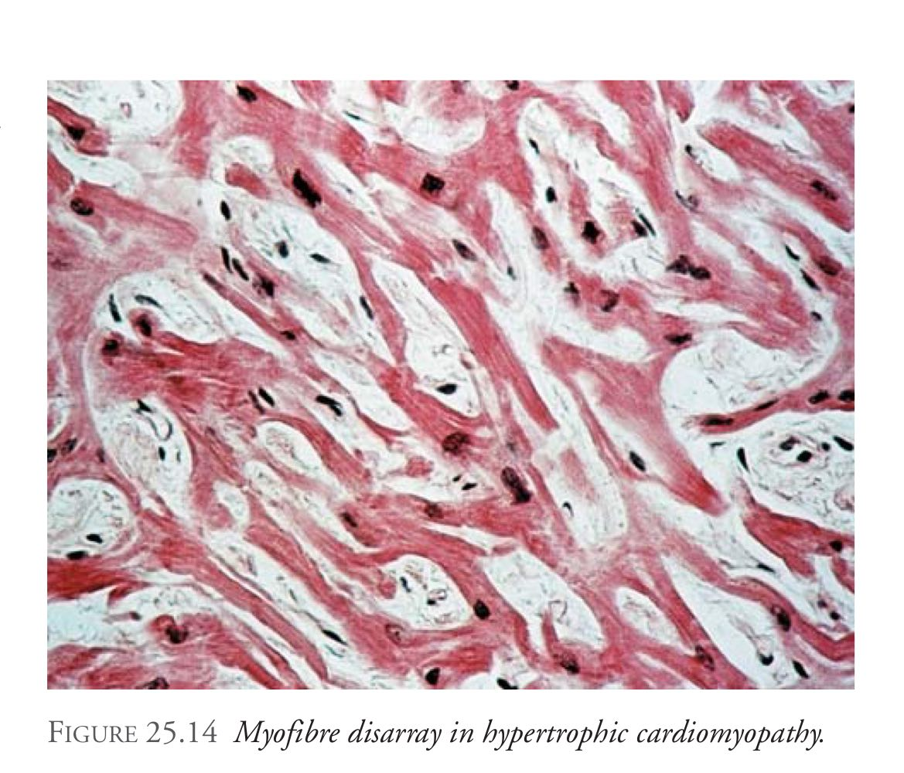
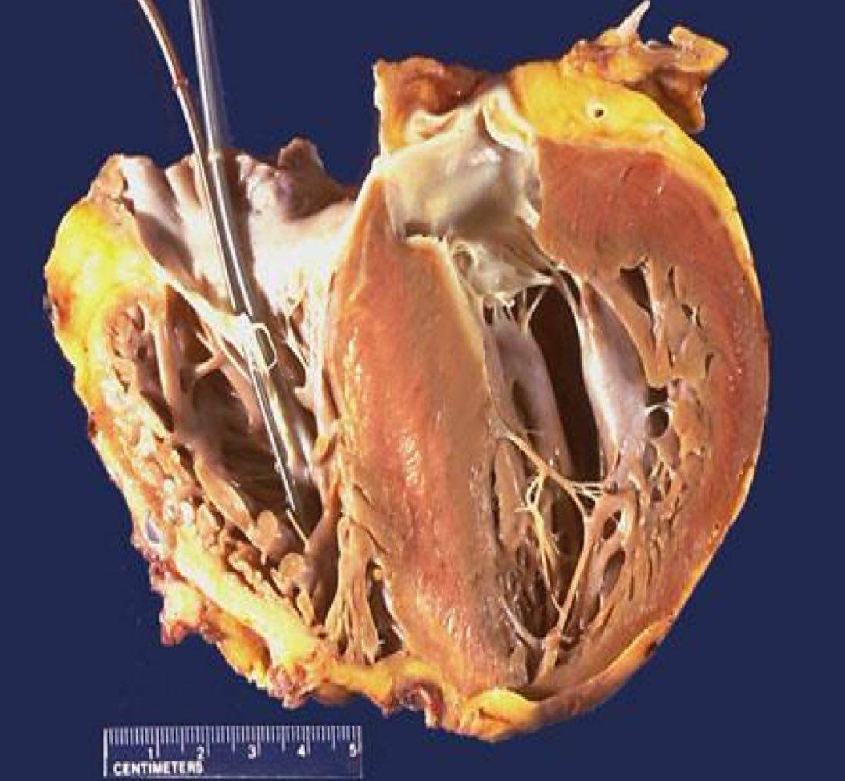
Cardiomyopathies (cont)
Hypertrophic cardiomyopathy (HCM):
Inherited (AD) or sporadic
Disease of cardiac muscle sarcomeric proteins, that causes asymmetrical hypertrophy, and characterized by myocyte disarray. This leads to stiff ventricle and decreased compliance
Leading cause of sudden cardiac death in young athletes, mainly due to ventricular fibrillation and may be the first manifestation.

Slide 26
Channelopathies (Functional abnormality)
The third most common cause of SCD
They are a group of disorders that represent a relatively small proportion of sudden deaths, presumed to be of cardiac origin, where investigations have failed to identify an alternative explanation for death.
Defects in genes encoding myocyte contractile units have been characterized, and these affect the function of sodium, potassium and calcium channels
These sudden deaths are often ‘triggered’ by a stimulus, including exercise, sudden loud noises or even during sleep. Such deaths are often characterized as falling into the broad category of sudden adult death syndrome (SADS).

Slide 27
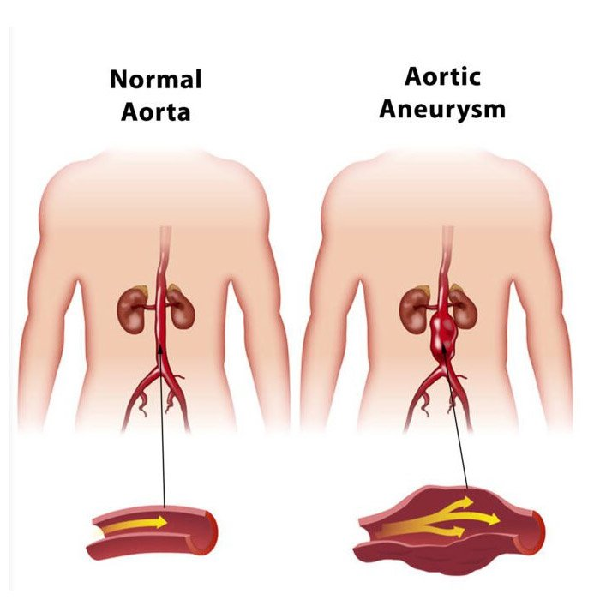
Diseases of the arteries
The atheromatous aneurysm :
The most common type and is seen mainly in the abdominal segment of the aorta
Fusiform or saccular in shape
Progressive destruction of the media leading to weakening of the aortic wall , bulging , platelet and fibrin deposition and eventually , retroperitoneal bleeding
Dark red mound may be seen projecting forwards over the lumbar spine , bulging at the root of the mesentery

Slide 28
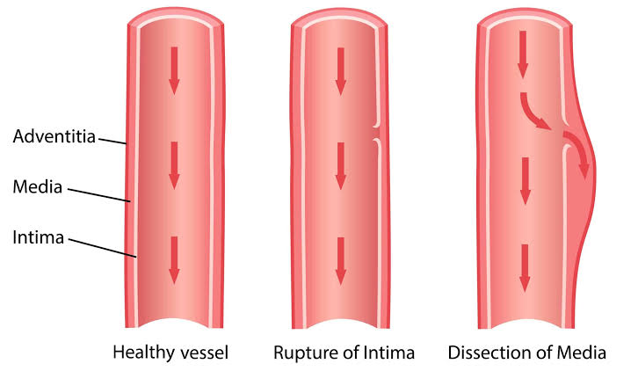
Diseases of the arteries …cont
The dissecting aneurysm :
The commonest site of origin is in the thoracic aorta (proximal 10 cm) and the dissection usually tracks distally towards the abdominal region. It can produce a hemopericardium, cardiac tamponade and sudden death.
Other causes of death: MI, hypovolemic shock and it may reach cerebral arteries.
Aortic dissection are principally found in individuals with hypertension but may also be seen in younger individuals with connective tissue defects, such as Marfan syndrome

Slide 29
Valvular heart diseases
Rheumatic heart disease
Bicuspid aortic valve
Mitral valve prolapse
Bacterial endocarditis

Slide 30
Central nervous system
Ruptured berry aneurysm
Epilepsy
Subarachnoid hemorrhage
Cerebral thrombosis/infarction
infection
Tumors

Slide 31
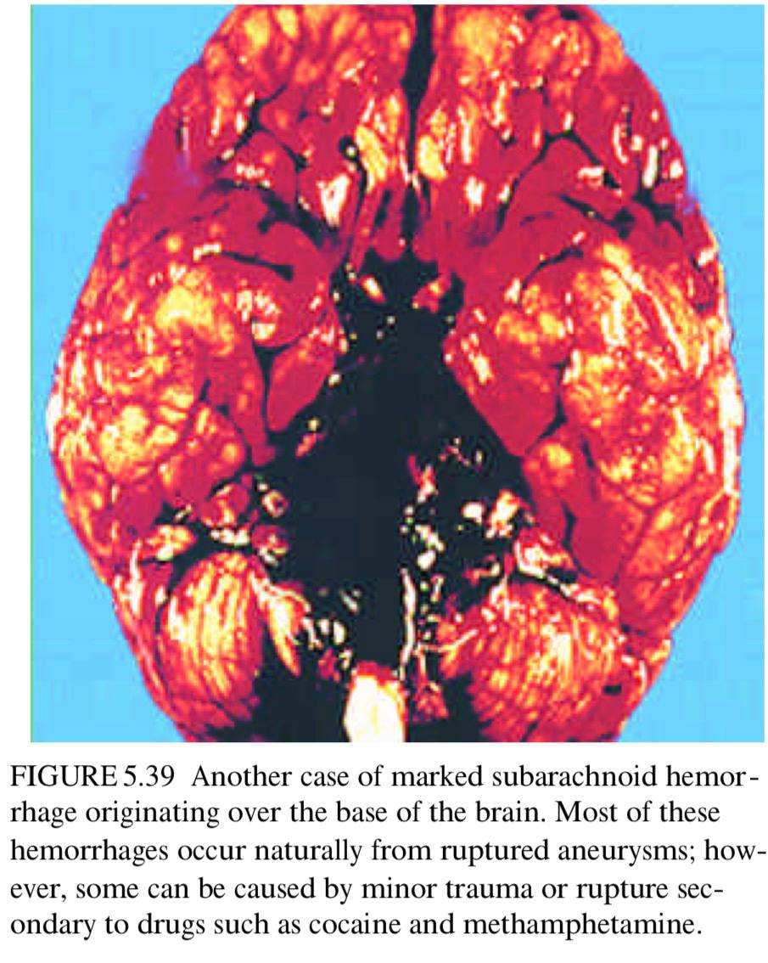
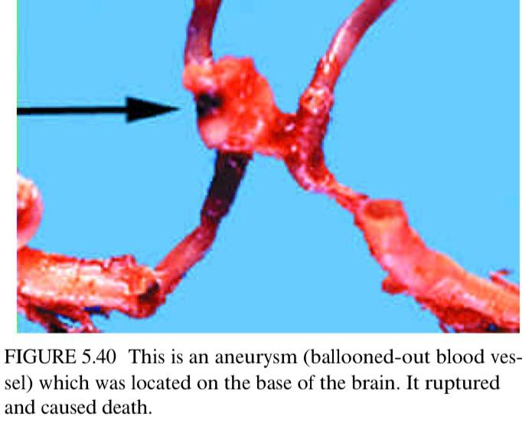
Rupture of berry aneurysm
Spontaneous rupture of an aneurysm of the circle of willis at the base of the brain
A useful rule of thumb , when presented with the sudden death of a woman of child-bearing age , to consider a complication of pregnancy ,self poisoning , PE and SAH as the first choices
It is also one of the most common causes of death in young adults , if CAD is excluded
Suggested mechanism of death : sudden bathing of the brainstem in blood causing cardiac arrest
Arterial spasm ???

Slide 32
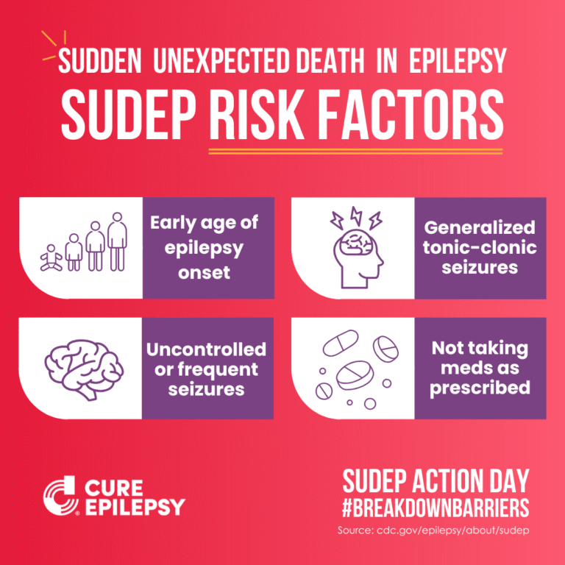
Epilepsy (Most common)
Epilepsy, Recurrent unprovoked seizures , is associated with an increased risk of mortality
Sudden unexpected death in epilepsy (SUDEP) : The sudden , unexpected and nontraumatic death of person with epilepsy in whom the postmortem examination fails to reveal a gross anatomical , toxicological or environmental cause of death . The event can be witnessed or unwitnessed and can occur with or without evidence of a seizure (excluding documented status epilepticus )
Seizure induced arrhythmia , seizure-mediated inhibition of respiratory centers or a complication of antiepileptic treatment

Slide 33
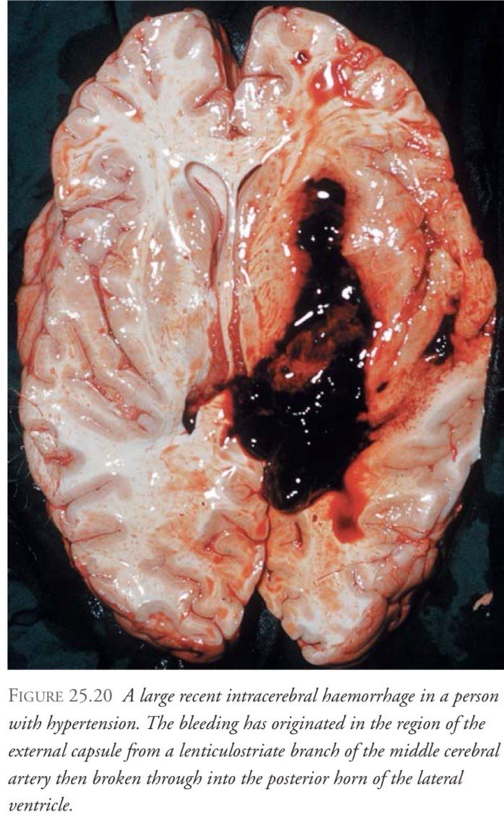
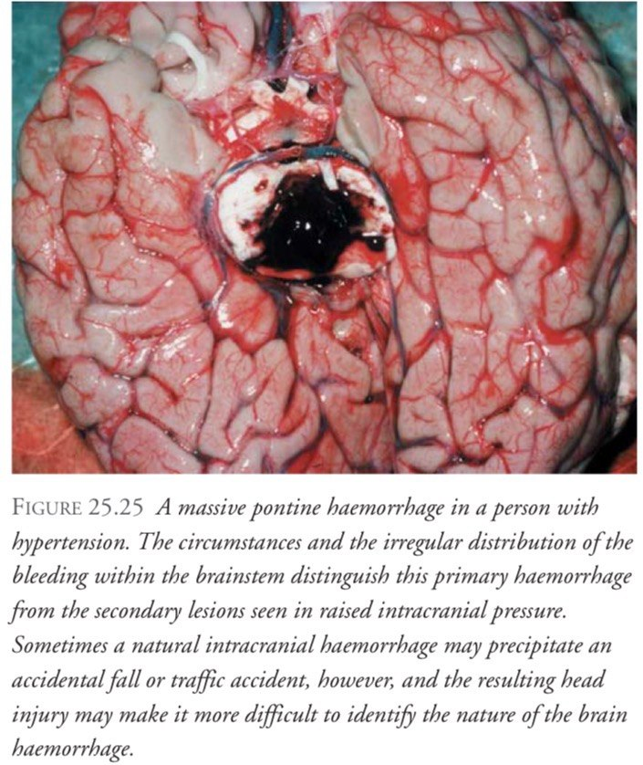
Cerebral thrombosis and infarction
A cerebral infarction is an area of necrotic tissue in the brain resulting from a blockage or narrowing in the arteries supplying blood and oxygen to the brain
Sudden bleeding into brain tissue is common, usually in old age and in those with significant hypertension
If a large stroke happens in a part of the brain vital to breathing or the heart, it can lead to death in a short time. If the stroke is very large, it can cause widespread damage that the brain can’t survive even if the cause of a clot or a bleed is treated.

Slide 34
Infection
Hyperacute bacterial meningitis in the very young and the elderly can lead to death within 24 hours of onset of symptoms
Meachanisms leading to sudden death include (cerebral edema , CSF flow obstruction and systemic collapse )
At autopsy , purulent exudates may not be apparent on gross inspection of the brain . Postmortem blood cultures and /or cerebrospinal fluid cultures need to be taken in such cases
Encephalitis: is a serious neurological condition and unfortunately, despite improvements in specific and more supportive treatments such as excellent intensive care management, it still has a high mortality rate. When death happens it is usually because of the brain swelling as a result of its severe inflammation.

Slide 35
Respiratory system
Pulmonary embolism (PE)
Asthma
Others (Pneumonia , massive hemoptysis ..etc)

Slide 36
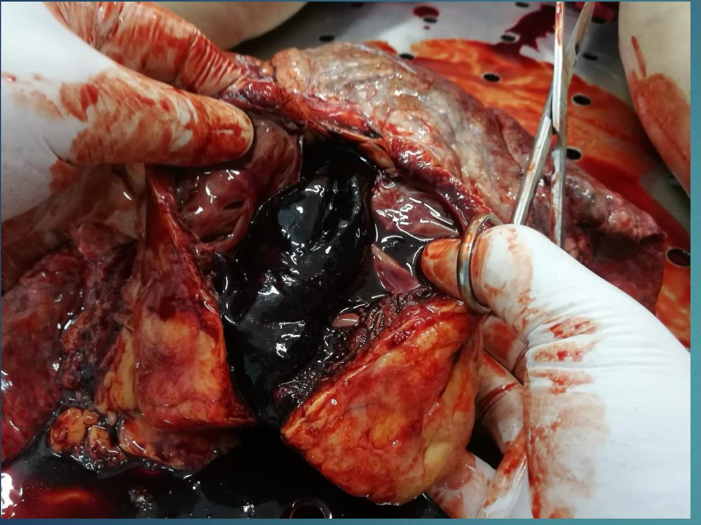
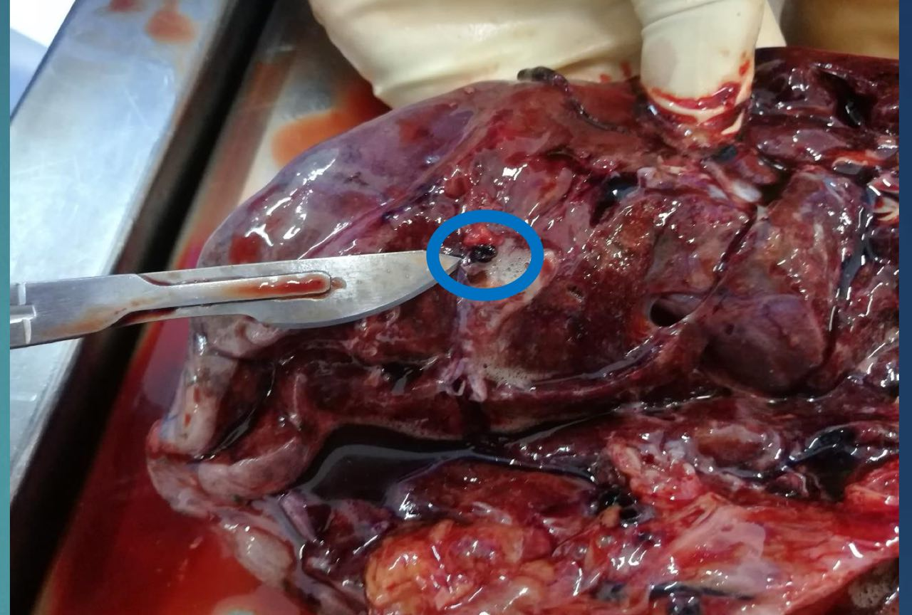
Pulmonary embolism (Most common )
The most underdiagnosed cause of death
The source of emboli is the deep leg or pelvic veins
PE is more common with advancing age , obesity , and with majority of instances there is a predisposing factor such as trauma , surgical operation , confinement to bed or immobility
Large vs small thromboemboli

Slide 37
Asthma
Sufferers from asthma may die suddenly and unexpectedely , without necessarily being in status asthmaticus .
Hypoxia and respiratory acidosis occur in asthma and increase myocardial irritability .
Inhalers containing bronchodilators ???

Slide 38
Gastrointestinal system
Massive hemorrhage
Peritonitis
Mesenteric thrombosis and embolism

Slide 39
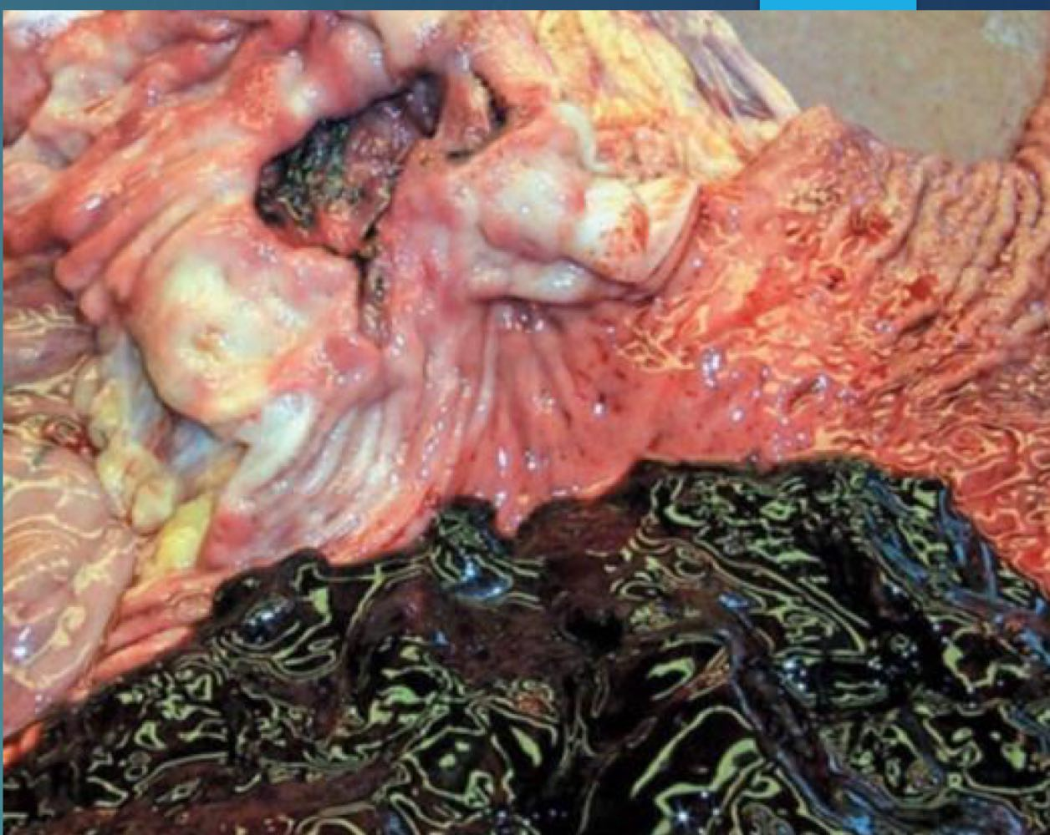
Massive hemorrhage
The main causes of sudden death in the gastrointestinal system are predominantly vascular in nature, E.g. Severe bleeding from:
Esophageal varices
Gastric and duodenal ulcers
Others (gastric / colonic tumors ..etc )

Slide 40
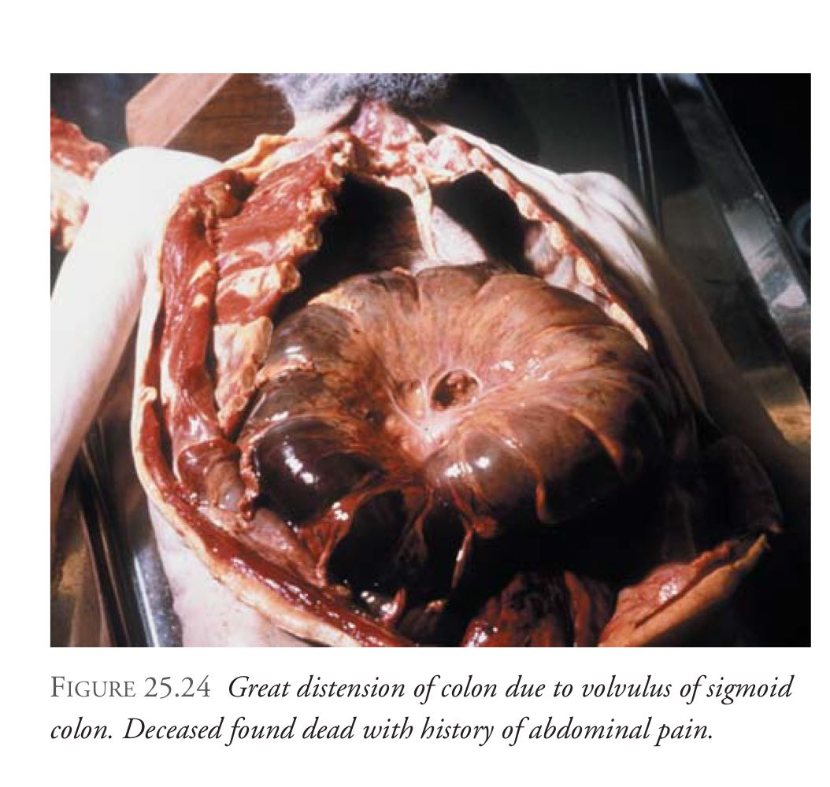
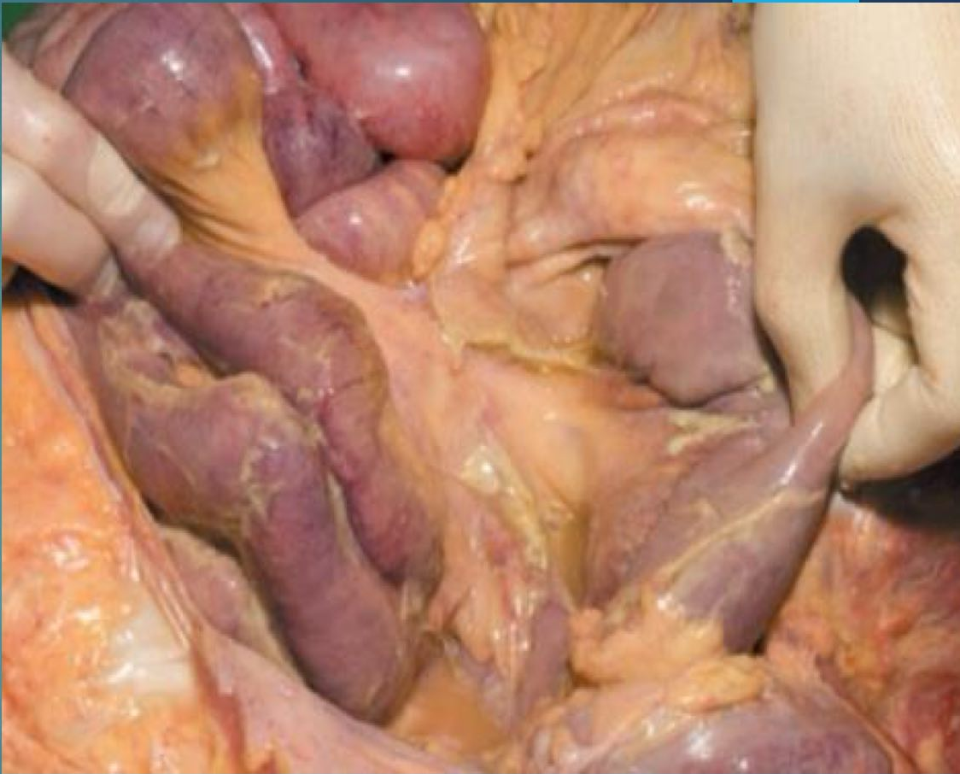
Mesenteric thrombosis and embolism / peritonitis
Mesenteric thrombosis and embolism , usually related to aortic or more generalized atherosclerosis, may result in infarction of the gut; a rapid but not sudden death is expected if the infarction remains undiagnosed. Intestinal infarction owing to a strangulated hernia, or obstruction owing to torsion of the bowel as a consequence of adhesions can also prove rapidly fatal .
Peritonitis , following perforation of a peptic ulcer, diverticulitis or perforation at the site of a colonic tumor for example, can be rapidly fatal if not treated Many of these conditions present as sudden death in elderly people because they cannot, or will not, seek medical assistance at the onset of the symptoms, and are then unable to do so as their condition worsens

Slide 41
Gynecological conditions
Ruptured tubal ectopic pregnancy
Ruptured uterus
Air embolism
Amniotic fluid embolism
Induced abortions

Slide 42
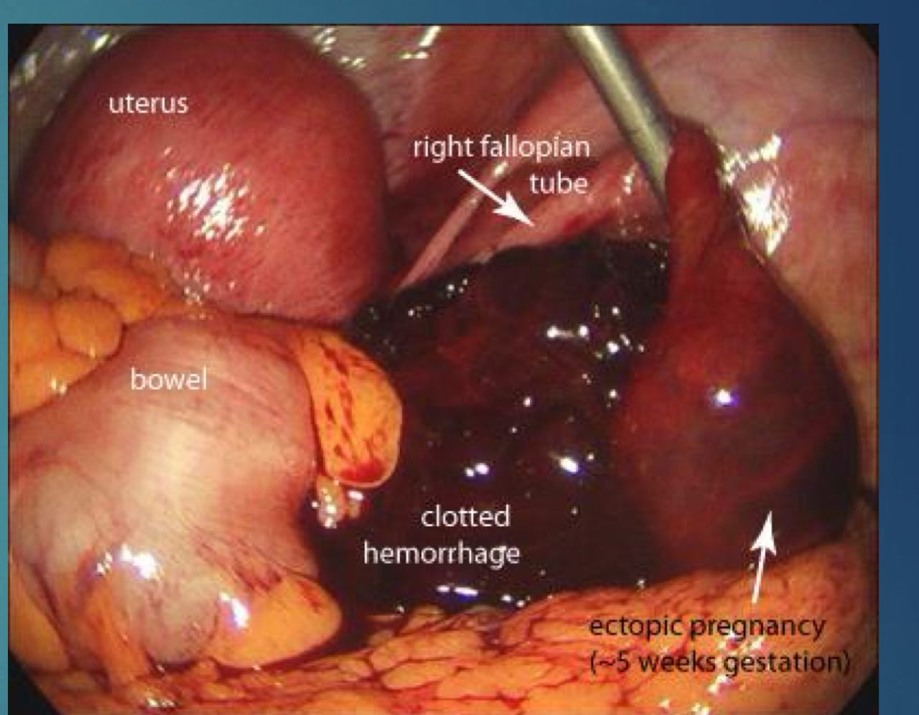
Gynecological system
Ectopic pregnancy , usually in the tubes , can rupture with massive intraperitoneal hemorrhage .
Induced abortions , unless under reputable medical control , are another source of death from hemorrhage , air embolism , perforation of vagina or uterus , infection and the use of toxic substances

Slide 43
Deaths associated with pregnancy (Maternal deaths )
Maternal deaths: Deaths of women while pregnant or within 42 days of the end of the pregnancy from any cause related to or aggravated by the pregnancy or its management, but not from accidental or incidental causes, and is classified into direct and indirect:
Direct Deaths: resulting from obstetric complications of the pregnant state (pregnancy, labor and puerperium), from interventions, omissions, incorrect treatment or from a chain of events resulting from any of the above.
Indirect Deaths: resulting from previous existing disease, or disease that developed during pregnancy and which was not due to direct obstetric causes, but which was aggravated by the physiologic effects of pregnancy.

Slide 44
Sudden Infant death syndrome (SIDS)
The sudden death of any infant or young child that is unexpected by history and in whom a thorough necropsy fails to demonstrate an adequate cause of death .
Multiple theories , each provides the possible cause in a proportion of infants . The findings of most studies in England support the view that sudden infant death is essentially a mode of death in children suffering from some occult illness
Risk factors include (winter season , respiratory disease , male gender , younger age , poor socioeconomic status …etc )

Slide 45
Sudden infant death syndrome (cont)
exclude child abuse or an ‘accidental death’.
Birth weight and full measurements must be taken. Gross examination should include all the orifices.
Swabs need to be collected from air passages, middle ear , and blood from heart may be preserved for microbiological culture.

Slide 46
Sudden infant death syndrome …cont
A separate piece of lung may be sent for virological culture
Petechial haemorrhages on the visceral pleura, epicardium and thymus may be seen in a few cases
The findings of gastric contents in the air passages may not be used as a cause of death in itself. It should be evaluated in conjunction with the other attending circumstances.

Slide 47
Negative autopsy
Cases where no apparent cause of death can be found after performing a full autopsy with full investigations . Causes of negative autopsy include :
Endocrinopathies (DKA , hypoglycemia ,thyroid storm , adrenocortical insufficiency )
Electrolyte abnormalities
Cardiac dysrhythmia : Channelopathies
Others : seizure , anaphylaxis , Neuroleptic malignant syndrome , serotonin syndrome .

Slide 48
References
Knight’s forensic pathology , third edition
Textbook of forensic medicine and toxicology , principles and practice , fifth edition
Forensic medicine slides

Slide 49
NOT THE END

