Slide 1

Hand Infections
Mohammed Tayyem

Slide 2
Learning objectives
Recognize key hand infection patterns that require urgent referral
Differentiate common fingertip and sheath infections
Apply anatomy to predict spread
Choose initial management: investigations, antibiotics, surgery
Identify red flags and complications

Slide 3
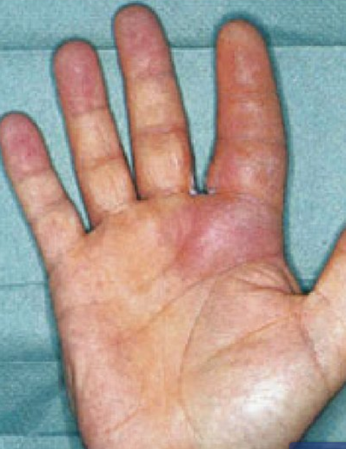
Case 1 – Swollen finger after minor injury
Case
28 year-old gardener
Thorn prick 2 days ago
Progressive swelling and pain
Finger held slightly flexed
Severe pain on passive extension
Questions
Is this cellulitis?
What is your Differential diagnosis?
Which examination findings
are critical?
Does this need urgent surgery?

Slide 4
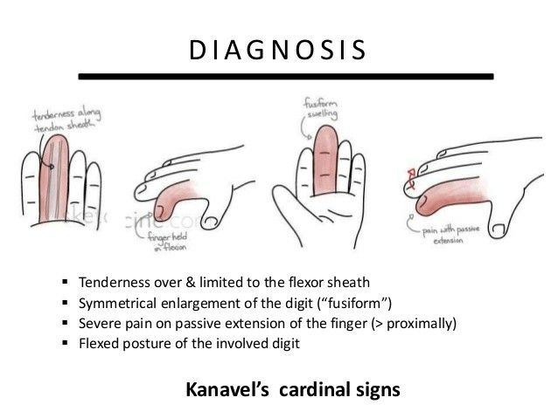
Flexor Tenosynovitis

Slide 5
Pathophysiology
Why is the finger held in flexion?
Why does passive extension cause severe pain?
How quickly can tendon/vascular compromise occur?
Notes:
Pause here. Make them reason from anatomy and pressure in a closed compartment (sheath).

Slide 6
Answers – Pathophysiology
Closed space infection in the flexor tendon sheath → rising pressure
Flexed posture reduces sheath pressure (position of comfort)
Passive extension stretches inflamed sheath
Reduced perfusion → risk of tendon necrosis (can be within 24–48 hours)
Mini Compartment Syndrome
Notes:
delayed presentation = worse outcome. Mention higher risk in diabetes/immunosuppression.

Slide 7
Initial management – Flexor sheath infection
Investigations:
Do we wait for MRI?
Antibiotics:
Operate ?

Slide 8
Initial management – Flexor sheath infection
Investigations:
  Clinical diagnosis primarily
  Bloods (WBC, CRP) to support severity
  X-ray: foreign body, gas, bone involvement
Do we wait for MRI?
Antibiotics:
  Start empiric coverage for Staph/Strep; consider MRSA risk
  Adjust to local guideline and cultures
Operate when:
  Clear Kanavel signs
  Delayed presentation (>24h) or severe symptoms
  Systemic signs, diabetes/immunocompromise
  Failure to improve on early conservative trial
Notes:
If your hospital protocol differs (e.g., specific antibiotic choices), edit this slide to local policy.

Slide 9
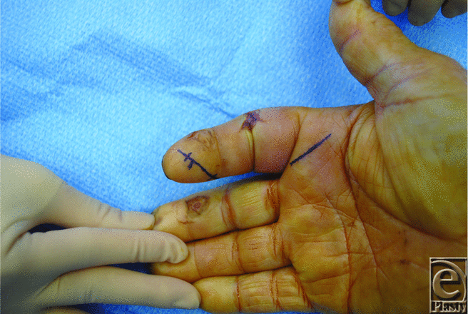

Slide 10
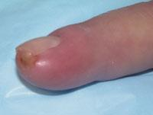
Case 2 – Painful fingertip
Case
35-year-old woman
Severe throbbing fingertip pain
Tense swollen pulp
No obvious nail fold infection
Questions
What is the Diagnosis ?

Slide 11
Case 2 –Felon
Felon = infection of fingertip pulp space
Key features: tense pulp, severe throbbing pain
Important differential: Paronychia
Notes:
Highlight: herpetic whitlow has grouped vesicles; incision worsens. Felon needs drainage when tense.

Slide 12
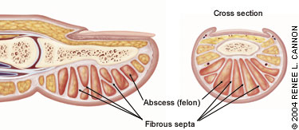
Why antibiotics alone often fail in Felon
Pulp contains multiple septa → closed compartments
Pressure rises → ischemia and severe pain
Complications: distal phalanx osteomyelitis, skin necrosis
Management: drainage (safe approach), antibiotics, leave open
Notes:
Avoid midline incision across pulp. Consider lateral/volar-lateral approach per local practice.

Slide 13
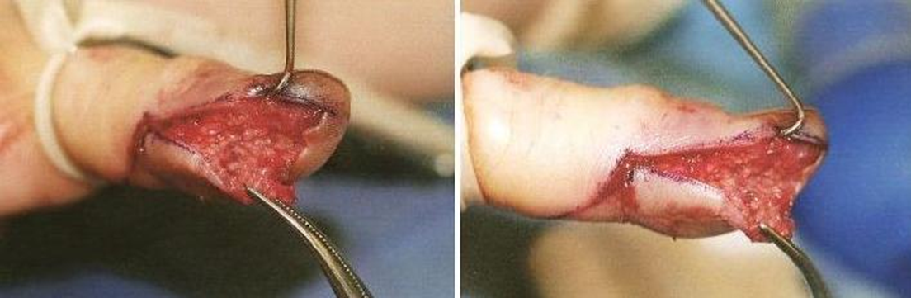
Surgical drainage of felon

Slide 14
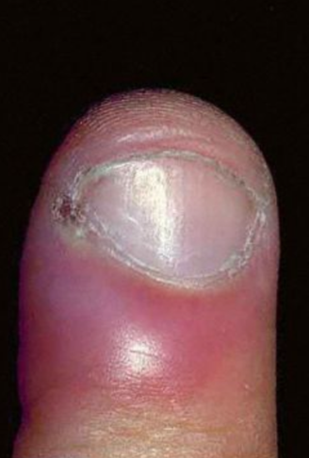
Diagnosis ?

Slide 15
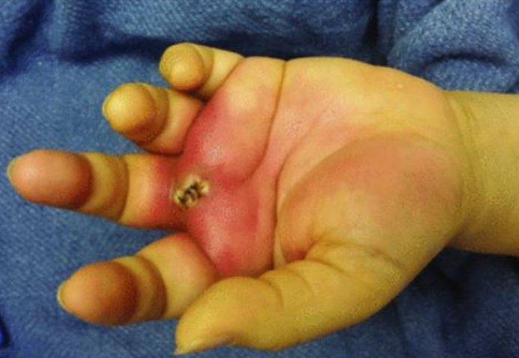
Case 3 – Swollen painful palm + fever
Case
Swollen palm
Painful hand
Limited finger movement
Fever / systemic symptoms

Slide 16
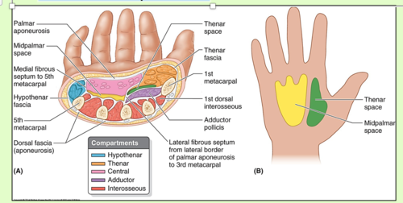
Deep hand spaces

Slide 17
Deep space infection –
Thenar space infection:
  Thenar eminence swelling
  Thumb/index movement painful
Midpalmar space infection:
  Central palm swelling
  Pain with finger flexion/extension; cupped palm
Dorsal hand infection:
  Swelling common; but assess for deeper involvement
Management:
  Urgent surgical drainage + IV antibiotics
  Assess for spread; culture
Notes:
Mention ulnar/radial bursae and possible 'horseshoe' spread as an advanced concept.

Slide 18
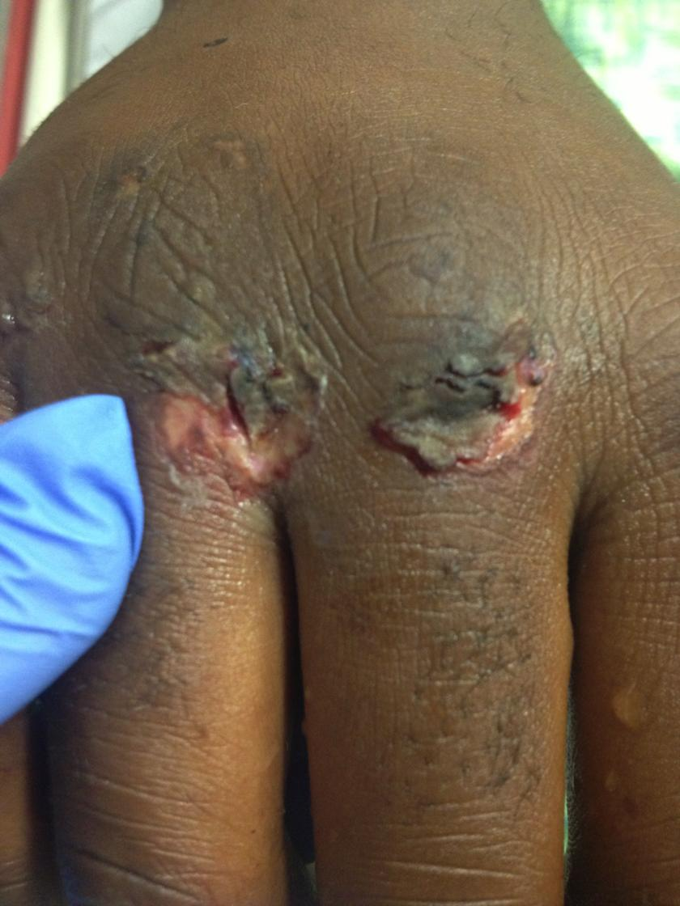
Case 4
Case
Man punched someone in the mouth
Now has painful swollen MCP joint
Small laceration over knuckle
Questions for students
What is this injury called?
Why is it high-risk?
What organisms should you cover?
What is the management?
Notes:
Key teaching: even tiny wound may penetrate extensor tendon/joint capsule when fist was clenched.

Slide 19
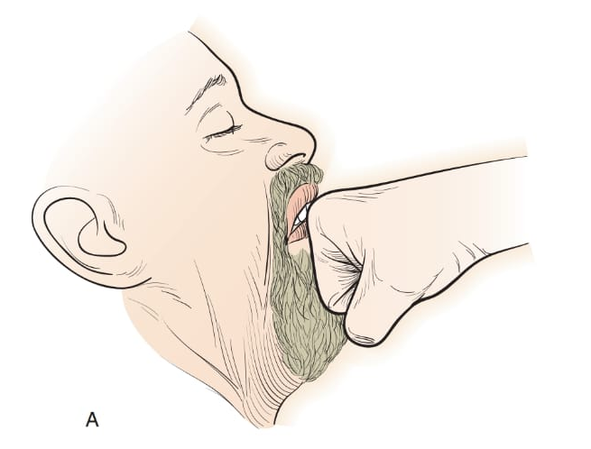
Case 4 – Answers (Clenched fist injury)
Clenched fist injury ('fight bite') – high-risk for septic arthritis
Tooth inoculates joint capsule/tendon → Septic arthritis
Organisms: mixed oral flora; include Eikenella + anaerobes
Management: urgent washout, IV antibiotics, do NOT close primarily

Slide 20
Microbiology
Most common organism in hand infections?
Cat bite organism?
Human bite organism?
IV drug user: what to suspect?
Notes:
Make it competitive: first team to answer gets a point.

Slide 21
Microbiology – Answers
Most common: Staphylococcus aureus (± Streptococci)
Cat bite: Pasteurella multocida
Human bite: Eikenella corrodens + mixed flora
IV drug user: MRSA and polymicrobial infection
Notes:
Remind: local prevalence and resistance matter; adjust based on culture results.

Slide 22
Red flags – When to call Orthopaedics urgently
Kanavel signs / suspected flexor sheath infection
Tense pulp (felon) with severe pain
Deep palmar swelling + systemic signs
Bite injuries over joints or tendon zones
Diabetes/immunosuppression with rapidly progressive infection

Slide 23
Take-home messages
Clinical diagnosis first; imaging supports, but should not delay treatment
Early recognition prevents tendon necrosis, stiffness, and disability
When in doubt: treat as serious and escalate early

