Slide 1


Shoulder Disorders:
Mohammed Tayyem
Faculty of Medicine
University of Jordan

Slide 2

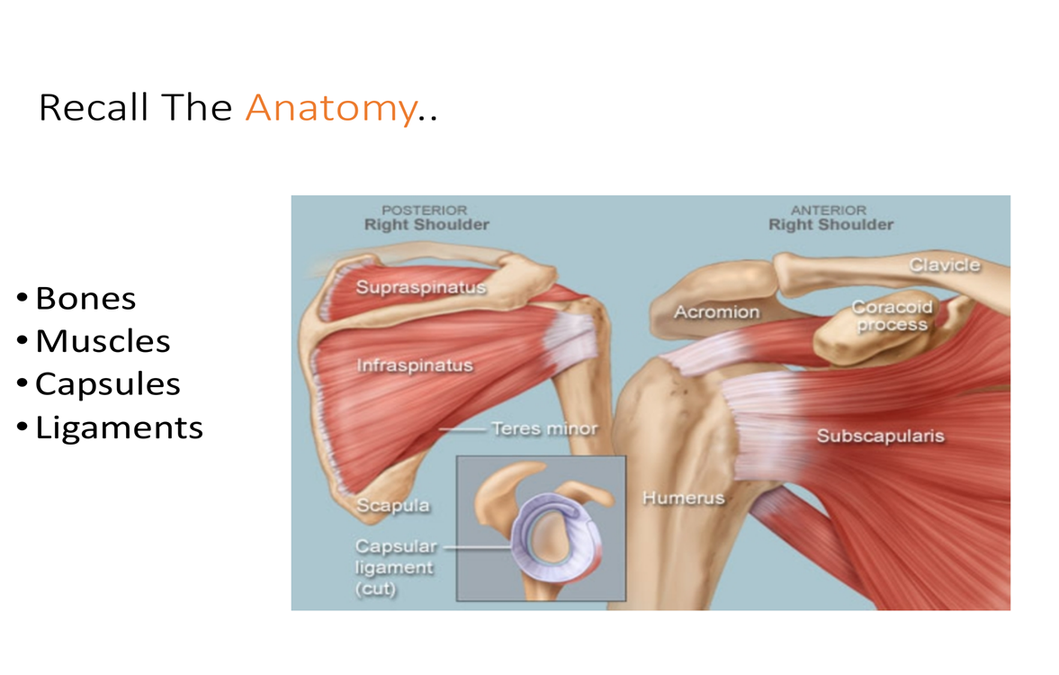
Quick Shoulder Anatomy
Glenohumeral Joint
Rotator Cuff
Acromion
AC Joint

Slide 3
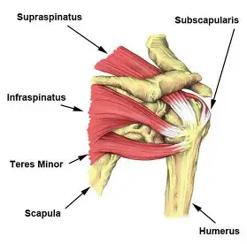
Rotator Cuff Overview
Supraspinatus –abduction
Infraspinatus – external rotation
Teres minor – external rotation
Subscapularis – internal rotation
Supraspinatus
Infraspinatus
Teres Minor
Subscapularis

Slide 4


Age-Related Pathology Overview
Young
Middle-Aged
Older
< 35 years
40 - 60 years
60+ years
Instability
Frozen Shoulder
Osteoarthritis
Impingement
Rotator Cuff Tears
Rotator Cuff Disease

Slide 5
Shoulder Exam
Look
Feel
Move

Slide 6
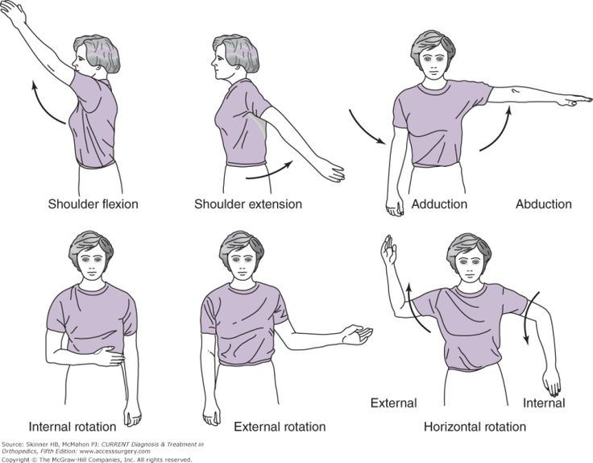
The Move: Active Range of Motion
Forward Flexion
Extension
Abduction
Adducton
Internal Rotation
External Rotation

Slide 7
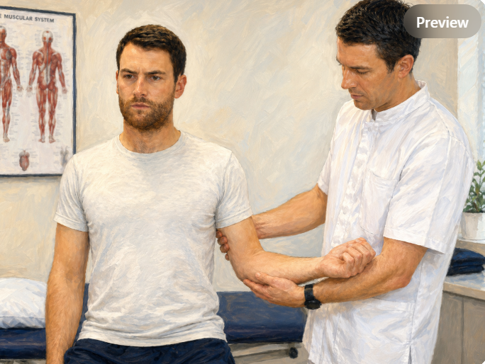
The Critical Test: Passive External Rotation
The First Step
If passive external rotation at the side is LIMITED:
The diagnosis is Glenohumeral Pathology (Osteoarthritis or Frozen Shoulder). Stop here—impingement tests will be falsely positive.

Slide 8



Surgeon’s Diagnostic Algorithm
1
2
3
Check Passive ER at Side
Assess AC Joint
Evaluate Subacromial Space
If Limited
If Positive
If Positive
Glenohumeral Pathology
(OA or Frozen Shoulder)
AC Joint Pathology
(Arthritis or Sprain)
Impingement or
Rotator Cuff Disease
Special Note for Young Patients (<35): ALWAYS think instability first, even if they present with impingement symptoms.

Slide 9
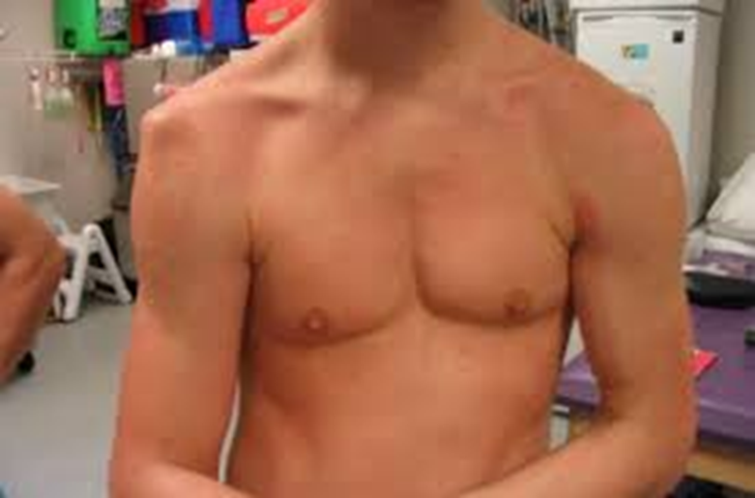
Clinical Case 1
22‑year‑old football player falls on outstretched hand.
Severe pain and deformity.
Numbness over lateral shoulder
likely diagnosis?

Slide 10
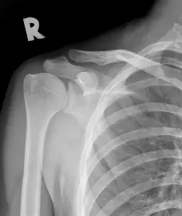
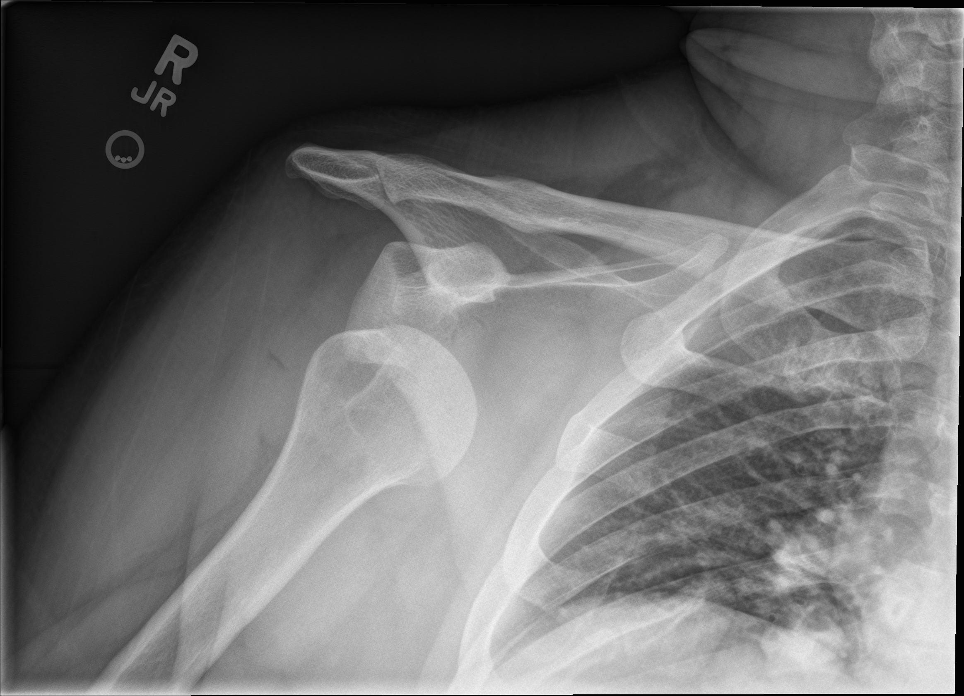
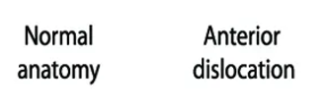
Shoulder dislocation

Slide 11
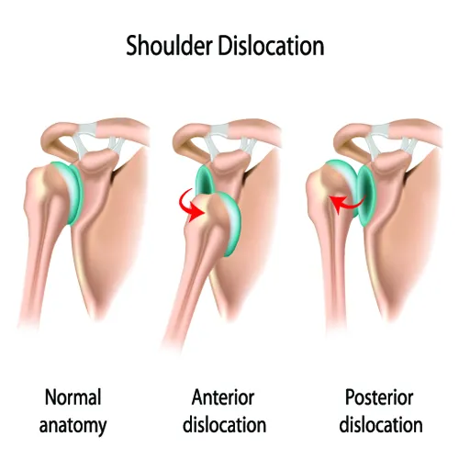

Slide 12
Shoulder stabilizers
Gleno-humeral ligament
Glenoid labrum
Bony anatomy
Negative pressure inside capsule
Rotator cuff muscles

Slide 13
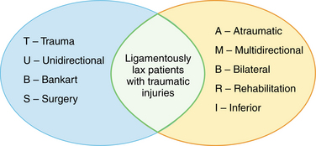
Pathophysiology

Slide 14
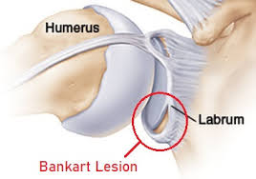
Labral tear

Slide 15
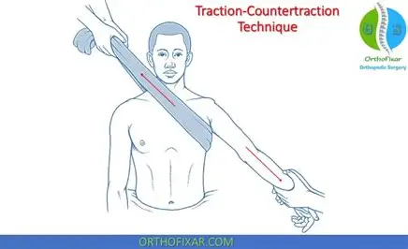
Acute management

Slide 16
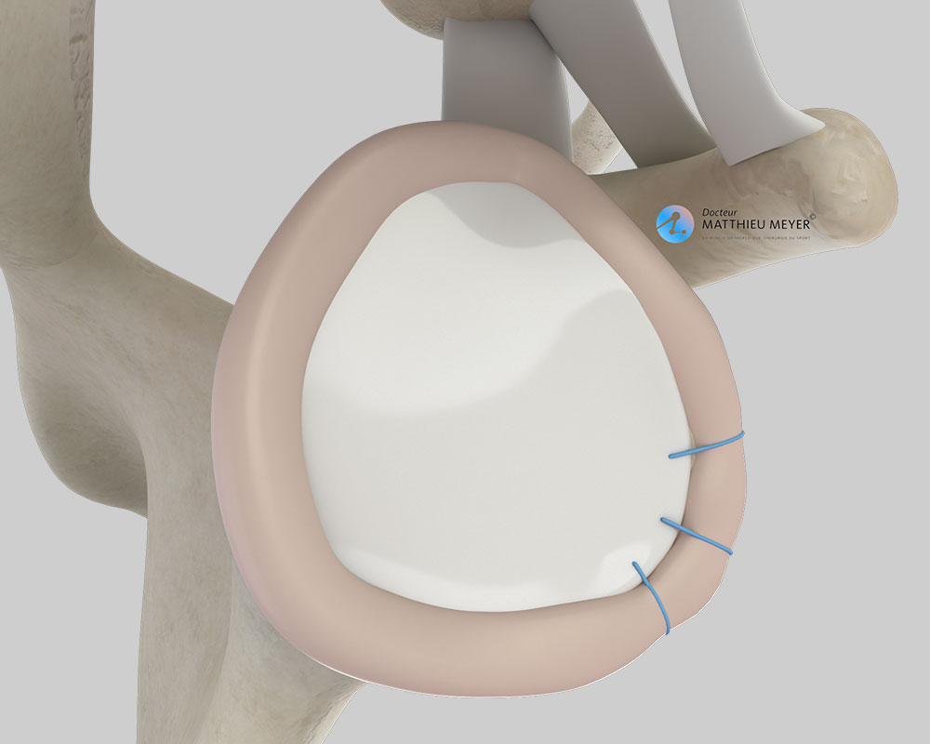
Ongoing management
Risk of recurrent dislocation ➔ young
Physiotherapy
Shoulder stabilization surgery
  Repairing labral tear

Slide 17
Clinical Case 2
52‑year‑old man with shoulder pain for 6 months
Pain lifting the arm and reaching overhead
Night pain
Weakness in abduction

Slide 18
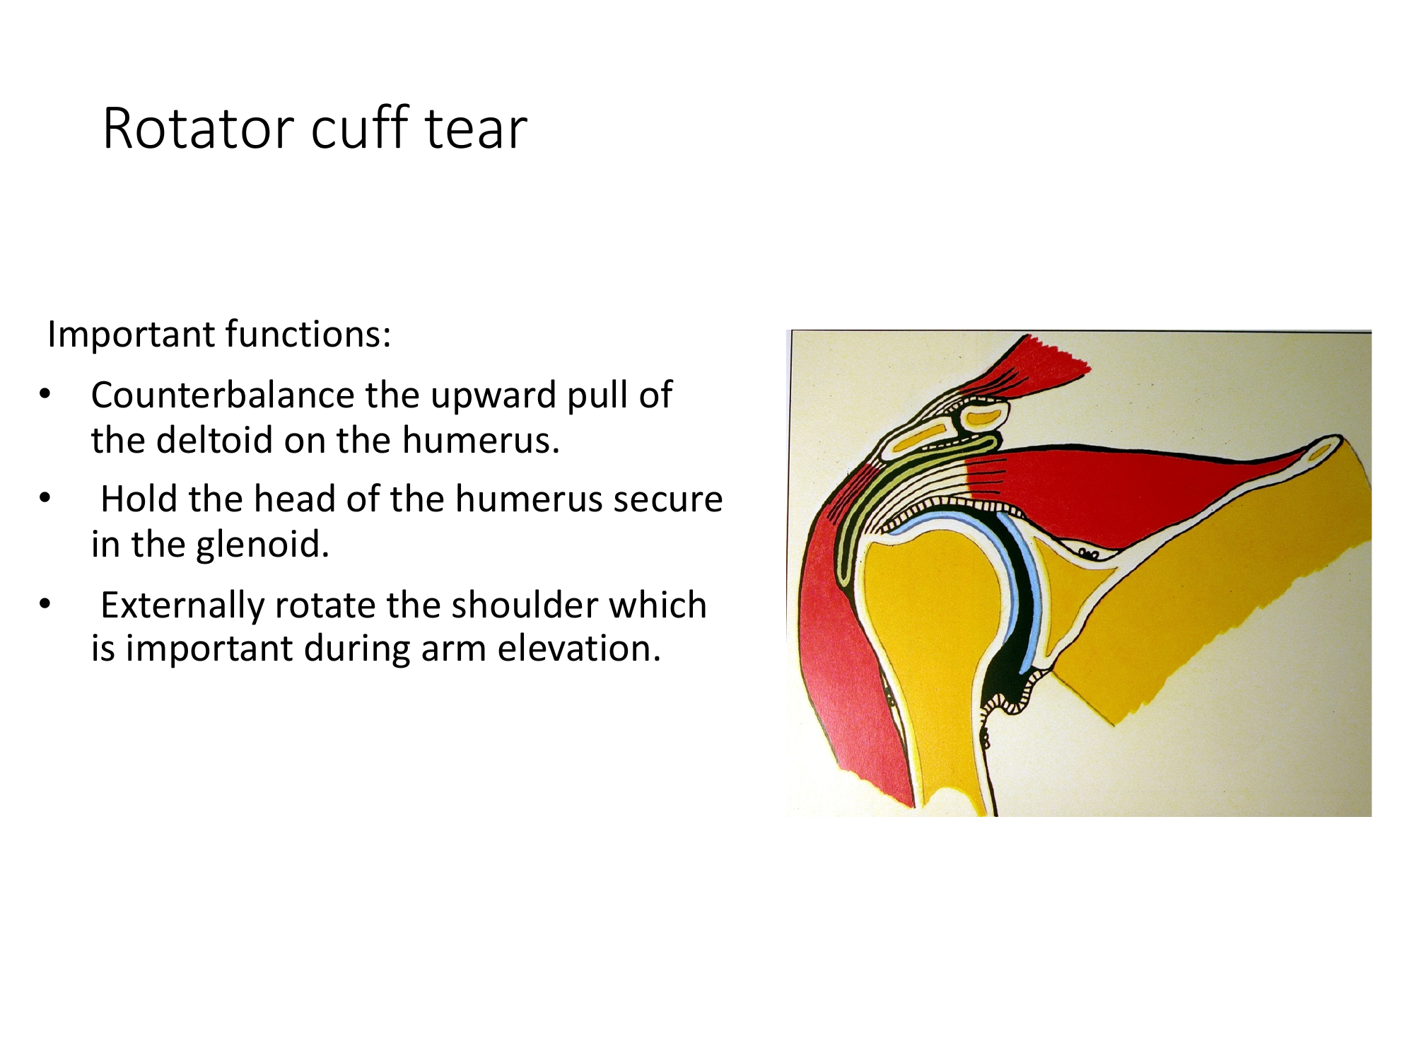
Rotator Cuff Tear

Slide 19
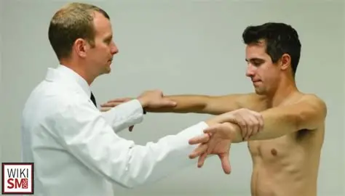
Presentation
Pain around shoulder
Sleep disturbed by pain
Weakness with specific movements relating to the muscle

Slide 20
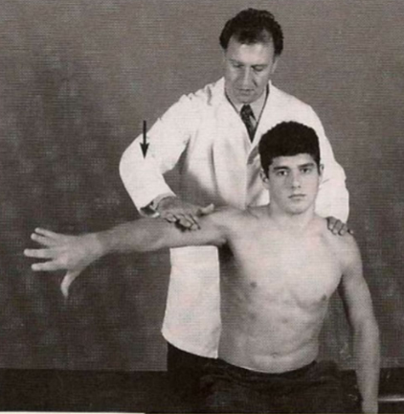
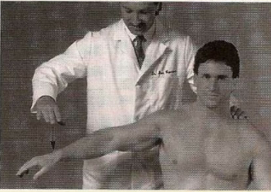
Supraspinatus Tests
Tests Supraspinatus Strength

Slide 21
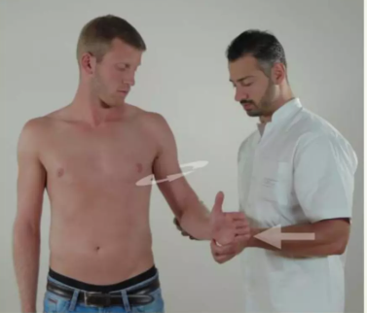
Infraspinatus Test
Resisted external rotation at side

Slide 22
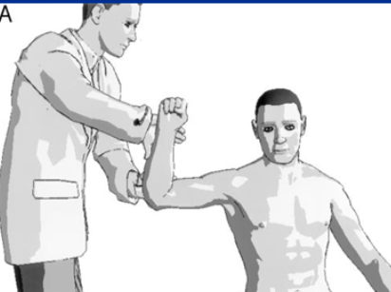
Teres Minor Test
Resisted external rotation at 90 degrees

Slide 23
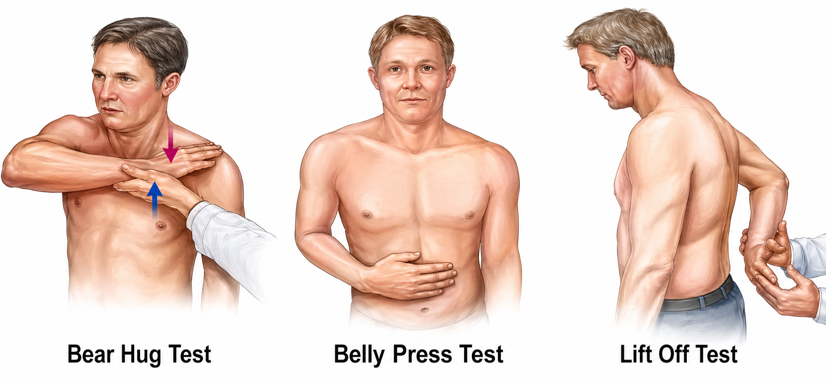
Subscapularis Test

Slide 24

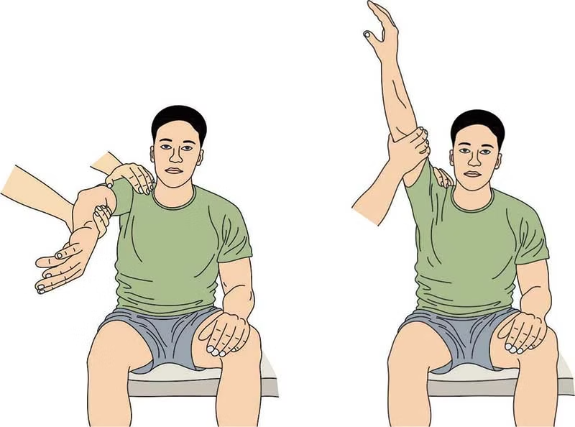
Impingement Tests
Neer's Test
Hawkins-Kennedy Test

Slide 25
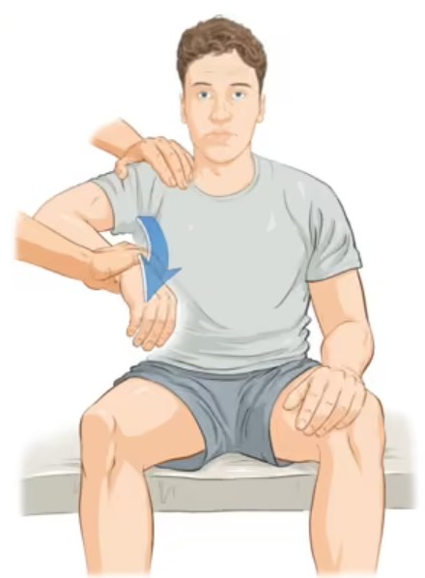
Impingement Tests
Neer's Test
Hawkins-Kennedy Test

Slide 26
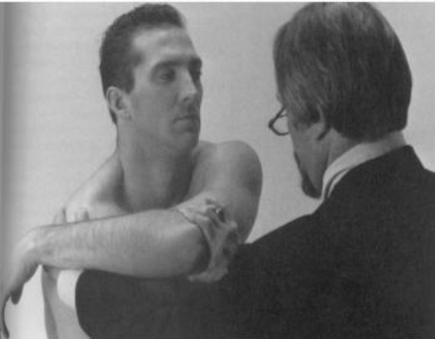

AC Joint Tests
Direct Palpation
Press directly on the acromioclavicular joint to check for localized tenderness.
Cross-Body Adduction
Elevate the arm to 90° and adduct across the body to compress the AC joint.

Slide 27

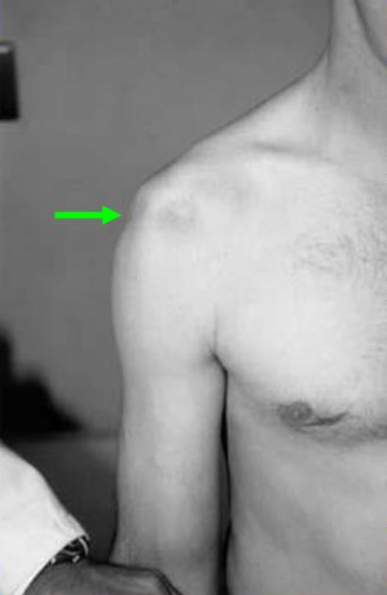
Instability Tests: Sulcus Sign
Test Action
Apply downward traction on the arm while the patient is relaxed. Observe the space between the acromion and the humeral head.

Slide 28


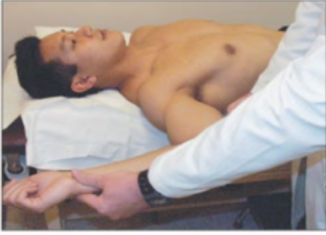
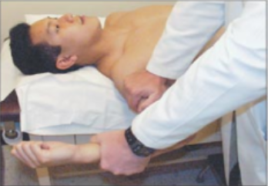
Instability Tests: Apprehension & Relocation
Apprehension Test
Relocation Test
Positive if the patient's apprehension is relieved and further external rotation is possible.
Positive if the patient feels apprehension (fear of dislocation), not just pain.

Slide 29
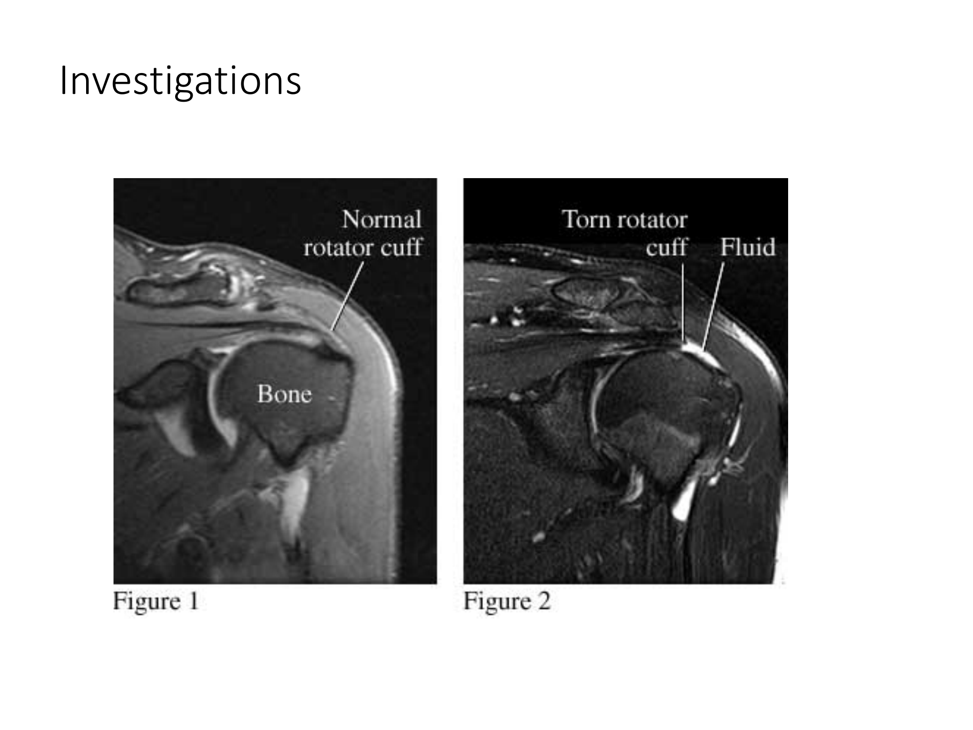
Rotator Cuff MRI

Slide 30
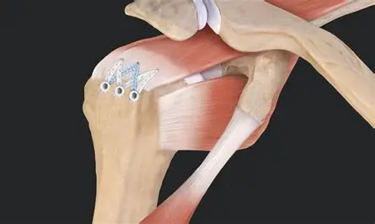
Management
Rest and adapted activities
Analgesia
Physiotherapy
Steroid injection
Surgery ➔ Arthroscopic rotator cuff repair

Slide 31
Clinical Case 3
48‑year‑old lady with 7 month shoulder pain
Gradually worsening stiffness
Limited external rotation on physical exam
PMHx : Type 2 diabates, Hypothyroidism
Differential ????

Slide 32
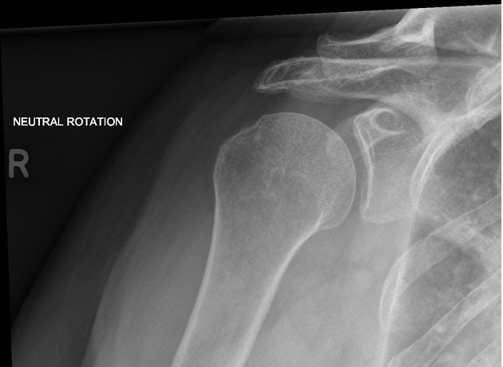

Slide 33
Frozen shoulder- Adhesive Capsulitis
Inflammation & fibrosis of glenohumeral joint capsule
Middle age , Diabetes , Hypothyrodism
Primay vs. Secondary ( Post trauma or surgery)

Slide 34
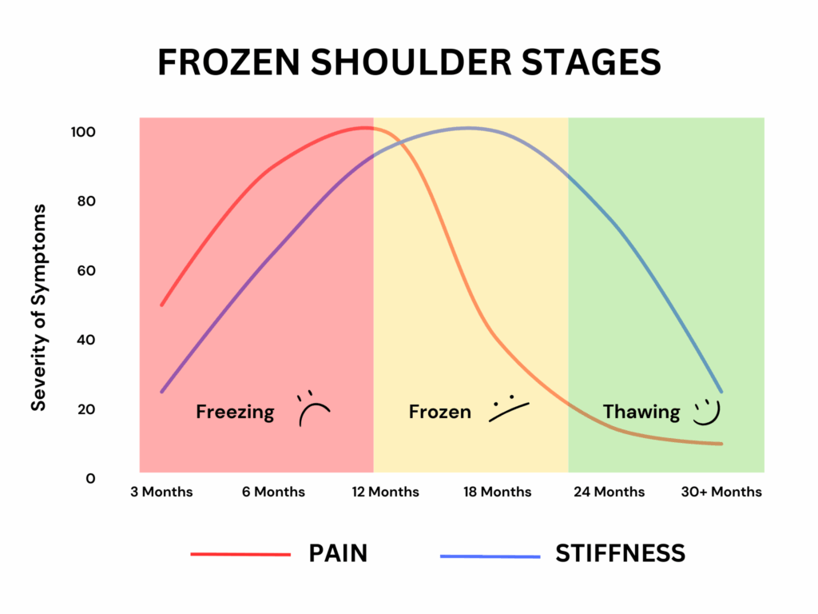
Frozen shoulder

Slide 35
Treatment- Frozen shoulder
Physiotherapy
Analgesia
Injection
Arthroscopic capsular release
Manipulation under anaesthesia

Slide 36
Clinical Case 4
75‑year‑old lady with chronic shoulder pain
Gradually worsening stiffness
Difficulty reaching overhead

Slide 37
Glenohumeral Osteoarthritis
Degenerative joint disease of the shoulder
Affects articular cartilage
Pain, stiffness
Crepitus , muscle wasting and reduced range of motion ( External rotation)
Risk factors
Old age, post – trauma, family history, inflammatory arthritis

Slide 38
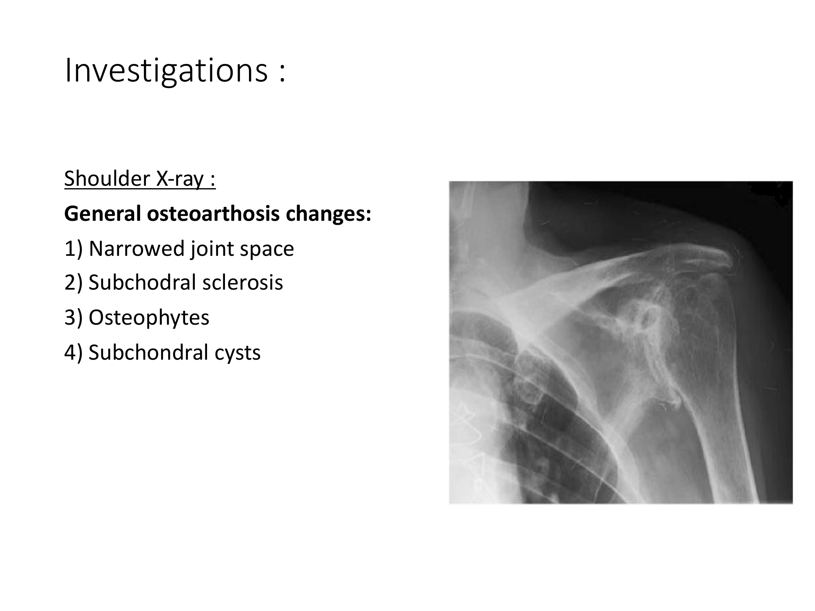

Slide 39
Management
Analgesia
Activity modification
Physiotherapy – Deltoid strengthening
Steroid injections
Surgery – Shoulder replacement

Slide 40
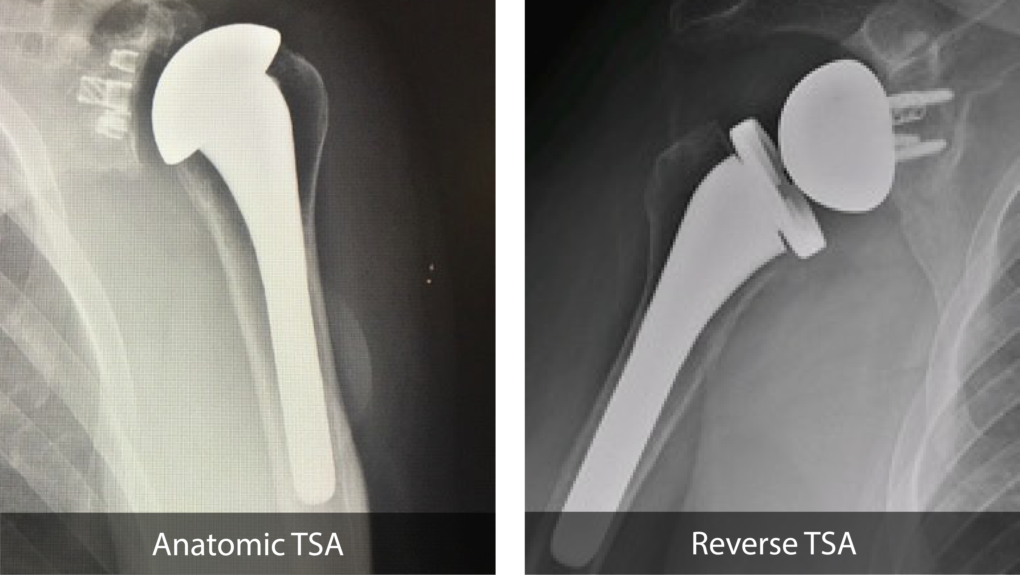

Slide 41
Take‑Home Messages
Young trauma → dislocation
Middle age pain → rotator cuff tear
Old age → Glenohumeral Arthritis
Anatomy explains shoulder pathology

Slide 42


Thank You
Questions?

